Slide 1
Resonance Saturation in Hypernuclear Decay
Axel Pérez-Obiol, Assumpta Parreño and Bruno Juliá-Díaz
Departament ECM, Facultat de Física, Universitat de Barcelona, Spain

Slide 2
outline
Basics: production and decays
OME vs EFT
Work in progress

Slide 3
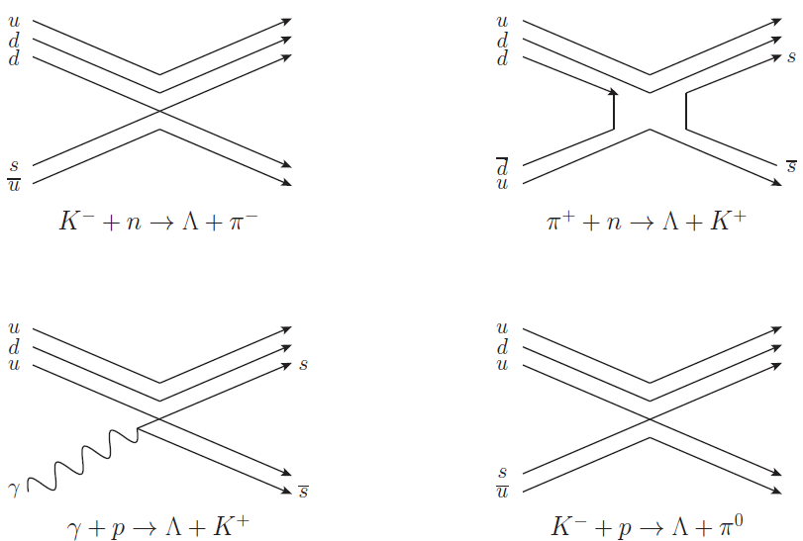
Basics: production and decays
Hypernucleus: Bound system of nucleons and one or more hyperons.
Production reactions:
E.V. Hungerford, Lect. Notes Phys. 724, 1-29 (2007)

Slide 4
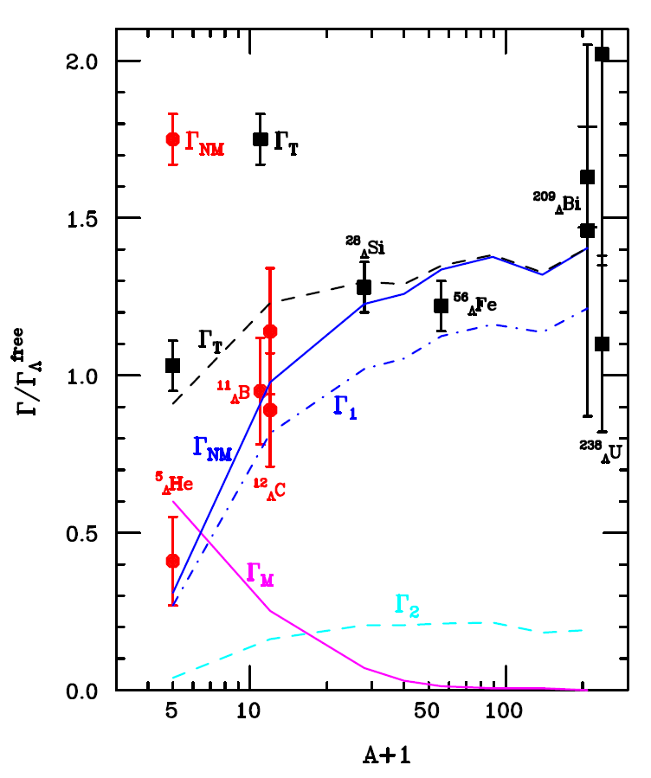
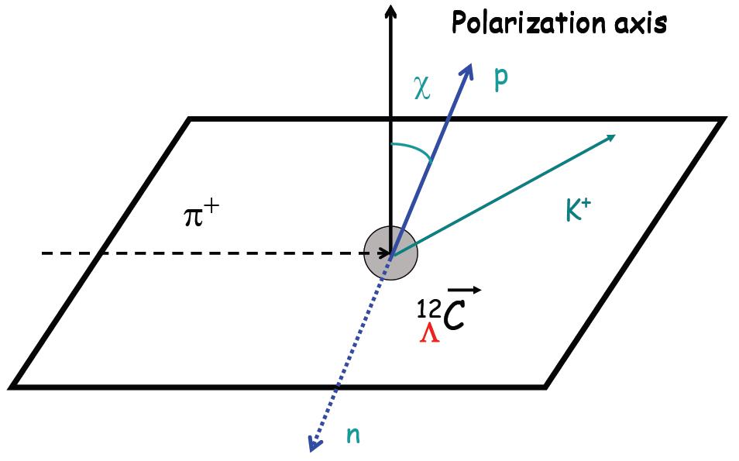
Basics: production and decays
Unstable against weak interaction (τ ~10⁻¹⁰s) → they decay
Possible decays: Λ→πN , ΛΝ→NN, ΛNN→NNN, …
Weak decay observables: decay rates and parity violating asymmetry.
W.M. Alberico, A. de Pace, G. Garbarino, and A. Ramos, Phys. Rev. C 61, 044314 (2000)
Notes:
Referencia proceedings assum

Slide 5
Basics: production and decays
Unstable against weak interaction (τ ~10⁻¹⁰s) → they decay
Possible decays: Λ→πN , ΛΝ→NN, ΛNN→NNN, …
Weak decay observables: decay rates and parity violating asymmetry.
T-matrix
ΛN→NN
interaction
In the Born approximation
V(q)=iM(q)
We can describe the interaction in the one meson exchange picture (OME) previously developed and through an effective field theory (EFT).
Our goal is compare both potentials.

Slide 6
OME VERSUS EFT
EFT
ΛN→NN
OME
EFT is a systematic approximation to some underlying dynamics (short wavelength) that is valid in some specified regime (long wavelength).
It includes the appropriate degrees of freedom to describe physical phenomena occurring at a chosen length scale, while ignoring substructure and degrees of freedom at shorter distances.
Our transfered momentum is q~400 MeV. This gives us the dynamical scale of the phenomena studied: the theory must include as explicit degrees of freedom, at least, those with masses or energies lower than 400 MeV. We take these to be the pion (m_{π} =135 MeV) and the kaon (m_{Κ} =494 MeV).

Slide 7
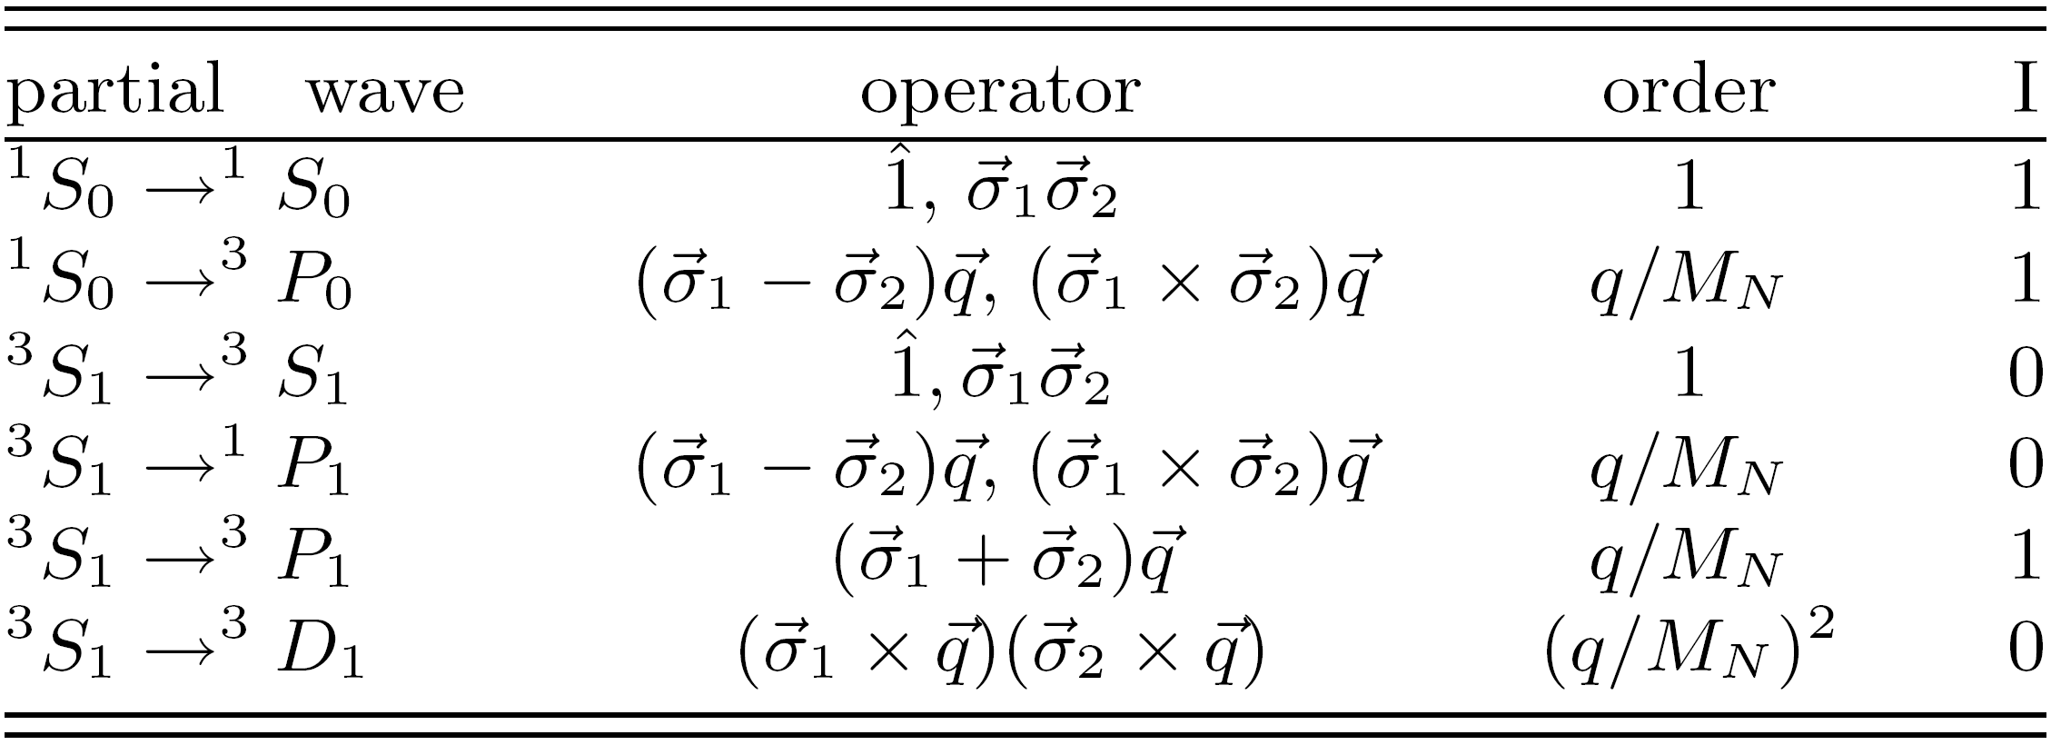

OME VERSUS EFT
EFT
ΛN→NN
OME
We establish our effective theory by considering all the operational structures compatible with the underlying symmetries in the ΛN→NN weak transition.
The resulting transition potential is organized in a series of contact terms of increasing dimension in the ratio of the transferred momentum over the nucleon mass, q/M_{N}.
The contact terms introduce singularities in the form of a delta function, which is smeared to a gaussian form of width α. The parameter α, which is taken to be the inverse of the first meson excluded, provides a natural cutoff to the theory.
Notes:
Referencia lectures daniel phyllips

Slide 8
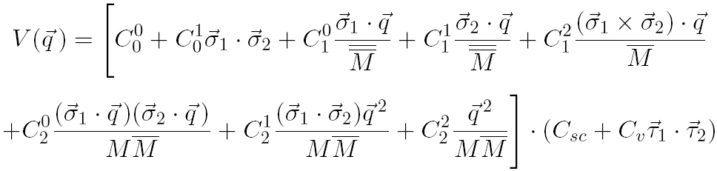
OME VERSUS EFT
EFT
ΛN→NN
OME
LO
NLO
NNLO

Slide 9
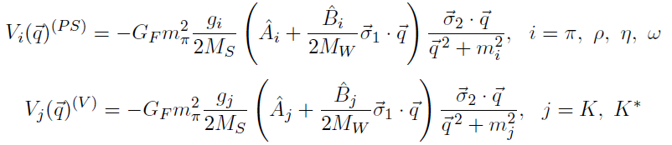
OME VERSUS EFT
EFT
ΛN→NN
OME
In the OME picture the ΛN→NN process is assumed to proceed via the virtual exchange of mesons belonging to the ground-state pseudoscalar and vector meson octets.
The exchange of these mesons, and according to their masses, accounts for the different ranges of the interaction.
m_{π} =135 MeV, m_{Κ} =494 MeV,
m_{η} =548 MeV, m_{ρ} =775,
m_{ω} =783 MeV, m_{Κ*} =892 MeV
Given the meson coupling constants and applying the feynman rules, two types of potentials are found:

Slide 10
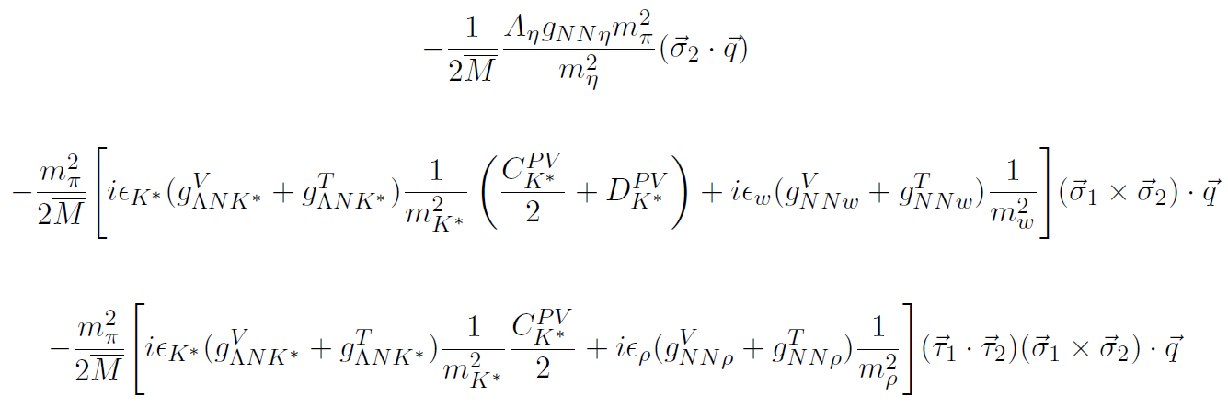
OME VERSUS EFT
EFT
ΛN→NN
OME
In order to compare the OME and the EFT potentials we expand the potentials for the η, ρ, ω and K*.
We organize them as powers of q² (the expansion parameter is q²/m_{meson}²). For example, at next to leading order we find different PV contributions:

Slide 11
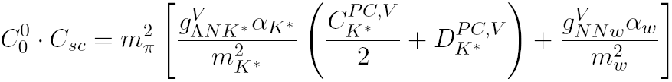
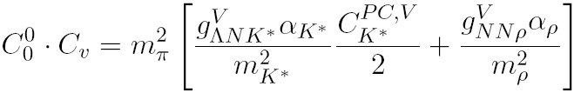

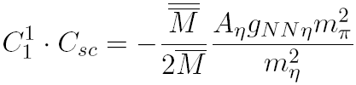
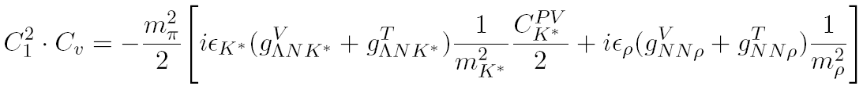
OME VERSUS EFT
EFT
ΛN→NN
OME
V=V_{π}+V_{K}+V_{contact terms}
V=V_{π}+V_{K}+V_{expansion}
We relate the low energy constants (LEC’s) that appear in the EFT transition potential and the coupling constants of the pertinent meson-exchange mechanisms by comparing the two potentials at each order.
Calculate LECS:
Extract information about meson coupling constants
Give new contributions not condidered in the OME (sigma)

Slide 12
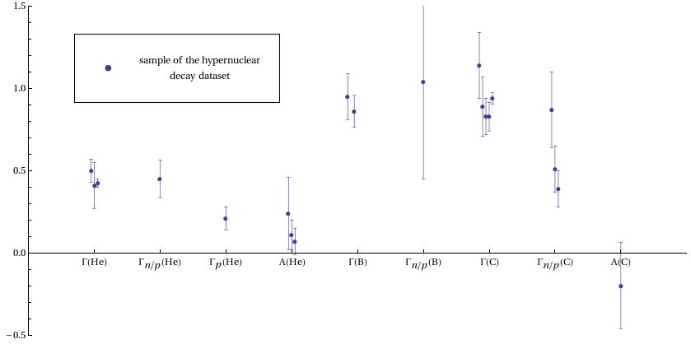
Work in progress
Derivation of the EFT up to NNLO (matching to the OME).
Calculation of the low energy constants (LECs) in the EFT. The theory has
been implemented into a hypernuclear code, which is prepared to extract the
LECs by performing minimizations to existing hypernuclear decay database
(⁵He_{Λ}, ¹¹B_{Λ} and ¹²C_{Λ}).
Sensitivity to the cutoff of the theory (the α parameter regularizing the delta
function).
Sensitivity to the strong ΛΝ and NN potential models.
Inclusion of the ΔI=3/2 transitions.
Thank you
Notes:
Posar alguna referencia

