Slide 2
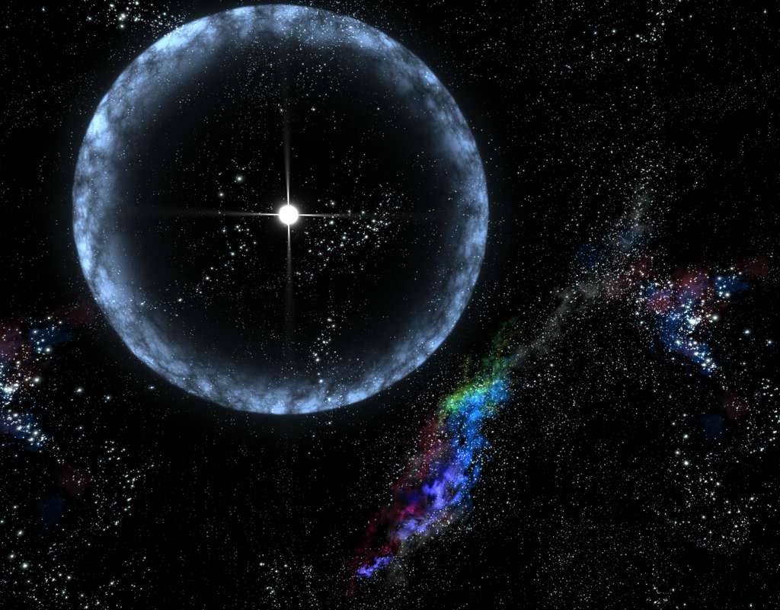
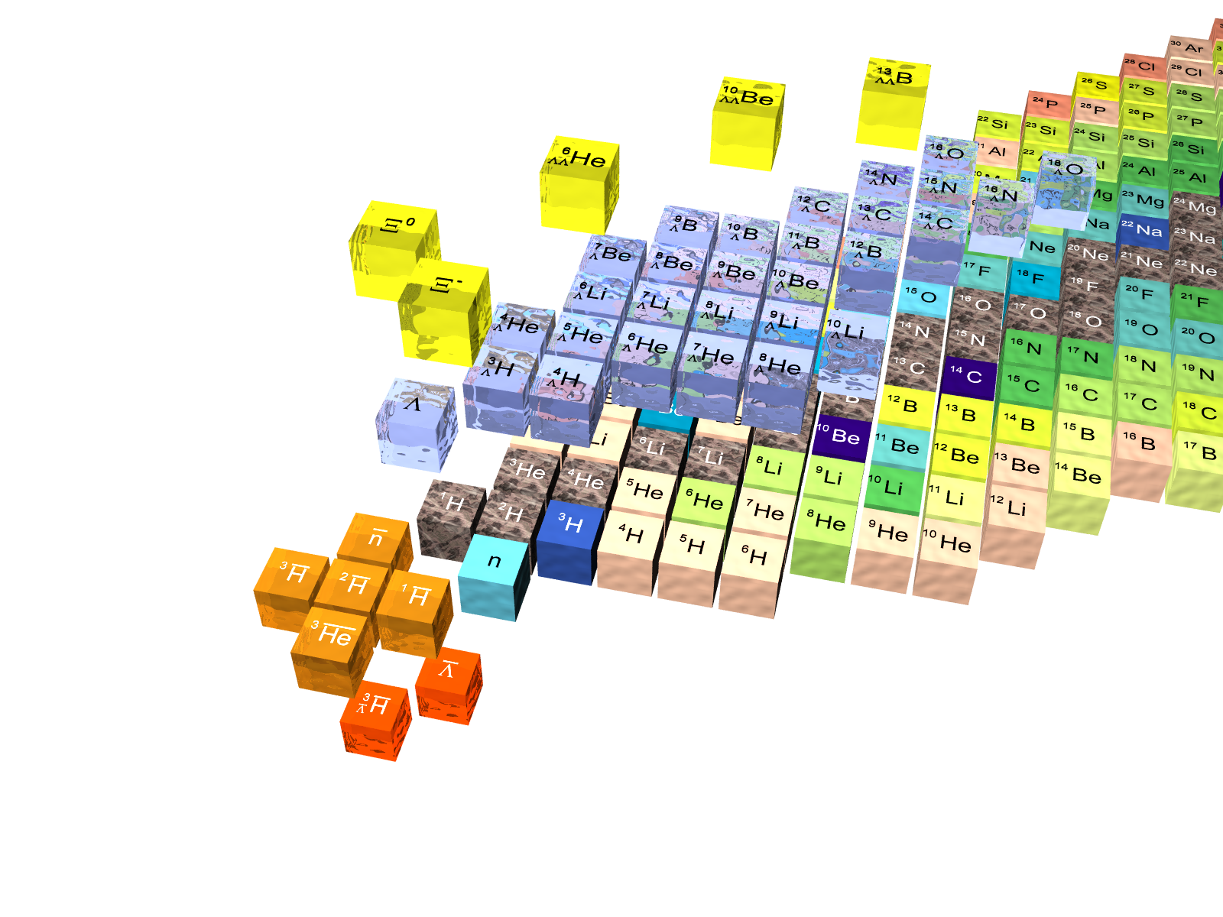

Slide 3


Double Hypernuclei an experimental challenge
Josef Pochodzalla
XXIInd Indian-Summer School and SPHERE School on Strangenes Nuclear Physics
introduction/reminder
present data
  emulsion data
  hybrid emulsion experiments
  E906 - a fully electronic experiment
future options
  PANDA
  ΛΛ Hypernuclei in central RHIC ?
summary

Slide 4
Weak decay of hypernuclei
mesonic decay
of hypernuclei
non-mesonic decay
of hypernuclei
free Λ decay
p_{F}≈270MeV/c
N
N
p_{N}≈100MeV/c
π
N
N
w
π
π
s
w
w
Λ
Λ
Λ
N
suppressed by Pauli blocking
ΔI=1/2 rule
dominant in all but the lightest hypernuclei

Slide 5
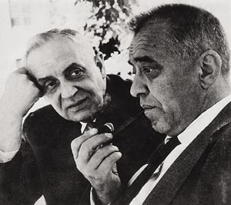
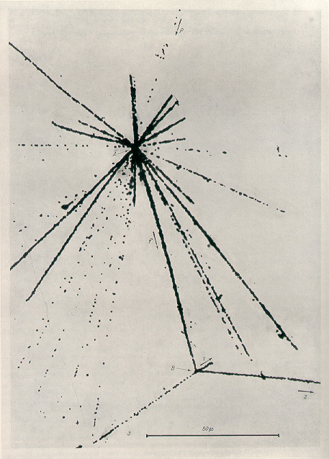
How it began
Marian Danysz, Jerzy Pniewski, et al. Bull. Acad. Pol. Sci. III 1, 42 (1953)
Marian Danysz, Jerzy Pniewski, Phil. Mag. 44, 348 (1953)
received 1. December 1952
A cosmic ray particle (E≈30 GeV) enters the emulsion from the top
Interacting with a bromine or silver nucleus the particle creates an upper star.
  21 tracks: 9α+ 11H +1 _{Λ}X
  Finally, _{Λ}X disintegrates initiating the bottom star.
  second star consists of four tracks:
    2 p,d,t or α
    1 π, p, d, or t
    1 recoil
  energy release >140MeV
cosmic ray
J.P.
M.D.

Slide 6
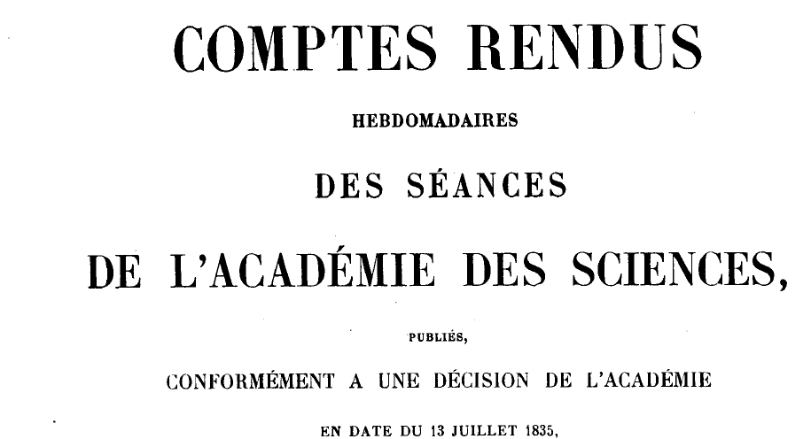
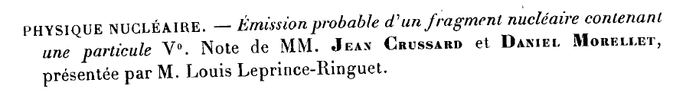
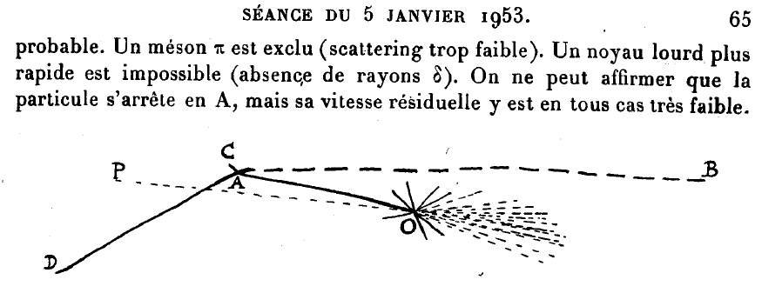
The second event

Slide 7
Birth, life and death of a hypernucleus
target nucleus
γ
electromagnetic decays
γ
p,n  Λ
γ
mesonic decays
nonmesonic weak decay
strangeness deposition
FINUDA
hadronic decay in emulsion, heavy ion recations
strangeness production (π⁺, K⁺), (π⁻, K⁰) BNL,KEK,(GSI)
strangeness exchange (K_, π⁻) ,(K_, π⁰)
BNL,KEK,JPARC
electroproduction (e,e´K⁺) , (γ,K⁺) Jlab, MAMI-C

Slide 8
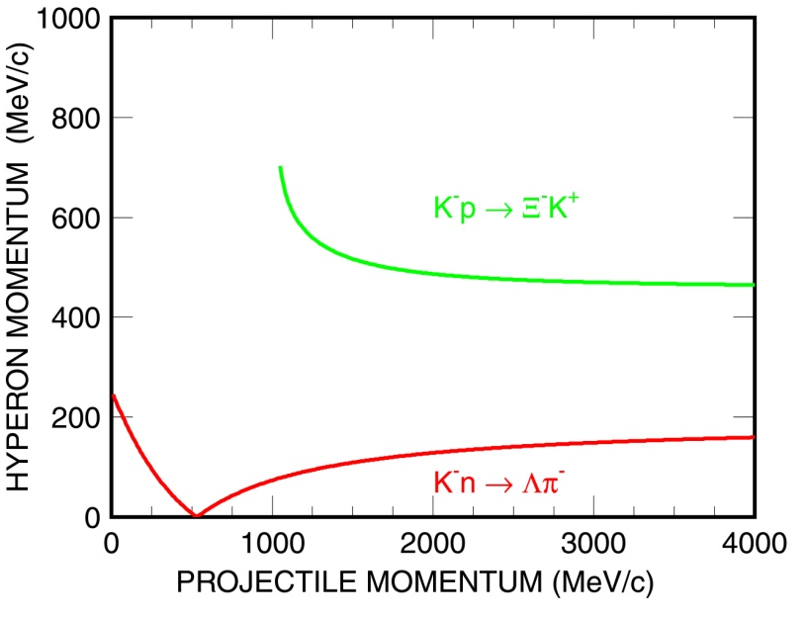
Production of ΛΛ Hypernuclei
simultaneous implantation of two Λ’s impossible
Ξ⁻ conversion in 2Λ: Ξ⁻+p →Λ+Λ + 28MeV
⇒large probability that two Λ’s stick to same nucleus
two-step process
⇒ spectroscopic studies only via the decay products
K⁺
primary
production of
of X⁻
K⁻
p→Ξ⁻
Ξ-p→ΛΛ
Ξ⁻
capture
of X⁻ in
secondary
target;
atomic
transistion
γ
L
Ξ⁻pΛΛ
conversion
γ-decay and
weak decay
strong decay
L
γ
+28MeV
Notes:
If neutral particles emitted – initial nucleus not uniquely known => Ambiguity
Step-by-step

Slide 9
Ξ⁻ capture
Ξ⁻-atoms: x-rays
conversion
  Ξ⁻(dss) p(uud) → Λ(uds) Λ(uds)
  ΔQ = 28 MeV
Conversion probability few %
Y. Hirata, J. Randrup et al.,

Slide 10
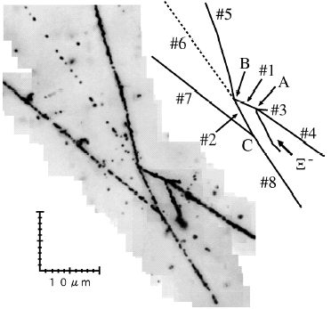
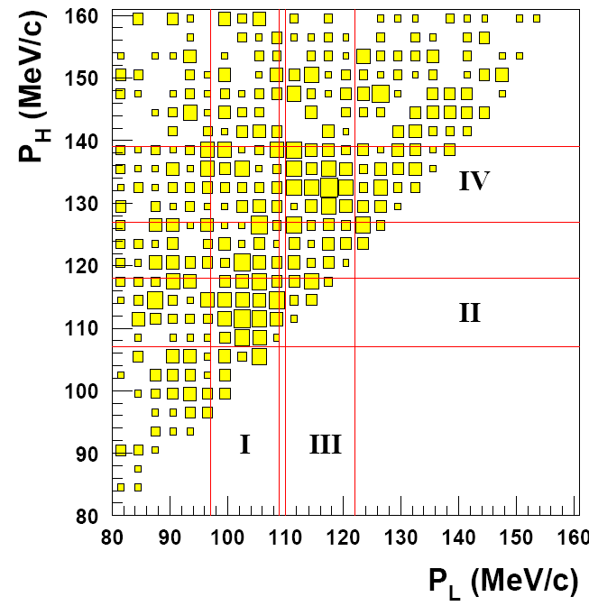
Decay Products of ΛΛ Hypernuclei
nuclear fragments after weak decay ⇒ emulsion hadron+nucleus
  detection of charged products only
  limited to light nuclei
weak decay products (pions) ⇒ BNL-AGS E906 ⁹Be(K⁻,K⁺)X
  Electronic experiment but resolution limited
  no information on excited states
  interpretation not unique because π momenta are similar
γ- spectroscopy prior weak decay ⇒ PANDA p+A
  no excited states observed yet, but theoretically predicted
  How to identify the nucleus ?
twin hypernuclei
E906

Slide 11
Emulsion data
Across the universe
Notes:
Outdated ?

Slide 12
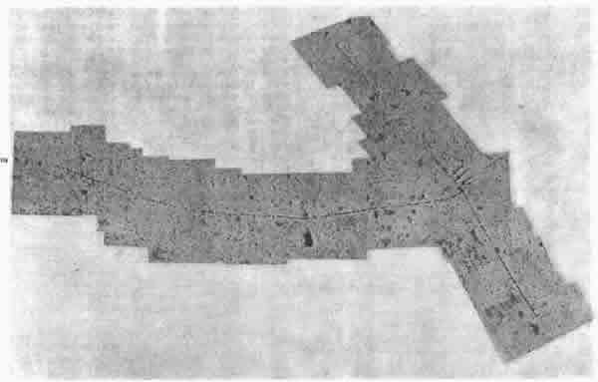

Nuclear Emulsion
Cecil Frank Powell (1903-1969)
  Nobel Prize in Physics 1950
Multiple layers of emulsion were historically the first means of visualizing charged particle tracks
  very high positional precision
  ionisation density (dE/dx)
  range
  3-dimensional view of the interaction
An emulsion is made, as for photographic film, of a silver salt, (AgBr), embedded in gelatine and spread thinly on a substrate.
  grain size 0.2-0.5μm (today: 40nm)
  during developement excited grains are reduced to elemental silver
  density 3g/cm³
Data acquisition by automated means (e.g. by scanning the film with a CCD camera) is now possible.

Slide 13
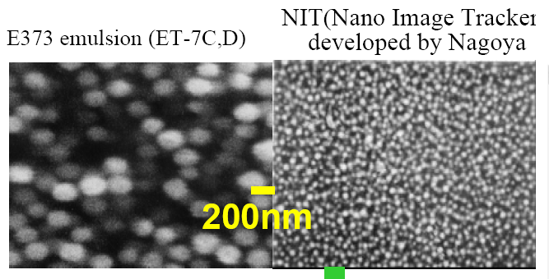
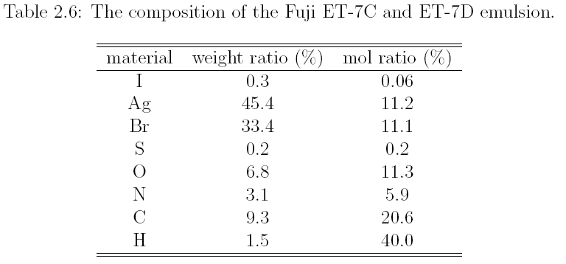
Composition of Emulsions
heavy elements
light elements
Notes:
Target, which captures the Xi can only be determined from the decay products

Slide 14
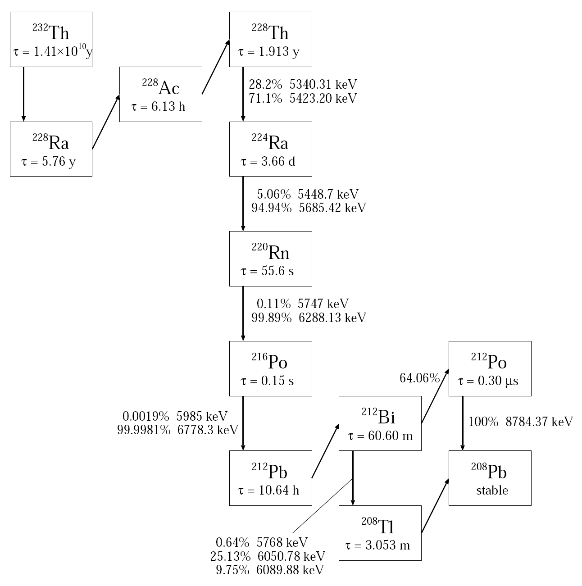
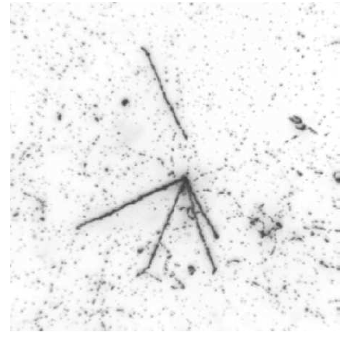
Emulsion - calibration
Density of gel of emulsion may vary
Range-energy relation needs to be calibrated
α-particles from ²¹²P and ²²⁸Th;
  Range 22.9 ± 0.3 μm for 5.4MeV α from ²²⁸Th
Hitoshi Takahashi, thesis 2003

Slide 15
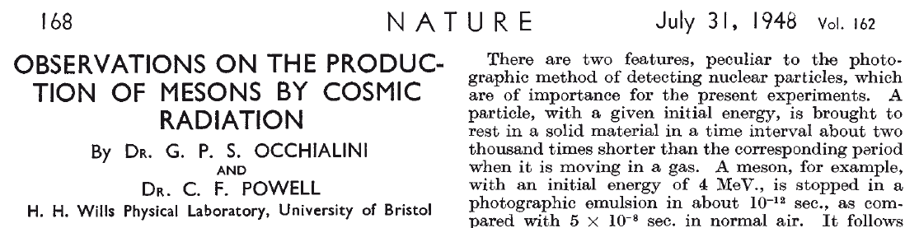
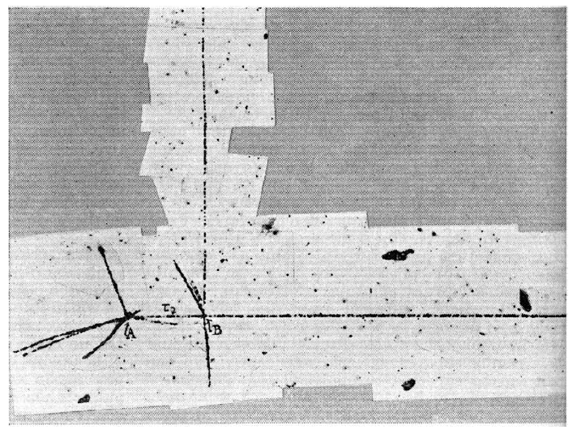

Slide 16
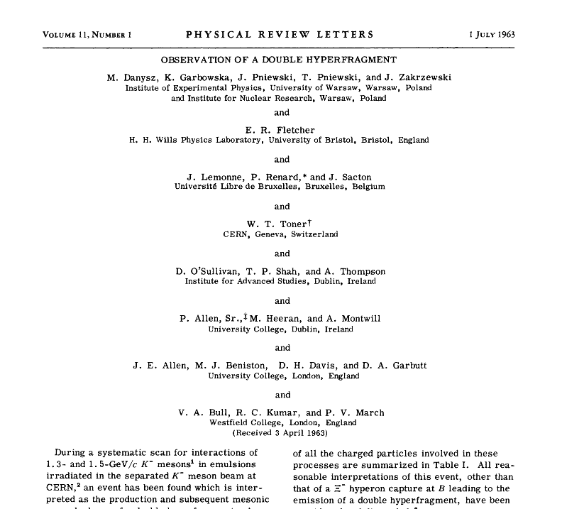
The first event (1)
1.3-1.5 GeV/c K⁻+Emulsion; 31000 K⁻
carefully reanalyzed
  ≈1963 by P.H. Fowler, V.M. Mayes and E.R.Fletcher
  Dalitz et al., Proc. R. Soc. Lond. A426, 1 (1989)

Slide 17
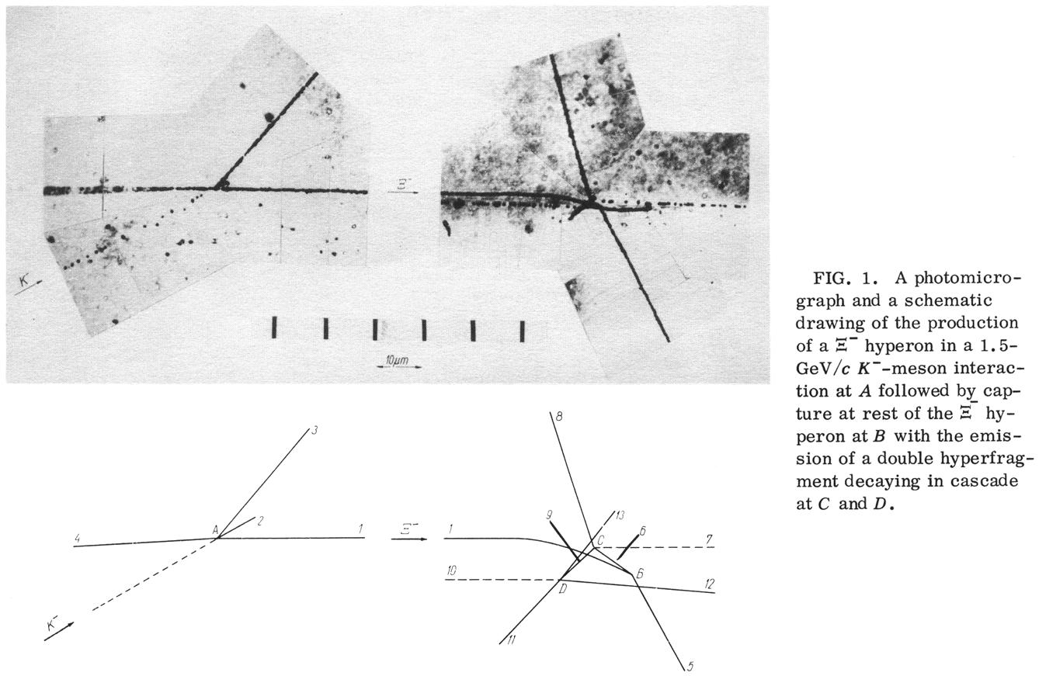
The observed first event
50μm
p
1.5 GeV/c K⁻
_{Λ}Y
α
_{ΛΛ}X
π⁻
π⁻
p
Ξ⁻
α
H
Notes:
reaction C,N or O because Coulomb barrier

Slide 18
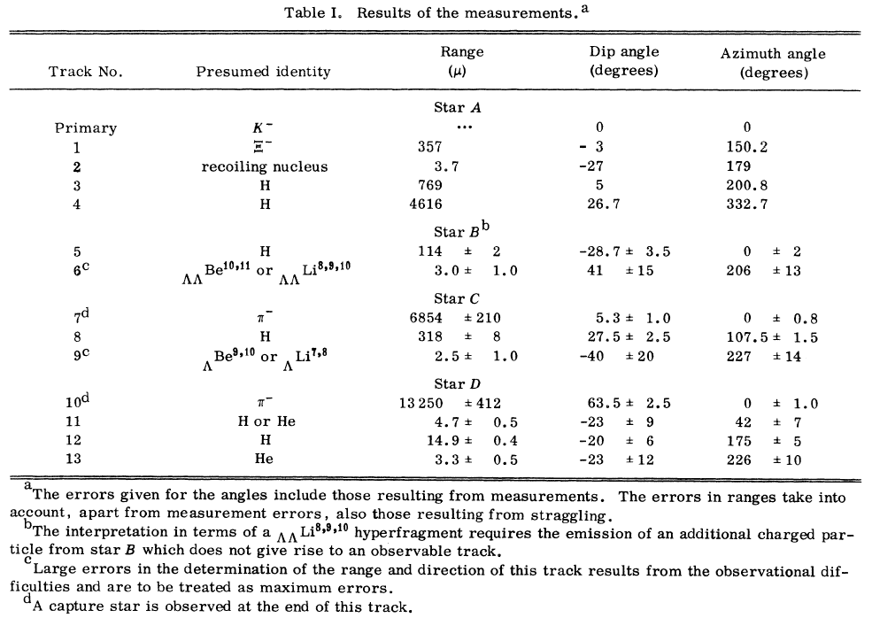
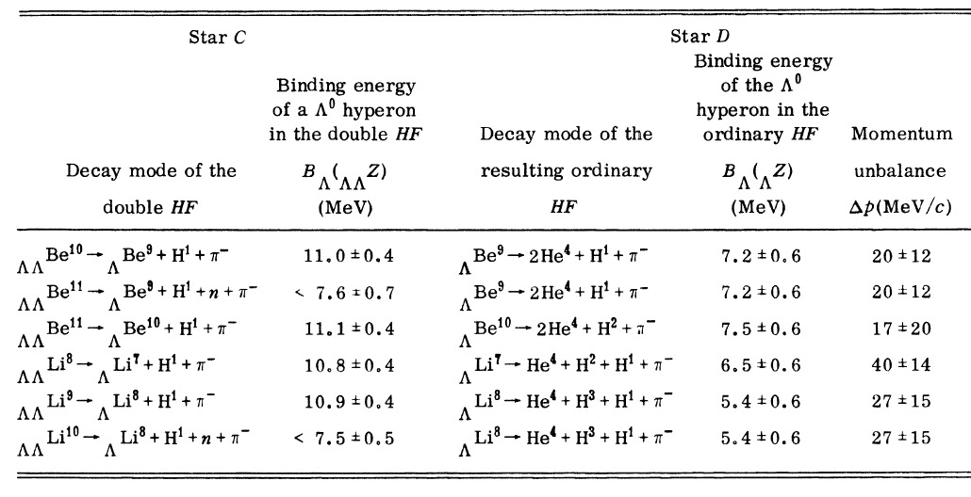
Analysis of the Danysz-Event
Ionisation density ⇒ dE/dx ⇒ charge, momentum
Range ⇒ mass, charge, momentum
angles ⇒ momentum balance
there remains some ambiguity!

Slide 19
Can we determine the ΛΛ interaction?
The binding energy B_{Λ} of a Λ particle in a hypernucleus can be determined from energy balance of the decay products at point C
  for example
Problem: if excited states in ⁹_{Λ}Be involved → B_{ΛΛ} overestimated
Result: B_{ΛΛ}=17.5±0.4MeV
C
Notes:
Mass of 9LB is underestimated
Subtract a too small number

Slide 20
Production analysis
Capture of the negative Ξ by an atom
Ξ⁻ Binding energy B_{Ξ}
B_{ΛΛ} from point B
B_{ΛΛ}=10.9±0.6MeV
Lower limit
B
Notes:
Lower limit: B_Xi, kinetic energy of neutral particles

Slide 21
First approach to the ΛΛ interaction
We are mainly interested in the additinal binding energy between the two Λs
in the case of the Danysz-event one obtains
positive ⇒ attractive interaction
this is the net ΛΛ binding provided that
  the core is not distorted by adding one Λ after the other
  the core spin is zero
  no γ-unstable excited states are produced
= + +
Λ
Λ
Λ
Λ
Λ
Λ
Λ
Λ
note:
ΔB_{ΛΛ} is proportional to the kinetic energy of the produced pions
Notes:
if spinnot zero, different spin dependent interaction for the two L

Slide 22
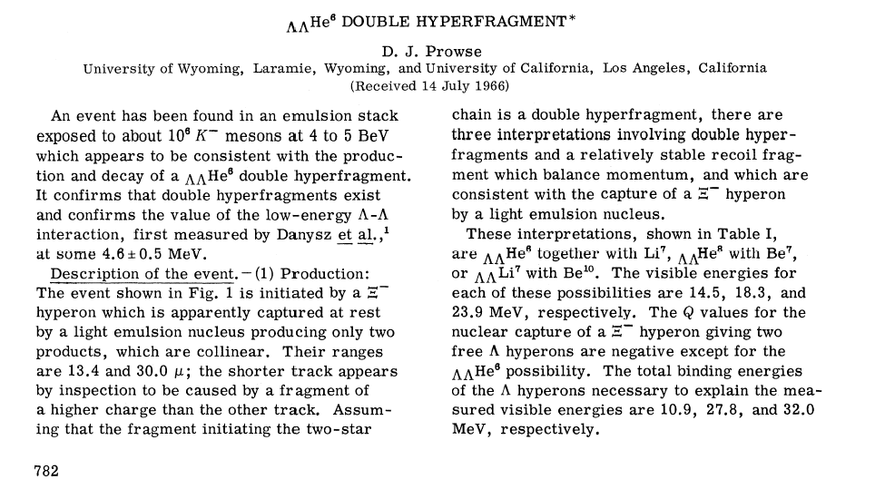
The Prowse Event (1)

Slide 23
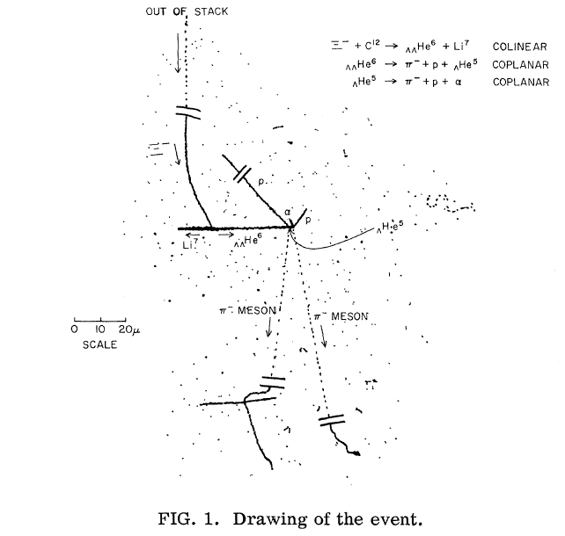
The Prowse event (2)
interpreted as
very likely no excited state
core spin is zero
no independent study of the event
reconsidered by Dalitz et al., Proc. R. Soc. Lond. A426, 1 (1989)
event is now regarded as questionable

Slide 24
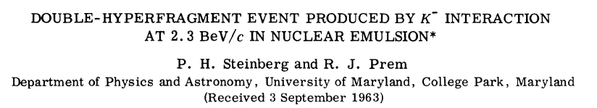
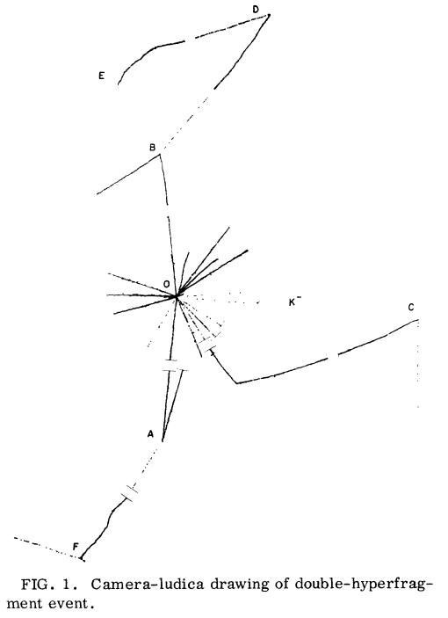
The first twin nuclei

Slide 25
Emulsion Hybrids
With a little help from my friends

Slide 26
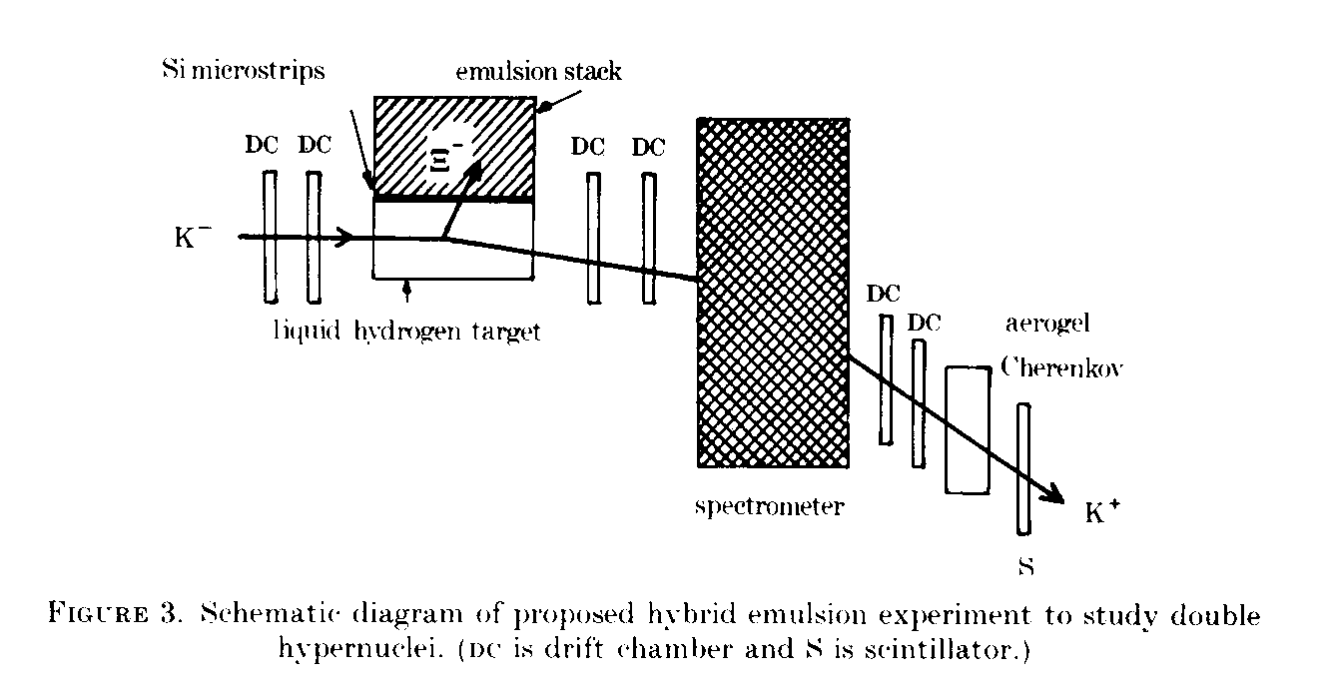
Pros and Cons of Emulsion Technique
+ excellent track resolution
- time consuming analysis: it just takes a long time to find the very few interesting events
higher K-rates needed
combine emulsion technique with electronic counters
  use (K⁻,K⁺) to produce Ξ⁻
  track K⁻ and K⁺ to determine interaction point in the emulsion/target
  e.g. suggested 1989 by Dalitz et al.
applied by KEK-E176 and KEK-E373 collaboration

Slide 27
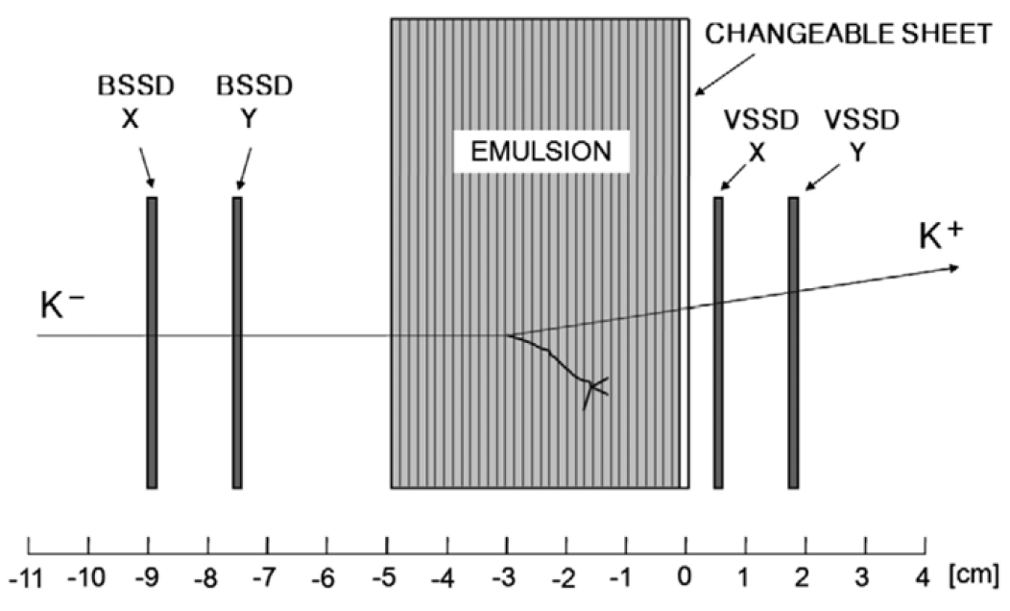
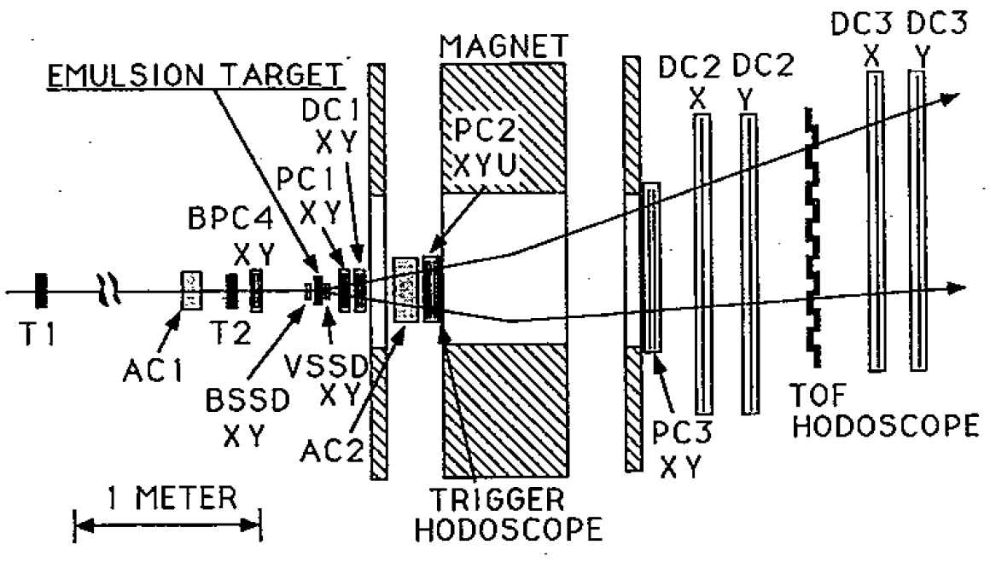
KEK-E176 Experiment
Ξ⁻ stops: 77.6±5.1 events
Captured
  43.3% by light elements
  57.7% by heavy elements

Slide 28
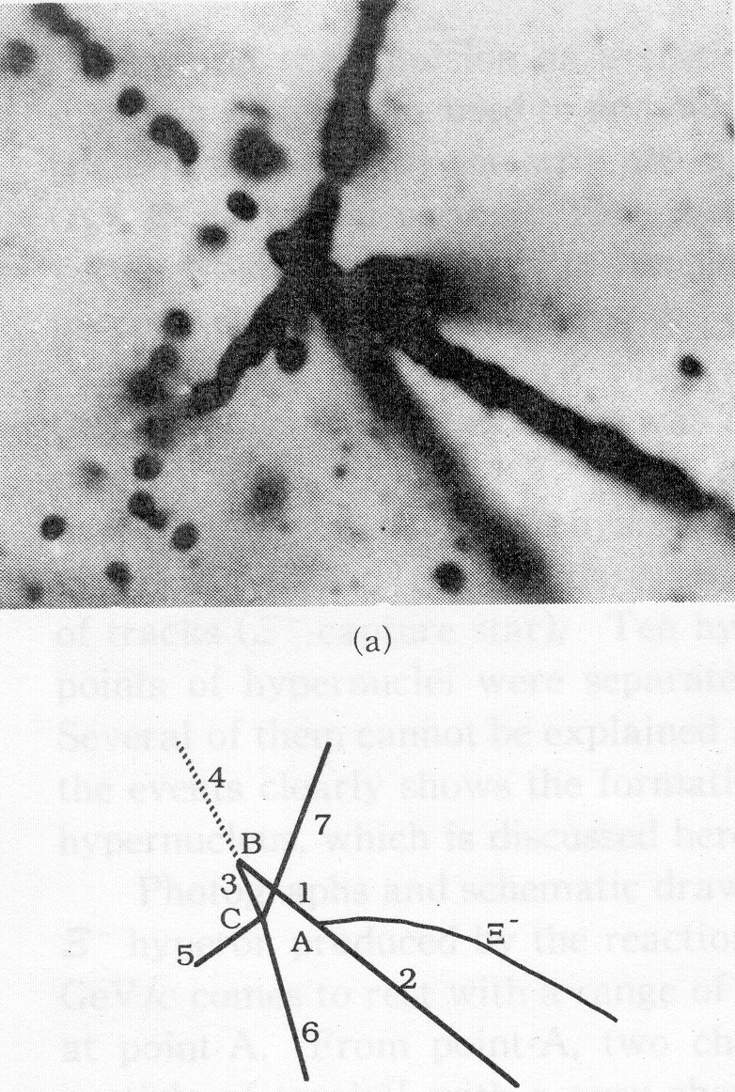

The KEK-E176Event (Aoki-event)
S. Aoki et al., Prog. Theor. Phys. 85, 1287 (1991)
  repulsive ΛΛ interaction!?
re-interpretation: C.B. Dover, D.J. Millener, A. Gal and D.H. Davis, Phys. Rev. C 44, 1905 (1991)

Slide 29
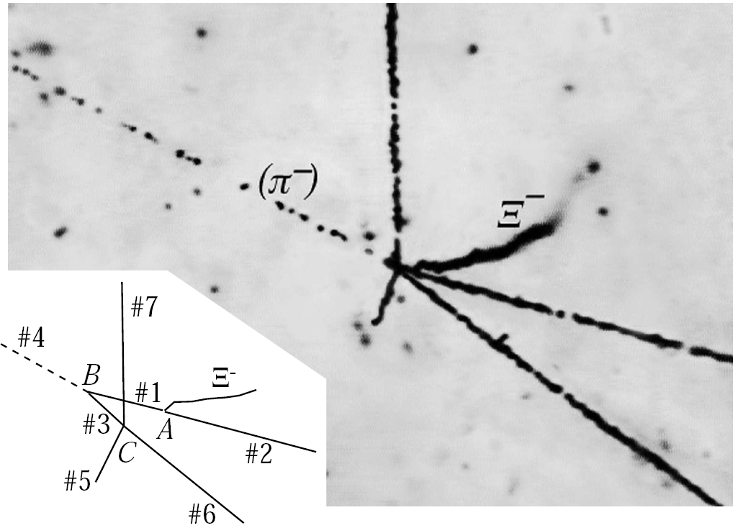
Reanalysis of E176 Event
Hitoshi Takahashi, thesis 2003; S. Aoki et al., Nucl. Phys. A828 (2009) 191;
Allow for excited state
Use recalibrated range-energy relation
Updated values of hyperon and meson mases
  PDG 2006: M(Ξ⁻)= 1321.31±0.13 MeV
  PDG 2008: M(Ξ⁻)= 1321.71±0.07
B_{Ξ}=0.17MeV (atomic 3D state in ¹⁴N+Ξ system)

Slide 30
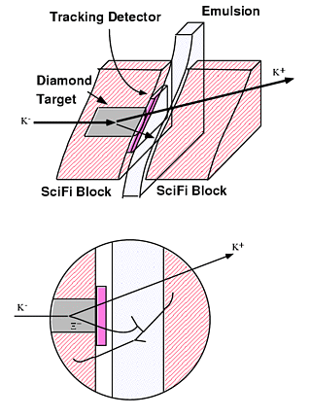
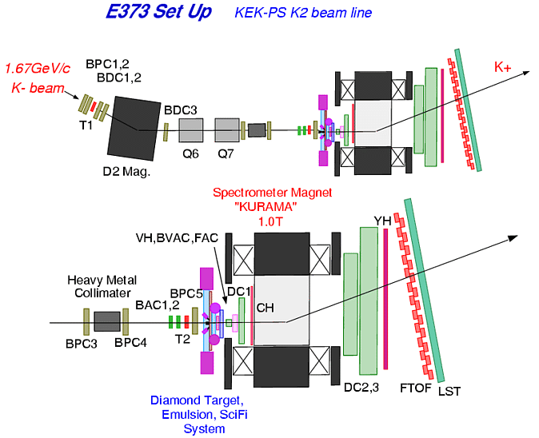
The KEK-E373 Experiment
KEK proton synchrotron
1.66 GeV/c K⁻ beam
  Diamond target (high density)
  shorter stopping distance
  tracking detector for incoming Ξ⁻
KEK-E176
  1·10⁹ K⁻ on target
  766 analyzed (K⁻,K⁺) reactions, 497 Ξ⁻ candidates
KEK-E373 (1998-2000)
  1.4·10¹⁰ K⁻ on target, 1.3 ·10⁷ trigger
  9·10⁴ (K⁻,K⁺) reactions, 5096 Ξ⁻ tracks in SciFi

Slide 31
KEK-E373: the NAGARA event
H. Takahashi et al., PRL 87, 212502-1 (2001)
hybrid emulsion technique
cleanest event so far (also theoretically)
  inconsistent with Prowse event

Slide 32
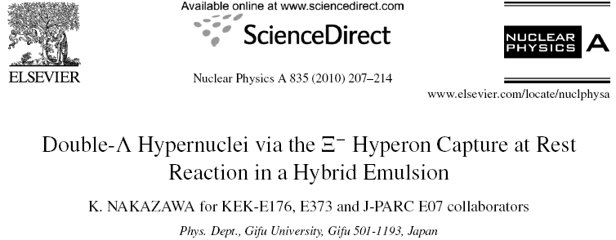
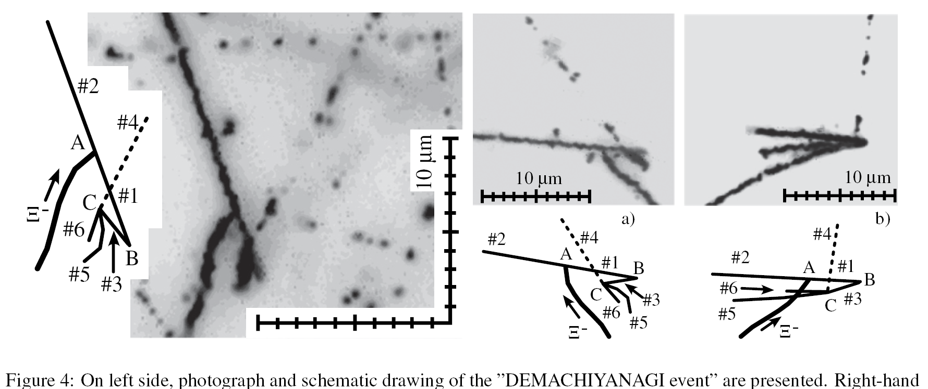
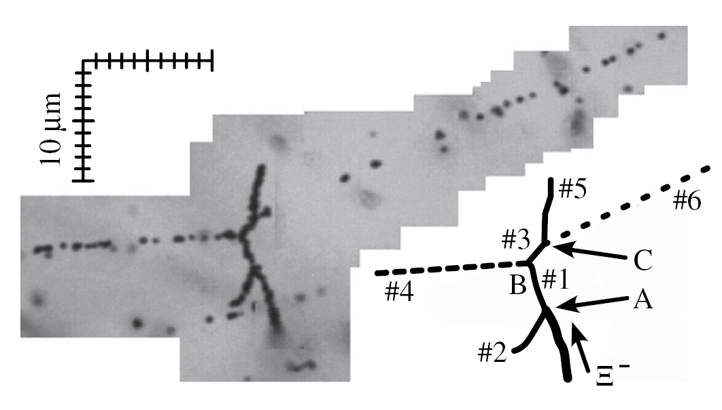
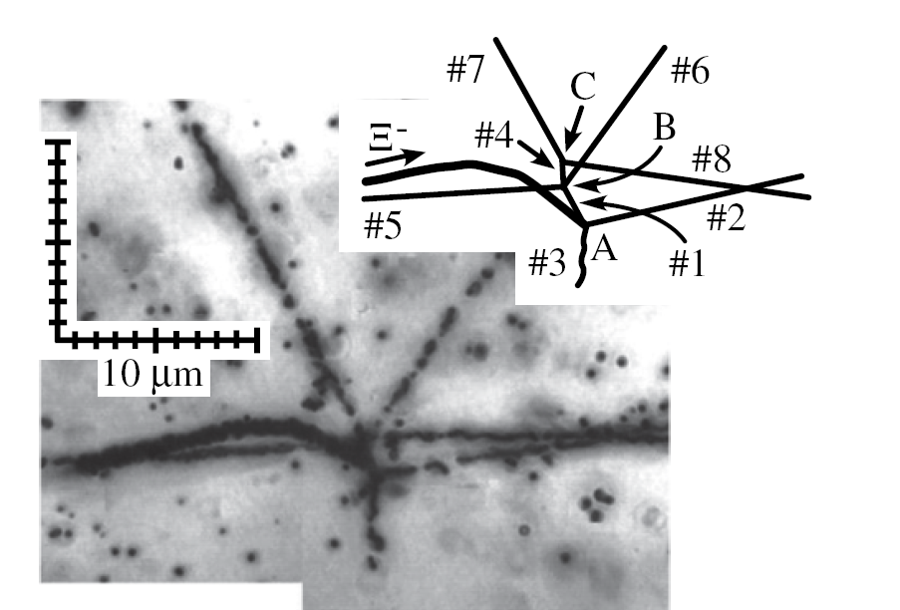
After HYP-X 2009

Slide 33
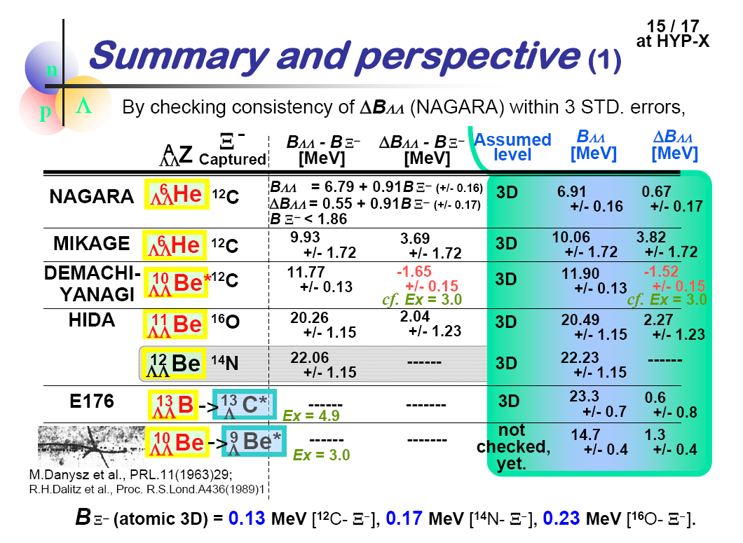
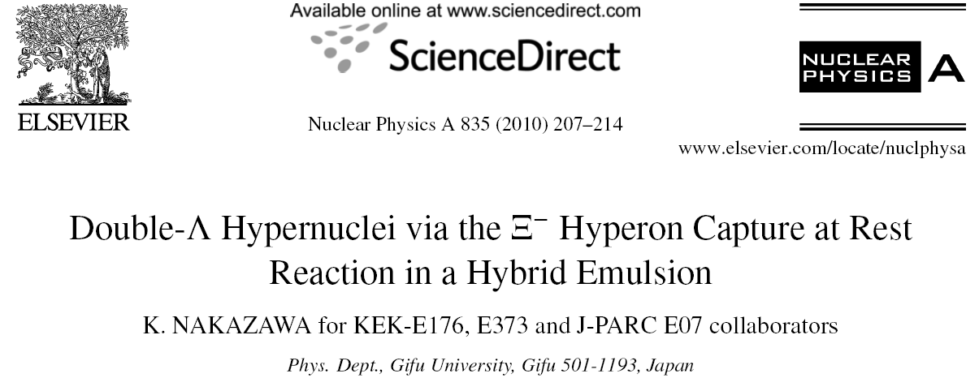
Summary – HYPX 2009
Notes:
The more data, the more confusing
Needs to be sorted out

Slide 34
Experiment | Observed stopped Ξ- | Double Hypernuclei
Emulsion |  | ~1
KEK E176 | ~100 | 1
KEK E373 | ~1000 | 4
AGS-E906
Future Experiments
J-PARC E07 | ~10000
FAIR-PANDA

Slide 35
Tulio Bressani:
„One event contains all (physics)“

Slide 36
Y-N or Y-Y Interaction in Hypernuclei
Mass difference between Σ and Λ in single hypernuclei and ΛΛ, ΞΝ, ΛΣ in double hypernuclei are small
  m(Ξ⁰n)-m(ΛΛ)=23MeV m(Σ⁰Λ)-m(ΛΛ)=77MeV
⇒ mixing important
Thomas A. Rijken,HYP2006

Slide 37
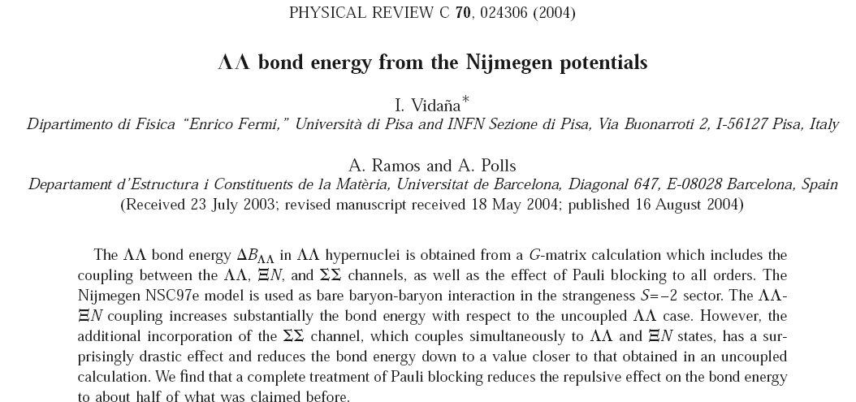
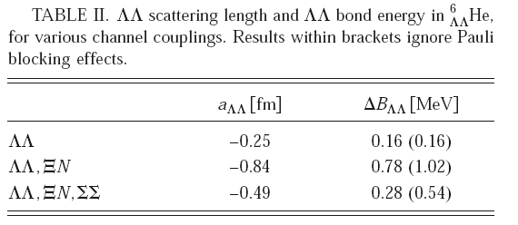

Slide 38
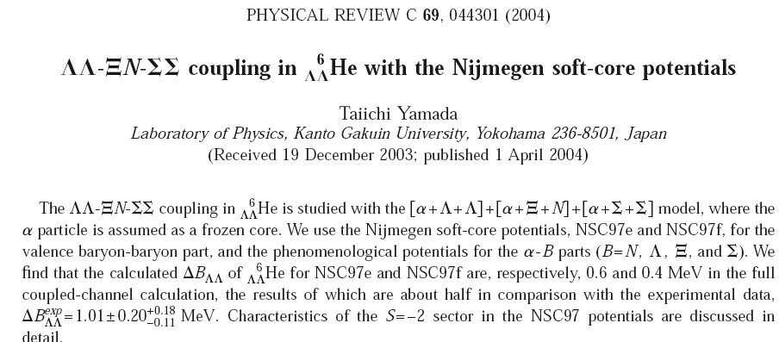
Considering the experimental information, any conclusion might be still premature
More precission data are needed
NSC97e and NSC97f Nijmegen potential describe single hypernuclei reasonably well
Notes:
Precission needed!

Slide 39
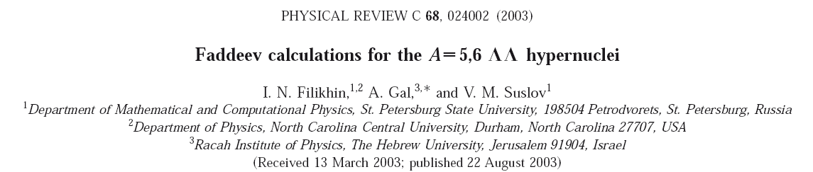
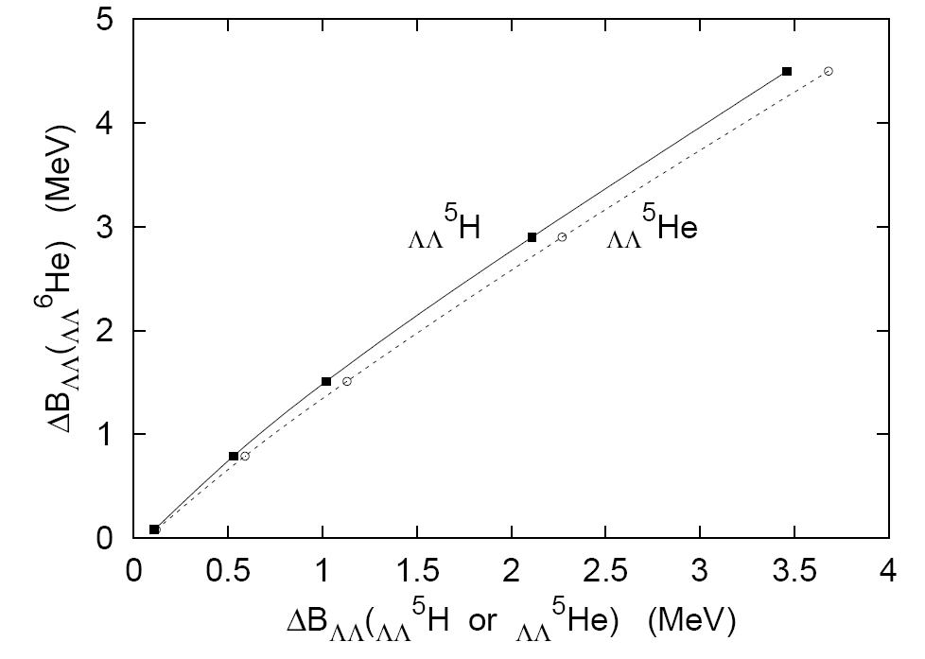
Predictive Power

Slide 40
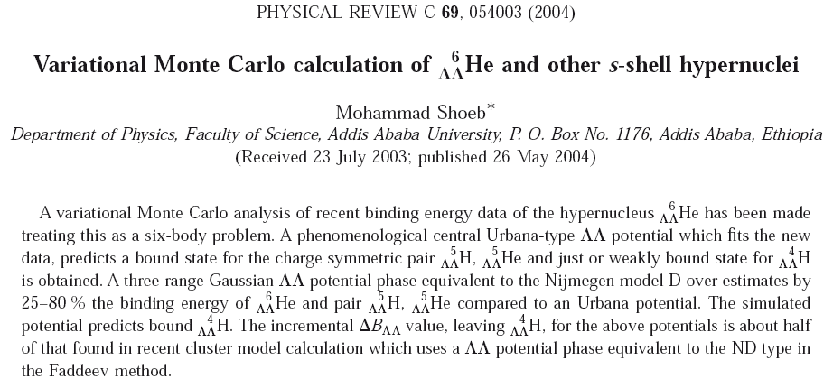

Slide 41
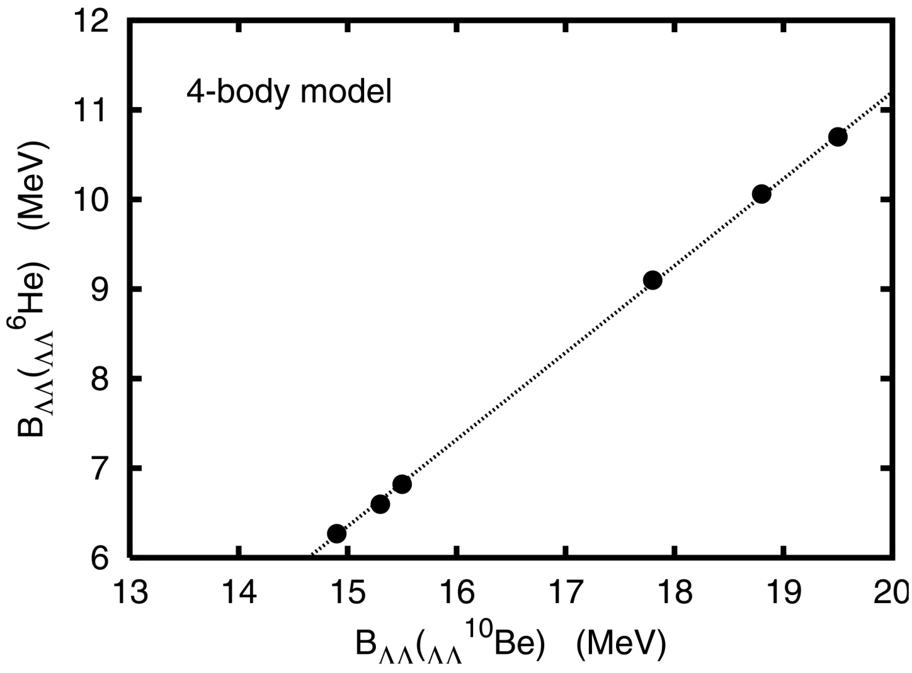
Consistent Description - not yet!
I.N. Filikhin, A. Gal, Phys. Rev. C 65, 041001 (R) (2002)
  Faddeev-Yakubovsky calculation
no convincing consistent description possible so far
Notes:
NAGARA and MIKAGE

Slide 42
Summary – HYPX 2009
Notes:
The more data, the more confusing
Needs to be sorted out

Slide 43
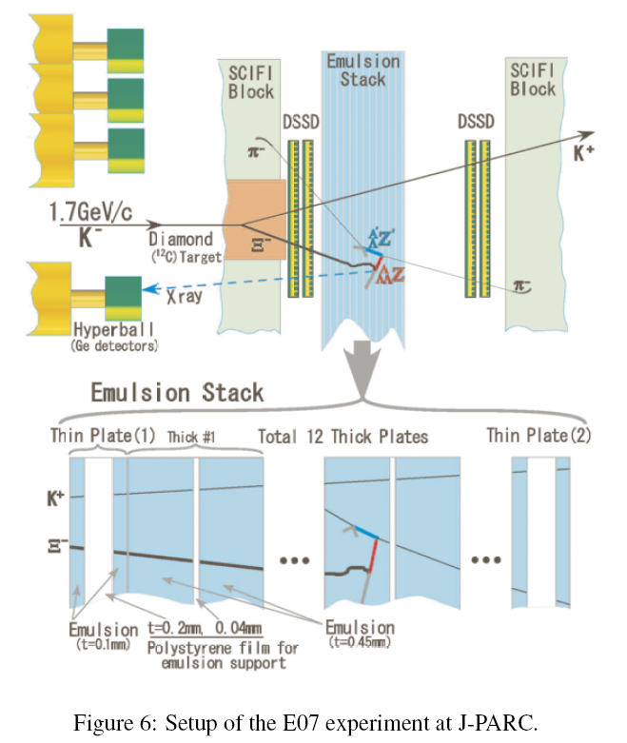
JPARC: E07 experiment
1.7GeV K- beam
3·10⁵ K⁻/4.8s
3 times larger emulsion volume
Ξ atomic transisions?
Factor of 10

Slide 44
The E906 Experiment
The magical mystery tour

Slide 45
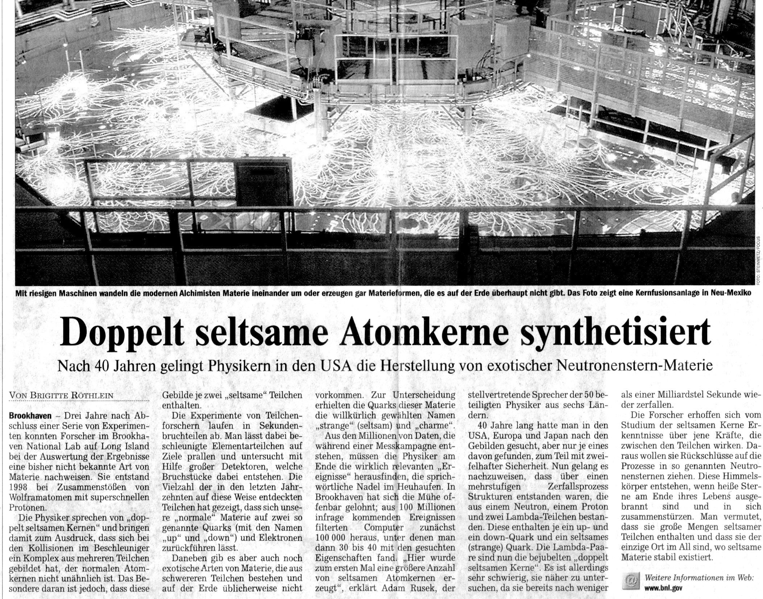
DIE WELT 4. September 2001
AGS-E906

Slide 46
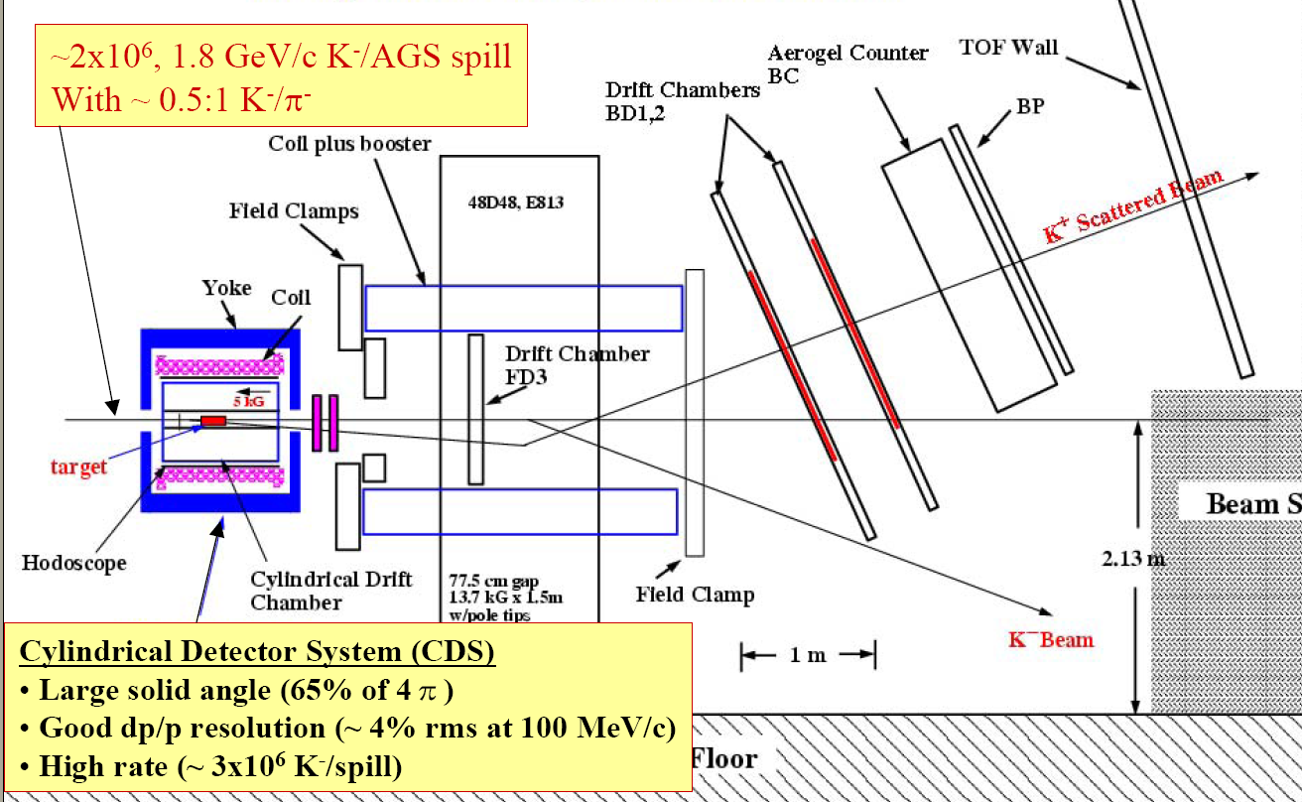
The E906 experiment
K⁺
K⁻
beam
dump

Slide 47
The E906 strategy
fully electronic detector
use p(K⁻,K⁺)Ξ⁻ to produce Ξ⁻ on a nuclear target
Ξ⁻p→ΛΛ conversion after capture by another target (⁹Be)
Identification of ΛΛ hypernucleus through sequential weak decay via π⁻ emission
  in light nuclei the pionic weak decay significant
  the pion kinetic energy is proportional to ΔB_{ΛΛ}
  coincidences between two pions help to trace the decay of the ΛΛ-nucleus
example
N
p_{N}≈100MeV/c
π
w
Λ

Slide 48
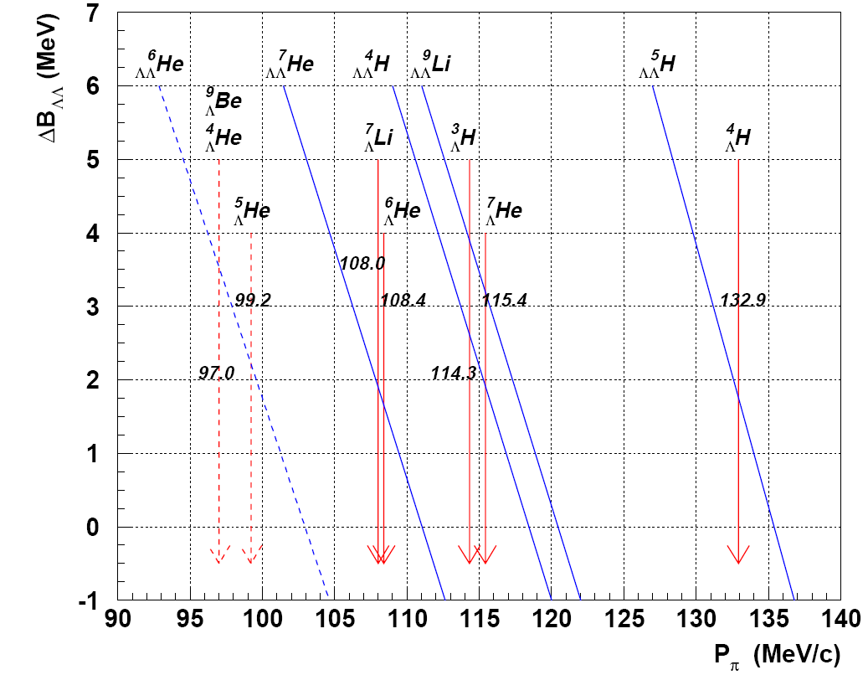
Assignement of pion momenta
104 MeV/c
114 MeV/c
133 MeV/c
…is not straight forward

Slide 49
…but life is not so easy
there may be excited states involved
the assignment may not be unique
  of course mass and charge conservation may provide additional constraints
two coincident pions may be emitted also from twin nuclei
i.e. two single hypernuclei produced in the initial reaction with the Ξ⁻

Slide 50
Double Hypernuclei an experimental challenge
Josef Pochodzalla
XXIInd Indian-Summer School and SPHERE School on Strangenes Nuclear Physics
introduction/reminder
present data
  emulsion data
  hybrid emulsion experiments
  E906 - a fully electronic experiment
future options
  PANDA
  ΛΛ Hypernuclei in central RHIC ?
summary

Slide 51
E906
9·10¹¹ K⁻ on Be target
1.1·10⁵ trigger
consistent with single Λ hypernuclei
twin hypernuclei
114 MeV/c
133 MeV/c
104 MeV/c
114 MeV/c
momentum of the pion with lower momentum
momentum of the pion with lower momentum

Slide 52
9Be(K⁻,K⁺) at E906
Two scenarios:
Correlated pion momenta
  (104,114) ⇒ ?
  (114,133) ⇒ ³_{Λ}H + ⁴_{Λ}H
104 MeV/c
114 MeV/c
133 MeV/c
Notes:
Two main structures

Slide 53
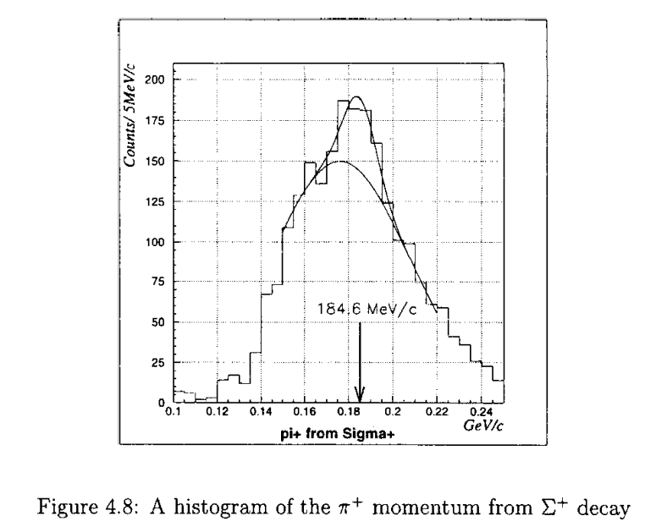


Momentum Calibration of E906 CDC

Slide 54
Suggested decay mode (104/114)
PRL 87, 132504-1 (2001)
  ΔB_{ΛΛ} depends then on excitation energy
p
E_{x} (MeV) | ΔB_{ΛΛ} (MeV)
7.75 | 1.8
8.75 | 0.8
9.84 | -0.26
7.75MeV
Hungerford (HYP03)
  requires isomeric state at 3.8MeV
Gal (HYP03)
3.8 MeV

Slide 55



104/114 Structure – What is it?
P_{high}
P_{low}

Slide 56


Hungerford:

Slide 57

Multifragmentation
conversion width Ξ+pΛΛ around Γ=1MeV
excitation energy ~ 40MeV/12≈ 3MeV/nucleon
  fragmentation of excited projectile remnants are well understood in that regime
⇒ Statistical decay models may work (E. Fermi; J.P. Bondorf et al.)
  De-excitation of light nuclei via Fermi break-up process
  Conservation of A, Z, H, Energy and momentum
Input
  All normal bound nuclei (p,d,t,3He…)
  and their particle stable escited states
  All known stable single hypernuclei
  and their particle stable states
  All bound double hypernuclei
  and their excited states
    ΔB_{ΛΛ}=1MeV
    Theoretically predicted states
    + core excited states

Slide 58



Slide 59


Slide 60

(104,114), (114,133)
  (104,114) ⇒ idea of ⁷_{ΛΛ}He supported
  (114,133) ⇒ ³_{Λ}H + ⁴_{Λ}H questionable
  may be ⁴_{Λ}H and ⁶_{Λ}He

Slide 61
The PANDA Experiment
The long and winding road or
When I´m sixty four

Slide 62

PANDA Setup
p

Slide 63


Ξ⁻ properties
Ξ⁻ mean lifetime 0.164 ns
minimal distance production ⇔ capture
initial momentum 100-500 MeV/c → range ~ few g/cm²

Slide 64



The Discovery of the anti-Xi
discovered simultaneously at CERN and SLAC

Slide 65
Production of Double Hypernuclei
Kaons
_
1.
Hyperon-
antihyperon
production
at threshold
trigger
_
Ξ
p
3 GeV/c
Ξ⁻ capture:
Ξ⁻ p → ΛΛ + 28 MeV
Ξ⁻
2.
Capture
of Ξ⁻ in
secondary target nucleus
γ
L
L
γ
+28MeV
3.
γ-spectroskopy with Ge-detectors

Slide 66

PANDA Setup
θ_{lab}< 45°: X-, K- trigger (PANDA)
θ_{lab}= 45°-90°: Ξ-capture, hypernucleus formation
θ_{lab}>90°: γ-detection Euroball (?) at backward angles

Slide 67


Production of ΛΛ Hypernuclei at PANDA
HESR
Sandwich target
Si-strip +
Be,B,C absorbers
Kaons
_
Ξ
trigger
_
p
p beam
3 GeV/c
Ξ⁻
primary ¹²C target
Active secondary target
L
L
γ
+28MeV
Array of HPGe

Slide 68
Spectroscopy of ΛΛ-hypernuclei
E. Hiyama, M. Kamimura, T.Motoba, T. Yamada and Y. Yamamoto
Phys. Rev. 66 (2002) , 024007
many excited, particle stable states in double hypernuclei predicted
level structure reflects levels of core nucleus

Slide 69

Excitation Function for decays
DHP ⬄: double hypernuclei dominates
SHP ⬅ : single hypernuclei below B_{Ξ}=-12MeV only ¹²_{Λ}B states
THP ↑⬅: twin hypernuclei ~10%
note: relevant range probably B_{Ξ}≈0MeV

Slide 70

Population of individual states for ¹²C
⁹_{ΛΛ}Li, ¹⁰_{ΛΛ}Be, ¹¹_{ΛΛ}Be dominate (few percent)
excited state in ¹⁰_{ΛΛ}Be more likely than ground state ⇒ c.f. E. Hiyama
relative large probability (~5%) for individual excited states ↑

Slide 71

Identification of double hypernuclei
PANDA will explore several targets: ⁹Be, ¹⁰B, ¹¹B, ¹²C, ¹³C
Sum of dominating first and second excited state
caveat: probabilities need to be folded with efficiency

Slide 72

Simulation within PANDA_ROOT
Example: secondary ¹²C target (~2 weeks^{*)} )
Alicia Sanchez (Mainz)
^{*)}In these simulations we assume a Ξ capture and conversion probability of 5%
(arXiv:0903.3905)

Slide 73

p – Annihilation at Rest
K. Kilian (1987)
…FLAIR
count rate
  1.5·10⁻³ probability for
  20% survival probability of K* prior interaction
  10⁻³ probability for
  stopping probability 20%
  10⁶ antiprotons/s
  ⇒ 5000 stopped Ξ⁻ per day
_
_
K_{s}
pp → K*K* p(K*(892)) = 285 MeV/c
↪ K*pn → π⁺ K Η
p ³He → KKπ⁺Η
π⁺
_
_
p
multiplicity jump
trigger 1→ 5
K_{s}
_
_
pp → K*K* p(K*) = 285 MeV/c
↪ K*N → K Ξ
_
Notes:
possibel reaction in scond step: antiK*0 + neutron => K+ + Xi-
m(n)=939.56 (u,d,d)
m(antiK*)=891.66 (dbar,s)
m(K+)=493.67 (u,sbar)
m(Xi)1321.31 (d,s,s)
Loss of K*: some K+ leave the nucleus, some decay
Gamma(K*) = 50MeV

Slide 74
Other options
Here, there and everywhere

Slide 75



Hypernuclei in central HI Reactions
STAR @ RHIC
HI collider
anti Λ-hypernuclei
exotica?
PANDA @ FAIR
anti-proton beam
double Λ-hypernuclei
γ-ray spectroscopy
Dubna
heavy ion beam
single Λ-hypernuclei
weak decays
200 AGev Au+ Au
HypHI @ GSI
heavy ion beams
single Λ-hypernuclei at extreme isospins
magnetic moments
KAOS @ MAMI
electro-production
single Λ-hypernuclei
Λ-wavefunction
Other HI projects:
FOPI@GSI has also observed as signal compatible with hypertriton
ALICE@LHC will also look for hypernucleus production
CBM@FAIR
Dubna, HypHI, AGS …have seen hypernuclei in projectile fragmentation
Educated guess for multi-strange nuclei…?
JLab
electro-production
single Λ-hypernuclei
Λ-wavefunction
FINUDA @ DAFNE
e⁺e⁻ collider
stopped-K- reaction
single Λ-hypernuclei
γ-ray spectroscopy
KEK  J-PARC
intense K- beam
single and double Λ-hypernuclei
γ-ray spectroscopy for single Λ
2010
2020
KEK
FINUDA
JLAB
RHIC
HYPHI
JPARC
MAMI
PANDA

Slide 76

³_{Λ}H at STAR
STAR Preliminary
background shape determined from rotated background analysis
Signal observed from the data (bin-by-bin counting): 177 ± 30
Mass: 2.990 ± 0.001 GeV; Width (fixed): 0.0025 GeV.

Slide 77

The first antihypernucleus: ³_{L}H @ STAR
STAR Preliminary
Signal observed from the data (bin-by-bin counting): 68±18
Mass: 2.991±0.001 GeV; Width (fixed): 0.0025 GeV

Slide 78


⁶_{ΛΛ} He Production in central RHIC ?

Slide 79

Statistical model – central Pb+Pb
A. Andronic, P. Braun-Munzinger, J. Stachel. H. Stöcker (in preparation)

Slide 80
THANK YOU
Notes:
Stellar Quakes
In December 2004, a neutron star flared up so brightly, it temporarily blinded all the x-ray satellites in space, and lit up the Earth's upper atmosphere. This tremendous blast of energy was from a giant flare created by the neutron star's twisting magnetic field. Objects like this are called magnetars, and they produce magnetic fields trillions of time more powerful than those here on Earth. These fields are so strong they can actually buckle the surface of the neutron star causing these powerful star quakes.

