Slide 1
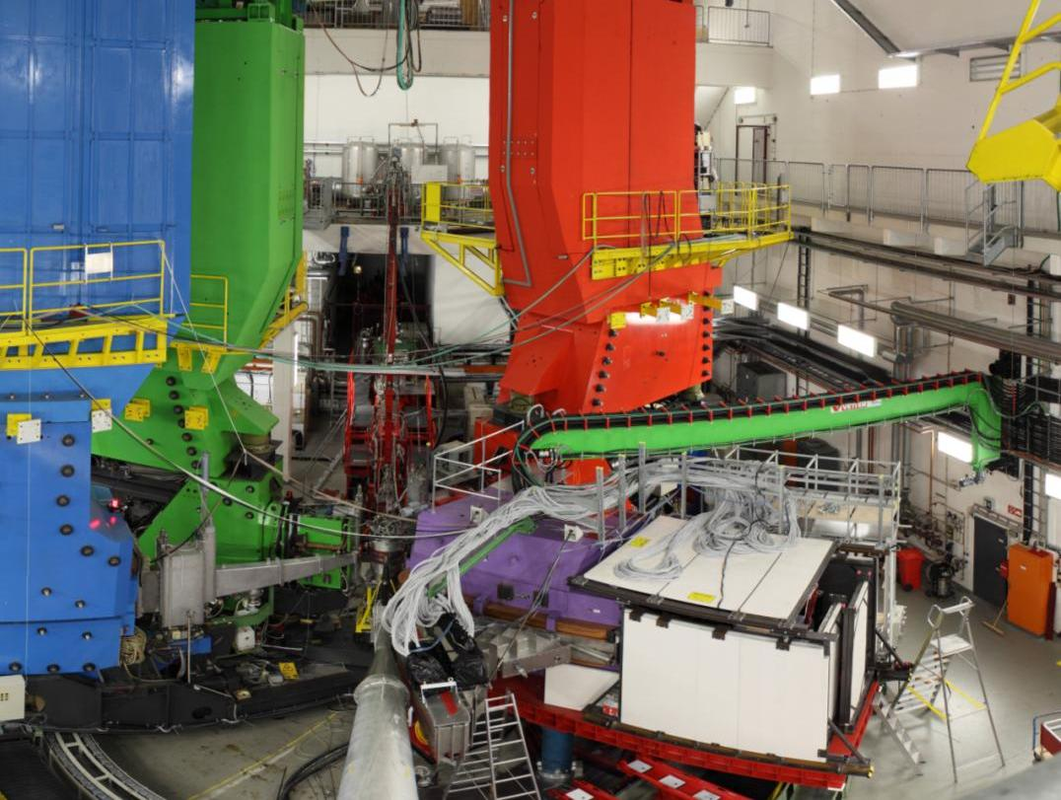
Overview of Measurements on Strange and Nuclear Systems at MAMI
A
C
B
KAOS
Patrick Achenbach
for the Collaboration A1 at MAMI
2o1o

Slide 2
Strangeness physics and developments in Mainz
What is the topic of this talk?
open strangeness electro-production at MAMI
What progress was made in the data analysis since 2oo9?
final (much improved) version of the tracking code
near-final study of efficiencies and acceptances
ongoing study of kaon identification
What hardware was improved since 2oo9?
near-final completion of the fibre detector
successful beam-test of the spectrometer’s electron-arm
final (much improved) design of the pre-target beam chicane
What else was done?
two background studies on coherent φ-meson electro-production on nuclear targets in the two-kaon decay channel and the dilepton decay channel
a feasibility study on hypernuclear decay pion spectroscopy in a single-arm measurement

Slide 3
Kaon electro-production

Slide 4
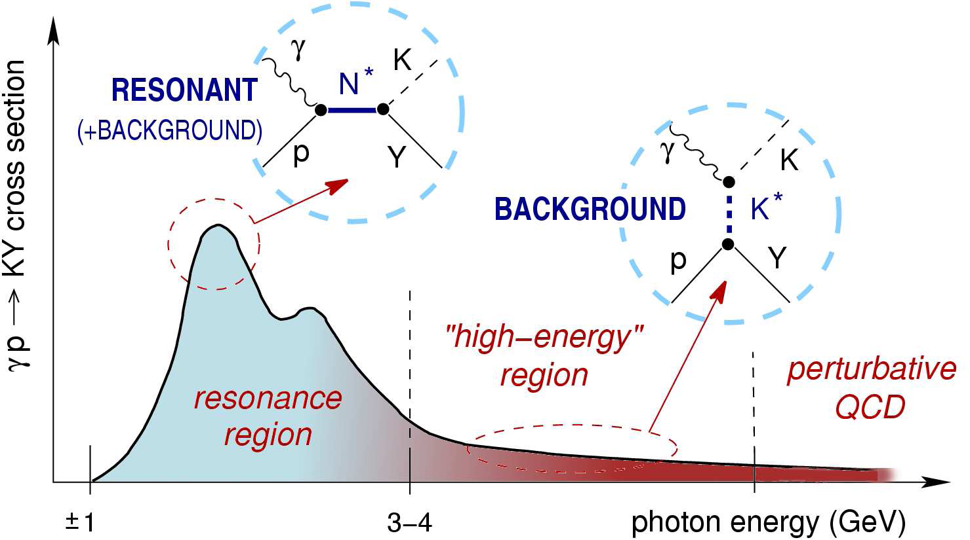
A glimpse at the theory
task: finding right degrees-of-freedom, interactions and structures
[Fig. from Tamara Corthals]

Slide 5
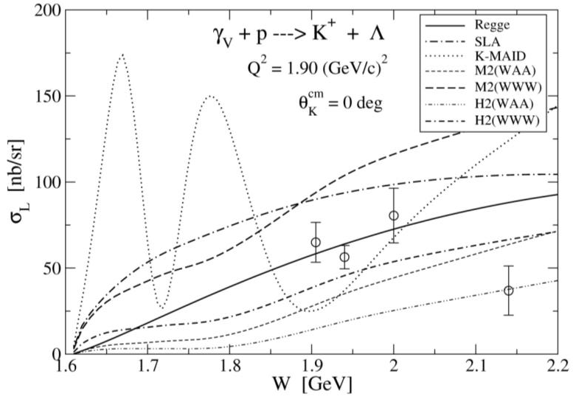
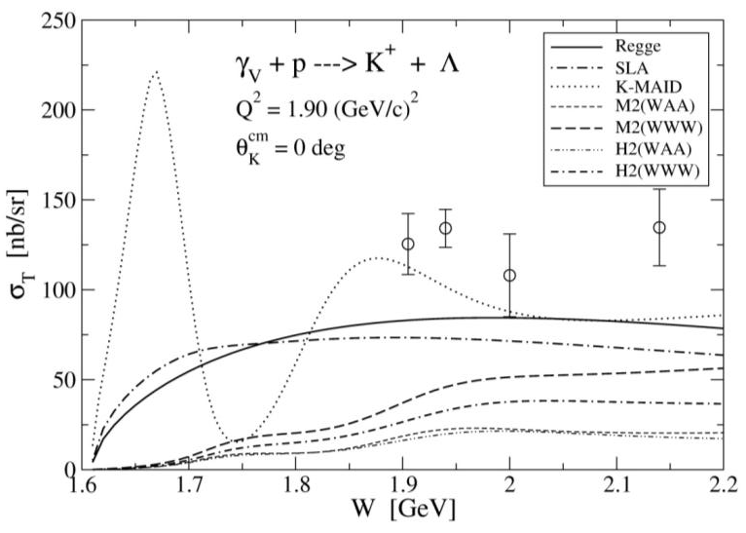
Isobar models for strange processes
• Saclay-Lyon A: no hadronic f. f., SU(3), crossing symmetry,
  nucleon (spin 1/2 and 3/2) and hyperon resonances
  [T. Mart, C. Bennhold, Phys. Rev. C 61 (2000) 012201(R)]
• Kaon-MAID: hadronic f. f., SU(3), no hyperon,
only nucleon (spin 1/2 and 3/2) resonances
[T. Mizutani et al., Phys. Rev. C 58 (1998) 75]
all models: extended Born terms (p, Λ, Σ, K), K*(890), K₁(1270)
• H2: hadronic f. f., SU(3), four nucleon (spin up to 3/2) and two hyperon resonances
• Janssen et al.: like H2 but off-mass-shell effects for spin 3/2 resonance
• Adelseck-Saghai: no hadronic f. f., SU(3), one nucleon and one hyperon resonance
• Williams-Ji-Cotanch: no hadronic f. f., no SU(3), duality, two nucleon resonances
Kaon-Maid
Kaon-Maid
[Figs. from Petr Bydzovsky]

Slide 6
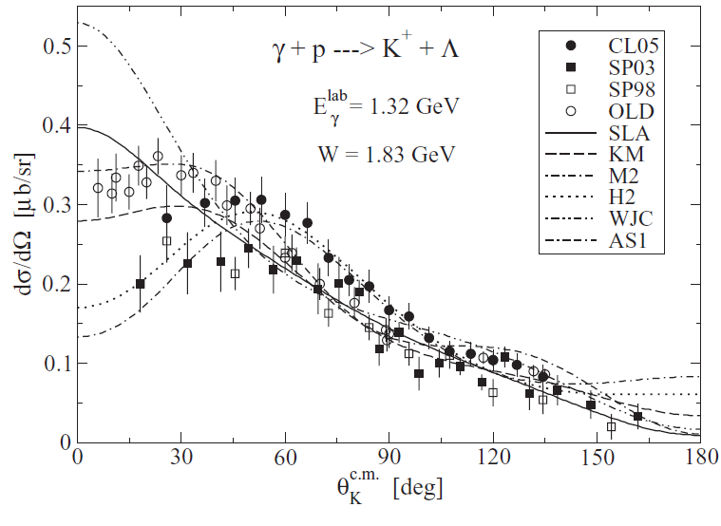
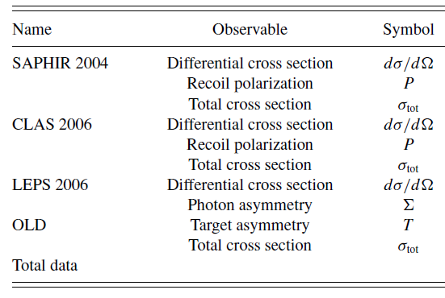
Kaon production at forward angles
Kaos data from 2oo9 and 2o1o
From: [T. Mart and A. Sulaksono, Phys. Rev. C 74, 055203 (2006).]
Data points: [K. H. Glander et al., Eur. Phys. J. A 19, 251 (2004).
R. Bradford et al. (CLAS Collaboration), Phys. Rev. C 73, 035202 (2006).
M. Sumihama et al. (LEPS Collaboration), Phys. Rev. C 73, 035214 (2006).
K. H. Althoff et al., Nucl. Phys. B 137, 269 (1978).
M. Q. Tran et al. (SAPHIR Collaboration), Phys. Lett. B 445, 20 (1998).]

Slide 7
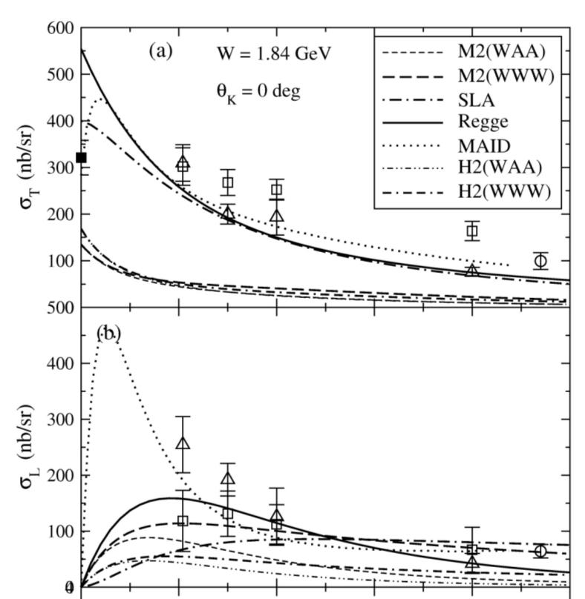
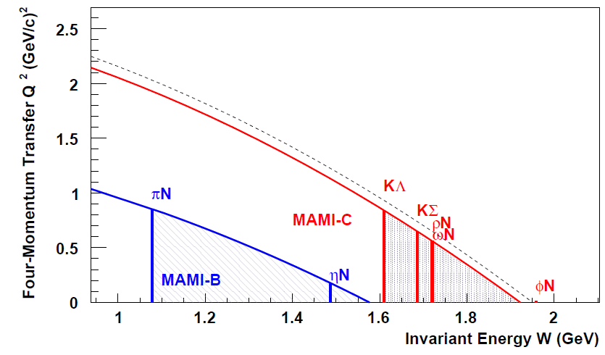
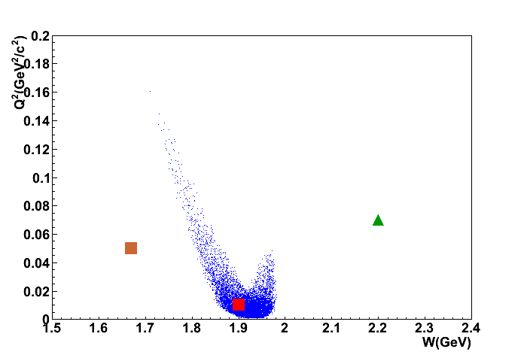
The importance of low momentum transfer
[kinematic regime at MAMI]
[adapted from T. Maruta, 2nd JSPS Core-2-Core Meeting, Dec. 2010]
E05-115
E94-107
Mainz 08
Mainz 09
E01-011
1 (GeV/c)²
Q²

Slide 8
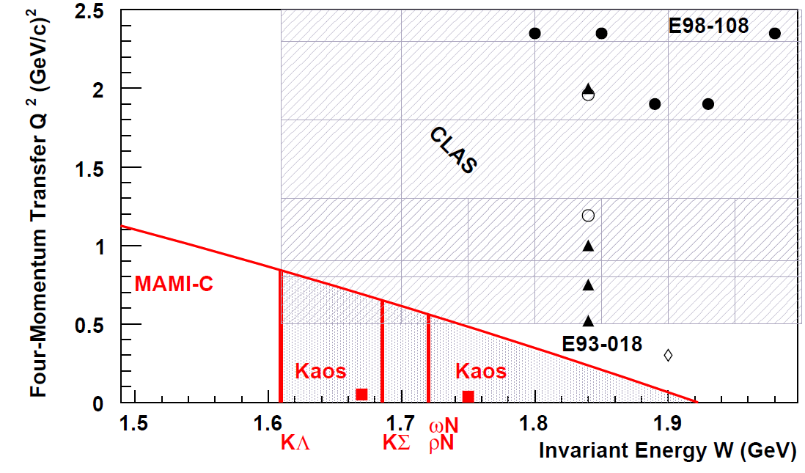
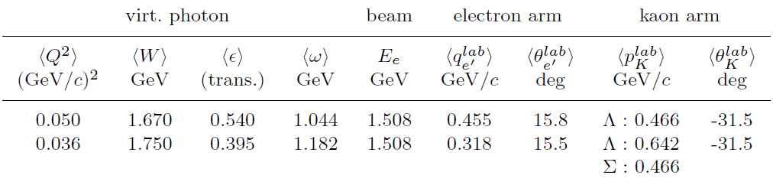
Kaon electro-production measurements
[E93-018: R. M. Mohring et al., Phys. Rev. C 67, 055205 (2003); reanalysis in G. Niculescu et al., Phys. Rev. Lett. 81, 1805 (1998).
E98-108: M. Coman, PhD thesis, Florida International University,
2005 (unpublished).
CLAS: Ambrozewicz et al., Phys. Rev. C 75, 045203 (2007).]
photo-production

Slide 9
Experimental aspects

Slide 10
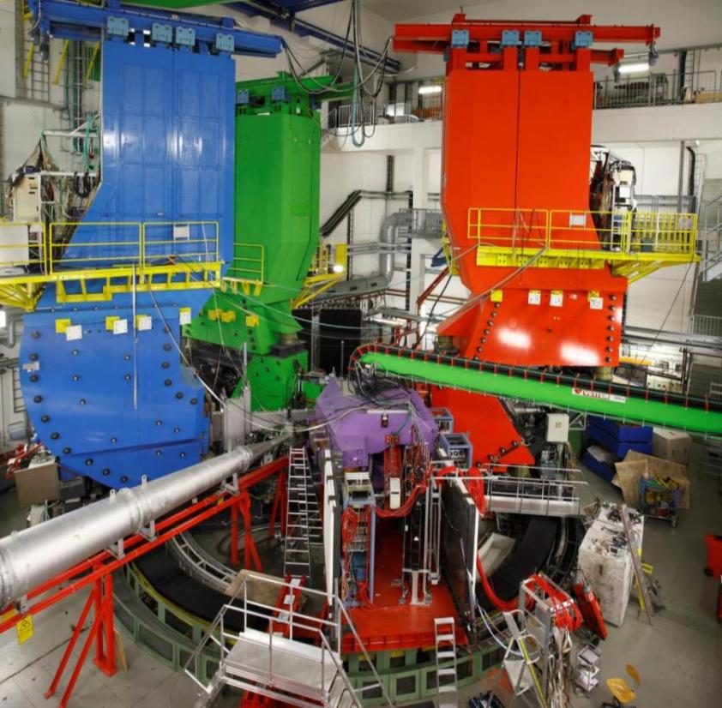
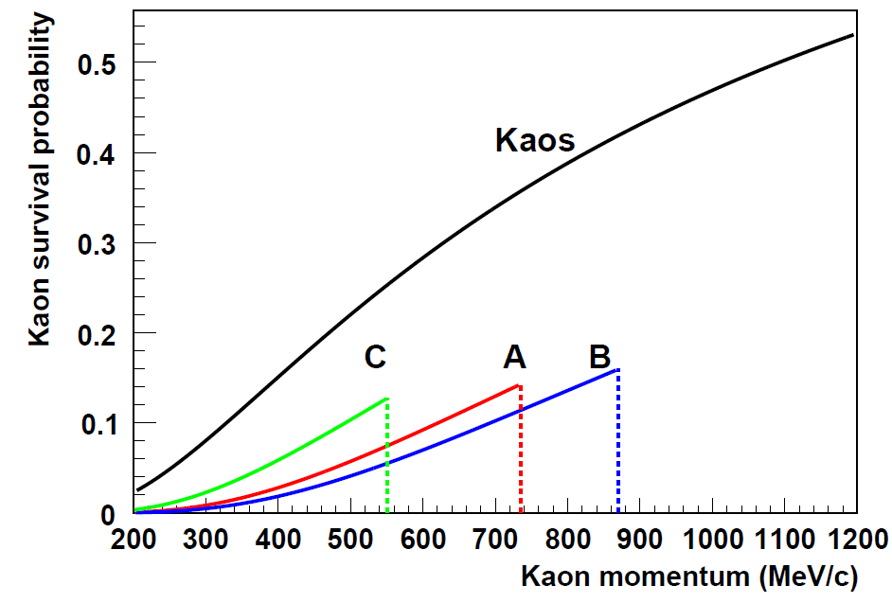
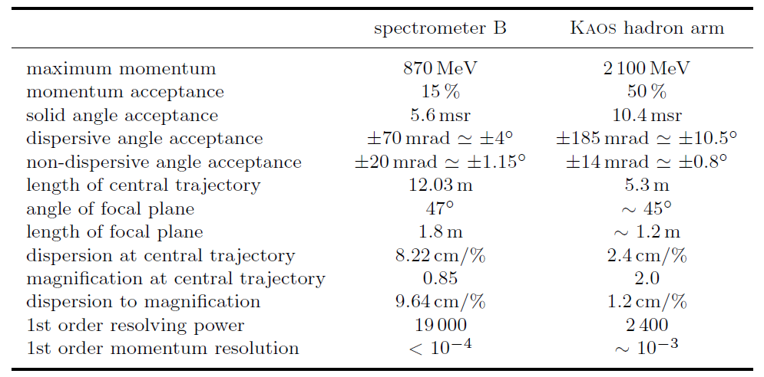
Adaption of the spectrometer facility
B
C
A
KAOS
max momentum and path length limit kaon survival probability < 15% in A/B/C

Slide 11
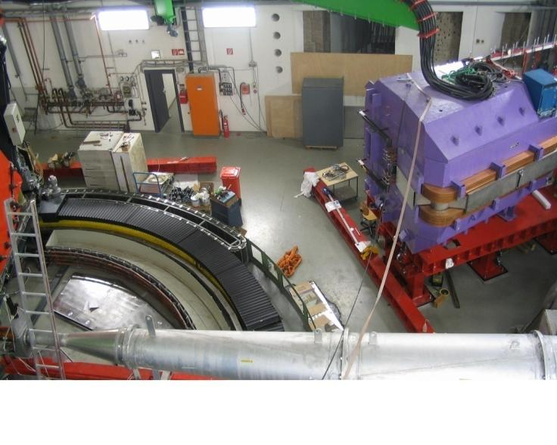
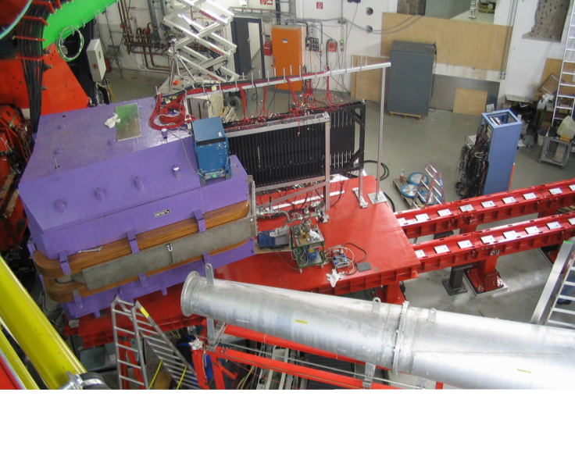
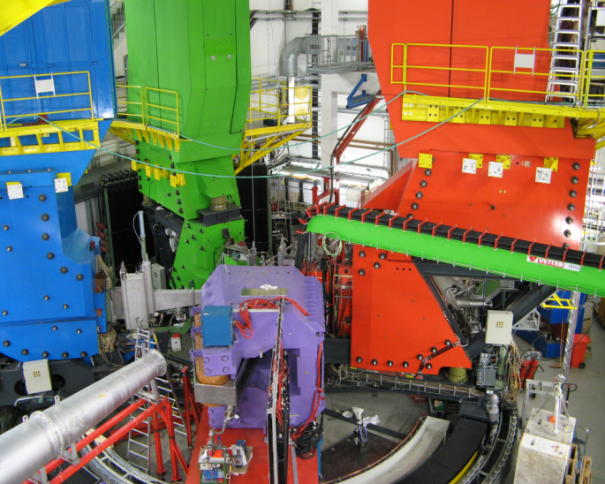
Installation of KAOS in 2007

Slide 12
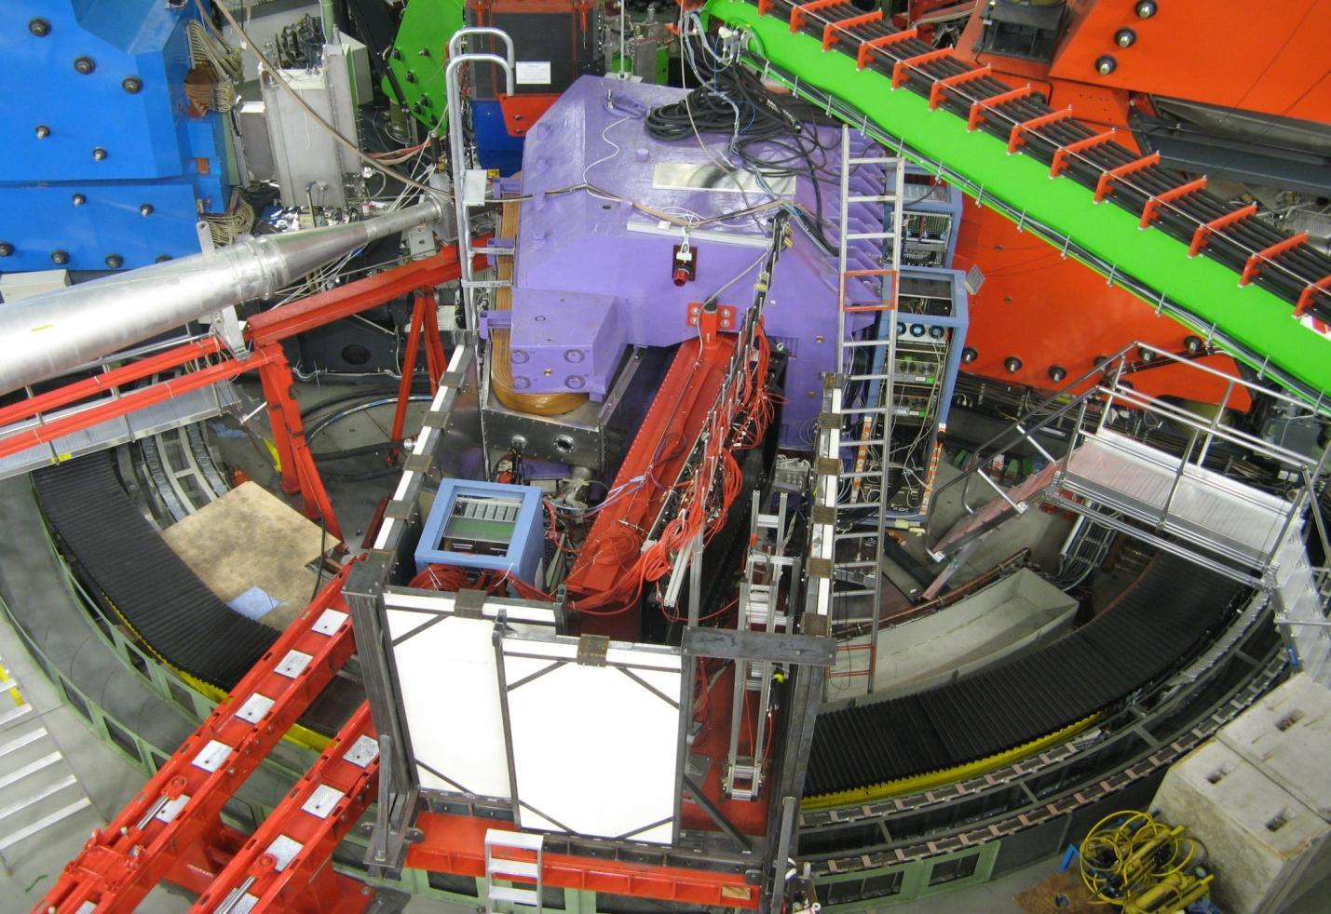
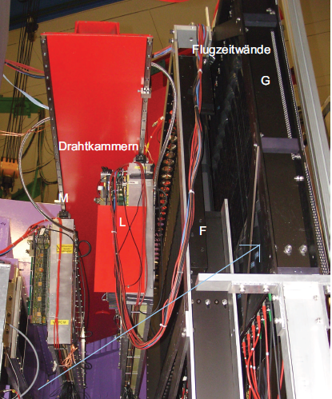
Kaos hadron arm operational since 2008
target
A
C
B
Kaos
dipole
MWPC
TOF

Slide 13
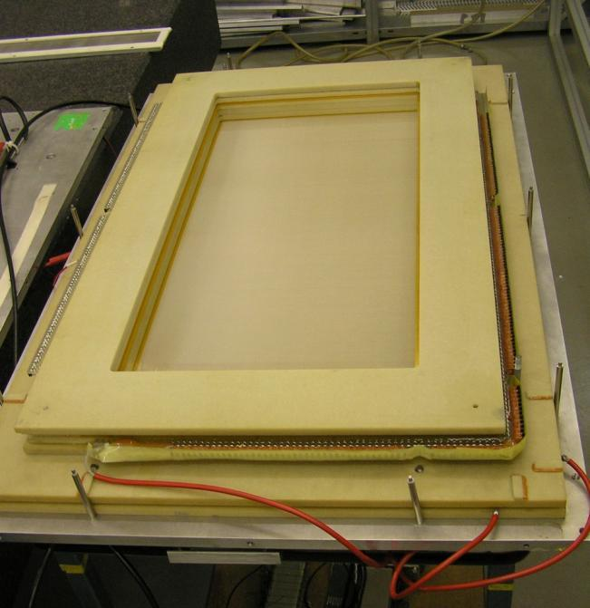
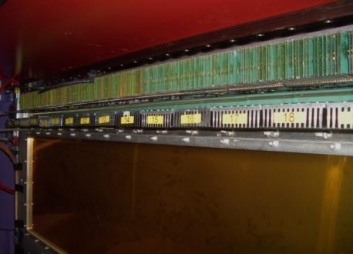
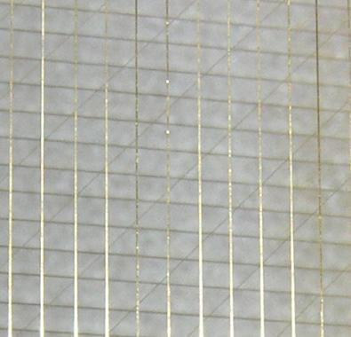
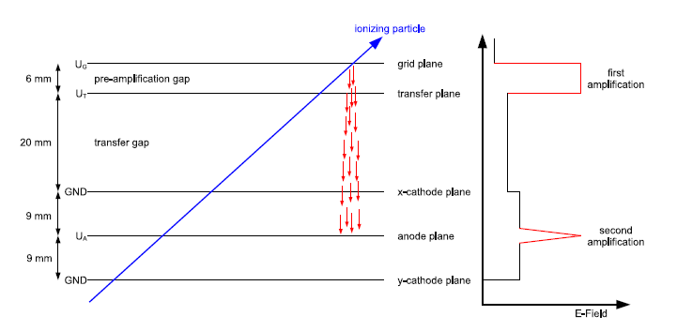
Tracking with two cathode-charge read-out MWPCs
anode wires
implementation of MWPC, new frontend read-out and cluster analysis in early 2oo8
trigger, DAQ, and cluster analysis now consolidated

Slide 14
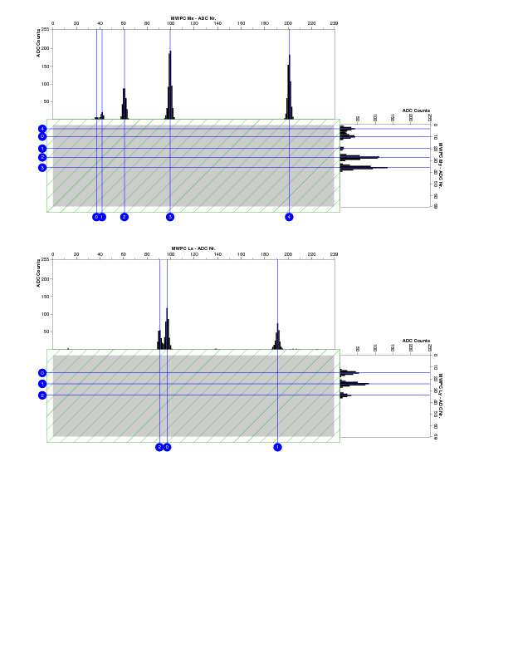
Cluster analysis
Challenges:
charge centroids often do not correspond to the trajectory position
correlation ←→ between induced charges
other continuous clusters often divide into individual peaks
Task:
resolving multi-hit ambiguities important for beam currents above 1 μA
[P. Achenbach et al., Particle tracking with cathode-charge sampling in multi-wire proportional chambers, in preparation]
data taken with 2 μA beam current

Slide 15
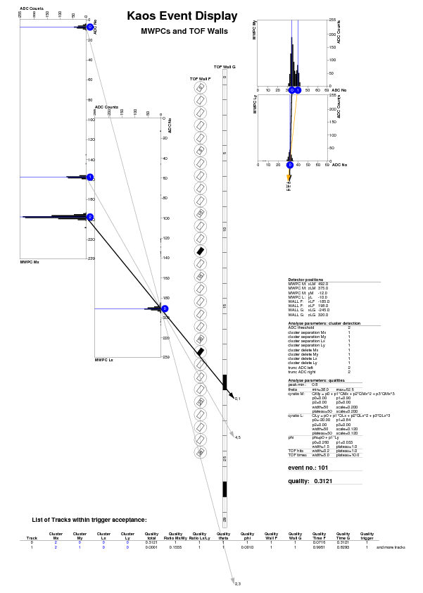
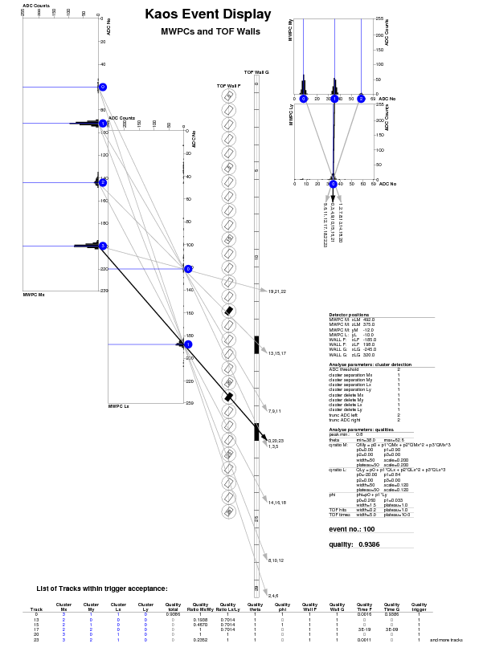
Track finding
Each track is assigned a quality factor including:
shape of clusters,
spectrometer acceptance
relation of charge in
one plane to the
perpendicular plane,
relation of extrapolated
hit position to detected
hits in F and G, etc.

Slide 16
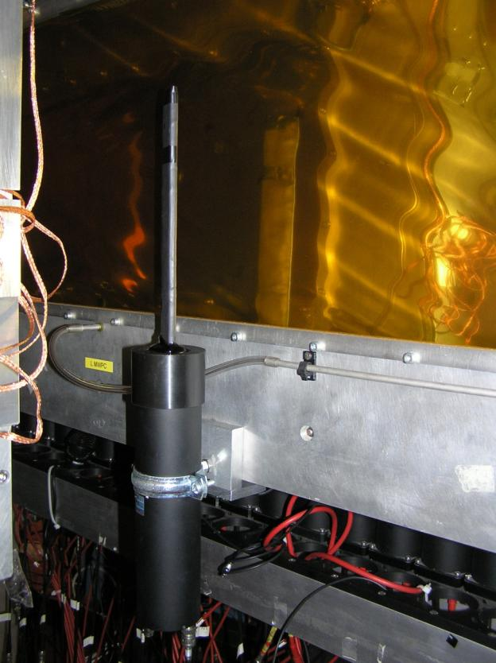
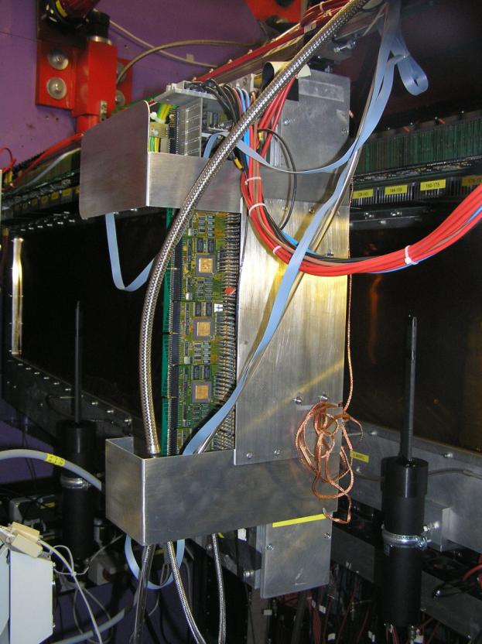
Efficiency counter set-up
two 5 mm thick efficiency counters with minimum thickness were built and placed in front of MWPC L and M -- only top of the detectors were active
Notes:
16

Slide 17
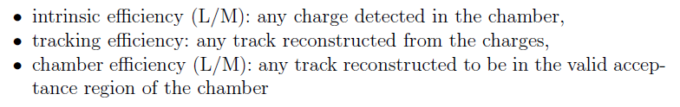
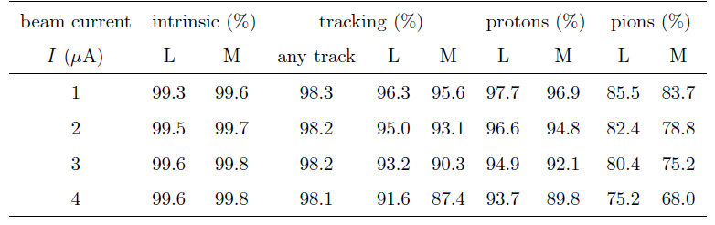
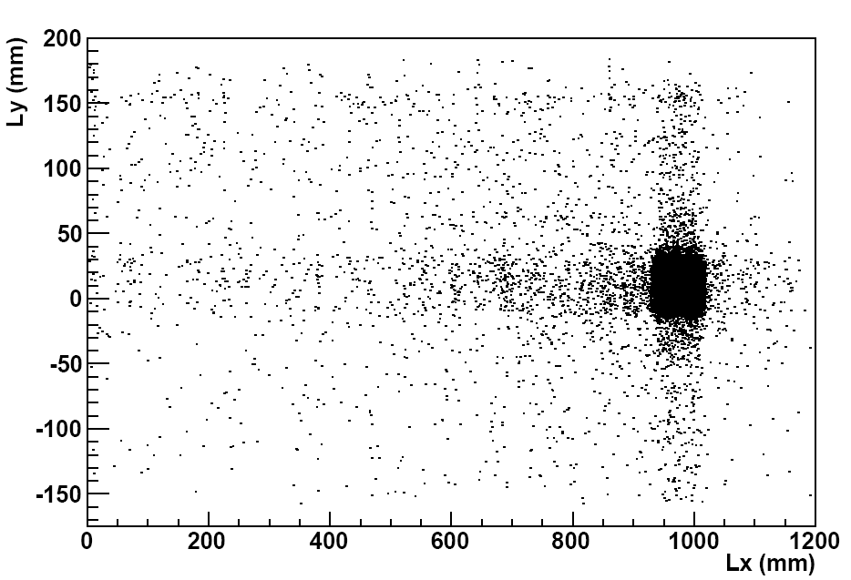
Extracted tracking efficiencies
bad reconstruction example created by original analysis:

Slide 18
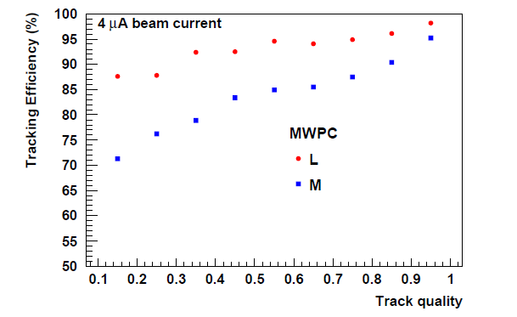
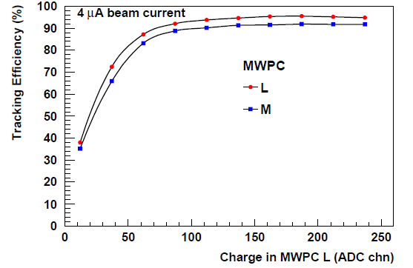
Track efficiency as a function of quality
strong dependence on charge, i.e. particle species
strong dependence on quality
for the cross-section extraction kaon tracking efficiency for events passing the missing-mass cut are being deduced

Slide 19
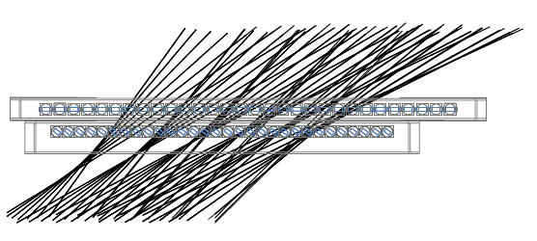
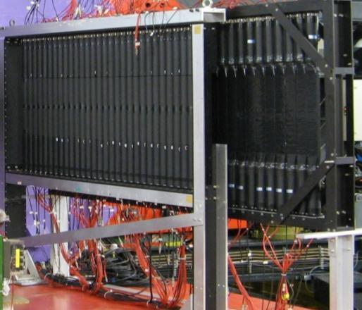
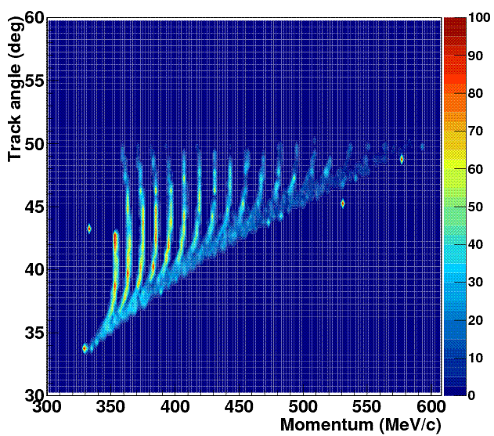
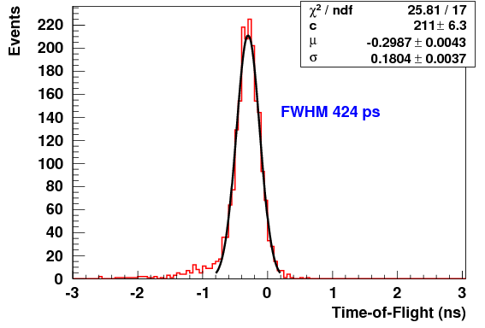
TOF walls “along“ the focal plane
simulated
tracks
simulated trigger inefficiency
F to G time-of-flight resolution

Slide 20
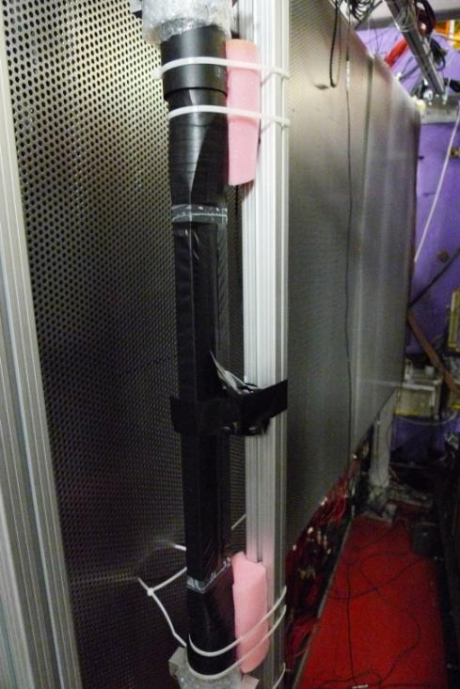
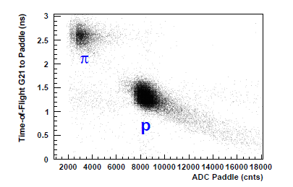
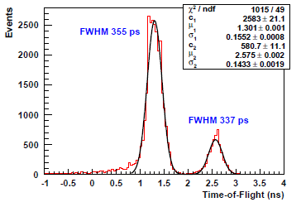
Paddle beam-test Aug. 2o1o
Task:
rebuilding at least one of the scintillator walls to overcome drawbacks of existing detectors
collaboration with Osamu Hashimoto, Satoshi ‘Nue’ Nakamura, and Satoshi Hirose

Slide 21
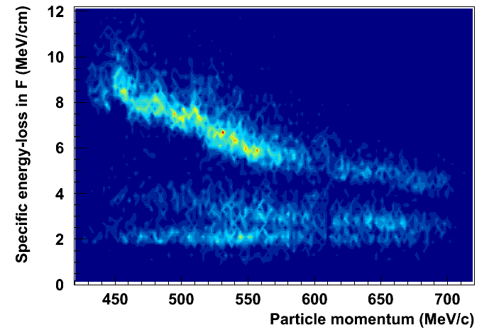
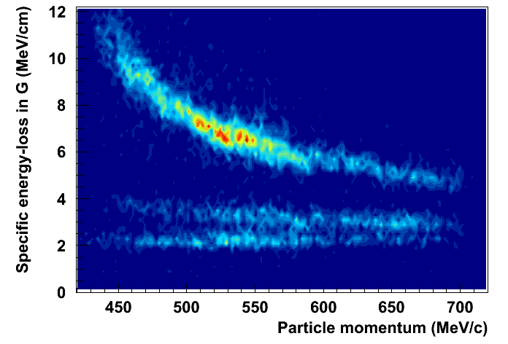
Pion/proton suppression by dE/dx
p
p
K
K
π
π
cuts on time-of-flight and missing mass to find dE/dx band for kaons

Slide 22
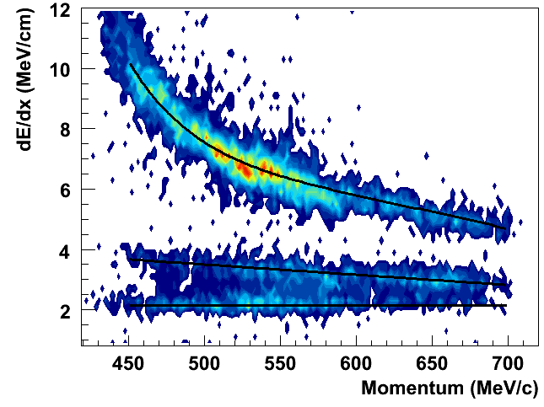
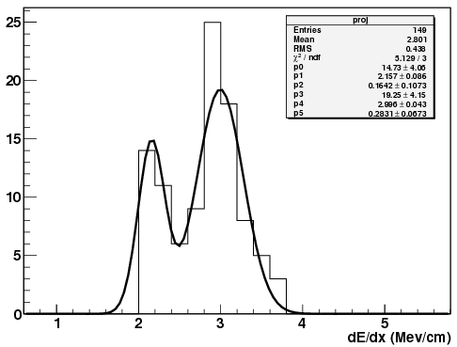
dE/dx cut efficiency
description of energy-loss:
p: 4th order polynomial fit
K: linear fit
π: constant
original cut at ±150 keV/cm with approx. 50% cut efficiency (0.5 σ)

Slide 23
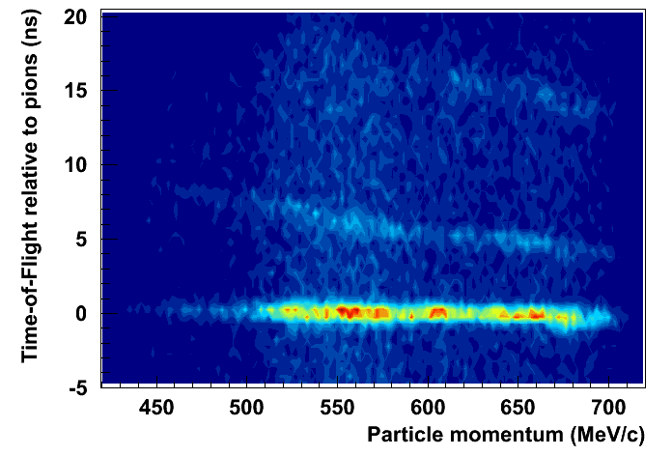
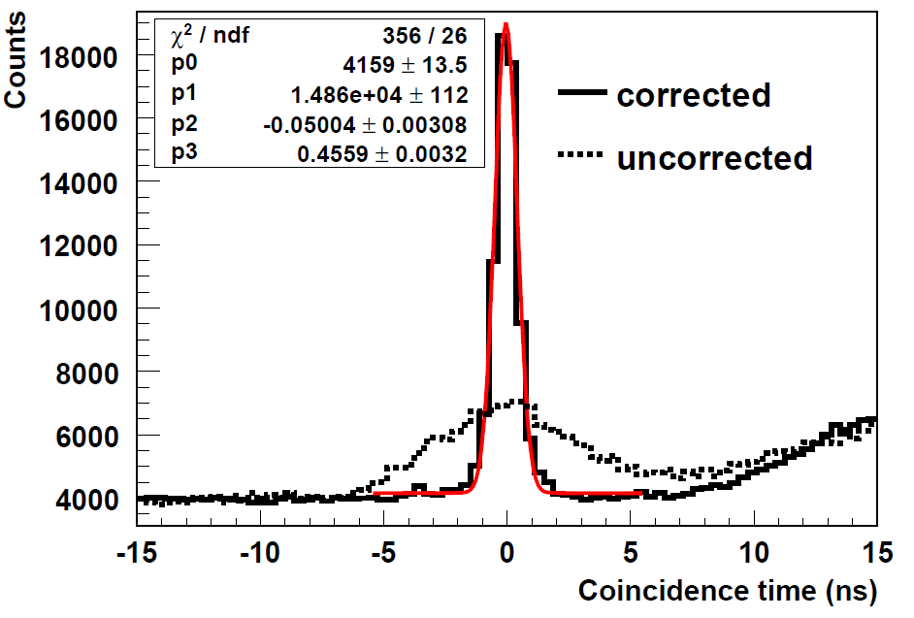
Time-of-flight and coincidence time resolution
p
FWHM= 1ns
inter-spectrometer!
K
π
π
cuts on dE/dx and missing mass to find time-of-flight band for kaons

Slide 24
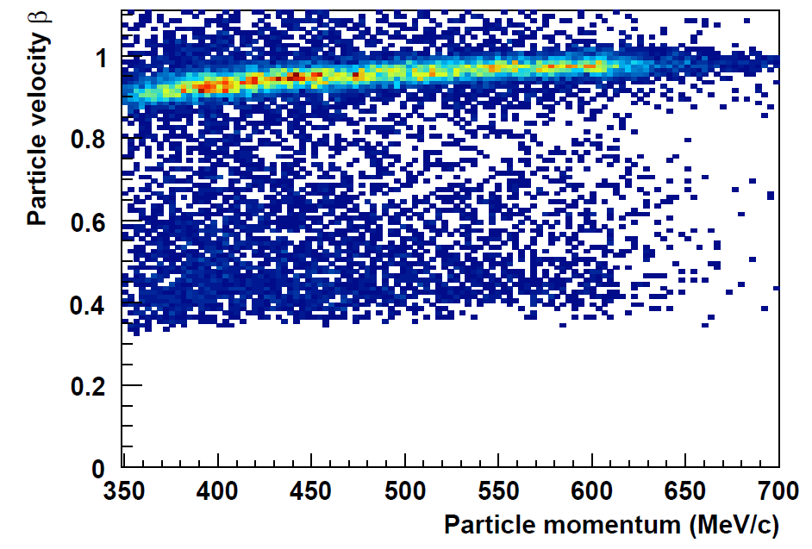
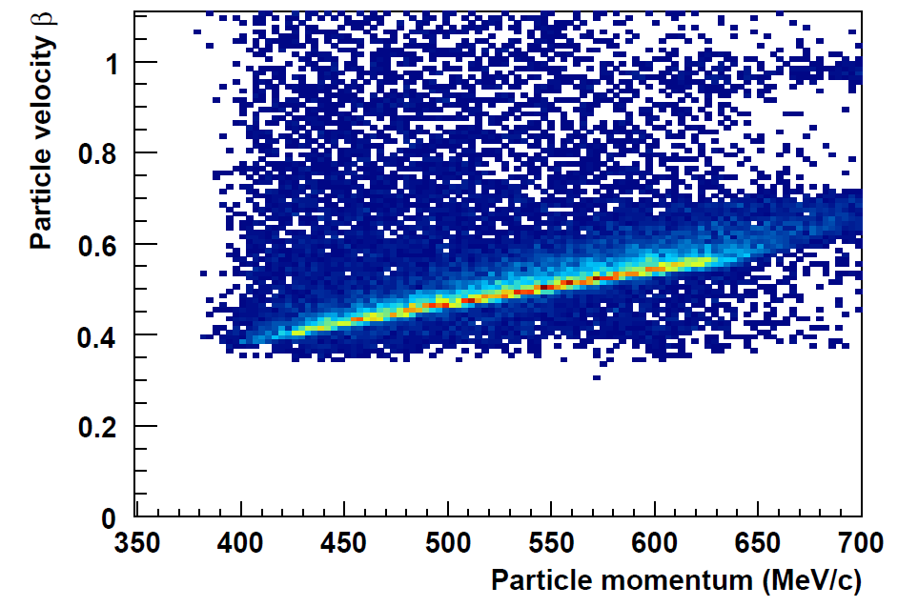
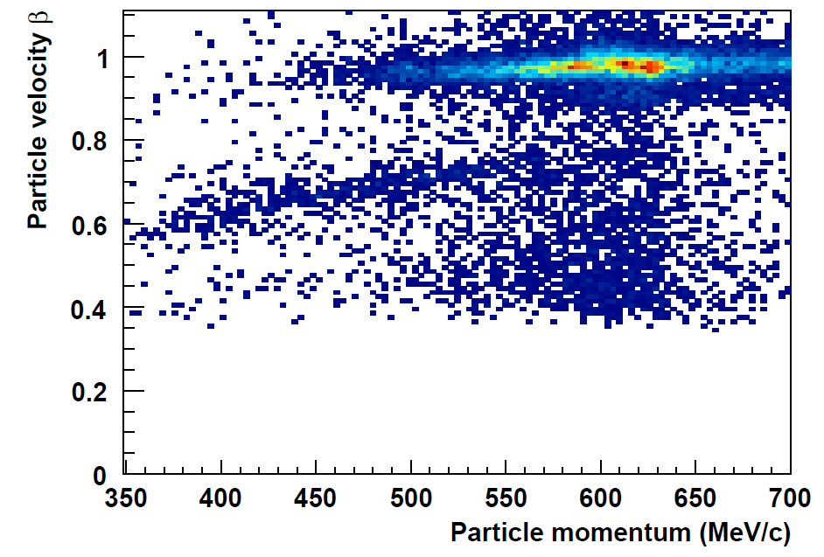

Particle velocities in the 400-600 MeV/c range
π
p
K
momentum acceptance from 300 – 700 MeV/c

Slide 25
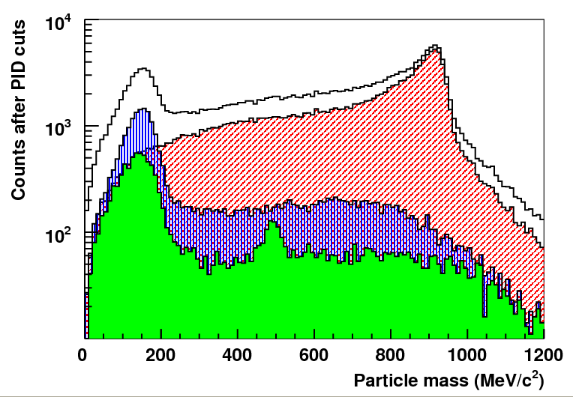


Event reconstruction
π : K : p =
1 : 0.03 : 1.38
kaon peak after dE/dx cut
[Kaos 2oo8 data]

Slide 26

Λ- and Σ-hyperons in a single kinematic setting
Λ
Kaos acceptance
Σ
‹p_{K}› = 466 MeV/c
‹p_{K}› = 642 MeV/c

Slide 27


Λ and Σ yield extraction
[Kaos at MAMI: preliminary analysis]
reconstruction momentum dependent
2009 ← 2008
FWHM = 14 MeV/c²
FWHM =
4 MeV/c²
reconstruction problem

Slide 28


Cross-section determination
cross-section extraction performed by scaling based on K-Maid
angular dependency is strong in this kinematic region
cross-section given for 7 kaon centre-of-mass angular bins
equivalent Monte Carlo yield determined for a cross-check of procedure
Monte Carlo
measurements, simulations
measurements
Kaon-Maid
Kaon-Maid + simulation + measured efficiencies and luminosity

Slide 29


Phase space simulation
simulated phase space
data phase space

Slide 30


Extracted kaon yields
in both channels models folded with acceptances and efficiencies reproduce the angular distributions
no surprise
data prefer Saclay-Lyon A or
K-Maid without longitudinal coupling of D₁₃
still preliminary
because
efficiencies not yet fixed
background subject to cuts

Slide 31
Towards a zero-degree experiment at MAMI

Slide 32



Realisation of Kaos as a double spectrometer

Slide 33



Installation of a beam chicane for a zero-degree operation of KAOS
beam exit
hadrons
electrons
hadrons
electrons
beam exit

Slide 34


Final beam chicane design
all pre-target components available
installation work started last week
former head of the MAMI accelerator took responsibility for beam transport and monitoring

Slide 35

Kaos double-arm set-up
target
Kaos
dipole
electron
arm
hadron arm
beam exit

Slide 36


Electron arm Detector Front-End
[P. Achenbach et al.,
Front-end electronics for the Kaos spectrometer at MAMI, IEEE Trans. Nucl. Sci. 56 (2009)]

Slide 37





Read-out with position-sensitive photomultipliers
0.8 x 7 mm² anode,
1 mm channel pitch
[P. Achenbach, et al.,
New detectors for the kaon and hypernuclear experiments with KAOS at MAMI and with PANDA at GSI, Proc. SNIC06 (2006)]
R7259K linear array

Slide 38


VUPROM Trigger System
256 LVDS I/O
6U VME card
400 MHz FPGA
37 cards used with the KAOS spectrometer:

Slide 39


Flexible trigger concept
e.g. strong correlation between momenta/positions
goal: suppression of background on trigger level
requirements:
  correlation of > 60 ⊗ 4000 channels
  tracking information (clustering)‏
  flexibility (different beams, magnet settings…)
  → programmable, fast trigger decision

Slide 40



Results of 2009 beam-tests
Møller
100 MHz Møller scattering rate at 1 μA
[P. Achenbach et al., A Large-Scale FPGA-Based Trigger and Dead-Time Free DAQ System for the Kaos Spectrometer at MAMI, IEEE Real-Time 2010 Conference Record]

Slide 41



Detector production finished in 2010
18 432 fibres in 144 bundles with associated 144 bundle connectors, MaPMTs, front-end boards, etc...
all work done by ‘HiWi’ and doctorate students
quality control after
each production stage:
fibre bundle rejection,
cable rejection,
connector rejection
for more on detector production, quality control, test-stands for PMT alignment → see talk by Anselm Esser

Slide 42


Detector calibration and characterisation
collimated ⁹⁰Sr source
short fibre with PMT as trigger
automatic course of action:
computer controlled carriage moves
along detector
data-taking for precise positioning
data taking for fibre bundle calibration
MCS
fibres
betas
several months of preparation work
for gain calibration and final control
of all detector modules
details → see talk by Anselm Esser
moving calibration system
‘MCS’

Slide 43



Beam-tests 24–29 August 2010
beam energy: 510 MeV
beam intensity: 0.1–100 μA
spectrometer angle: 37.5°
targets: CH₂ and ¹²C
~ 120 fibre detectors in
two planes
placed in high radiation environment
7 front-end CPUs
~ 4 000 detector signals
~ 40 trigger modules with
FPGA programming
~ 6 kHz data-taking rate in each ROB PC

Slide 44


Fibre detector as electron arm spectrometer
p(e,C:e’K:p)
with θe = 80.4°±5°
θp = 37.5°±10°
coincidence acceptance limited by SpekC
varying magnetic field
θ (dispersive coordinate)
dispersion at central trajectory:
dx/dp = 1.6 cm/%p
x
x (dispersive coordinate)

Slide 45
Further studies

Slide 46
Concept for a study of φ vector mesons
Invariant mass distributions of φ vector mesons inside and outside the nuclear medium via K⁺/K⁻ pair spectroscopy at ρ_{N} ≅ ρ₀ and T=0
modification studied by two decay channels:
K+/K-
di-lepton: difficulty in the treatment
of the background
K+/K-
KK: distortion by the KN and KN
interactions
r (A=60) ≈ 4 fm
Meson | Mass (MeV/c²) | Γ (MeV/c²) | cτ (fm) | Main decay | e⁺e⁻ BR
ρ | 768 | 152 | 1.3 | π⁺ π⁻ | 4.4 x 10⁻⁵
ω | 782 | 8.43 | 23.4 | π⁺ π⁻ π⁰ | 7.2 x 10⁻⁵
φ | 1019 | 4.43 | 44.4 | K⁺ K⁻ | 3.1 x 10⁻⁴

Slide 47


Experimental set-up at MAMI
new demands on spectrometer set-up:
SpekB at 90°; SpekC at -20°; Kaos at 35°
Kaos
Beam
Trajectory length:
SpekB: 12.03 m
SpekC: 8.53 m
Kaos: 5.50 m
Solid angle:
SpekB: 5.6 msr
SpekC: 28 msr
Kaos : 11 msr
SpekC
SpekB

Slide 48



Count rate estimate
Kaon survival:
P =
P(Kaos) = 0.11
P(SpekC) = 0.04
P(KK) = 4.4 x 10⁻³

Slide 49
φ → di-lepton background study
set-up:
SpekA at -51.3°, negative polarity, central momentum= 646 MeV/c
SpekB at +52.8°, positive polarity, central momentum= 646 MeV/c
25 μA electron beam of 1508 MeV on 45 mg/cm² ¹²C target
data:
27 runs x 30 min.: 13.5 h
coincidence rate: 2 Hz
coincident events: 86 827
missing mass events: 33 487
coincidences in 1.6 ns: 889
random coincidences: 330
positron ID (Cherenkov): 35

Slide 50
Time-line 2o1o onwards
Time | Activities at MAMI
August 2010 | In-beam tests of electron arm detectors and sophisticated FPGA trigger system at very forward angles (8-10 degrees to the beam-line); measurements of background rates; implementation of different trigger options for background suppression; in-beam test of a prototype scintillator paddle
September – November 2010 | Installation work for the pre-target beam chicane: primary dipole (DCI I), positioning plates, mountings, vacuum chambers, beam pipes, secondary dipole (DCI II), pre-target steering system, beam position monitors, exit beam-line
Winter 2010/11 | Possibility for in-beam tests of new scintillator wall elements Elementary kaon electroproduction measurements with the Kaos spectrometer at zero degree using the commissioned beam chicane?
Spring 2011 | Commissioning of a new scintillator wall? First decay pion spectroscopy experiment using the new scintillator wall in the Kaos spectrometer as kaon tagger and SpekA for pion detection?
Summer 2011 | First hypernuclear spectroscopy experiment using the Kaos spectrometer at zero degree and the electron arm detector for small angle electron tagging?

Slide 51
Thank you!

Slide 52


New reaction channels with MAMI-C
MAMI-B
MAMI-C
kinematic plane in
electro-production:

