Slide 1
JSPS Core2CORE/SPHERE Meeting
4th Sep 2010
Satoshi N Nakamura
Tohoku University
Overview and Status of JLab Hall-C
Hypernuclear Experiments

Slide 2
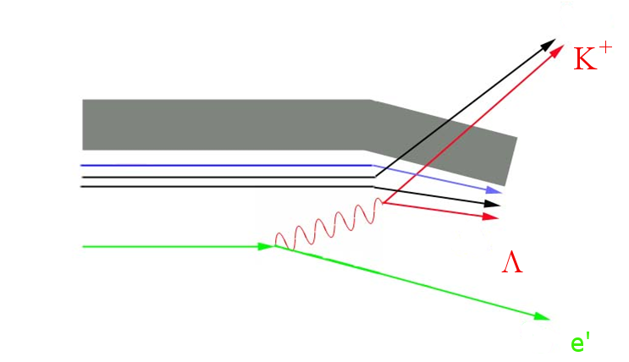
The ^{A}Z(e,e’K⁺) ^{A}_{Λ}(Z-1) reaction for hypernuclear spectroscopy
(π,K) reaction established hypernuclear reaction spectroscopy
(e,e’K) has similar features with better resolution
^{A}Z
p
^{A}_{Λ}(Z-1)

Slide 3
Characteristics of (e,e’K) HY study
Electromagnetic production
  Photo/electron strangeness production
Proton goes to Lambda
Both spin flip and non-spin flip amplitudes
High quality primary beam
  High energy resolution (< 1MeV)
  Thin enriched target
Real photon (γ,K) HY spectroscopy is practically impossible.
Eg. JLab-CLAS Bremsstrahlung tagged photon
~ 5o MHz, 10⁻³ E₀ = 2 MeV for 2 GeV

Slide 4
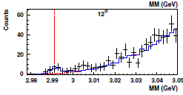
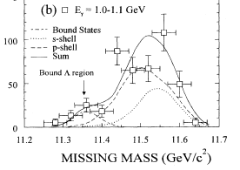
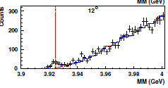
Early works :
EM production of Λ Hypernucleus
¹²C(γ,K⁺)¹²_{Λ}B
³He(e,e’K⁺)³_{Λ}H
⁴He(e,e’K⁺)⁴_{Λ}H
ES132 @INS-TAGX, PRC 52 (1995) 1157.
NEXT STEP: Spectroscopy with
mass resolution of sub-MeV
E91-016 @ JLab-HallC , PRL 93(2004)242501

Slide 5
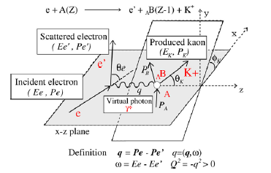
Definition of Kinematic Parameters

Slide 6
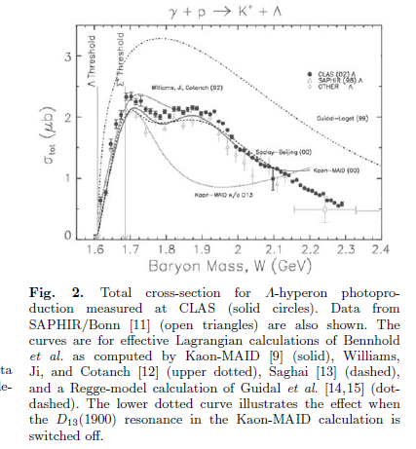
Elementary p(γ,K⁺) Λ
Eγ ~ 1.5 GeV
Eγ ~ 2.2 GeV
R.A.Schmacher for CLAS
σ for elementary process
Max. at Eγ ~ 1.5 GeV
Lower Eγ : Close unnecessary reaction channel
Higher Eγ : Smaller K decay loss, Larger Λ trapping rate

Slide 7
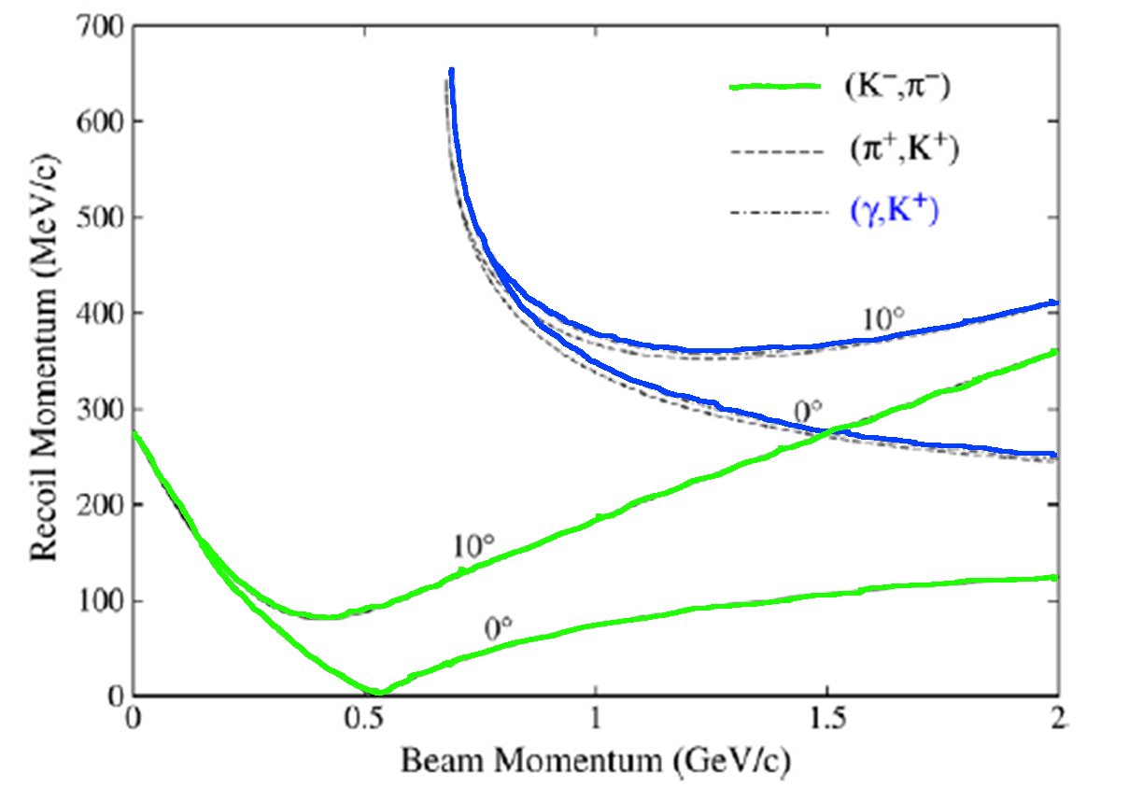
Hypernucleus recoil momentum for various reactions
¹²C target
Exoergic
Endoergic
1.5GeV/c

Slide 8
p(e,e’K)Λ Cross Section
E01-011 : Q² ~ 0.01 (GeV/c)² , θ_{e}~6.5 deg.
ε ∼ 0.04, ε_{L}~1.7x10⁻⁴
Virtual but almost real photon

Slide 9
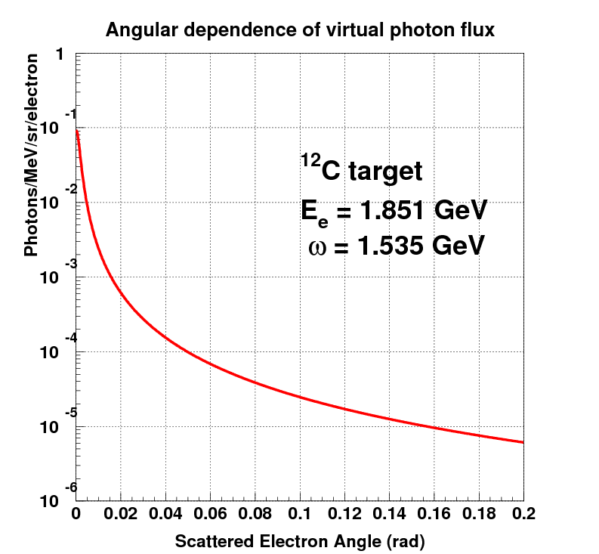
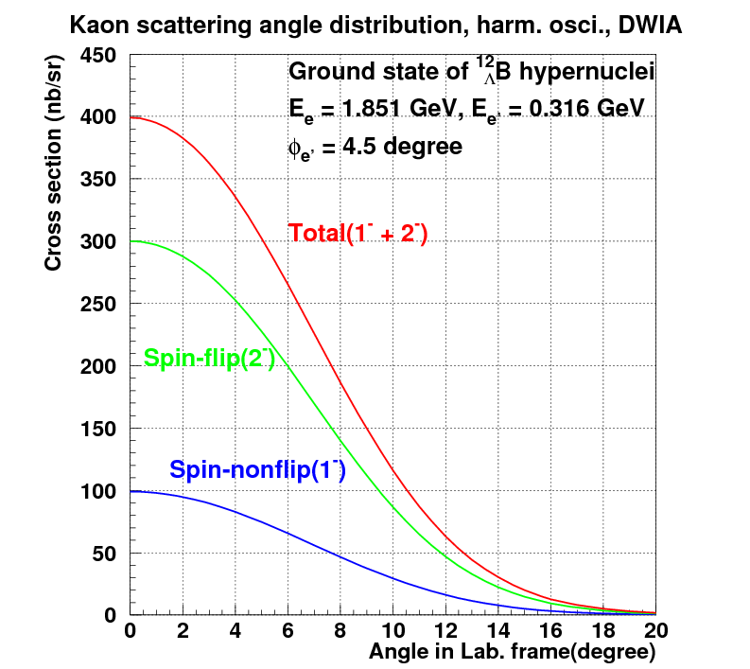
Angular Dependences
0.3 GeV/c, e’
1.8 GeV, e
Λ
1.5 GeV, γ*
p
1.2 GeV/c, K⁺
Both of e’ & K+ are forward.

Slide 10
Challenge of (e,e’K) HY Study
Large e’ Background due to Bremsstrahlung and Mφller scattering
Signal/Noise, Detector
Less Hypernuclear Cross Section
Coincidence Measurement (e’, K⁺)
Limited Statistics, DC beam is necessary
High Quality Electron Beam is Essential !

Slide 11
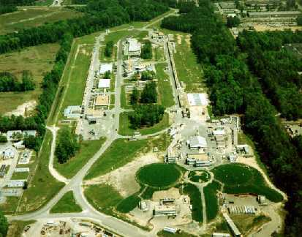
Beam requirements
Continuous beam for coincidence exp.
Electron beam E > 1.5 GeV
High current beam > 30μA
Beam stability
  Momentum Δp/p < 1 x 10⁻⁴
  Good emittance : σx < 100μm, σx’ <1mrad
Until upgrade of MAMI-C, CEBAF had been only facility
for this program.

Slide 12
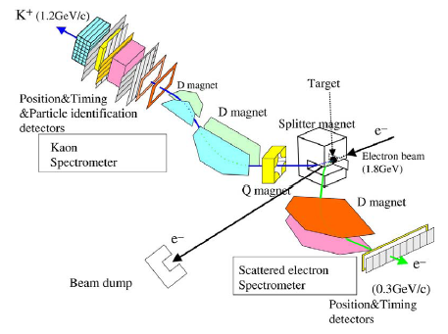
First Generation Experiment
SPL + SOS +HMS
E89-009 (HNSS; HyperNuclear Spectrometer System)

Slide 13
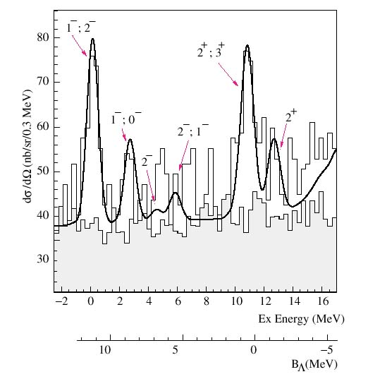
The first (e,e’K⁺) hypernuclear experiment (E89-009, HNSS)
Data taking year 2000
¹²C(e,e’K⁺) ¹²_{Λ}B
Demonstrated that
the (e,e’K) hypernuclear spectroscopy is possible!
s_{Λ}
p_{Λ}
Good energy resolution
<800 keV (FWHM)
Best hypernuclear energy resolution achieved by the reaction spectroscopy
at that time
PRL 90 (2003) 232502, PRC 73 (2006) 044607

Slide 14
Improvement of the E89-009 experiment
Energy resolution as well as acceptance are limited by the kaon spectrometer (SOS)
cτ (K⁺) ~4m
New Spectrometer
High resolution Kaon Spectrometer (HKS)
Zero degree tagging method to maximize virtual photon flux
Severe background from electrons associated with
Bremsstrahlung (200 MHz for e’ arm)
Tilt Method
The 2nd Generation Experiment was approved by Jlab PAC19
E01-011 (Spokesmen: Hashimoto, Tang, Reinhold, Nakamura)
Notes:
Beam intensity was limited

Slide 15
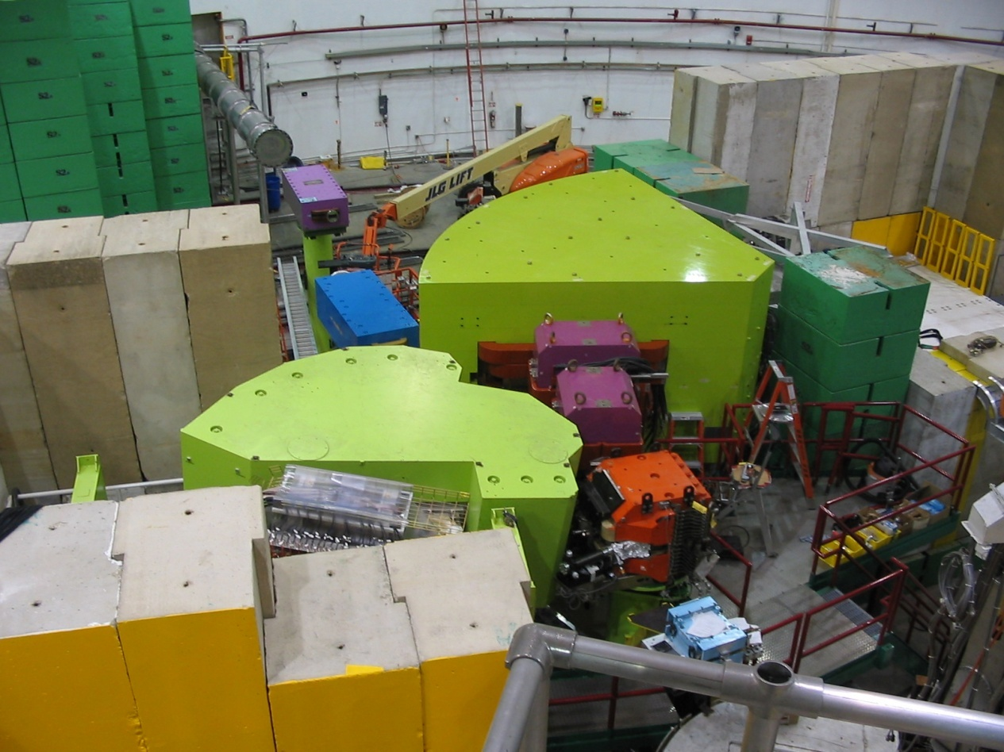
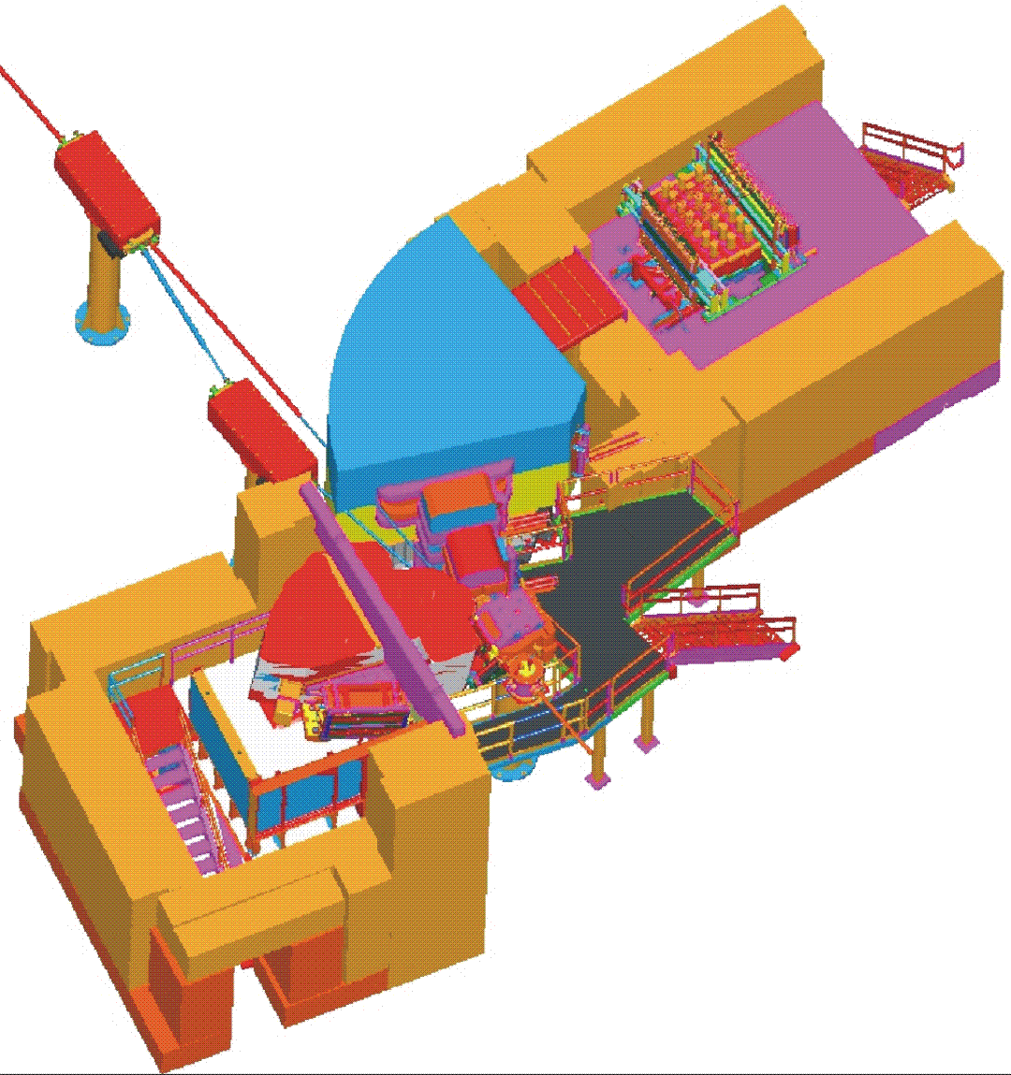
Second Generation Exp. at JLab
2005 E01-011 (Hall C)
First step to midium heavy hypernuclei (²⁸Si, ¹²C, ⁷Li)
To beam dump
HKS
Two Major Improvements
New HKS
ENGE
Splitter
Tilt Method
Target
Beam: 30 μA , 1.8GeV
HKS: Δp/p=2 x 10 ^{-4 [FWHM]}
Solid angle 16msr(w/ splitter)
Electron beam

Slide 16
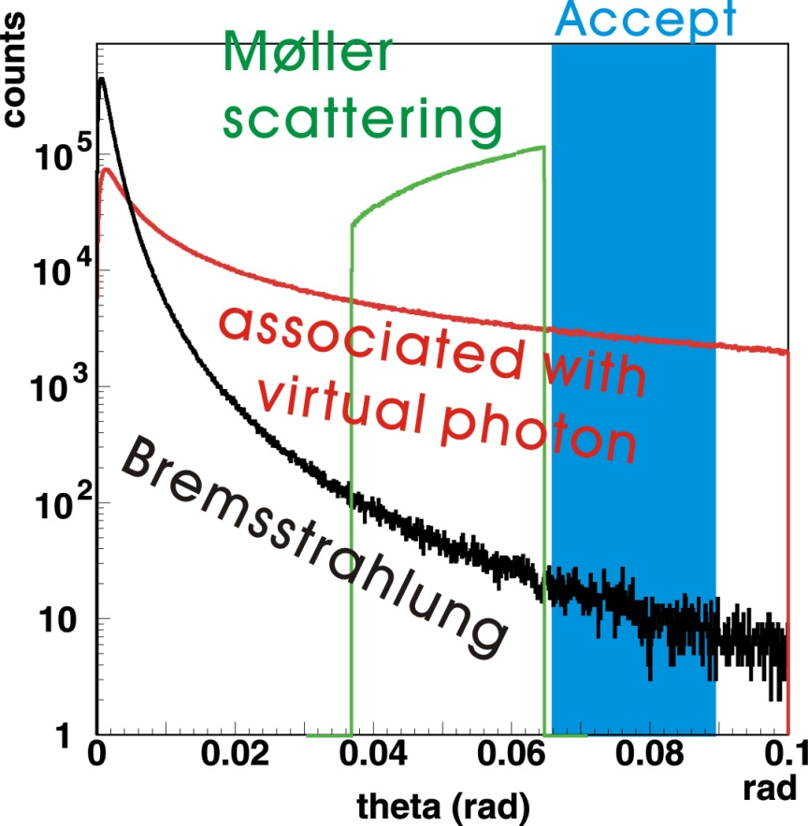
Tilt method
Background electrons
Bremsstrahlung
very forward peaked
Møller scattering
scattering angle and momentum are correlated
to avoid them
e’
8 degree
Tilt Enge spectrometer
by 8 degree
(optimization of e’
detection angle)

Slide 17
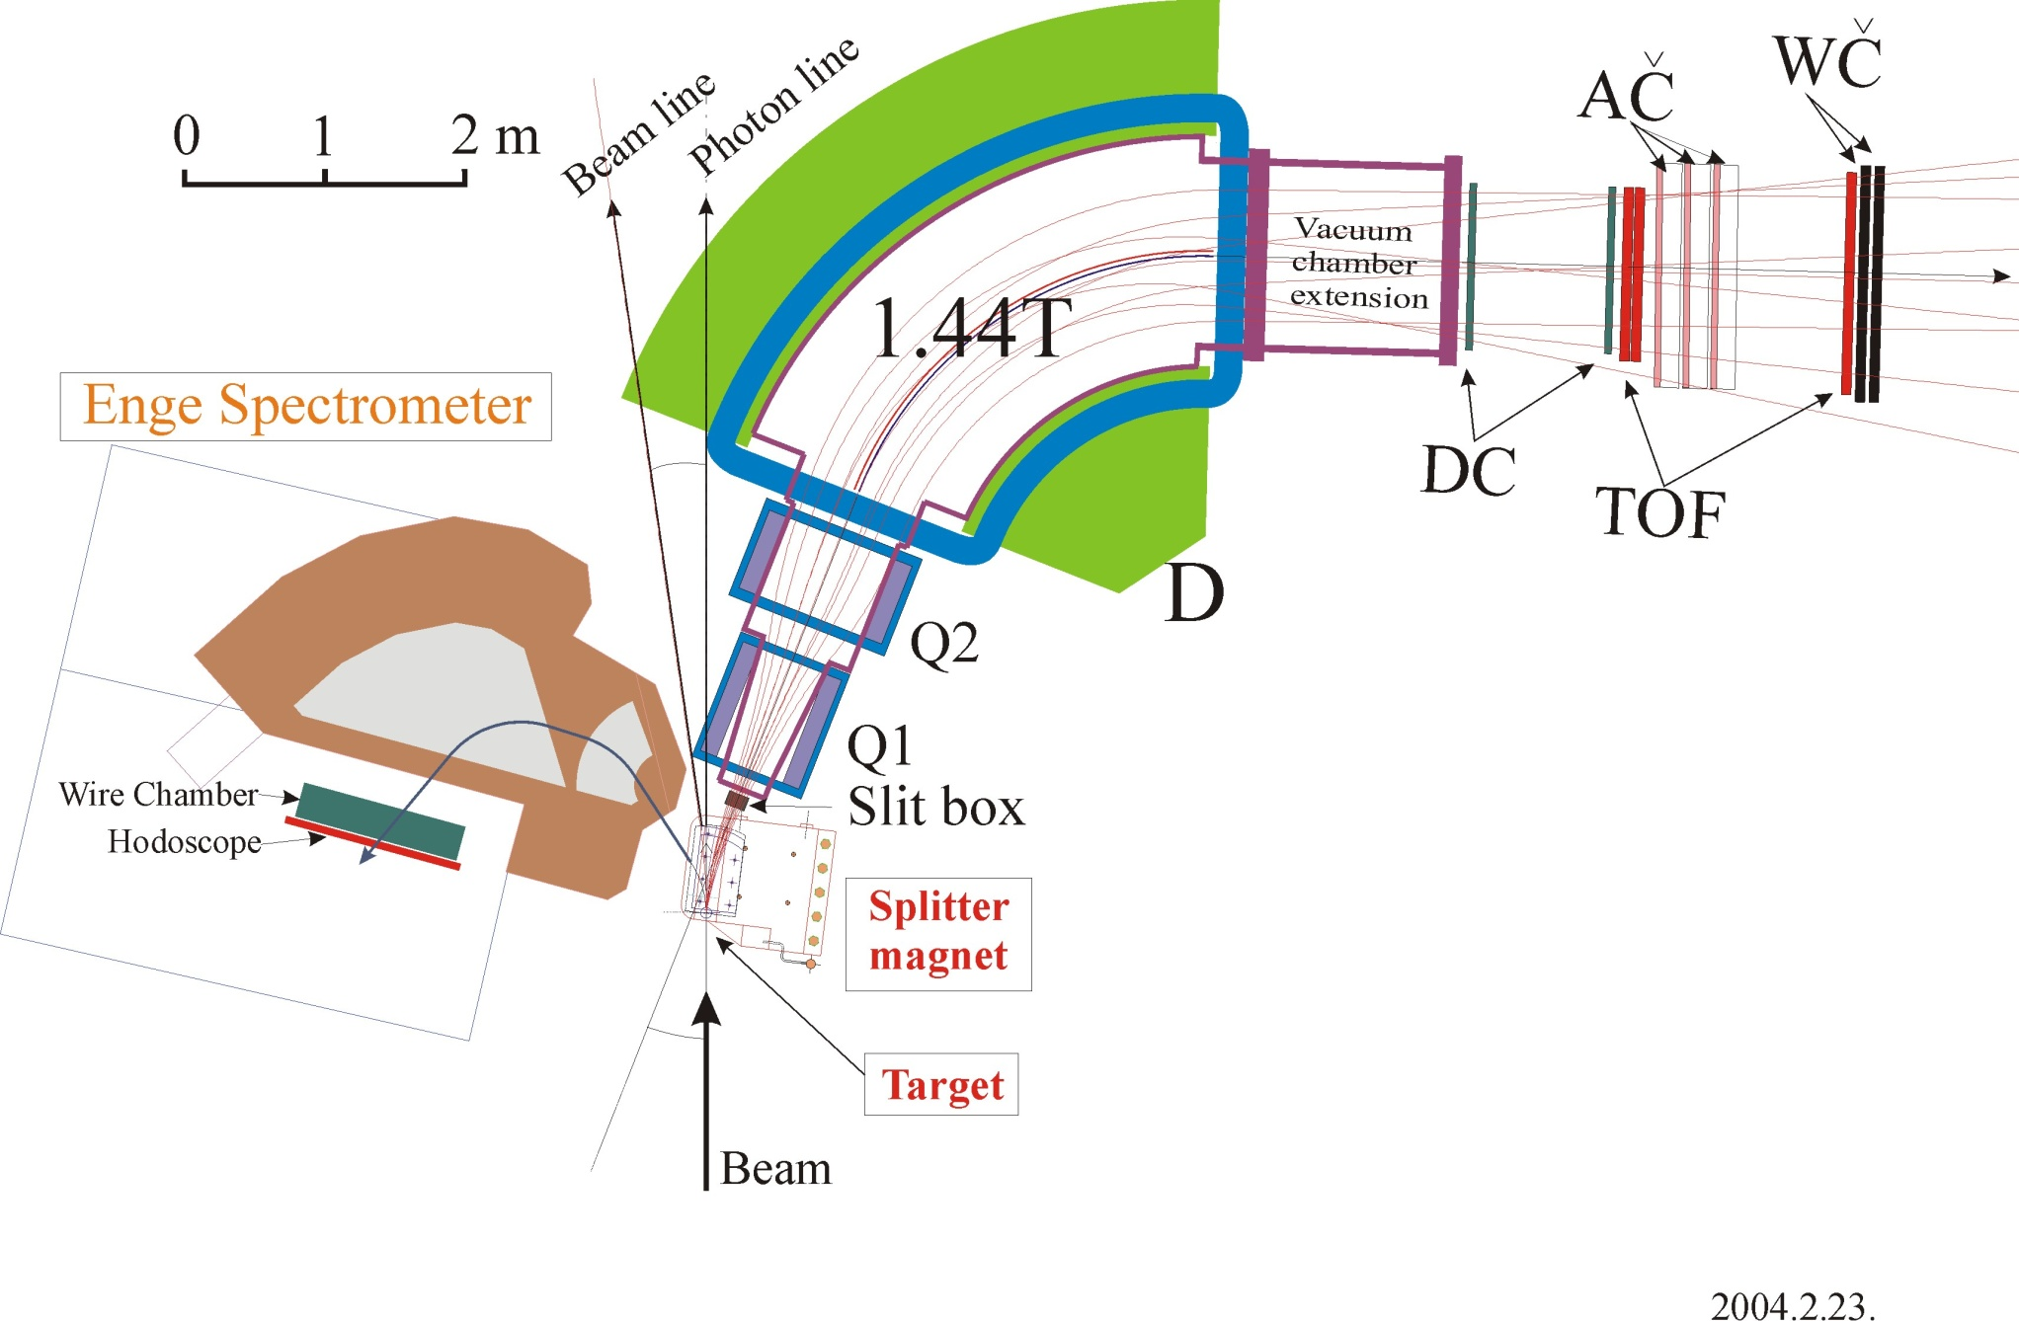
Second Generation Exp.
E01-011 setup
K⁺ 1.2 GeV/c
e’ 0.3 GeV/c
HKS (newly designed)
Configuration | QQD
Momentum acceptance | 1.2 GeV/c± 12.5 %
Momentum resolution | 2×10⁻⁴ (FWHM)
Angular acceptance | 1°~ 13°
Solid angle | 16 msr (w/ splitter)
configuration | Split-pole
Momentum acceptance | 0.316 GeV/c± 30 %
Momentum resolution | 4×10⁻⁴ (FWHM)
e
1.8 GeV

Slide 18
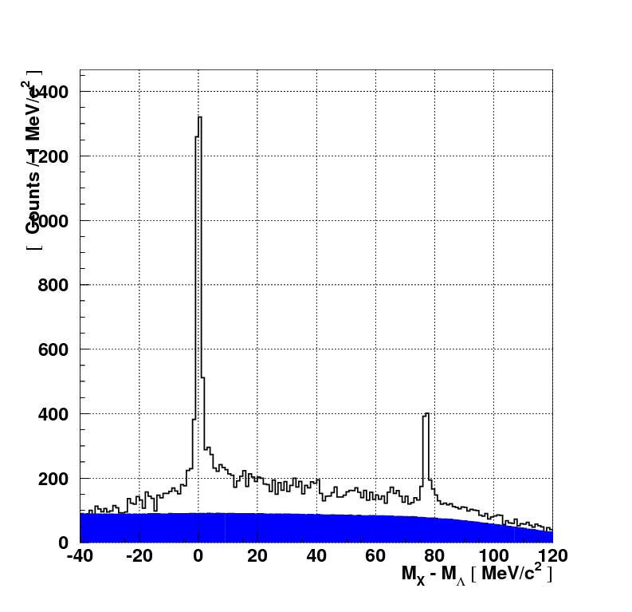
Λ and Σ spectra (CH₂ target)
Absolute mass scale calibration
E01-011
~70 hours
(450 mg/cm², 1.5 uA)
Λ
c.f. E89-009, 183 hours
(8.8 mg/cm², 0.5 or 1.0 uA)
T. Miyoshi et al.,
Phy. Rev. Lett. 90, 232502(2003)
Λ
1.9 MeV
(FWHM)
Σ
2.3 MeV
(FWHM)
Σ⁰
~ 3.5 MeV
(FWHM)
Better resolution and statistics

Slide 19
Highlights of E01-011 Results
To be published soon.
¹²_{Λ}B : Reference Spectrum w/ best resolution
²⁸_{Λ}Al : First beyond-p shell HY. by (e,e’K)
⁷_{Λ}He : First reliable data, CSB effect

Slide 20
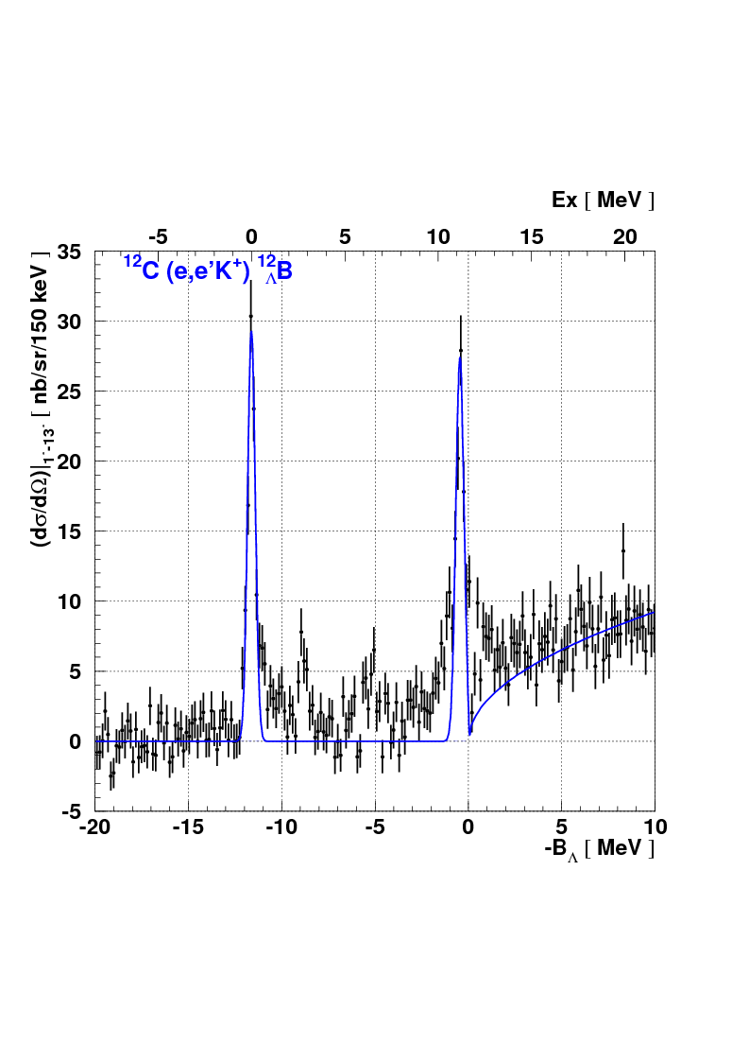
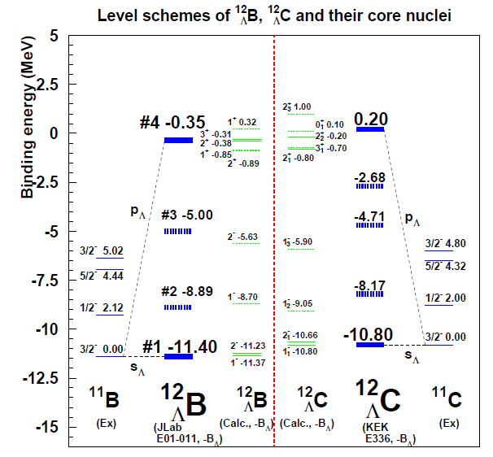
¹²C(e,e’K⁺)¹²_{Λ}B, ¹²C(π⁺,K⁺)¹²_{Λ}C
Emulsion

Slide 21
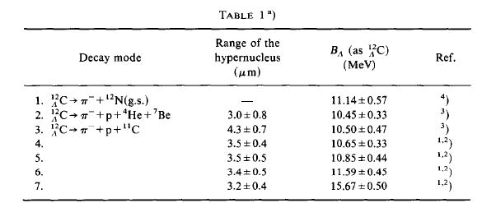

¹²_{Λ}C emulsion data
¹¹C (3/2-) : Ex = 4.8MeV
Reference for all (π, K) B_{Λ} data:
B_{Λ} (¹²_{Λ}Cg.s.) = 10.76 +-0.19MeV
Statistical error only

Slide 22
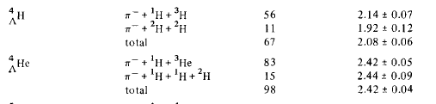
¹²_{Λ}B emulsion data
(# of events)
B_{Λ} (¹²_{Λ}Bg.s.) = 11.45 +-0.07 MeV
Emulsion Result (M.Juric et al.)
Ref) A=4 System
Different modes
give 0.22 MeV
difference
Systematic Error?

Slide 23
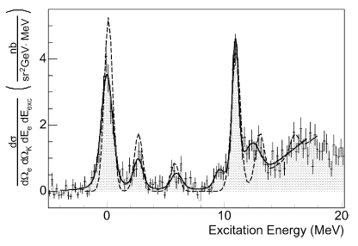
¹²C(e,e’K⁺)¹²_{Λ}B @ JLab Hall C & A
Binding energies are consistent with
The other (e,e’K) data.
#1
#2

Slide 24
¹²_{Λ}B emulsion data
(# of events)
B_{Λ} (¹²_{Λ}Bg.s.) = 11.45 +-0.07 MeV
Emulsion Result (M.Juric et al.)
B_{Λ} (¹²_{Λ}Bg.s.) = 11.40 +-0.01+-0.14MeV
Totally Independent Measurement
E01-011 Result (A.Matsumura Ph.D. Thesis)
Ref) A=4 System
Decay π spectroscopy is important
Different modes
give 0.22 MeV
difference
Systematic Error?

Slide 25
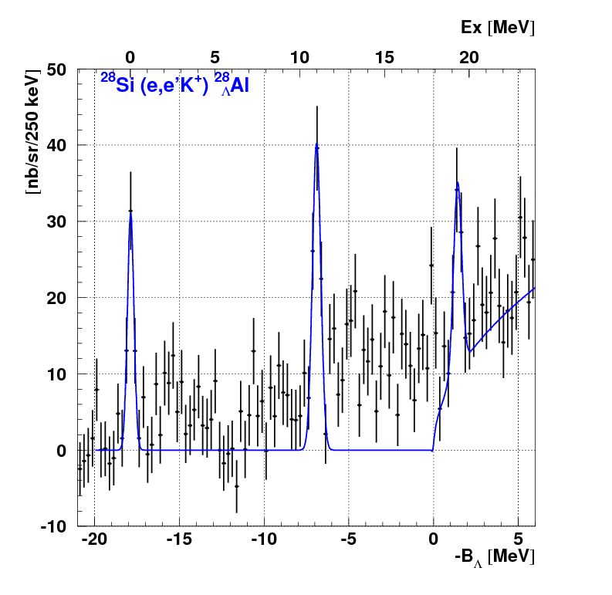
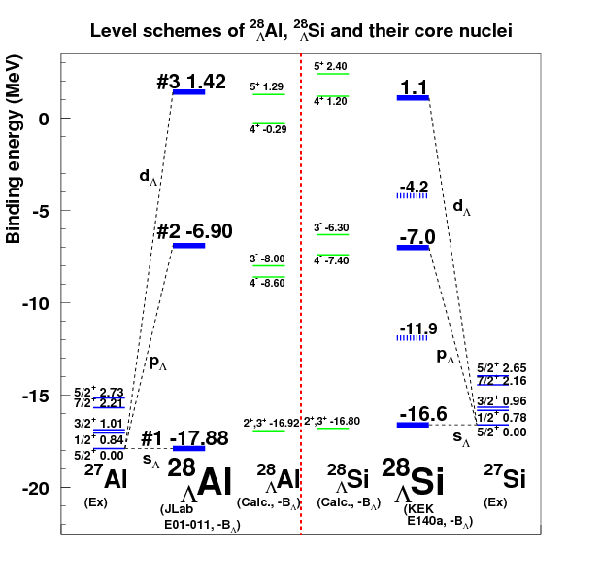
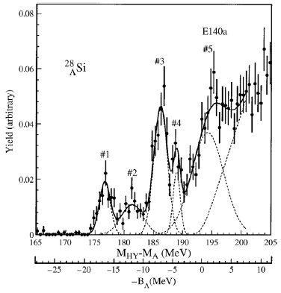
²⁸Si(e,e’K⁺)²⁸_{Λ}Al, ²⁸Si(π⁺,K⁺)²⁸_{Λ}Si
First sd-shell hypernuclear
spectroscopy by (e,e’K⁺)
#1
#3
#2

Slide 26
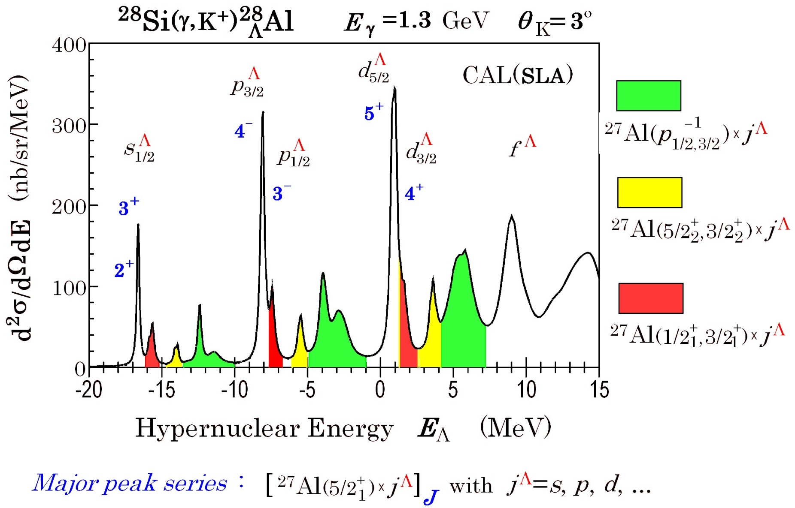
²⁸Si(e,e’K⁺)²⁸_{Λ}Al @ JLab Hall C
#1
#3
#2
Full space
(0d_{5/2}0d_{3/2}1s_{1/2})_{pn}^{11,12}
DWIA
YNG interaction

Slide 27
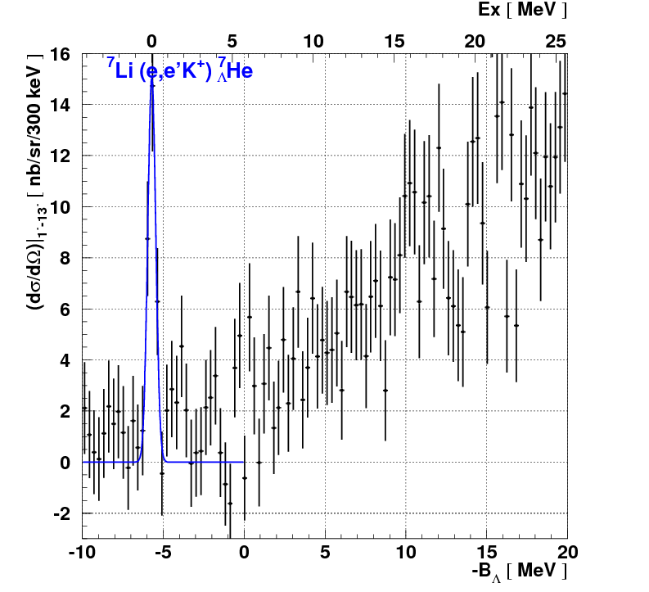
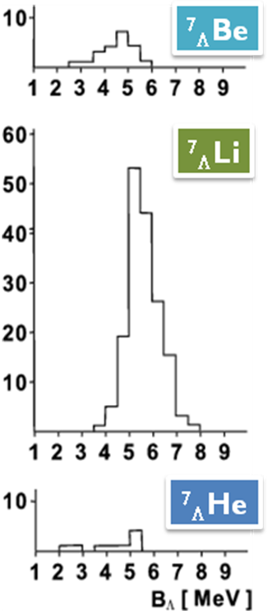
⁷Li(e,e’K⁺)⁷_{Λ}He
First reliable observation of ⁷_{Λ}He w/ good statistics
#1
M.Juric et al. NP B52 (1973) 1
Detailed Discussion : Tomorrow

Slide 28
CSB effect by cluster model
Four-body cluster model
A=4, T=1/2 System
Λ
n
Λ
n
p
p
p
⁴_{Λ}H, ⁴_{Λ}He
n
A=7, T=1 iso-triplet
Λ
α
α
Λ
α
Λ
n
p
⁷_{Λ}He, ⁷_{Λ}Li*, ⁷_{Λ}Be
n
p
n
p
A=10, T=1/2 system
Λ
α
α
Λ
¹⁰_{Λ}Be, ¹⁰_{Λ}B
n
α
p
α

Slide 29
Hypernuclei in wide mass range
1
E89-009
¹²C
20
50
200
10⁵⁷
A
Elementary Process
E01-011
⁷Li ¹²C ²⁸Si
Strangeness electro-production
  Neutron/Hyperon star,
  Strangeness matter
Light Hypernuclei (s,p shell)
  Hyperonization →
Softening of EOS ?
  Fine structure
  Baryon-baryon interaction in SU(3)
  ΛΣ coupling in large isospin hypernuclei
  Cluster structure
Medium - Heavy hypernuclei
Single-particle potential
  Distinguishability of a Λ hyperon
    U₀(r), m_{Λ}*(r), V_{ΛNN}, ...

Slide 30
Hypernuclei in wide mass range
1
E89-009
¹²C
20
50
200
10⁵⁷
A
E05-115
^{6,7}Li ^{10,11}B ¹²C ⁵¹V ⁵²Cr
Elementary Process
E01-011
⁷Li ¹²C ²⁸Si
Strangeness electro-production
  Neutron/Hyperon star,
  Strangeness matter
Light Hypernuclei (s,p shell)
  Hyperonization →
Softening of EOS ?
  Fine structure
  Baryon-baryon interaction in SU(3)
  ΛΣ coupling in large isospin hypernuclei
  Cluster structure
Medium - Heavy hypernuclei
Single-particle potential
  Distinguishability of a Λ hyperon
    U₀(r), m_{Λ}*(r), V_{ΛNN}, ...
3rd Generation Experiment

Slide 31
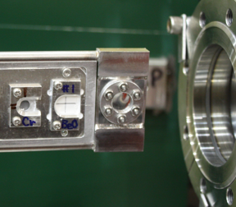
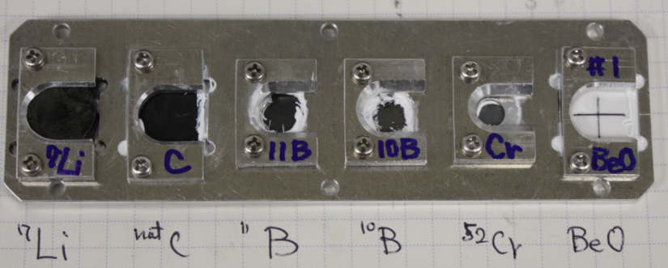
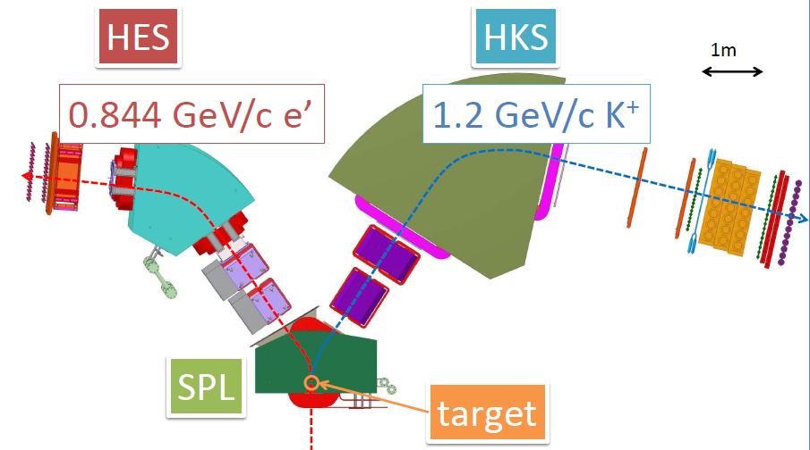
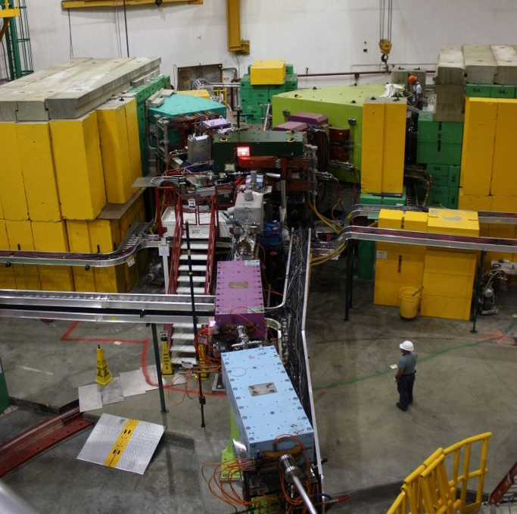
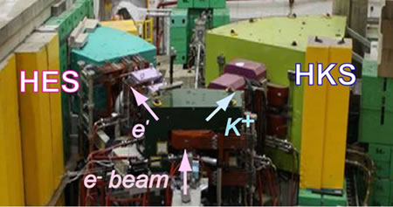
Third Generation Exp. at JLab
2009 E05-115 (Hall C)
Wide mass range hypernuclear spectroscopy (⁵²_{Λ}V, ¹²_{Λ}B ,¹⁰_{Λ}Be, ⁹_{Λ}Li, ⁷_{Λ}He )
Major Improvements
(10 times more VP tagging )
New HES
best match to HKS
New Calibrations
H2O cell target
Beam energy scan

Slide 32
Goals of the 3rd Generation Experiment
⁷Li(e,e’K⁺)⁷_{Λ}He,¹⁰B(e,e’K⁺)¹⁰_{Λ}Be
- Cluster model, shell model approach
  Charge Symmetry Breaking in ΛN interaction
  ΛN-ΣN coupling effect
⁵²Cr(e,e’K⁺)⁵²_{Λ}V
- Shell model, Mean field theory
  A dependence of Λ single particle energies
  Measurement of fine structure (core configuration mixing, ls splitting…)

Slide 33
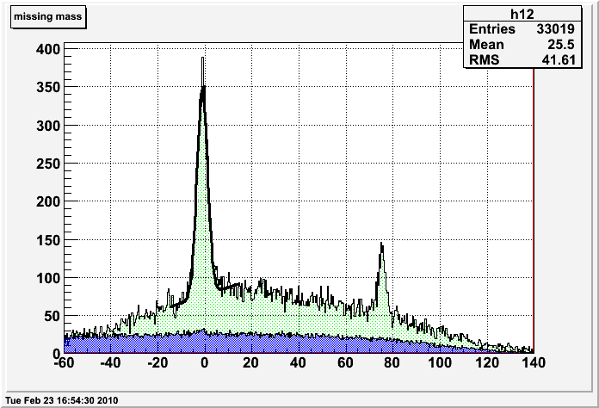
Missing mass calibration data
Elementary process of
Electromagnetic production of strangeness
CH₂ target missing mass
Λ
Analysis Status
By Kawama
Σ⁰
M_{x}-M_{Λ} [MeV]
E05-115 (2009) preliminary

Slide 34
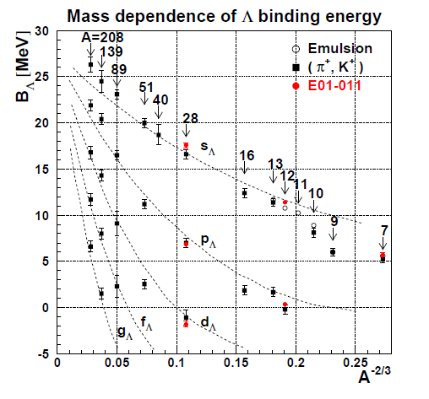
Λ single particle energies
JLab E05-115
JLab E01-011

Slide 35
Summary
With a high quality electron beam from CEBAF,
(e,e’K) hypernuclear spectroscopy was established
The second gen. exp. E01-011 (HKS) achieved ~500keV (FWHM) resolution
¹²_{Λ}B : reference data with the best resolution
⁷_{Λ}He : first reliable observation of g.s., CSB
²⁸_{Λ}Al : first observation, doorway to mid-heavy HY
The third gen. exp. E05-115 (HKS-HES) successfully finished
Λ, Σ⁰ , ⁷_{Λ}He, ⁹_{Λ}Li, ¹⁰_{Λ}Be, ¹²_{Λ}B, ⁵²_{Λ}V

