Slide 1
Decay pion spectroscopy for study of light Λ-hypernuclei
Liguang Tang
Department of Physics, Hampton University
Jefferson National Laboratory (JLAB)
Sphere/Core-to-Core meetings, September 4-6, 2010, Prague, Czech Republic

Slide 2
Electro-production of Hypernuclei and Hyperfragments from the Continuum
e
e’
e
e’
γ*
K⁺
γ*
K⁺
Background
p
Λ
p
Λ
A
_{Y}A
A
(A-1)
Direct production of Hypernuclei
Quasi-free Λ production (Continuum)
e
e’
e
e’
A rich source of a variety of light hypernuclei for new findings and discoveries
2B decay pion is used as the tool
γ*
K⁺
γ*
K⁺
Λ
N
p
Λ
N
p
A
_{Y}(A-1)
A_{a}
(A_{a}-1)
_{Y}(A_{b}-1)
A_{b}
Production of Hyperfragment (Continuum)
Production of Hyperfragment (Continuum)

Slide 3
Decay Pion Spectroscopy for Study of Light Λ-Hypernuclei
e’
Example:
K⁺
Direct Production
¹²C
Ground state doublet of ¹²_{Λ}B
B_{Λ} and τ
e
p
¹²_{Λ}B_{g.s.}
2⁻
~150 keV
Λ
1⁻
0.0
¹²C_{g.s.}
π ⁻
Weak mesonic two body decay

Slide 4
Decay Pion Spectroscopy for Light and Exotic Λ-Hypernuclei
Fragmentation Process
e’
K⁺
Example:
Access to variety of light and exotic hypernuclei, some of which cannot be produced or measured precisely by other means
¹²C
e
p
¹²_{Λ}B*
Λ
α
⁴_{Λ}H
Λ
π ⁻
α
Weak mesonic two body decay (~10⁻¹⁰s)
Fragmentation (<10⁻¹⁶s)
⁴He

Slide 5
Decay Pion Spectroscopy for Study
Light Λ-Hypernuclei
High precision on ground state light hypernuclei
  Resolution: ~130 keV FWHM; mass precision : < ±30 keV
  Precise Λ binding energy
  Charge symmetry breaking
Linkage between structures of hypernuclei and nuclei
  Determining ground state spin/parity
Search for Isomeric low lying states (Isomerism)
Study the drip line limit on Λ-hypernuclei, such as heavy hyper-hydrogen: ⁶_{Λ}H, ⁷_{Λ}H, and ⁸_{Λ}H
Medium modification of baryon property

Slide 6
Hall A Experimental Layout
Trigger II: HRS(K) – HRS(e’) - Spectroscopy Experiment
HRS - Hadron
K⁺
Septum
e
Lucite Č
e’
π⁻
HRS - Electron
Hodoscope
Drift Chamber
Trigger I: HRS(K) – Enge(π) - Decay Pion Experiment
For the 2012 test run:
Aim to the Be window
of the H₂O target

Slide 7
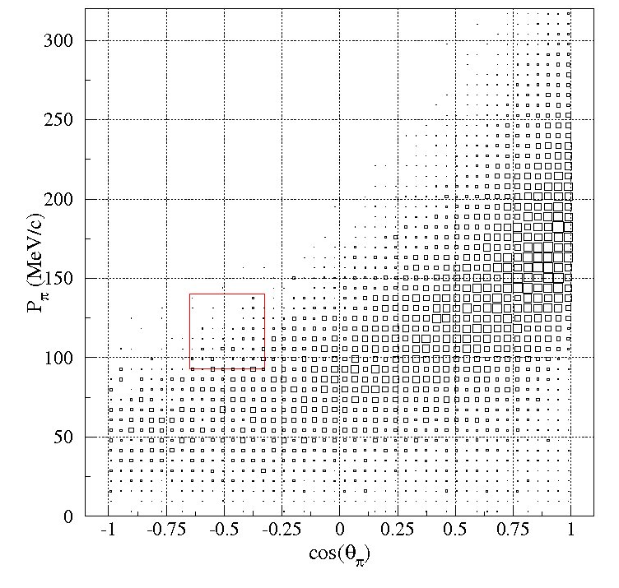
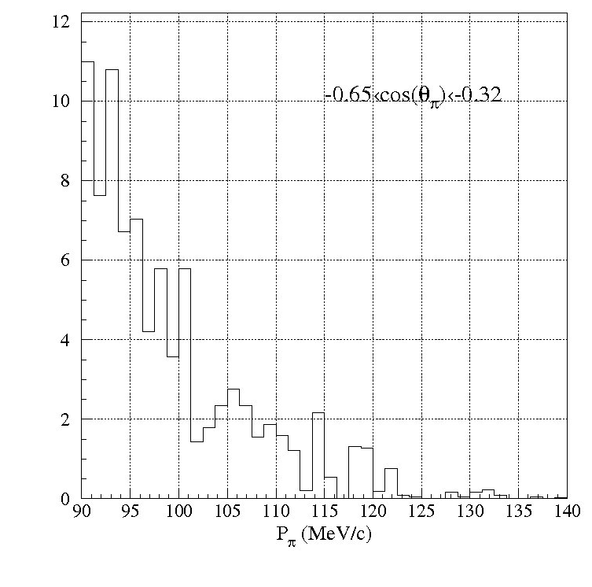
Free of Q.F. Λ Background
Quasi-free Λ → p + π⁻ (all)
Within the HES acceptances

Slide 8
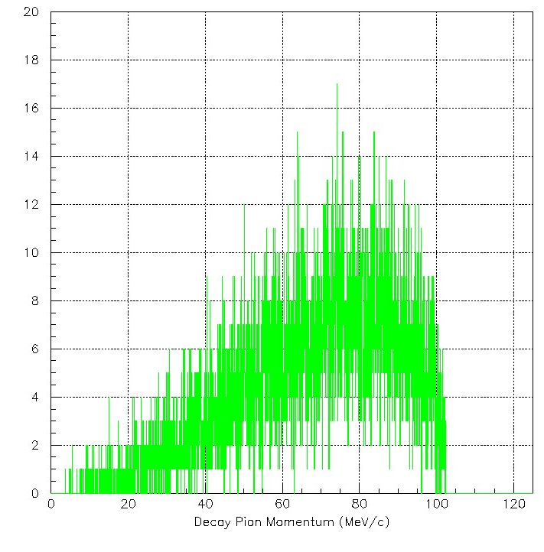
Three-Body Decay Background
Example: ⁴_{Λ}He → ³He + p + π⁻
P_{π} Acceptance

Slide 9
Hypernuclei from a ⁷Li Target
Two-Body decay – 6 possible hypernuclei
Breakup Mode | Q value (MeV) | π⁻ Decay | P_{π} (MeV/c) | Width (keV/c) FWHM
⁷_{Λ}He | - | ⁷Li + π⁻ | 114.61 | 165
p + ⁶_{Λ}H | -23.503 (B_{Λ}=5.1) | ⁶He + π⁻ | 133.47 | 165
n + ⁶_{Λ}He | -3.409 | ⁶Li + π⁻ | 108.39 | 165
d + ⁵_{Λ}H | -23.011 (B_{Λ}=4.1) | ⁵He + π⁻ | 133.42 | ~900*
³H + ⁴_{Λ}H | -16.995 | ⁴He + π⁻ | 132.95 | 165
⁴H + ³_{Λ}H | -26.981 | ³He + π⁻ | 114.29 | 165
Three-Body decay – Background
Breakup Mode | Q value (MeV) | π⁻ Decay | P_{π} max (MeV/c) – cut off
d + ⁵_{Λ}H | -23.011 (B_{Λ}=4.1) | ⁴He + n + π⁻ | 139.27*
2n + ⁵_{Λ}He | -3.567 | ⁴He + p + π⁻ | 102.42
3n + ⁴_{Λ}He | -24.868 | ³He + p + π⁻ | 103.15

Slide 10
Hypernuclei from a ⁹Be Target
Two-Body decay – 6 additional hypernuclei
Breakup Mode | Q value (MeV) | π⁻ Decay | P_{π} (MeV/c) | Width (keV/c) FWHM
⁹_{Λ}Li | - | ⁹Be + π⁻ | 121.18 | 165
p + ⁸_{Λ}He | -13.817 | ⁸Li + π⁻ | 116.40 | 165
n + ⁸_{Λ}Li | -3.756 | ⁸Be + π⁻ | 124.12 | 165
2p + ⁷_{Λ}H | -40.328 (B_{Λ}=6.1) | ⁷He + π⁻ | 135.17 | ~270*
d + ⁷_{Λ}He | -12.568 | ⁷Li + π⁻ | 114.61 | 165§
2n + ⁷_{Λ}Li | -12.218 | ⁷Be + π⁻ | 108.02 | 165
³He + ⁶_{Λ}H | -29.608 (B_{Λ}=5.1) | ⁶He + π⁻ | 133.47 | 165§
³H + ⁶_{Λ}He | -9.745 | ⁶Li + π⁻ | 108.39 | 165§
3n + ⁶_{Λ}Li | -18.957 | ⁶Be + π⁻ | 100.58 | ~220**
α + ⁵_{Λ}H | -11.749 (B_{Λ}=4.1) | ⁵He + π⁻ | 133.42 | ~900*§
n + α + ⁴_{Λ}H | -12.005 | ⁴He + π⁻ | 132.95 | 165§
⁶He + ³_{Λ}H | -18.183 | ³He + π⁻ | 114.29 | 165§

Slide 11
Hypernuclei from a ¹²C Target
Two-Body decay – 12 additional hypernuclei
Breakup Mode | Q value (MeV) | π⁻ Decay | P_{π} (MeV/c) | Width (keV/c) FWHM
¹²_{Λ}B | - | ¹²C + π⁻ | 115.49 | 165
p + ¹¹_{Λ}Be | -12.280 (B_{Λ}=10.5) | ¹¹B + π⁻ | 109.66 | 165
n + ¹¹_{Λ}B | -12.765 | ¹¹C + π⁻ | 105.99 | 165
2p + ¹⁰_{Λ}Li | -32.908 (B_{Λ}=12.3) | ¹⁰Be + π⁻ | 119.78 | 165
d + ¹⁰_{Λ}Be | -18.264 | ¹⁰B + π⁻ | 104.31 | 165
2n + ¹⁰_{Λ}B | -22.544 | ¹⁰C + π⁻ | 95.84 | 165
3p + ⁹_{Λ}He | -48.534 (B_{Λ}=7.8) | ⁹Li + π⁻ | 117.83 | 165
³He + ⁹_{Λ}Li | -30.237 | ⁹Be + π⁻ | 121.18 | 165§
³H + ⁹_{Λ}Be | -16.072 | ⁹B + π⁻ | 96.88 | 165*
3n + ⁹_{Λ}B | -41.713 | ⁹C + π⁻ | 96.71 | 165
4p + ⁸_{Λ}H | -68.937 (B_{Λ}=7.1) | ⁸He + π⁻ | 137.15 | 165
⁴Li + ⁸_{Λ}He | -46.961 | ⁸Li + π⁻ | 116.40 | 165§
α + ⁸_{Λ}Li | -14.444 | ⁸Be + π⁻ | 124.12 | 165§
⁴H + ⁸_{Λ}Be | -37.659 | ⁸B + π⁻ | 97.09 | 165
4n + ⁸_{Λ}B | -56.317 (B_{Λ}=6.7) | ⁸C + π⁻ | 97.21 | 365**
p + ⁴Li + ⁷_{Λ}H | -73.473 (B_{Λ}=6.1) | ⁷He + π⁻ | 135.17 | ~270*§
⁵Li + ⁷_{Λ}He | -26.436 | ⁷Li + π⁻ | 114.61 | 165§
⁵He + ⁷_{Λ}Li | -25.782 | ⁷Be + π⁻ | 108.02 | 165§
⁶Be + ⁶_{Λ}H | -48.317 (B_{Λ}=5.1) | ⁶He + π⁻ | 133.47 | 165§
⁶Li + ⁶_{Λ}He | -24.186 | ⁶Li + π⁻ | 108.39 | 165§
⁶He + ⁶_{Λ}Li | -27.663 | ⁶Be + π⁻ | 100.58 | ~220**§
⁷Be + ⁵_{Λ}H | -44.499 (B_{Λ}=4.1) | ⁵He + π⁻ | 133.42 | ~900*§
2α + ⁴_{Λ}H | -22.693 | ⁴He + π⁻ | 132.95 | 165§
⁹Be + ³_{Λ}H | -27.244 | ³He + π⁻ | 114.29 | 165§

Slide 12
Illustration of Decay Pion Spectroscopy
(c)
1⁻
¹²_{Λ}B
Additions from ¹²_{Λ}B and its continuum
(Phase III: ¹²C target)
⁹_{Λ}Be 1/2⁺
Light Hypernuclei to Be Investigated
⁹_{Λ}B J^{p}=?
¹⁰_{Λ}Be
p
⁹_{Λ}He
⁸_{Λ}Be
¹¹_{Λ}B
¹¹_{Λ}Be
¹⁰_{Λ}Li
¹⁰_{Λ}B
J^{p}=?
J^{p}=?
⁸_{Λ}H
J^{p}=?
J^{p}=?
5/2⁺
J^{p}=?
J^{p}=?
3B background
Previously measured
6
⁸_{Λ}B
(b)
Mirror pairs
Additions from ⁹_{Λ}Li and its continuum
(Phase II: ⁹Be target)
3/2⁺
¹⁰_{Λ}B
¹¹_{Λ}B
¹²_{Λ}B
5
1/2⁺
J^{p}=?
⁸_{Λ}B
⁹_{Λ}B
⁷_{Λ}Li
1⁻
⁸_{Λ}He
⁹_{Λ}Li
⁸_{Λ}Li
4
⁶_{Λ}Li
⁸_{Λ}Be
⁹_{Λ}Be
¹⁰_{Λ}Be
¹¹_{Λ}Be
3B background
1/2⁺
⁷_{Λ}H
1⁻ ?
3/2⁺
5/2⁺
⁸_{Λ}Li
2⁻
3
⁶_{Λ}Li
⁷_{Λ}Li
⁹_{Λ}Li
¹⁰_{Λ}Li
(a)
0
1
E_{x}
0
1
E_{x}
0
1
E_{x}
2
⁶_{Λ}He
⁷_{Λ}He
⁸_{Λ}He
⁹_{Λ}He
2-B decay from ⁷_{Λ}He and its continuum
(Phase I: ⁷Li target)
0
2
E_{x}
1⁻ ?
³_{Λ}H
1/2⁺
0⁺
³_{Λ}H
⁴_{Λ}H
⁵_{Λ}H
⁶_{Λ}H
⁷_{Λ}H
⁸_{Λ}H
1
⁶_{Λ}He
1/2⁺
⁴_{Λ}H
⁶_{Λ}H
⁷_{Λ}He
A
3B background
1
2
3
4
5
6
7
8
9
10
11
12
3/2⁺
⁵_{Λ}H
5/2⁺
HES P_{Min}
0
2
E_{x}
E_{x}
HES P_{Max}
0
2
90.0
100.0
110.0
120.0
130.0
140.0
π⁻ Momentum (MeV/c)

Slide 13
Proposal to JLAB PAC35
Study of Light Hypernuclei by Pionic Decay at JLab
M. Christy, C. Keppel, M. Kohl, Liguang Tang (spokesperson), L. Yuan (spokesperson), L. Zhu, Hampton University, USA
N. Grigoryan, S. Knyazyan, A. Margaryan (spokesperson), L. Parlakyan, S. Zhamkochyan, H. Vardanyan, Yerevan Physics Institute, Armenia
O. Hashimoto, S.N. Nakamura (spokesperson), Tohoku University , Japan
P. Baturin, W. Boeglin, P. Markowitz, J. Reinhold (spokesperson), Florida International University, USA
P. Bosted, K. de Jager, R. Ent, H. Fenker, D. Gaskell, T. Horn, M. Jones, J. LeRose (spokesperson), G. Smith, W. Vulcan, S.A. Wood, JLAB, USA
E. Cisbani, F. Cusanno, S. Frullani, F. Garibaldi (spokesperson), M.L. Magliozzi, Istituto Nazionale di Fisica Nucleare, Sezione di Roma, Italy
Ed.V. Hungerford, Department of Physics, University of Houston, USA
L. Majling, Nuclear Physics Institute, Academy of Sciences of the Czech Republic, Czech Republic
B. Gibson, Los Alamos National Laboratory, USA
T. Motoba, Laboratory of Physics, Osaka Electro-Comm. University, Japan
B. Hu, J. Shen, W. Wang, X. Zhang, Y. Zhang, Nuclear Physics Institute, Lanzhou University, China
D. Androic, M. Furic, T. Petkovic, T. Seva, University of Zagreb, Croatia
A. Ahmidouch, S. Danagoulian, A. Gasparian, North Carolina A&T State University, USA
G. Niculescu, I. Niculescu, James Madison University, USA
M. Iodice, Istituto Nazionale di Fisica Nucleare, Italy
G.M. Urciuoli, Istituto Nazionale di Fisica Nucleare, Sezione di Roma1, Italy
R. De Leo, L. Lagamba, S. Marrone, Istituto Nazionale di Fisica Nucleare, Italy
H.J.Schulze, Istituto Nazionale di Fisica Nucleare, Italy
J. Feng, Y. Fu, J. Zhou, S. Zhou, China Institute of Atomic Energy, China
Y. Jiang, H. Lu, X. Yan, Y. Ye, P. Zhu, University of Science & Technology of China, China.
Current Status:
PAC35 approved it as we requested
Tentative schedule – Spring 2012

Slide 14
Summary
High quality and high intensity CW CEBAF beam at JLAB made high precision hypernuclear programs possible
Electroproduced hypernuclei are neutron rich and have complementary features to those produced by mesonic beams. Together with J-PARC’s new programs, as well as those at other facilities around world, the hypernuclear physics will have great achievement in the next couple of decades
The mass spectroscopy program will continue beyond JLAB 12 GeV upgrade
The new decay pion spectroscopy program will start a new frontier

Slide 15
Top View of the Experimental Layout
Figure 6. Schematic top view of the experimental configuration for the JLAB hypernuclear decay pion spectroscopy experiment (Hall A).
To Hall Dump
To a local photon dump
1.2 GeV/c
K⁺
HES
22mg/cm²
64mg/cm²
π⁻
94 – 140 MeV/c
2.3 GeV
Hall Z-axis
Ideal if HKS and HES move to Hall A

