Slide 1
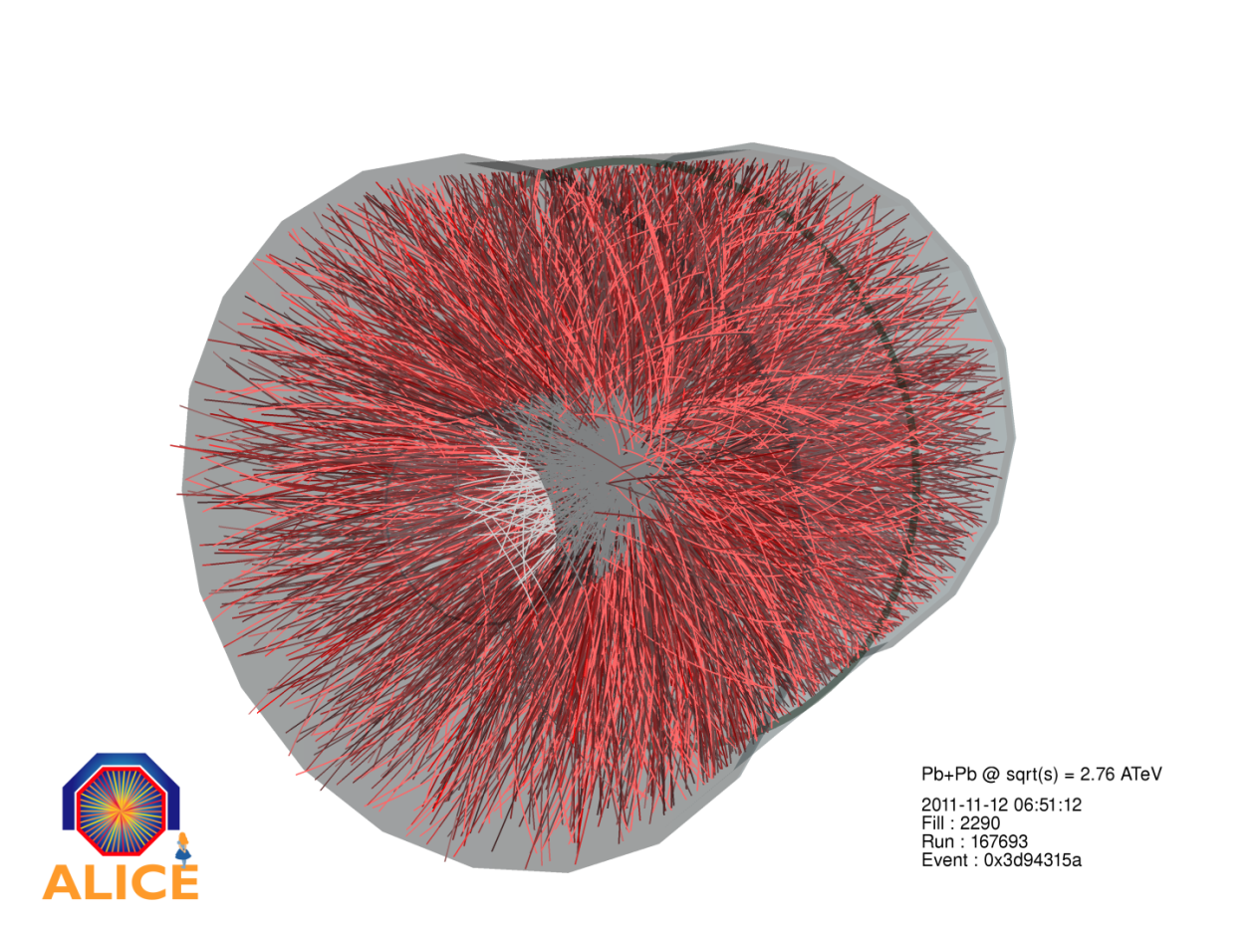

Soft Physics in Relativistic
Heavy-ion Collisions
Karel Šafařík, CERN

Slide 2
Outlook
Motivation for Heavy-Ion Collisions
  Hadron masses
  QCD phase transitions
Centrality determination
History, from SPS to RHIC and to LHC
  First observables: strangeness enhancement, J/ψ suppression
Particle spectra and yields
  Statistical thermalization
  Strangeness measurement
  Baryon anomaly
  Radial flow
Azimuthal anisotropy
  Elliptic flow, directed flow
  Higher harmonics
  Event engineering
  Chiral magnetic effects
Future
  Heavy-flavour production, quarkonia production
  Low-mass dilepton production

Slide 3
Hadron masses & QCD phase transitions

Slide 4
Hadron masses
Σ quark masses ~
~ 1 % of p/n mass !
Energy of gluon field

Slide 5
Vacuum
Energy of pair created from vacuum:
E_{kin} = p ~ 1/r (p×r ≥ 1)
E_{pot} = – q²/(4πr) (q = e or q = g_{s})
E = E_{kin} + E_{pot} = (1/r)×(1 – q²/4π) = (1/r)×(1 – α_{em,s})
in QED this is true for any distance (down to Planck scale 10⁻²⁰ fm)
in QCD it’s restricted to small distances, up to few fm at most
  for larger distances the colour field is restricted to a tube…

Slide 6
QED vs. QCD
in QED
  for large distances α_{em} = 1/137
  at EW scale (r = 2×10⁻³ fm) α_{em} = 1/128
  at Planck scale (r = 10⁻²⁰ fm) α_{em} = 1/76
numerical factor in energy (1 – α_{em}) varies
  between 0.987 – 0.993 (i.e. 0.6%) changing the pair separation from Planck scale to infinity
in QCD
  α_{s} decreases for small distances (asymptotic freedom)
  at Λ_{QCD} ≈ 0.2GeV (r ≈ 1 fm) α_{s} ≈ 1
  at EW scale α_{s} = 0.118
  at Planck scale α_{s} = 0.04
numerical factor in energy (1 – α_{s})
  decreases with distance, at Planck scale 0.96
  however, at r ≈ 1 fm it became negative !
at even larger separation E = σ×r (σ ≈ 1 GeV/fm)
  and became again positive

Slide 7
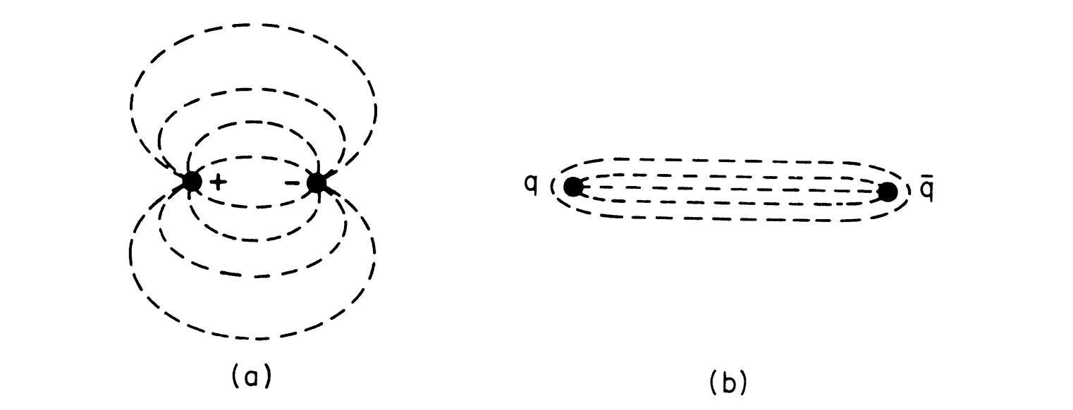
Confining potential in QCD
QED
QCD
r
In QCD, the field lines are compressed into a “flux tube” (or “string”) of constant cross-section (~fm²), leading to a long-distance potential which grows linearly with r:
with k ~ 1 GeV/fm

Slide 8
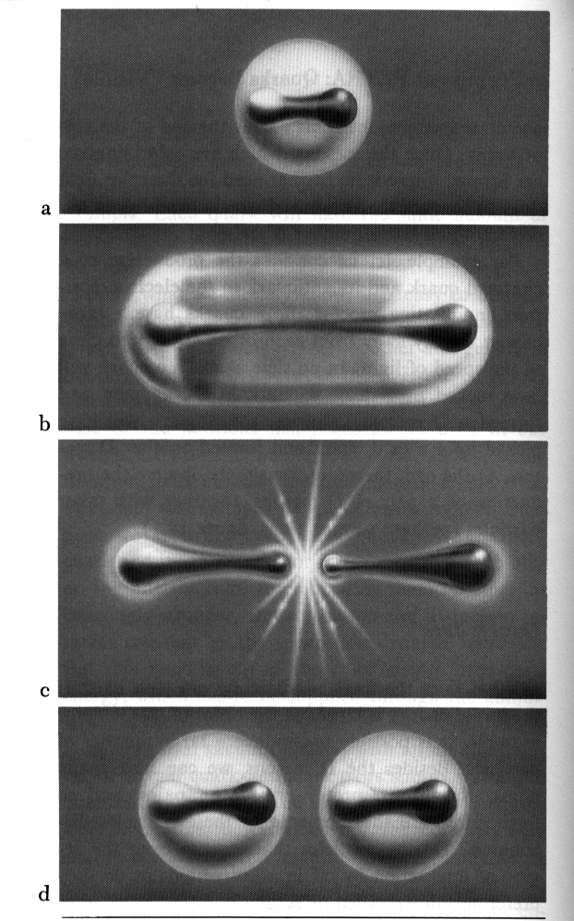
String breaking
If one tries to pull the string apart, when the energy stored in the string (k r) reaches the point where it is energetically favourable to create a qq pair, the string breaks…
...and one ends up with two colour-neutral strings (and eventually hadrons)
[illustration from H. Fritzsch]

Slide 9
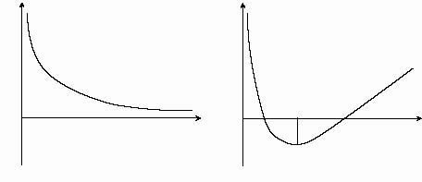
QED vs. QCD
QED
QCD
Energy of pair
Energy of pair
Distance
Distance
r = 1fm
Kinetic energy always dominates
over potential energy (weak field)
virtual pairs
Energy stored in field overcomes
kinetic energy at some distance
real pairs – vacuum condensate

Slide 10
QCD vacuum
The “empty” vacuum is unstable. There is a state of lower energy that consists of cells, each containing a gluon pair in colour- and spin- singlet state. The size of these cells is of order r₀. We may speak of a “liquid” vacuum.
Gottfried-Weisskopf, IV C

Slide 11
QCD symmetries
QCD Lagrangian has two approximate symmetries
  Z₃–(centre) symmetry (for pure guage, i.e. in the limit m_{q}→ ∞ )
  chiral–symmetry (restored with vanishing masses, i.e. m_{q}→ 0)
At high density and temperature eventually
  Z₃–symmetry destroyed (confinement—deconfinement transition)
  chiral–symmetry restored (chiral phase transition)
  responsible: vacuum condensate
Questions:
  is there one phase transition for both or two ?
  what is the order of the phase transition(s) ?
    is it first order (it has a latent heat) ?
    is it second order (is just a `kink’) ?
    is just cross-over transition ?

Slide 12
Confinement
massive quark in purely gluonic vacuum at zero temperature
  not seen by detector due destructive inference
  expectation value for trace of quark propagator – 3–valued path integral with different phases
  exp (i × 2πj/3), j=1,2,3 (generators of Z₃)
  increasing the temperature T until some value this will stay
    till gluon field will have enough time to follow (re-arrange coherently) our shaking test charge
  increasing temperature further (above some critical value) gluon field will have not time enough
    interference of 3 paths will be destroyed
    test colour charge will became detectable, will be deconfined
  to calculate this we have to continue analytically the quark propagator over complex time (t = +i/T) – Polyakov loop – which will became non-zero for T > T_{c}
    Polyakov loop is the order parameter

Slide 13
Chiral symmetry
For m_{q}→ 0 quark helicity will be conserved
  because gluons have helicity ±1 QCD Lagrangian in this limit has SU(3)_{L}×SU(3)_{R} symmetry
    QCD world decayed into two worlds which do not communicate – left-handed and right-handed
  when we put into QCD vacuum massless left-handed quark it can annihilate with left-handed anti-quark from vacuum condensate – liberating thus right-handed quark
    for an outside observer our test quark changed spontaneously its helicity and therefore it has to acquire some dynamic mass !
    QCD quark—anti-quark condensate generates dynamic quark masses and chiral symmetry is destroyed
  when we rise temperature kinetic energy term of the pair energy will above some value overcome potential energy
    quark—anti-quark condensate will disappear from vacuum
    chiral symmetry is restored above some critical temperature
    value of <0|qq|0> is the order parameter

Slide 14
QCD symmetries
Both symmetries are broken dynamically
  Z₃ symmetry is broken by kinetic energy (at high T)
    order parameter (Polyakov loop) is zero below T_{c} and non-zero above
    it is a order – disorder phase transition, Z₃ is restored below T_{c}
  chiral symmetry is broken by potential energy (at low T)
    order parameter (quark—anti-quark condensate) is non-zero below T_{c} and zero above
    it is a disorder – order phase transition, chiral symmetry is restored above T_{c}
Both are broken also explicitly – by mass term
  because of smallness of m_{q} it’s reasonable to expect that the scenario concerning chiral symmetry will be a good approximation
  what about Z₃ symmetry, why it’s not completely destroyed by small m_{q} ?

Slide 15
Confinement restoration
When we try to drop m_{q} from infinity down its bare (small) value what happen will depend on temperature
  at low temperature m_{q} will effectively stop decreasing when we go below quark dynamic mass M_{q} ≈ 350 MeV because chiral symmetry is broken
  Z₃ symmetry remains an approximate symmetry at low temperature even after this severe explicit breaking attempt
  chiral symmetry breaking effectively increases quark masses and therefore drives the Z₃ symmetry restoration
  this is an argument that the two phase transition might occur at the same point

Slide 16
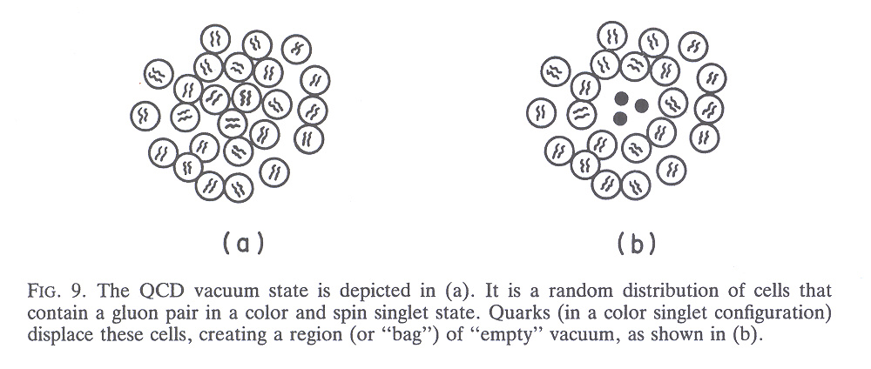
Bag Model
Due to the non-abelian nature of QCD and to the large value of the QCD coupling, the QCD vacuum is a rather complex object, behaving practically as a liquid
The MIT bag model describes the essential phenomenology of confinement by assuming that quarks are confined within bubbles (bags) of perturbative ( = empty) vacuum of radius R upon which the QCD vacuum exerts a confining pressure B
[see e.g. Gottfried-Weisskopf, p. 399]

Slide 17
The bubble radius R is determined by the balance between the vacuum pressure B and the outward kinetic pressure exerted by the quarks
From hadron spectra:
B ~ (200 MeV)⁴
Bag model of a hadron:
pressure =
B
"empty" vacuum
"true" (QCD) vacuum
B
= "bag constant"
B
1/4
~
200 MeV

Slide 18
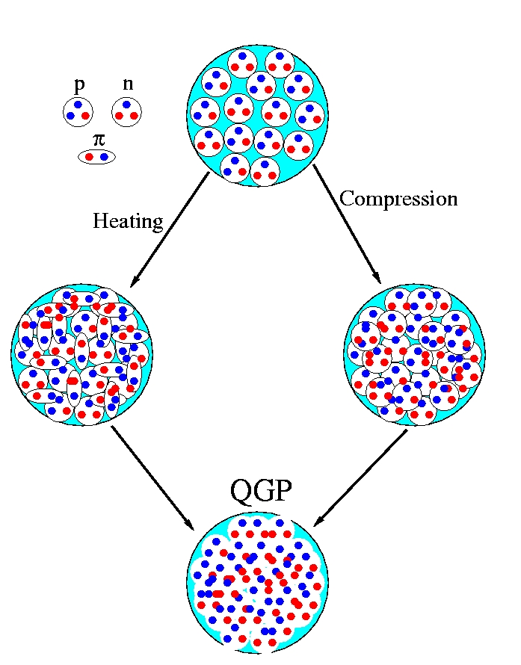
Deconfinement
What if we compress/heat matter so much that the individual hadrons start to interpenetrate?
Lattice QCD predicts that if a system of hadrons is brought to sufficiently large density and/or temperature a deconfinement phase transition should occur
In the new phase, called Quark-Gluon Plasma (QGP), quarks and gluons are no longer confined within individual hadrons, but are free to move around over a larger volume

Slide 19
Deconfinement: a toy model
Hadron (pion) Gas
Quark-Gluon Plasma
d
d
d
u
u
u
u
u
u
u
u
u
d
d
u
g
u
u
d
u
d
d
d
u
d
g
d
d
u
d
g
g
d
u
g
d
d
u
u
d
u
d
d
u
d
d
d
d
g
u
u
u
g
d
u
u
u
u
u
g
g
u
d
g
d
u
d
d
g
g
u
u
u
u
u
u
d
d
u
d
g
g
d
d
d
perturbative vacuum
QCD vacuum
QCD vacuum
Gibbs’ criterion:the stable phase is the one with the largest pressure
From statistical mechanics:
(for an ideal gas)

Slide 20
Hadron (pion) Gas
Quark-Gluon Plasma
d
d
d
u
u
u
u
u
u
u
u
u
d
d
u
g
u
u
d
u
d
d
d
u
d
g
d
d
u
d
g
g
d
u
g
d
d
u
u
d
u
d
d
u
d
d
d
d
g
u
u
u
g
d
u
u
u
u
u
g
g
u
d
g
d
u
d
d
g
g
u
u
u
u
u
u
d
d
u
d
g
g
d
d
d
perturbative vacuum
QCD vacuum
QCD vacuum

Slide 21
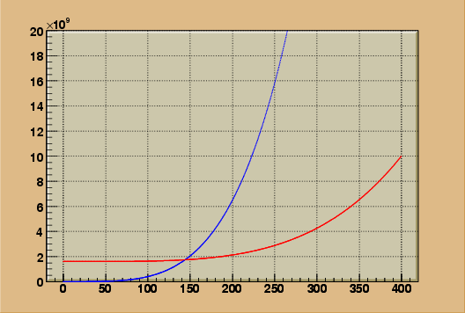
At low temperature the hadron gas is the stable phase
There is a temperature T_{C} above which the QGP “wins”, thanks to the larger number of degrees of freedom
P (MeV⁴)
QGP
very simplified calculation…
  more refined estimates:
→ Tc ≈ 170 MeV
pion gas
Tc
170 MeV?
recall: T_{room} (300 K) ~ 25 meV
(of course, lowercase m)
Tc ≈ 170 MeV ≈ 2000 billion K
(compare Sun core: 15 million K)
T (MeV)

Slide 22
QCD Phases – Perturbation Theory
at non-zero baryon density – first order p-QCD
  = [16(1 – 15α_{s}/4π) + (7/8)12n_{q}(1 – 50α_{s}/21π)] (1/30) π²T⁴ +
  + Σ_{q} 16(1 – 15α_{s}/2π) (3/ π²)μ_{q}²(π²T⁴ + μ_{q}²( /2)
  (for μ_{q} = 0, α_{s} = 0, and n_{q} = 2 we get our toy model)
  using α_{s} = 0.4 the same way we estimate T_{c} = 164 MeV
today analytical calculations exist for higher orders

Slide 23
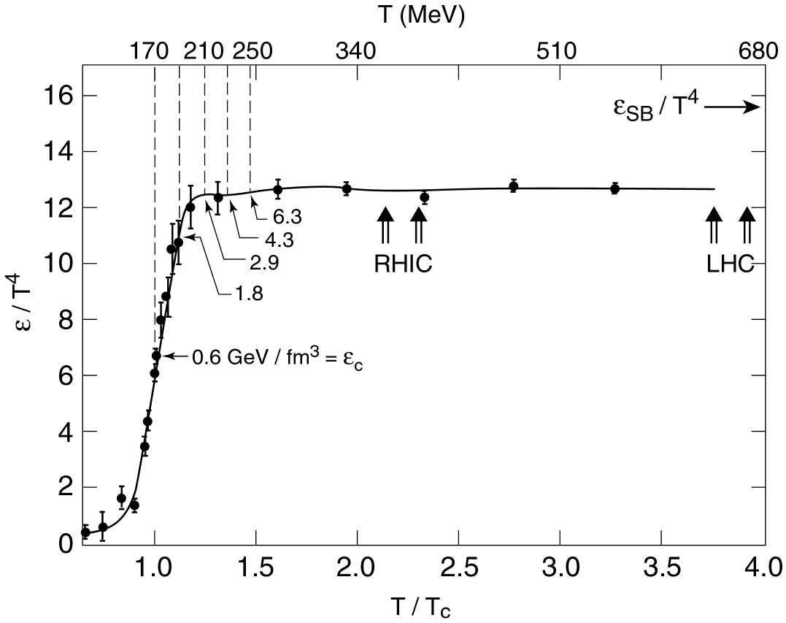
Lattice QCD
rigorous way of doing calculations in non-perturbative regime of QCD
discretization on a space-time lattice
  → ultraviolet (large momentum scale) divergencies can be avoided
zero baryon density, 3 flavours
ε changes rapidly around T_{c}
T_{c} = 170 MeV:
→ ε_{c} = 0.6 GeV/fm³
at T~1.2 T_{c} ε settles at about 80% of the Stefan-Boltzmann value for an ideal gas of q,q g (ε_{SB})
3 flavours; (q-q)=0

Slide 24
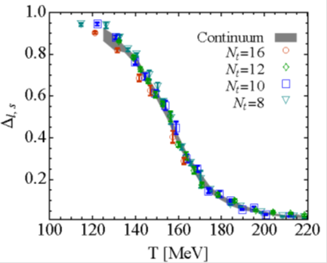
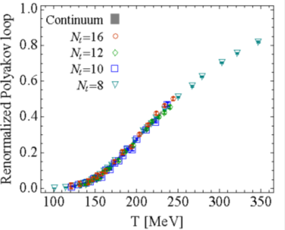
Lattice QCD at high temperature
Order parameters of QCD phase transitions:
  quark – antiquark vacuum condensate
    chiral phase transition in limit m_{q} → 0
  expectation value of Polyakov loop
    deconfinement phase transition in limit m_{q} → ∞

Slide 25
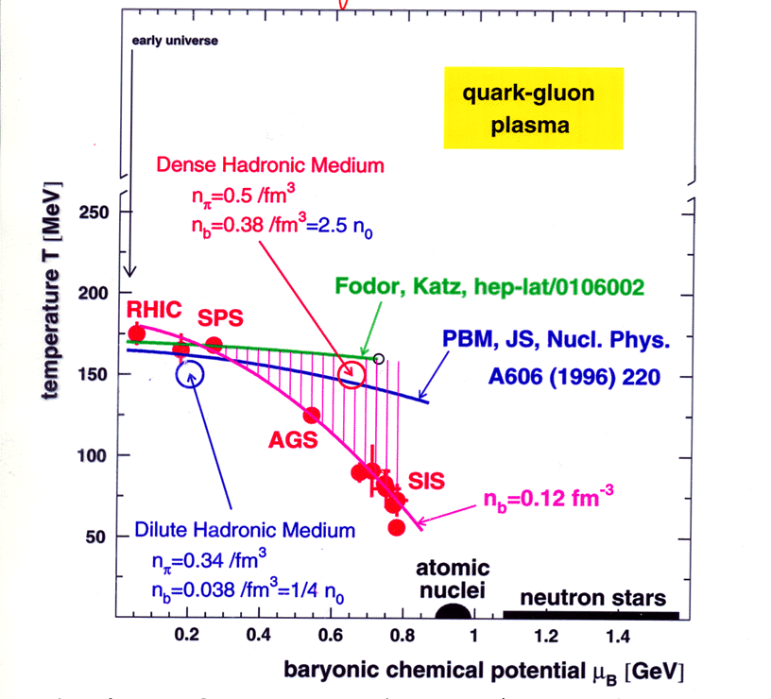
Phase Diagram of QCD

Slide 26
Heavy-Ion collisions

Slide 27
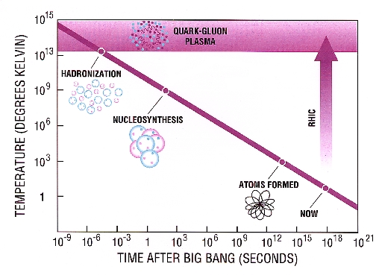
Phase transition in early Universe
10 – 100 μs
SPS LHC

Slide 28
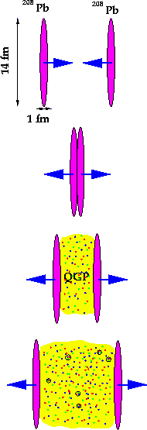
Nucleus-nucleus collisions
How do we test this theory in the lab?
How can we compress/heat matter to such cosmic energy densities?
By colliding two heavy nuclei at ultrarelativistic energies we recreate, for a short time span (about 10⁻²³s, or a few fm/c) the conditions for deconfinement

Slide 29
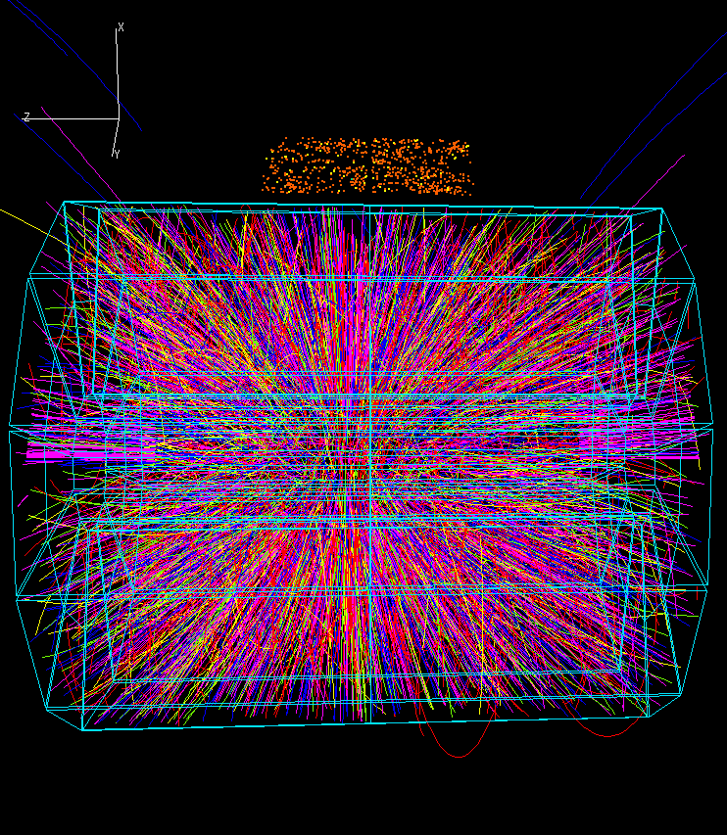
as the system expands and cools down it will undergo a phase transition from QGP to hadrons again, like at the beginning of the life of the Universe: we end up with confined matter again
  QGP lifetime ~ a few fm/c
The properties of the medium must be inferred from the properties of the hadronic final state

Slide 30
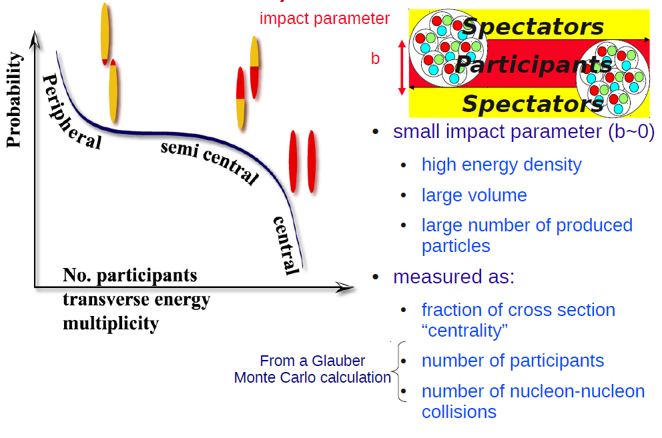
Geometry of AA collision

Slide 31
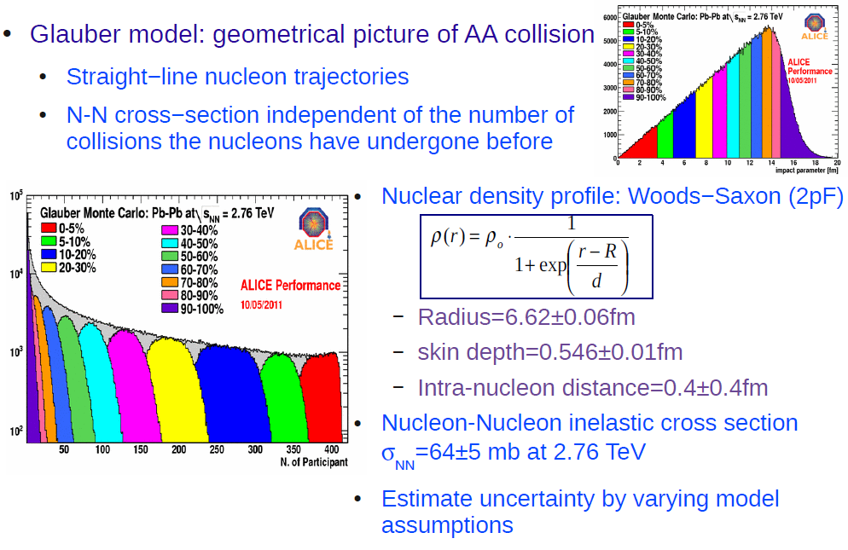
Glauber Monte Carlo

Slide 32
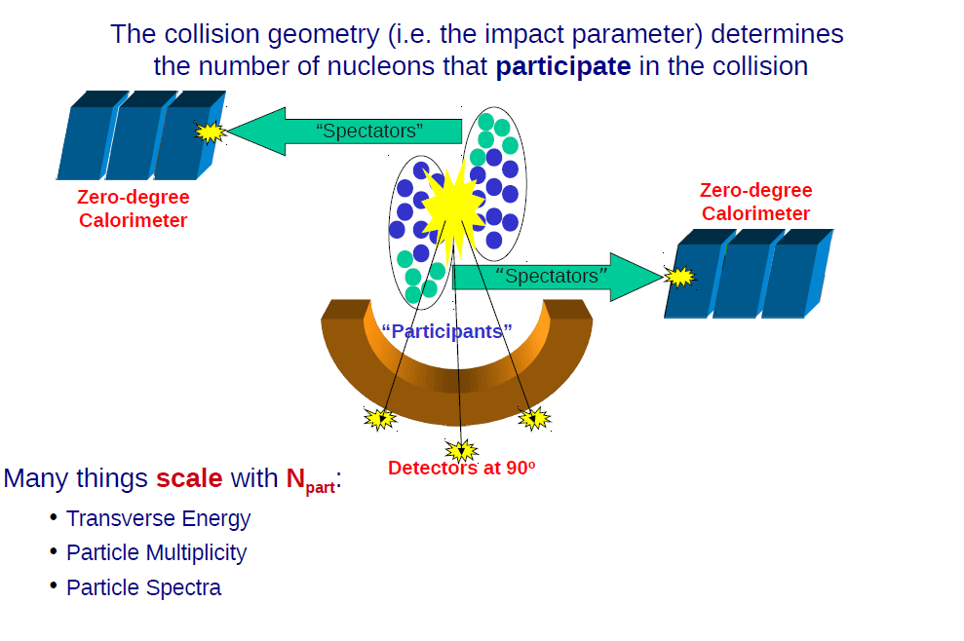
Centrality experimentally

Slide 33
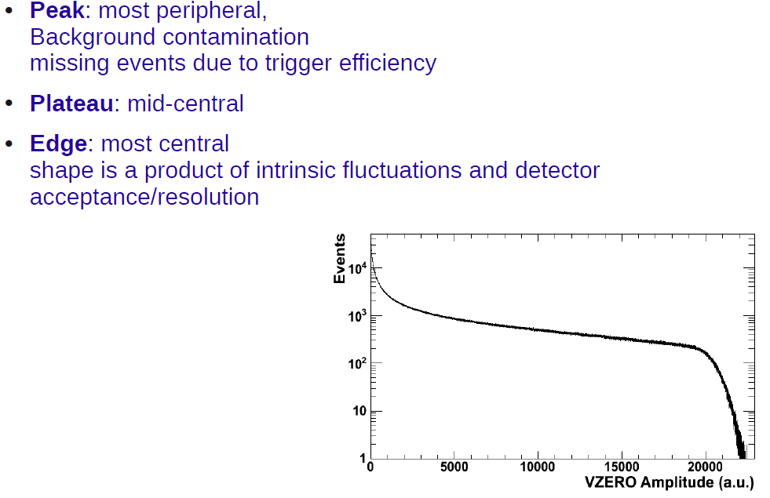
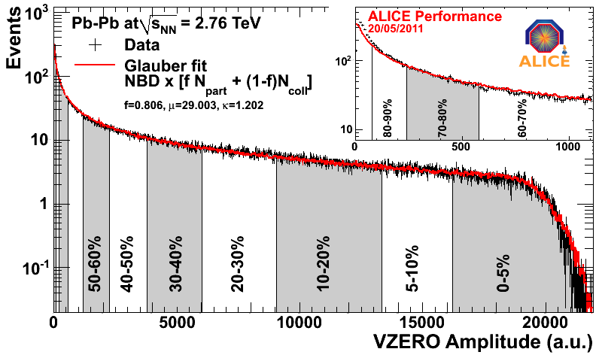
Multiplicity distribution

Slide 34
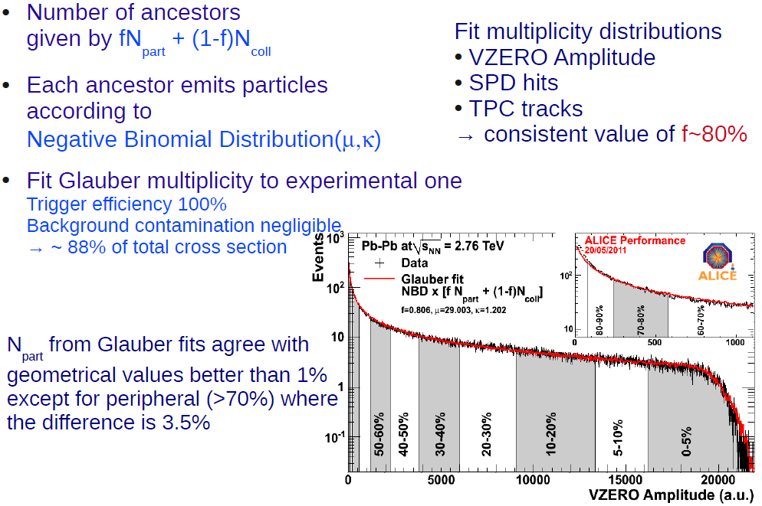
Glauber fit
P(n,m,k) = Γ(n + k) / (Γ(k) n!) · (m/k)^{n} / (1 + m/k)^{n+k}

Slide 35
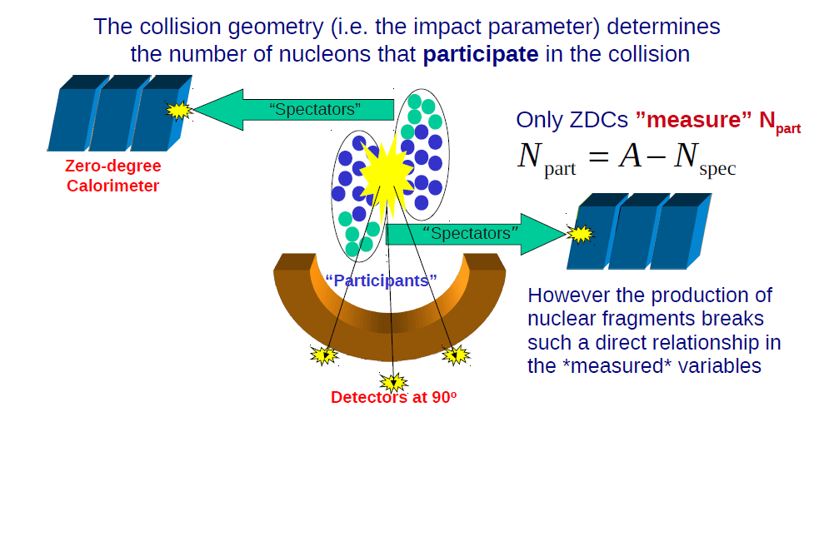
Centrality experimentally

Slide 36
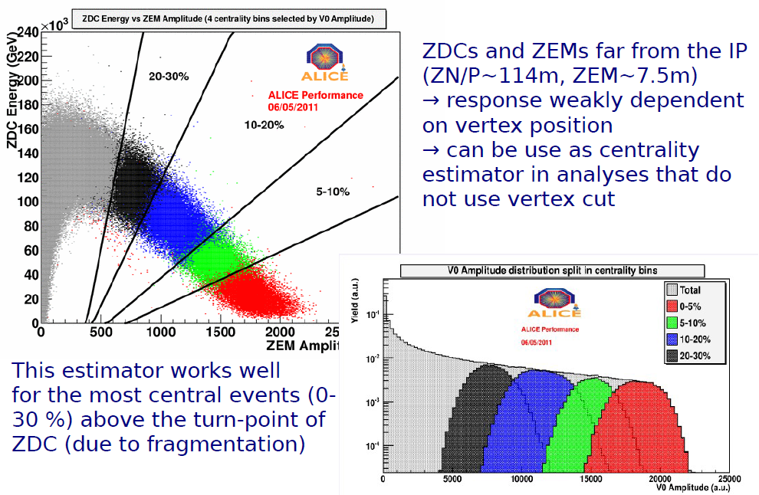
ZDC measurement

Slide 37
Collisions of Heavy Nuclei at SPS and RHIC
Super Proton Synchrotron (SPS) at CERN (Geneva):
  Pb-Pb fixed target, p = 158 A GeV →√ s_{NN} = 17.3 GeV
  1994 - 2003
  9 experiments:
    WA97 (silicon pixel telescope spectrometer: production of strange and multiply strange particles)
    WA98 (photon and hadron spectrometer: photon and hadronn production)
    NA44 (single arm spectrometer: particle spectra, interferometry, particle correlations)
    NA45 (e⁺e⁻ spectrometer: low mass lepton pairs)
    NA49 (large acceptance TPC: particle spectra, strangeness production, interferometry, event-by-event , …)
    NA50 (dimuon spectrometer: high mass lepton pairs, J/ψ production)
    NA52 (focussing spectrometer: strangelet search, particle production)
    NA57 (silicon pixel telescope spectrometer: production of strange and multiply strange particles)
    NA60 (dimuon spectrometer + pixels: dileptons and charm)
    NA61 (large acceptance TPC, continuation of NA49)
Relativistic Heavy Ion Collider (RHIC) at BNL (Long Island)
  Au-Au collider, √ s_{NN} = 200 GeV
  2000 - …
  4 experiments:
    STAR (multi-purpose experiment: focus on hadrons)
    PHENIX (multi-purpose experiment: focus on leptons, photons)
    BRAHMS (two-arm spectrometer: particle spectra, forward rapidity)
    PHOBOS (silicon array: particle spectra)

Slide 38
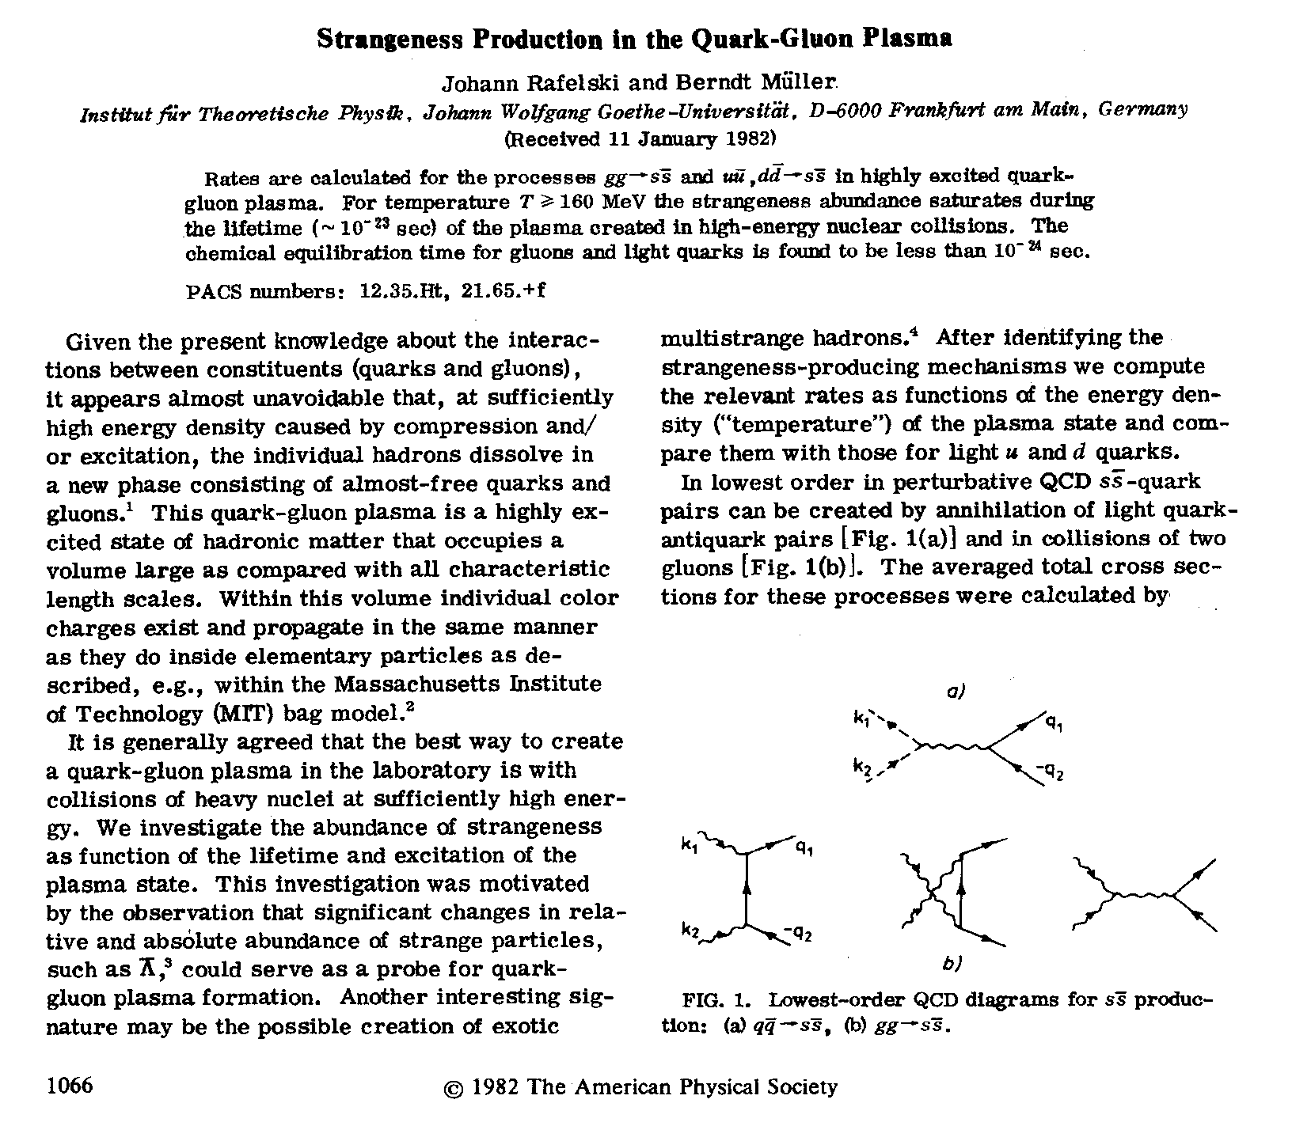
Historic QGP predictions
restoration of chiral symmetry -> increased production of s
  mass of strange quark in QGP expected to go back to current value
    m_{S} ~ 150 MeV ~ Tc
  copious production of ss pairs, mostly by gg fusion
[Rafelski: Phys. Rep. 88 (1982) 331]
[Rafelski-Müller: P. R. Lett. 48 (1982) 1066]
deconfinement → stronger effect
for multi-strange
  can be built recombining s quarks
  strangeness enhancement increasing
  with strangeness content
[Koch, Müller & Rafelski: Phys. Rep. 142 (1986) 167]
K⁺
d
d
s
u
u
u
u
d
Ξ⁻
d
u
π⁻
d
u
d
d
d
u
s
s
u
s
d
d
d
π⁺
u
d
d
d
d
u
u
s
d
u
u
u
u
d
s
s
u
u
p
s
u
d
Ω⁺
d
s
d
s
s
u
u
d
u
u
s
s
u
s
u
d
d
u
s
s
d
Λ

Slide 39
Strangeness enhancement
Strangeness enhancement - among the first signatures proposed for QGP observation
  J. Rafelski, R. Hagedorn and B. Müller (‘81 - ‘84)
At normal conditions strange quark production is suppressed by
  γ_{s} ≈ exp (√m_{s}²+T²/T) / exp (√m_{q}²+T²/T) ,
  for m_{s} = 500 MeV, m_{q} = 350 MeV and T = 150 MeV we obtain γ_{s} ≈ 0.4
In QGP, after chiral symmetry restoration
  for m_{s} = 150 MeV, m_{q} = 0 MeV (and T = 150 MeV) we obtain γ_{s} ≈ 0.8

Slide 40
Strangeness enhancement
Chiral symmetry restoration - enhancement factor for strange quarks E_{s} ≈ 2
In baryon rich environment - further enhancement
  E_{S} ∝ exp (μ_{q}/T)
  which gives (μ_{q} ≈ 60 MeV at SPS)
  E_{s} ≈ 2.5 - 3
  (very rough estimate)
Σ: enhancement in QGP due to gg → ss
  s-quark mass will eventually drop to its bare value
  in high baryon density additional production of new uu or dd pairs will be suppressed due to Pauli blocking

Slide 41
Strangeness enhancement
This will lead to
  increase of over-all strangeness production by factor
  E_{s} ≈ 2.5 - 3
  even larger increase in production of multi-strange baryons (Ξ and Ω) and especially anti-baryons
  Ξ: E_{s}² ≈ 6 - 9
  Ω: E_{s}³ ≈ 15 - 25
Σ: In QGP scenario strange particles (including multi-strange baryons and anti-baryons) will be driven very quickly near to chemical equilibrium due to abundant production of strange quarks at the early stage

Slide 42
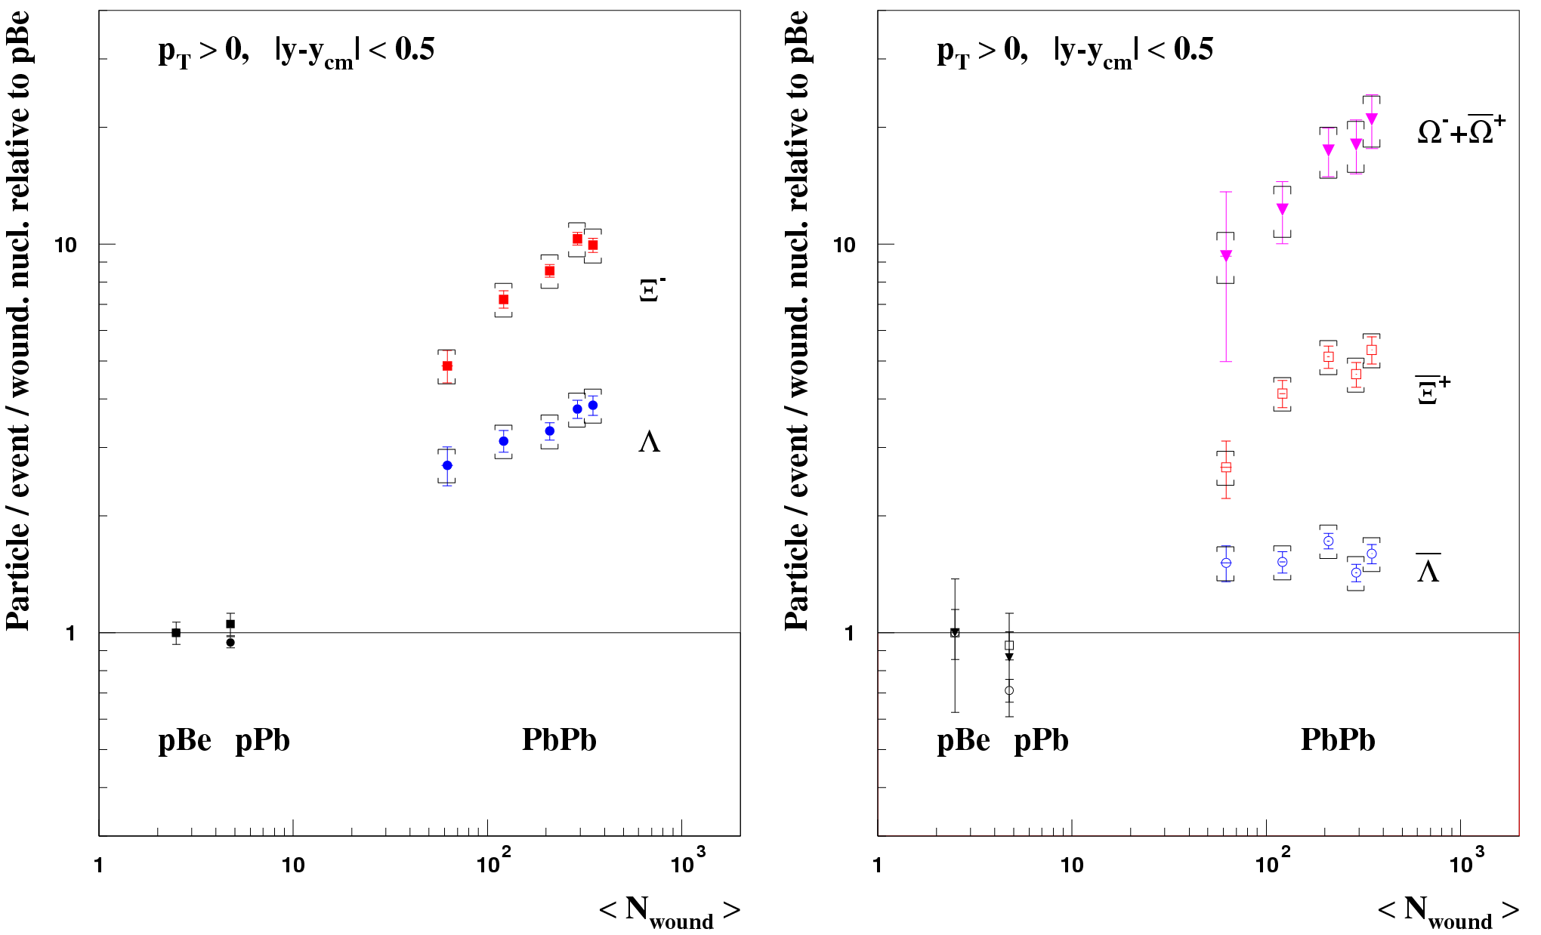
Strangeness enhancement at the SPS
Enhancement in Pb-Pb relative to p-Be (WA97/NA57)
Enhancement is larger for particles of higher strangeness content (QGP prediction!)
up to a factor ~ 20 for Ω
So far, no hadronic model has reproduced these observations (try harder!)
Actually, the most reliable hadronic models predicted an opposite behaviour of enhancement vs strangeness

Slide 43
Debye screening
In the state with high density of colour charges
  attractive potential between two charges screened
  confinement forces irrelevant
When cc pair produced in gg->cc (cannot be J/ψ 1⁻⁻)
  first (cc)₈ which has ~9/4 times the normal J/ψ cross-section (J/ψN -- 2 - 3 mb, (cc)₈ -- 6 - 7 mb)
  (cc)₈ do not know if it will became J/ψ , χ_{c} or J/ψ’
If there is around deconfined phase (QGP) then the largest is melted first (ψ’ out)
  then goes χ_{c} (about 40% of J/ψ are produced via χ_{c} -> J/ψ )
  only after goes J/ψ itself, at T_{d} = 1.3 T_{c}
Energy density ~ T⁴, therefore ε_{d} = 2.8 ε_{c}

Slide 44
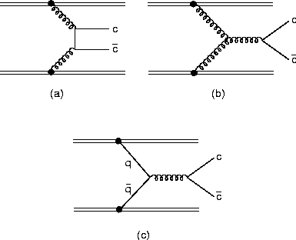
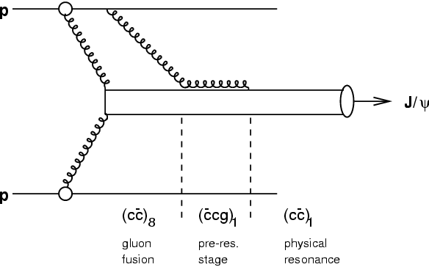
J/ψ production
Charm quark production
J/ψ production

Slide 45
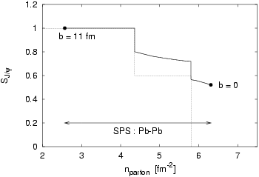
Debye screening
J/ψ survival probability

Slide 46
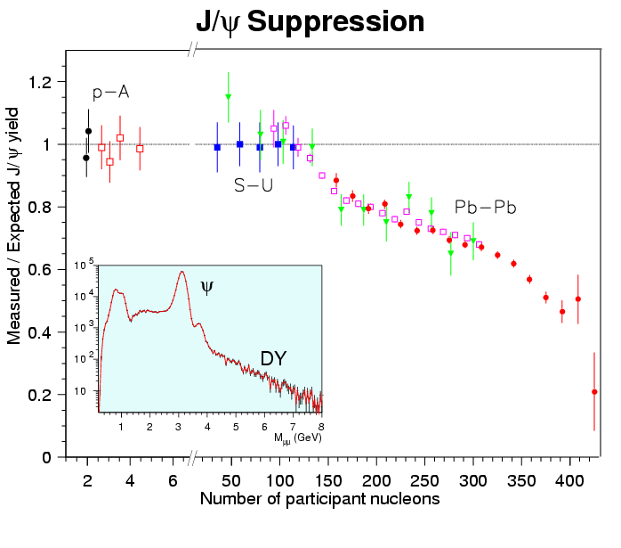
J/ψ suppression
NA38/50
  CERN

Slide 47
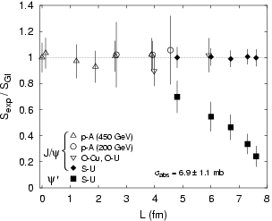
ψ‘ suppression
NA38 CERN SPS

Slide 48
Nucleus-Nucleus collisions at the LHC!
 |  | SPS | RHIC | LHC
√s_{NN} | [GeV] | 17.3 | 200 | 5500
dN_{ch}/dy |  | 450 | 800 | 1600
ε | [GeV/fm³] | 3 | 5.5 | ~ 10
large ε → deeper in deconfinement region
  → closer to “ideal” behaviour?
large cross section for “hard probes” !
  a new set of tools to probe the medium properties
  e.g.:
Pb
Pb
b
b
b
b

Slide 49
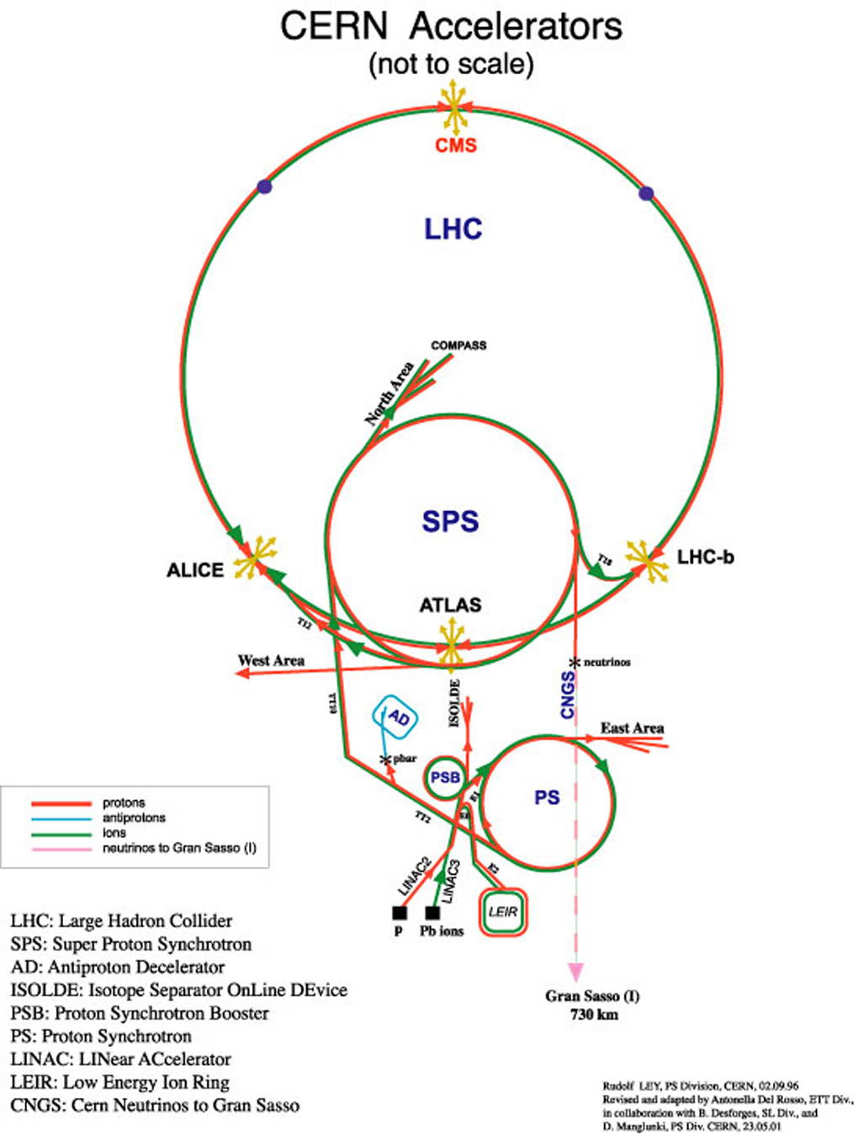
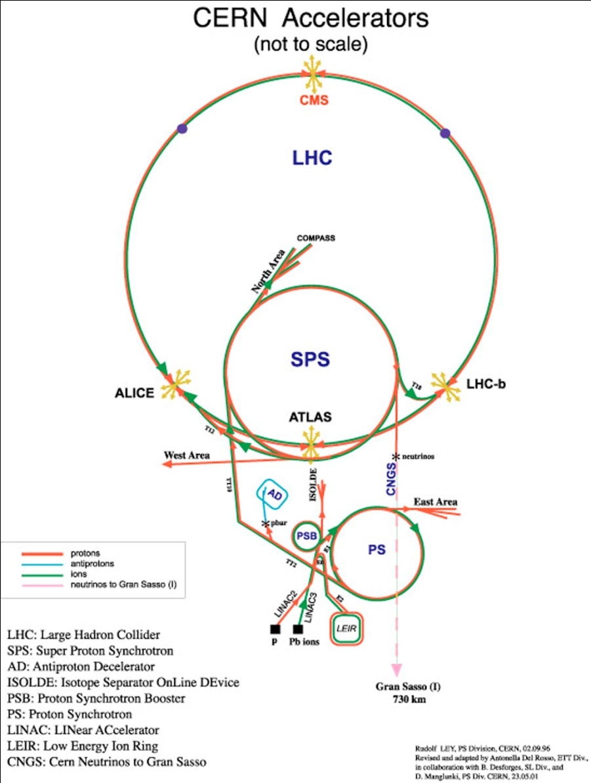
Heavy Ions at CERN
Acceleration of Pb ions:
  ECR source: Pb²⁷⁺ (80 μA)
  RFQ: Pb²⁷⁺ to 250 A keV
  Linac3: Pb²⁷⁺ to 4.2 A MeV
  Stripper: Pb⁵³⁺
  PS Booster: Pb⁵³⁺ to 95 A MeV
  PS: Pb⁵³⁺ to 4.25 A GeV
  Stripper: Pb⁸²⁺ (full ionisation)
  SPS: Pb⁸²⁺ to 158 A GeV
  LHC: Pb⁸²⁺ to 2.76 A TeV)

Slide 50
LHC as a HI accelerator
Fully ionised ²⁰⁸Pb nucleus accelerated in LHC
(configuration magnetically identical to that for pp), e.g. (2011 numbers):
the relevant figure is √s per nucleon-nucleon collision: √s_{NN}
… of course, real life is more complicated…
  ion collimation
  sensitivity of LHC instrumentation
  injection chain
  …

Slide 51
LHC Energy
For A-A collisions:
E_{cms} = 5500 A GeV
E_{lab} = E_{cms}² / (2A m_{N}) = 1.61 × 10⁷ A GeV
for lead ions E_{lab Pb-Pb} = 3.35 × 10⁹ GeV = 3.35 × 10¹² MeV
Further we need Harald Fritzsch Identity (definition of Anglo-Saxon pound £_{AS})
2 × 10⁻³⁰ £_{AS} = m_{e} (= 0.511 MeV)
and some other definitions (gravitational acceleration g,
g = 1 in/tr² (1 s = 19.65 tr, trice)
(speed of light c) c = 6 × 10⁸ in/tr
m_{e}c² = 72 × 10⁻¹⁴ £_{AS} in (= 0.511 MeV)
1 MeV = 1.41 × 10⁻¹² £_{AS} in
Finally
E_{lab Pb-Pb} = 1 £_{AS} × 4.7’’ (= 0.45 kg × 12 cm)

Slide 52
LHC Energy (cont.)
And for pp collisions:
E_{lab pp(14TeV)} = 0.15 £_{AS} in ≈ ¼ £_{AS} × ½’’ = ⅛ £_{AS} × 1’’ = …
For those who don’t like to be seated on a lead ion (and to fly inside LHC vacuum pipe)
E_{cms Pb-Pb} = 5500 A GeV = 1.14 × 10⁹ MeV
(HFI, etc.)
E_{cms Pb-Pb} = 10⁻³ £_{AS} × 1.6’’ (= 0.45 g × 4 cm)
Still, macroscopic energy !!! (one can actually hear it)
But the size of ions
is by factor more than 10⁻¹² smaller than a coin

Slide 53
Luminosity limitations
Bound-Free Pair Production (BFPP):
with subsequent loss of the ²⁰⁸Pb⁸¹⁺
  creates a small beam of ²⁰⁸Pb⁸¹⁺, with an intensity ∝ Luminosity
  impinging on a superconducting dipole (that you don’t want to quench…)
  cross section ∝ Z⁷ (!) ~ 280 b for PbPb at LHC (hadronic cross section ~ 8 b)
Collimation losses
  collimation for ions (which can break up into fragments) is harder than for protons
  limitation on the total intensity
luminosity limited to ~ 10²⁷ cm⁻²s⁻¹

Slide 54
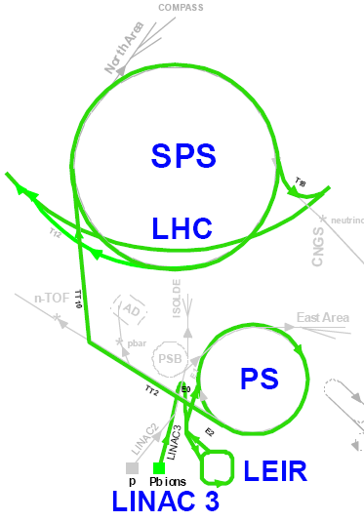
Pb nuclei in the LHC
For 2011 Pb-Pb run:
  ~ 1.1 10⁸ ions/bunch
  358 bunches (200 ns basic spacing)
  β* = 1 m
  L ~ 5 10²⁶ cm⁻²s⁻¹
  ~ 4000 Hz interaction rate
one dedicated AA experiment: ALICE
and AA capability in ATLAS and CMS
LHCb joined pA programme

Slide 55
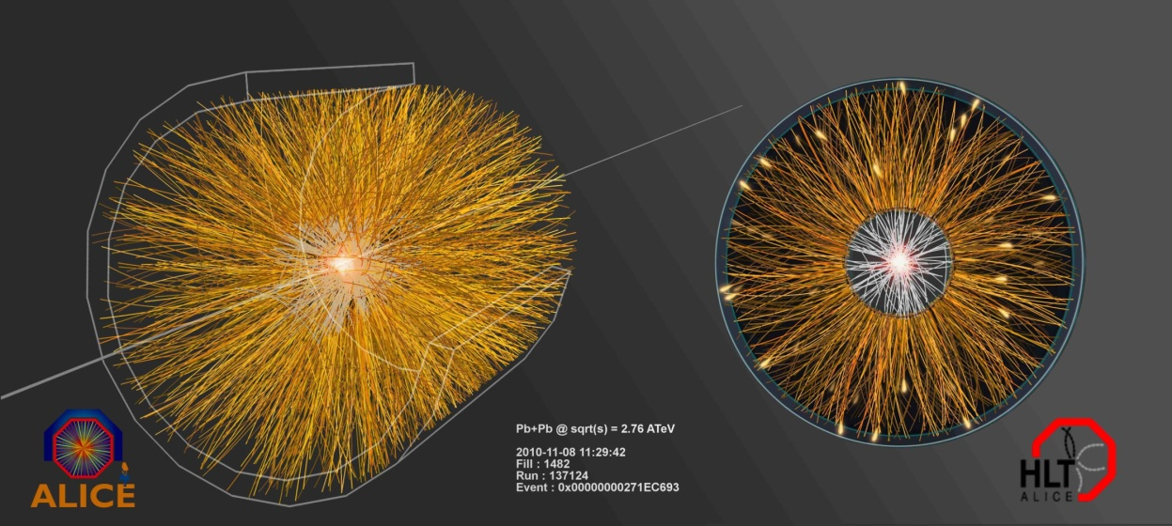
A Pb-Pb collision at the LHC

Slide 56
Bulk observables: multiplicity and volume

Slide 57
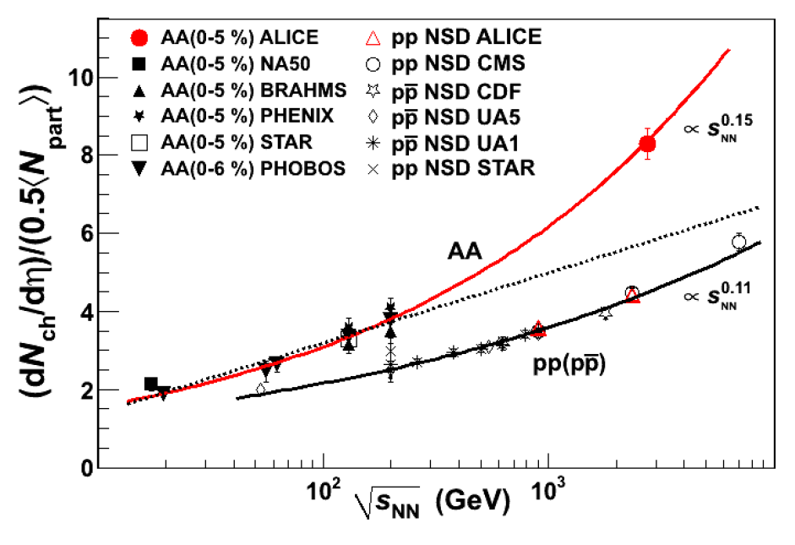
Particle multiplicity
most central collisions at LHC: ~ 1600 charged particles per unit of η
ALICE: PRL105 (2010) 252301
log extrapolation:
  OK at lower energies
  finally fails at the LHC
√s_{NN}=2.76 TeV Pb+Pb, 0-5% central, |η|<0.5
dNch/dη / (<Npart>/2) = 8.3 ± 0.4 (sys.)

Slide 58
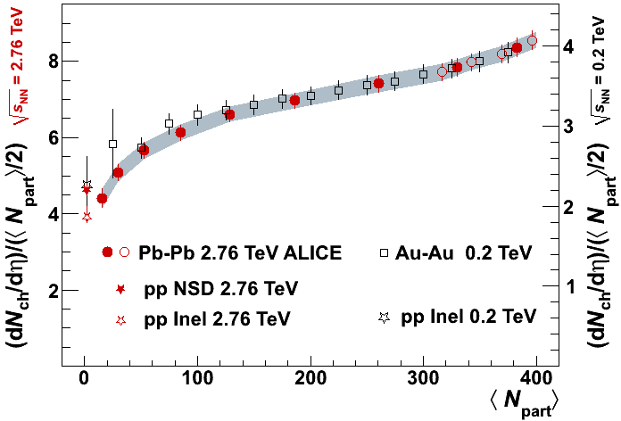
Particle multiplicity
Centrality dependence of pseudorapidity density: shape very similar to that at RHIC; per <Npart>/2 factor ~ 2.1 higher
ALICE: PRL105 (2010) 252301

Slide 59
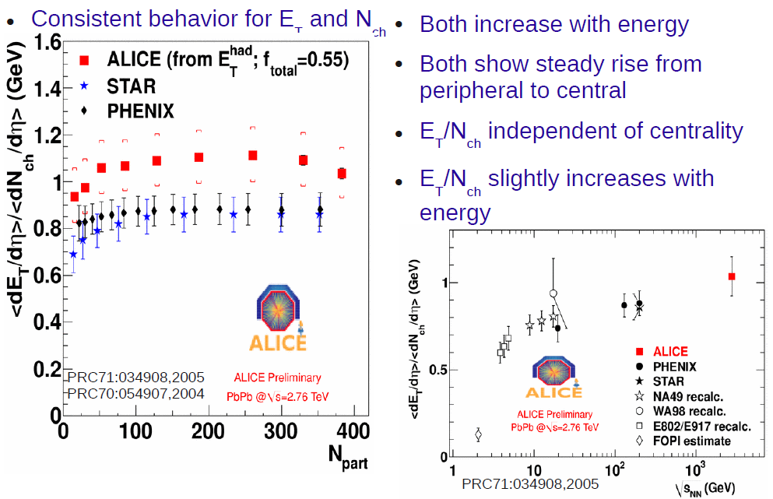
Transverse energy

Slide 60
Bjorken’s formula
To evaluate the energy density reached in the collision:
for central collisions at LHC:
Initial time t₀ normally taken to be ~ 1 fm/c
  i.e. equal to the “formation time”: the time it takes for the energy initially stored in the field to materialize into particles
Transverse dimension:
More than enough
for deconfinement!
Factor ~3 higher
than on RHIC
→

Slide 61
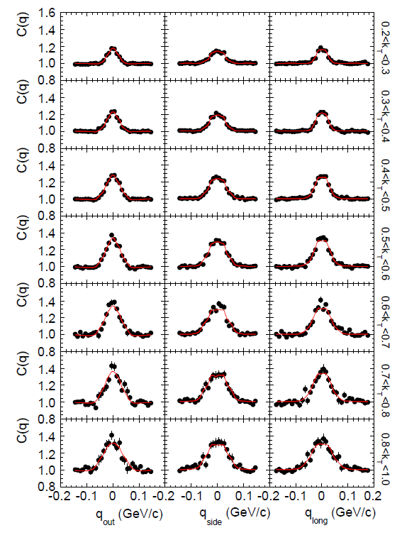
Hanbury Brown - Twiss interferometry
quantum phenomenon: enhancement of correlation function for identical bosons
from Heisenberg’s uncertainty principle:
  Δp · Δx ~ ħ (Planck’s constant)
  (width of enhancement) · (source size) ~ ħ
  extract source size from correlation function
first used with photons in the 1950s by astronomers Hanbury Brown and Twiss
  measured size of star Sirius by aiming at it two photomultipliers separated by a few metres
e.g.: three components of correlation function C(q = momentum difference) for pairs of pions for eight intervals of pair transverse momentum (k_{T})

Slide 62
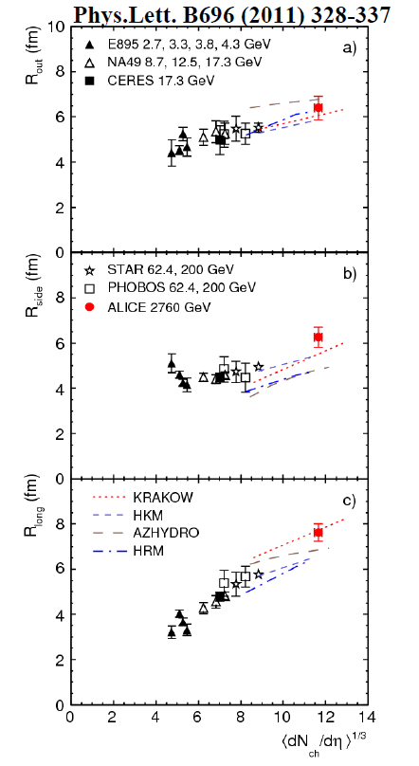
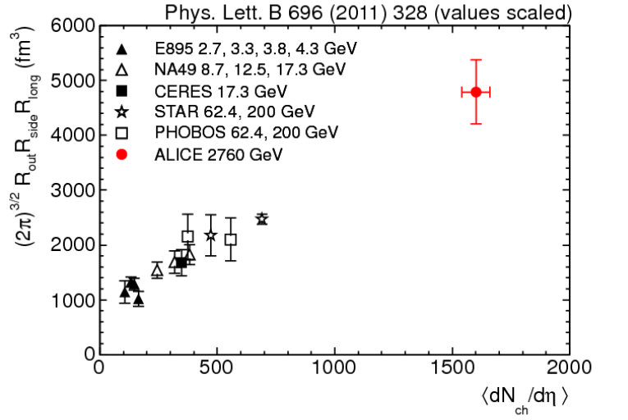
HBT interferometry
from RHIC to LHC:
increase of size in the 3 dimensions
  out, long, and (finally!) side
“homogeneity” volume ~ x 2
for comparison: R(Pb) ~ 7 fm → V ~ 1500 fm³
substantial expansion!
R_{out}
R_{side}
R_{long}

Slide 63
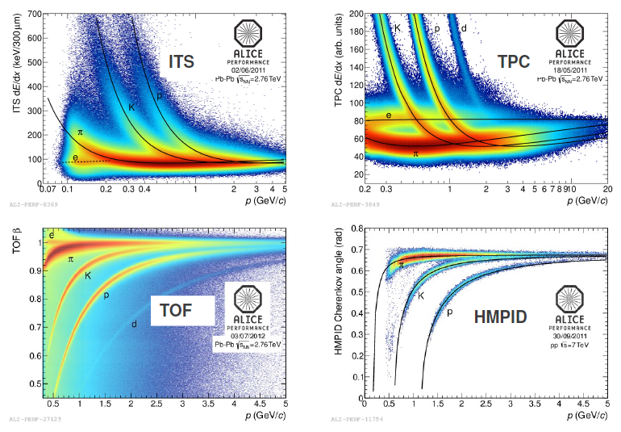
Particle identification

Slide 64
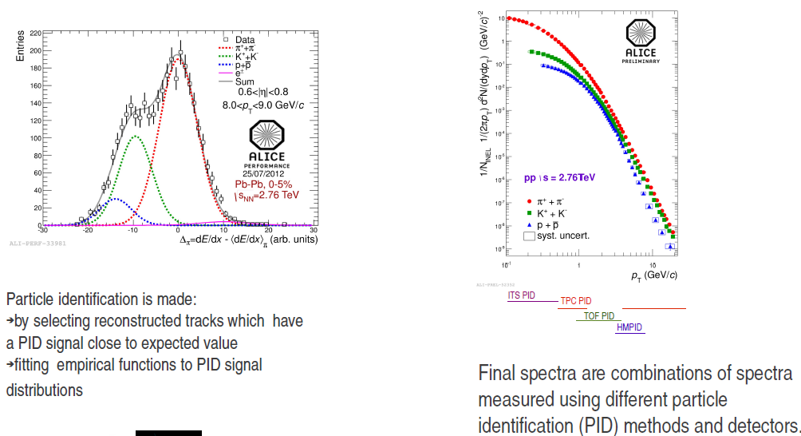
Particle identification methods

Slide 65
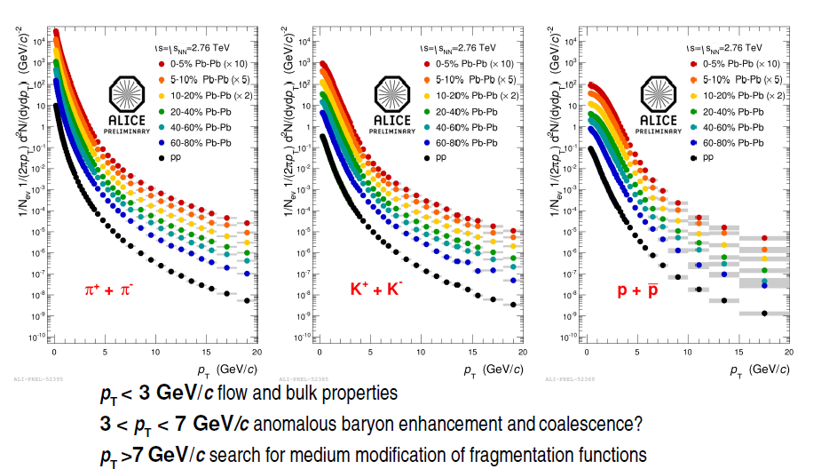
Transverse momentum spectra

Slide 66
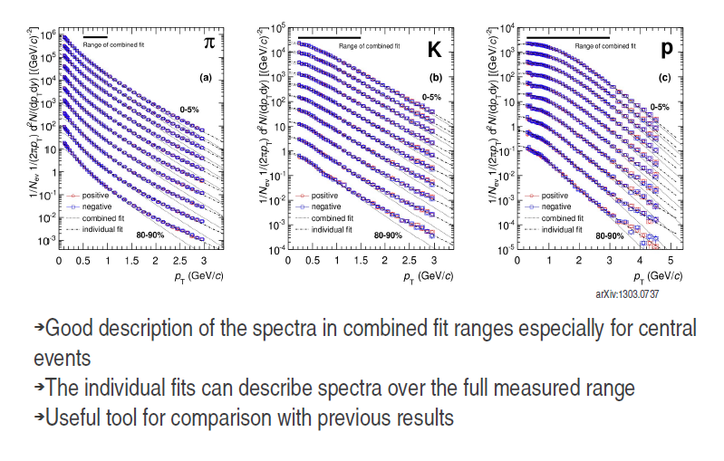
Blast wave fits

Slide 67
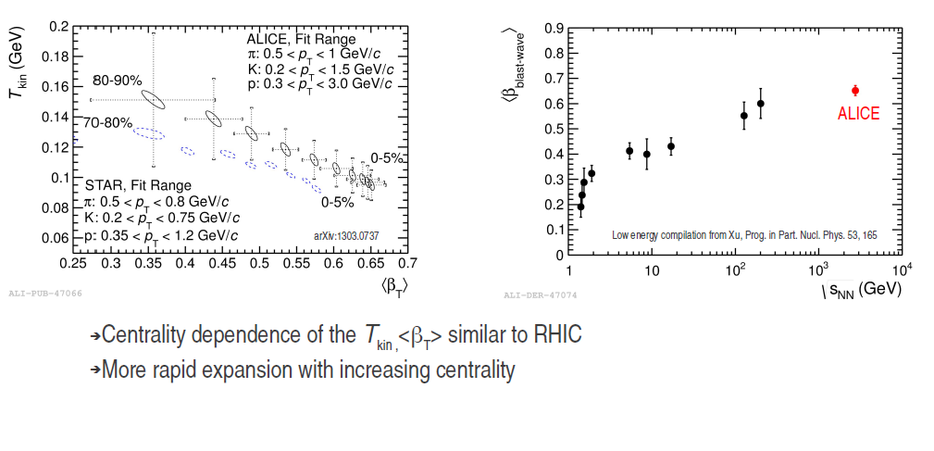
Radial flow

Slide 68
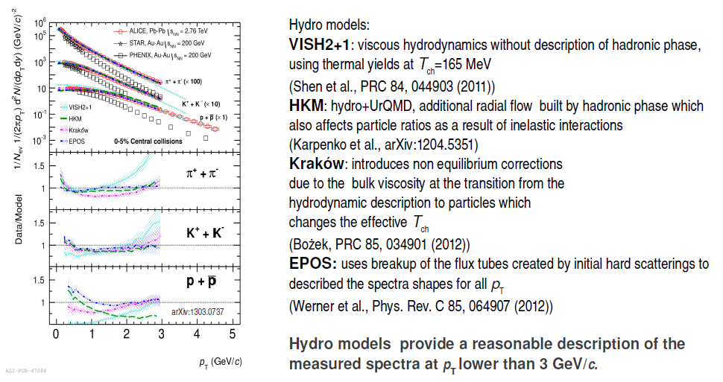
Hydrodynamical models
Pb-Pb central collisions 0 – 5 % centrality

Slide 69
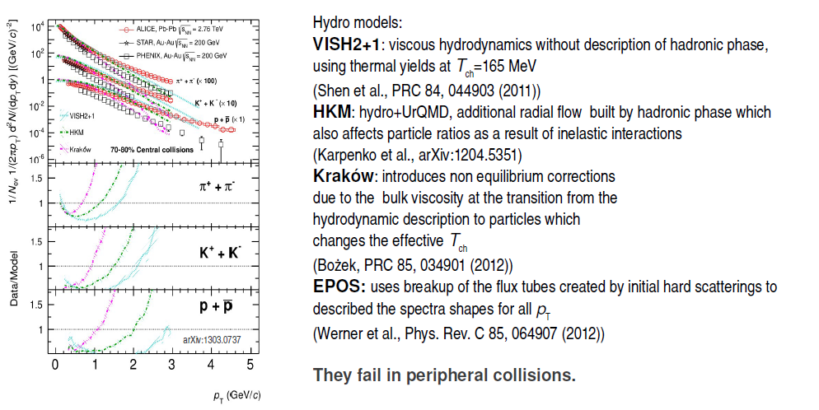
Hydrodynamical models
Pb-Pb peripheral collisions 70 – 80 % centrality

Slide 70
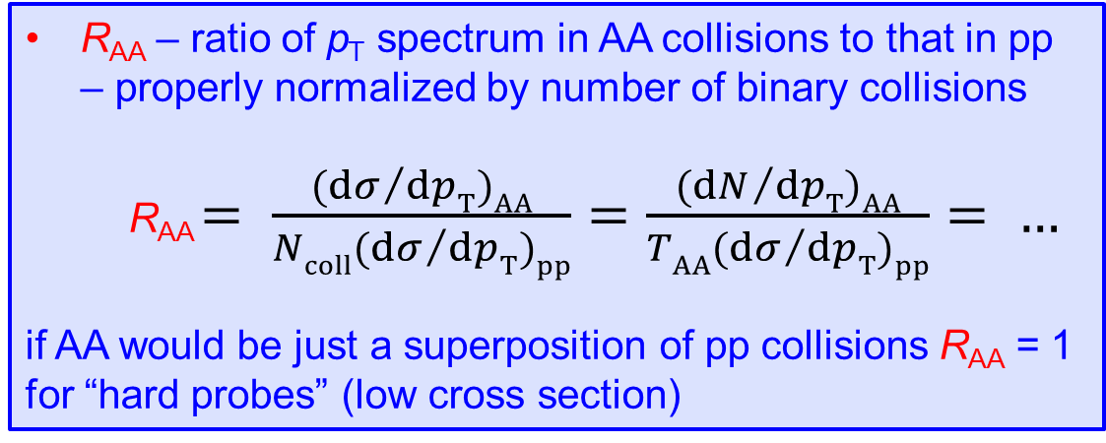
R_{AA} – definition
R_{AA} – ratio of p_{T} spectrum in AA collisions to that in pp – properly normalized by number of binary collisions
  R_{AA} $= \frac{{(dσ}/{dpT)AA}}{{Ncoll(dσ}/{dpT)pp}}=\frac{{(dN}/{dpT)AA}}{{TAA(dσ}/{dpT)pp}}= …$
if AA would be just a superposition of pp collisions R_{AA} = 1
for “hard probes” (low cross section)

Slide 71
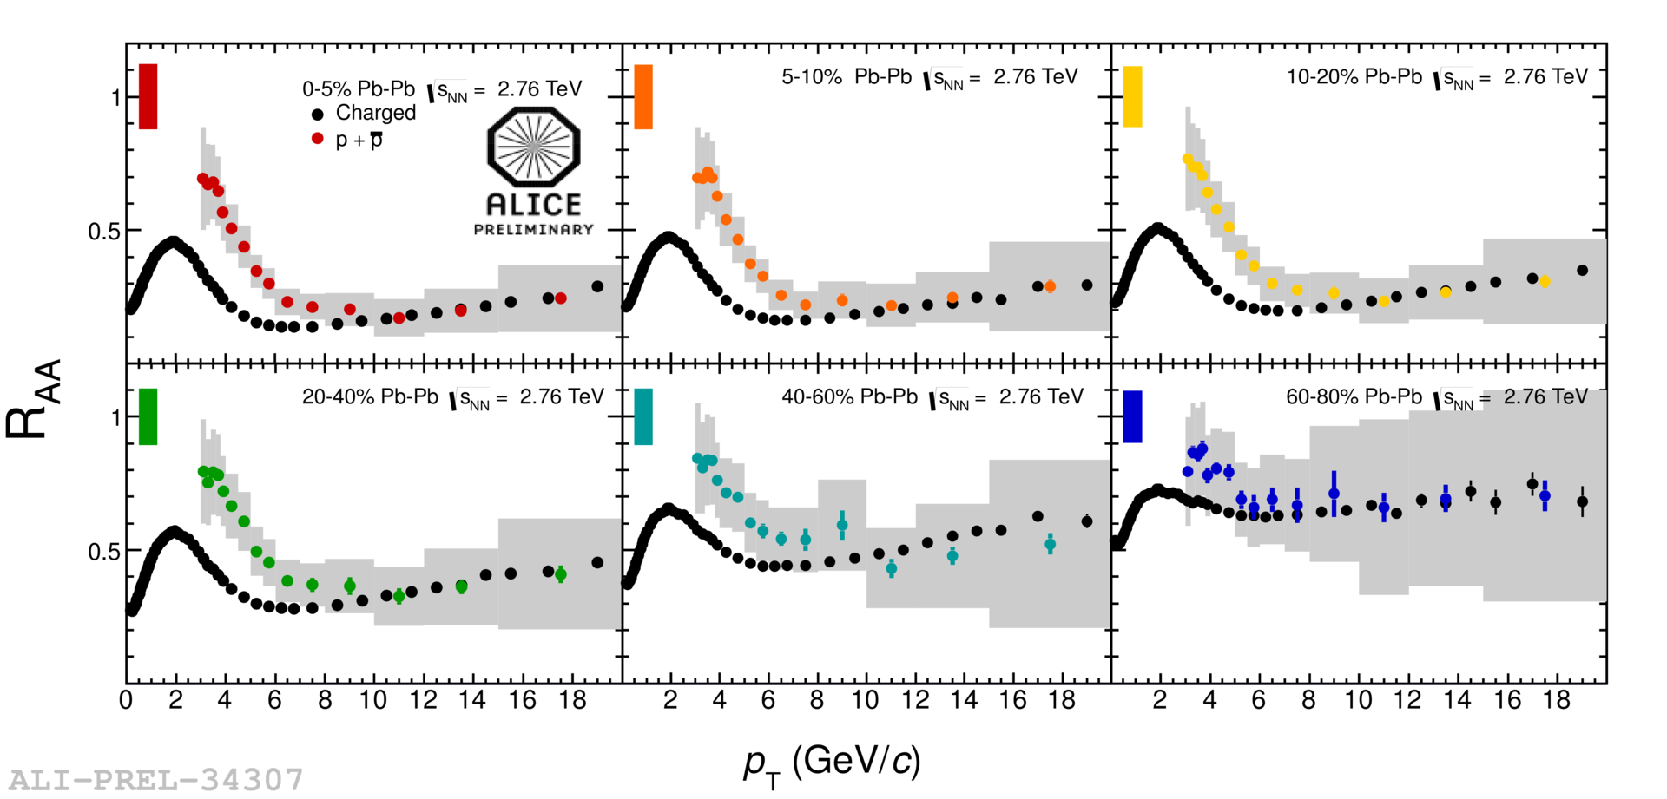
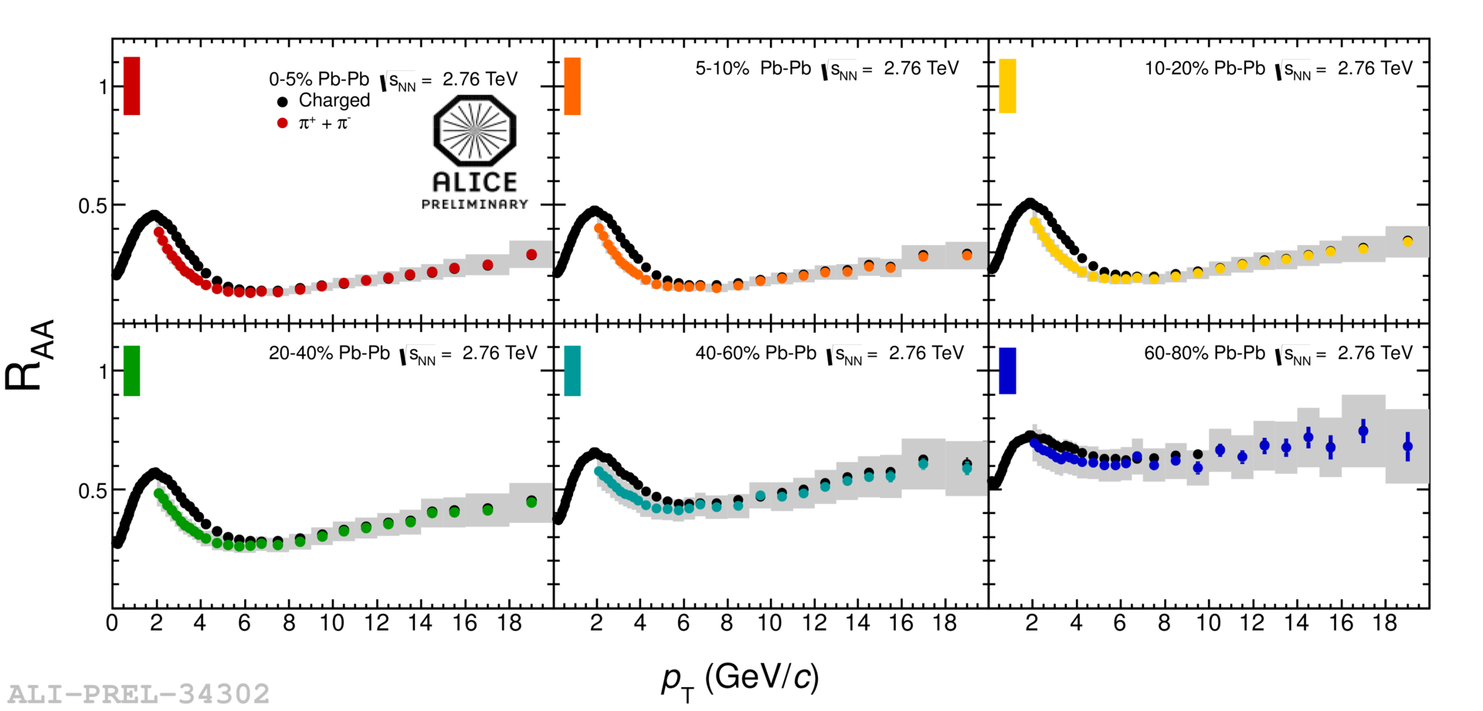
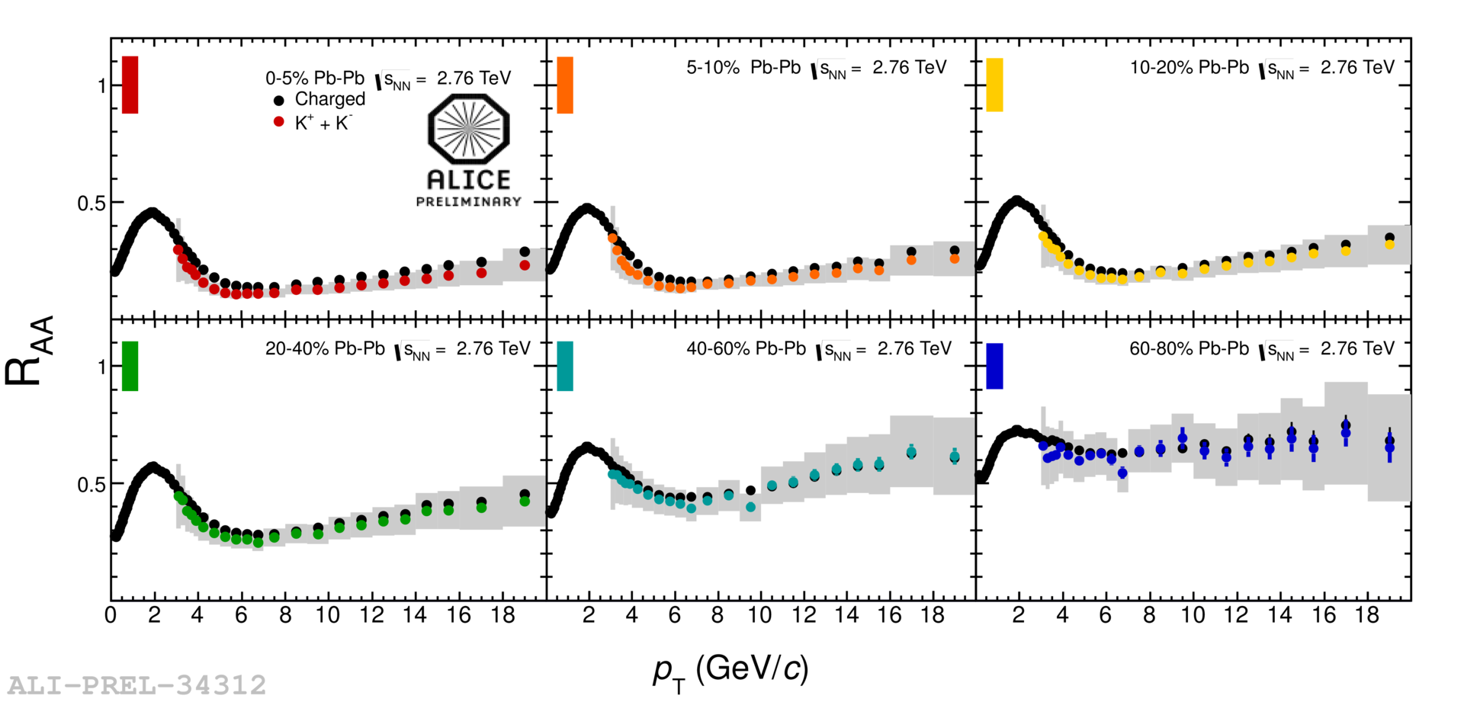
Identified particles at intermediate p_{T}
● charged particles ●●●●●● different centralities for identified particles
K⁺ + K⁻
p + p
π⁺ + π⁻
0–5%
5–10%
10–20%
40–60%
60–80%
20–40%
For p_{T} below ~ 7 GeV/c: R_{AA}(π) < R_{AA}(h±), R_{AA}(K) ≈ R_{AA}(h±)
For p_{T} below ~ 7 GeV/c: R_{AA}(π) < R_{AA}(h±), R_{AA}(K) ≈ R_{AA}(h±), R_{AA}(p) > R_{AA}(h±)
For p_{T} below ~ 7 GeV/c: R_{AA}(π) < R_{AA}(h±)
At higher p_{T}: R_{AA} are compatible

Slide 72

Strange particle reconstruction

Slide 73

Strange particle reconstruction

Slide 74

Strange particle selection

Slide 75

Strangeness enhancement

Slide 76

Strangeness to pion

Slide 77

Strangeness spectra K⁰_{s} Λ

Slide 78

Strangeness spectra Ξ

Slide 79

Strangeness spectra Ξ Ω

Slide 80
Hadronic resonances in Pb-Pb
A. Knospe
Resonances:
  production/abundance sensitive to temperature and lifetime of fireball
    time between chemical to kinetic freeze-out
  Mass and width – sensitivity to chiral symmetry restoration
    No modifications seen in the data
<pT> at LHC larger than at RHIC
– consistent with stronger radial flow
Notes:
Hadronic Phase: Temperature and Lifetime of fireball
– Resonance formation at hadronization, through regeneration – Re-scattering prevents resonance reconstruction
• Most important at low pT (< 2 GeV/c)
– Statistical models, UrQMD predict resonance/stable ratios
• Given chemical freeze-out temperature and time between chemical and thermal freeze-out (Δt)
• Chiral Symmetry Restoration
– Resonances may decay when chiral symmetry was (partially) restored
– Mass shift and width broadening
• Near Tc ρ lifetime may increase by factor of ~5*

Slide 81
Hadronic resonances in Pb-Pb
A. Knospe
Ratios:
  K*⁰/K– decreases for central collisions – signature for re-scattering in central collisions
  φ/K independent of energy and system from RHIC to LHC
    Pb–Pb: consistent with Grand Canonical thermal model (Andronic et al.)
Notes:
Hadronic Phase: Temperature and Lifetime of fireball
– Resonance formation at hadronization, through regeneration – Re-scattering prevents resonance reconstruction
• Most important at low pT (< 2 GeV/c)
– Statistical models, UrQMD predict resonance/stable ratios
• Given chemical freeze-out temperature and time between chemical and thermal freeze-out (Δt)
• Chiral Symmetry Restoration
– Resonances may decay when chiral symmetry was (partially) restored
– Mass shift and width broadening
• Near Tc ρ lifetime may increase by factor of ~5*

Slide 82

Strangeness R_{AA}

Slide 83


Baryon-to-meson ratio: p/π
● proton–proton ●●●●●● Pb–Pb different centralities
0–5%
5–10%
10–20%
recombination
model
20–40%
40–60%
60–80%
p/π ratio at p_{T} ≈ 3 GeV/c in 0–5% central Pb–Pb collisions factor ~ 3 higher than in pp
at p_{T} above ~ 10 GeV/c back to the “normal” pp value
recombination – radial flow ?
R.J.Fries et al., PRL 90 202303; PR C68 044902

Slide 84

Baryon-to-meson ratio: Λ/K

Slide 85

Baryon-to-meson ratio: Λ/K

Slide 86


PID in jet structures
PYTHIA pp
Near-side peak (after bulk subtraction): p/π ratio compatible with that of pp (PYTHIA)
Bulk region: p/π ratio strongly enhanced – compatible with overall baryon enhancement
Jet particle ratios not modified in medium? Could this still be surface bias?

Slide 87

Pion/Kaon/Proton in Pb-Pb
Radial flow (mesons – protons – mass dependence)
Radial flow (pions – protons – mass dependence)
Baryon/meson anomaly
- Radial flow / recombination?
Jet quenching / modifications of jet
fragmentation?
Baryon/meson anomaly
- Radial flow / recombination?

Slide 88

What about p-A ?

Slide 89
Intermezzo: p-Pb multiplicity
Forward rapidity
Central rapidity
Central rapidity
Much broader correlation between different multiplictiy (event class) estimators
expect different sensitivity (bias) to event geometry (Glauber! – N_{coll} scaling)

Slide 90

π K p spectra

Slide 91

and K⁰_{s} Λ spectra

Slide 92

p-Pb Blast-wave analysis

Slide 93
Blast-wave in pp, pPb and Pb-Pb
Proton-proton
p-Pb
Pb-Pb
Blast-wave fits: similar T vs Beta trend in p-Pb and Pb-Pb;
  however, also in pp collisions
Fits (spectra) sensitive not only to a collective behaviour (radial flow) but also to other sources of correlations? -> pp, pPb cases (Colour Reconnections ?)
Notes:
Add a figure with pp Pythia simulation and Bwave fits ? – depending on the tune etc…
simultaneous fit of all particles with 3 parameters:
<βT> radial flow
Tfo freeze-out temperature
n velocity profile
● global fit performed in the following pT ranges:
π 0.5 – 1.0 GeV/c
K 0.3 – 1.3 GeV/c
p 0.5 – 2.0 GeV/c

Slide 94

Comparison with models

Slide 95

Global event properties: mean pT vs multiplicity

Slide 96

Global event properties: mean pT vs multiplicity

Slide 97

<pT> of identified particles vs multiplicity

Slide 98

Baryon-to-meson ratio in p-Pb

Slide 99

Statistical hadronization model

Slide 100

Thermal fit to all ALICE data

Slide 101

Thermal fit excluding protons

Slide 102
Thermal fits
Global fit: freeze-out T of 152/156 MeV, (predicted ~160 MeV) – not right for multi-strange
w/o protons – better fit is at 164 MeV, and works well for Ξ, Ω
=> Unique chemical freeze-out T does not describe p, Λ, Ξ, Ω
Ramona Lea

Slide 103
Possible explanations
There was already this discrepancy at RHIC, but was overlooked due to
misinterpretation of feed-down corrections
At high hadron density, re-interactions after freeze-out are important,
especially baryon–antibaryon annihilations, this will affect mostly protons
Introduce non-equilibrium statistical hadronization, quark population of
phase space is frozen at phase transition and may differ from thermal
equilibrium, two more parameters γ_{q} and γ_{s} needed
In statistical hadronization models, the resonance spectrum is accounted
for only up to ~ 2 GeV, higher resonance would add mostly pions, thus
effectively decreasing the model prediction for p/π (buy also for strange
baryons)
The freeze-out temperature may be different for different flavours, some
evidence from lattice QCD

Slide 104

Thermal non-equilibrium fit
M.Petran
J.Rafelski

Slide 105
Azimuthal anisotropies

Slide 106



v_{n} – definition
v_{n} – Fourier coefficients of particle distributions in azimuthal angle φ with respect to n-th reaction plane
  $\frac{dN}{dφ}\left(…\right)∝1+2\sum_{n=1}^{∞}{vn\cos{n(φ−ψn)}}$
v_{n} = 0 would mean azimuthally symmetric distribution
ψ₂
ψ₃
ψ₄

Slide 107
Elliptic Flow
Non-central collisions are azimuthally asymmetric
The transfer of this asymmetry to momentum space provides a measure of the strength of collective phenomena
Large mean free path
  particles stream out isotropically, no memory of the asymmetry
  extreme: ideal gas (infinite mean free path)
Small mean free path
  larger density gradient -> larger pressure gradient -> larger momentum
  extreme: ideal liquid (zero mean free path, hydrodynamic limit)

Slide 108

Azimuthal Asymmetry
Fourier expansion of azimuthal distribution:
@RHIC:
at low p_{T}: azimuthal asymmetry almost as large as expected at hydro limit!
  “perfect liquid”?
very far from “ideal gas” picture of plasma

Slide 109


v₂ at the LHC
v₂ still large at the LHC
system still behaves very close to ideal liquid (low viscosity)
v₂(p_{T}) very similar at LHC and RHIC
→ similar hydrodynamical behaviour?
ALICE: PRL 105 (2010) 252302

Slide 110



Mach cone?
double-hump structure on away-side, at 120° and 240°
a proposed explanation:
  shock wave (sonic boom) : propagation through medium of recoiling parton
[Casalderrey-Solana, et al.: hep-ph/0411315]

Slide 111




Fluctuations → v₃
“ideal” shape of participants’ overlap is ~ elliptic
  in particular: no odd harmonics expected
  participants’ plane coincides with event plane
but fluctuations in initial conditions:
  participants plane ≠ event plane
  v₃ (“triangular”) harmonic appears
  [B Alver & G Roland, PRC81 (2010) 054905]
and indeed, v3 ≠ 0 !
v₃ has weaker centrality dependence than v₂
when calculated wrt participants plane, v₃ vanishes
  as expected, if due to fluctuations…
Matt Luzum (QM 2011)
v₂
v₃
ALICE: PRL 107 (2011) 032301

Slide 112




Long-η-range correlations
“ultra-central” events: dramatic shape evolution in a very narrow centrality range
double hump structure on away-side appears on 1% most central
  visible without any need for v₂ subtraction!
first five harmonics describe shape at 10⁻³ level
  “ridge” and “Mach cone”
  explanations based on medium response to propagating partons were proposed at RHIC
  Fourier analysis of new data suggests very natural alternative explanation in terms of hydrodynamic response to initial state fluctuations
Andrew Adare – ALICE (QM2011)
ALICE: Phys. Lett. B 708 (2012) 249

Slide 113


Directed flow v₁

Slide 114

Directed flow p_{T} dependence

Slide 115







Identified-particle v₂
v₂ for π, p, K±, K⁰_{s}, Λ, φ (not shown for Ξ, Ω)
φ at low p_{T} (<3 GeV/c) follows mass hierarchy
– at higher p_{T} joins mesons
overall qualitative agreement with hydro up to p_{T} 1.5–3 GeV/c (π–p); quantitative precision needs improvements – hadronic afterburner
n_{q}(m_{T})-scaling worse than at RHIC
n_{q}(p_{T})-scaling at p_{T} > 1.2 GeV/c violation 10–20%

Slide 116

n_{q}(m_{T}) scaling violation

Slide 117



v₂ and v₃ versus η
v₂ and v₃ measurements extended up to η = 5
observed plateau in pseudorapidity (|η| < 2)
very good agreement between ALICE and CMS for v₂ in |η| < 2.4
consistent with longitudinal scaling in η – y_{beam} with PHOBOS data

Slide 118


v₂ , v₃, v₄ versus p_{T}
arXiv:1205.5761 [hep-ex]
W.Horowitz,M.Gyulassy, J.Phys. G38 124114
0–5%
10–20%
5–10%
30–40%
40–50%
20–30%
v_{n} measurements up to 20 GeV/c – where dominated by jet quenching
Non-flow effects suppressed by rapidity gap or using higher cumulants
Non-zero value of v₂ at high p_{T} both for Δη > 2 and 4-particle cumulant
v₃ and v₄ diminish above 10 GeV/c – indication of disappearance of fluctuations at high p_{T}

Slide 119

Elliptic flow fluctuations

Slide 120




Event Shape Engineering
$$Q_{n,x}= \sum_{i=1}^{M}{\cos{nϕ_{i}}}$$
$$Q_{n,y}= \sum_{i=1}^{M}{\sin{nϕ_{i}}}$$
$q_{n}$= $Q_{n}$/$\sqrt{M}$
At fixed centrality large flow fluctuations:
Select events of given v₂ by means of
q₂-vector length in a subevent and
study another region (subevent)
v₂ splits by factor of two for semi-central
events (30–50%)
Initial shape fluctuation effect very similar
up to p_{T} ~ 6–8 GeV/c

Slide 121

Symmetry plane correlations

Slide 122

Chiral Magnetic Effects (CME)

Slide 123

Search for CME

Slide 124

Double ridge in p-Pb

Slide 125

Double ridge in p-Pb: v₂ v₃

Slide 126

p-Pb correlations with PID

Slide 127

p-Pb v₂ v₃ with PID

Slide 128

v₂ mass splitting in p-Pb

Slide 129
Future

Slide 130
Future plans
Precision measurement of the QGP parameters at μ_{b} = 0
to fully exploit scientific potential of the LHC – unique in:
  large cross sections for hard probes
  high initial temperature
Main physics topics, uniquely accessible with the ALICE detector:
  measurement of heavy-flavour transport parameters
    study of QGP properties via transport coefficients (η/s, q)
  J/ψ , ψ’, and χ_{c} states down to zero p_{T} in wide rapidity range
    statistical hadronization versus dissociation/recombination
  measurement of low-mass and low-p_{T} di-leptons
    study of chiral-symmetry restoration
    space-time evolution and equation of state of the QGP
  for main physics programme factor > 100 increase in statistics
    (maximum readout with present ALICE ~ 500 Hz)
  for triggered probes increase in statistics by factor > 10
ˆ

Slide 131



… and more
Jet quenching and fragmentation
  jet energy recuperation at very low p_{T}
  heavy-flavour tagged jets, gluon vs. quark induced jets
  heavy-flavour produced in fragmentation
  particle identified fragmentation functions
Heavy nuclear states
  high statistics mass-4 and -5 (anti-)hypernuclei
  search for H-dibaryon, Λn bound state, etc.

Slide 132






ALICE Upgrade – build on demonstrated strengths…
ITS
TPC
TOF
TRD
HMPID
vertexing
  particle identification (practically all known techniques)
  extremely low-mass tracker ~ 10% of X₀
  excellent vertexing capability
  efficient low-momentum tracking – down to ~ 100 MeV/c

Slide 133
ALICE Upgrade strategy
  Luminosity upgrade – target 50 kHz minimum bias rate for Pb–Pb
  run ALICE at this high rate, inspecting all events
    corresponds to Pb–Pb luminosity 6x10²⁷ cm⁻²s⁻¹ – achievable at LHC
  Upgrade heavy-ion programme already after LS2 (2018)
  collect more than 10 nb⁻¹ of integrated luminosity
  – increase by factor 10 compared to initially approved programme
    implies running with heavy ions few years after LS3 (until 2026-7)
Improved vertexing and tracking at low p_{T}
Preserve particle-identification capability
High-luminosity operation without dead-time
  New, smaller radius, beam pipe
  New inner tracker (ITS) (performance and rate upgrade)
  High-rate upgrade for the readout of the TPC, TRD, TOF, CALs, DAQ-HLT, Muon-Arm and Trigger detectors
Additional proposal to be submitted: Muon Forward Tracker (MFT)
postponed: Forward Calorimeter (FoCal)

Slide 134
Heavy-flavour production
Two main topics under study:
  thermalization of heavy quarks in the medium
    baryon-to-meson ratio, i.e. Λ_{c}/D, Λ_{b}/B
    azimuthal anisotropy v₂
    possible thermal charm production?
  in-medium energy loss
    separately for D and B mesons
    wide p_{T} range, and especially low p_{T}
Two topics connected via transport coefficient
Significant differences between c and b predicted
Benchmark analyses:
  charm meson production D⁰ → K⁻π⁺
  charm-strange meson D_{s}⁺ → K⁺K⁻π⁺
  beauty meson production B → D⁰(→ K⁻π⁺) + X; B → J/ψ(→l⁺l⁻) + X
  charm baryon production Λ_{c} → pK⁻π⁺

Slide 135


D meson R_{AA}
Average D-meson R_{AA}:
– p_{T} < 8 GeV/c hint of slightly less
suppression than for light hadrons
– p_{T} > 8 GeV/c both (all) very similar
no indication of colour charge dependence

Slide 136

  D⁰ → K⁻π⁺
Signal-to-background ratio
Significance (multiply by ~10⁵)
With new ITS: signal-to-background improved by one order of magnitude
significance per event improved by factor 2–4
(additional factor 10 due to event statistics)

Slide 137

  Systemic uncertainties: D⁰ → K⁻π⁺
D-meson R_{AA} for 10 nb⁻¹
Contributions to systemic error
High precision measurement of D meson !

Slide 138



  D_{s}⁺ → K⁺K⁻π⁺
Significance (multiply by ~10⁵)
Signal-to-background ratio
Today
Upgrade
With new ITS: significant improvement for D_{s}⁺
high-precision measurement down to p_{T} = 2 GeV/c

Slide 139

  B → D⁰ (→ K⁻π⁺) + X
Impact parameter distribution
for D and B
Relative statistical error
on B fraction (new ITS)
Significantly improved resolution for prompt D meson with new ITS
For B-meson measurement high statistics necessary
Study of systemic uncertainties presented in LoI

Slide 140



  B → J/ψ (→ e⁺e⁻) + X
Resolution of pseudo-proper
decay length
Distribution of pseudo-proper
decay length
Improved resolution of pseudo-proper decay length with new ITS by factor ~ 3
Statistical error on J/ψ from B ~ few %

Slide 141


  Λ_{c} → pK⁻π⁺
Signal-to-background ratio
Significance (multiply by ~10⁵)
new ITS
high rate
With new ITS: signal-to-background ratio improved by more than two
orders of magnitude!
significance improvement ~ one order, statistics bring another order
For Λ_{c}-baryon measurement – high statistics necessary

Slide 142


Heavy-flavour “results”
Beauty via non-prompt D⁰ -> Kπ – mass dependence of energy loss
  needs precision of the new ITS
Λ_{c} – charm in-medium hadronization, baryon-to-meson ratio
  needs both: new ITS and luminosity ~ 10 nb⁻¹
B/D R_{AA} suppression
Λ_{c}/D enhancement
Pb–Pb
10¹⁰ central events
New ITS
Pb–Pb
10⁹ central events
New ITS

Slide 143


Heavy-flavour e(μ) R_{AA} & v₂
Strong suppression of heavy-flavour e up to p_{T} 18 GeV/c in
0–10% centrality and non-zero v₂ in 20–40% centrality class
Ongoing effort to separate beauty contribution…
Suppression of heavy-flavour μ in forward region very similar to that of e

Slide 144

Heavy- flavour R_{AA}: D, e, μ
Comparison of heavy-flavour R_{AA}:
– p_{T} < 8 GeV/c all measurements
close together
– p_{T} > 8 GeV/c heavy-flavour e
systematically above D meson

Slide 145





c, b via μ decays
MC templates for impact parameter distribution in p_{T} bins of
  – μ←c μ←b μ–background
Fit templates to data
total
charm
background
beauty
charm
beauty
With new MFT: μ impact parameter resolution ~ 60 μm

Slide 146


Motivation for elliptic flow
A Dainese slide
HF elliptic flow (v₂) sensitive to:
  Thermalization of c and b quarks in the QGP
  Heavy-quark diffusion coefficient of the QGP, which characterizes its coupling strength, and is related to its η/s (viscosity/entropy-density)
J. Uphoff et al. arXiv:1205.4945
J. Aichelin et al. in arXiv:1201:4192

Slide 147

Motivation for elliptic flow
New: ALICE preliminary results with full 2011 sample (10⁷ events in 30-50%)
Indication of non-zero v₂
But uncertainties are substantial
Factor 3 larger statistics 2015-16 data?
Need precise measurement of v₂ of D and B mesons to answer these questions:
- is v₂ of charm the same as of pions?
- is v₂ of beauty smaller than of charm?
- comparison with models → HQ transport coefficient of QGP
A Dainese slide

Slide 148



Heavy-flavour v₂
Thermalization of heavy quarks
v₂ D⁰ and B→D⁰ + X
v₂ B→J/ψ(e⁺e⁻) + X
v₂ D_{s}⁺
ˆ
need high statistics for precise measurement of charm and beauty v₂
systematic uncertainties and corrections mostly cancel in v₂

Slide 149
Production of quarkonia
Measurement proposed:
  high-statistics measurement of J/ψ in wide rapidity range
    nuclear modification factor R_{AA}
    azimuthal anisotropy v₂
    dissociation (re)generation ?
    J/ψ polarization
    low-p_{T} J/ψ excess
  ψ(2S) production – nuclear modification factor
  access to χ_{c} under study
Measurement both in e⁺e⁻ (barrel) and in
μ⁺μ⁻ (forward muon spectrometer) channels
Complementary measurement of Υ family in forward region

Slide 150


J/ψ R_{AA} centrality dependence
0<p_{T}<2 GeV/c
5<p_{T}<8 GeV/c
J/ψ suppression measurements both in central and forward regions
– from N_{part} > 100 suppression independent of centrality
– in central collisions, less suppression than at RHIC
– at low p_{T} (< 2 GeV/c) less suppression than at high p_{T}, especially
in more central collisions
Indication of J/ψ regeneration at low p_{T} ?

Slide 151



J/ψ R_{AA} vs. centrality and p_{T}
total
primordial
total
regeneration
primordial
regeneration
0–20%
Comparison to regeneration model:
X.Zhao, R.Rapp NPA 859 114
Different suppression pattern at low/high-p_{T}
At low p_{T} ~50% J/ψ from recombination
Fair agreement for different centralities
Statistical hadronization model also
describes the data: P.Braun-Munzinger et al.
40–90%
total
total
regeneration

Slide 152

J/ψ → e⁺e⁻ (barrel)
High-rate – significant improvement at high p_{T}

Slide 153


J/ψ elliptic flow
J/ψ produced by recombination of thermalized c-quarks should have
non-zero elliptic flow
– measurements give a hint for non-zero v₂
– qualitative agreement with transport models, including regeneration
– complementary to indications obtained from J/ψ R_{AA} studies

Slide 154

  J/ψ elliptic flow
J/ψ in muon channel, forward region
J/ψ in electron channel, central region
Azimuthal anisotropy – even more demand for high-rate upgrade…

Slide 155

  J/ψ polarization
J/ψ in muon channel, λ_{θ}
J/ψ in muon channel, λ_{φ}
Polarization parameters – factor 3–4 improvement with high-rate upgrade…

Slide 156

ψ(2S) to J/ψ double ratio
No firm conclusion on ψ’ enhancement
or suppression with centrality within
current stat. and syst. uncertainties
Large ψ(2S) enhancement with respect
to J/ψ reported by CMS at p_{T} above
3 GeV/c not confirmed
Is this a tension ?

Slide 157

  ψ(2S) in muon channel
ψ(2S) according statistical
model prediction
ψ(2S) according to pp rate
with N_{coll} scaling
ψ(2S) statistical error – factor 3 improvement with high-rate upgrade…

Slide 158

  ψ(2S) in muon channel with MFT
ψ(2S) without MFT
ψ(2S) with MFT
ψ(2S) statistical and systematic error large improvement with MFT

Slide 159

  ψ(2S) in electron channel
ψ(2S) according two scenarios
ψ(2S) to J/ψ RAA ratio (or double ratio)
With high-rate upgrade – good discrimination power for different models

Slide 160
Low-mass dileptons
One of the most fundamental (and difficult) measurements, potentially giving access to:
  chiral-symmetry breaking mechanism by modification of ρ-meson spectral function
  direct photon thermal emission extrapolating to zero dilepton mass
  partonic equation of state studying space–time evolution with invariant-mass and p_{T} distributions of dileptons
Measurements to be done:
  mapping of dilepton yields in invariant mass and p_{T}
  elliptic flow of dileptons
  (after experimentally driven subtraction of all backgrounds…)
Need for special run at lower magnetic field (B = 0.2T) to enhance acceptance at low p_{T}, thus integrated luminosity of 3 nb⁻¹ assumed

Slide 161


Direct photon production
Exponential fit for p_{T} < 2.2 GeV/c
inv. slope T = 304±51 MeV
for 0–40% Pb–Pb at √s 2.76 TeV
PHENIX: T = 221±19±19 MeV
for 0–20% Au–Au at √s 200 GeV
http://www.guinnessworldrecords.com/world-records/10000/highest-man-made-temperature
p_{T} < 2 GeV/c
~20% excess of direct photons
p_{T} > 4 GeV/c
agreement with N_{coll}-scaled NLO

Slide 162

NA60 dimuon measurement
… probably the best dilepton result to date…
… but at quite high baryon density …
measurements at RHIC still in tension…

Slide 163

  Signal and Background(s)…
Signal & background
Signal-to-background ratio
Significance: multiply by ~10⁵
0–10%
40–60%
In general: new ITS helps to suppress background by a factor of ~2

Slide 164

  ALICE dielectrons
inclusive dielectron invariant mass
… excess after subtraction
current ITS and event rate, no cut on impact parameter…

Slide 165

  ALICE dielectrons
inclusive dielectron invariant mass
… excess after subtraction
new ITS and high-rate upgrade, with “tight” impact parameter cut…

Slide 166

  Dielectron p_{T} spectra
current ITS, no hight-rate upgrade
new ITS, high-rate upgrade
new ITS and high-rate: significant improvement…

Slide 167

  Dielectron v₂
current ITS, no hight-rate upgrade
new ITS, high-rate upgrade
new ITS and high-rate: significant improvement (one order of magnitude)…

Slide 168

  Temperature from dielectrons…
new ITS and high-rate: significant improvement in precision…

Slide 169
Summary
LHC heavy-ion programme is obtaining a wealth of physics results from the first two LHC heavy-ion runs:
  bulk, soft probes:
    spectra and flow of identified particles, thermal photons
  high-p_{T} probes:
    jet quenching and fragmentation, particle-type dependent
  heavy-flavour physics:
    suppression and flow of D mesons, leptons, J/ψ
Entering the precision measurement era – charmed era of the QGP
  before LS2 (2018): p–Pb and Pb–Pb, higher energy and complete approved ALICE detector
Long-term upgrade for high-luminosity LHC based on:
  ambitious physics programme
  clear detector upgrade plan for improved vertexing and tracking
  high-rate capability of all subdetectors

