Slide 1
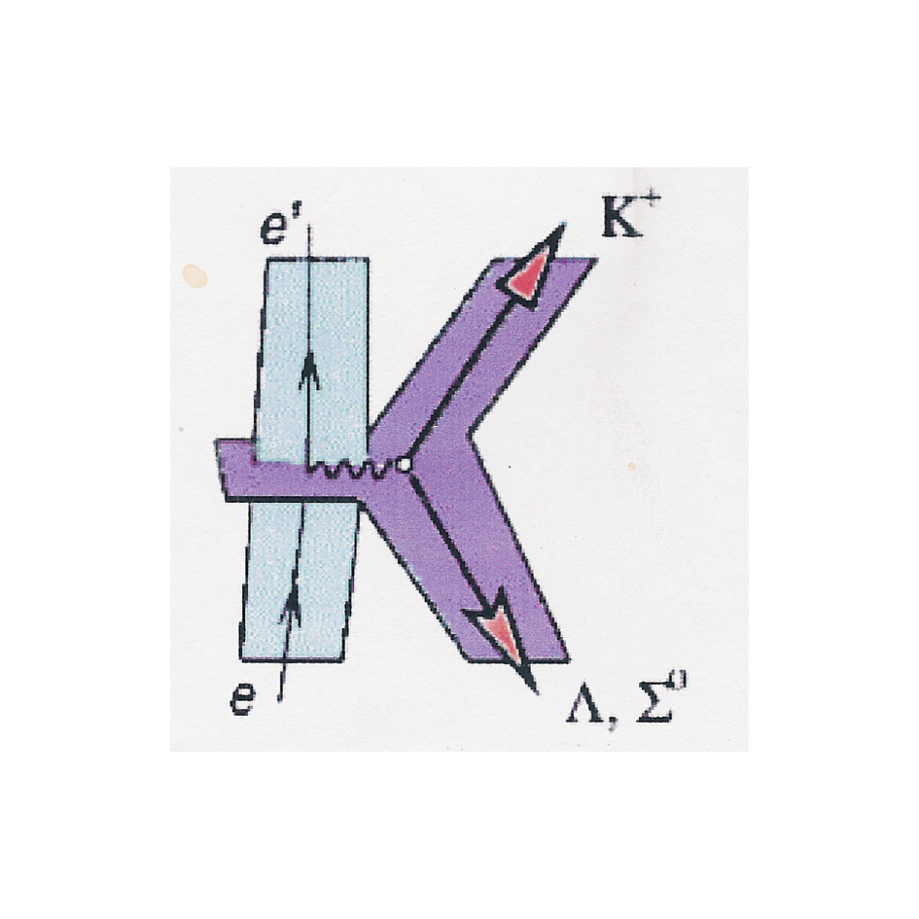
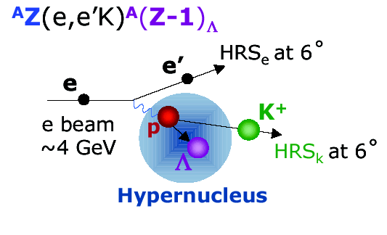
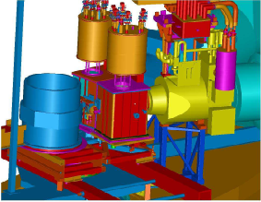
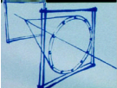
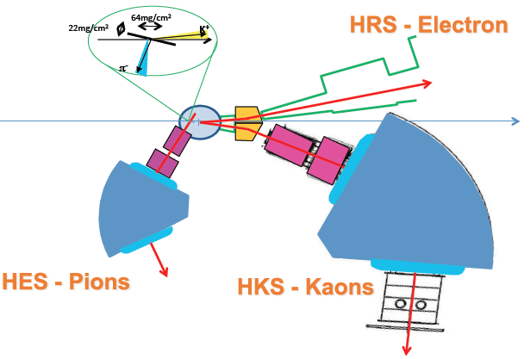
High-Resolution Hypernuclear Spectroscopy JLab, Hall A. Results and perspectives
F. Garibaldi – SPHERE meeting - Prague September 9 – 2014
Hypernuclear spectroscopy in Hall A
  ¹²C, ¹⁶O, ⁹Be, H
  E-07-012
Experimental issues
Prospectives: ²⁰⁸(e,e’K+)²⁰⁸_{L}Ti
  PID
  Target
  Counting rates

Slide 2
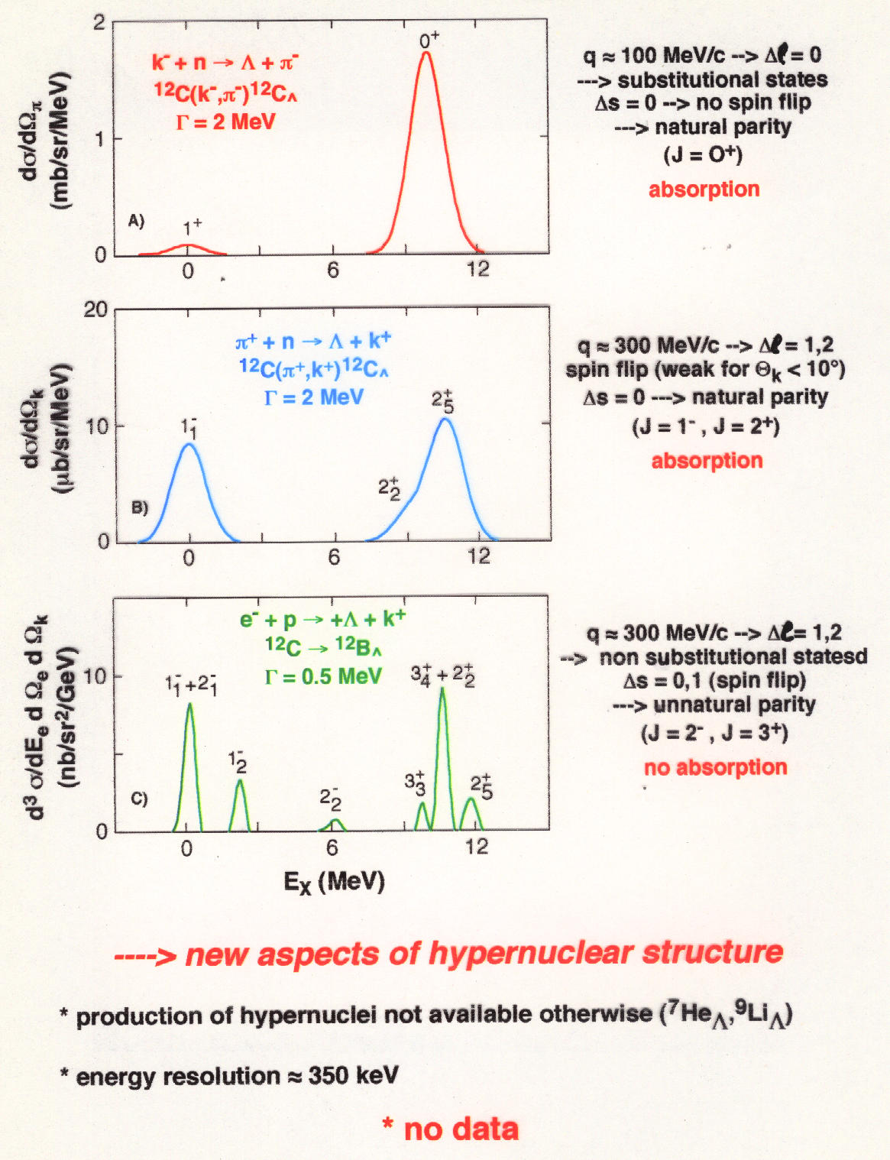
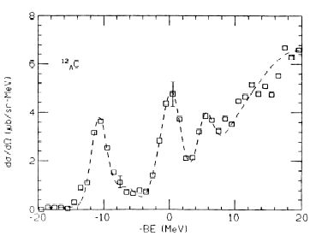
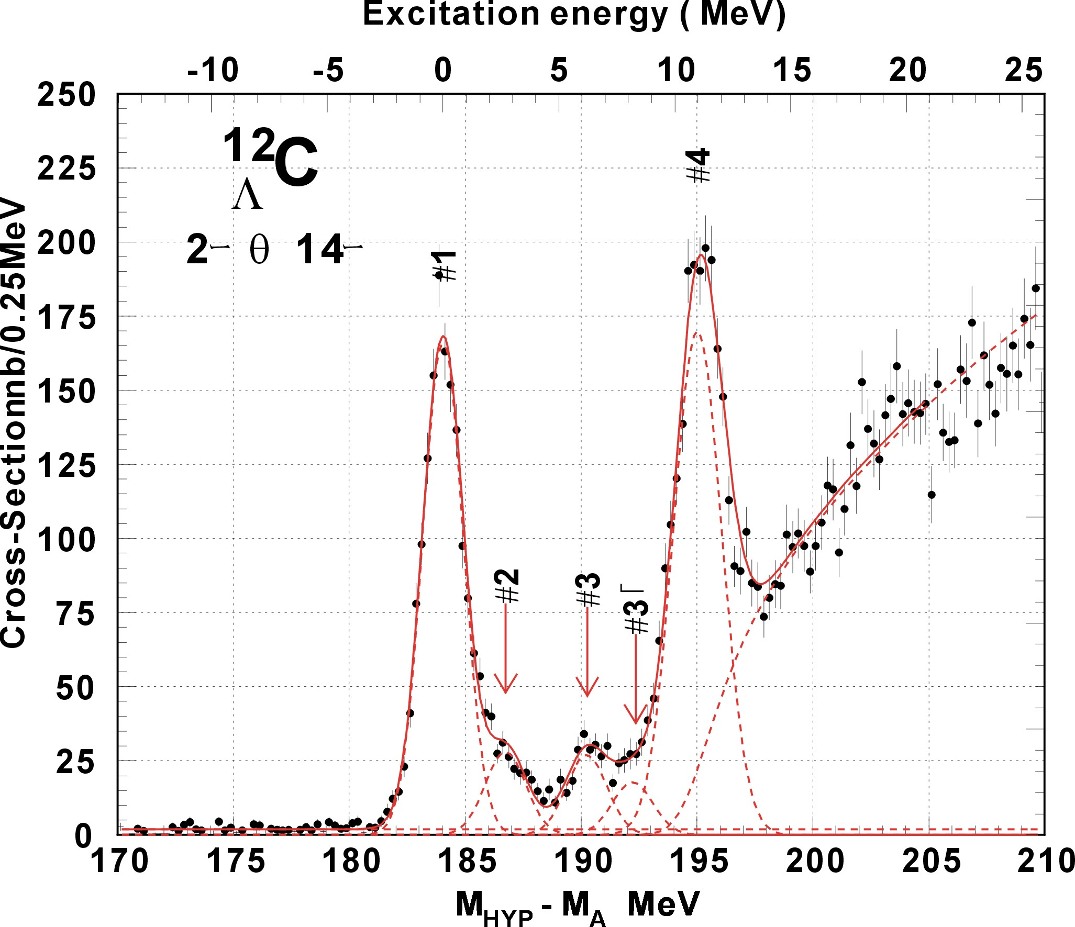
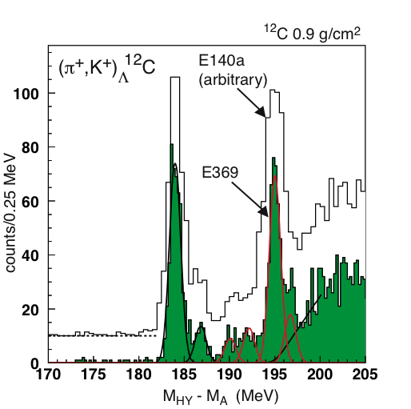
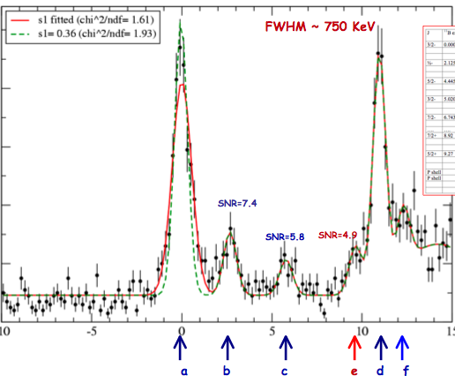
BNL 3 MeV
KEK336 2 MeV
Improving energy resolution
~ 1.5 MeV
and
using electromagnetic probe
635 KeV
635 KeV
new aspects of hyernuclear structure
High resolution, high yield, and systematic study is essential
production of mirror hypernuclei
energy resolution ~ 500 KeV

Slide 3
ELECTROproduction of hypernuclei
e + A -> e’ + K⁺ + H
in DWIA (incoming/outgoing particle momenta are ≥ 1 GeV)
- J^{m}(i) elementary hadron current in lab frame (frozen-nucleon approx)
- c_{g}virtual-photon wave function (one-photon approx, no Coulomb distortion)
- c_{K}– distorted kaon w. f. (eikonal approx. with 1st order optical potential)
-Y_{A}(Y_{H}) - target nucleus (hypernucleus) nonrelativistic wave functions (shell model - weak coupling model)

Slide 4
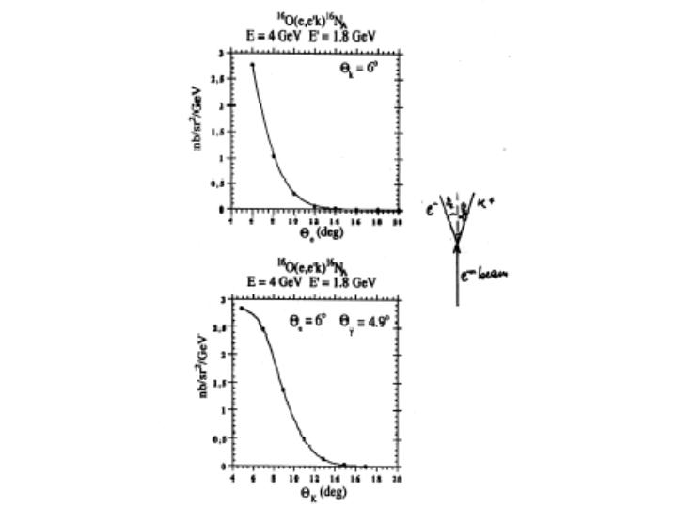
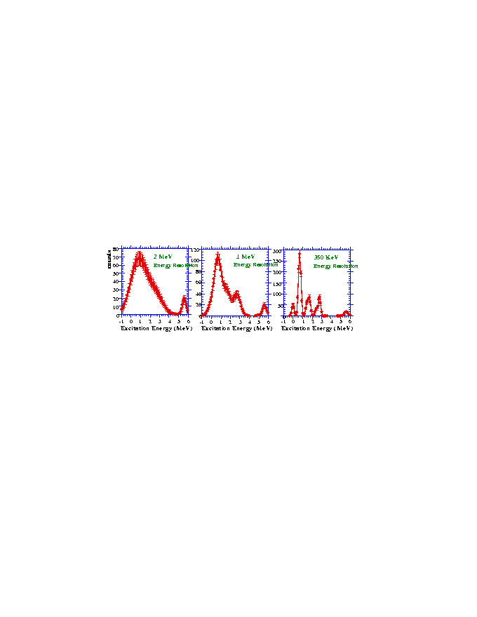
Experimental challenges
Septum magnets
reasonable counting rates
good energy resolution
minimize beam energy instability
“background free” spectrum
unambiguous K identification
RICH detector
The target (Pb)
10 – 25(35) mA on 100 mg/cm² Pb (cryocooling)

Slide 5





Kaon collaboration
JLAB Hall A Experiment E94-107
E94107 COLLABORATION
  A.Acha, H.Breuer, C.C.Chang, E.Cisbani, F.Cusanno, C.J.DeJager, R. De Leo, R.Feuerbach, S.Frullani, F.Garibaldi*, D.Higinbotham, M.Iodice, L.Lagamba, J.LeRose, P.Markowitz, S.Marrone, R.Michaels, Y.Qiang, B.Reitz, G.M.Urciuoli, B.Wojtsekhowski, and the Hall A Collaboration
  and Theorists: Petr Bydzovsky, John Millener, Miloslav Sotona
¹⁶O(e,e’K⁺)¹⁶☹N
¹²C(e,e’K⁺)¹²☹
Be(e,e’K⁺)⁹☹Li
H(e,e’K⁺)☹⁰
E_{beam} = 4.016, 3.777, 3.656 GeV
P_{e}= 1.80, 1.57, 1.44 GeV/c P_{k}= 1.96 GeV/c
q_{e} = q_{K} = 6°
W  2.2 GeV Q² ~ 0.07 (GeV/c)²
Beam current : <100 mA Target thickness : ~100 mg/cm²
Counting Rates ~ 0.1 – 10 counts/peak/hour
E-98-108. Electroproduction of Kaons up to Q2=3(GeV/c)2 (P. Markowitz, M. Iodice, S. Frullani, G. Chang spokespersons)
E-07-012. The angular dependence of ¹⁶O(e,e’K⁺)¹⁶N and H(e,e’K⁺)L (F. Garibaldi, M.Iodice, J. LeRose, P. Markowitz spokespersons) (run : April-May 2012)

Slide 6
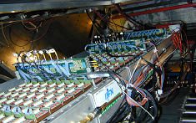
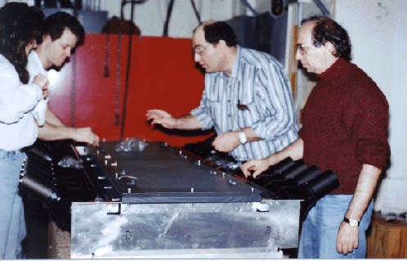
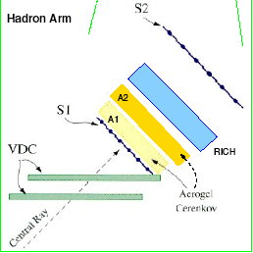
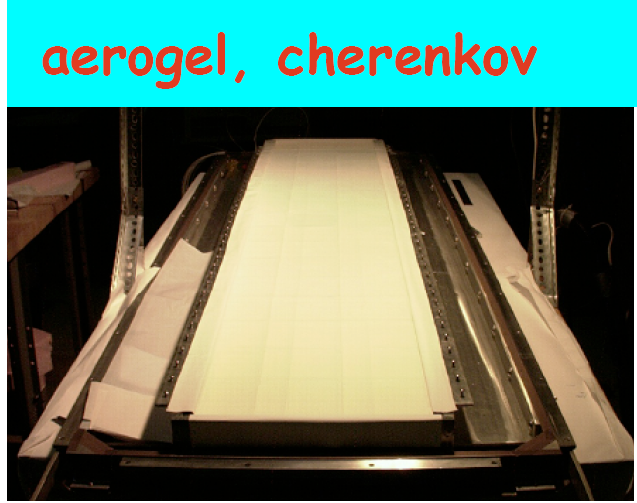
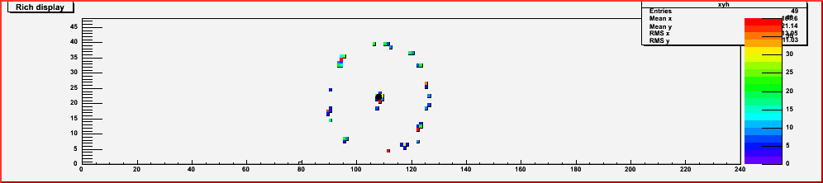
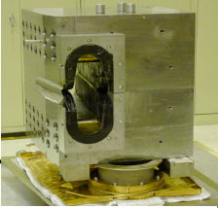
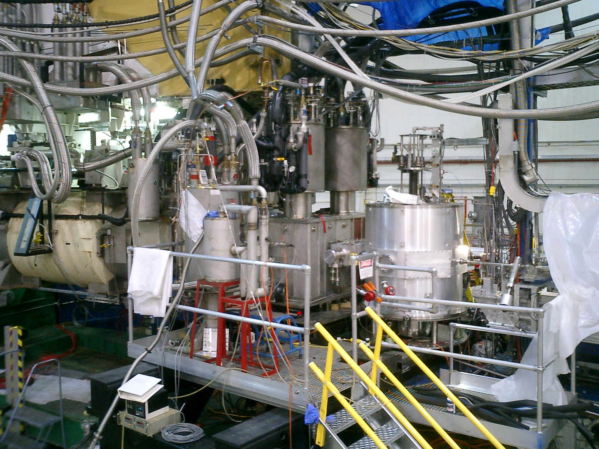
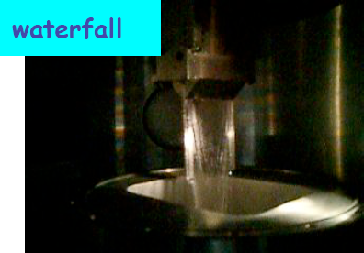
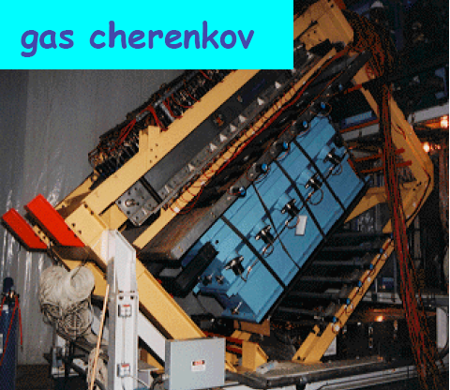
Hall A deector setup
RICH Detector
aerogel first generation
hadron arm
septum magnets
aerogel second generation
electron arm
To be added to do the experiment

Slide 7
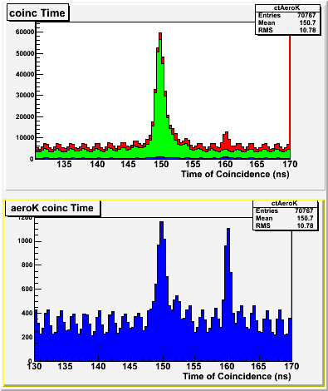
The PID Challenge
Very forward angle ---> high background of p and p
TOF and 2 aerogel in not sufficient for unambiguous K identification !
Kaon Identification through Aerogels
p_{h} = 1.7 : 2.5 GeV/c
p
p
All events
k
k
p
p
AERO1
n=1.015
AERO2
n=1.055
k
Pions = A1•A2
Kaons = A1•A2
Protons = A1•A2

Slide 8
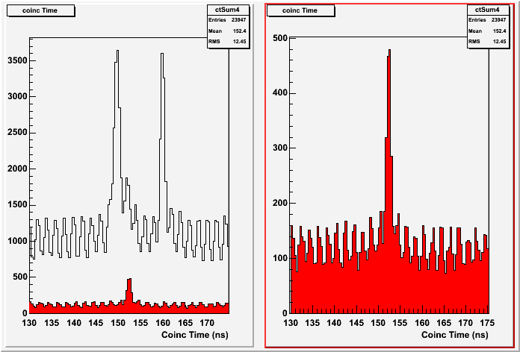
RICH – PID – Effect of ‘Kaon selection
Coincidence Time selecting kaons on Aerogels and on RICH
AERO K
AERO K && RICH K
p
P
K
Pion rejection factor ~ 1000

Slide 9
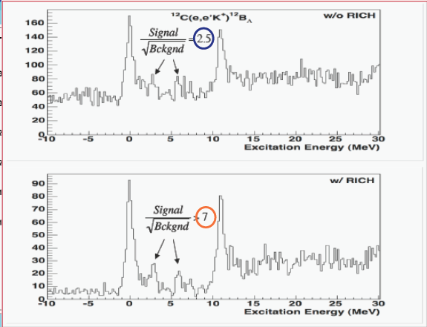
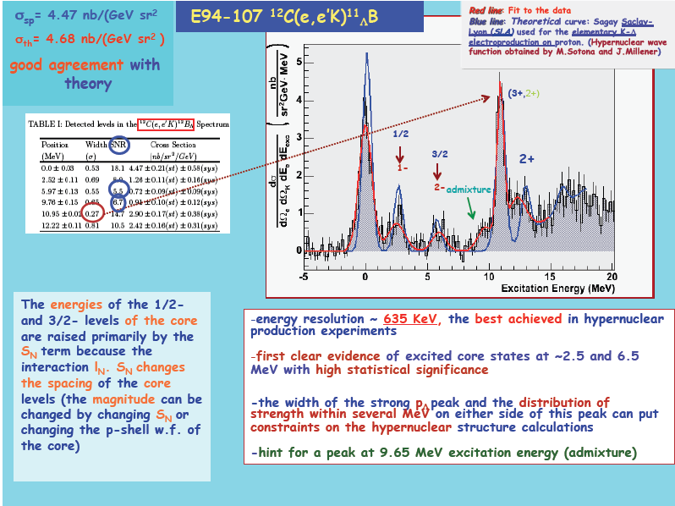
¹²C(e,e’K)¹²B_{L} M.Iodice et al., Phys. Rev. Lett. E052501, 99 (2007)

Slide 10
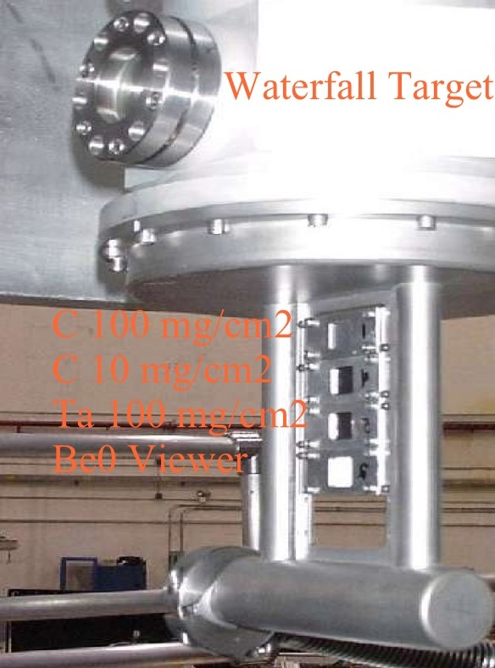
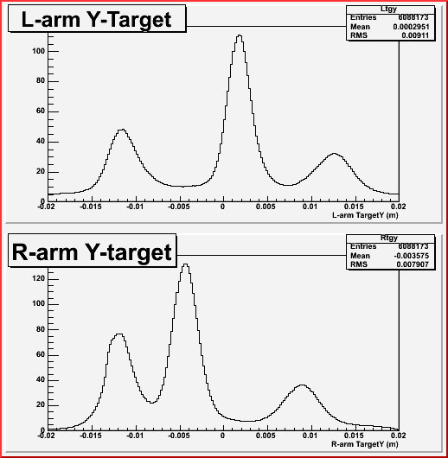
The WATERFALL target: reactions on ¹⁶O and ¹H nuclei
Be windows
H₂O “foil”
H₂O “foil”

Slide 11
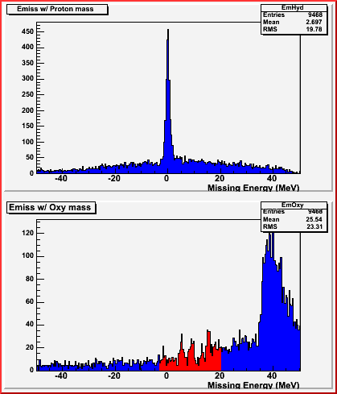
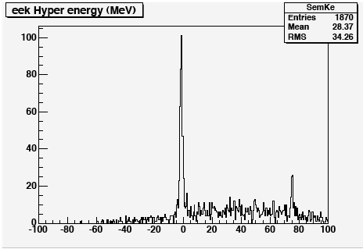
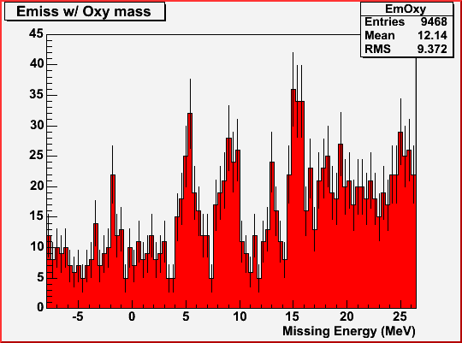
Results on the WATERFALL target - ¹⁶O and ¹H
¹H (e,e’K)L
¹H (e,e’K)L,S
L
Energy Calibration Run
S
¹⁶O(e,e’K)¹⁶N_{L}
Water thickness from elastic cross section on H
Precise determination of the particle momenta and beam energy
using the Lambda and Sigma peak reconstruction (energy scale calibration)

Slide 12
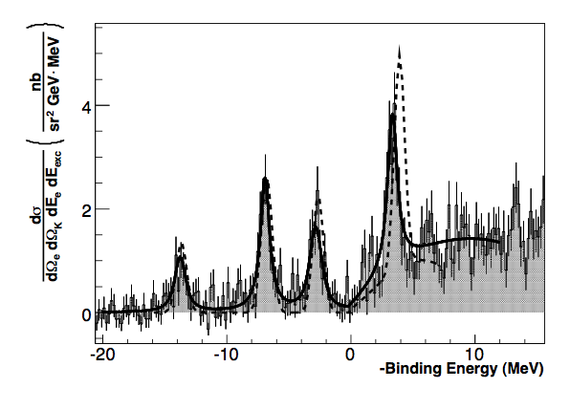
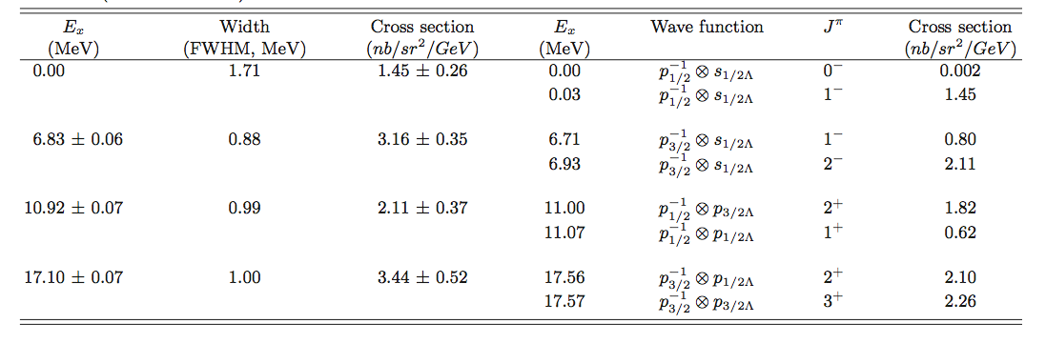
Results on ¹⁶O target – Hypernuclear Spectrum of ¹⁶N_{L}
Fit 4 regions with 4 Voigt functions
c²_{/ndf} = 1.19
Theoretical model based on :
SLA p(e,e’K⁺)☹ (elementary process)
☹N interaction fixed parameters from KEK and BNL ¹⁶☹O spectra
Four peaks reproduced by theory
The fourth peak (☹ in p state) position disagrees with theory. This might be an indication of a large spin-orbit term S☹
0.0/13.760.16

Slide 13
Results on ¹⁶O target – Hypernuclear Spectrum of ¹⁶N_{L}
Fit 4 regions with 4 Voigt functions
c²_{/ndf} = 1.19
Binding Energy B_{L}=13.76±0.16 MeV
Measured for the first time with this level of accuracy
(ambiguous interpretation from emulsion data; interaction involving L production on n more difficult to normalize)
Within errors, the binding energy and the excited levels of the mirror hypernuclei ¹⁶O☹ and ¹⁶N☹ (this experiment) are in agreement, giving no strong evidence of charge-dependent effects
0.0/13.760.16

Slide 14
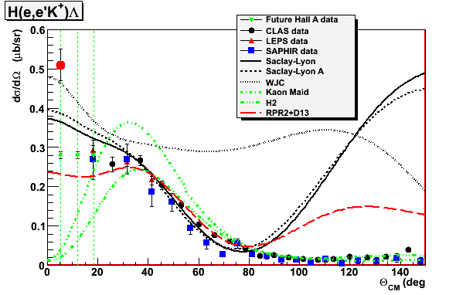
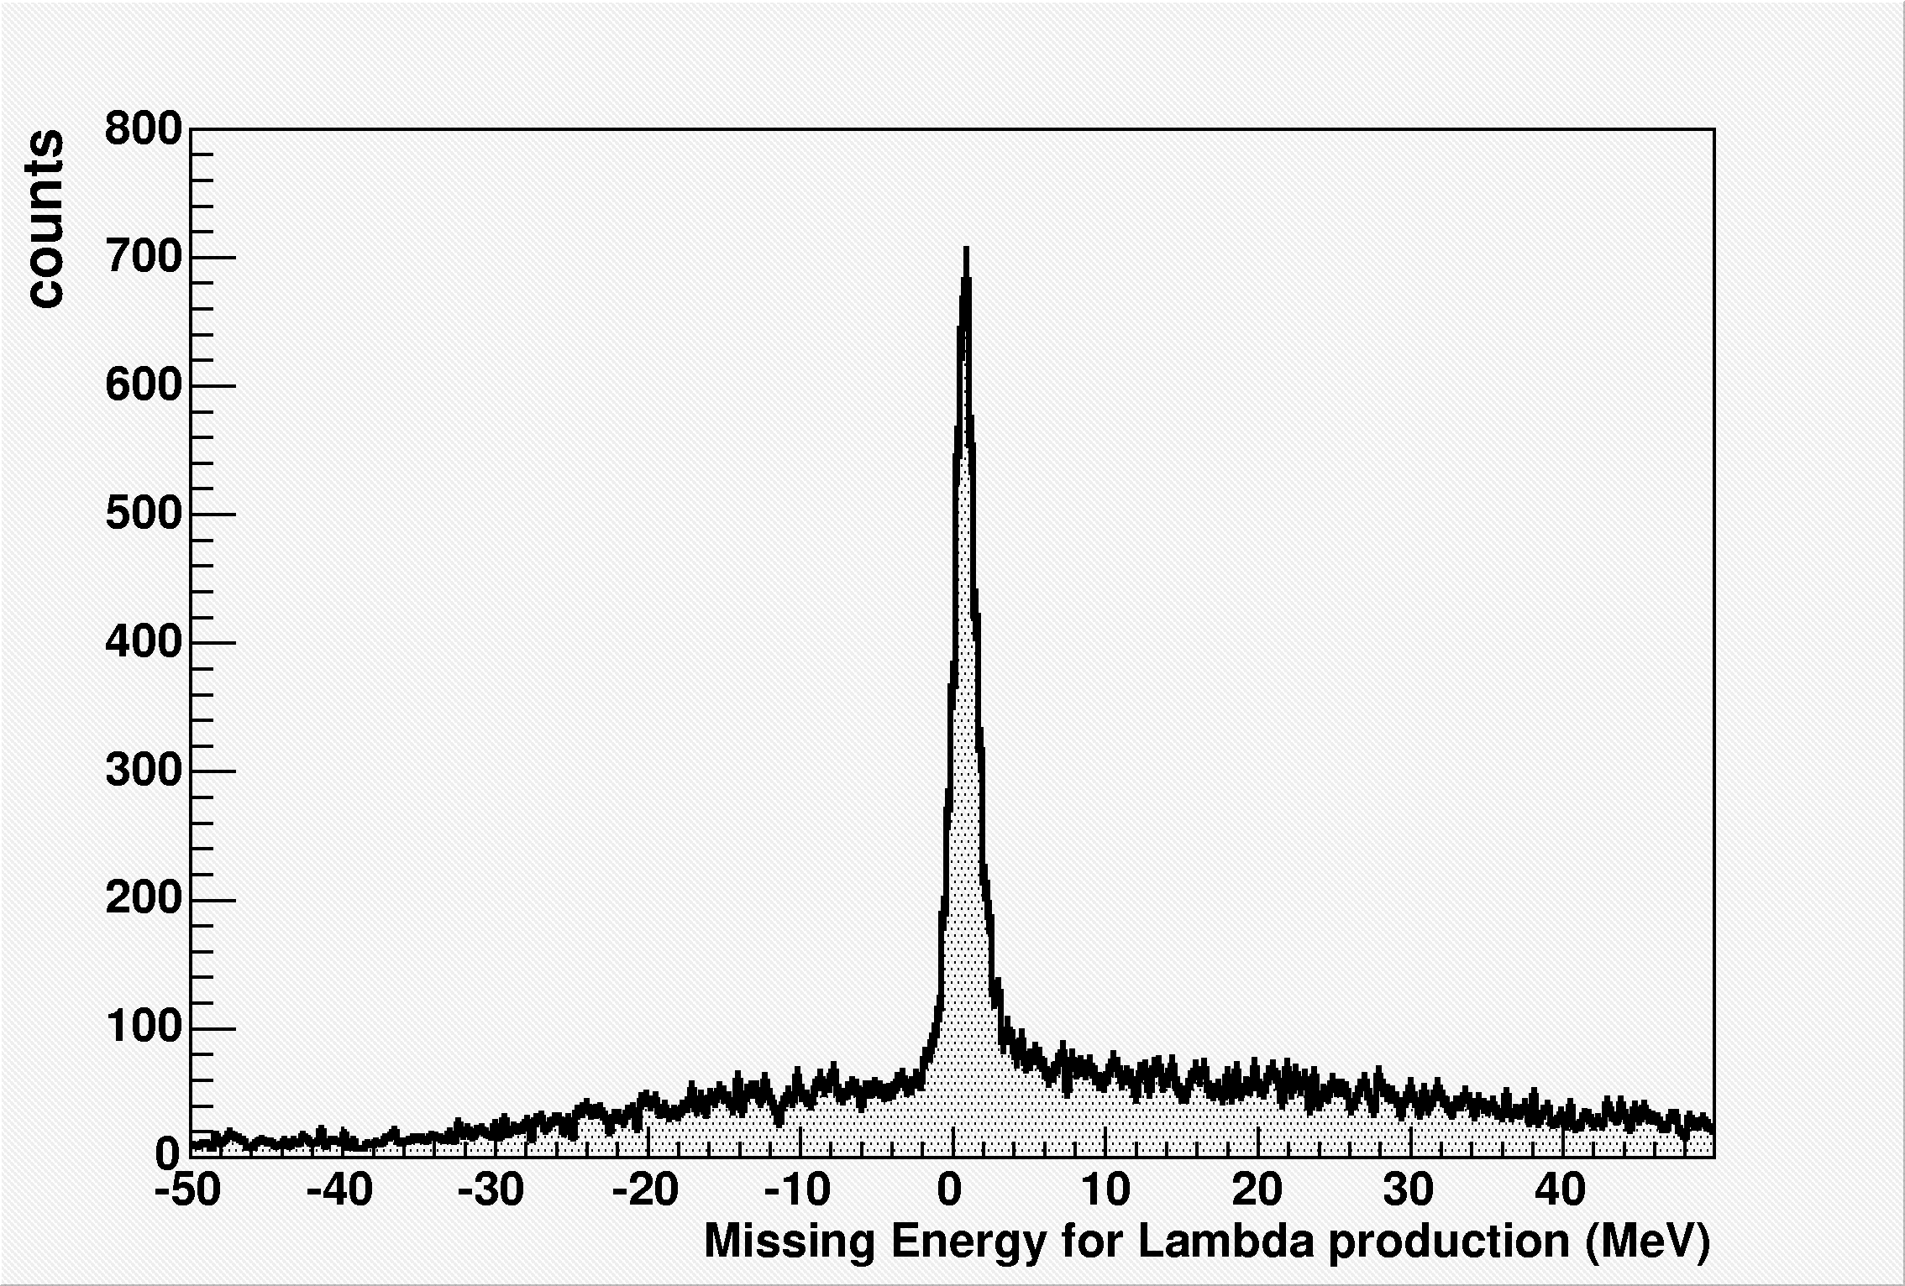
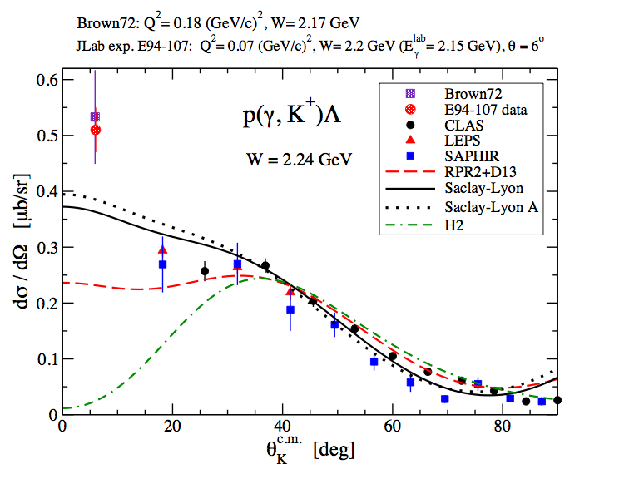
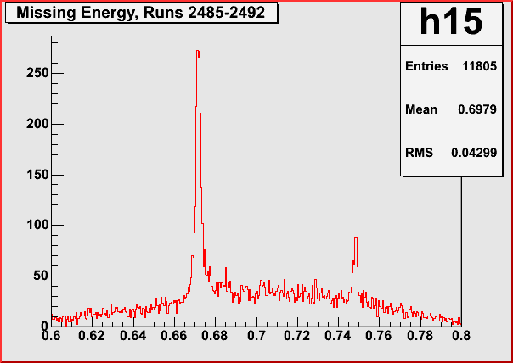
Results on H target – The p(e,e’K)L Cross Section
p(e,e'K⁺)L on Waterfall
Production run
W=2.2 GeV
p(e,e'K⁺)L on LH₂ Cryo Target
Calibration run
Expected data from E07-012, study the angular dependence of
p(e,e’K)L and ¹⁶O(e,e’K)¹⁶N_{L}
at low Q²
➔ None of the models is able to describe the data over the entire range
➔ New data is electroproduction – could longitudinal amplitudes dominate?

Slide 15
⁹Be(e,e’K)⁹Li_{L} (G.M. Urciuoli et al. Submitted to PHYS REV C)
Experimental excitation energy vs Monte Carlo Data (red curve) and vs Monte Carlo data with radiative effects “turned off” (blue curve)
Radiative corrected experimental excitation energy vs theoretical data (thin green curve). Thick curve: four gaussian fits of the radiative corrected data

Slide 17
Radiative corrections do not depend on the hypothesis on the peak structure producing the experimental data
Non radiative corrected spectra
Radiative corrected spectra

Slide 18
Binding energy difficult to determine because of the incertainties on the values of the incident beam energy and of the central momenta and angles of the HRS spectrometers
→ determined calibrating the spectrum with ¹²_{L}B
Is equal to a shift that is equal for all the targets + a small term that depends unphysically on scattering coordinates

Slide 19
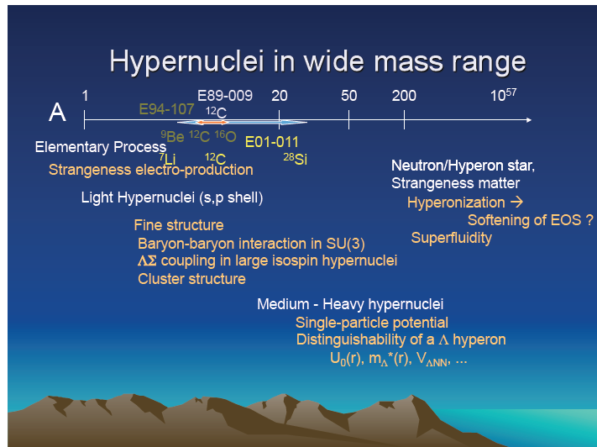
Hypernuclear spectroscopy prospectives at Jlab
Collaboration meeting - F. Garibaldi – Jlab 13 December 2011
Future mass spectroscopy
Decay Pion Spectroscopy to Study ☹-Hypernuclei

Slide 20
Goals
. Elementary kaon electroproduction
. Spectroscopy of light Λ-Hypernuclei
. Spectroscopy of medium-heavy Λ-Hypernuclei
. Spectroscopy of ²⁰⁸Pb
. Pion decay spectroscopy

Slide 21
Medium heavy hypernuclei
• to what extent does a Λ hyperon keep its identity as a baryon inside a nucleus?
• the mean-field approximation and the role that the sub-structure of nucleons plays in the nucleus.
• the existing data from (π+,K+) reactions obtained at KEK, do not resolve the fine structure in the missing mass spectra due to limited energy resolution (a few MeV), and theoretical analyses suffer from those uncertainties
• the improved energy resolution (~ 500 - 800 keV) of (e,e’K) hypernuclear spectroscopy, which is comparable to the spreading widths of the excited hypernuclear states, will provide important information

Slide 22
L Hyperon in heavier nuclei – ²⁰⁸(e,e’K+)²⁰⁸_{L}Ti
✔ A range of the mass spectroscopy to its extreme
✔ Studied with (p,k) reaction, levels barely visible (poor energy resolution)
(e,e’K) reaction can do much better.
Energy resolution → Much more precise L single particle energies. Complementarity with (p,k) reaction
✔ the mass dependence of the binding energy for each shell model orbital will be extended to A = 208, where the ambiguity in the relativistic mean field theories become smaller.
✔ neutron stars structure and dynamics
✔ distinguishability of the hyperon in the nuclear medium

Slide 23
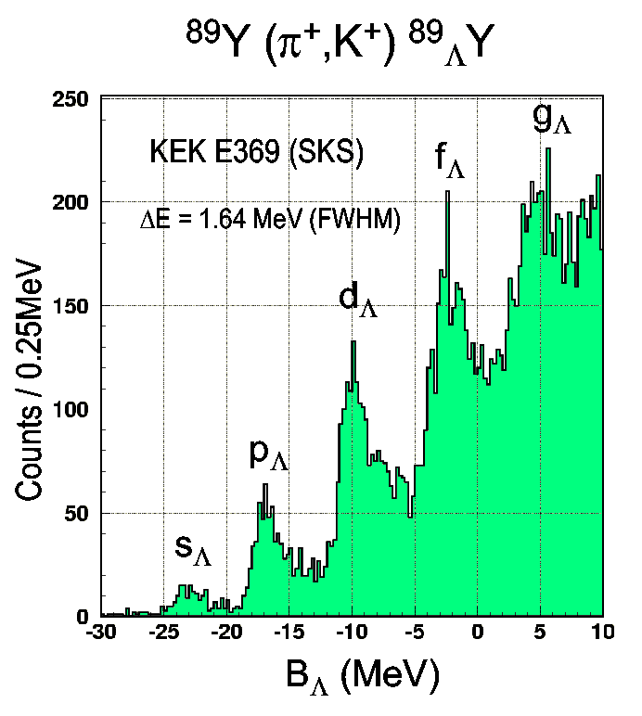
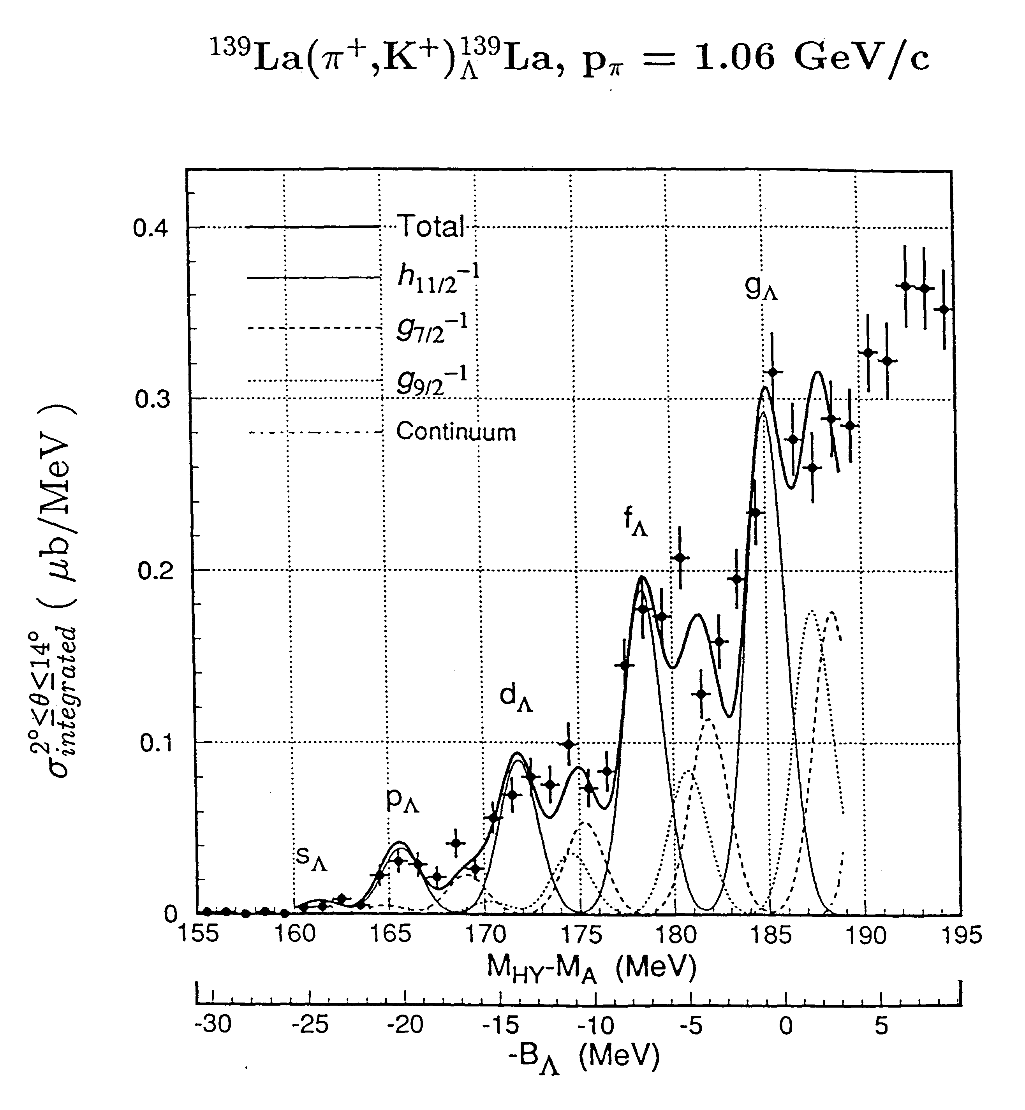
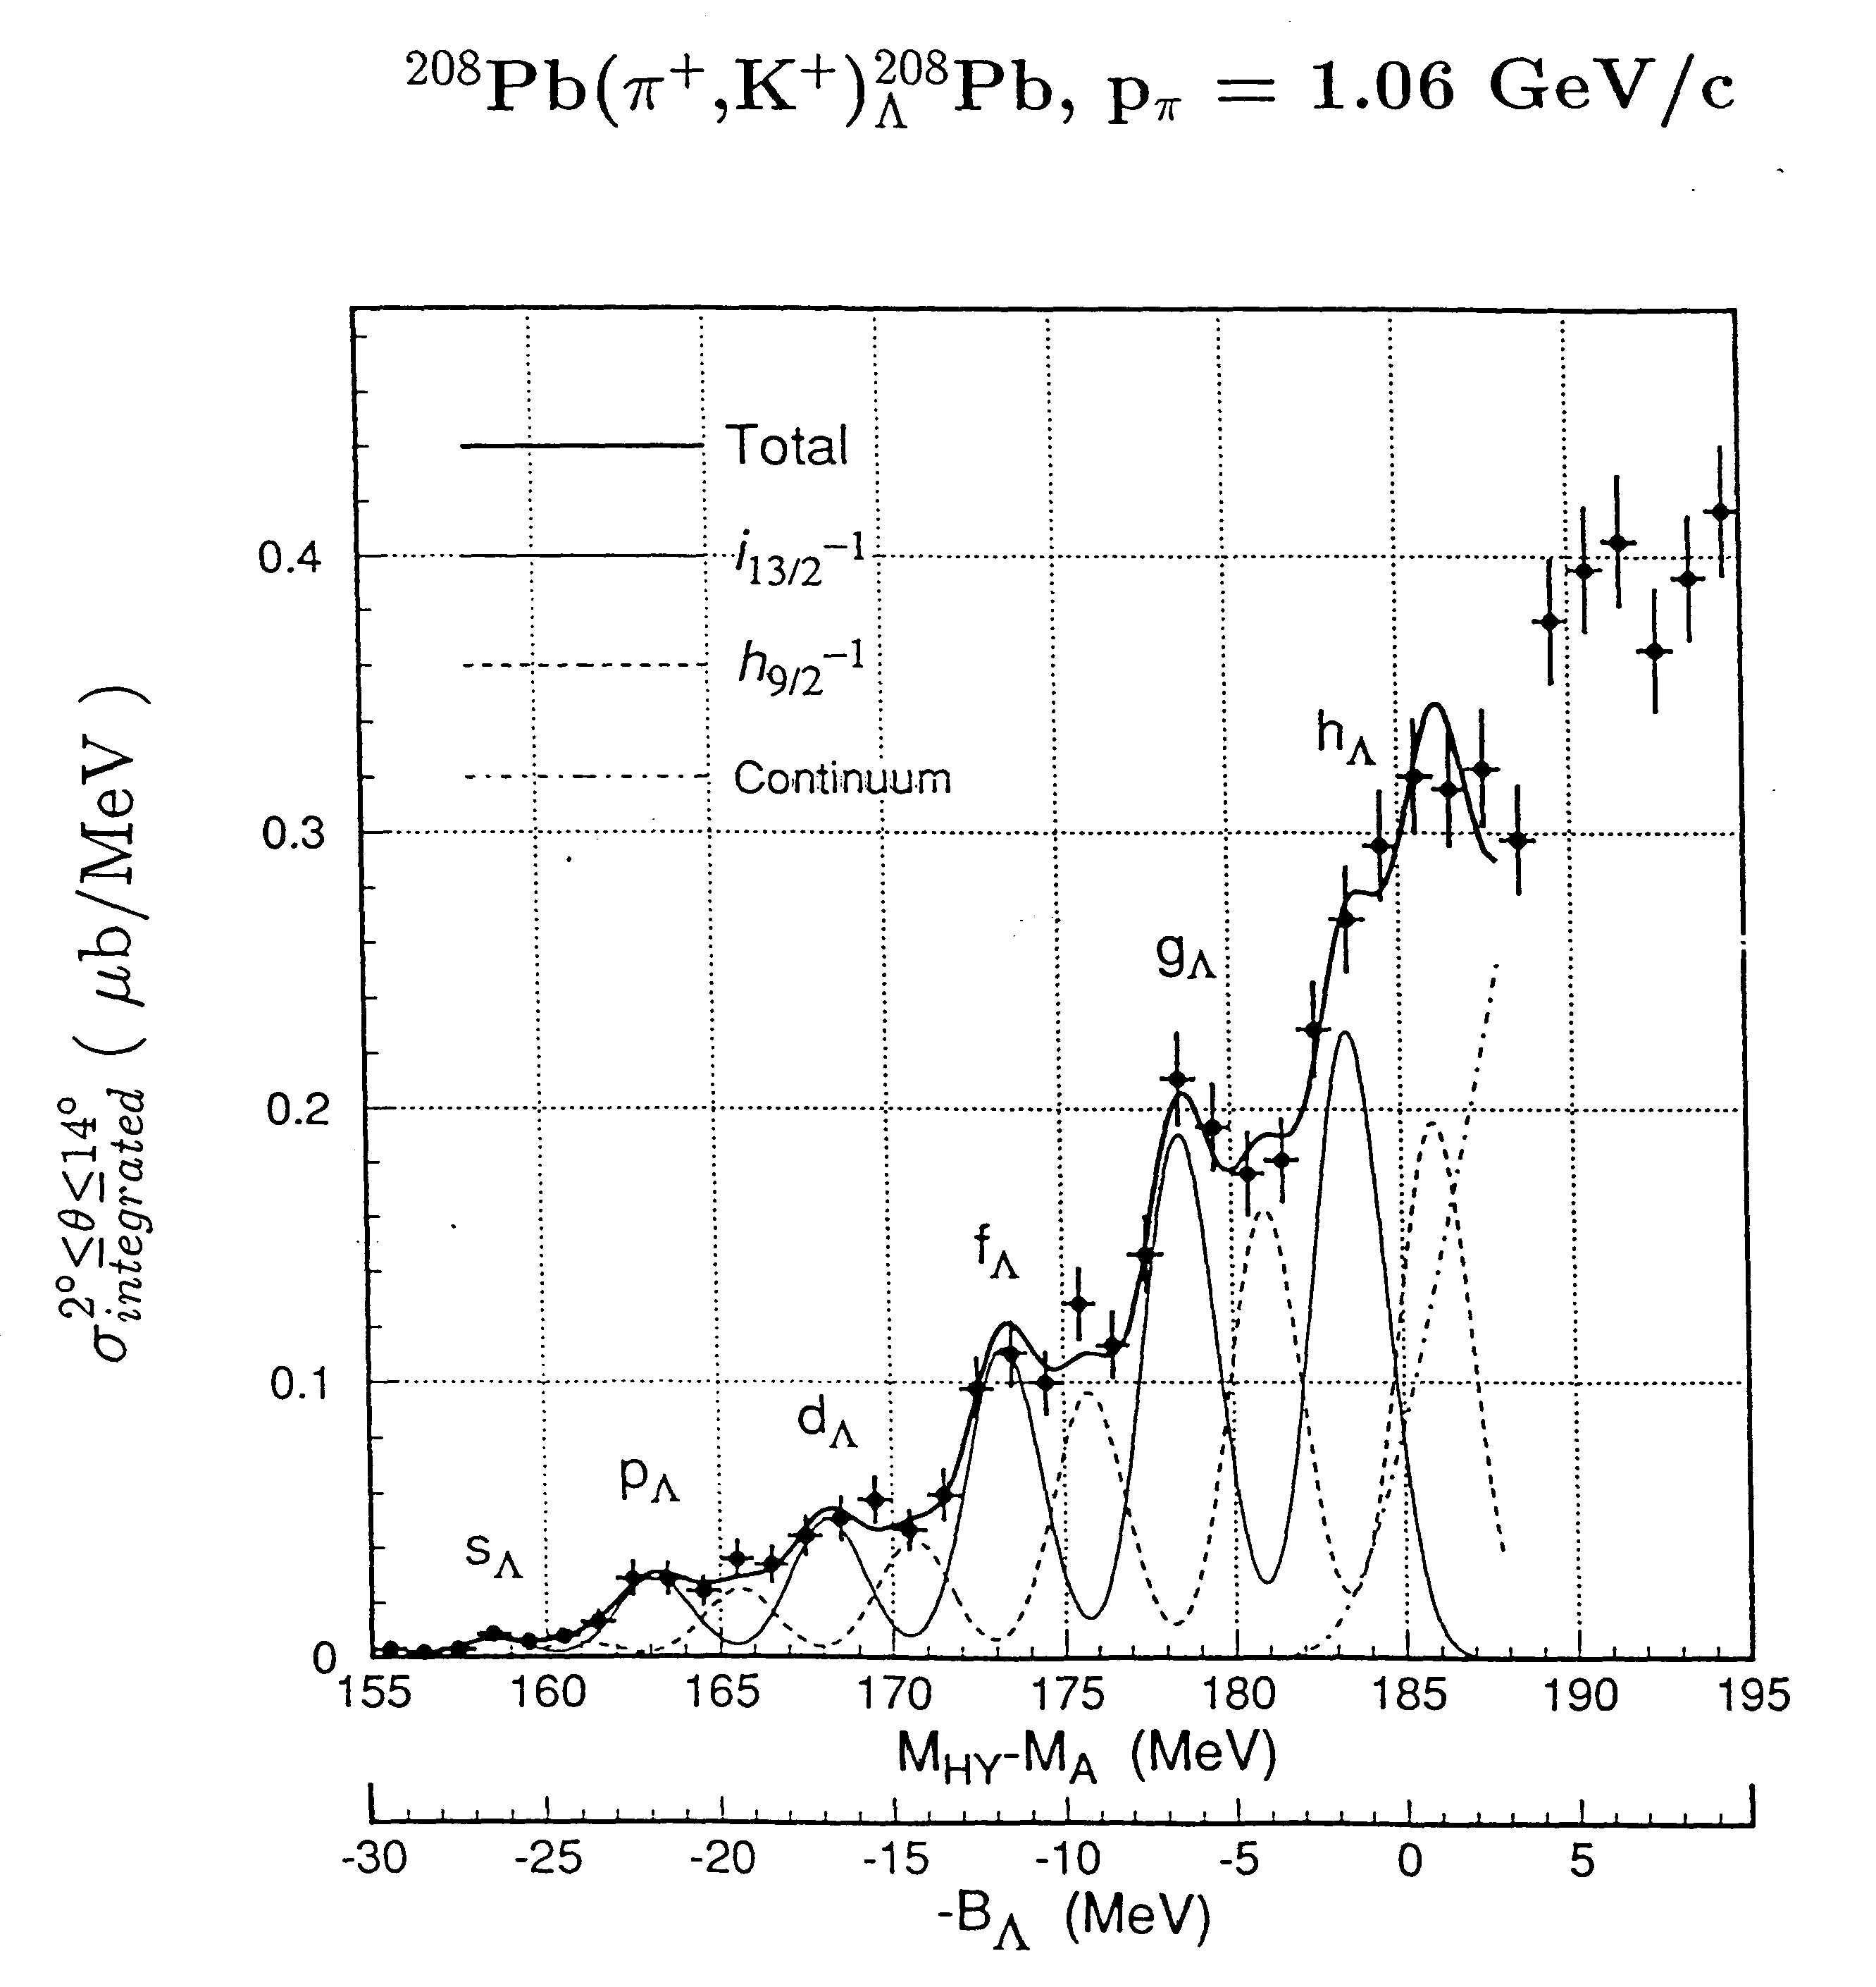
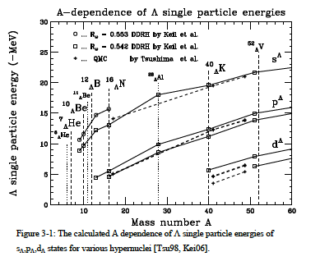
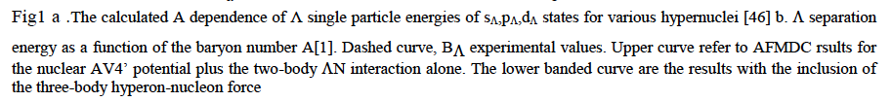
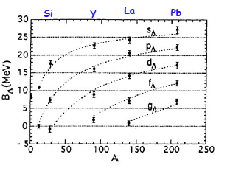
L Hyperon in heavy nuclei (p,K)
Hotchi et al., PRC 64 (2001) 044302
Hasegawa et. al., PRC 53 (1996)1210
Measured (p,K)

Slide 24
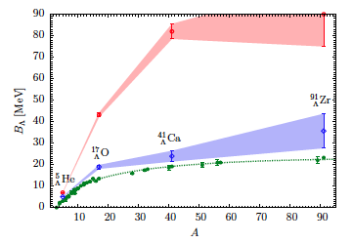
D. Lonardoni et al.
Separation energy as a function of the baryon number A.
Plain green dots [dashed curve] are B_{L} experimental values.
Empty red dots [upper banded curve] refer to the AFDMC results for the nuclear AV4' potential plus the two-body LN interaction alone.
Empty blue diamonds [lower banded curve] are the results with the inclusion of the three-body hyperon-nucleon force.

Slide 25
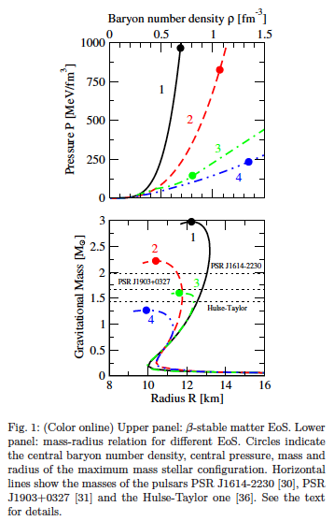
Appearence of hyperons brings the maximum mass of a stable neutron star down to values incompatible with the recent observation of a star of about two solar masses.
It clearly appears that the inclusion of YNN forces (curve 3) leads to a large increase of the maximum mass, although the resulting value is still below the two solar mass line.
A precise knowledge of the level structure can, by constraining the hyperon-nucleon potentials, contribute to more reliable predictions regarding the internal structure of neutrons stars, and in particular their maximum mass
It is a motivation to perform more realistic and sophisticated studies of hyperonic TBF and their effects on the neutron star structure and dynamics, since they have a pivotal role in this issue
It seems that only simultaneous strong repulsion in all relevant channels could significantly raise the maximum mass

Slide 26
Binding energies of the Λ inferred assuming they correspond to the peak centroids of the bumps, altough they may depend on detail of the bump structures.
Spectrum smoother than expected (DWA calculation) and experimental energy resolution.
” Therefore it is of vital importance to perform precision spectroscopy of medium - heavy hypernculei with mass resolution comparable to or better than the energy differences of the core excitation in order to further investigate the structure of the Λ hyperon deeply boud states in heavier nucle ”
(e,e’K) spectroscopy is a very promising approach to this probem ”
(O. Hashimoto and H. Tamura, Progr. N Part. and Nucl. Physic 57 (2006)
“Up to now these data are the best proof ever of quasi particle motion in a strongly interacting system”

Slide 27
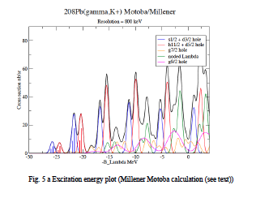
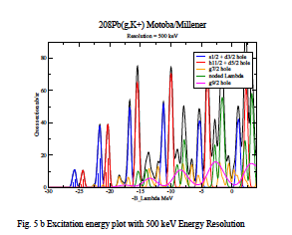
Millener-Motoba calculations
Particle hole calulation, weak-coupling of the L hyperon to the hole states of the core (i.e. no residual L-N interaction).
Each peak does correspond to more than one proton-hole state
- Interpretation will not be difficult because configuration mixing effects should be small
- Comparison will be made also with many-body calculations using the Auxiliary Field Diffusion Monte Carlo (AFDMC) that include explicitely the three body forces.
- Once the L single particle energies are known the AFMDC can be used to try to determine the balance between the spin independent components of the LN and LNN interactions required to fit L single-particle energies across the entire periodic table.

Slide 28
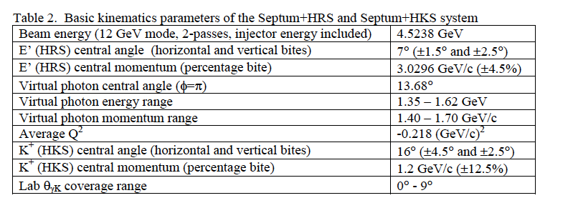
kinematics
A Lower energy kinematics would allow better energy resolution, but the price to pay would be the yield

Slide 29
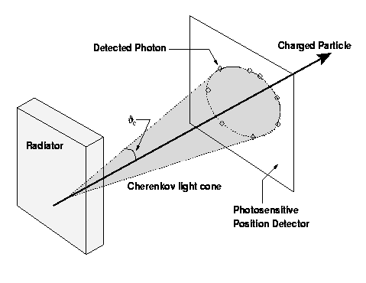
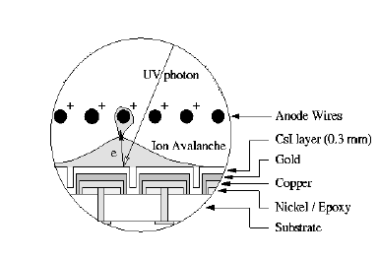


RICH detector – C₆F₁₄/CsI proximity focusing RICH
“MIP”
Cherenkov angle resolution
Separation Power
N. of detected photoelectrons
Performances
- N_{p.e.} # of detected photons(p.e.)
- and  (angular resolution)
maximize
minimize

Slide 30



RICH upgrated for Transversity experiment

Slide 31

The target
NIKHEF target (C. Marchand, Saclay)

Slide 32


Elastic scattering measurement off Pb-208 to know the actual thickness of the target then monitor continuously by measuring the electron scattering rate as a function of two-dimensional positions by using raster information.

Slide 33



HKS PID
3 TOF, 2 water Cherenkov, three aerogel Cerenkov
Power rejection capability is:
- In the beam p:K:p 10000:1:2000
- in the on-line trigger 90:1:90
- after analysis it is 0.01:1:0.02
- so for p the rejection power is 10⁶
- and for p 10⁵
HKS PID
(gas Cherenkof + shower counter)
e,p rejection 10⁵
RICH Detector
Target
solid cryocooled for Pb
PID p/K ~ 10¹² ^{(threshold + RICH)}
<i> = 25 mA - 100 mg/cm cryocooling
Elastic scattering measurement off Pb-208 to know the actual thickness of the target then monitor continuously by measuring the electron scattering rate as a function of two-dimensional positions by using raster information.

Slide 34

Counting rates

Slide 35
<I> (mA) | Target thickness (mg/cm2) | Peak significance | Peak
10 | 100 | 3.48 | s-shell
10 | 200 | 4.13 | s-shell
10 | 300 | 4.48 | s-shell
10 | 100 | 7.54 | p-shell
10 | 200 | 9.21 | p-shell
10 | 300 | 11.52 | p-shell
20 | 100 | 4.13 | s-shell
20 | 200 | 4.63 | s-shell
20 | 300 | 4.84 | s-shell
25 | 100 | 4.3 | s-shell
25 | 200 | 4.7 | s-shell
25 | 300 | 4.9 | s-shell
25 | 100 | 10.5 | p-shell
25 | 200 | 12.8 | p-shell
25 | 300 | 14.0 | p-shell

Slide 36

Francesco Cusanno December 1971 - 29 – 08 2014
A great scientist, man, friend
“The world is a lesser place for his having left it, but a better place for his having been here” (J. LeRose)

Slide 37


Slide 38



Slide 39
Summary and conclusions
The of hypernculear physics is an important part of the modern nuclear and hadronic physics
The (e,e’K) experiments performed at Jlab in the 6 GeV era confirmed the specific, crucial role of this technique in the framework of experiments performed and planned in other facilties.
The importance of the study of the pion decay spectroscopy, the elementary reaction , the few body and medium mass nuclei has been shown in other talks
Interesting comparison betwen different kind of calculations, namely lattice QCD calulations, standard Mcarlo calulation, ab initio Mcarlo calculations possible in the entire A range
The study of (medium and) heavy hypernuclei is an essential part of the series of measurements we propose, fully complementary to what performed and proposed with (e,e’K) reactions and in the framework of experiments performed or planned at other facilities

Slide 40
Important information will be obtained on the limits of the description of hypernculei
and nuclei in terms of shell model/mean field approximation
The role of three body interaction both in hypernuclei and in the structure and dynamics of neutron stars will be shown
Comparison between standard shell/model-mean field calculations and microscopic Mcarlo consistent calculations in the whole A range
The behaviour of L binding energy as function of A will be extended at his extreme
Comparison of (e,e’K) with (p,K) results might reveal the limits of the distinguishability
of the hyperon in the dense nuclear medium
Combining the informations from the performed and proposed (e,e’K) experiment will
allow a step forward in the comprehension of the role of the strangeness in our
world.

Slide 41


Slide 42
Very preliminary commments by Sotona on Be
The underlying core nucleus ⁸Li can be a good canditate for some unexpected behaviour. In this unstable (beta decay) core nucleus with rather large excess of neutral particles (% neutrons + Lambda against 3 protons only); the radii of distribution of protons and neutrons are rather different
There are at least two measurement on radioactive beams of neutron (Rn) and matter (Rm) radius of the distribution
Rn Rm
2.67 2.53
2.44 2.37
(Liatard et al., Europhys. Lett. 13(1990)401, (Obuti et. al., Nucl. Phys. A609(1996)74)
Any calculation of the cross section depends on the exact value of matter distribution via single-particle wavefunction of the lambda in ⁹Li-lambda hypernucleus.
About the shift of the position of the second and third hypernuclear doublet., this discrepancy can be used as a valuable information on the structure of underlying ⁸Li core.

