Slide 1
Population of small asteroid systems:
Binaries, triples, and pairs
Petr Pravec
Astronomical Institute AS CR, Ondřejov, Czech Republic
AIM Science Meeting
ESAC, Madrid, 2016 March 1

Slide 2
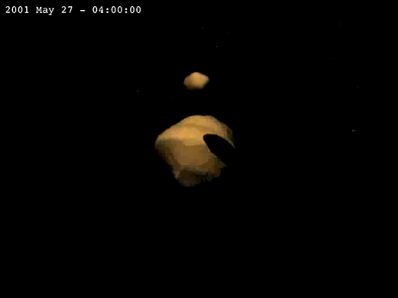
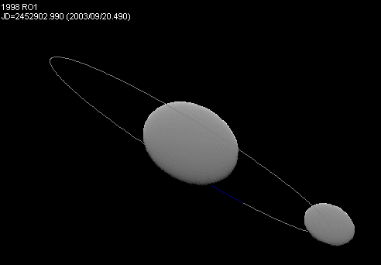

Asteroid systems
Systems of 2 or more components, bound or unbound.
Bound asteroids –
Binary/ternary systems:
About 15% (±4%) of asteroids smaller than 15 km are binary.
Currently known (discovered) more than 150 of them.
Bound asteroids –
Binary/ternary systems:
(Ostro et al. 2006)
(Scheirich and Pravec 2009)
Unbound asteroids –
Asteroid pairs:
Have highly similar heliocentric orbits (due to low-speed separation).
Currently identified more than 200 of them (all in the main belt).
Unbound asteroids –
Asteroid pairs:
(Pravec et al. 2010)

Slide 3
Observational techniques for detection and description of asteroid systems
Photometry (light curve observations)
Radar
Adaptive optics

Slide 4
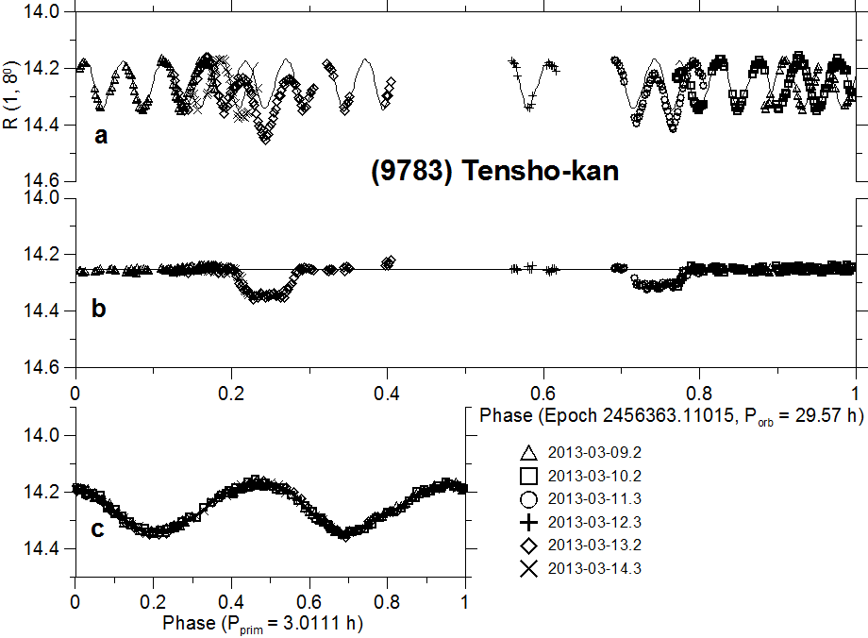
Photometric observations of a binary asteroid
Full lightcurve
Decomposition:
Mutual events
eclipses/occultations
(after lc decomposition, i.e.,
the primary rotational lc was
subtracted)
Primary rotational lc
(enlarged)

Slide 5
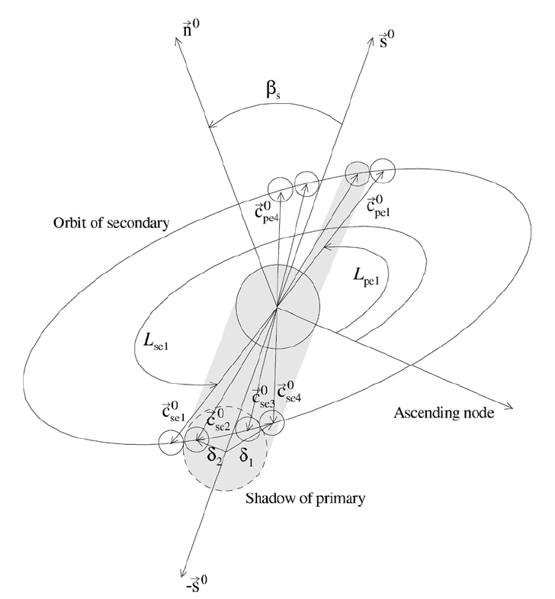
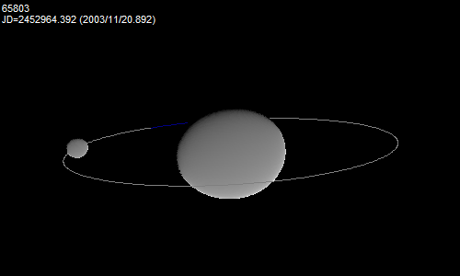
Modeling of binary asteroids from photometry
Modeling of observed mutual events (their timings and shapes) between system’s components and their rotational lightcurves.
Derived/constrained parameters:
P1, (P2) .... primary (secondary) periods
D2/D1 .... ratio of effective diameters
a1/b1, (b1/c1), (a2/b2) …. axial ratios
Porb, Lorb, Borb, a_{orb}, e_{orb}, Morb …. mutual orbit
ρ₁ …. primary bulk density
More parameters when combined with radar,
thermal or spectral data.
(Scheirich and Pravec 2009)

Slide 6
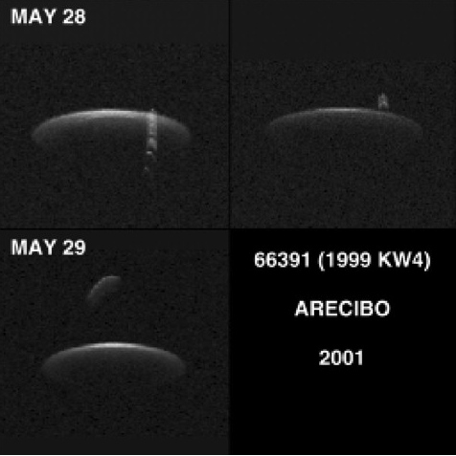
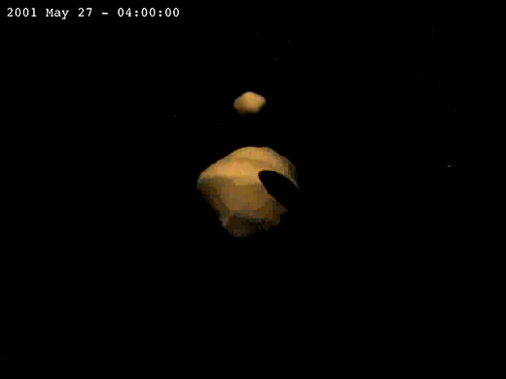
Radar observations of a binary asteroid
The best characterized binary: (66391) 1999 KW4 observed with
the Arecibo radar in 2001 at distance 0.042-0.050 AU. The detailed model constructed by Ostro et al. (Science 314, 1276-1280, 2006).
Radar images:
Frequency (Hz)
Distance from radar (m)
Model of the binary system:

Slide 7
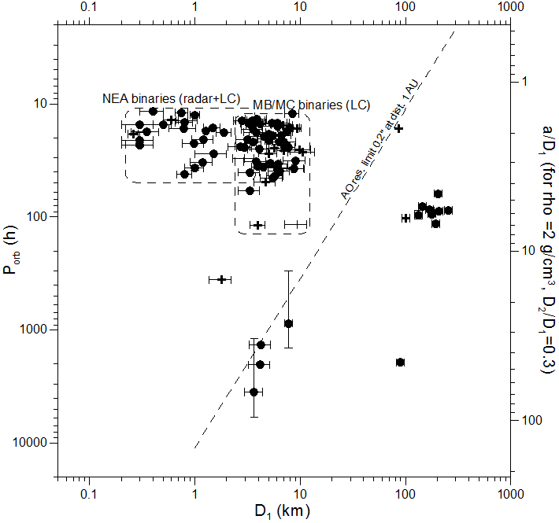
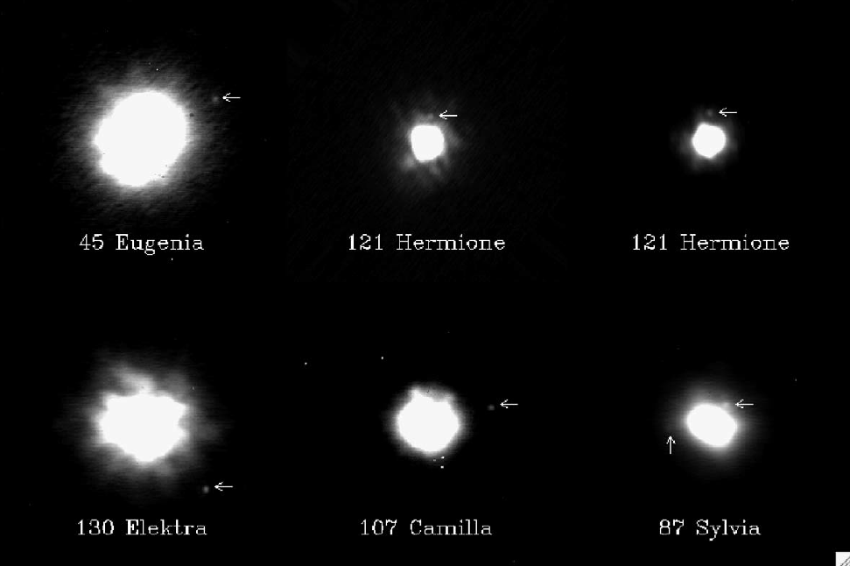
Adaptive optics observations
Typical resolution limit: angular separation 0.2 arcsec.
Limited to wide/large binary systems.
(Marchis et al. 2006)
(Scheirich and Pravec 2012)

Slide 8
Observational techniques - summary
Each of the three techniques has strong points as well as limitations. Main ones:
Radar + Detailed model of the primary and a lower-resolution model of the secondary (when sufficient S/N and sky coverage)
+ Direct determination of the mutual orbit (when sufficient S/N and sky/time coverage)
– Echo strength decreases with the 4th power of the distance from target; efficient for objects closer than ~0.1 AU (only limited data for more distant NEAs)
– Observing windows for radar observations are usually short (days, rarely weeks), precluding or limiting studies requiring long time coverage.
Photometry + Binary asteroids detected at large distances
+ Long time coverage can be obtained (depending on favorable observing circumstances, e.g., angular distance from the sun, phase angle)
– Only limited constraints on primary and secondary shapes
– Determination of absolute dimensions requires adding thermal data (a constraint possible when albedo estimated based on spectral data)
Adaptive optics + Direct resolution of system’s components: Astrometric solution for the mutual orbit
– Limited to wide/large binary systems; most binary systems not resolved.

Slide 9
Properties of small asteroid systems

Slide 10
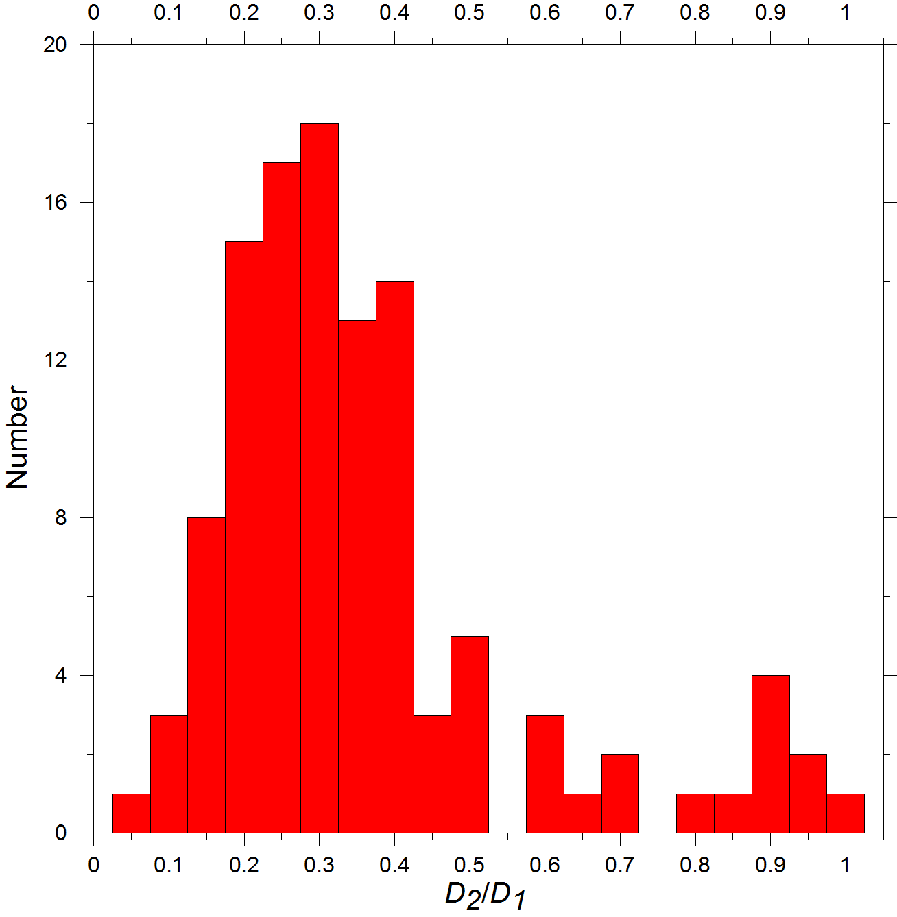
Component size ratios
Secondaries mostly less than half primary diameter (less than ~10% primary mass)
Largest D₂/D₁ close to 1 (“Double Asteroids”)
(69230) Hermes, (809) Lundia, (854) Frostia,
(1089) Tama, (1139) Atami, (1313) Berna, (2478) Tokai,
(4492) Debussy, (4951) Iwamoto – all have D₂ /D₁
between 0.8 and 1
Smallest D₂/D₁ (observational sensitivity-limited)
(1862) Apollo: D₂/D₁ ~ 0.04 (Ostro et al. 2005, unc. factor 2)
Systems with D₂/D₁ < ~0.4-0.5 abundant.
Decrease at D₂/D₁ < 0.3 and especially below 0.2
maybe observational bias.
(65803) Didymos

Slide 11
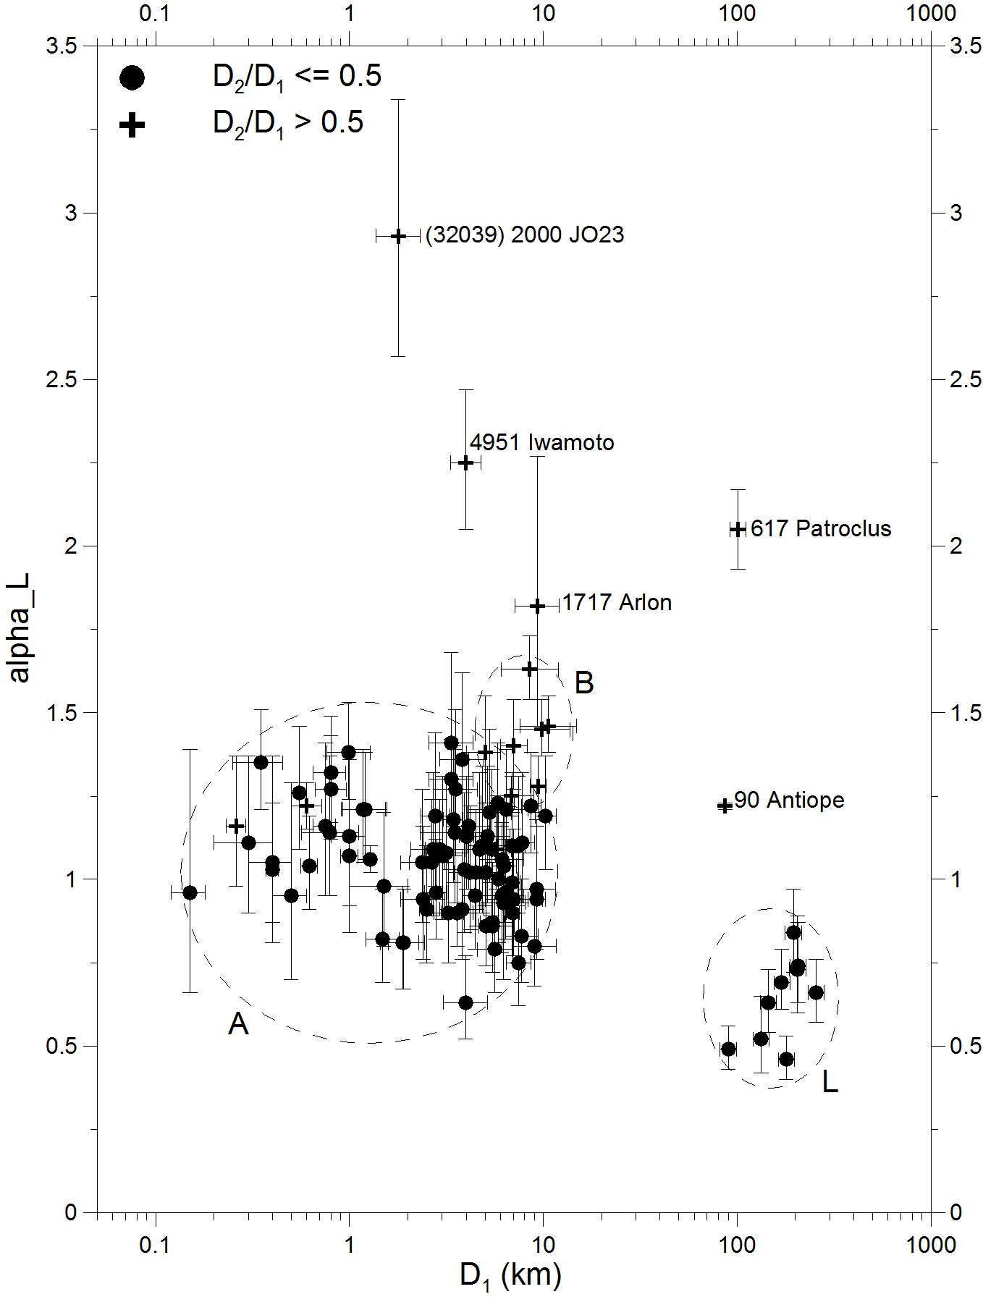
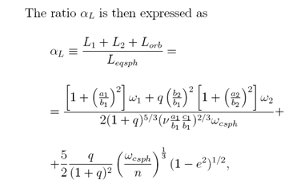
Total angular momentum
Small asteroid binaries have the total angular momentum close to critical.
α_{L} is the total angular momentum of the binary system normalized to the angular momentum of a critically rotating equivalent sphere with zero tensile strength and angle of friction/repose of 90°.
For systems originating from critically spinning rubble piles, e.g., by a spin fission, α_{L} is close to 1 (Pravec and Harris 2007).
(65803) Didymos

Slide 12
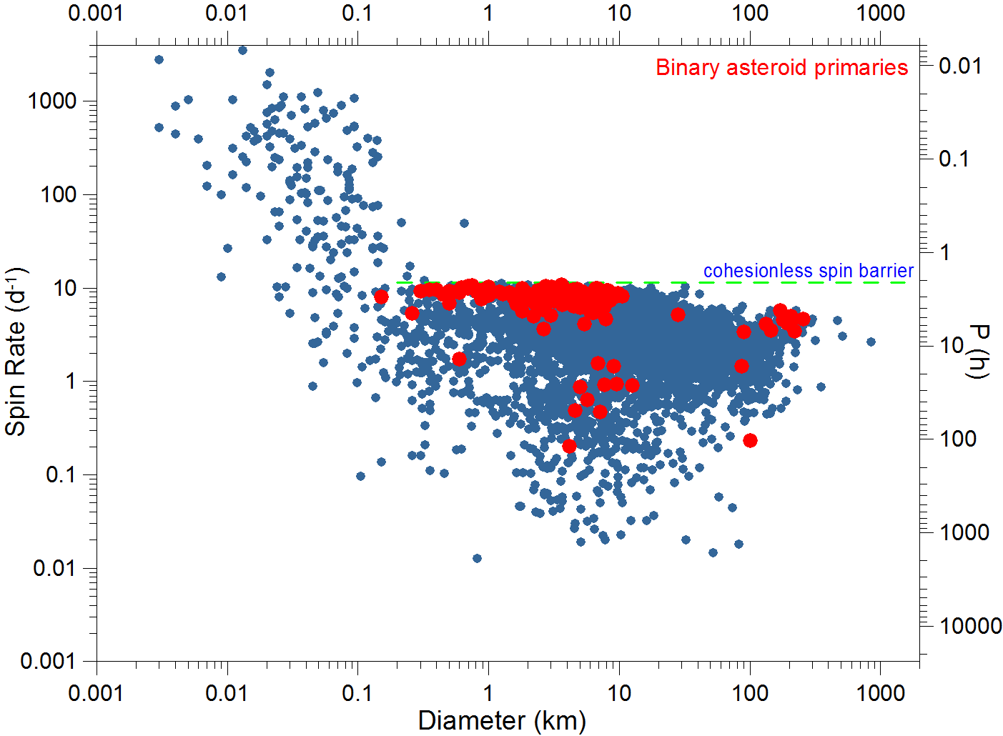
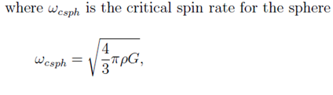
Primary rotations (mostly fast)
(65803) Didymos
Primaries concentrate below the spin barrier at 2.2 h; their rotational periods are mostly between 2.2 and 4 hours, with a tail to longer periods (some primaries were slowed down by spin-orbit interaction with large secondaries).
This suggests that they are gravity-dominated aggregates (might call them “rubble piles”), though a small cohesion is not ruled out.
At the spin barrier – balance between the gravity and centrifugal acceleration at the equator of a sphere with ρ ~ 3 g/cm³, taking into account also the angle of repose/ friction of 30-40°.

Slide 13
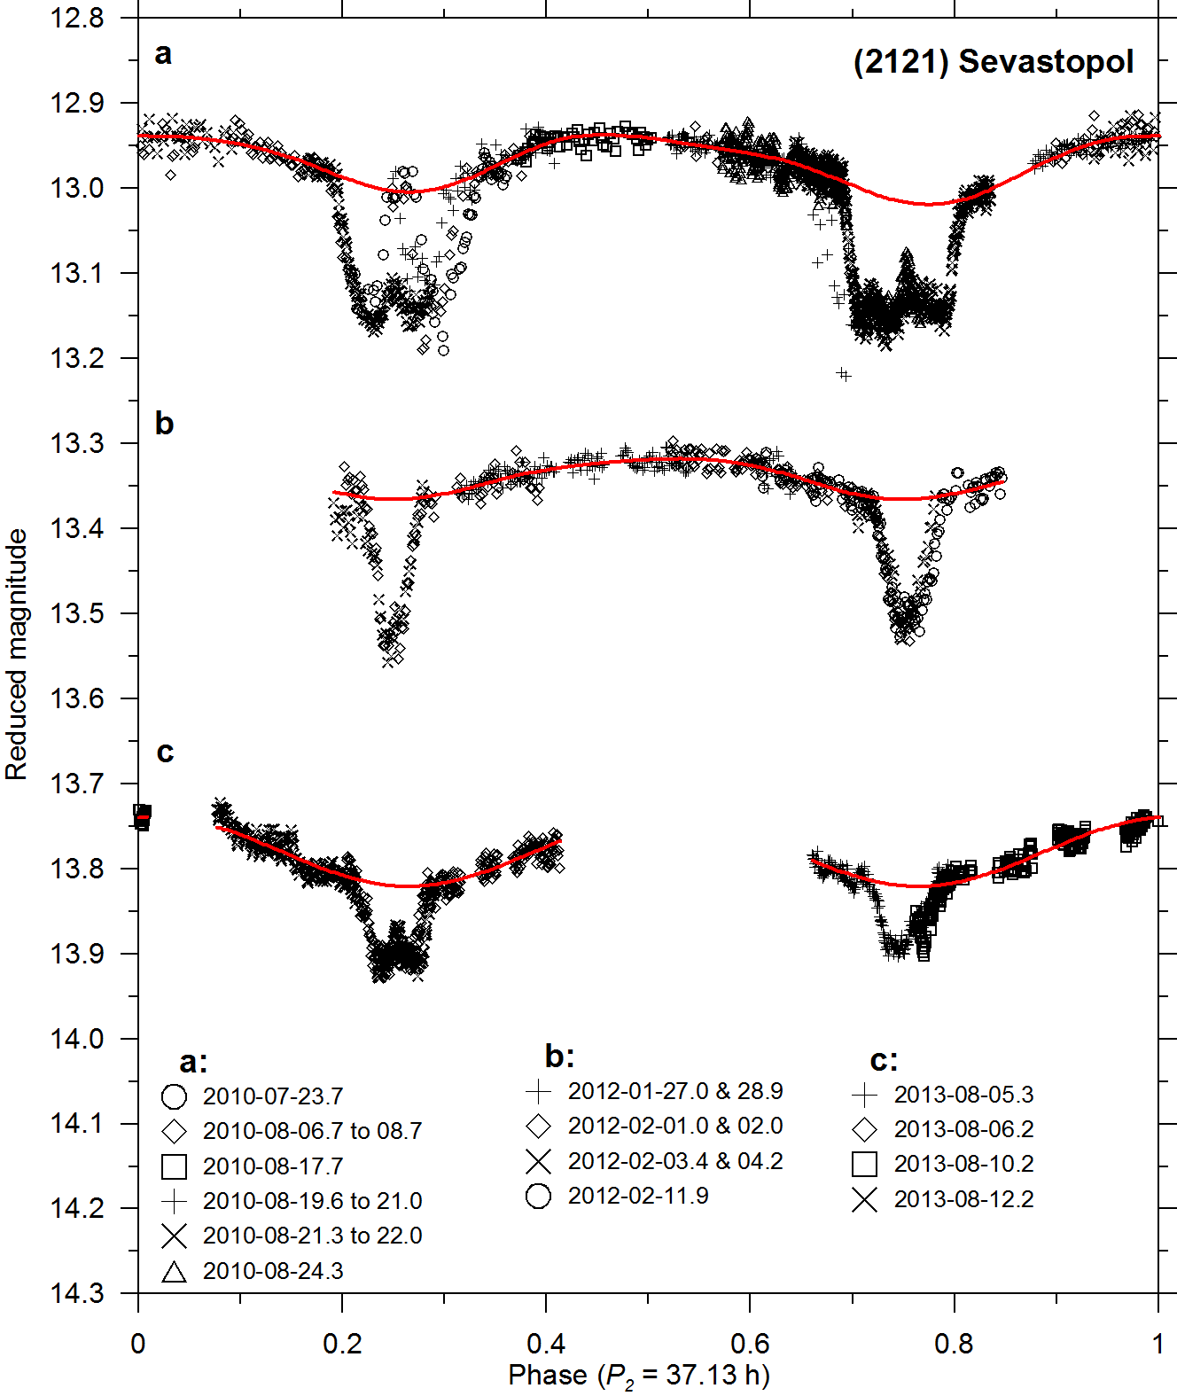
Secondary rotations
Secondaries on close orbits (a/D₁ <~ 3) are mostly on low (near-zero) eccentricity orbits and in synchronous rotations (in 1:1 spin-orbit resonance). Their long principal axes are approximately aligned with the primary and secondary COMs, libration angles are constrained to be mostly < 20° (Pravec et al. 2016).
Rotation of the secondary of
(65803) Didymos has not been observationally constrained yet, but we expect it is in 1:1 synchronous state, like other close asteroid secondaries with similar properties.
The next opportunity to directly establish the rotation of Didymoon will be during 2017-03-21 to 04-03 (two nights with a 6-m or larger telescope needed).
Secondary rotational mimima aligned with mutual events
P_{orb}/2 (e ~ 0)

Slide 14
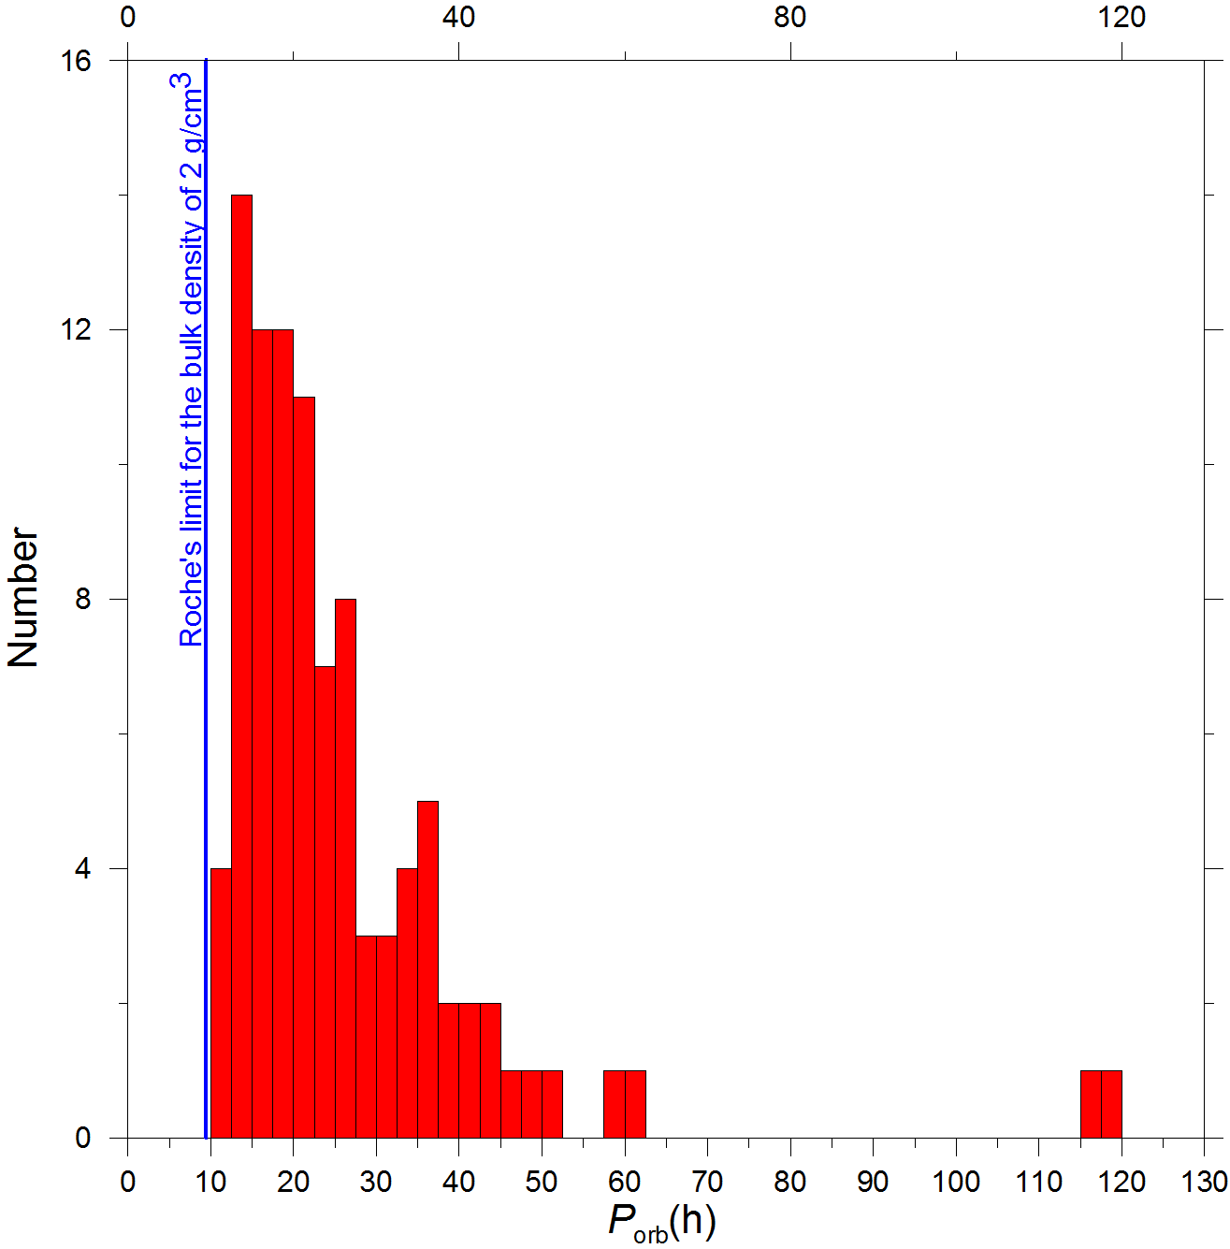
Secondaries above the Roche’s limit for strenghtless satellites
Distances between components:
Shortest P_{orb}:
(65803) Didymos: 11.920 ± 0.005 h
(Scheirich and Pravec 2009, updated)
2006 GY2: 11.7 ± 0.2 h
(Brooks 2006)
Corresponds to a/R₁ ~ 3.0. Consistent with the Roche’s limit for strengthless satellites at a/R₁ = 2.54 (for same densities of the two bodies) that corresponds to P_{orb} ~ 9.5 h for the bulk density of 2 g/cm³.
Alternative hypothesis: Closer orbits may be unstable or short-living?

Slide 15
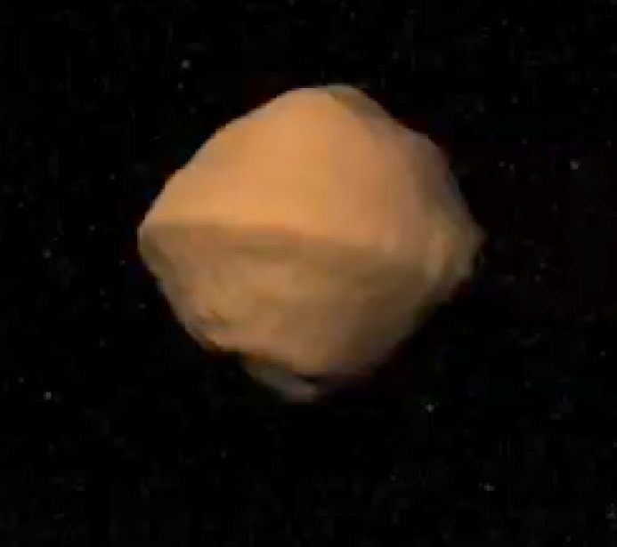
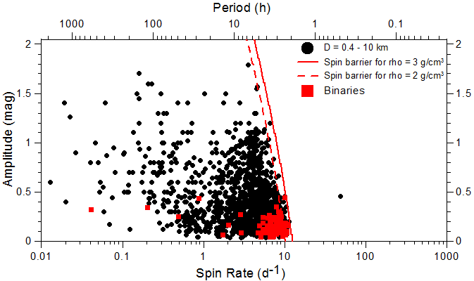
Primary shapes
Primaries:
not far from spheroidal, low equatorial elongations: a₁/b₁ = 1.1 ± 0.1 for > 90% of systems
A primary shape not far from rotational symmetry suggested to be a requirement for satellite formation or orbital stability (Walsh et al. 2008, Scheeres 2007).
Model of the primary of 1999 KW4 (Ostro et al. 2006)
(65803) Didymos

Slide 16
Primary shapes (cont.)
Model of the primary of 1999 KW4 (Ostro et al. 2006)
The primary’s “top shape” with equatorial ridge – suggested to be a result of “landsliding” and re-deposition of a large amount of regolith by tides from the secondary (Harris et al. 2009).
Preliminary model of Didymos’ primary shows it has a similar shape (Benner and Naidu, in prep.)
Suggests a rubble pile character of the “surface layer” at least.
Extremely low rigidity suggested from the apparent tidal-YORP equilibrium for 1996 FG3 (Scheirich et al. 2015). This suggests that also the interior of the primary is rubble pile.

Slide 17
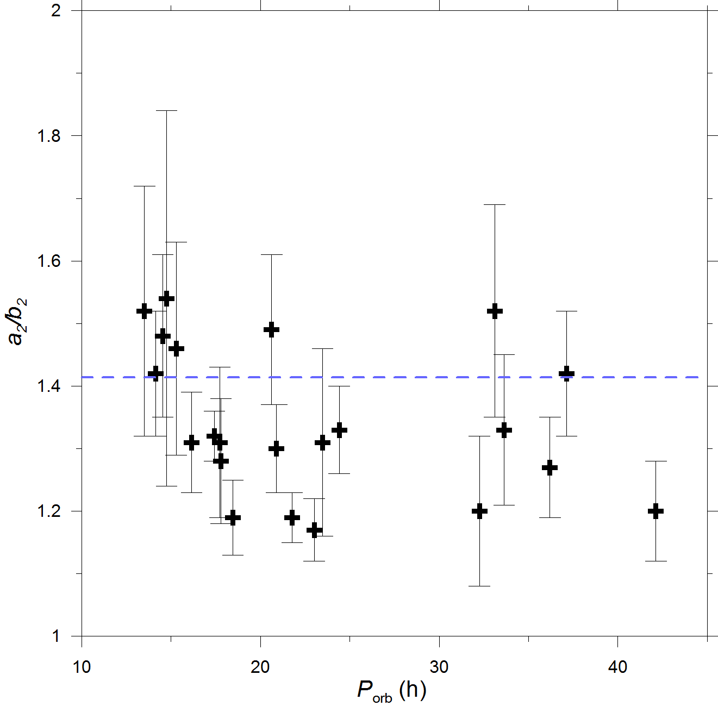
Secondary shapes
Secondary equatorial elongations (a₂/b₂) derived from amplitudes of synchronous secondary rotational lightcurves reveal an upper limit of a₂/b₂ ~ 1.5 (Pravec et al. 2016).
This may be due to chaotic rotations of more elongated secondaries or because they do not form or stay very elongated in gravitational (tidal) field from the primary.
We expect that Didymoon also has a₂/b₂ <~ 1.5.

Slide 18
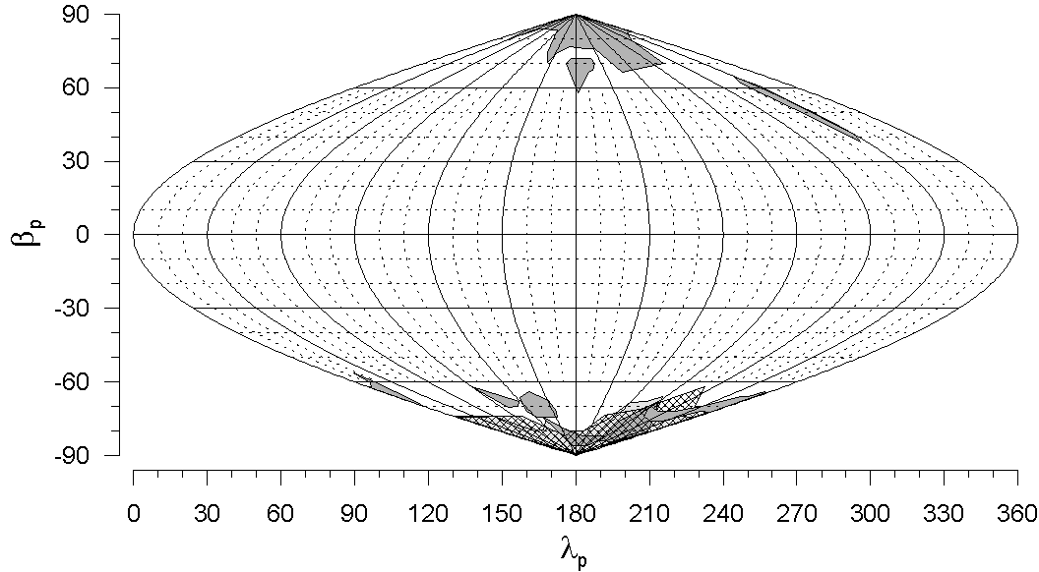
Orbital pole distribution
Orbital poles of small binary MBAs show a highly anisotropic distribution: they are oriented preferentially up/down-right, concentrating within 30° of the ecliptic poles (Pravec et al. 2012). A smaller sample of NEA binary orbital poles show a similar distribution (Scheirich et al., in prep.)
It is proposed to be due to the YORP tilt of spin axes of their parent bodies or the primaries toward the asymptotic states near obliquities 0 and 180°.
(65803) Didymos

Slide 19
Binary/pair/multiple asteroid formation

Slide 20
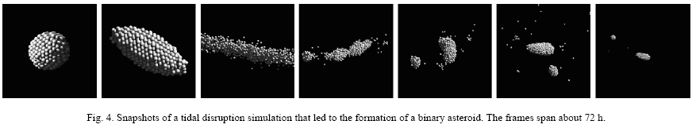
Binary formation theories
Ejecta from large asteroidal impacts (e.g., Durda et al. 2004) – does not predict the observed critical spin.
Tidal disruptions during close encounters with terrestrial planets (Bottke et al. 1996; Richardson and Walsh) – does not work in the main belt, so, it cannot be a formation mechanism for MB binaries. It may contribute to and shape the population of NEA binaries.
Fission of critically spinning parent bodies spun up by YORP
– appears to be a primary formation mechanism for small binary asteroids (e.g., Walsh et al. 2008) as well as for asteroid pairs (Scheeres 2007, Pravec et al. 2010)
(Walsh and Richardson 2006)

Slide 21
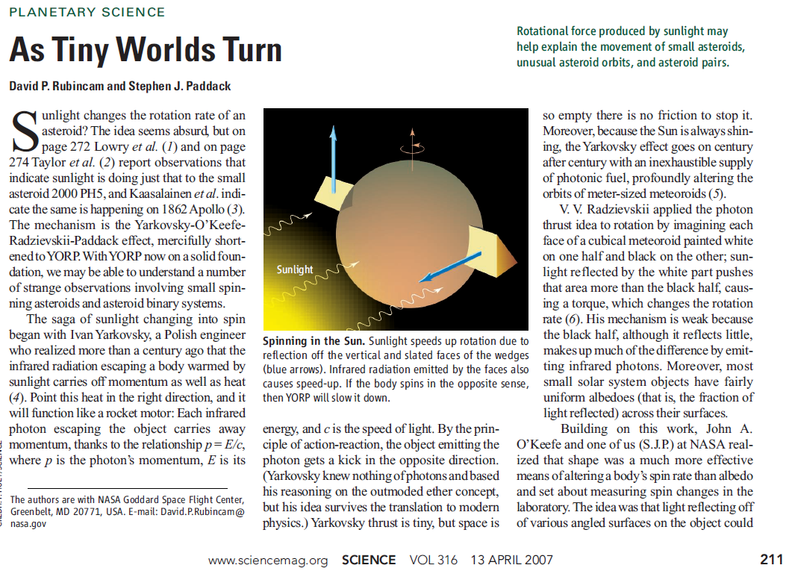
Yarkovsky-O'Keefe-Radzievskii-Paddack (YORP) effect
(Rubincam and Paddack 2007)

Slide 22

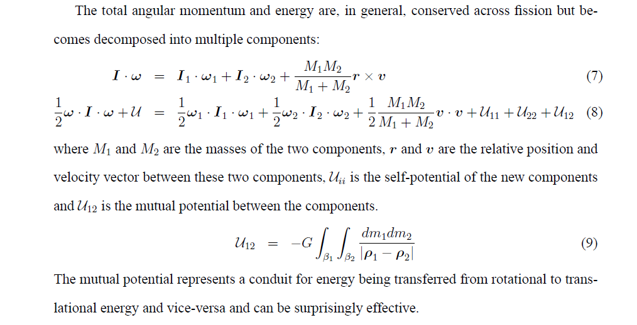
Pair formation by spin fission due to YORP spin-up
(Pravec et al. 2010)
Rotational fission theory by Scheeres
(Icarus 189, 370, 2007):
Spun-up by YORP, the “rubble pile” aster-
oid reaches a critical spin rate and fissions.
The secondary orbiting the primary, energy
being transferred from rotational to transla-
tional energy and vice-versa. If q < ~0.2,
the proto-binary has a positive free energy
and the two components can escape from
each other, after a period of chaotic orbit
evolution (~ several months), and become
an “asteroid pair”.

Slide 23
Didymos in context of the binary asteroid population
Didymos appears to be a typical member of the population of small binary asteroids formed by spin-up fission, in most of its characteristics.
With P₁ = 2.26 h and P_{orb} = 11.9 h, it lies close to the high end of the distributions of primary rotational and secondary orbital rates among small binary asteroid systems – this might be due to its bulk density higher than average for binary asteroids.
Thank you!

Slide 24
Thank you

Slide 25
Additional slides

Slide 26
Evidence for formation by rotational fission

Slide 27
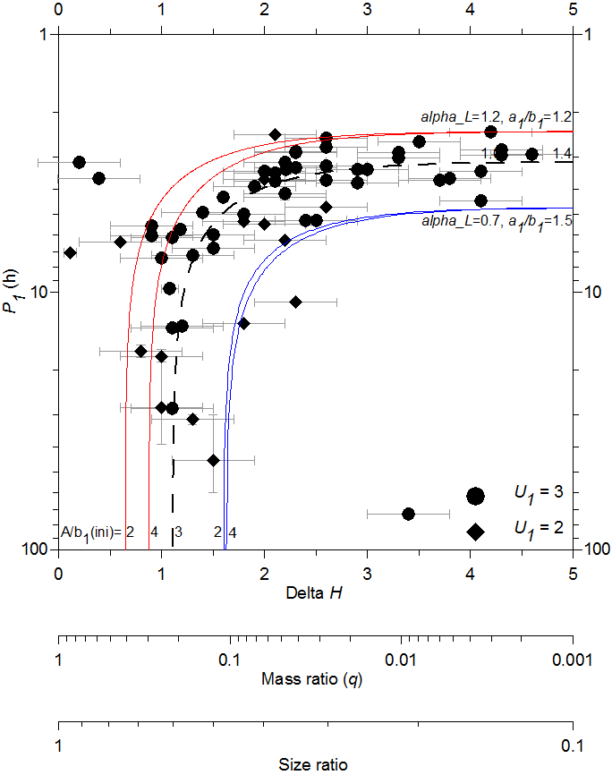
Asteroid pairs - correlation between P₁ and q
The observed correlation is an evidence for formation of asteroid pairs by rotational fission.
(Pravec et al. 2010)
P₁ measured for 64 asteroid pair primaries.
The correlation between P₁ and q holds for 60:
Low-mass ratio pairs (q <~0.05): Primary rotations not substantially slowed down in the separation process, P₁ = 2.4 to 5 h.
Medium-mass ratio pairs (q = 0.05 to ~0.2): Primaries slowed down as a substantial amount of angular momentum taken away by the escaped secondary.
High-mass ratio pairs (q > 0.2): Three observed cases require an additional supply of angular momentum.

Slide 28
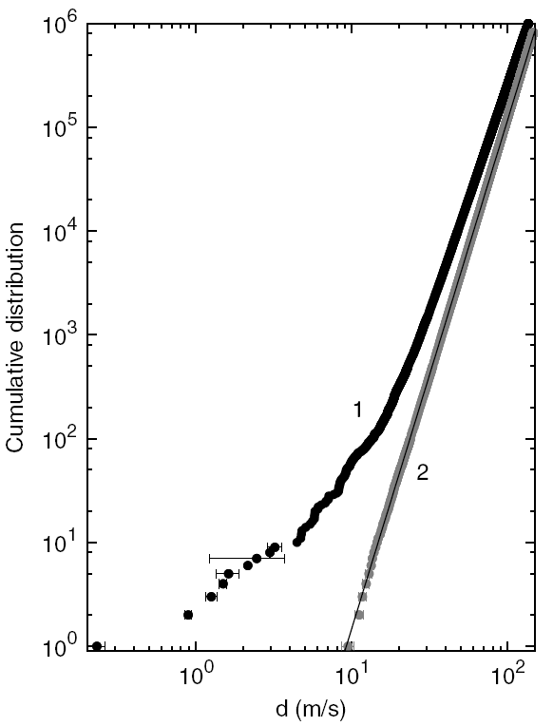
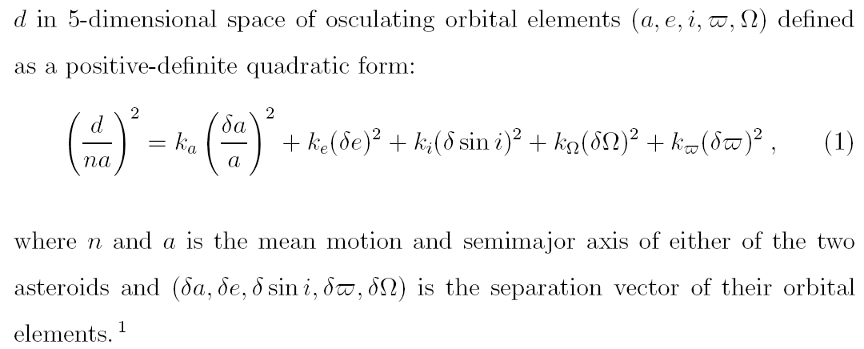

Asteroid pairs
Vokrouhlický and Nesvorný (2008) found a population of pairs of asteroids residing on very similar orbits. They showed that the pairs cannot be random, but they must be genetically related.
Pravec and Vokrouhlický (2009) extended the analysis
and found numerous significant pairs. Backward
integrations and spectral observations (e.g., Polishook
et al., Moskovitz et al.) of pair components confirmed
their relation.

Slide 29
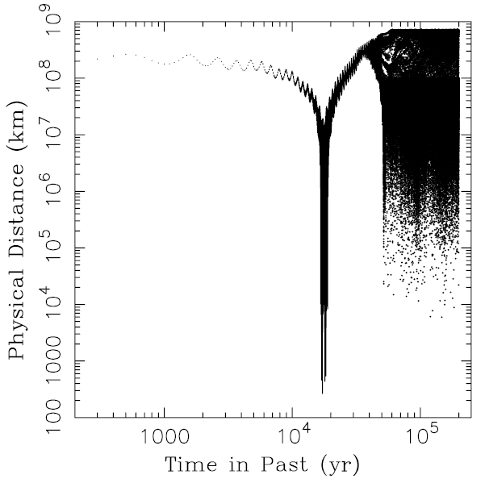
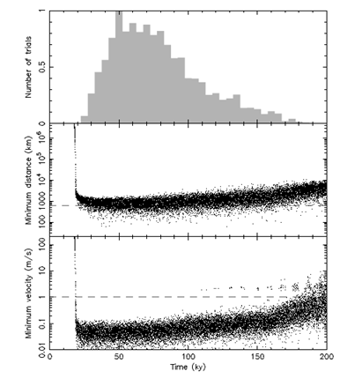
Low relative velocities of asteroid pair components; low satellite’s inclination in binaries
1) Relative velocities < 1 m/s, on an order of the escape velocity from parent body.
2) Orbital poles of most binary asteroids constant, i.e., the orbits not precessing on timescales of days to years, indicating a low inclination of the satellite’s orbit - in the primary’s equatorial plane.

Slide 30
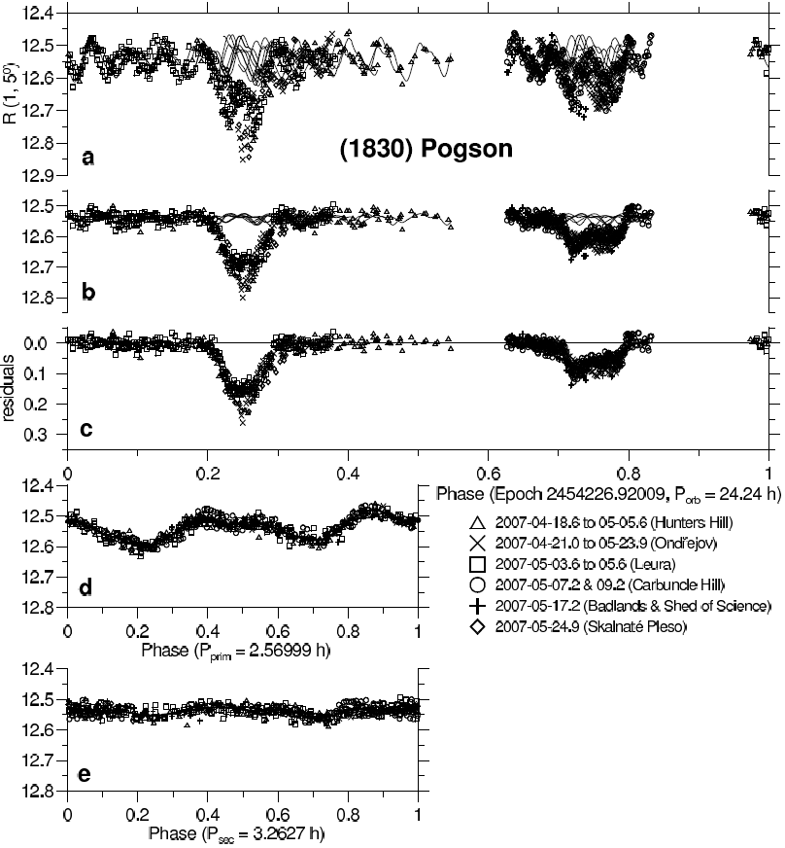
Ternary systems: (1830) Pogson
(Pravec et al. 2012)

Slide 31
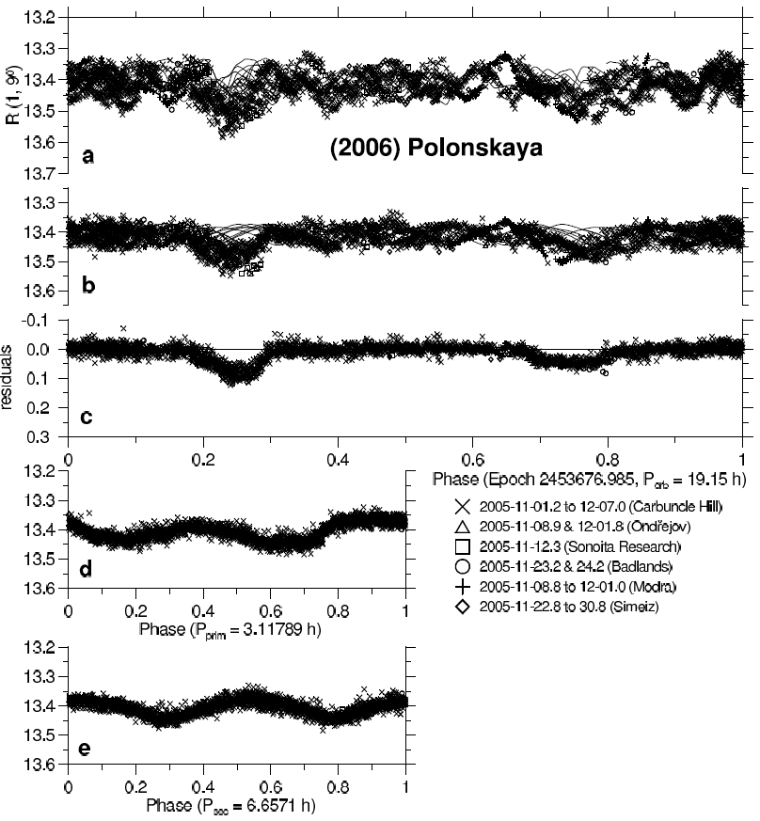
Ternary systems: (2006) Polonskaya
(Pravec et al. 2012)

Slide 32
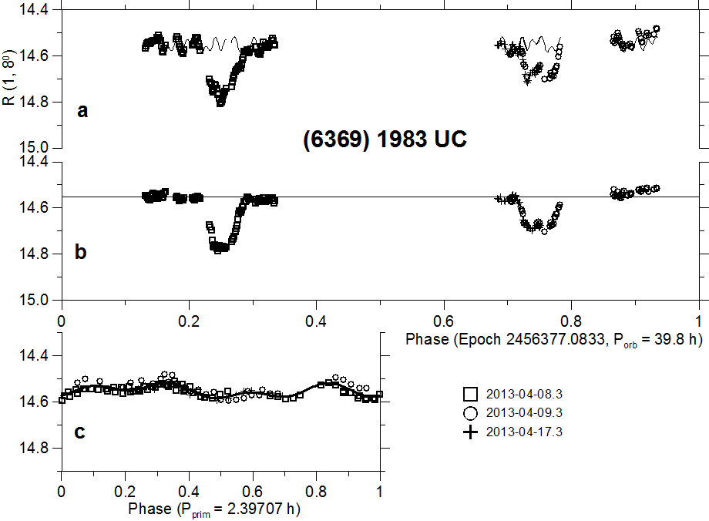
Survey for binaries among paired asteroids
We run a photometric survey for binaries among primaries of asteroid pairs with the 1.54-m telescope on La Silla since October 2012. Supporting observations are taken with smaller telescopes at Ondřejov and collaborating stations.
A proper observational strategy for resolving binarity (by detecting mutual events superimposed to the primary rotational lightcurve) is used.

Slide 33
Asteroid pairs with bound secondaries
We know 10 now (in a sample of 72 pairs)
Paired binary/ternary Pair Discovery Refs
-----------------------------------------------------------------------------------------------------------------------------
(3749) Balam 3749-312497 2002-2009 Merline et al. (2002), Marchis et al. (2008), Vokr. (2009)
(6369) 1983 UC 6369-2010UY57 2013 Pravec et al. (this work)
(8306) Shoko 8306-2011SR158 2013 Pravec et al. (2013)
(9783) Tensho-kan 9783-348018 2013 Pravec et al. (this work)
(10123) Fideoja 10123-117306 2013 Pravec et al. (this work)
(21436) Chaoyichi 21436-2003YK39 2014 Pravec et al. (this work)
(26416) 1999 XM84 26416-214954 2014-2015 susp. by Polishook (2014) confirmed by Pravec et al. (2015)
(43008) 1999 UD31 43008-2008TM68 2014 Pravec et al. (this work)
(44620) 1999 RS43 44620-295745 2014 Pravec et al. (this work)
(80218) 1999 VO123 80218-213471 2012 Pravec et al. (this work)
-----------------------------------------------------------------------------------------------------------------------------

Slide 34
Trends in properties of paired binaries/triples

Slide 35
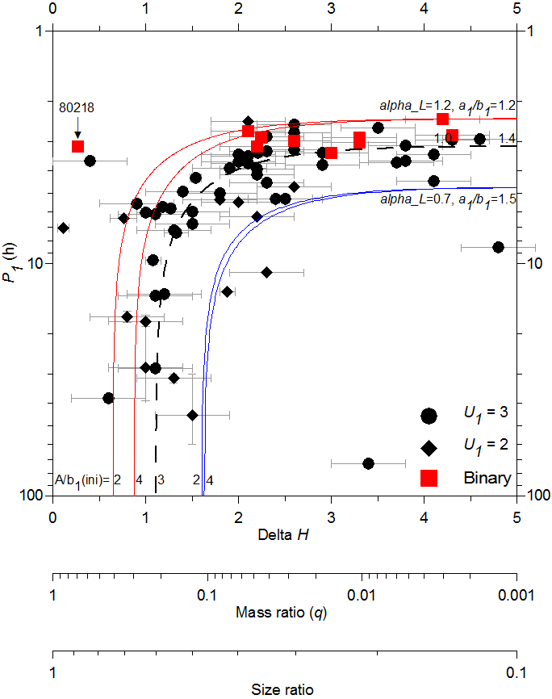
Primary rotations
Primaries of the 10 paired binaries/triples have P₁ from 2.40 to 3.35 h.
They are on the high end of the distribution of spin rates of primaries of asteroid pairs.
They are also in the upper half of the distribution of spin rates of primaries of similar binary asteroids in the MBA and NEA background population, which have P₁ from 2.2 up to 5 hours.
Asteroid systems with paired binaries/triples tend to have a higher-than-average (for ordinary asteroid pairs as well as for binaries in the background asteroid population) total angular momentum content.

Slide 36
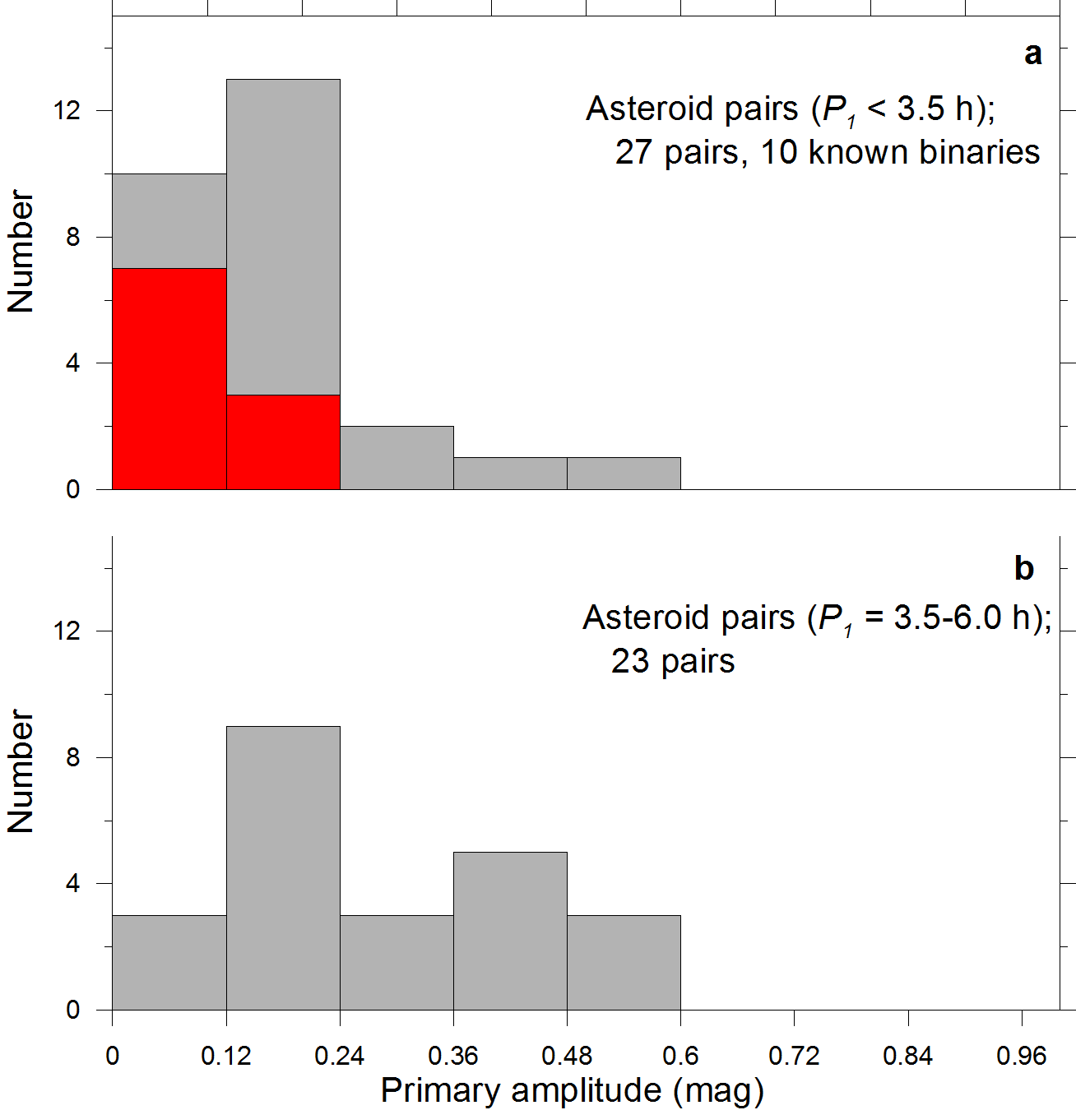
Primary shapes
Low amplitudes of the their rotational lightcurves indicate nearly spheroidal shapes of the primaries of paired binaries/ternaries – the same feature as observed for primaries of binaries in the background MBA/NEA population.
However, it is significant that most, if not all pairs with P₁ < 3.5 h and primary amplitudes ≤ 0.12 mag (a₁/b₁ ≤ 1.12) have bound secondaries around their primaries.

Slide 37
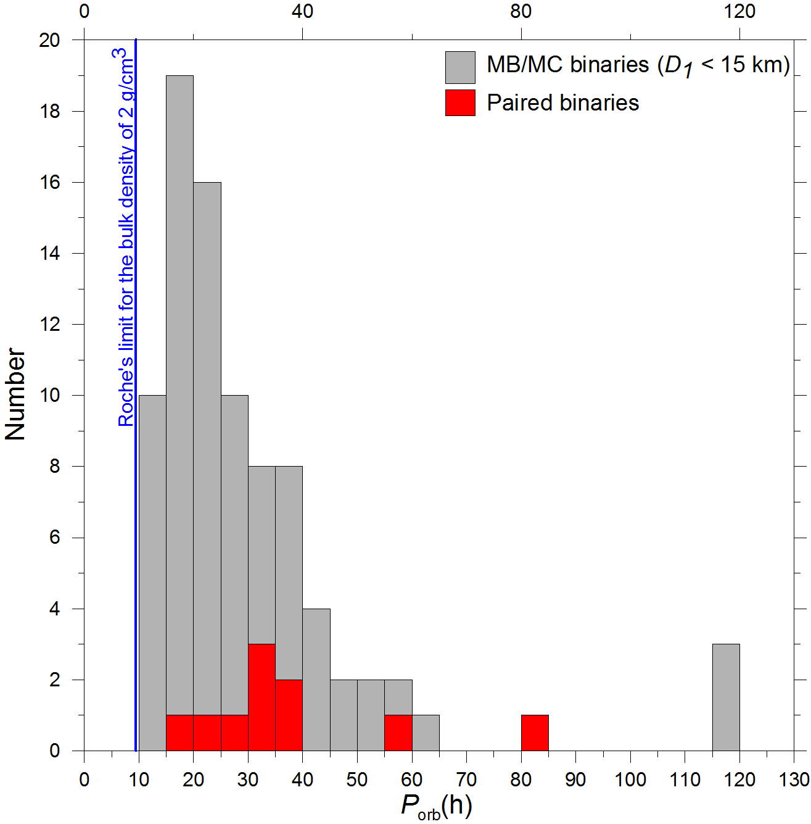
Orbital periods (of inner satellites)
There is a possible tendency of paired binaries to have longer orbital periods than the median (or the mode) for binaries in the background population of MB asteroids, but this needs to be confirmed on a larger sample.

Slide 38
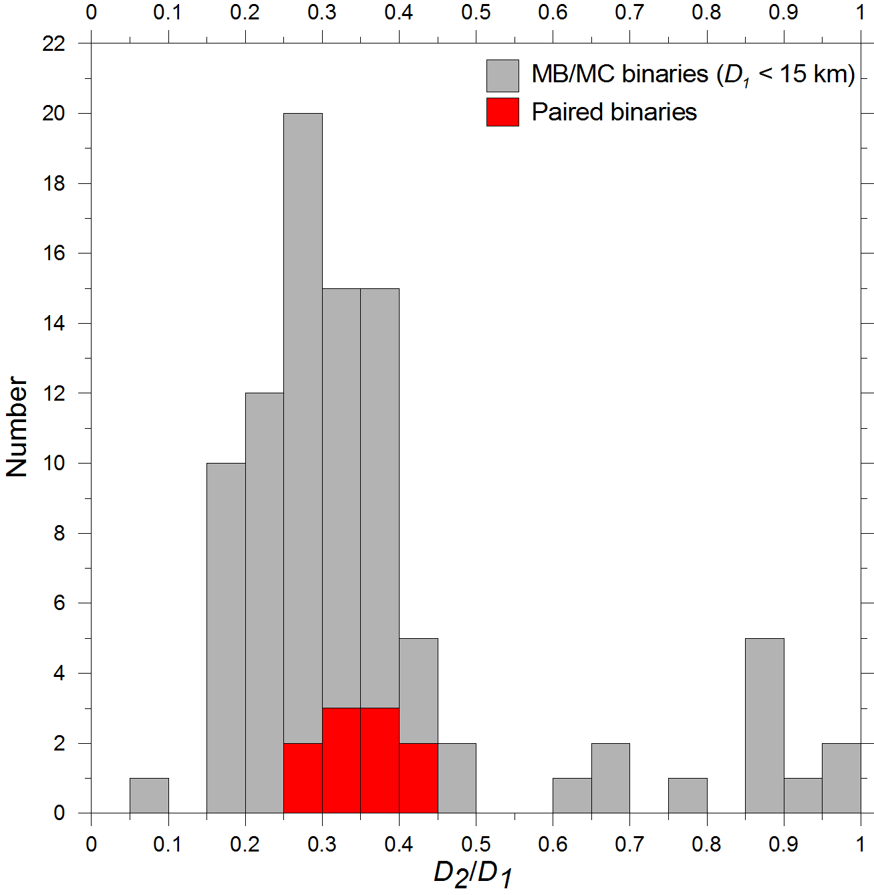
D₂/ D₁ (bound secondary-to-primary size ratios)
The bound secondaries of paired binaries (or the inner satellites of paired ternaries) have D₂/ D₁ in a range of 0.35 ± 0.10.
The lack of bound secondaries with D₂/ D₁ < 0.25 may be an observational bias; bound secondaries of asteroid pairs may have a similar relative size distribution as those of binaries in the background MB asteroid population.

Slide 39
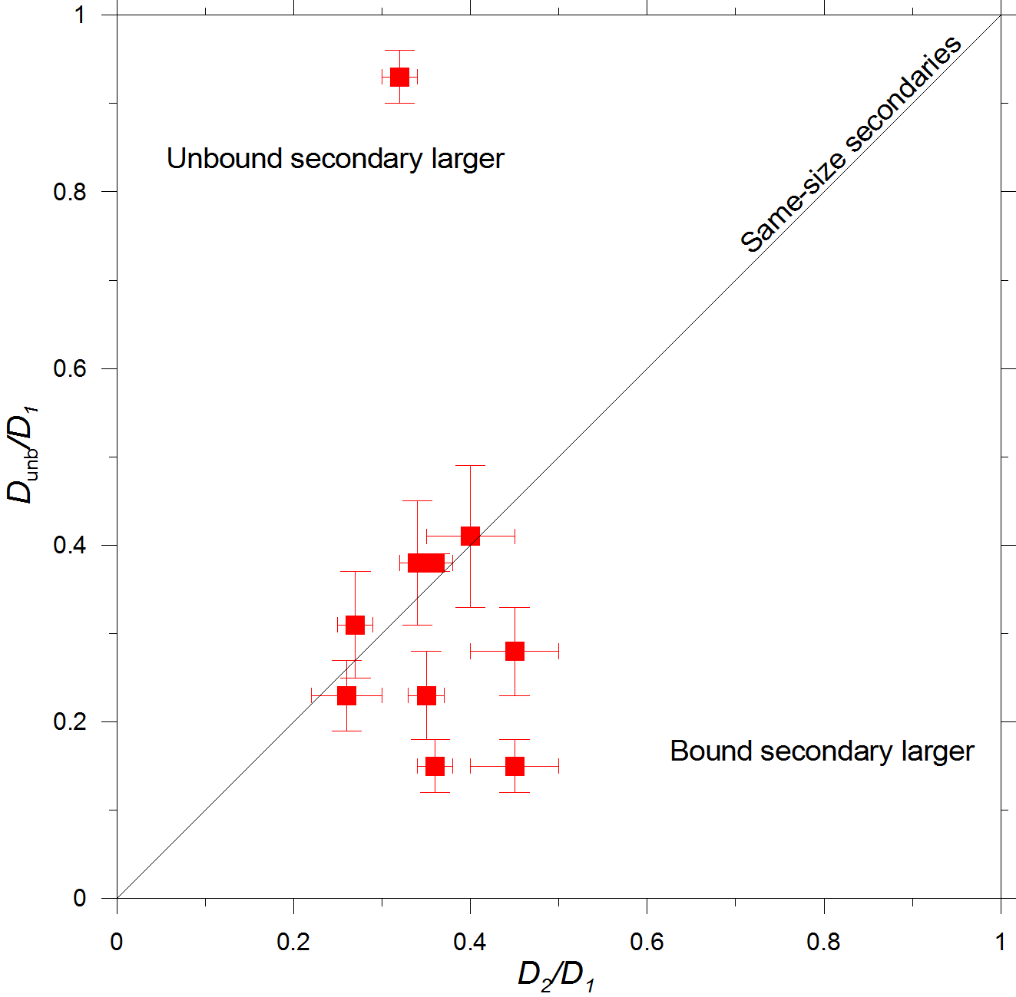
Bound vs unbound secondary sizes
The unbound secondaries tend to be of the same size or smaller than the bound secondaries.
Does it suggest that when there were two secondaries around the primary at some time in the past, the smaller one was typically ejected?
An exception is the pair 80218-213471 that has an anomalously large unbound secondary with D_{unb}/ D₁ = 0.93 ± 0.03.
It required an additional source or supply of angular momentum than provided by rotational fission of a cohesionless rubble-pile original asteroid to be ejected.

Slide 40
Additional properties
Following parameters and characteristics were obtained for some of the paired binaries only.
Three of the ten paired binaries have synchronous secondary rotations: (8306) Shoko, (44620) 1999 RS43 and (80218) 1999 VO123. Secondary rotations of the other seven have not been constrained.
Two of the ten paired binaries have a non-zero eccentricity of 0.06-0.1: (3749) Balam and (21436) Chayoichi. The other eight are consistent with circular orbits (though they could have small eccentricities too, just unresolved yet).
One to three of the ten paired binaries are triple systems: (3749) Balam is a confirmed triple, having a larger close and a smaller distant satellite, and (8306) Shoko and
(10123) Fideoja are suspect triples as they show additional rotational lightcurve components.

Slide 41
Ages of the bound and unbound secondaries

Slide 42

Unbound secondary ages
Backward integrations by J. Žižka and D. Vokrouhlický suggest following ages:
Paired binary/ternary Pair Time (kyr) since separation (unc. factor 1.2-2)
-----------------------------------------------------------------------------------------------------------------------------
(3749) Balam 3749-312497 310
(6369) 1983 UC 6369-2010UY57 750
(8306) Shoko 8306-2011SR158 500
(9783) Tensho-kan 9783-348018 840
(10123) Fideoja 10123-117306 1110
(21436) Chaoyichi 21436-2003YK39 70
(26416) 1999 XM84 26416-214954 310
(43008) 1999 UD31 43008-2008TM68 300
(44620) 1999 RS43 44620-295745 790
(80218) 1999 VO123 80218-213471 110
-----------------------------------------------------------------------------------------------------------------------------

Slide 43
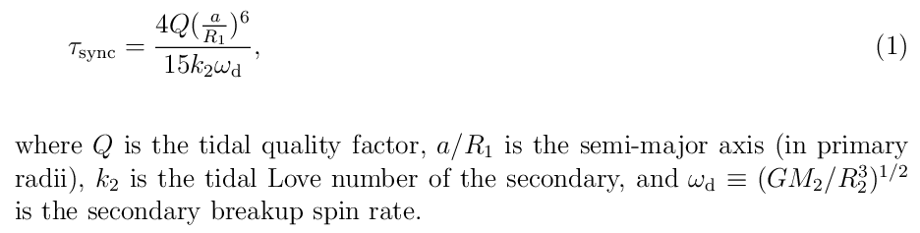
Bound secondary ages
Constraints obtained from the observation that the bound secondaries of (8306) Shoko, (44620) 1999 RS43 and (80218) 1999 VO123 are in synchronous rotation.
The tidal synchronization time scale (from Goldreich and Sari 2009):
For the three synchronous binaries, we estimate a/R₁ = 6.6, 6.2 and 6.2.
We assume ω_{d} = 7.5*10⁻⁴ s (for bulk density 2 g cm⁻³).
We assume Q = 10¹ to 10².
For the Love number, Goldreich and Sari (2009) give k_{rubble} <~ 10⁻⁵ R/km. For the
three synchronous binaries, we estimate R₂ = 0.55, 0.33 and 0.14 km, which gives
k₂ <~ 1*10⁻⁶ to 5*10⁻⁶; we assume k₂ = 10⁻⁶ for all the three.
This gives an estimated τ_{sync} ~ 2*10⁷ yr. The three bound secondaries are in their orbits for longer times.

Slide 44
Bound secondaries older than the unbound ones?
For the three systems, the unbound secondaries separated ~1-8*10⁵ yr ago, while the observed synchronous rotations of the bound secondaries suggest that they are in their orbits for >~ 2*10⁷ yr.
The bound secondaries might be formed in an earlier fission event (but could their orbits remain unchanged during the process of secondary ejection after a recent fission event? Note their D_{unb}/D₂ = 0.6, 1.1 and 2.9!),
OR
their tidal synchronization was much faster than thought so far (Q/k lower by at least 1-2 orders of magnitude than suggested by the theory),
OR
the unbound secondaries were not ejected quickly after fission, but they separated from the system after spending a longer time in orbit around the primary.
Data on the complex asteroid systems containing both bound and unbound secondaries are going to provide important constraints on the processes of spin-up fission and subsequent evolution of rubble pile asteroids.

Slide 45
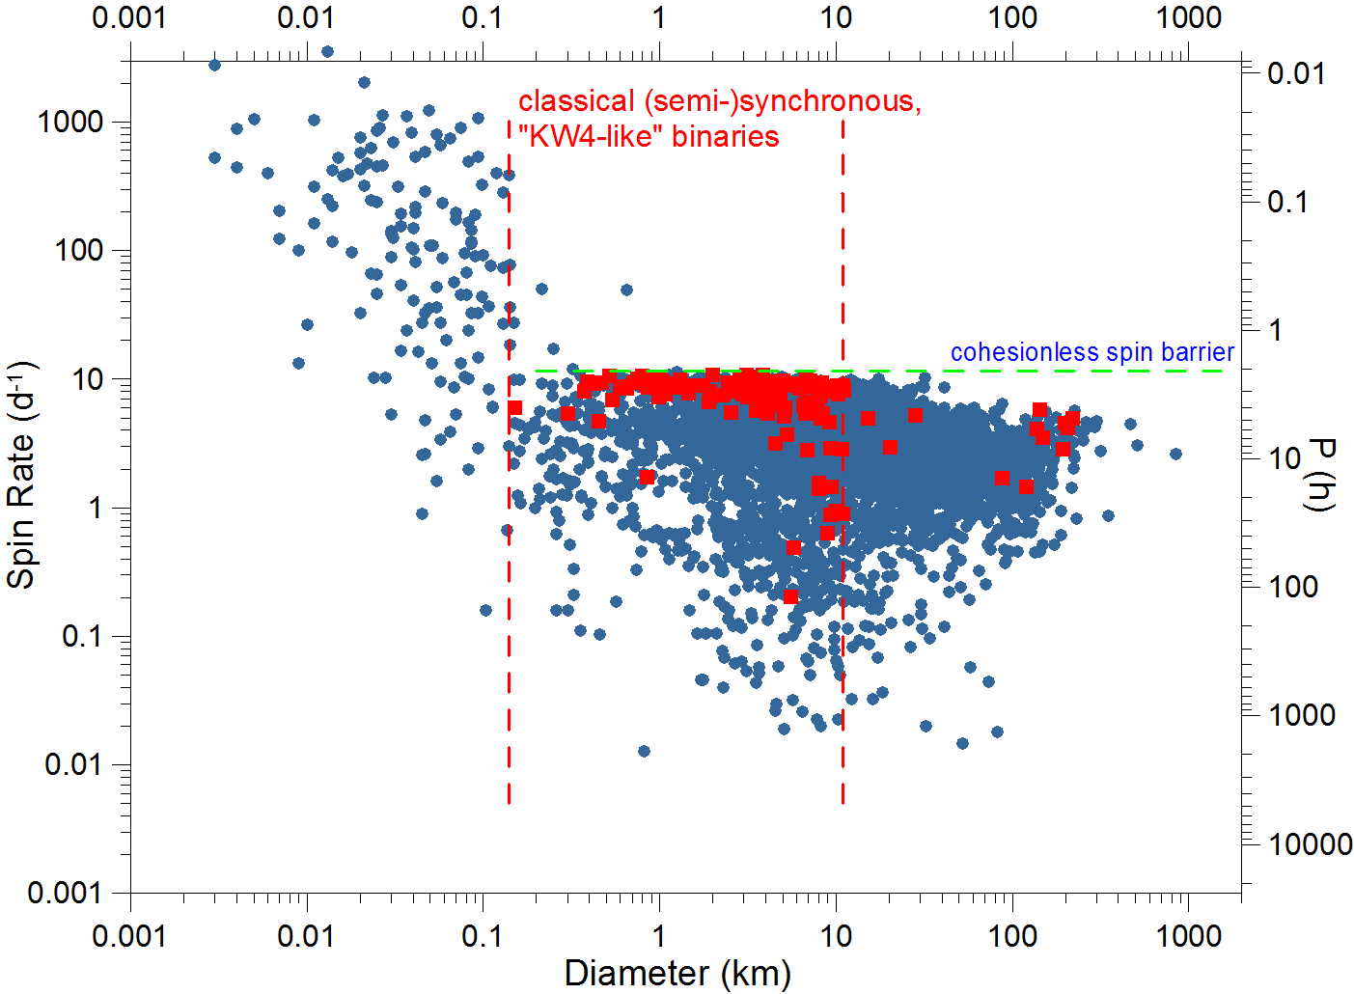
Spin-up fission asteroid systems
Primary sizes:
Largest D₁ ~ 10 km
(1052) Belgica: 10.3 ± 1.3 km (Franco et al. 2013)
(3868) Mendoza: 9.3 ± 1.0 km (Pravec et al. 2012)
Smallest D₁ ~ 0.15 km
2004 FG11: 0.15 ± 0.03 km (Taylor et al. 2012)
2003 SS84: 0.12 km (Nolan et al. 2003, no unc.)
This primary diameter range 0.15 to 10 km is the same range where we observe the spin barrier (gravity dominated regime, predominantly cohesionless, ‘rubble-pile’ asteroid structure implied).
The upper limit on D₁ seems to be because asteroids larger than ~10 km don’t get quite to the spin barrier where they would fission; asteroid spin rates fall off from the spin barrier at D > 10 km. (Are they too big to be spun up to the spin barrier by YORP during their lifetime? But see the talk by Holsapple.)
The lower limit on D₁ is likely because asteroids smaller than ~0.15 km are predominantly not “rubble piles”. But the observational selection effect against detection of smaller binaries has to be checked.

