Slide 1
A proposed ppK⁻ analysis for HADES
Eliane Epple
Ana Solaguren Beascoa Negre
Laura Fabbietti
Thue., 22.5.2011
12:00 – 12:30
Introduction
Exp signal
Background description
Proposed way to go
1
2
3
4

Slide 2
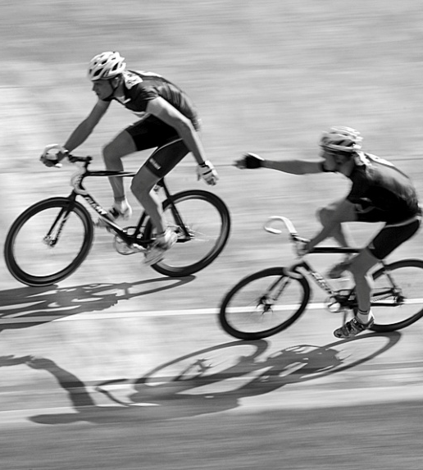
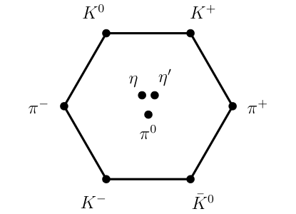
KN interaction near threshold
Theory
Experiment
Framework:
Effective Field Theory
hadronic degrees of freedom
With coupled channels
MB pairs transform into each other
KN <-> Σπ <-> Λπ⁰ <-> Λη … S=-1
Based on the chiral SU(3)
meson baryon effective Lagrangian
Constraints:
Threshold branching ratios
Г(K⁻p→π⁺Σ⁻), Г(K⁻p→π⁻Σ⁺),
Г(K⁻p→π⁰Λ)
ΔE and Г of the 1s state
in kaonic hydrogen
Low energy K⁻p scattering
cross sections
N. Kaiser, P. B. Siegel, and W. Weise, Nucl. Phys. A594 (1995)
E. Oset and A. Ramos, Nucl. Phys. A635 (1998)
J. A. Oller and U. G. Meißner, Phys. Lett. B500, (2001)
M. F. M. Lutz and E. E. Kolomeitsev, Nucl. Phys. A700 (2002)
Y. Ikeda, T. Hyodo,W. Weise Nucl. Phys. A 881 (2012)

Slide 3
The Λ(1405)
ready for publication
preliminary
First measurement in p+p
reactions of Λ(1405)→Σ^{+/-} π^{-/+}
Σ(1385)⁺
G. Agakishiev (HADES Coll.), Phys. Rev. C 85, 035203 (2012)
Σ(1385)⁰/Λ(1405) ratio
E. Epple (HADES Coll.), Hyp. Int. 210, 45-51 (2011)
Σ^{+/-}π^{-/+}pK⁺ production
J. Siebenson (HADES Coll.) , Int. J. Mod. Phys. A 26, 616-618 (2011)
Yoichi Ikeda, Tetsuo Hyodo, Wolfram Weise
Nuclear Physics A 881 (2012) 98–114

Slide 4
The Idea of bound kaonic-nuclear clusters
K⁻
K⁻
p
Is this possible?
p
p
Part of the Λ(1405) resonance
Prediction of deeply bound Anti-Kaon nuclear states
S. Wycech, Nucl.Phys. A450 399 (1986)
T. Yamazaki and Y. Akaishi, Phys Lett. B 535 (2002)
T. Yamazaki and Y. Akaishi, Phys Rev. C 65 (2002)
Variational calculations
Fadeev Calculations
T. Yamazaki, Y. Akaishi Phys. Rev. C76 (2007)
A. Doté, T. Hyodo, W. Weise Nucl. Phys. A804 (2008)
A. Doté, T. Hyodo, W. Weise Phys. Rev. C79 (2009)
S. Wycech, A. M. Green, Phys. Rev. C79 (2009)
N. Barnea, A. Gal, E. Z. Liverts, Phys. Lett. B712 (2012)
N.V. Shevchenko, A. Gal, J. Mares, Phys. Rev. Lett. 98 (2007)
N.V. Shevchenko, A. Gal, J. Mares, J. Révay, Phys. Rev. C76 (2007)
Y. Ikeda, T. Sato, Phys. Rev. C76 (2007)
Y. Ikeda, T. Sato, Phys. Rev. C79 (2009)
Y. Ikeda, H. Kamano T. Sato, Prog. Theor. Phys. 124 (2010)
E. Oset et al. Nucl. Phys. A881 (2012)
B(ppK⁻)≈ 14-80 MeV
Г(ppK⁻) ≈ 40-110 MeV/c²
W. Weise, R. Hartle, Nucl.Phys. A 804 (2008) 173-185
A. Cieply, E. Friedman, A. Gal, D. Gazda, J. Mares, Phys. Rev. C 84 (2011) 045206
D. Gazda, E. Friedman, A. Gal, J. Mares, Phys.Rev. C76 (2007) 055204

Slide 5
Isospin Configurations
|I ,I_{Z}> | p | n
K⁰ | |1,+1> | |1,0>, |0,0>
K⁻ | |1,0>, |0, 0> | |1,-1>

Slide 6
Isospin Configurations
|I ,I_{Z}> | p | n
K⁰ | |1,+1> | |1,0>, |0,0>
K⁻ | |1,0>, |0, 0> | |1,-1>
K⁻
K⁰
p
p
p
n
I_{NN} = 1
I_{NN} = 1

Slide 7
Isospin Configurations
|I ,I_{Z}> | p | n
K⁰ | |1,+1> | |1,0>, |0,0>
K⁻ | |1,0>, |0, 0> | |1,-1>
K⁻
K⁰
p
p
p
n
I_{NN} = 1
I_{NN} = 1
Property | Value
Charge | +1
Strangeness | -1
Baryon Number | 2
|I , I_{z} > | |1/2,+1/2>

Slide 8
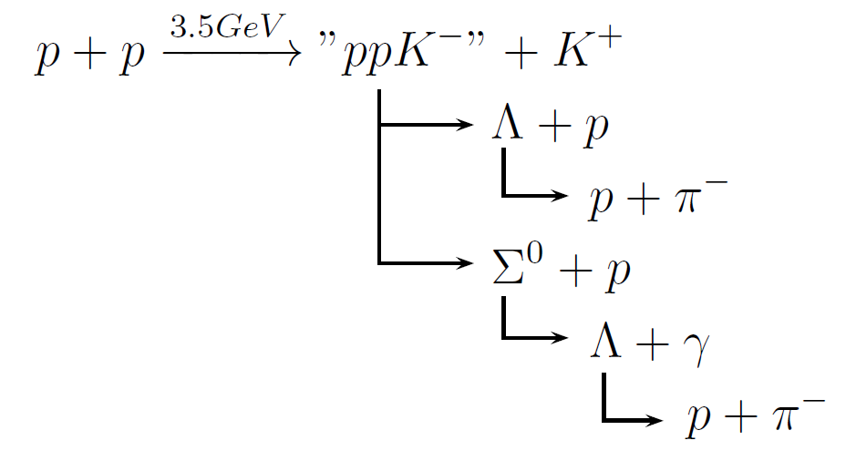
Isospin Configurations
|I ,I_{Z}> | p | n
K⁰ | |1,+1> | |1,0>, |0,0>
K⁻ | |1,0>, |0, 0> | |1,-1>
K⁻
K⁰
p
p
p
n
I_{NN} = 1
I_{NN} = 1
Property | Value
Charge | +1
Strangeness | -1
Baryon Number | 2
|I , I_{z} > | |1/2,+1/2>

Slide 9
Isospin Configurations
|I ,I_{Z}> | p | n
K⁰ | |1,+1> | |1,0>, |0,0>
K⁻ | |1,0>, |0, 0> | |1,-1>
K⁻
K⁰
p
p
p
n
I_{NN} = 1
I_{NN} = 1
Property | Value
Charge | +1
Strangeness | -1
Baryon Number | 2
|I , I_{z} > | |1/2,+1/2>

Slide 10
Experimental history

Slide 11
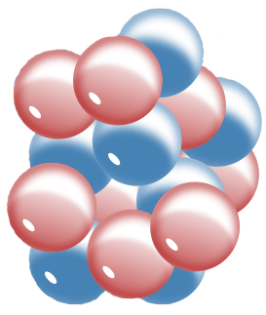
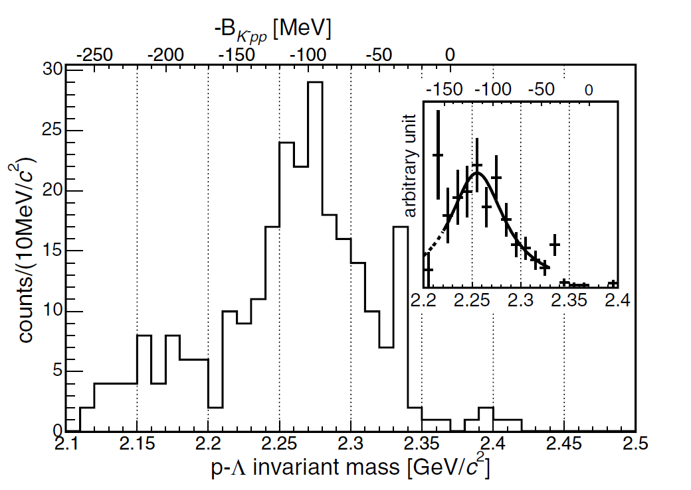
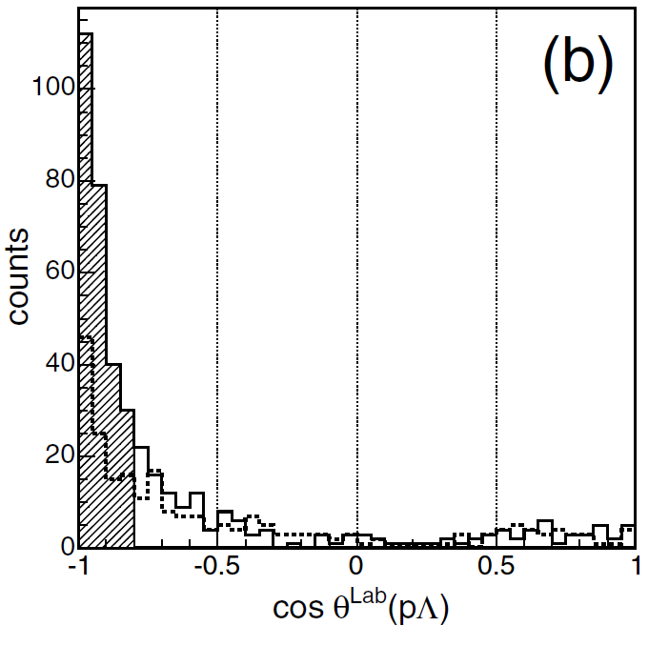
FINUDA
K⁻ + (⁶Li, ⁷Li, ¹²C)
-
K
Λ
M. Agnello et al. Phys. Rev. Lett. 94 (2005)
measured
Constraints:
cos(θ)^{LAB} < -0.8
Acc. p_{Λ}>300 MeV/c
acc. corr
M(ppK⁻) = 2.255 GeV/c
B(ppK⁻) = 115 MeV
Г(ppK⁻) = 67 MeV/c²

Slide 12
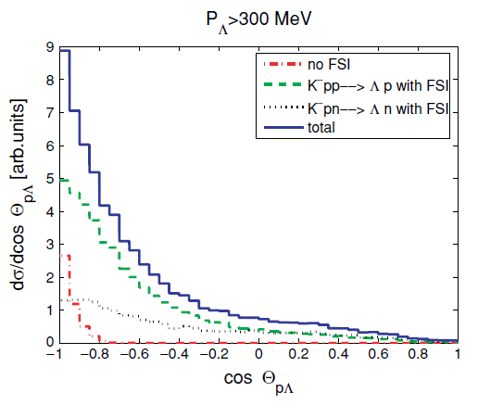
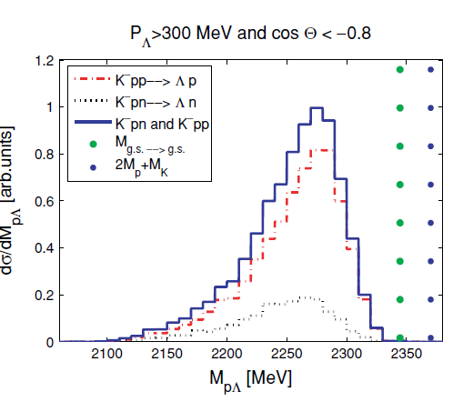
Contra interpretation
V.K. Magas et al. Physical Review C 74, (2006)
Simulated
K⁻ absorption on two nucleons
K⁻+p+p → Λp
K⁻+n+p → Λn
The decay products Λ and N
undergo final state interaction
with the rest nucleus

Slide 13
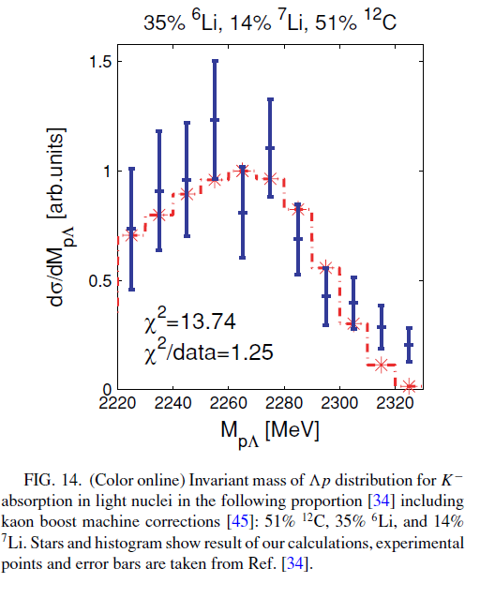
Sim
Exp
V.K. Magas et al. Phys. Rev. C 74, (2006)
M. Agnello et al. Phys. Rev. Lett. 94 (2005)
V.K. Magas et al. Phys. Rev. C 74, (2006)

Slide 14
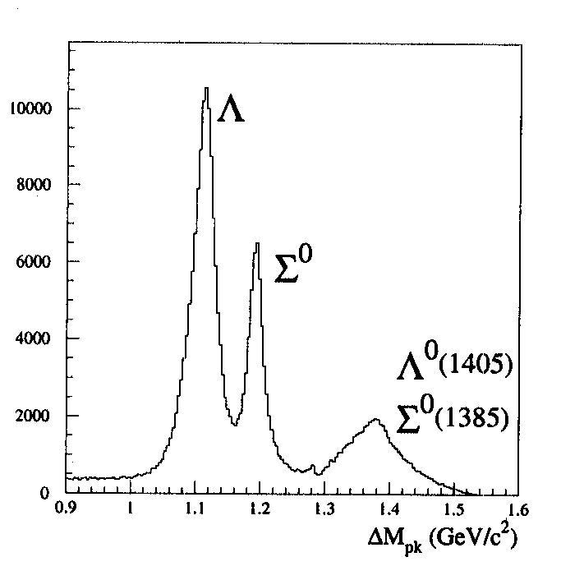
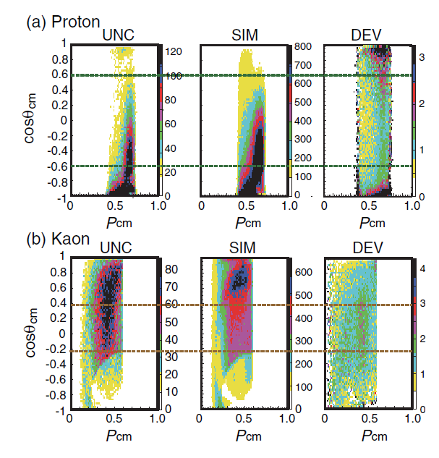
DISTO Results
Direct production of
pK⁺Λ according to phase space
p+p → p K⁺ Y
E_{Kin}(p) = 2.85 GeV
Strategy:
Select p K⁺ Λ production
Cuts on |cos(θ)_{p}^{CM} | < 0.6, (LAP)
Cut on -0.2< cos(θ)_{K}^{CM} < 0.4
Deviation Spectrum

Slide 15
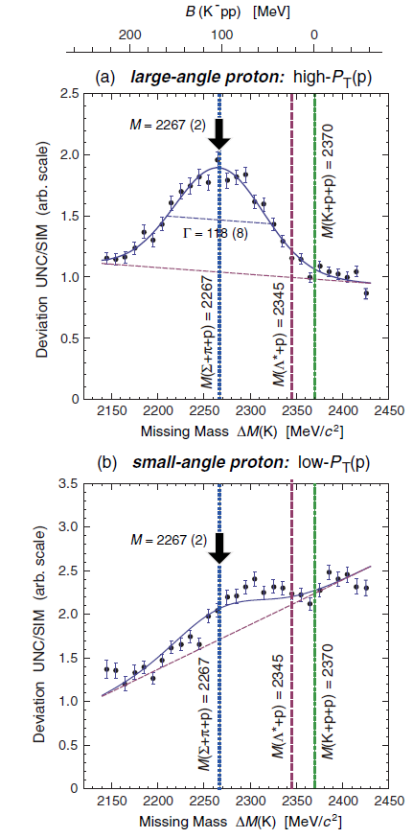
DISTO Results
M(ppK⁻) = 2.267 GeV/c
B(ppK⁻) = 103 MeV
Г(ppK⁻) = 118 MeV/c²
T. Yamazaki et al. Phys. Rev. Lett. 104, (2010)
M. Maggiora et al. Nucl. Phys. A 835 (2010)

Slide 16
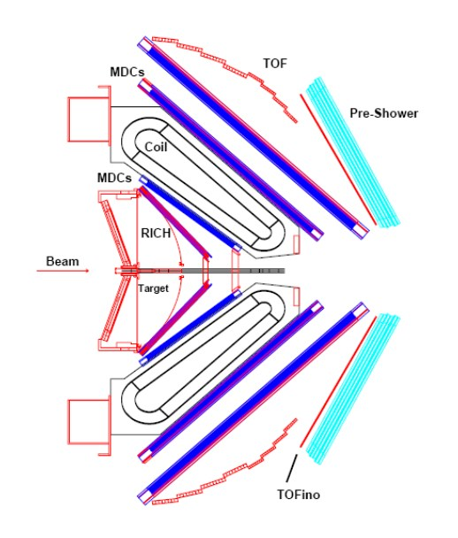
HADES analysis
p+p

Slide 17
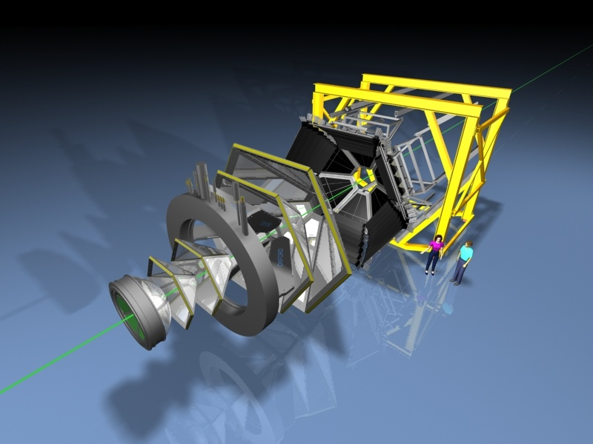
The HADES experiment
High Acceptance Di-electron Spectrometer
GSI, Darmstadt
85°
44°
15°
7°
HADES Coll. (G. Agakishiev et al.),
Eur. Phys. J. A41, 243-277 (2009)
FW
Fixed-target experiment
Full azimuthal coverage, 15˚- 85˚ in polar angle
Momentum resolution ≈ 1 % - 5 %
Particle identification via dE/dx & Tof

Slide 18
Selected Statistics
Event with : p,π⁻,p,K⁺
Λ
Σ⁰
Σ(1385)⁰
Λ(1405)

Slide 19
Selected Statistics
Event with : p,π⁻,p,K⁺
Λ
Λ
Σ⁰
Σ(1385)⁰
Λ(1405)

Slide 20
Selected Statistics
Event with : p,π⁻,p,K⁺
mass of Λ+p = 2053.96 MeV/c²
mass of Σ⁰+p = 2130.82 MeV/c²
mass of p+p+K⁻ = 2370.22 MeV/c²
Λ
Λ
Σ⁰
Σ(1385)⁰
Λ(1405)

Slide 21
Selected Statistics
Event with : p,π⁻,p,K⁺
mass of Λ+p = 2053.96 MeV/c²
mass of Σ⁰+p = 2130.82 MeV/c²
mass of p+p+K⁻ = 2370.22 MeV/c²
Λ
Λ
Σ⁰
Σ(1385)⁰
Λ(1405)

Slide 22
Selected Statistics
Event with : p,π⁻,p,K⁺
mass of Λ+p = 2053.96 MeV/c²
mass of Σ⁰+p = 2130.82 MeV/c²
mass of p+p+K⁻ = 2370.22 MeV/c²
Λ
Λ
Σ⁰
Σ(1385)⁰
Λ(1405)
Fantasy curve
Signal Extraction
Background determination
Subtraction/Division

Slide 23
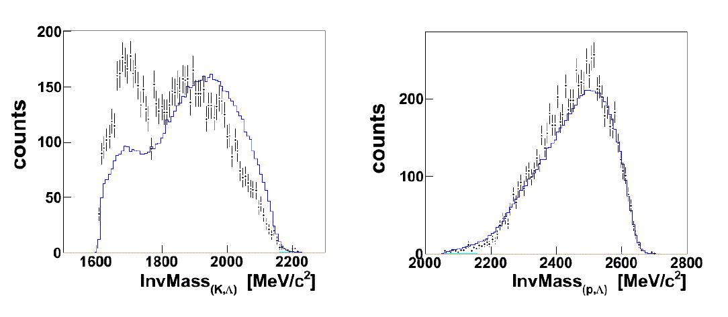
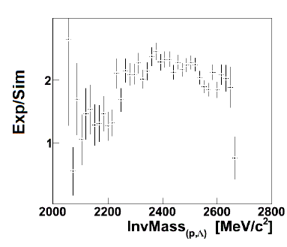
One Version for a background
A. Solaguren-Beascoa Negre, Mastherthesis, TU-München (2012)
p+p, 3.5 GeV
Exp Data
pKΛ phase
space sim
work in progress
work in progress
What to learn here from?
A deviation spectrum shows the differences between Experimental data and Simulations.

Slide 24
Background determination

Slide 25
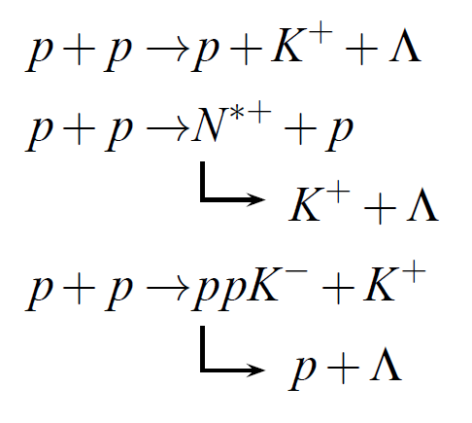
Sources for p+K+Λ
Processes
Observables

Slide 26
Sources for p+K+Λ
Processes
Observables

Slide 27
Sources for p+K+Λ
Processes
Observables
N*⁺(1650)
N*⁺(1720)
N*⁺(1900)
N*⁺(2190)

Slide 28
Sources for p+K+Λ
Processes
Observables
M(ppK⁻) = 2332 MeV/c²
M(ppK⁻) = 60 MeV/c²

Slide 29
Sources for p+K+Λ
Processes
Observables
N*⁺(1650)
N*⁺(1720)
N*⁺(1900)
N*⁺(2190)
M(ppK⁻) = 2332 MeV/c²
M(ppK⁻) = 60 MeV/c²

Slide 30
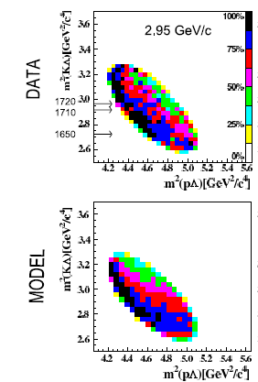
Findings from COSY-TOF
W. Eyrich et al. Phys. Lett. B688 (2010)
p+p → p K⁺ Λ
p+p → p N*
K⁺ Λ

Slide 31
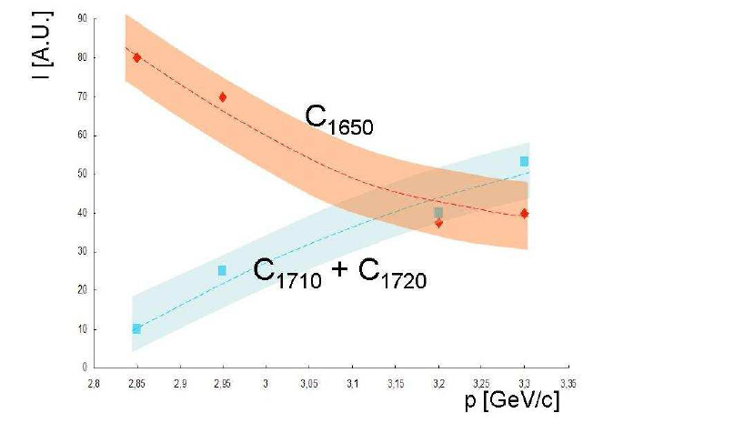
Findings from COSY-TOF
W. Eyrich et al. Phys. Lett. B688 (2010)
p+p → p K⁺ Λ
p+p → p N*
K⁺ Λ

Slide 32
Findings from COSY-TOF
W. Eyrich et al. Phys. Lett. B688 (2010)
p+p → p K⁺ Λ
p+p → p N*
K⁺ Λ
non resonant production of p K⁺ Λ is one order of
magnitude smaller as the resonant production

Slide 33
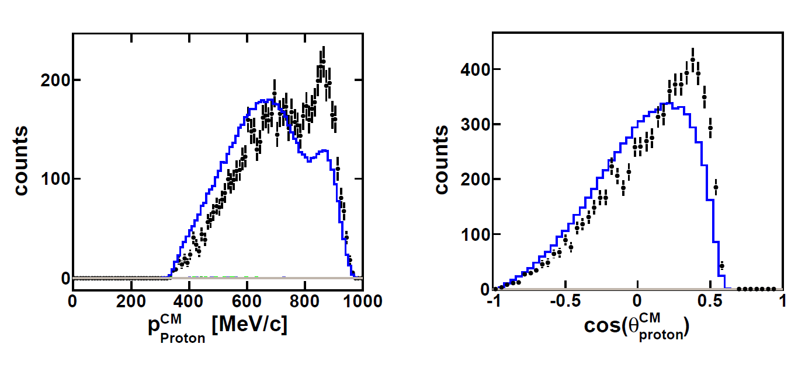
Momentum distribution
Exp Data
pKΛ phase-space sim
work in progress

Slide 34
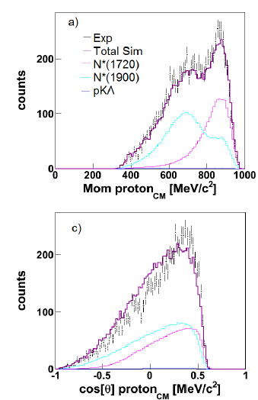
Proton distributions
A. Solaguren-Beascoa Negre, Mastherthesis, TU-München (2012)
Exp Data
pKΛ phase
space sim
work in progress

Slide 35
Kaon distributions
A. Solaguren-Beascoa Negre, Mastherthesis, TU-München (2012)
work in progress

Slide 36
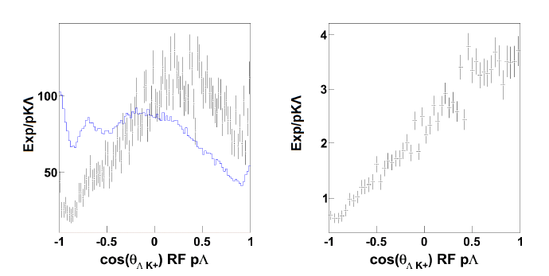
Helicity Angle
A. Solaguren-Beascoa Negre, Mastherthesis, TU-München (2012)
Exp Data
pKΛ phase
space sim
work in progress
+
Λ
K
θ
Beam
Target
p
p
K⁺Λ
K⁺Λ
`
p
K⁺Λ
K⁺Λ
ΛK⁺

Slide 37
Invariant Masses
A. Solaguren-Beascoa Negre, Mastherthesis, TU-München (2012)
Exp Data
pKΛ phase
space sim
work in progress

Slide 38
Signal Extraction

Slide 39
How to proceed?
Compare hypothesis to the data.
Calculate the confidence level of the
hypothesis
HIRES Coll., Phys. Rev. D 84, 032002 (2011)

Slide 40
How to proceed?
excluded
cross section
possible
cross section
HIRES Coll., Phys. Rev. D 84, 032002 (2011)

Slide 41
Summary
A broad theoretical discussion is ongoing about possible Anti-Kaon Nuclear
bound states. No clear picture
From experimental side the situation also stays discrepant
HADES data can deliver new information
The kinematics of the pK⁺Λ production has to be understood first
The PWA analysis can be helpful here
Adding a new signal to the analysis might bring a hint for a signal or
upper limits of a production cross section.

Slide 42
The HADES Collaboration
Jörn Adamczewski-Musch, Geydar Agakishiev, Claudia Behnke, Alexander Belyaev, Jia-Chii Berger-Chen, Alberto Blanco,
Christoph Blume, Michael Böhmer, Pablo Cabanelas, Nuno Carolino, Sergey Chernenko, Jose Díaz, Adrian Dybczak,
Eliane Epple, Laura Fabbietti, Oleg Fateev, Paulo Fonte, Jürgen Friese, Ingo Fröhlich, Tetyana Galatyuk, Juan A. Garzón,
Roman Gernhäuser, Alejandro Gil, Marina Golubeva, Fedor Guber, Malgorzata Gumberidze, Szymon Harabasz,
Klaus Heidel, Thorsten Heinz, Thierry Hennino, Romain Holzmann, Jochen Hutsch, Claudia Höhne, Alexander Ierusalimov,
Alexander Ivashkin, Burkhard Kämpfer, Marcin Kajetanowicz, Tatiana Karavicheva, Vladimir Khomyakov, Ilse Koenig,
Wolfgang Koenig, Burkhard W. Kolb, Vladimir Kolganov, Grzegorz Korcyl, Georgy Kornakov, Roland Kotte, Erik Krebs,
Hubert Kuc, Wolfgang Kühn, Andrej Kugler, Alexei Kurepin, Alexei Kurilkin, Pavel Kurilkin, Vladimir Ladygin, Rafal Lalik,
Kirill Lapidus, Alexander Lebedev, Ming Liu, Luís Lopes, Manuel Lorenz, Gennady Lykasov, Ludwig Maier,
Alexander Malakhov, Alessio Mangiarotti, Jochen Markert, Volker Metag, Jan Michel, Christian Müntz, Rober Münzer,
Lothar Naumann, Marek Palka, Vladimir Pechenov, Olga Pechenova, Americo Pereira, Jerzy Pietraszko, Witold Przygoda,
Nicolay Rabin, Béatrice Ramstein, Andrei Reshetin, Laura Rehnisch, Philippe Rosier, Anar Rustamov, Alexander Sadovsky, Piotr Salabura, Timo Scheib, Alexander Schmah, Heidi Schuldes, Erwin Schwab, Johannes Siebenson, Vladimir Smolyankin, Manfred Sobiella, Yuri Sobolev, Stefano Spataro, Herbert Ströbele, Joachim Stroth, Christian Sturm, Khaled Teilab, Vladimir Tiflov, Pavel Tlusty, Michael Traxler, Alexander Troyan, Haralabos Tsertos, Evgeny Usenko, Taras Vasiliev, Vladimir Wagner, Christian Wendisch, Jörn Wüstenfeld, Yuri Zanevsky

Slide 43
Backup

Slide 44
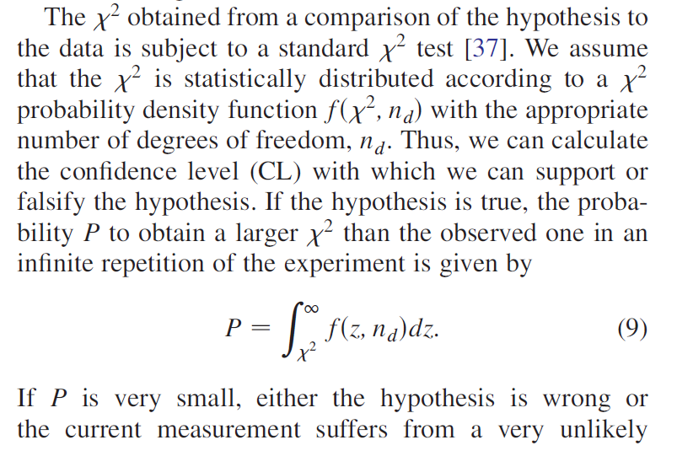
How to proceed?
Phys. Rev. D 84, 032002 (2011)
Compare hypothesis to the data.
Calculate the confidence level of the hypothesis

Slide 45
Publications
Papers:
K⁰
HADES Collaboration (G. Agakishiev et al.), Phys. Rev. C 82, 044907 (2010)
K^{+/-}
HADES Collaboration (G. Agakishiev et al.), Phys. Rev. C 80, 025209 (2009)
Ξ⁻
HADES Collaboration (G. Agakishiev et al.), Phys. Rev. Lett. 103, 132301 (2009)
Hyperons
HADES Collaboration (G. Agakishiev et al.), Eur. Phys. J. A 47, 21 (2011)
Technical paper
HADES Collaboration (G. Agakishiev et al.), Eur. Phys. J. A 41, 243-277 (2009)
Σ(1385)⁺
HADES Collaboration (G. Agakishiev et al.), Phys. Rev. C 85, 035203 (2012)
Dileptons ArKCl
HADES Collaboration (G. Agakishiev et al.), Phys. Rev. C 84, 014902 (2011)

Slide 46
The HADES experiment
High Acceptance Di-electron Spectrometer
GSI, Darmstadt
85°
44°
15°
7°
HADES Coll. (G. Agakishiev et al.),
Eur. Phys. J. A41, 243-277 (2009)
FW
Fixed-target experiment
Full azimuthal coverage, 15˚- 85˚ in polar angle
Momentum resolution ≈ 1 % - 5 %
Particle identification via dE/dx & Tof

Slide 47
Isospin Configurations
|I ,I_{Z}> | p | n
K⁰ | |1,+1> | |1,0>,|0,0>
K⁻ | |1,0>,|0, 0> | |1,-1>
K⁻
K⁰
p
p
p
n
I_{NN} = 1
Charge Q = +1
Strangeness S = -1
Baryon Number = 2
I | I_{z} = 3/2, 1/2 | +1/2
I_{NN} = 1
symmetric
pn combination
K⁰
Charge Q = +1
Strangeness S = -1
Baryon Number = 2
I | I_{z} = 1/2 | +1/2
p
n
I_{NN} = 0
anti-symmetric
pn combination

Slide 48
Isospin Configurations
|I ,I_{Z}> | p | n
K⁰ | |1,+1> | |1,0>,|0,0>
K⁻ | |1,0>,|0, 0> | |1,-1>
K⁻
K⁰
p
p
p
n
I_{NN} = 1
Charge Q = +1
Strangeness S = -1
Baryon Number = 2
|I , I_{z} >= |1/2,+1/2>
I_{NN} = 1
The “ppK⁻” is a linear combination of a
ppK⁻ and a pnK⁰
with total isospin I=1/2
and I_{NN}=1 → S=0
The pnK⁰ state
with total isospin I=1/2
and I_{NN}=0 → S=1
is called “K⁻d”
symmetric
pn combination
K⁰
Charge Q = +1
Strangeness S = -1
Baryon Number = 2
I | I_{z} = 1/2 | +1/2
p
n
I_{NN} = 0
anti-symmetric
pn combination

Slide 49
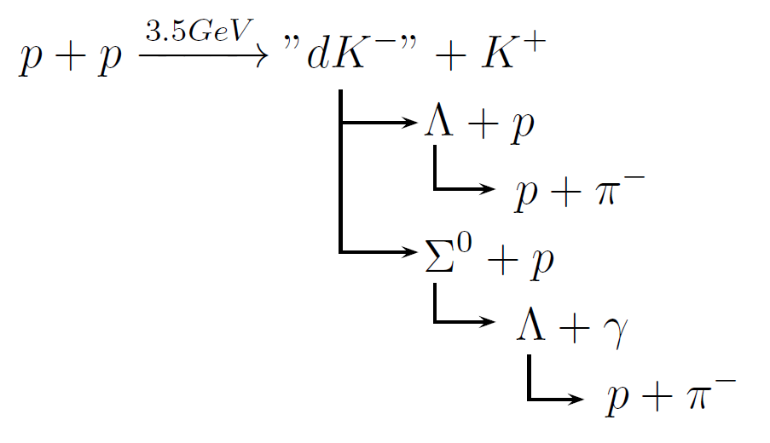
The three KNN states with Q=+1
K⁻
K⁰
K⁰
p
p
p
n
p
n
I_{NN} = 1
I_{NN} = 1
I_{NN} = 0
Charge Q = +1
Strangeness S = -1
Baryon Number = 2
I | I_{z} = 1/2 | +1/2

Slide 50
The three KNN states with Q=+1
K⁻
K⁰
K⁰
p
p
p
n
p
n
I_{NN} = 1
I_{NN} = 1
I_{NN} = 0
Charge Q = +1
Strangeness S = -1
Baryon Number = 2
I | I_{z} = 1/2 | +1/2

Slide 51
Isospin Configurations
I | I_{z} | p | n
K⁰ | 1 | +1 | 1,0 | 0
K⁻ | 1,0 | 0 | 1 | -1
Q=0
K⁻
K⁰
p
n
n
n
I_{NN} = 1
Charge Q = 0
Strangeness S = -1
Baryon Number = 2
I | I_{z} = 3/2, 1/2 | -1/2
I_{NN} = 1
symmetric
pn combination
K⁻
p
n
Charge Q = 0
Strangeness S = -1
Baryon Number = 2
I | I_{z} = 1/2 | -1/2
I_{NN} = 0
anti-symmetric
pn combination

Slide 52
Theta distributions
Exp Data
pKΛ phase-space sim

Slide 53
The Idea of a bound kaonic-nuclear clusters
I | I_{z} | pp | nn | pn, I=1 | pn, I=0
K⁰ | 3/2 | +3/2 | 3/2,1/2 | -1/2 | 3/2,1/2 | +1/2 | 1/2 | +1/2
K⁻ | 3/2,1/2 | +1/2 | 3/2 | -3/2 | 3/2,1/2 | -1/2 | 1/2 | +1/2

Slide 54
The Idea of a bound kaonic-nuclear clusters
I | I_{z} | pp | nn | pn, I=1 | pn, I=0
K⁰ | 3/2 | +3/2 | 3/2,1/2 | -1/2 | 3/2,1/2 | +1/2 | 1/2 | +1/2
K⁻ | 3/2,1/2 | +1/2 | 3/2 | -3/2 | 3/2,1/2 | -1/2 | 1/2 | +1/2
not bound

Slide 55
The Idea of a bound kaonic-nuclear clusters
I | I_{z} | pp | nn | pn, I=1 | pn, I=0
K⁰ | 3/2 | +3/2 | 3/2,1/2 | -1/2 | 3/2,1/2 | +1/2 | 1/2 | +1/2
K⁻ | 3/2,1/2 | +1/2 | 3/2 | -3/2 | 3/2,1/2 | -1/2 | 1/2 | +1/2
not bound
ppK⁻
K⁻d
Pauli rule I_{NN}=1 → S=0
spin=1

Slide 56
The Idea of a bound kaonic-nuclear clusters
I | I_{z} | pp | nn | pn, I=1 | pn, I=0
K⁰ | - | 1/2 | -1/2 | 1/2 | +1/2 | 1/2 | +1/2
K⁻ | 1/2 | +1/2 | - | 1/2 | -1/2 | 1/2 | +1/2
not bound
ppK⁻
K⁻d
Pauli rule I_{NN}=1 → S=0
spin=1

