Slide 1
Status of the FOPI pp Beamtime
Motivation
Particle Reconstruction
Inclusive Reconstruction
Exclusive Reconstruction with kinematical Refit
Summary and Outlook

Slide 2
Motivation

Slide 3
Kaonic bound states
Λ(1405)
Λ (1405)
Σ
π
p
Doorway Mechanism
Κ
+
p
T. Yamazaki et T. Akahishi, Phys. Rev. C 76 (2007) 045201
p
p
Κ
p–K⁻ Potential

Slide 4
N* - Resonances
Production Mechanism: p + p -> p + K⁺ + Λ
M. S.-W. : Eu. Phys. Jou. A 46

Slide 5
The Experiment

Slide 6
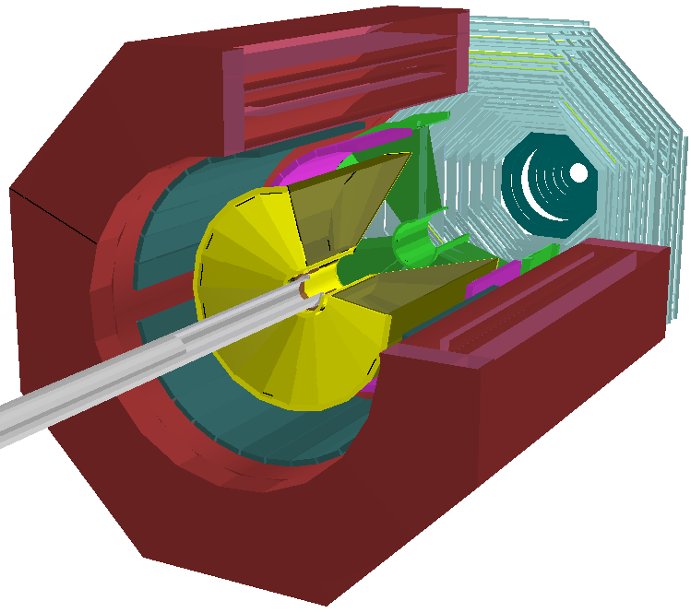
The Experiment
Magnet
Exclusive measurement:
PLAWA
RPC
3.1 GeV
p + p
Λ(1405) + p + K⁺
Helitron
ppK⁻
+ K⁺
CDC
Barrel
Λ
+ p
Beam
π⁻ + p
p-beam@3.1 GeV
Target: 2cm Liquid Hydrogen
80 Million LVL2 Trigger Events
σ(Start – RPC) : 200 ps
S(Start – PLAWA) : 400 ps

Slide 7
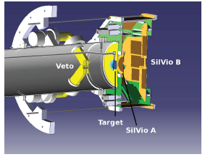
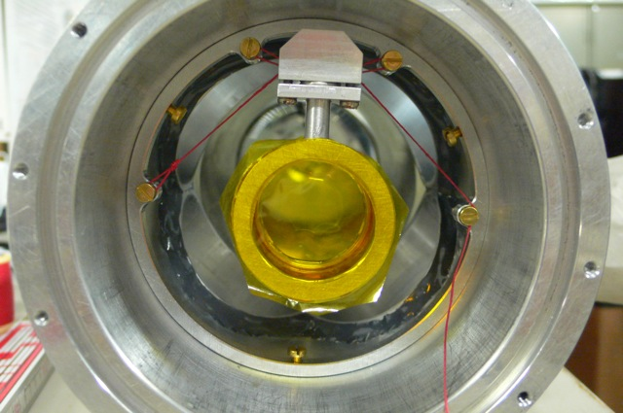
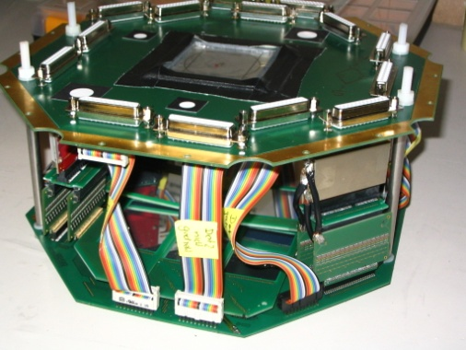
SiLViO
Magnet
PLAWA
RPC
Helitron
CDC
Barrel
Beam

Slide 8
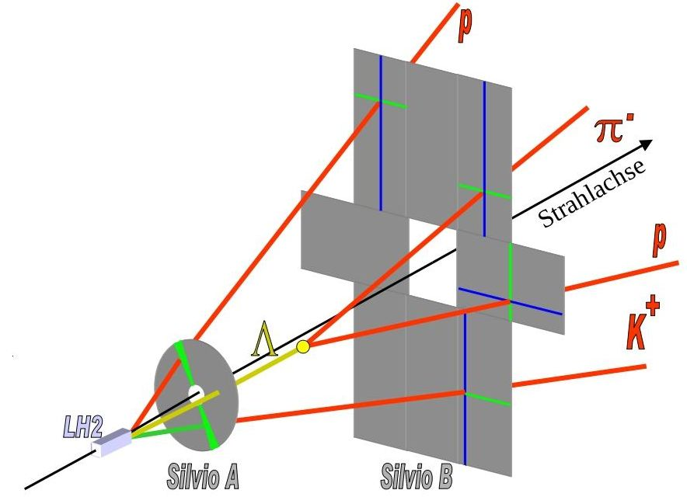
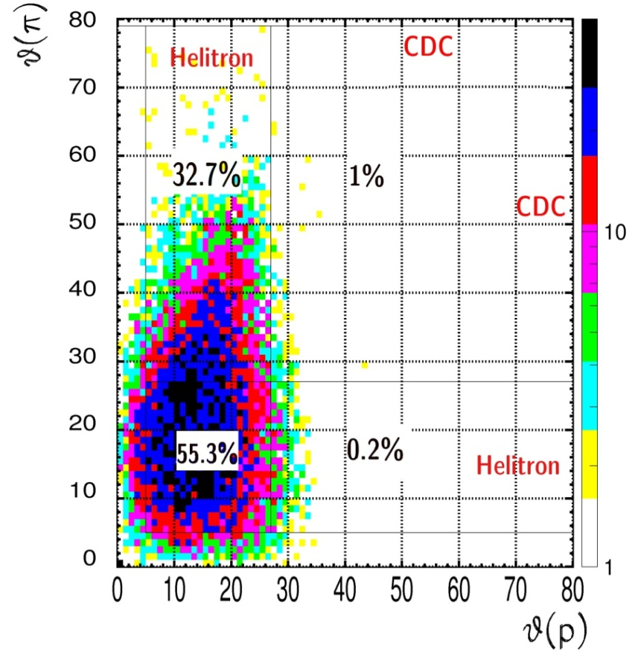
SiΛViO
Silicon Λ-Vertexing and Identification Online
M>1
Polar angle of particles from Λ decay
(pK⁺Λ / K⁺ in RPC acceptance)
M>0
NIMA617:300-302,2010
Trigger conditions
LVL1: M(TOF) > 1
LVL2: LVL1 + SiΛVIO
SiΛViO Acceptance
LVL1 / LVL2:
Signal (pK⁺Λ): 5.8
Background (UrQMD pp 3.1GeV): 20.3

Slide 9
Particle Selection

Slide 10
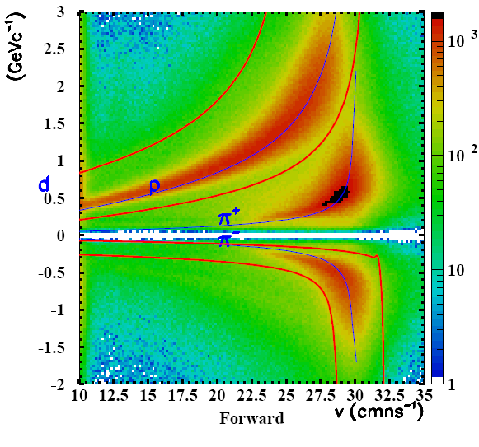
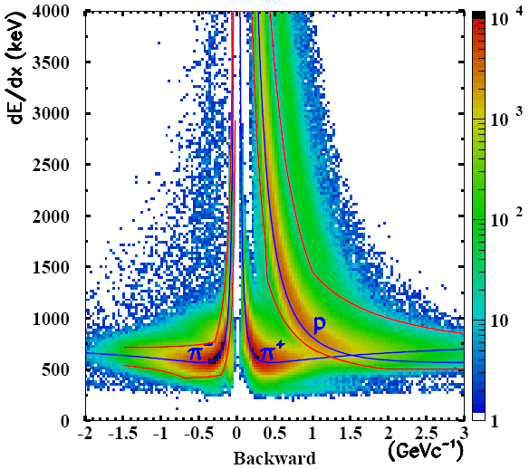
Particle Identification
Forward Hemisphere
Helitron momentum + Plawa TOF
Backward Hemisphere
CDC momentum + energy loss
Preliminary
Preliminary

Slide 11
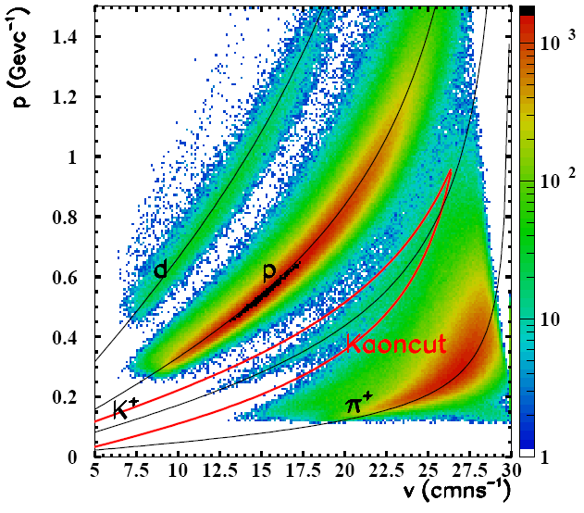
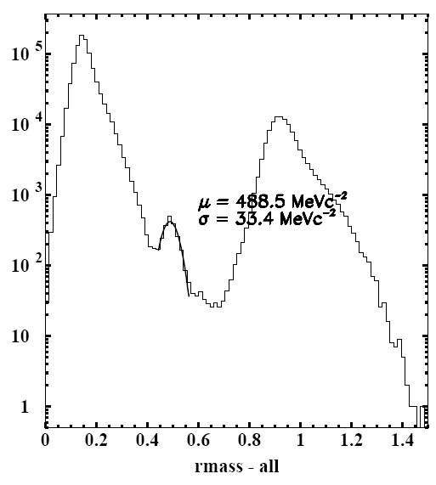
Kaon Identification
Time of Flight Detectors: Resistive Plate Chambers (RPC)
Preliminary
Preliminary
Calibration not final

Slide 12
Inclusive Reconstruction
π⁻
Λ
p

Slide 13
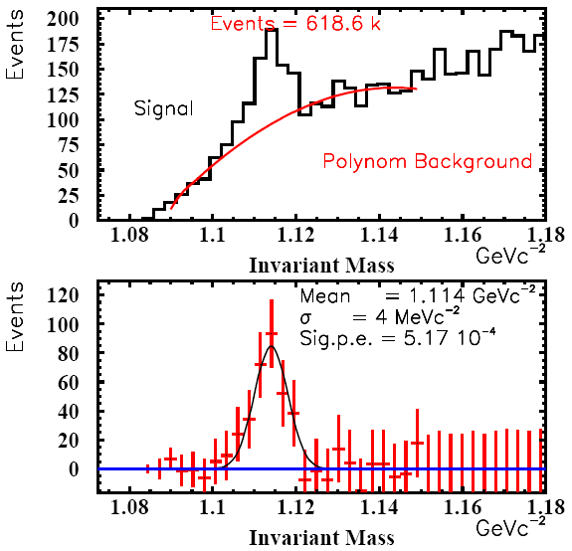
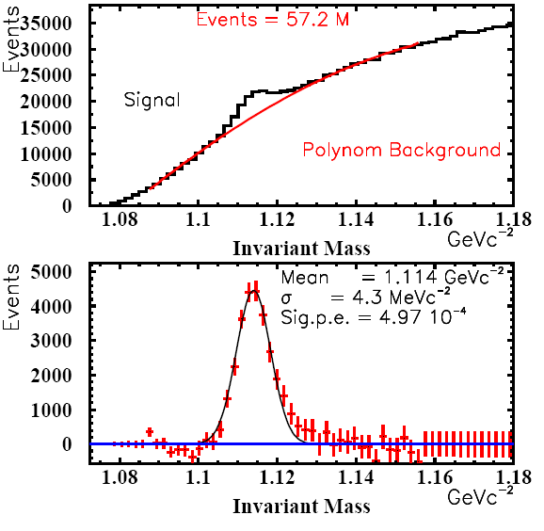
Inclusive Λ Reconstruction
RPC
p
SiΛViO
Λ
pp Simulation
Data
π
HELITRON
CDC
Preliminary
Preliminary

Slide 14
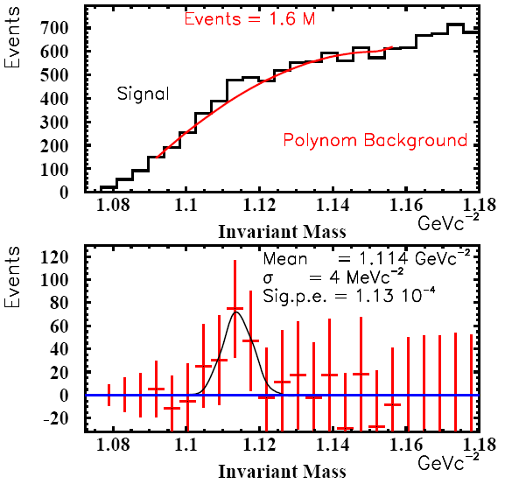
Inclusive Λ Reconstruction
RPC
p
SiΛViO
Λ
Data LVL1
Data LVL2
π
HELITRON
CDC
Preliminary
Preliminary
Enhancement:
> 4,4
Fits to simulation

Slide 15
Exlcusive Reconstruction
K⁺
π⁻
Λ
p

Slide 16
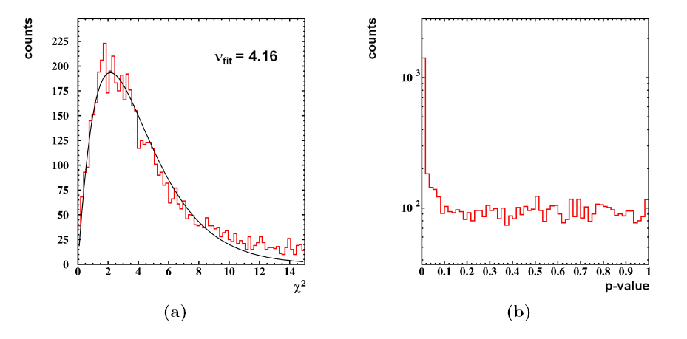
Kinematical Refit
Modify Particle Track Parameters (mom, phi, theta) within error
to fulfill contraints.
Results: New Particle Track Parameters , χ²
Diploma Thesis
D. Pleiner
Background
p-value(refit) = $\int_{χ²−refit}^{∞}{\text{f}\text{n}\text{=4}\text{(}χ\text{²}\text{) }\text{d}χ\text{2}\text{)}}$

Slide 17
Kinematical Refit
Conservation Constraint
K⁺
(E,p)_{kaon}
K⁺
(E,p)_{pion}
π⁻
Λ
(E,p)_{beam}
(E,p)_{target}
p
p
p
(E,p)_{secproton}
p
(E,p)_{primproton}
E_{secproton} + E_{pion} + E_{primproton} + E_{kaon} = E_{beam} + E_{target}
p_{secproton} + p_{pion} + p_{primproton} + p_{kaon} = p_{beam} + p_{target}

Slide 18
Kinematical Refit
Mass Constraint
K⁺
(E,p)_{kaon}
K⁺
(E,p)_{pion}
π⁻
Λ
(E,p)_{beam}
(E,p)_{target}
p
p
p
(E,p)_{secproton}
p
(E,p)_{primproton}
{ (E,p)_{secproton} + (E,p)_{pion} }² = M(Λ)²

Slide 19
Kinematical Refit
Mass Constraint
K⁺
(E,p)_{kaon}
K⁺
(E,p)_{pion}
π⁻
Λ
(E,p)_{beam}
(E,p)_{target}
p
p
p
(E,p)_{secproton}
p
(E,p)_{primproton}
Vertex Constraints: Intersection p and π

Slide 20
Kinematical Refit
Mass Constraint
K⁺
(E,p)_{kaon}
K⁺
(E,p)_{pion}
π⁻
Λ
(E,p)_{beam}
(E,p)_{target}
p
p
p
(E,p)_{secproton}
p
(E,p)_{primproton}
Vertex Constraints: Intersection p and K⁺

Slide 21
Kinematical Refit
Mass Constraint
K⁺
(E,p)_{kaon}
K⁺
(E,p)_{pion}
π⁻
Λ
(E,p)_{beam}
(E,p)_{target}
p
p
p
(E,p)_{secproton}
p
(E,p)_{primproton}
Vertex Constraints: Primary & Secondary Vertex

Slide 22
Exlcusive Reconstruction pp – Simulation (URQMD)
K⁺
π⁻
Λ
p

Slide 23
Conservation Constraint
E_{secproton} + E_{pion} + E_{primproton} + E_{kaon} = E_{beam} + E_{target}
p_{secproton} + p_{pion} + p_{primproton} + p_{kaon} = p_{beam} + p_{target}

Slide 24
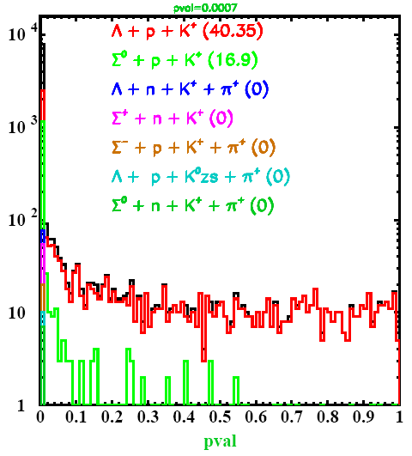
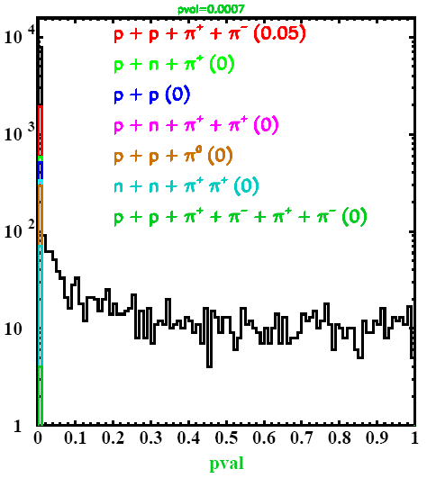
Conservation Constraint
pval> 0.007
pval> 0.007

Slide 25
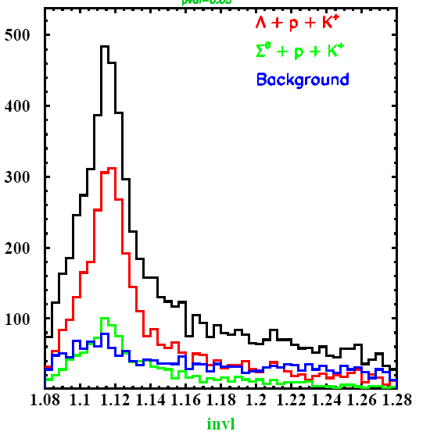
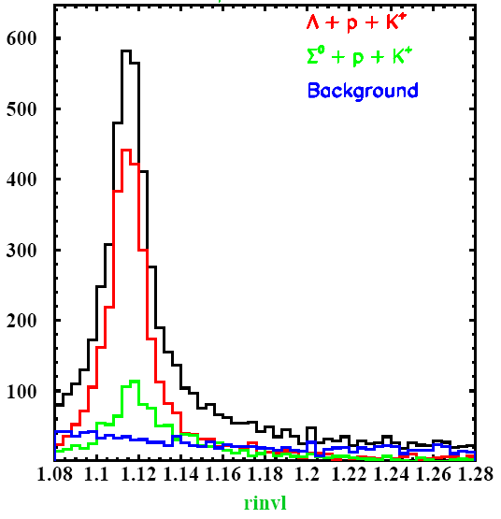
Invariant mass (p, π)
Without refit
With refit

Slide 26
Conservation + Mass Constraint
E_{secproton} + E_{pion} + E_{primproton} + E_{kaon} = E_{beam} + E_{target}
p_{secproton} + p_{pion} + p_{primproton} + p_{kaon} = p_{beam} + p_{target}
{ (E,p)_{secproton} + (E,p)_{pion} }² = M(Λ)²

Slide 27
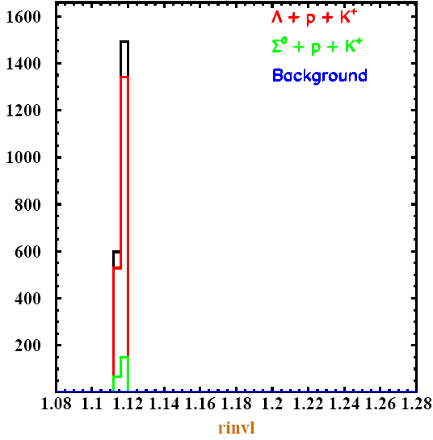
Invariant mass (p, π)
Without refit
With refit
pval>0.007

Slide 28
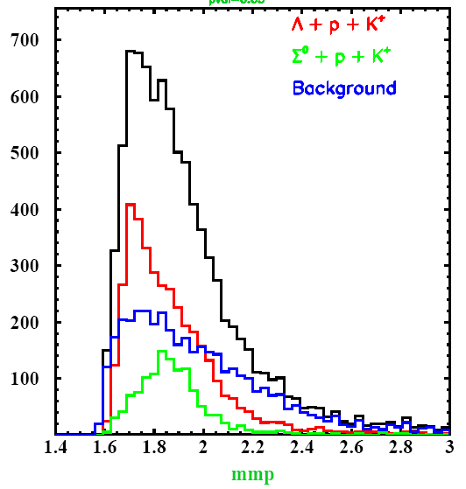
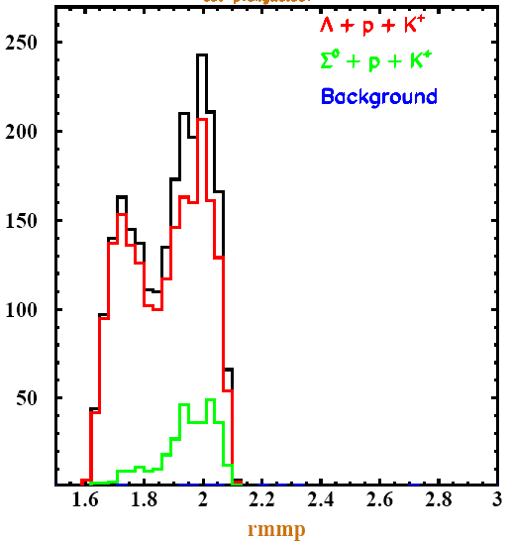
Missing Mass(p)
Without Refit
With Refit
p+p -> p + N* ( -> Λ + K⁺ )
pval>0.007
N* included in Urqmd

Slide 29
Exlcusive Reconstruction Data
K⁺
π⁻
Λ
p

Slide 30
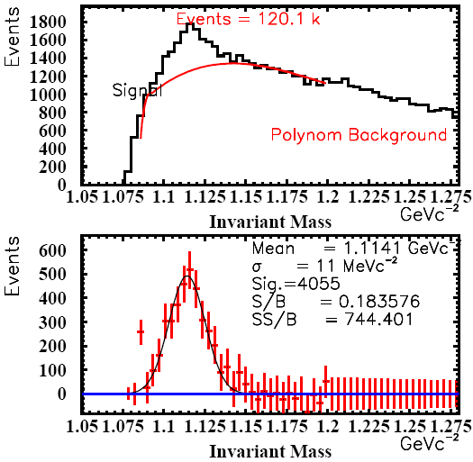
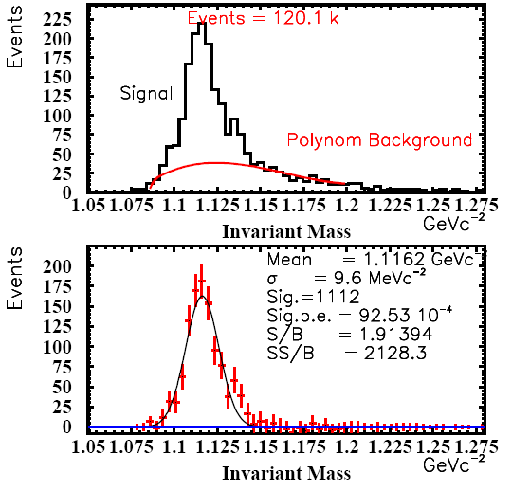
Data
Energy & Momentum Contraint
Original
Invariant Mass (p,π)
Original pval cut(>0.87)

Slide 31
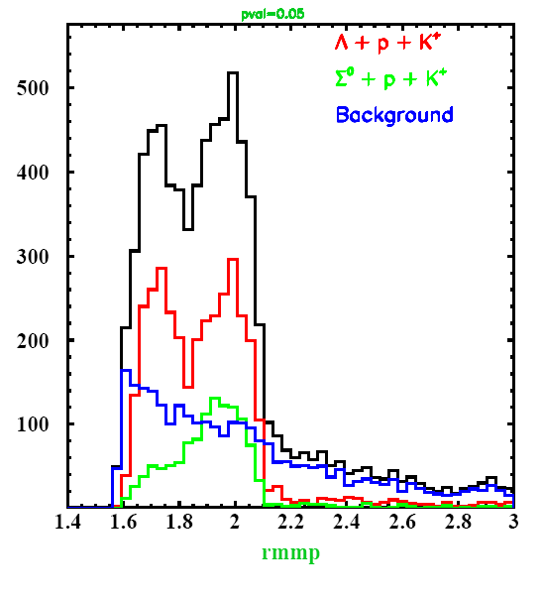
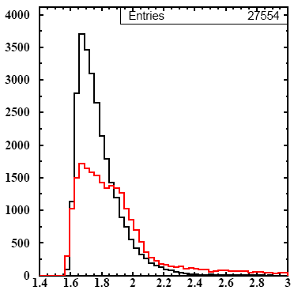
N*
Pp UrQMD
Data
Unrefitted
refitted
MM (p) - refitted
|Inv(p,pi)-1.116|<40 Mev
MM (p) - refitted

Slide 32
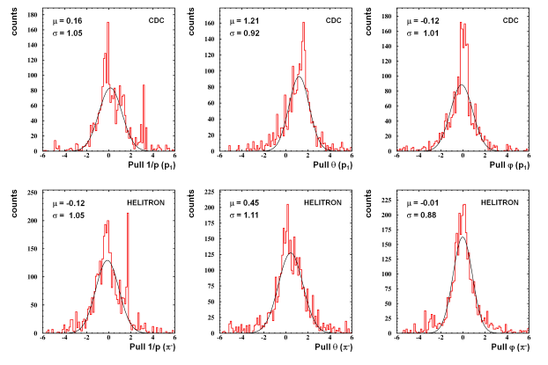
Systematical Errors
Primary
proton
pion
1/p
ϑ
φ

Slide 33
Summary & Outlook
Inclusive Lambda-Routine:
Lambda are visible in Semi Forward Kombination
Reduction Compareable with Simulations
Exclusive Reconstruction tested with simulation
Event Selection: Refit is sensitive to Different Channels
Additional Constraints (Vertex) has to be tested.
Resolutiuon can be improved signal: N* signal as a crosscheck
Refit with Data
Pval Cut reduced Background of Exclusive Lambda.
N*- signal visble : Crosscheck of analysis
Problem: Systematical Errors
New Calibration
Finished recently. Has to be tested.

Slide 34
Backup

Slide 35
Different Regions
Semi – Forward (CDC – (RPC) )
Polar angle of particles from Λ decay
(pK⁺Λ / K⁺ in RPC acceptance)
RPC
p
SiΛvio
Λ
π
HELITRON
CDC
Forward (SiΛViO – Helitron - Plawa)
RPC
p
SiΛvio
Λ
π
CDC
HELITRON

Slide 36
Event Selection
-
+
+
+
+
Available tracks
1
2
3
4
5
Pi-cand
1
K⁺ -
Cand
1
P-cand 1
P-cand
2
p-cand
3
Rough PID
1
2
3
4
5

Slide 37
Pi-cand
1
K⁺ -
Cand
1
P-cand 1
P-cand
2
p-cand
3
Bild Kombination
Komb 1
Komb 2
Pi-cand
1
P-cand 1
K⁺ -
Cand
1
P-cand
2
Pi-cand
1
P-cand 2
K⁺ -
Cand
1
P-cand
1
Komb 3
Komb i
Pi-cand
1
P-cand 1
K⁺ -
Cand
1
P-cand
3

Slide 38
Prefit
Komb (i)
Prefit
Komb (i)
Chi2 - Pval

Slide 39
Prefit
Komb (i)
Chi2 - Pval
Sort descending by pval
Remaining particle is treated as faketrack
Komb 1 (biggest pval) will be used
Best

Slide 40
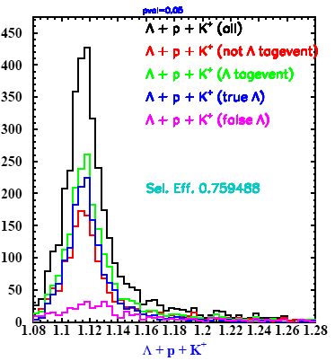
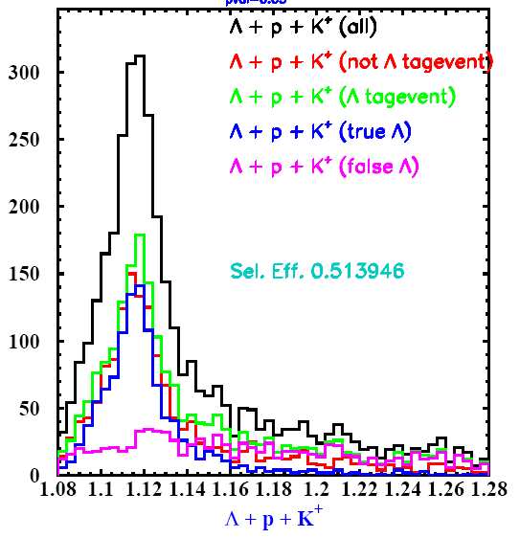
Lambda Preselection
Preselectio Option 2: 75% of Lambda Kombination are select

Slide 41
Main Fit
Komb 1 (biggest pval) will be used
Komb 1 (biggest pval) will be used
Orig
Orig
Orig
Orig
Refit
Ref
Ref
Ref
Ref
Best
Best
Ntuple
Chi2
Pval
Inv(p,π)
rInv(p,π)
Inv(Λ,p)
rInv(Λ,p)
Inv(Λ,K)
Inv(Λ,K)r
mm(p)
rmm(p)
mm(K)
rmm(K)
mm(K,p)
rmm(K,p)
Vertices
rVertices

Slide 42
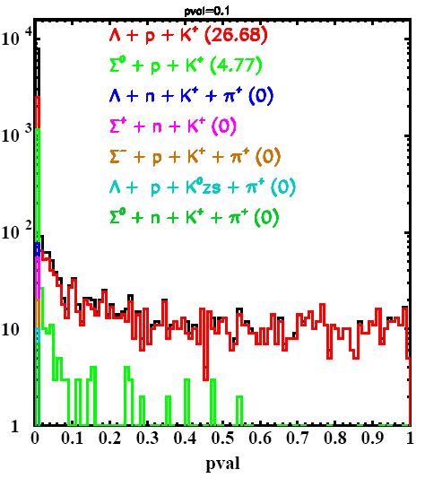
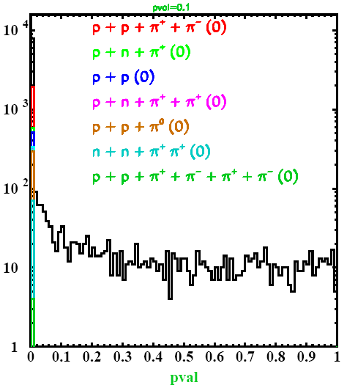
Conservation Constraint
Pval > 0.1

Slide 43
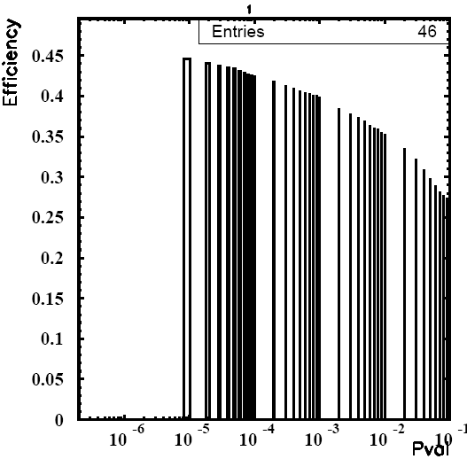
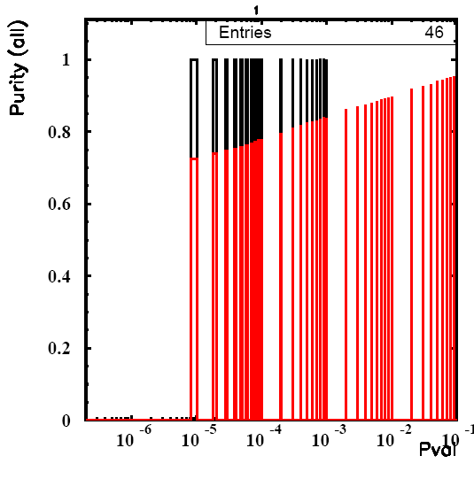
Conservation Constraint
$$Efficiency=\frac{pkL−Events(pval>pvalcut)}{pkL− Event(all)}$$
Purity $=\frac{Channel− Events(pval<pvalcut)}{Channel −Event(all)}$
all
pkΣ

Slide 44
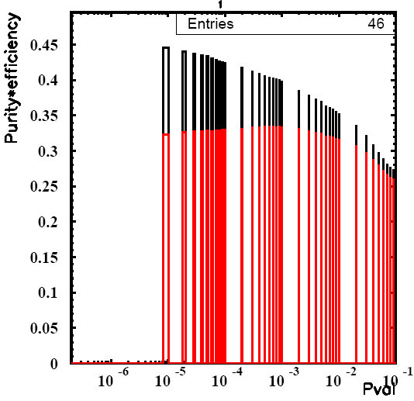
Conservation Constraint
$$Efficiency=\frac{pkL−Events(pval>pvalcut)}{pkL− Event(all)}$$
Purity $=\frac{Channel− Events(pval<pvalcut)}{Channel −Event(all)}$
all
pkΣ
Best Value: 0.0007

Slide 45
Conservation Constraint

Slide 46
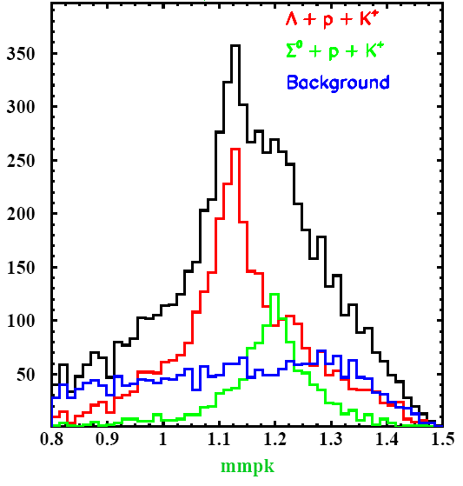
Missing Mass (p, K)

Slide 47
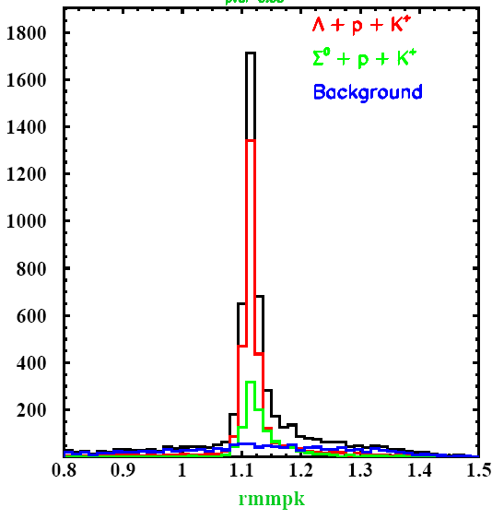
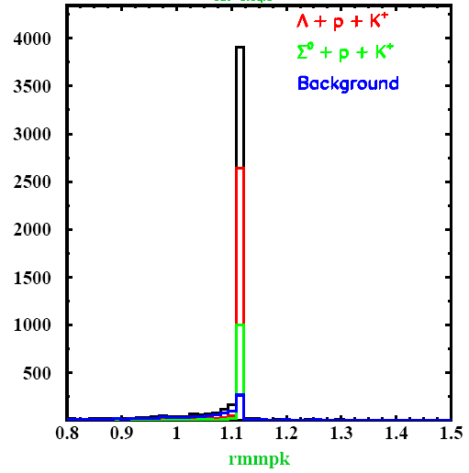
Different Contraints
Conservation
Conservation+ Mass

Slide 48
Invariant Mass (p,π)

Slide 49
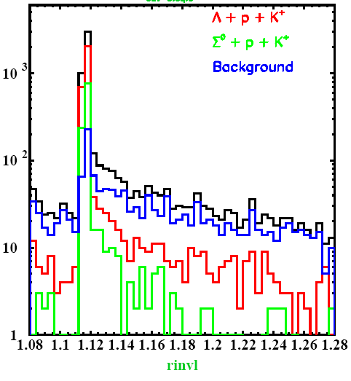
Invariant mass (p, π)
Conservation
Conservation+ Mass

Slide 50
Missing Mass (p)

Slide 51
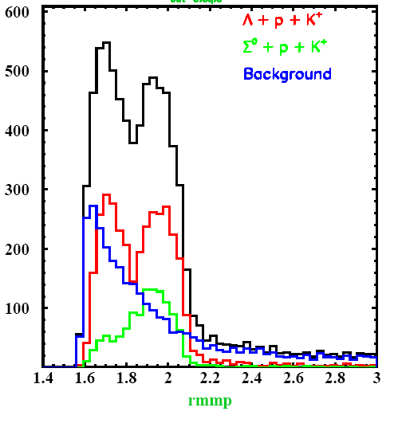
Missing Mass(p)
Conservation
Conservation+ Mass
N* included in Urqmd

Slide 52
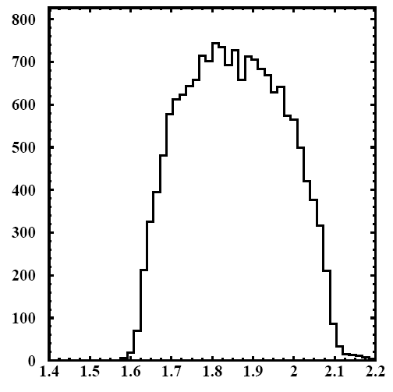
Missing Mass(p)
Conservation
pKL - Phasespace
N* included in Urqmd

Slide 53
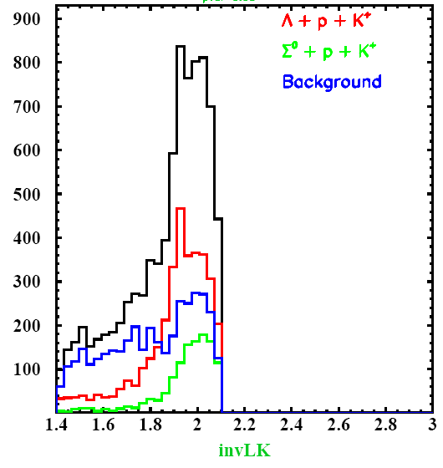
Missing Mass (p, K)

Slide 54
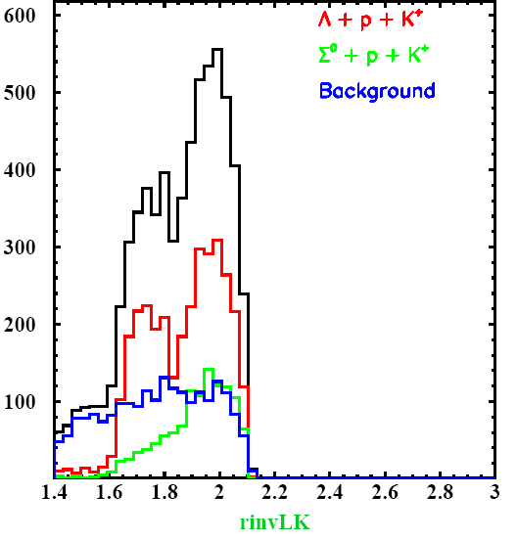
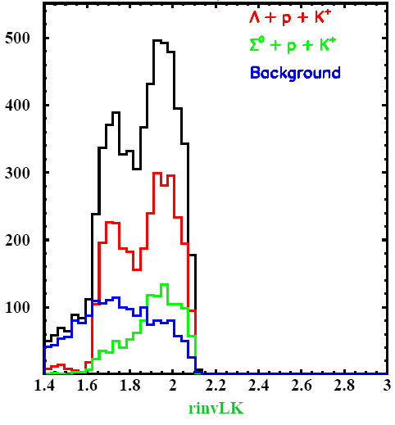
Different Contraints
Conservation
Conservation+ Mass

Slide 55
Exlcusive Reconstruction Data
K⁺
π⁻
Λ
p

Slide 56
Data
Energy & Momentum Contraint
Original
Invariant Mass (p,π)
Original pval cut(>0.87)

Slide 57
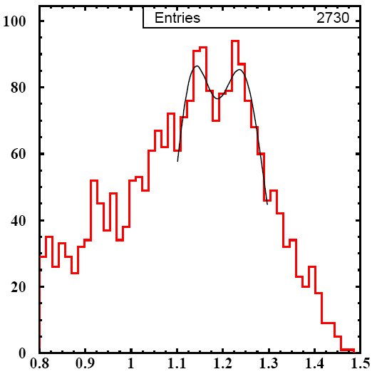
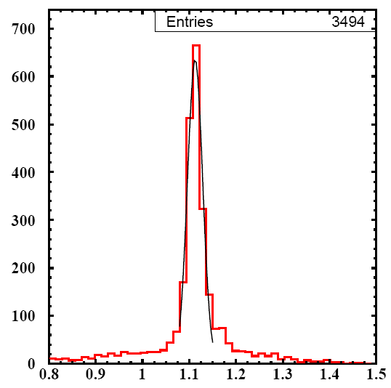
Data
Missing Mass pK+
Energy & Momentum Contraint
Original
Refitted
μ=1.132
σ=0.039
μ=1.24
σ=0.050
μ=1.112
σ=0.016
|InvM(p,p)-1.116|<0.02
Pval.ne.0

Slide 58
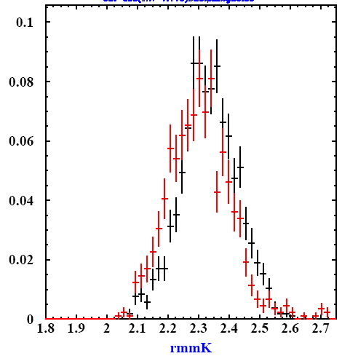
Absolutely Preliminary
Data
pkL Phasespace
Missing mass K (refitted)

Slide 59
Refit

Slide 60
Refit

