Slide 1
Photoproduction of Strangeness near the Threshold at Tohoku
Masashi Kaneta
for the NKS/NKS2 collaboration
Department of Physics, Tohoku University

Slide 2
Outline of this talk
Introduction
Experiments
Further Investigation
Summary
Notes:
This is the outline of my talk

Slide 3
Introduction

Slide 4
Motivation
Understanding the process of
Strangeness production
Neutral channel
Key:
Threshold region
via γ+n reaction
Notes:
We want to understand the process of the strangeness production.
There are some experimental approach, but Key of our approach is:
neutral channel and threshold region via gamma on neutron reaction.

Slide 5
Why
Neutral?
Notes:
Why focusing on neutral channel?

Slide 6
Neutral channel is requisite
Theoretical studies were based on
data of γ+p → K⁺+Y
and then there are huge discrepancies
in prediction of neutral channel
Notes:
Because the channel is requisite for the study.
Many models mainly based on the K+ production on proton target.
Then, there are huge discrepancies in prediction of neutral channel.

Slide 7
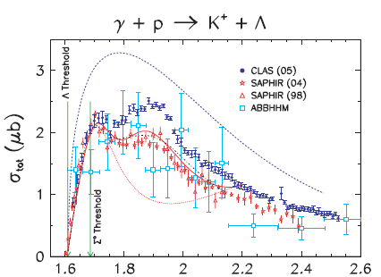
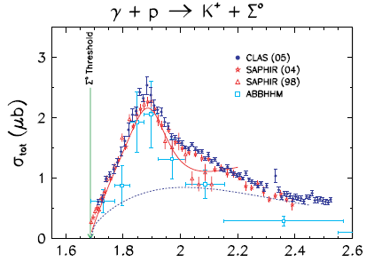
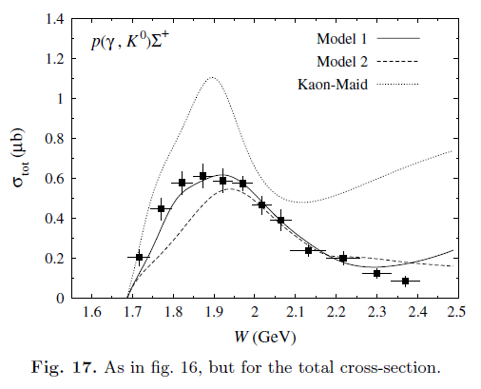
Data
γ+n→K⁰+Λ
Phys.Rev.C73(2006)035202
LEPS experiment:
differencial cross section
in Eγ=1.5-2.4 GeV
with polarized photon beam
PRL97 (2006)082003
PPRC76(2007)042201(R)
NKS experiment:
differencial cross section
in Eγ=0.8-1.1 GeV
PRC78(2008)014001
γ+n→K⁺+Σ⁻
Phys.Rev.C73(2006)035202
LEPS experiment:
differencial cross section in Eγ=1.5-2.4 GeV
with polarized photon beam
PRL97 (2006)082003
CLAS experiment:
differencial cross section in Eγ=1.1-3.6 GeV
PLB688(2010)289
γ+p→K⁰+Σ⁺
γ+n→K⁰+Σ⁰
SAPHIR
Phys.Lett.B464(1999)331
Notes:
This is a summary of data of six channels of gamma on nucleon experiments.
By the early of 2000’s, only proton target data is available.
Therefore, a model could use only those data.
Our experiment is focusing on k0 production on gamma + neutron reaction.
It is still unique experiment in the world.

Slide 8
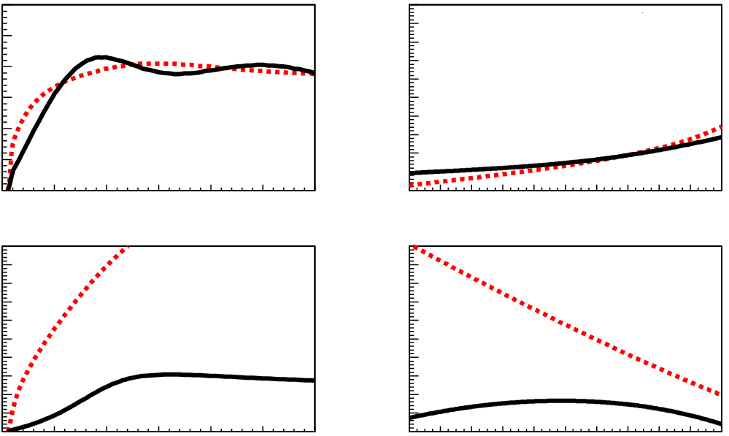
Discrepancy
3
1
γ+p →K⁺+Λ
γ+p →K⁺+Λ
2
σ [μb]
dσ/dΩ [μb/sr]
1
Kaon-MAID
Saclay-Lyon A
E_{γ}=1.05[GeV]
0
0
10
1
γ+n →K⁰+Λ
γ+n →K⁰+Λ
σ [μb]
5
dσ/dΩ [μb/sr]
E_{γ}=1.05[GeV]
0.9
1.0
1.1
1.2
1.3
1.4
1.5
0
-1.0
0.0
1.0
E_{γ} [GeV]
cosθ
Notes:
This figures show two model calculation, Kaon-MAID and Saclay-Lyon A.
Top side is for gamma on proton going to K+ Lambda
Bottom side is for gamma on neutron going to K0 Lambda
Left is total cross section as a function of gamma energy
Right is angle distribution at fixed gamma energy
Both models used gamma p reaction data.
There is huge discrepancy in prediction of neutron channel.
It means that the neutral channel is important

Slide 9
Why
Threshold ?

Slide 10
In the threshold region
Less effect of resonances than higher energy region
Simplicity
to compare the data with a model

Slide 11
Theoretical
Approach

Slide 12
Theoretical Study: Effective Lagrangian Approach
γ
K
Hadron coupling
Isospin symmetry
Electromagnetic (photo) coupling
Helicity amplitude
Charged and neutral nucleon resonances
Decay width
Charged and neutral Kaon resonances
However, the decay width of K₁ resonance is not known
s channel
N
N*
N
Y
γ
K
K,K*,K₁
t channel
N
Y
γ
K
g (K^{*0} K⁰ γ )
u channel
r (K* K γ ) = = -1.53
Y
Y*
g (K^{*+} K⁺ γ )
N
Y
− 0.45 in Kaon-MAID, estimated
from γp→K⁰Σ⁺ data
Free parameter in SLA
r (K₁ K γ ) =
γ
K
Contact term
N
Y

Slide 13
Characteristics of Two Models
Kaon-MAID
T.Mart, C.Bennhold, PRC61 (2000) 012201(R)
Input: γ+p→K⁺+Λ, γ+p→K⁺+Σ⁰, γ+p→K⁰+Σ⁺
Resonances:
N(1650) S₁₁, N(1710) P₁₁, N(1720) P₁₃,
Δ(1900) S₃₁, Δ(1910) P₃₁
K*(892), K₁(1270)
Hadronic form factor, contact term
Saclay-Lyon A
T. Mizutani et al. PRC58 (1998) 75
Input: γ+p→K⁺+Λ
Resonances:
N(1720) P₁₃
Λ(1405), Λ(1670), Λ(1810), Σ(1660)
K*(892), K₁(1270)
No hadronic form factor
Notes:
To keep gage invariance, Kaon-MAID introduced hadronic from factor in the model

Slide 14
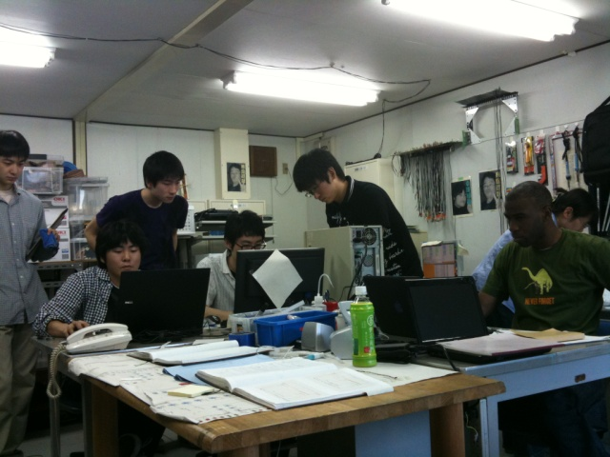
Experiments

Slide 16
Experiments to Investigate
Strangeness Photo-Production
at LNS/ELPH
NKS
and
NKS2

Slide 17
2000-2004:
Using TAGX spectrometer (INS, U. Tokyo)
Reconstruct K⁰_{S} from π⁺π⁻ decay
The first measurement of K⁰ cross section
from n(γ,K⁰)Λ reaction [Phys.Rev.C78(2008)014001]
NKS
Neutral Kaon Spectrometer

Slide 18
2005-2007:
Completely new spectrometer to cover
full kinematical region
2008-: Upgrade project
2010-: Taking physics data
NKS2
Neutral Kaon Spectrometer 2

Slide 19
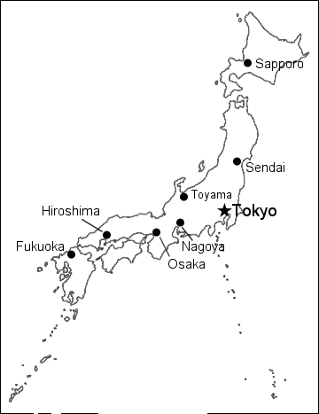
Place of the Experiment
Laboratory of Nuclear Science
(LNS)
Tohoku Univ.
Research Center for
Electron Photon Science
(ELPH)
Notes:
LNS was a part of Faculty of Science,
Now, it is research center of the university and joint usage/research center founded by Monkasho in this July

Slide 20
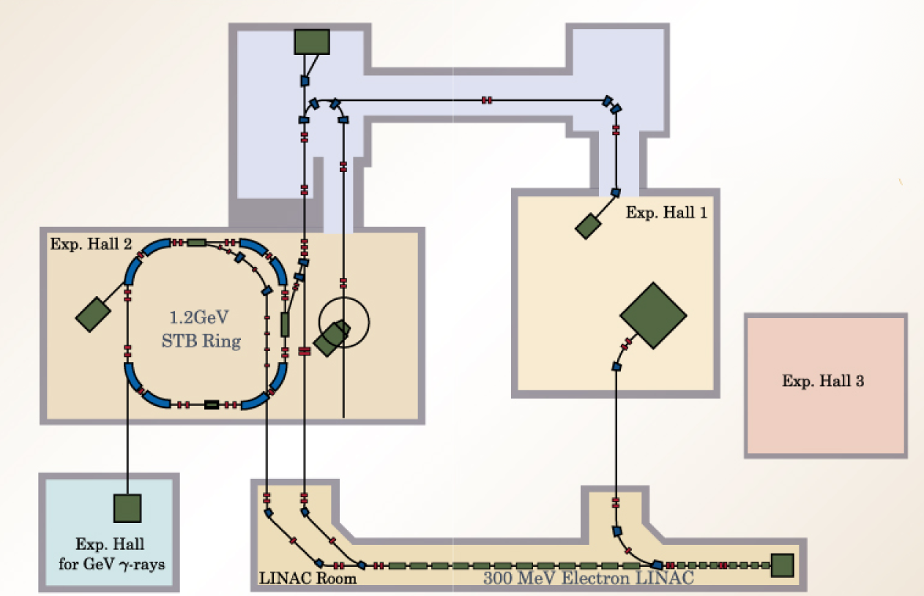
Accelerator of LNS/ELPH, Tohoku University
Notes:
Say the place of NKS2 and tagger system

Slide 21
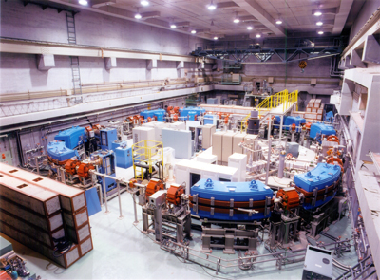
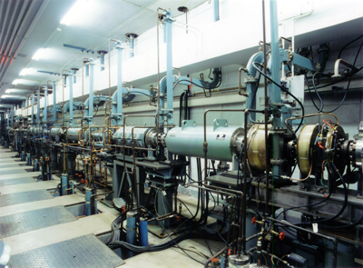
Accelerator of LNS/ELPH, Tohoku University

Slide 22
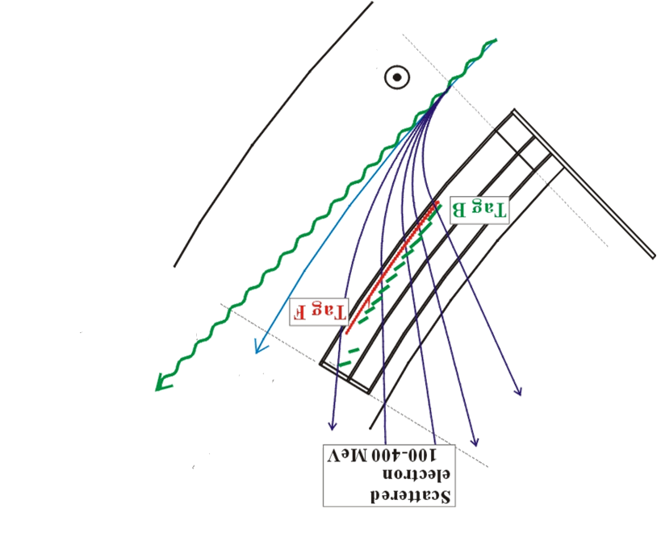
Photon Beam Line
Radiator (Carbon wire) to make Bremsstrahlung
Sweep magnet
B
BM4
tagger
Tag B
Tag F
NKS2
BM5
tagger
Photon Beam
Electron (1.2 GeV)
Scattered electron
(0.1-0.4 GeV)
to the GeV γ
experimental hall

Slide 23
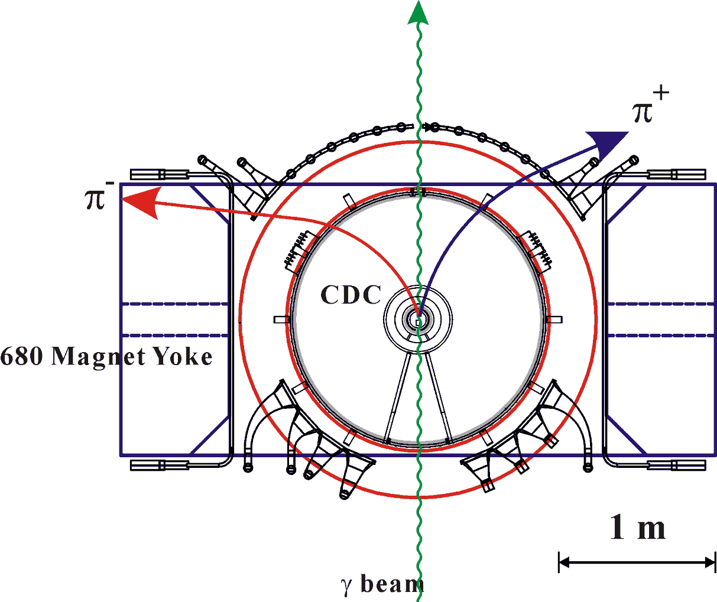
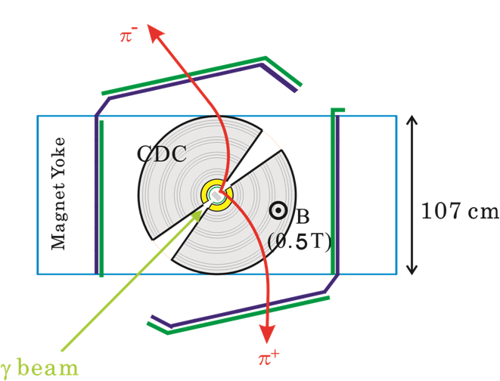
NKS to NKS2
NKS
NKS2
Improved Acceptance
by covering forward region
Notes:
Here is a comparison of NKS2 to NKS
The left-hand side is a schematic view of NKS, and the right-hand side is NKS2.
To avoid high rate back-ground, NKS is opened on beam line.
On the other hand, K zero acceptance become small due to this region.
It was necessary to cover this region to improve the acceptance.
The K zero acceptance in NKS2 becomes more than three times of NKS

Slide 24
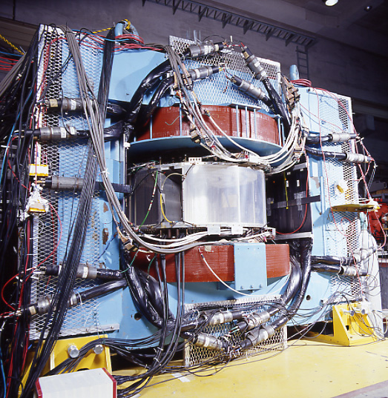
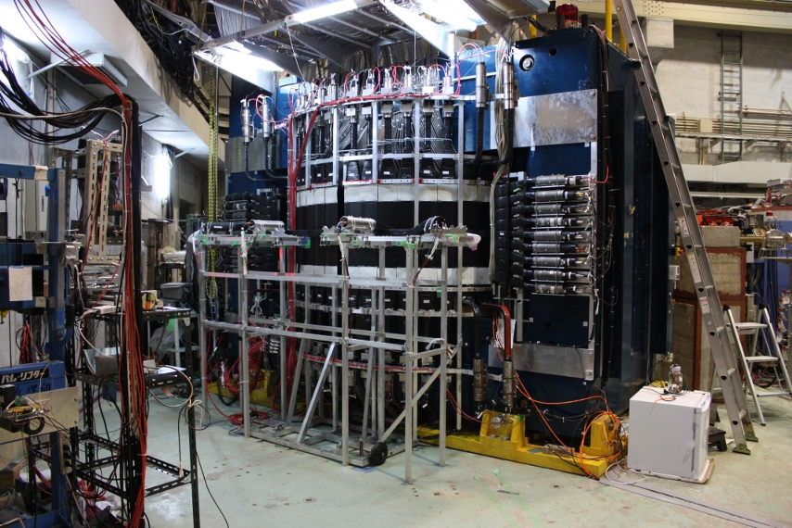
NKS
NKS2

Slide 25
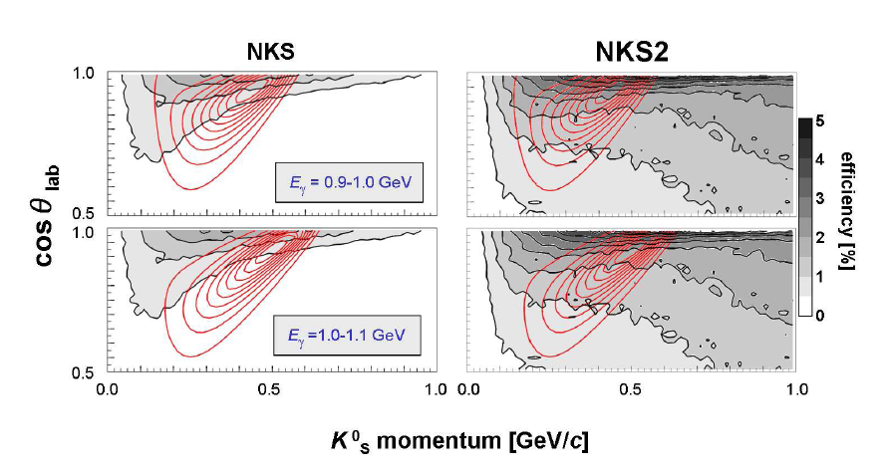
Acceptance of NKS and NKS2(-2007)

Slide 26
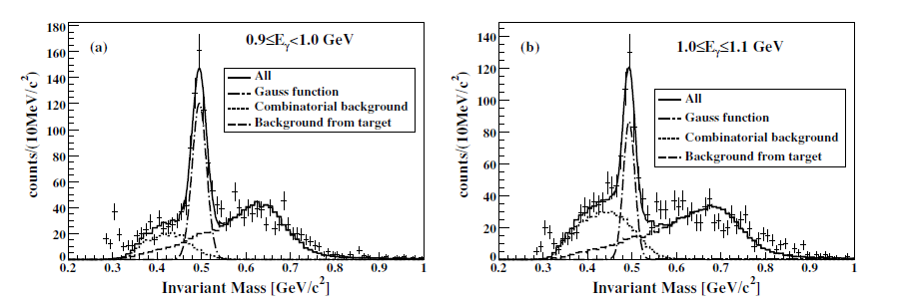
K. Tsukada et. al, Phys.Rev.C78(2008)014001
Results of NKS

Slide 27
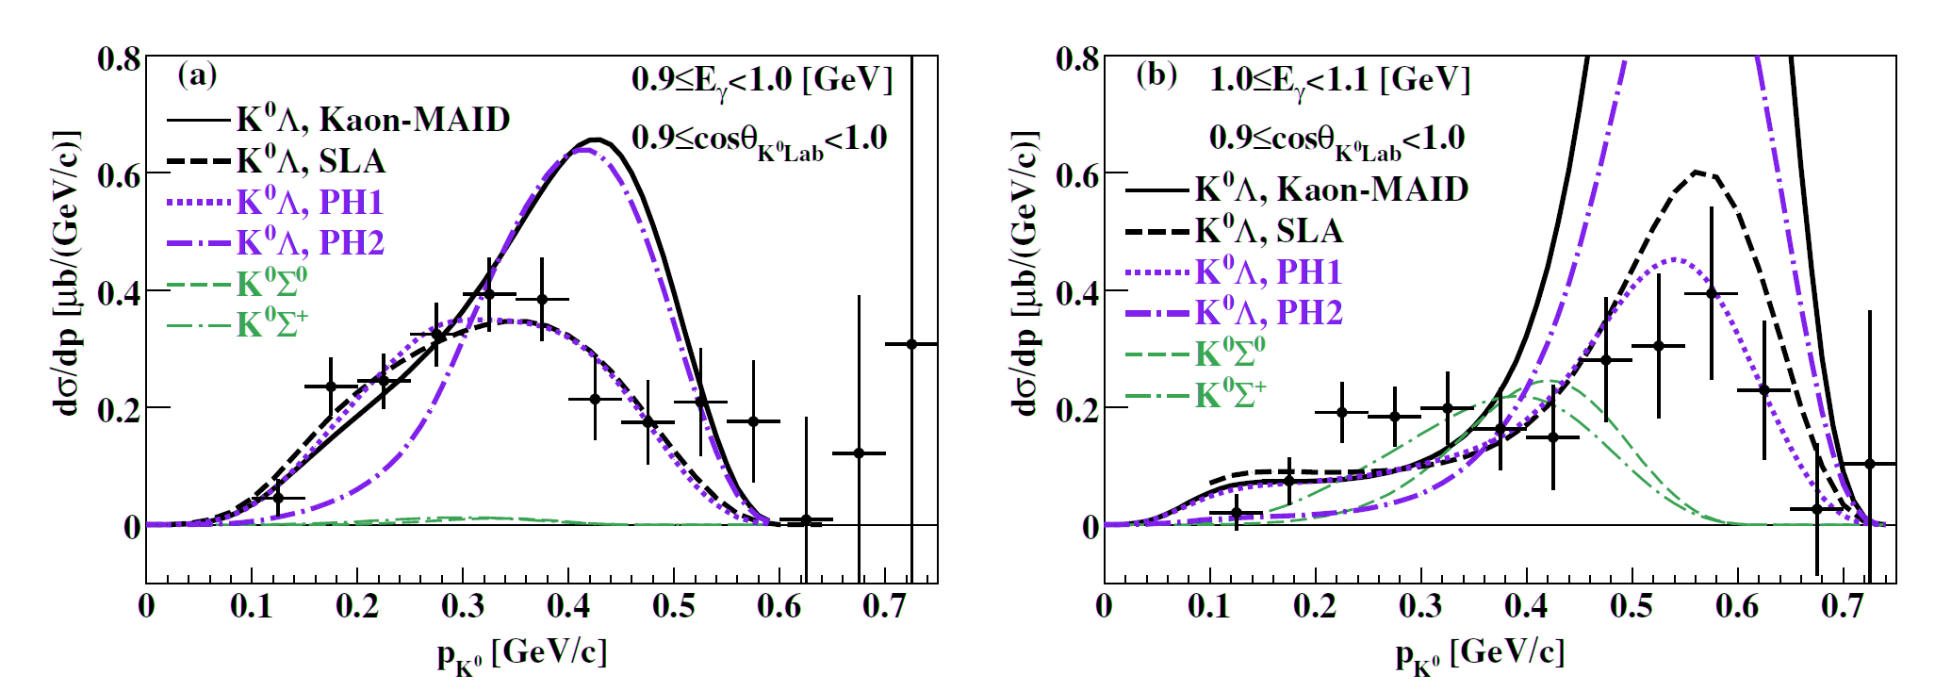
K. Tsukada et. al, Phys.Rev.C78(2008)014001
Results of NKS
r_{K1Kγ}=-2.09 for SLA
(Kaon-MAID’s value:-0.4474)

Slide 28
Suggestion from NKS Results
backward angular distribution in CM
K. Tsukada et. al, Phys.Rev.C78(2008)014001

Slide 29
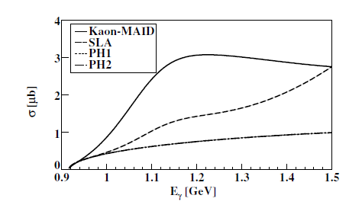
Suggestion from NKS Results
10
γ+n →K⁰+Λ
σ [μb]
Saclay-Lyon A
Kaon-MAID
before
5
0.9
1.0
1.1
1.2
1.3
1.4
1.5
E_{γ} [GeV]
after
K. Tsukada et. al, Phys.Rev.C78(2008)014001

Slide 30
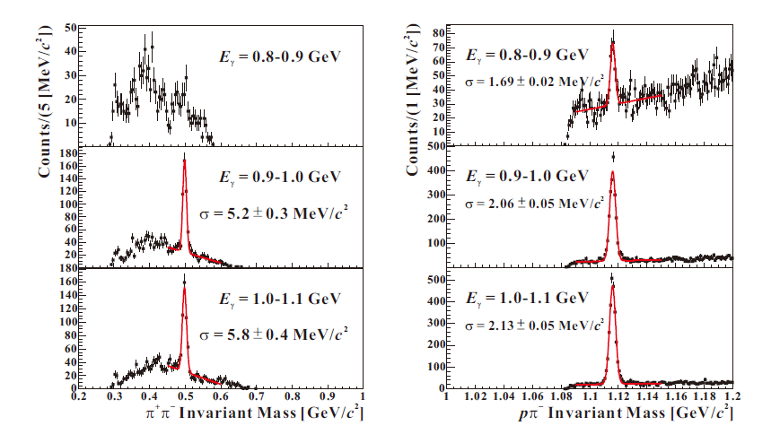
Results of NKS2
~370 K⁰_{S}
~2000 Λ
~360 K⁰_{S}
~2400 Λ
Analyzed by K. Futatsukawa (Ph.D student)

Slide 31
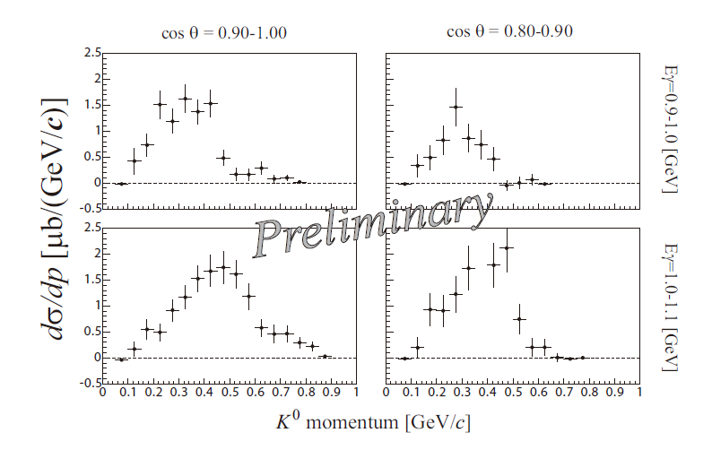
Results of NKS2
New region
Analyzed by K. Futatsukawa (Ph.D student)

Slide 32
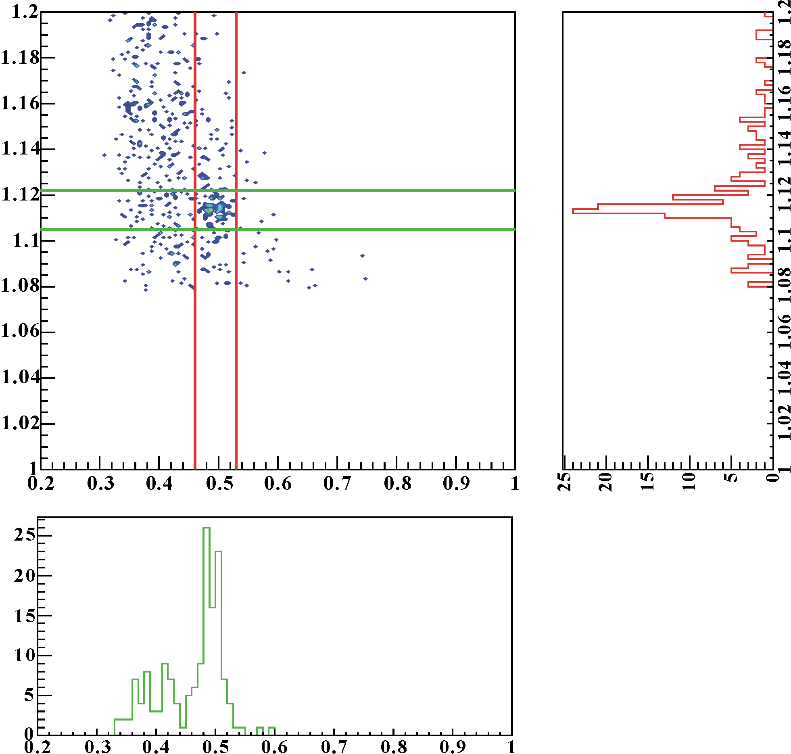
Results of NKS2
~90 events
in the peak
pπ⁻ Invariant Mass [GeV/c²]
preliminary
all of combinations
from pπ⁺π⁻π⁻ event
Analyzed by
K. Futatsukawa
(Ph.D student)
π⁺π⁻ Invariant Mass [GeV/c²]

Slide 33
Further investigation

Slide 34
The next targets
K⁰_{S}+Λ coincidence events
with reasonable statistics,
and
Determine the sign of
Λ recoil polarization

Slide 35
K ⁰_{S}+Λ coincidence events
Advantage: No.1
Less background
in the invariant mass distribution
(Remember p.28)

Slide 36
pπ⁻ Invariant Mass [GeV/c²]
preliminary
all of combinations
from pπ⁺π⁻π⁻ event
π⁺π⁻ Invariant Mass [GeV/c²]

Slide 37
K ⁰_{S}+Λ coincidence events
Advantage: No.2
Elimination of Fermi motion correction
Direct comparison with model
Separation of K⁰+Λ and K⁰+Σ⁰

Slide 38
K ⁰_{S}+Λ coincidence events
γ+n → K ⁰+Λ
π⁻+p
4 charged particles
in final state
K ⁰_{S} → π⁺+π⁻
Extending the acceptance is essential

Slide 39
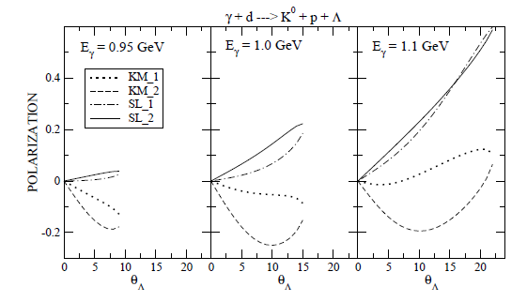
Λ recoil polarization
The information make a restriction to model

Slide 40
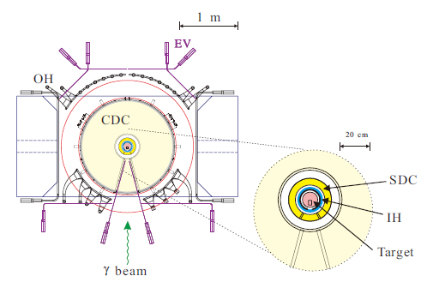
Upgrade Project
VDC
IH
20 cm
Target
To increase acceptance
Inner detectors are replaced by
Vertex Drift Chamber (VDC)
New Inner Hodoscope (IH)

Slide 41
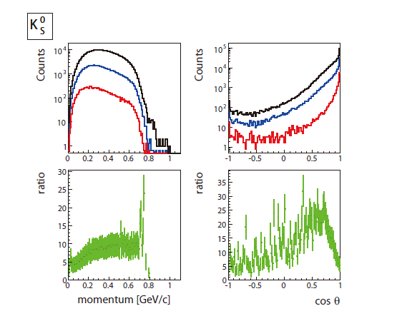
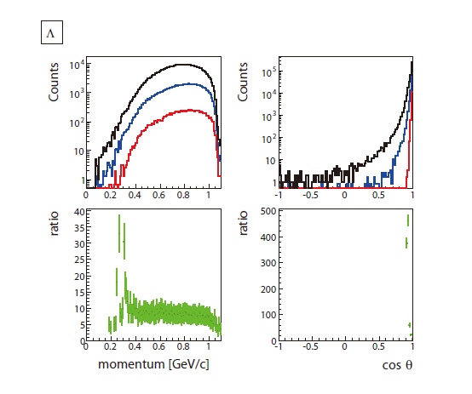
Gain of Acceptance
for K ⁰_{S}+Λ coincidence events
(1) Produced
(2) NKS2 with new detectors
(3) NKS2 prior
(4) ratio of (2)/(3)
about 7 times after upgrade

Slide 42
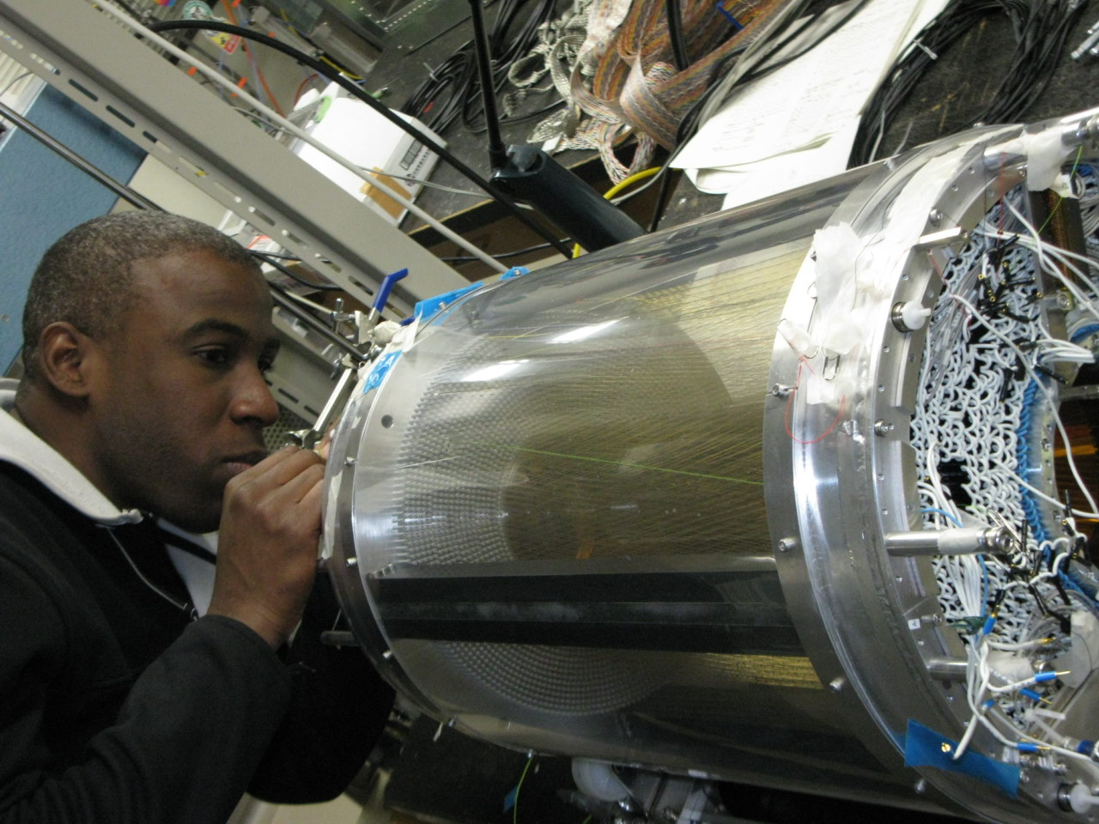
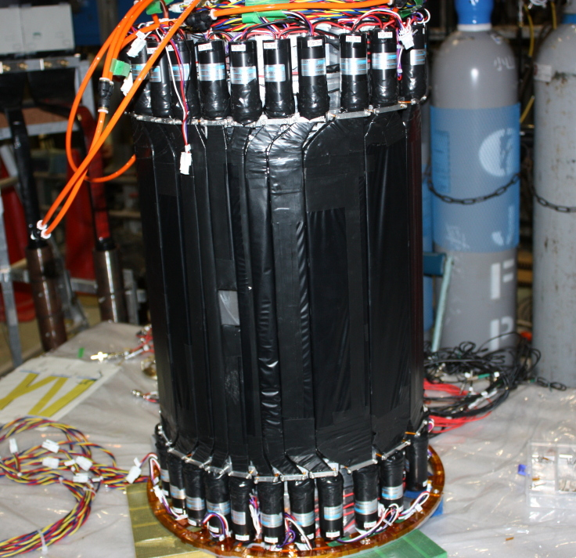
VDC
IH

Slide 43
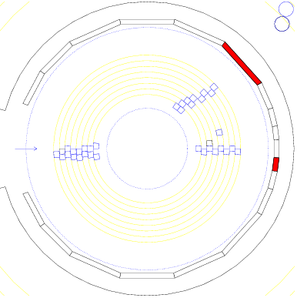
An Event Display from the Last Run

Slide 44
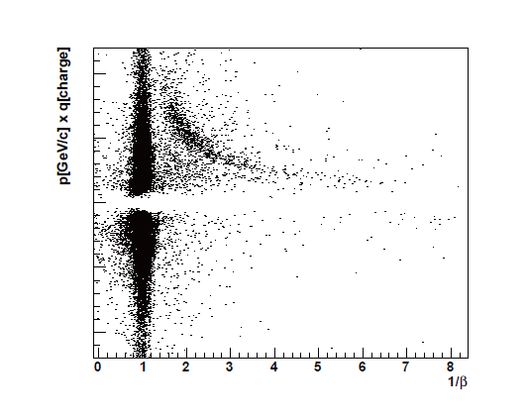
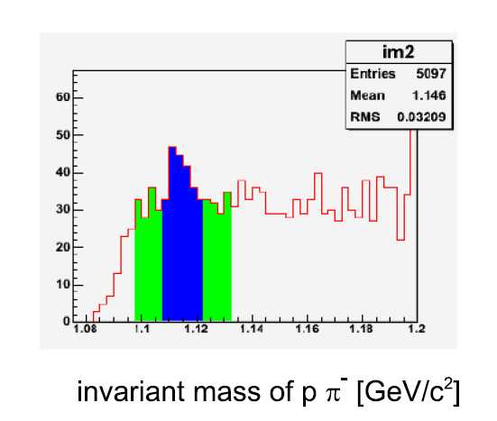
Preliminary results from the last run (2010/June-July)
PID plot: Momentum vs. 1/β
with rough counter calibration
for two track event
proton
pion
About 40 counts as Lambda
above the background

Slide 45
Summary

Slide 46
Investigation of strangeness photoproduction at ELPH, Tohoku Univ. in Sendai
NKS/NKS2 is an unique experiment
Focusing neutral channel
In the threshold region (E_{γ}=0.9-1.1 GeV)
NKS
The first measurement of n(γ, K⁰)X cross section
cosθ_{K0} = 0.9-1.0 in CM
NKS2
Covering forward region
cosθ_{K0} = 0.8-1.0 in CM
NKS2 upgraded
New detectors are added to increase the acceptance
Detector and the system is ready
Physics data taking is going to start soon
Sep/6–26 and Oct/1-31
~2.0×10¹² photon will be achieved
~400 K⁰_{s}+Λ coincidence events is expected

Slide 47
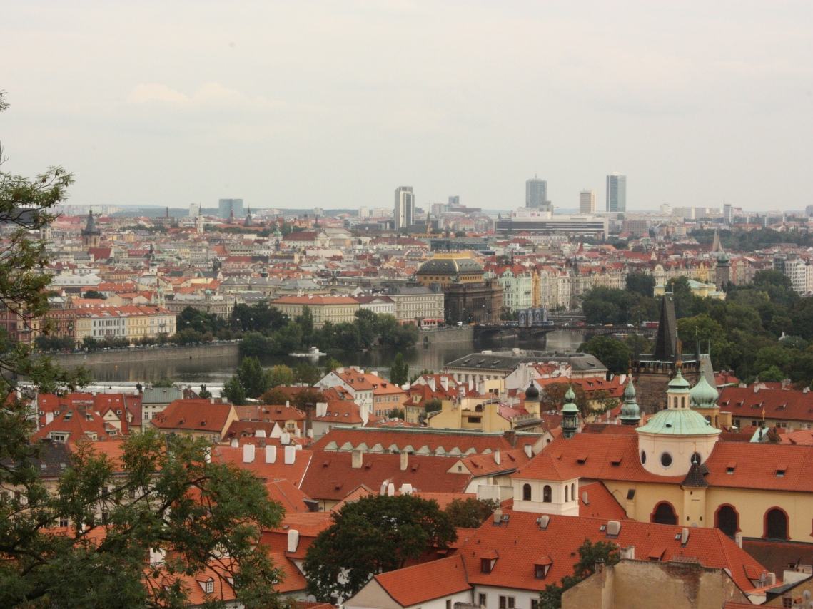
Thanks for listening

Slide 48
Back up

Slide 49
Λ Polarization Measurement
Transverse polarization measurement
p_{Λ}
t
t = p_{γ}×p_{Λ}
reaction plane
in CM
Λ_{CM}
θ_{Λ}
θ
p_{N}
p_{p}
p_{γ}
p_{π}
p_{K}
dN
N₀
A (cosθ ) (1+α P_{Λ}cosθ )
=
d (cosθ )
2
Acceptance
as a function of cosθ
polarization
decay parameter
0.642(PDG)

Slide 50
Λ Polarization Measurement
1
dN
1
N₀
d (cosθ )
(1+α P_{Λ}cosθ )
2
in a symmetrical acceptance A(cosθ) will be cancelled
after integration of azimuthal angle
-1 1
cosθ
N↑: Number of proton in cosθ≥0
N↓: Number of proton in cosθ<0
N_{total}=N↑+N↓
1
dN
N₀
d (cosθ )
N↓
N↑
~10% with N_{total}=1000
~14% with N_{total}=500
~20% with N_{total}=250
-1 1
cosθ

Slide 51
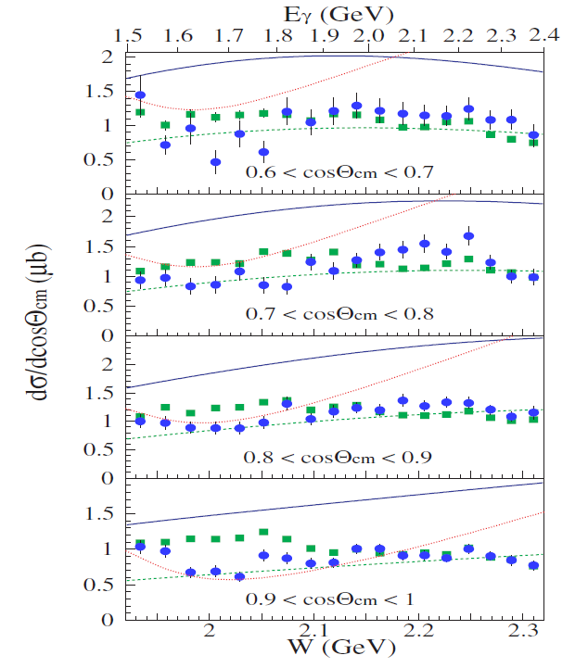
LEPS

Slide 52
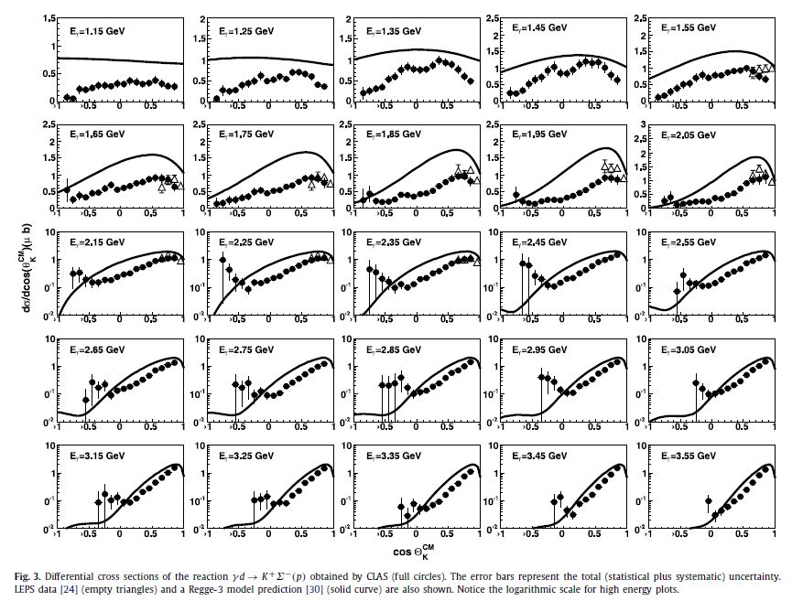
CLAS γ+d → K⁺+Σ⁻ (+p)

Slide 53
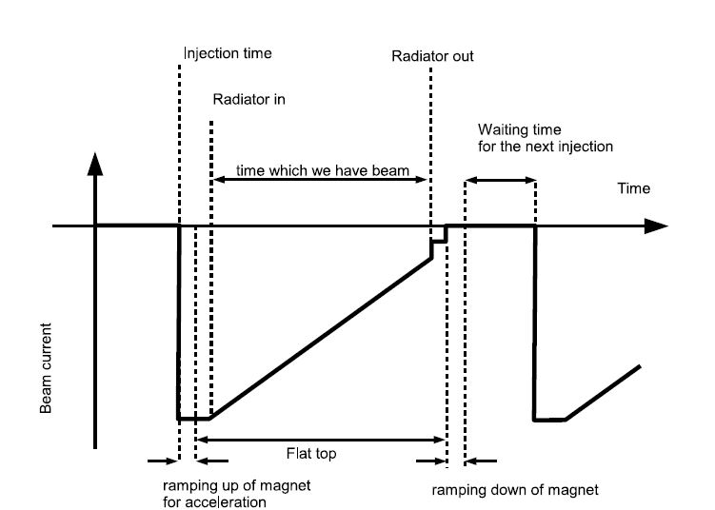
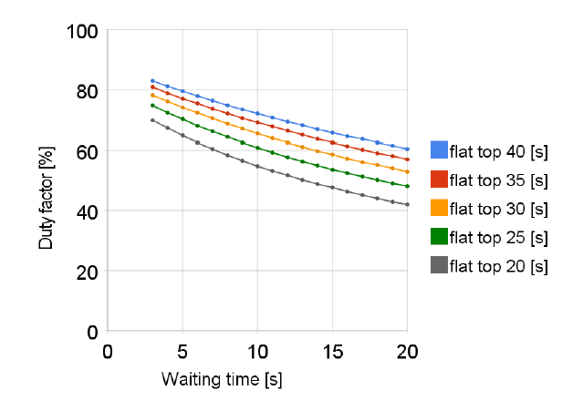
Beam cycle and Duty factor

