Slide 1
The analysis status of
JLab E05-115 experiment

Slide 2
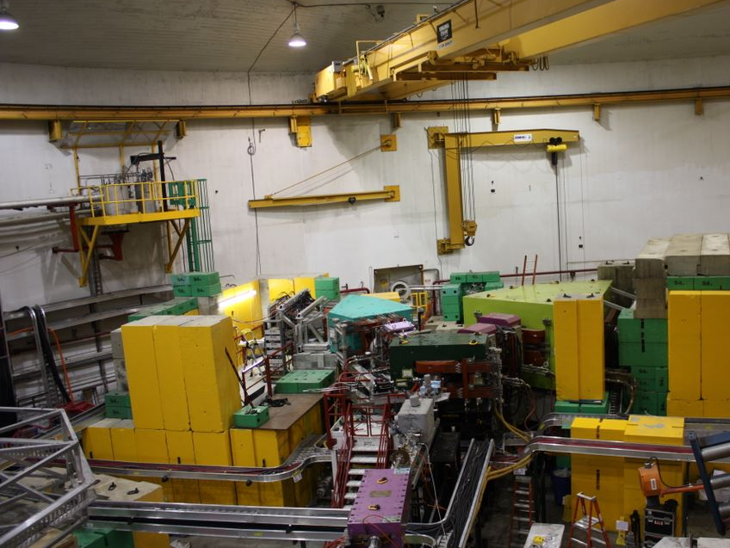
JLab E05-115 experiment : 2009 Aug to Nov at JLab Hall-C
Data Summary
Target | hypernucleus | Target Thickness [mg/cm²] | Average beam current [μA] | Total Charge [C]
CH₂ | Λ, Σ⁰ | 450.8 | 2.0 | 0.28
H₂O | Λ, Σ⁰ | ~500 | 2.7 | 0.20
⁷Li | ⁷_{Λ}He | 184.0 | 32.0 | 4.84
⁹Be | ⁹_{Λ}Li | 188.1 | 38.3 | 5.33
¹⁰B | ¹⁰_{Λ}Be | 56.1 | 38.7 | 6.25
¹²C | ¹²_{Λ}B | 112.5 | 26.8 | 5.90
⁵²Cr | ⁵²_{Λ}V | 134.0 154.0 | 7.6 | 0.83 5.53

Slide 3
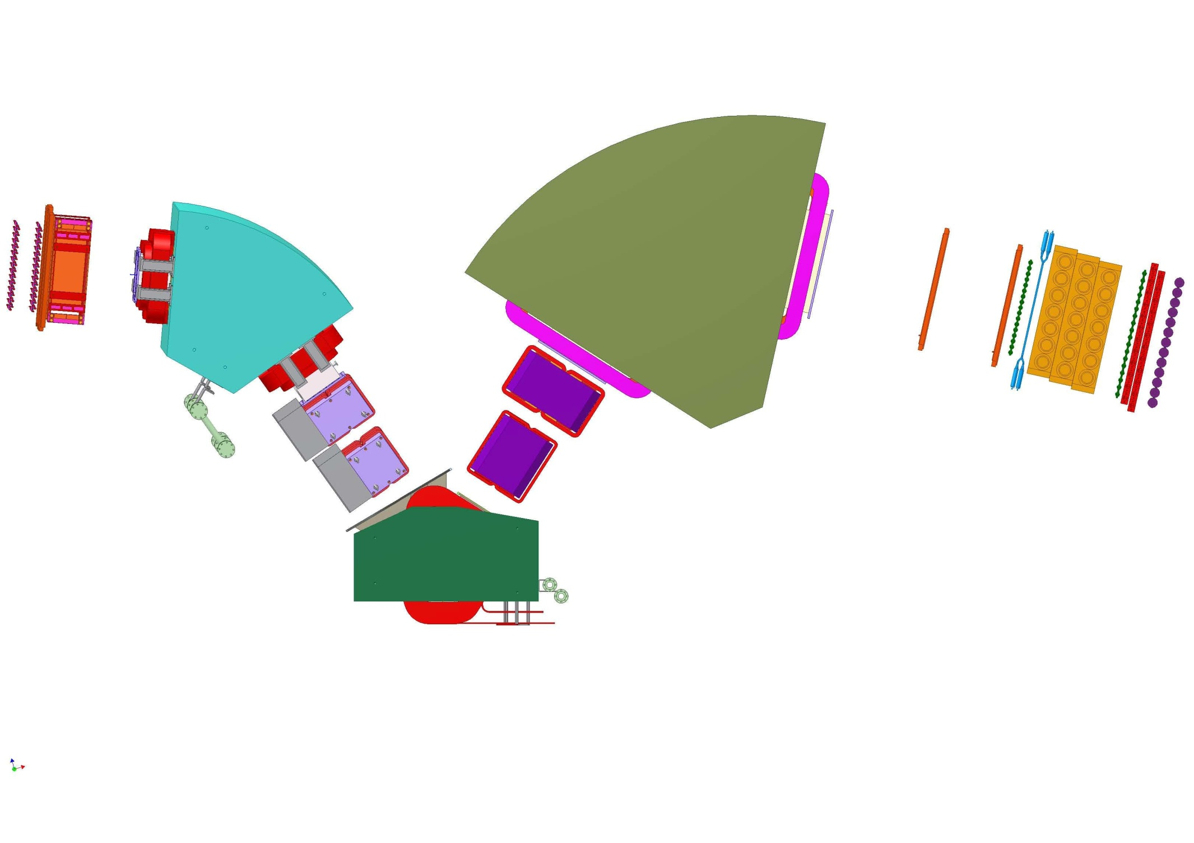
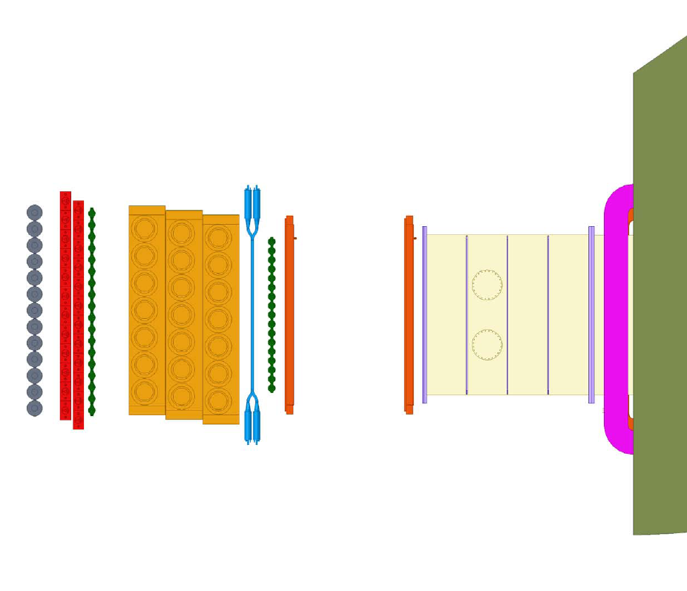
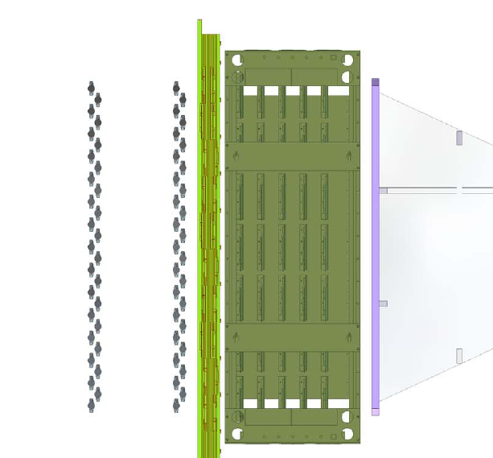
Experimental Setup
HES
HKS
1m
EH1, 2
EDC1
KDC1,2
0.84 GeV/c e’
1.2 GeV/c K⁺
WC
AC
LC
e-
K⁺
EDC2
1x
1y
2x
SPL
Drift Chamber … EDC1 + EDC2
Timing Counter … 1x + 2x
Drift Chamber … KDC1 + KDC2
Timing Counter … 1x + 1y + 2x
Pion rejection … AC
Proton rejection … WC, LC
target
2.344GeV
Electron Beam

Slide 4
HES-HKS Spec & Expected energy resolution
High resolution & Wide acceptance spectrometers
 | HES | HKS
Configuration | Q-Q-D （50deg） | Q-Q-D （70deg）
e’/K⁺ Central Momentum | 0.84 GeV/c | 1.2 GeV/c
e’/K⁺ Momentum Acceptance | ±0.15 GeV/c | ±0.15 GeV/c
e’/K⁺ Solid Angle | ~7msr | ~8.5msr
Mom. Resolution (FWHM) [MeV/c] | 2.0×10⁻⁴ | 2.0×10⁻⁴
Ang. Resolution (FWHM) [mrad] | 3 | 2
dE_{Beam}=190keV
dE_{HKS}=220keV
dE_{HES}=190keV
Total Energy Resolution = 350keV (Design value)
Notes:
表はいらない
wide acceptance、高分解能
short orbit

Slide 5
Analysis Procedure
Calc. momentum and time
at target
HES tracking,
Calc. FP variable
HKS tracking,
Calc. FP variable
Kaon PID
Calc. momentum and time
at target
Calc. cointime and missing mass
Energy scale calibration,
Cross Section analysis

Slide 6
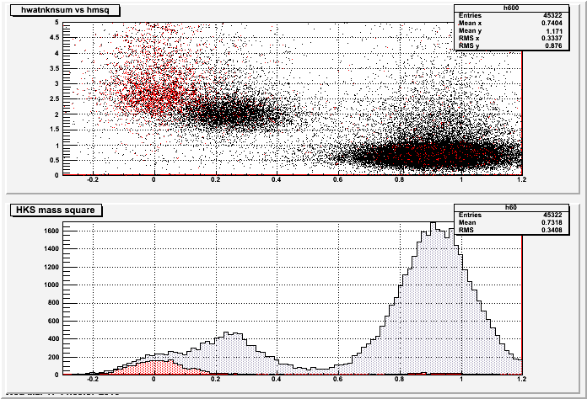
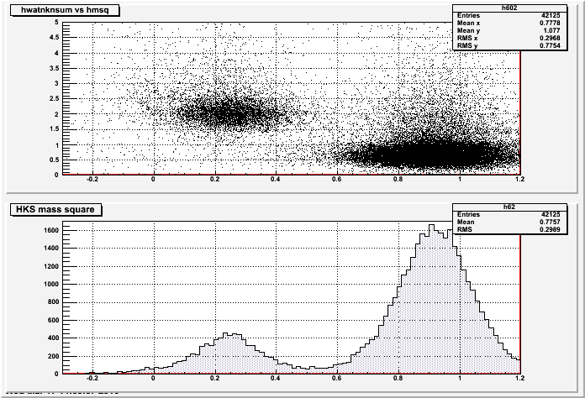
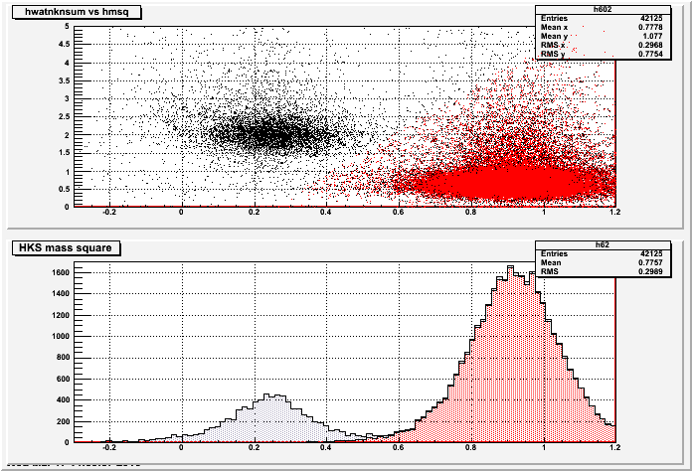
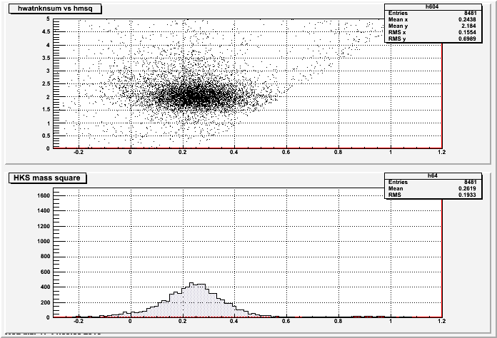
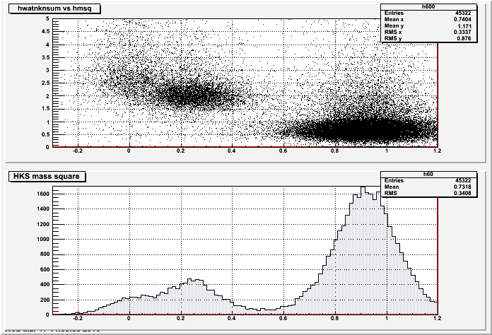
Kaon PID
HKS Detectors
Kaon
WC npe sum vs m²
KDC1,2
KDC1,2
WC
AC
WC
AC
LC
LC
Kaon
1x
1x
1y
1y
2x
2x
WC n=1.33
AC n=1.055
0
0.5
1.0
[(GeV/c²)²]
Kaon Cut
Reject π⁺/e⁺/e⁻ using AC npe
Reject p using WC npe
Select clean K⁺ using m²
Kaon Cut
Reject π⁺/e⁺/e⁻ using AC npe
Reject p using WC npe
Select clean K⁺ using m²
Kaon Cut
Reject π⁺/e⁺/e⁻ using AC npe
Reject p using WC npe
Select clean K⁺ using m²
Kaon Cut
Reject π⁺/e⁺/e⁻ using AC npe
Reject p using WC npe
Select clean K⁺ using m²
β

Slide 7
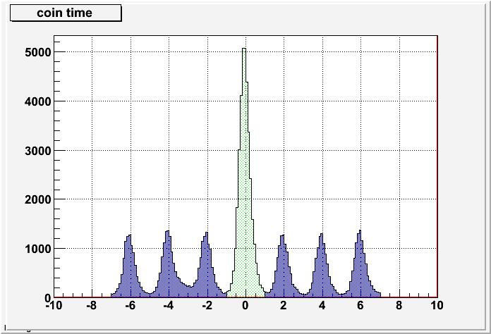
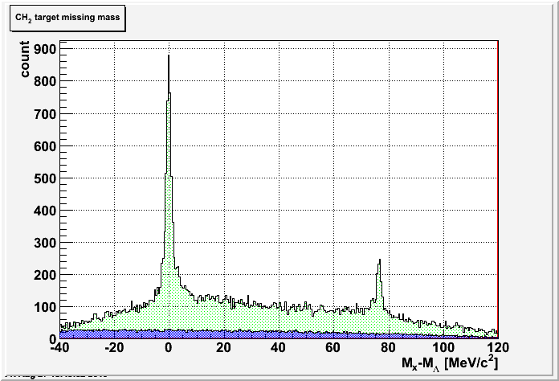
Coin Time Analysis
measure
T_{EFP}
T_{KFP}
HES
Ref. Plane
HKS
Ref. Plane
TF2T_{E}(x_{f}, x’_{f}, y_{f}, y’_{f})
… G4 simulation
TF2T_{K}(x_{f}, x’_{f}, y_{f}, y’_{f})
… G4 simulation
T_{Et}
T_{Kt}
Target
About TF2T
For path length correction
4th polynomial of x_{f}, x’_{f}, y_{f}, y’_{f}
coin time = T_{Kt}-T_{Et}
True coincidence
CH₂ target missing mass
Target : CH₂
σ~300ps
2ns
ns
Acc. Background
Notes:
2nsの説明

Slide 8
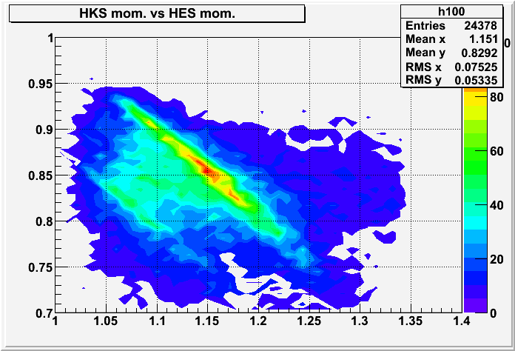
Momentum reconstruction
measure
X_{EFP}
X_{KFP}
HES
Ref. Plane
HKS
Ref. Plane
F2T function
F2T function
P_{Et}
Target
P_{Kt}
Assumption : point source at target
Real Data
HES mom [GeV/c] vs HKS mom [GeV/c]
Calculate from G4, TOSCA field map
→ Need to be optimized
Λ and Σ⁰ peak in proton target run
  Momentum calibration
Sieve Slit Run
  Angle calibration
Real Data
Λ
Σ⁰
Notes:
磁場のはなし

Slide 9
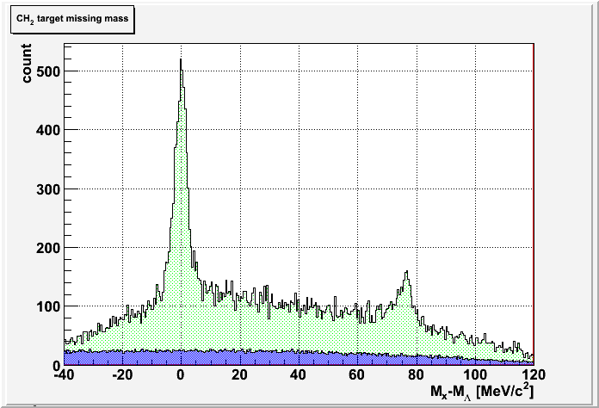
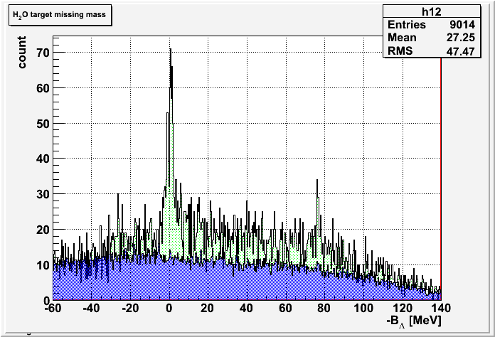
Energy Scale Calibration –Λ, Σ⁰ peak-
elementary reaction using proton target :
CH₂ target missing mass w/ initial F2T
CH₂ target missing mass w/ tuned F2T
Width of Λ
~4.6MeV (FWHM)
Width of Λ
~2.2MeV (FWHM)
Λ
Λ
¹²C QF
Σ⁰
¹²C QF
Σ⁰
Acc. Background
M_{x}-M_{Λ} [MeV/c²]
Acc. Background
M_{x}-M_{Λ} [MeV/c²]
H₂O target missing mass (preliminary)
Water Cell target
Havar foil (25μm x 2) -> background source
higher rate than CH₂ data
Λ
Σ⁰
Bad S/N ratio, poor statistics
→ Due to imperfect treatment of multiplicity
Analysis code development is in progress
M_{x}-M_{Λ} [MeV/c²]
Notes:
ハーバー、単位

Slide 10
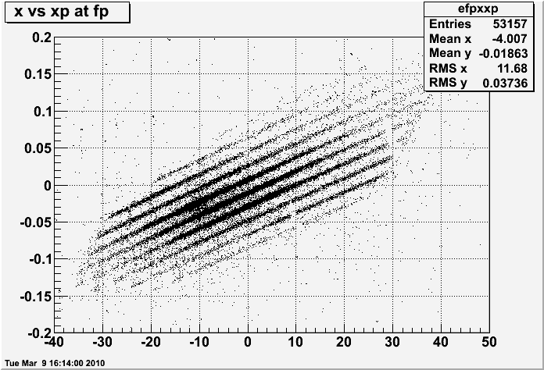
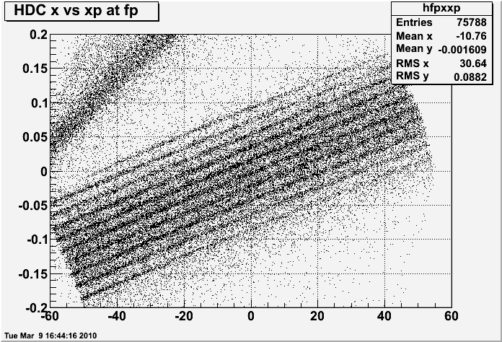
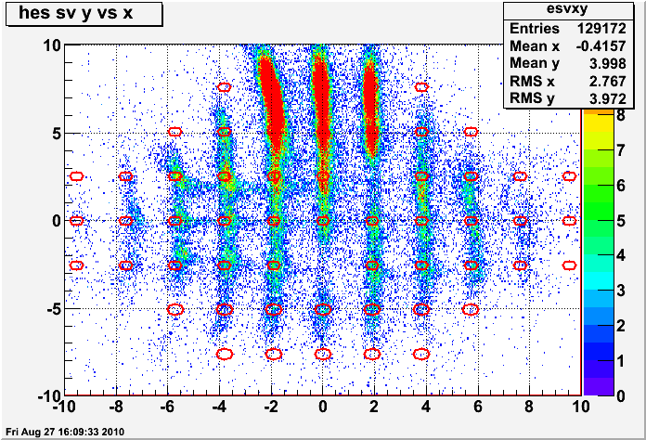
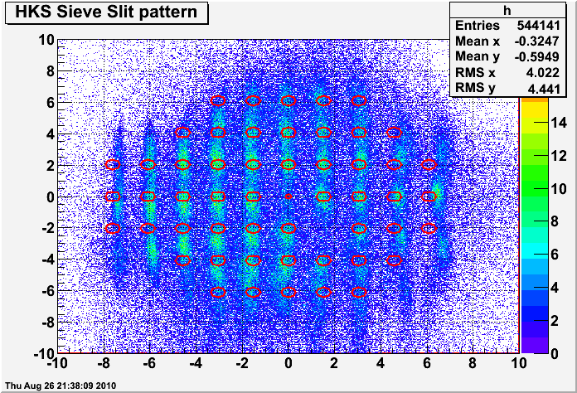
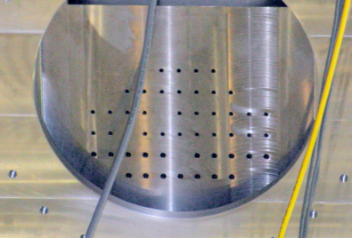
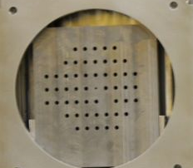
Energy Scale Calibration –Sieve Slit-
x (cm) vs x’ (rad) at HES FP
x (cm) vs x’ (rad) at HKS FP
Real Data
Real Data
reconstruct
reconstruct
K⁺
e’
HES Ref. Plane
HKS Ref. Plane
Real Data
cm
cm
HES SS
Real Data
HKS SS
cm
cm
Notes:
W合金、矢印、穴抜け

Slide 11
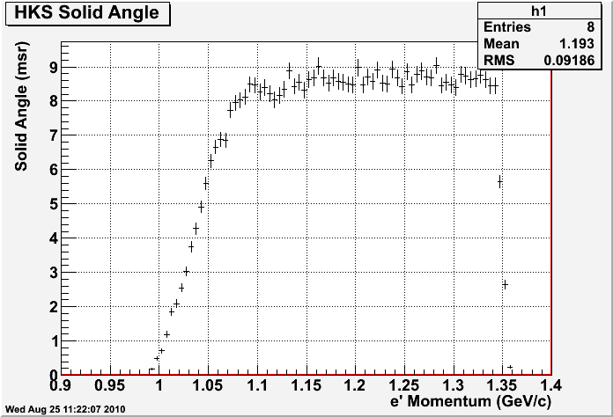
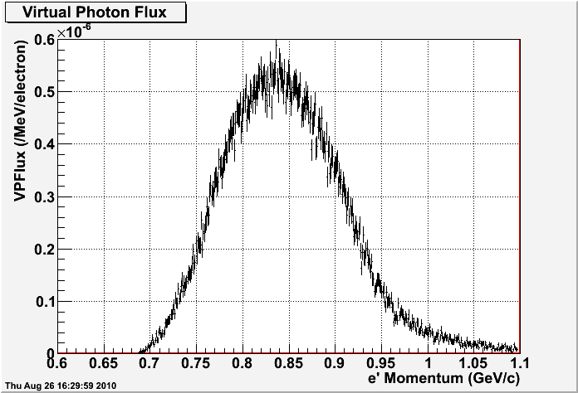
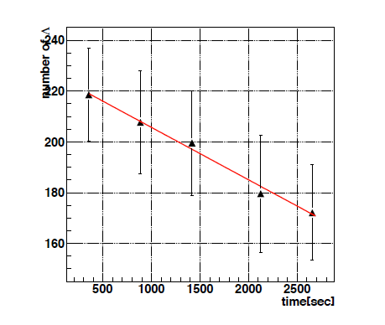
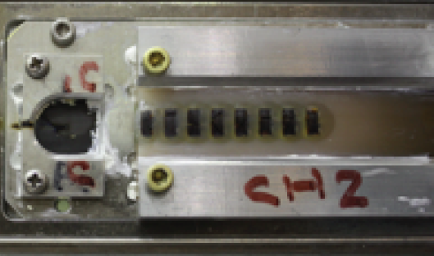
Cross section calculation at CH₂ target
N_{T} [1/cm²] | 4.05x10²²
effective N_{T} [1/cm²] | 3.21x10²²
N_{γ∗} [1/electron] | 1.51x10¹⁴
f_{decay} | 0.298
ε_{i} | 1 (assumed)
SIMULATION
SIMULATION
N_{T} … The number of target nuclei
N_{γ ∗}… The number of virtual photon
f_{decay} … Kaon decay factor in HKS
dΩ_{i} … HKS solid angle
ε_{i} … Total detector/cut efficiency,
including
  HKS/HES tracking efficiency
  Kaon cut efficiency
  Computer dead time
HKS Solid Angle
~ 8.5mrad
Integral … 8.63x10⁻⁵ /electron
Proton decrease in CH₂ target
(A.Shichijo master’s thesis)
picture of CH₂ target
Average number of proton -> 83%
Notes:
焦げたCH2

Slide 12
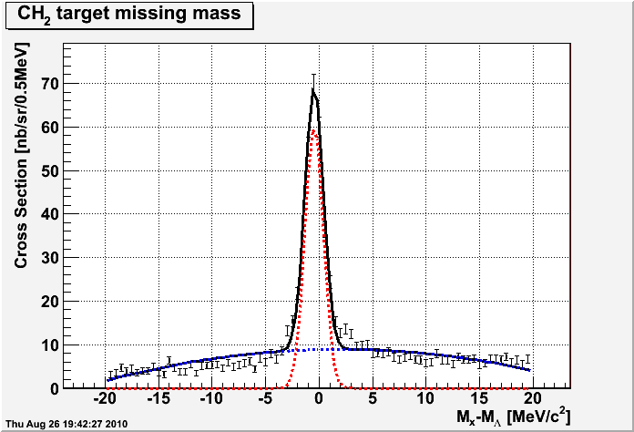
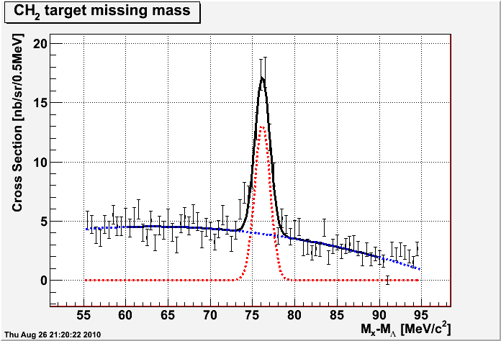
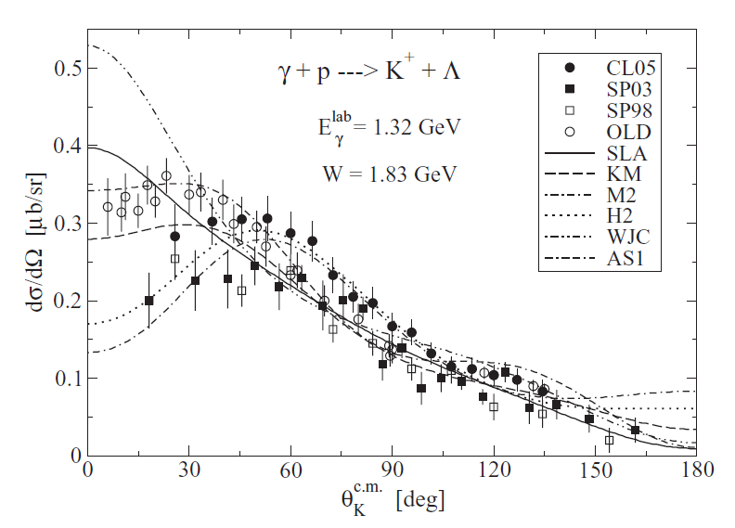
p(γ∗,K⁺)Λ/Σ⁰ Cross Section
preliminary,
efficiency is
NOT included
preliminary,
efficiency is
NOT included
Λ
Σ⁰
our data
P. BYDZOVSKY AND T. MART
PHYSICAL REVIEW C 76, 065202 (2007)
Further analysis should be done,
but experimental data looks fine

Slide 13
Summary
JLab E05-115 Experiment 2009 Aug-Nov
carried out successfully
Now we are at data analysis phase
Kaon is well idenfified
p(γ∗,K⁺)Λ/Σ⁰ cross section value is reasonable compared with past experiment data
To do
Multiplicity analysis especially for higher rate data
F2T func. parameter optimization (so-called matrix tuning)
Get hypernuclear spectra
Notes:
matrix tune

Slide 14
Backup

Slide 15
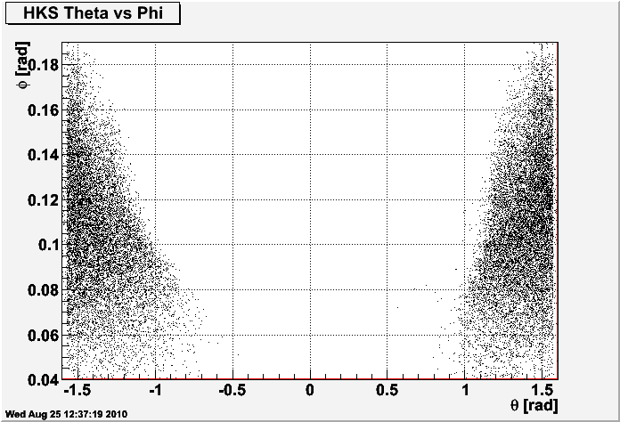
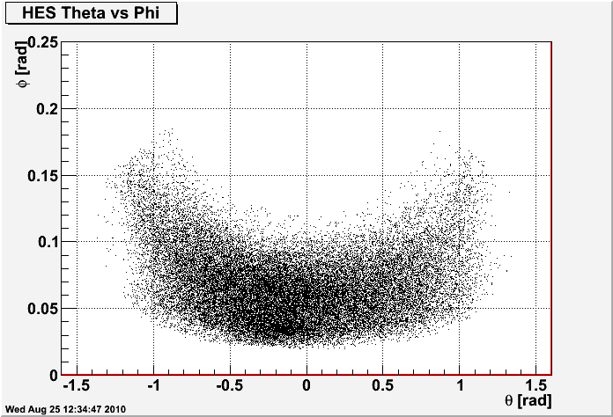
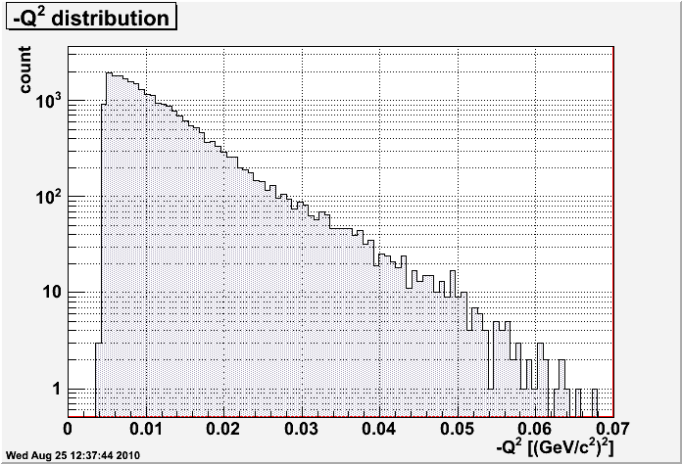
HKS/HES acceptance (real data)

Slide 16
Goals of the 3rd Generation Experiment
Precise Λ Hypernuclear Spectroscopy
in the wide mass region
⁷Li(e,e’K⁺)⁷_{Λ}He,¹⁰B(e,e’K⁺)¹⁰_{Λ}Be
- Cluster model, shell model approach
  Charge Symmetry Breaking in ΛN interaction
  ΛN-ΣN coupling effect
⁵²Cr(e,e’K⁺)⁵²_{Λ}V
- Shell model, Mean field theory
  A dependence of Λ single particle energies
  Measurement of fine structure (core configuration mixing, ls splitting…)

Slide 17
Detectors
Schematic view of HKS Detectors
KDC1,2
WC
AC
LC
Drift Chamber … KDC1 + KDC2
Timing Counter … 1x + 1y + 2x
Pion rejection … AC
Proton rejection … WC, LC
K⁺
1x
1y
2x
Schematic view of HES Detectors
EH1, 2
EDC1
Drift Chamber … EDC1 + EDC2
Timing Counter … 1x + 1y + 2x
e-
EDC2
Notes:
詳しく（AC, WCとか）
rejection efficiency
写真

Slide 18
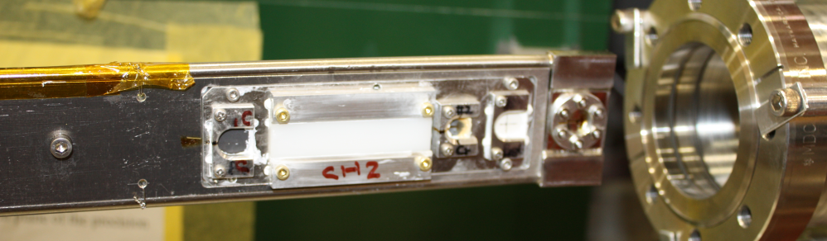
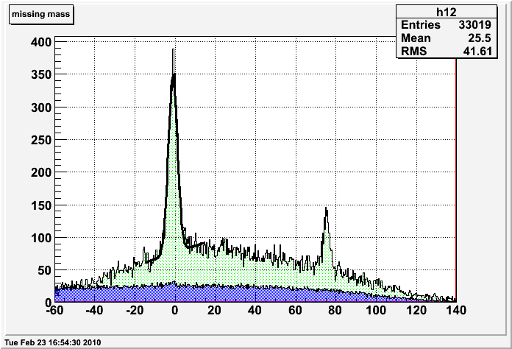
Energy Scale Calibration –Λ, Σ⁰ peak-
elementary reaction using proton target :
Water Cell target
Water Flow
Havar foil (25μm x 2)
-> background source
higher rate than CH₂ data
5cm
CH₂ target
Water Flow
CH₂ target missing mass (preliminary)
H₂O target missing mass (preliminary)
Λ
Width of Λ
~4MeV (FWHM)
Λ
Σ⁰
¹²C QF
# of incident
almost same
Σ⁰
Acc. Background
M_{x}-M_{Λ} [MeV/c²]
M_{x}-M_{Λ} [MeV/c²]
Bad S/N ratio, poor statistics
→ Due to multiplicity analysis problem
Notes:
ハーバー、単位

Slide 19
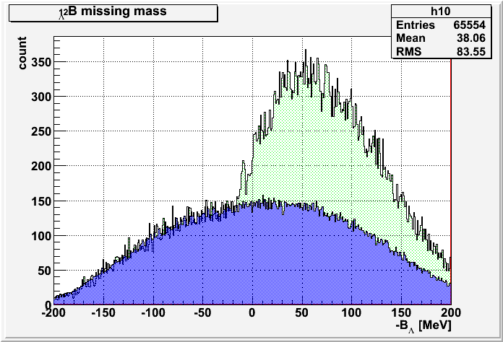
QF Yield on Each Target
The quality of F2T func. is not enough to count the number of bound state
-> Estimate using QF events and cross section
Target | Number of Quasi-Free Λ (measured, Online) | Quasi-Free Λ Cross Section (assumed) | Hypernuclei (g.s) Cross Section (assumed) | Expected number of g.s
⁷Li | 6.4*10⁴ | 1.0 μb/sr | 20 nb/sr | 1*10³
⁹Be | 4.5*10⁴ | 1.2 μb/sr | 5 nb/sr | 2*10²
¹⁰B | 4.8*10⁴ | 1.3 μb/sr | 20 nb/sr | 8*10²
¹²C | 3.4*10⁴ | 1.5 μb/sr | 100 nb/sr | 2*10³
⁵²Cr | 1.4*10⁴ | 4.7 μb/sr | 70 nb/sr | 2*10²
¹²_{Λ}B Missing mass
Cross section of QF Λ is assumed as 0.2*A^{0.8} [μb/sr]
# of g.s is calculated as
  (# of Λ)*(g.s cross section)/(QF Λ cross section)
# of lambda at carbon target includes some calibration run (+1MeV run).
QF
Acc. Background
Notes:
Cのmm、TOSCAでは分解能はでない（はじめに）、説明

