Slide 1


SIDDHARTA-2
Measurement of kaonic deuterium
with SIDDHARTA-2
from SIDDHARTA to SIDDHARTA-2
LEANNIS “kick-off” Meeting
HadronPhysics3
Prague May 21-22, 2012
by Johann Zmeskal
SMI, Vienna

Slide 2
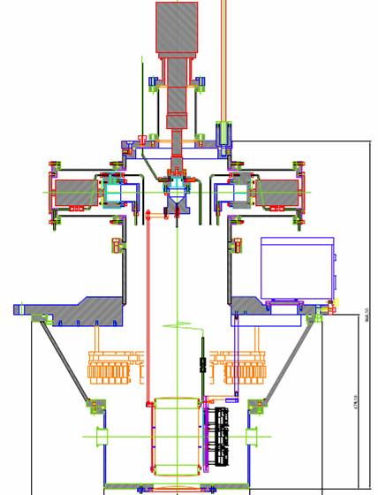
SIDDHARTA-2
The upgrade of the SIDDHARTA apparatus for
an enriched scientific case
Exploring the (very) low-energy QCD in the strangeness sector
by means of exotic atoms
14 June 2010

Slide 3

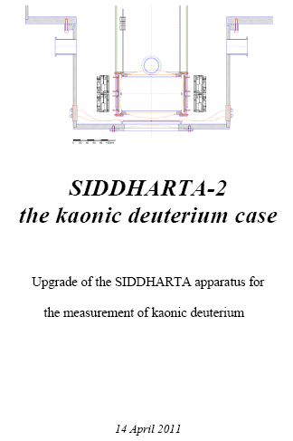
SIDDHARTA-2
Notes:
The SIDDHARTA collaboration deliver a document stipulating clearly how to improve the experiment, including a detailed description of the detector modifications, of the resulting improvement in signal and background rates, and of the reasons why 600 pb⁻¹ will be sufficient for a good kaonic-deuterium measurement. This new document should be available two months in advance of the next SC meeting, and should focus on the kaonic deuterium program.

Slide 4
Participating Institutions
INFN, Laboratori Nazionali di Frascati, Frascati, Roma, Italy
Stefan Meyer Institut für subatomare Physik, Vienna, Austria
IFIN-HH, Bucharest, Romania
Univ. Tokyo, Japan
RIKEN, Japan
INFN Sezione Roma1 and Ist. Superiore di Sanita’, Roma, Italy
Univ. Victoria, Victoria B.C., Canada
Politecnico Milano and INFN Milano, Milano, Italy
Excellence Cluster, TUM, Munich, Germany
Univ. Zagreb, Croatia

Slide 5
Motivation
Exotic (kaonic) atoms – probes for strong interaction
  hadronic shift ε_{1s} and width Γ_{1s} directly observable
  experimental study of low energy QCD.
  Testing chiral symmetry breaking in systems with strangeness
Kaonic hydrogen
  scattering lengths, no extrapolation to zero energy
  precise experimental data important/missing
  kaonic deuterium (never measured before)
    determination of the isospin dependent KN scattering lengths
Information on Λ(1405) sub-threshold resonance
  responsible for negative real part of scattering amplitude at threshold
  important for the search for the controversial „deeply bound kaonic states” (KEK, GSI, DAΦNE, J-PARC)

Slide 6
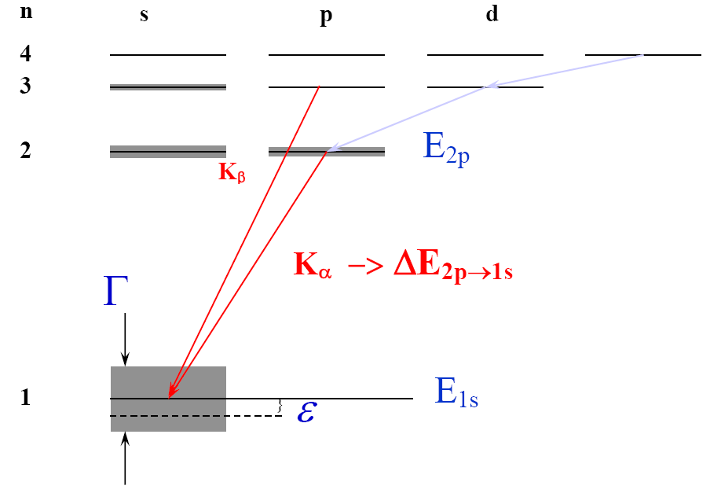
Kaonic deuterium X-rays
Kaonic deuterium
a_{K-p} = (a₀ + a₁)/2
a_{K-n} = a₁

Slide 7
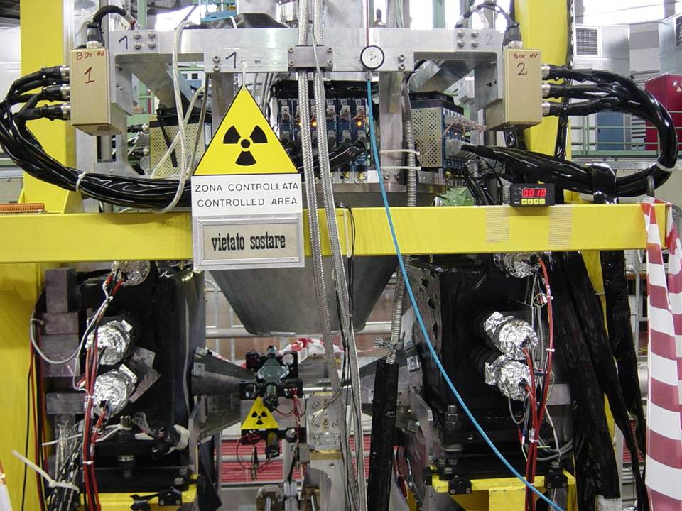
The SIDDHARTA setup
SIDDHARTA

Slide 8
The SIDDHARTA setup
SIDDHARTA

Slide 9
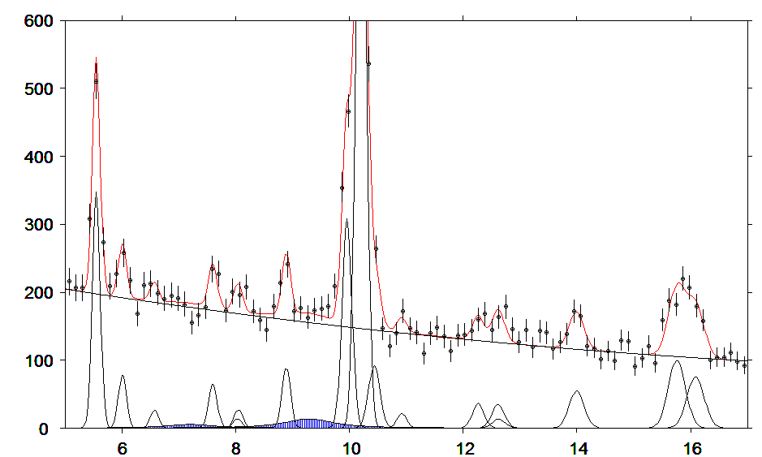
Kaonic deuterium data
fit for shift: about 500 eV
width: about 1000 eV
KC (5-4)
KC
(6-5)
KO
(6-5)
Kaonic deuterium
KO
(7-6)
KN
(6-5)
KC
(7-5)
KO
(9-7)
Cu
Kα
KAl
(8-7)
KAl
(10-8)
Pb
Lβ
KAl
(7-6)
KC
(6-4)
KN
(5-4)
KTi
(11-10)
Kd
Kcom
Kd
Kα
X-ray energy [keV]
Notes:
Kα / Kcomplex = 0.4

Slide 10
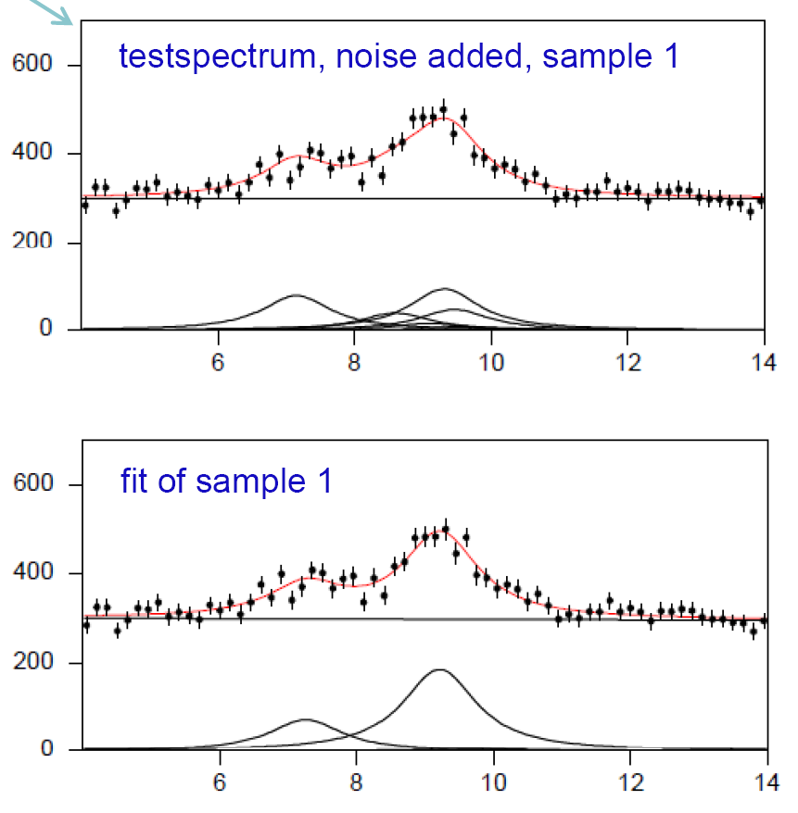
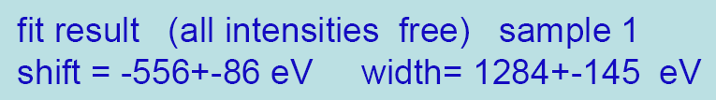
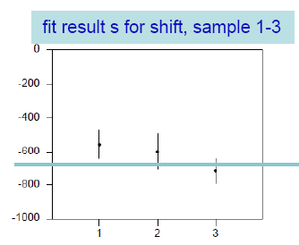
model input
shift = - 660 eV
width= 1200 eV
Kaonic deuterium

Slide 11
The SIDDHARTA-2 setup,
essential improvements
      new target design
      new SDD arrangement
      vacuum chamber
      more cooling power
      improved trigger scheme
      shielding and anti-coincidence
Kaonic deuterium

Slide 12
      new target design
      new SDD arrangement
Kaonic deuterium

Slide 13
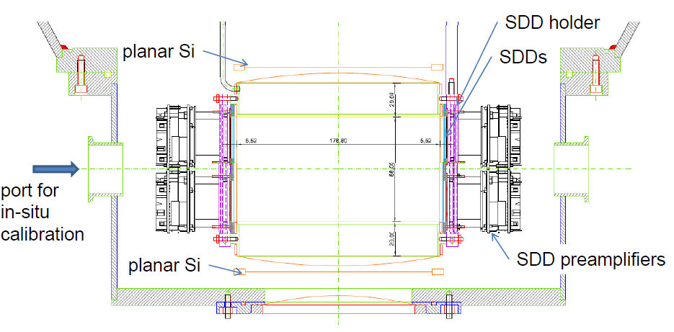
New target cell and SDD arrangement
Kaonic deuterium

Slide 14
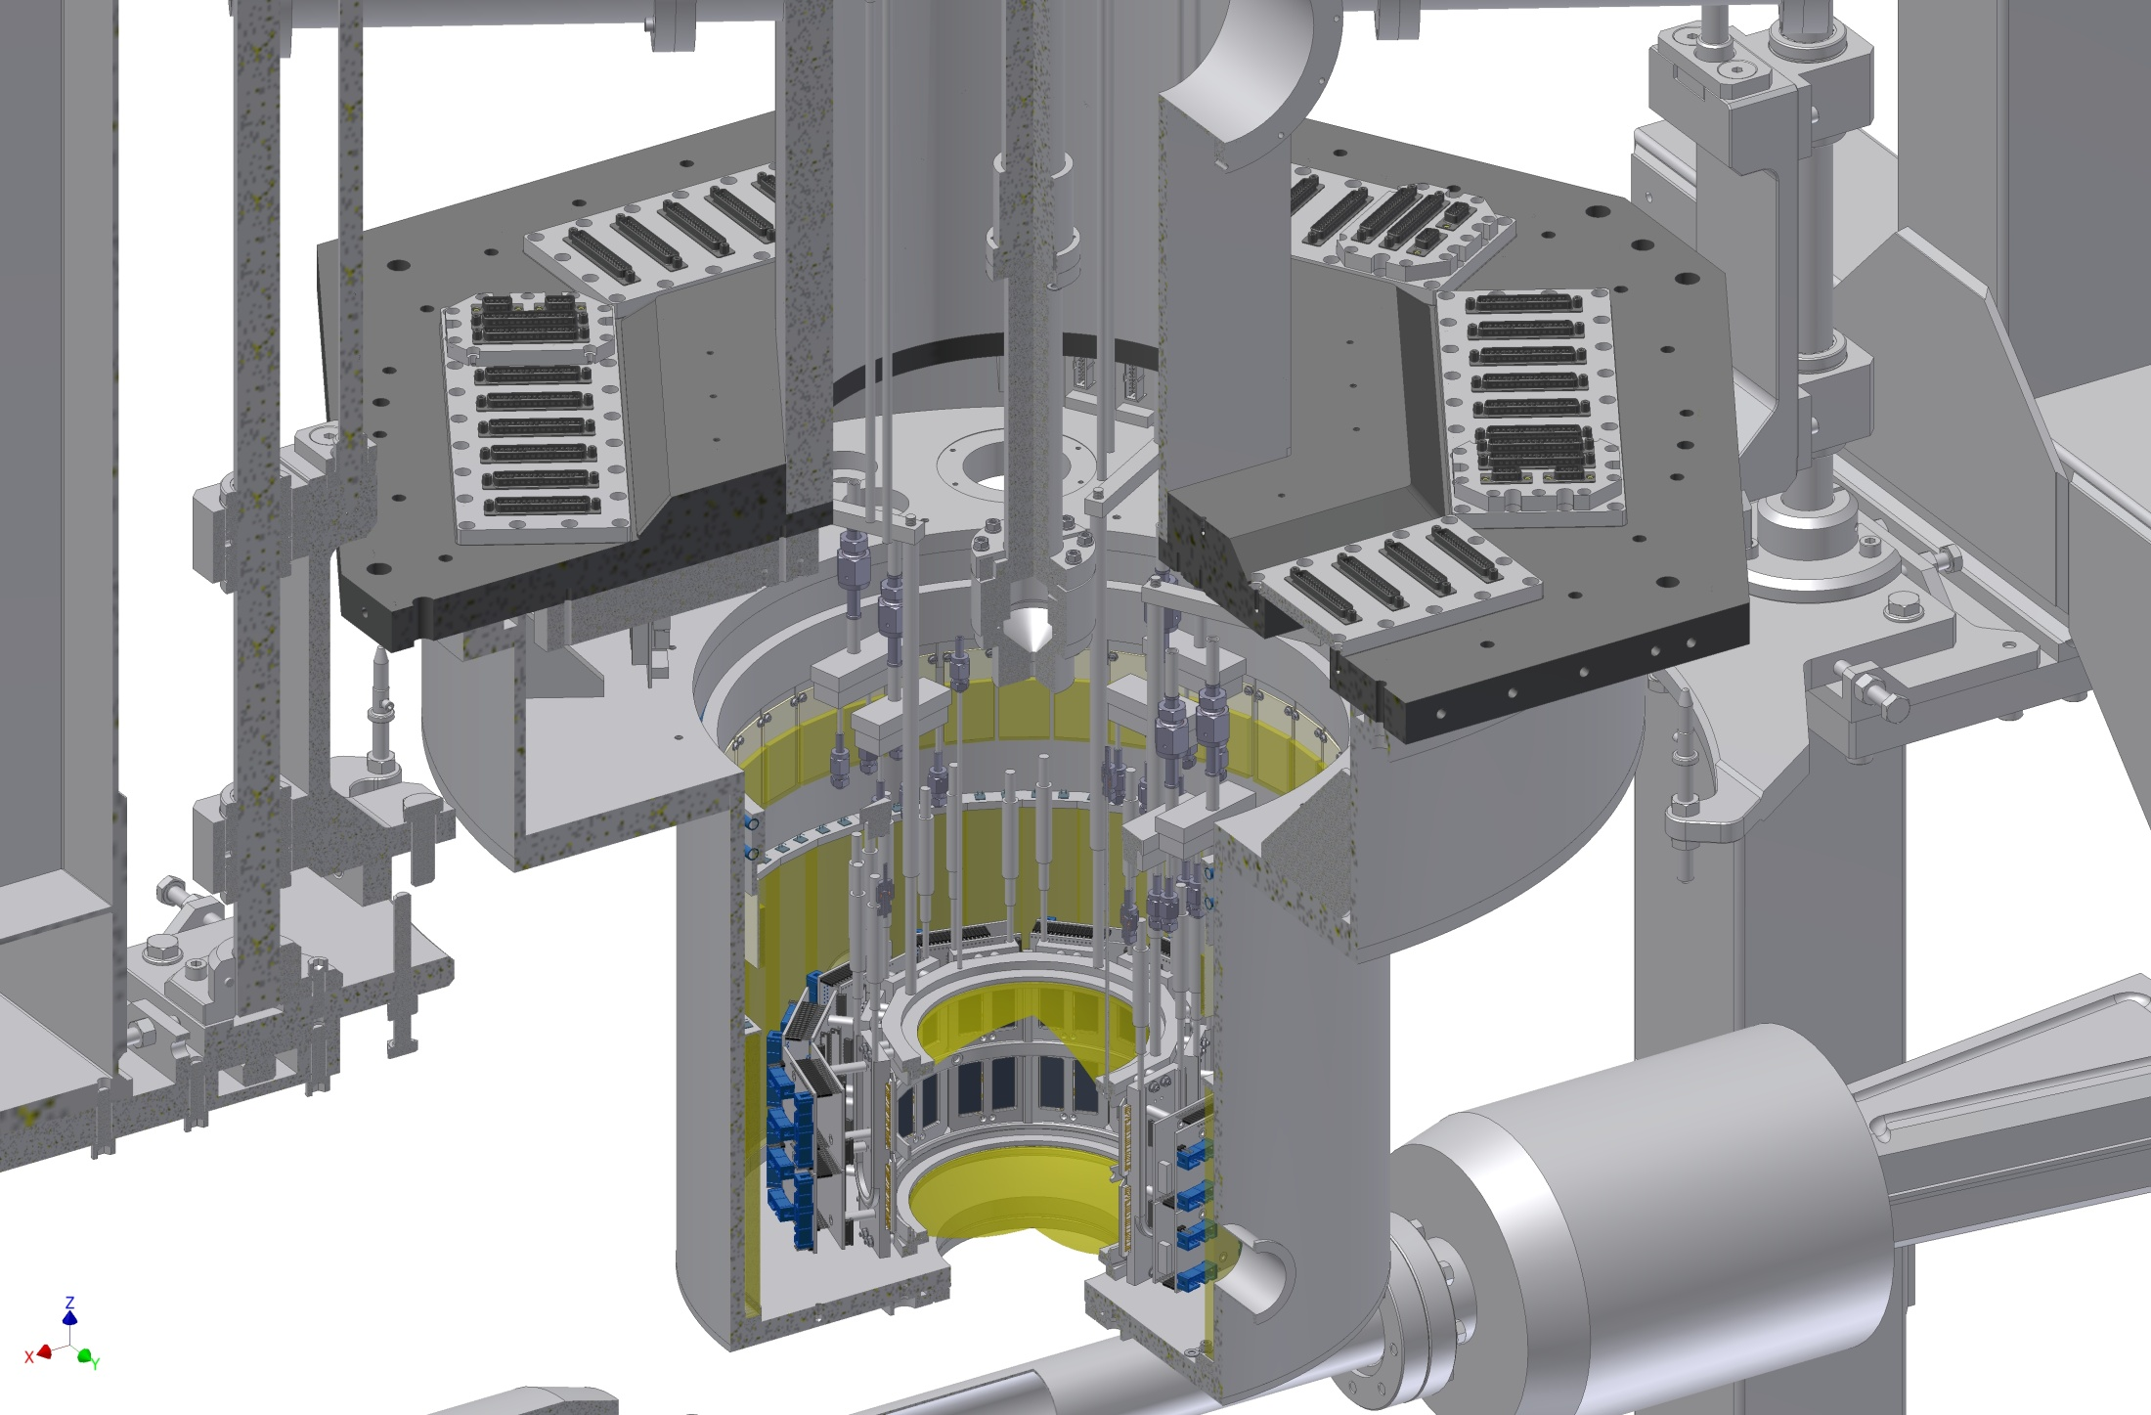
New target cell and SDD arrangement
Kaonic deuterium

Slide 15
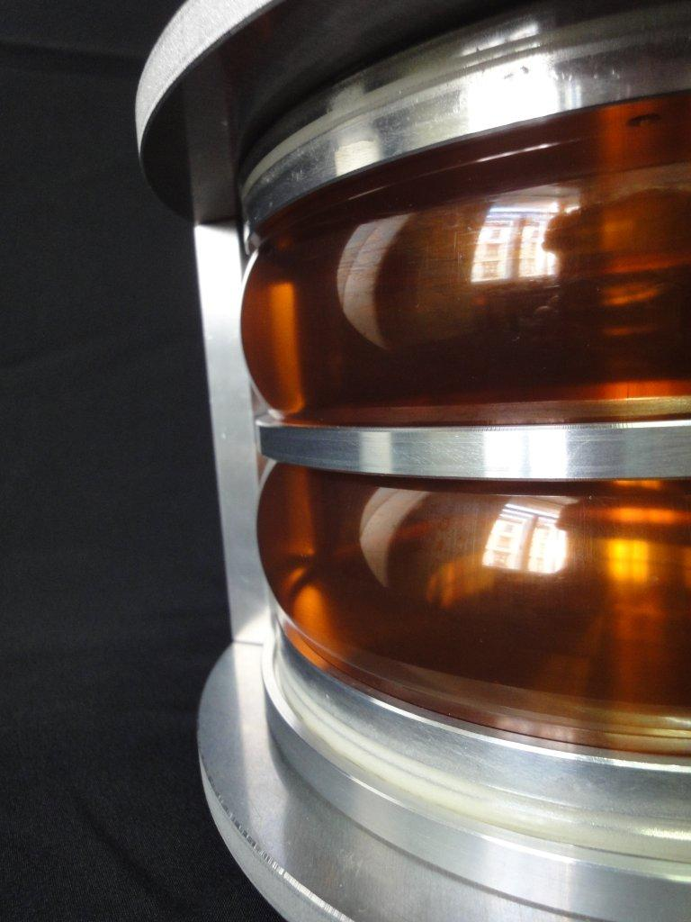
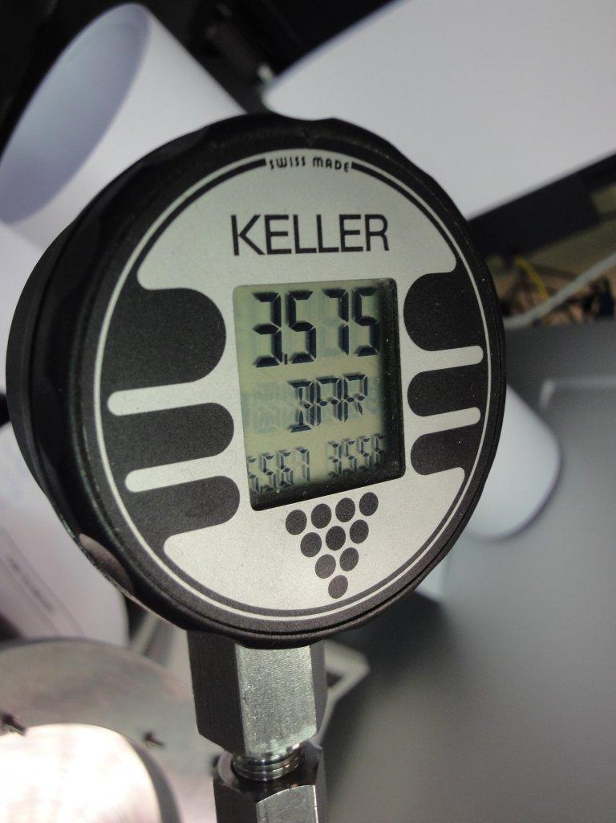
New target cell prototype
Kaonic deuterium

Slide 16
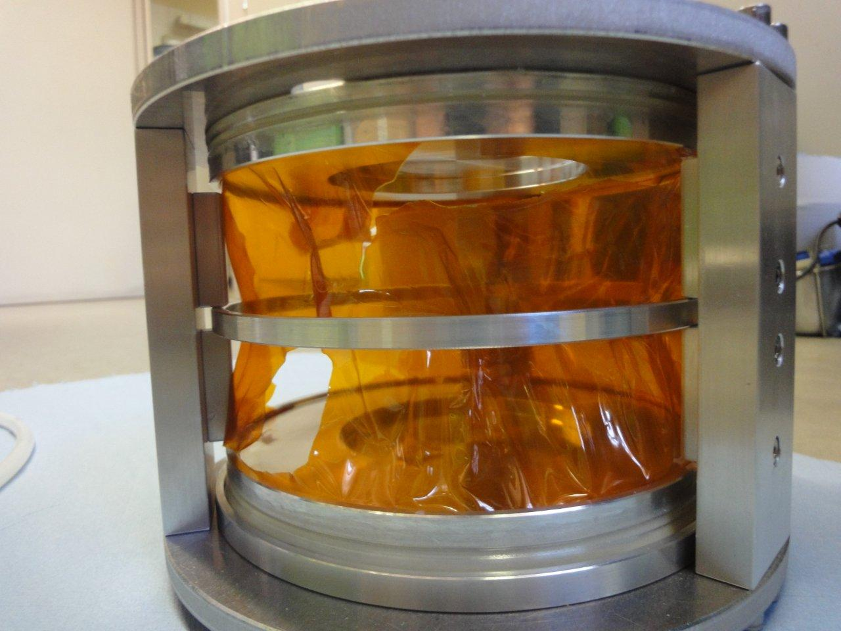
Burst pressure 3.5 bar (abs.)
Kaonic deuterium

Slide 17
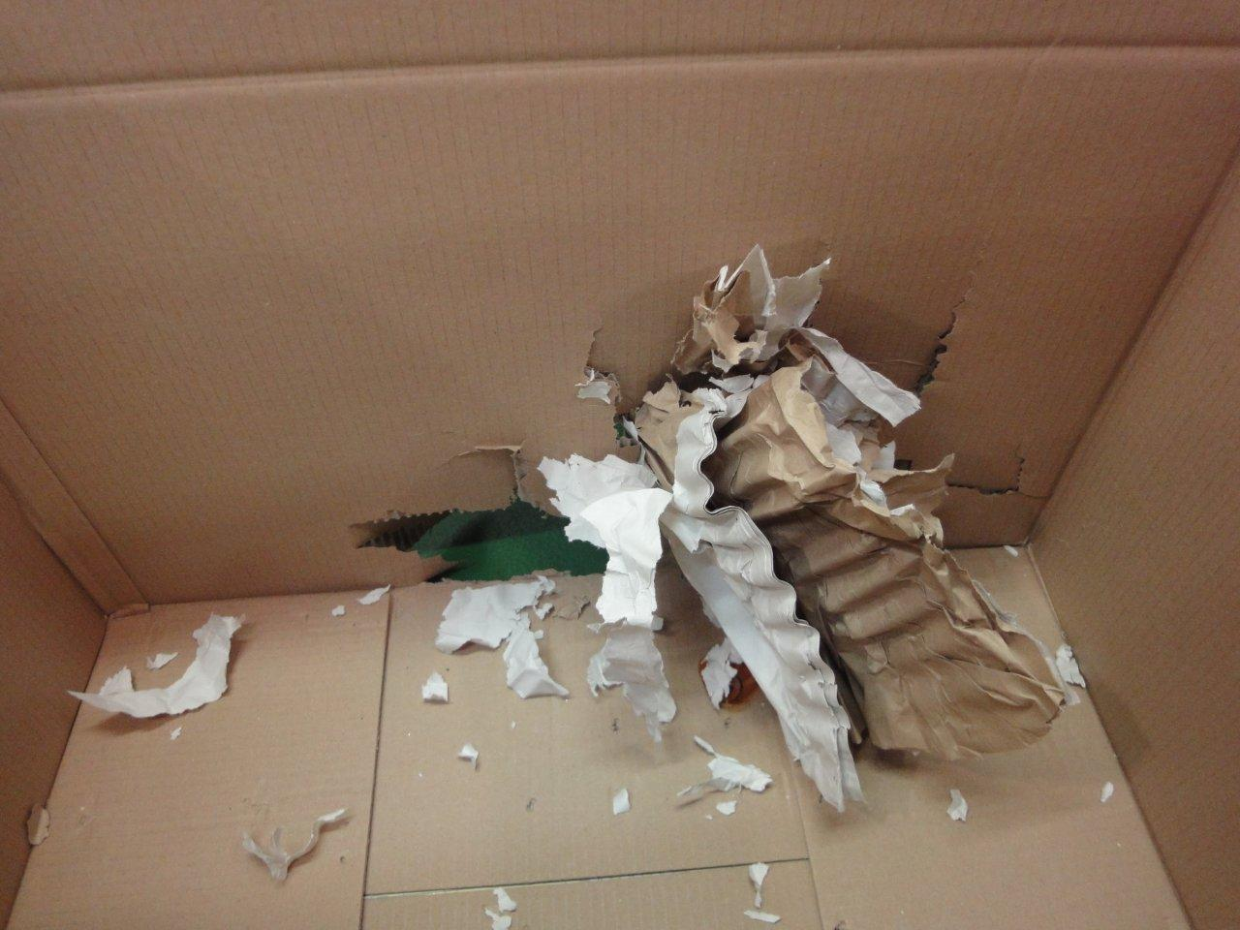
Results of a bursting target cell
Kaonic deuterium

Slide 18
  vacuum chamber
  more cooling power
Kaonic deuterium

Slide 19
New design of the cooling transfer lines for
target and SDDs
Target cooling:
1 Leybold – 16 W @ 20 K
Liquid hydrogen cooling lines,
new target cell, selected materials
SDD cooling:
4 CryoTiger – 60 W @ 120 K
Liquid argon cooling lines:
SDD cooling to 100 – 120 K
Kaonic deuterium

Slide 20
  improved trigger scheme
Kaonic deuterium

Slide 21
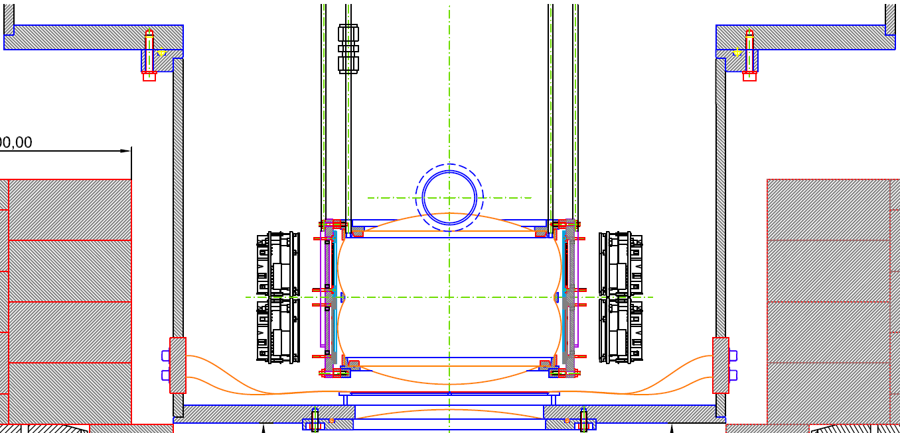
Target cell
SDDs
Kaonic deuterium
SDD-
electronic
Kaon monitor
upper scintillator
K⁻
Interaction
region
Veto counter
Kaon monitor
lower scintillator
K⁺
Kaonstopper:
K⁺-K⁻ discrimination

Slide 22
shielding and anti-coincidence
Kaonic deuterium

Slide 23
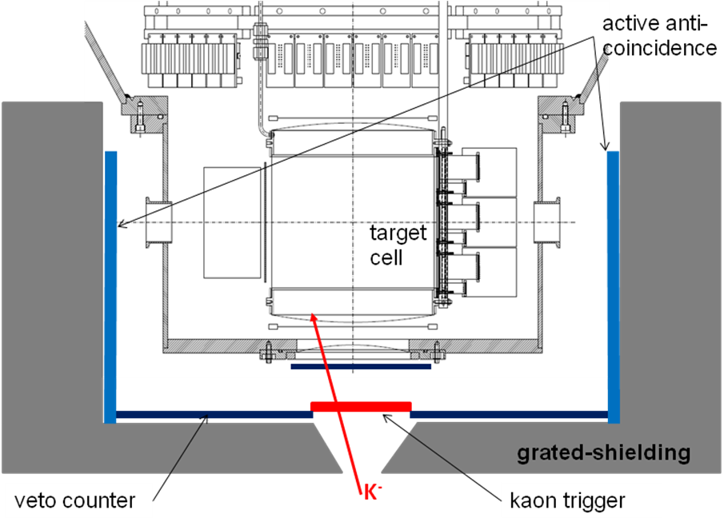
Kaonic deuterium

Slide 24
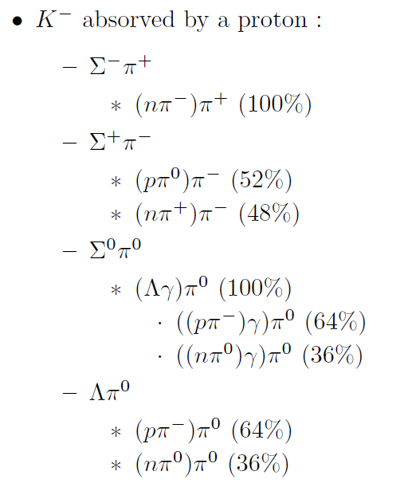
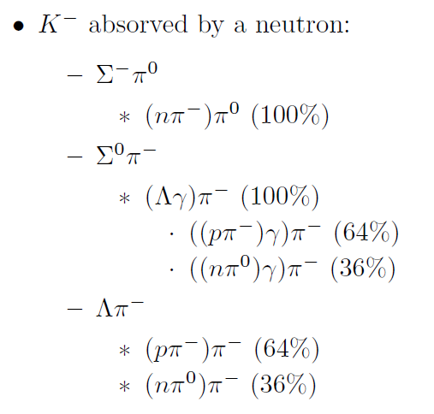
K⁻ captured by p
K⁻ captured by n
Kaonic deuterium

Slide 25
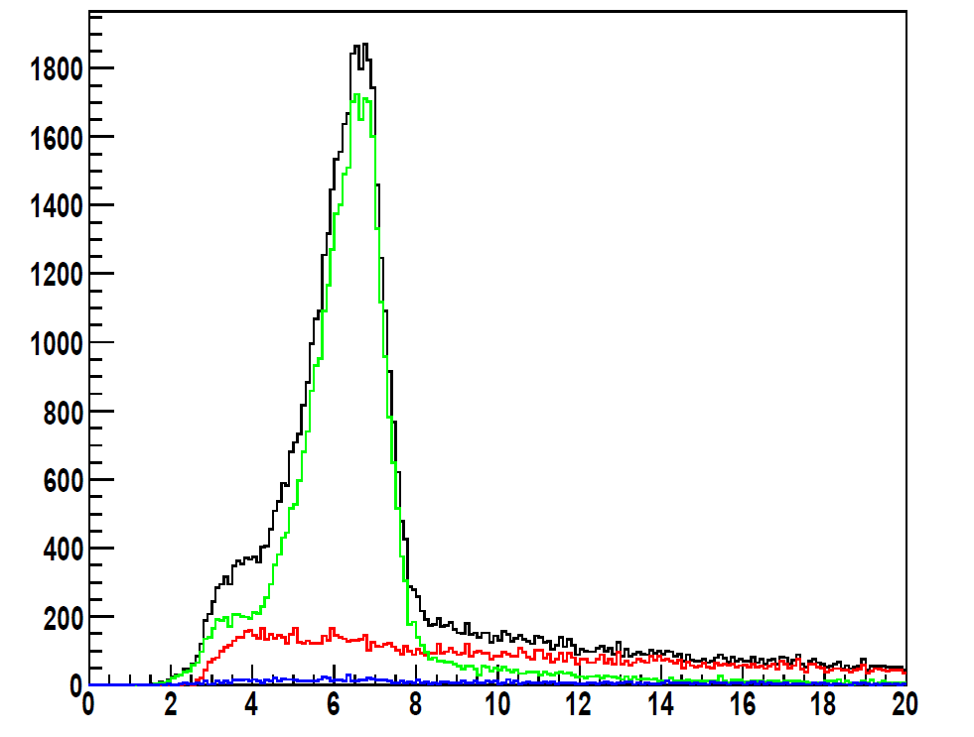
Timing (in ns) of a scintillator placed outside the vacuum chamber.
The main peak corresponds to particles produced by the K− absorption on a gas nucleus.
The green distribution is a selection of secondary tracks after the detection of a K+ in the bottom scintillator of the kaon detector (implying a K− reached the top side).
In red, the time spectrum is correlated to a K− crossing the bottom side of the kaon detector (the K+ is stopped in the target or in the walls); the distribution corresponds to the K+ decay.
In blue, the bottom kaon detector detects neither a K+ nor a K−.

Slide 26
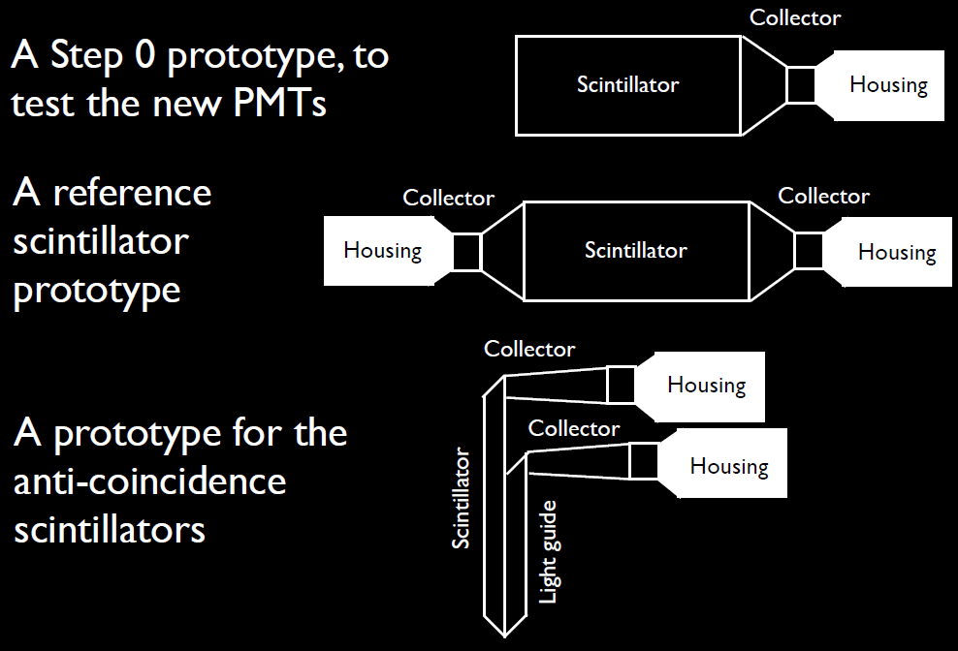
BTF veto counter - timing tests
Kaonic deuterium

Slide 27
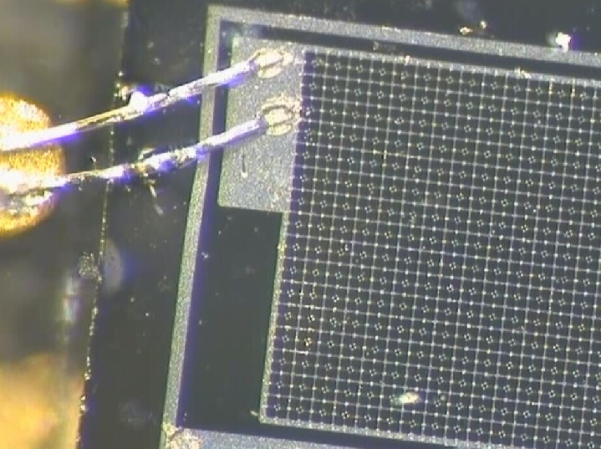
SiPM – Silicium photo multiplier
(Avalanche Photodiodes)
Test of different types of SiPM:
MAPD-Zecotek, SiPM Photonique,
MPPC Hamamatsu)
Basic performance of SiPMs, like:
timing, amplification, stability
FOPI
SIDDHARTA-2
PANDA
AMADEUS
EU-FP7 HP2: WP28 – SiPM
EU-FP7 HP3: WP28 – SiPM

Slide 28
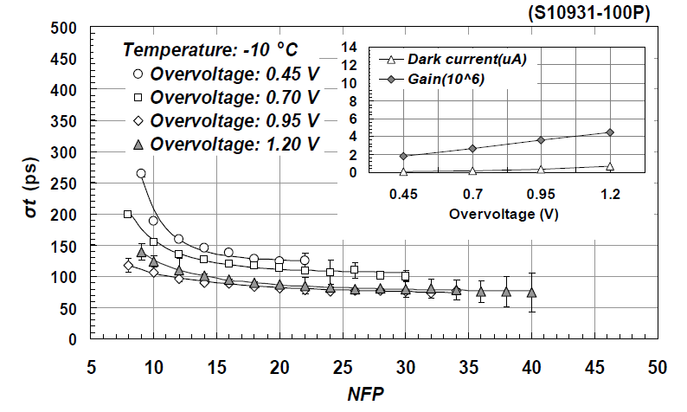
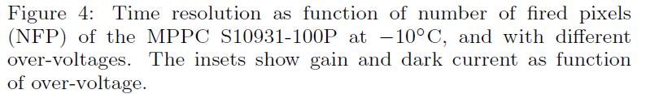
SiPM - timing
Advanced Instrumentation

Slide 29
Monte Carlo simulations
Kaonic deuterium

Slide 30
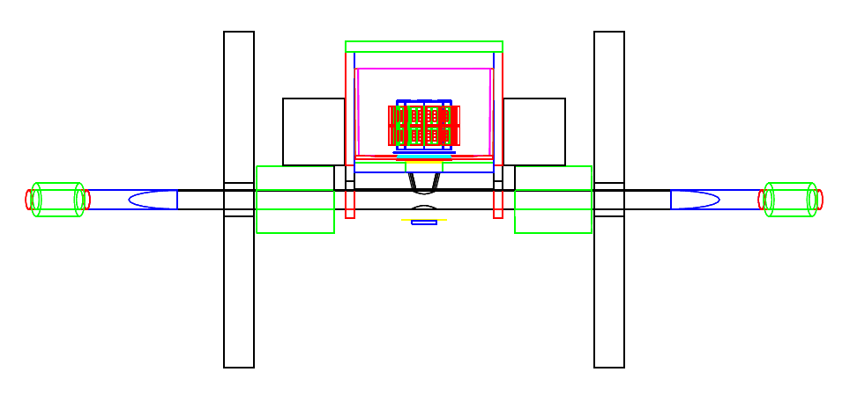
MC with Geant 4 – full setup
Kaonic deuterium
The GEANT4 package was used, with low energy tools included.
The low energy electromagnetic processes were simulated using the Livermore model, with particle tracking down to the few keV range and moreover, reproduces the X-ray fluorescence lines of the setup materials.
Both synchronous (hadronic) and asynchronous (machine) background were simulated, while the presence of other exotic atoms contributing to the acquired spectra were taken into account by a custom add-on of the atomic cascade to the standard kaon nuclear absorption class.
Notes:
All interaction region, full machine BG, ....

Slide 31
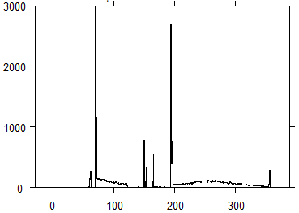
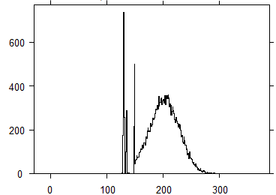
Result: Stopped kaon distribution
scintillator
shielding
degrader
SIDDHARTA, September 2009
vacuum
window
target windows
colli-
mator
gas
Kaonic deuterium
vaccum
window
scintillator
vertical position of stopped kaon (mm)
target window
SIDDHARTA-2
gas
vertical position of stopped kaons (mm)

Slide 32
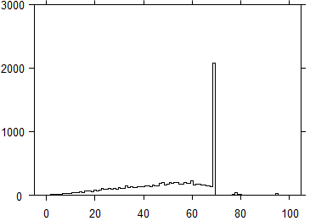
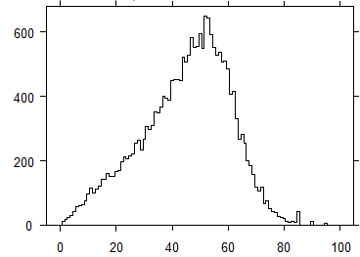
Result: Stopped kaon distribution
gas
cylindrical wall
SIDDHARTA, September 2009
Kaonic deuterium
radial position of stopped kaons (mm)
cylindrical
wall
gas
SIDDHARTA-2
radial position of stopped kaons (mm)

Slide 33
MC simulation - summary
 | new geometry & gas density | timing resolution | K± dis-crimination | del‘d anti-coinc. | prompt anti-coinc. | total impr. factor
Signal | 2.5 |  | 0.8 |  |  | 2.0
kaonic X-rays wall stops | 20 |  |  |  |  | 20
continuous background /Signal /keV | 3.8 ratio of gasstops vs. decay+wallstops |  | 2 events due to decay of K⁺ removed |  | 2 charged particle veto | 15.2
beam background (asynchron) | 4.8 less trigger per signal | 1.5 smaller coincidence gate |  | 3 „active shielding“ |  | 21.6
Kaonic deuterium

Slide 34
model input
shift = - 660 eV
width= 1200 eV
Kaonic deuterium

Slide 35
Conclusion
We are confident that with the planned improvements of the setup and with an integrated luminosity of 600 pb⁻¹, SIDDHARTA-2 will be able to perform a first X-ray measurement of the strong interaction parameters - the energy displacement and the width of the konic deuterium ground state.
Kaonic deuterium
Notes:
This window of opportunity should be realized.

Slide 36
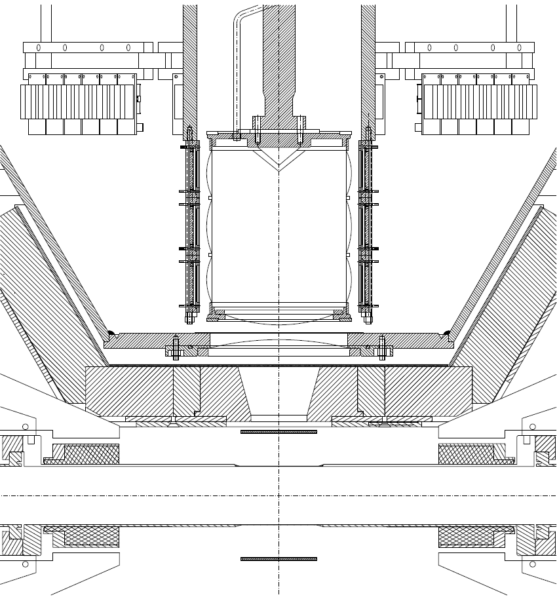
Detector arrangement below IR
50 cm
K⁺⁻
Pb shielding
HP-Ge
HP-Ge
20cm², GMX coaxial
5 – 1000 keV
Ortec
8cm², semi planar
6 – 500 keV
Eurisys
LN₂
LN₂
solid target

Slide 37
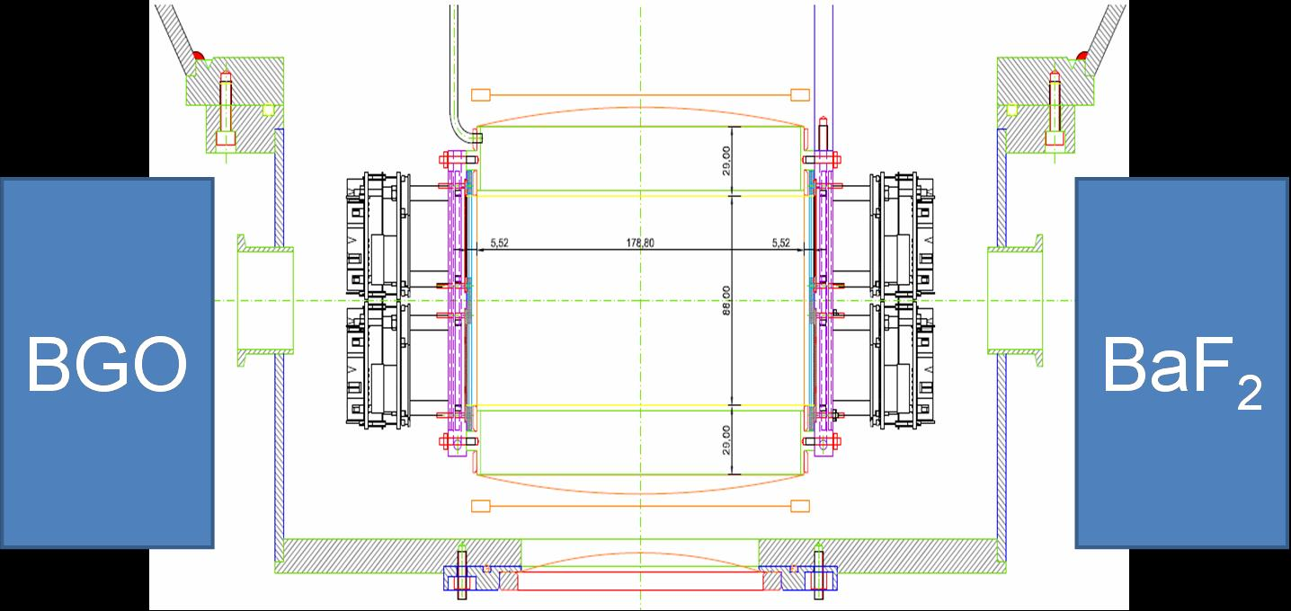
Additional γ-ray detectors
γ-ray detection: few MeV to 100 MeV

Slide 38
Conclusion - additional measurements
measurements with a setup below the beam pipe could
be done in parallel with the others measurements
  solid target measurements : Sn, Si, Ca, Ni targets
radiative kaon capture in hydrogen
(re-measuring kaonic hydrogen as well)
kaonic helium measurements to 1s levels
kaonic oxygen
crystal spectrometer measurements need completely
new setup – the strategy is under evaluation.

Slide 39


