Slide 1


Weak Decay Studies with FINUDA
Stefania Bufalino
INFN-Sezione di Torino
JOINT WORKSHOP JSPS CORE TO CORE SEMINAR and EU SPHERE NETWORK MEETING
September 4 -6, 2010 Prague, Czech Republic

Slide 2

Summary
Hypernuclear weak decay
FINUDA @ DAΦNE LNF-INFN
Hypernuclear decay study in FINUDA
Mesonic weak decay (MWD)
Non-Mesonic weak decay (NMWD)
Conclusions

Slide 3
Weak Decay modes of Λ hypernuclei (1)
The two main decay mechanism inside a hypernucleus are
Mesonic Weak decay
Non Mesonic Weak Decay (NMWD)
Mesonic weak decay like Λ free weak decay:
  Λ → pπ⁻ B.R. 63.9% (Г_{π-})
  Λ → nπ⁰ B.R. 35.8% (Г_{π0})
Negligible semi-leptonic and weak radiative decay modes:
  Λ → nγ B.R. 1.75×10⁻³
  Λ → pπ⁻ γ B.R. 8.4×10⁻⁴
  Λ → pe⁻ ν_{e} B.R. 8.32×10⁻⁴
  Λ → pμ⁻ ν_{μ} B.R. 1.57×10⁻⁴
  lifetime τ_{Λ}^{free}= 263 ps
nucleons emitted with a momentum q ~ 100MeV/c
Notes:
When a hypernucleus is formed it can decay through two main weak decay mechanism: the mesonic and non-mesonic channel. The mesonic weak decay is the same of the Lambda in the free space and it can decay ,with this two different B.R. , in a proton and a negative pion or in a neutron and a pi0.

Slide 4
Weak Decay modes of Λ hypernuclei (2)
Λ embedded in a nucleus
  Λn → nn (Г_{n}) “neutron-induced decay”
  Λp → np (Г_{p}) “proton-induced decay”
  ΛNN → nNN (Г₂) “two nucleons-induced decay”
Г_{M}= Г_{π-}+ Г_{π0}
Total width decay Г_{T}= Г_{M}+ Г_{NM}
Г_{NM}= Г_{n}+ Г_{p}+ Г₂
N
N
(~ 415 MeV/c)
The non mesonic decay in nuclear matter is not forbidden by Pauli blocking
Dominant decay channel for medium-heavy nuclei (A≥12)
momentum
270 MeV/c
π
Λ
N
Notes:
When the Lambda is embedded in a nucleus it can interact with a couple of nucleons and decay trough the non mesonic weak decay channel. Recently another decay mechanism has been predicted by theoriticians and it is the two nucleons induced decay. Until now there is no experimental evidence for this last decay channel. The nucleons in this kind of decay are emitted with momentum of about 415 MeV/c and this means that the non mesonic decay in nuclear matter is not forbidden by Pauli blocking. The non mesonic weak decay is dominant for nuclei with a mass number greater than 12.

Slide 5
Physics Motivations
MWD:
- J^{π} assignment
- π⁻-nucleus optical potential
NMWD:
- 4-baryon strangeness-changing weak interaction
- ΔI=1/2 from s-shell hypernuclei (⁴_{Λ}H)
- Γ_{n}/Γ_{p} (? … systematics)
- Γ_{2N}, FSI contributions

Slide 6

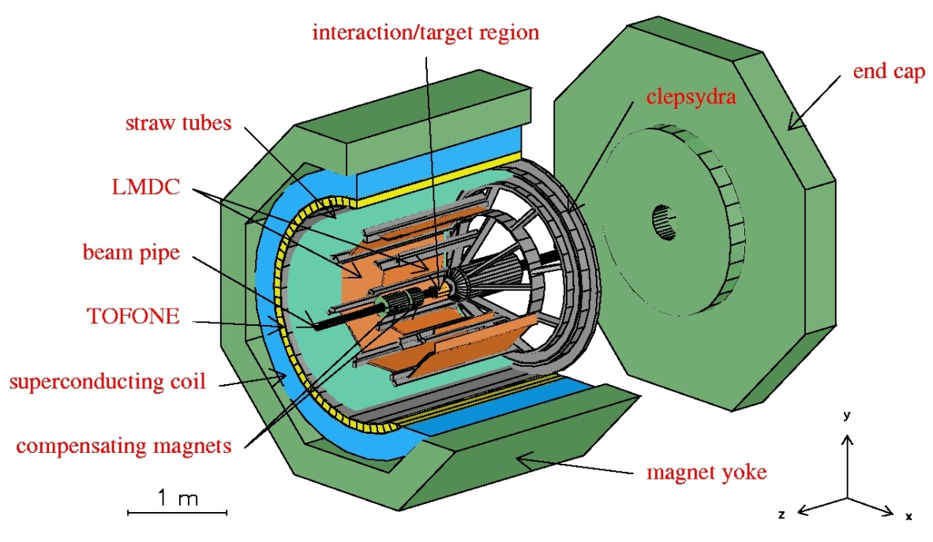
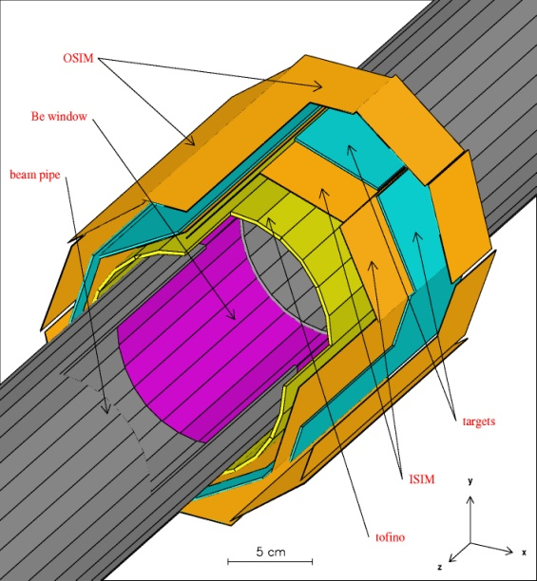
FINUDA @ DAΦNE
e⁺ + e⁻ → φ (1020) → K⁺ + K⁻ (127 MeV/c)
K⁻ _{stop} + ^{A}Z → ^{A}_{Λ}Z + π⁻
Detector capabilities:
Selective trigger based on fast scintillation detectors (TOFINO, TOFONE)
Clean K⁻ vertex identification
(ISIM P.ID.+ x,y,z resolution + K⁺ tagging)
π, K, p, d, … P.I.D. (OSIM&LMDs dE/dx, TOF)
High momentum resolution
(6‰ FWHM for π- @270 MeV/c for spectroscopy)
(1% FWHM for π- @270 MeV/c for decay study)
(6% FWHM for π- @110 MeV/c for decay study)
(2% FWHM for p @400 MeV/c for decay study)
(tracker resolution + He bag + thin targets)
Solid angle ~ 2π srad
Solenoid: B=1T
2003 data taking: 190 pb⁻¹ (2x⁶Li, ⁷Li, 3x¹²C, ²⁷Al, ⁵¹V)
2006 data taking: 966 pb⁻¹ (2x⁶Li, 2x⁷Li, 2x⁹Be, ¹³C, D₂O)
10 pb⁻¹/day

Slide 7
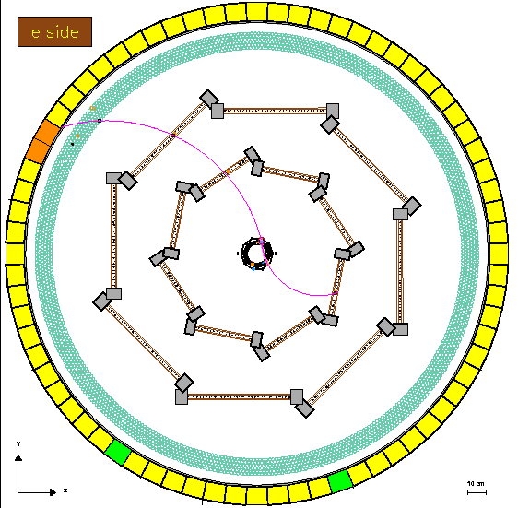
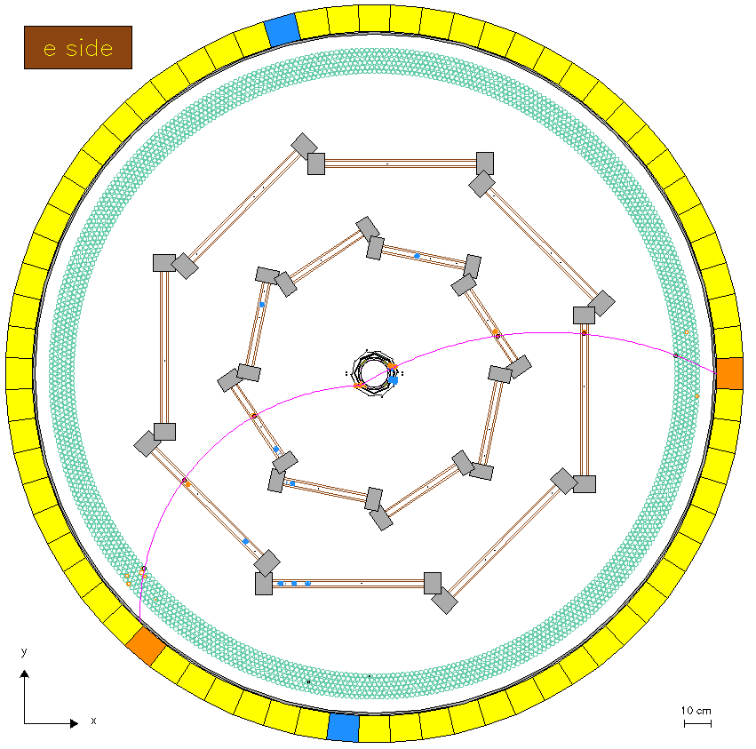
Hypernuclear decay study in FINUDA
Strategy: coincidence measurement
charged Mesonic channel
charged Non-Mesonic channel
K⁻ _{stop} + ^{A}Z → ^{A}_{Λ}Z + π⁻
^{A}_{Λ}Z →^{A}(Z+1) + π⁻
K⁻ _{stop} + ^{A}Z → ^{A}_{Λ}Z + π⁻
^{A}_{Λ}Z →^{A-2}(Z-1) + p + n
S-EX
260-280 MeV/c
MVD
80-110 MeV/c
NMWD
170-600 MeV/c
π⁻
p
π⁻
π⁻

Slide 8

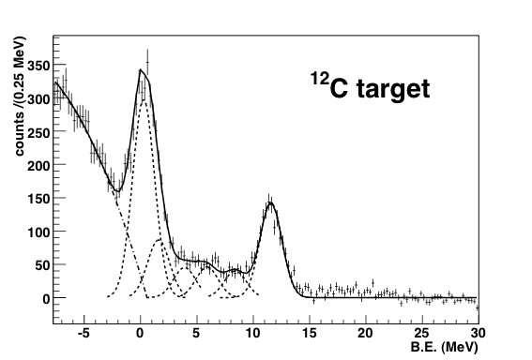
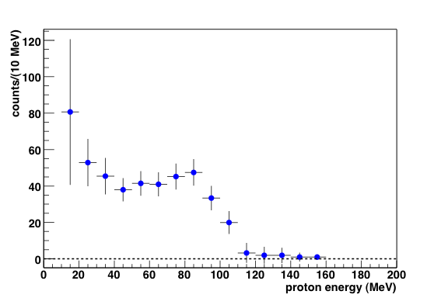
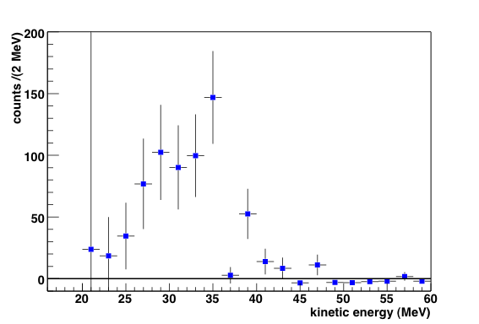
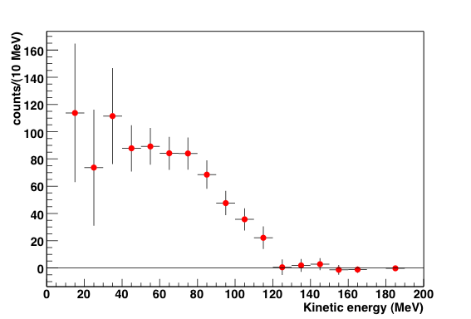
Hypernuclear decay study in FINUDA: strategy
Inclusive production π⁻ spectra
K⁻np background corrected
¹¹_{Λ}B
¹²_{Λ}C
¹²_{Λ}C
p
NMWD
NMWD
kinetic energy (MeV)
MWD
¹¹_{Λ}B
¹¹_{Λ}B
p
decay π⁻ and p spectra
(Λ_{qf} decay)/K⁻np background subtracted & acceptance corrected
π⁻
Notes:
Ricordare la soglia per la rivelazione dei pi- mesonici: 80 MeV/c ovvero 22 MeV.
Per la slide successiva: componenti del fondo: Lqf, K- decay in flight (dipende dalla posizione del bersaglio, boost o no boost)

Slide 9
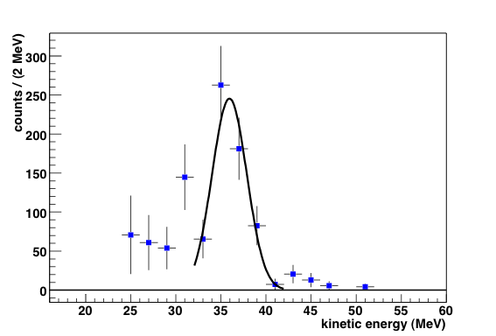
Mesonic weak decay spectra: ⁷_{Λ}Li
FINUDA Coll. and A. Gal, PLB 681 (2009) 139
Correspondence with the calculated strenght functions
T. Motoba et al, Progr. Theor. Phys. Suppl. 117 (1994) 477.
A. Gal, Nucl. Phys. A 828 (2009) 72.
Formation of different excited states of the daughter nucleus
Initial hypernucleus spin
J^{π} (⁷_{Λ}Li_{g.s.}) = 1/2⁺ (Sasao, PLB 579 (2004) 258.)
⁷Be: 3/2⁻_{gs} & 1/2⁻ (429keV)
3-body decays
Notes:
Motoba: empirical level energues where known and calculated where not known, in the Priv. Comm; only calculated levels in the old calculations.
FINUDA resolution @ 38 MeV: 4.2 MeV FWHM; part under acceptance threshold: negligible

Slide 10
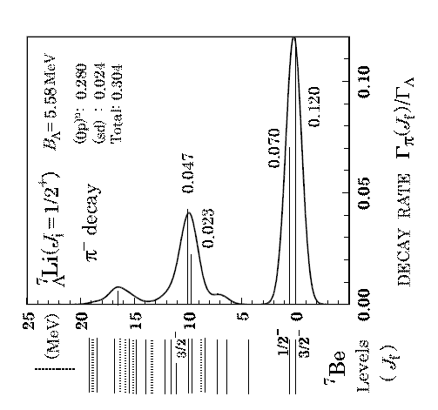
Mesonic weak decay spectra: ⁷_{Λ}Li
FINUDA Coll. and A. Gal, PLB 681 (2009) 139
Correspondence with the calculated strenght functions
T. Motoba et al, Progr. Theor. Phys. Suppl. 117 (1994) 477.
A. Gal, Nucl. Phys. A 828 (2009) 72.
Formation of different excited states of the daughter nucleus
Initial hypernucleus spin
J^{π} (⁷_{Λ}Li_{g.s.}) = 1/2⁺ (Sasao, PLB 579 (2004) 258.)
⁷Be: 3/2⁻_{gs} & 1/2⁻ (429keV)
3-body decays
T. Motoba (Private Communication))
Notes:
Motoba: empirical level energues where known and calculated where not known, in the Priv. Comm; only calculated levels in the old calculations.
FINUDA resolution @ 38 MeV: 4.2 MeV FWHM; part under acceptance threshold: negligible

Slide 11
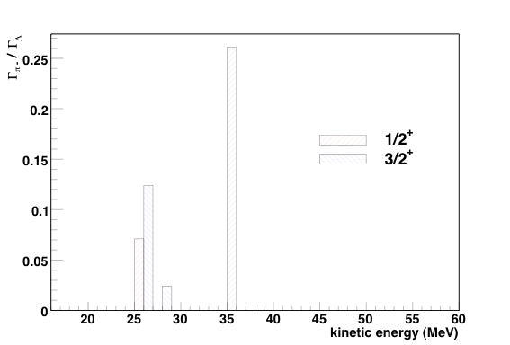
Mesonic weak decay spectra: ⁷_{Λ}Li
FINUDA Coll. and A. Gal, PLB 681 (2009) 139
Correspondence with the calculated strenght functions
T. Motoba et al, Progr. Theor. Phys. Suppl. 117 (1994) 477.
A. Gal, Nucl. Phys. A 828 (2009) 72.
Formation of different excited states of the daughter nucleus
Initial hypernucleus spin
J^{π} (⁷_{Λ}Li_{g.s.}) = 1/2⁺ (Sasao, PLB 579 (2004) 258.)
⁷Be: 3/2⁻_{gs} & 1/2⁻ (429keV)
3-body decays
T. Motoba (Private Communication))
Notes:
Gal: only major contributions are reported (with a common arbitrary width of 1 MeV) accounting for at least 20%(?) of the total decay rate; each of the 2 bars in 25-27 MeV stands for states spread over roughly 2-3 MeV)
Motoba: empirical level energues where known and calculated where not known, in the Priv. Comm; only calculated levels in the old calculations.
FINUDA resolution @ 38 MeV: 4.2 MeV FWHM; part under acceptance threshold: negligible

Slide 12
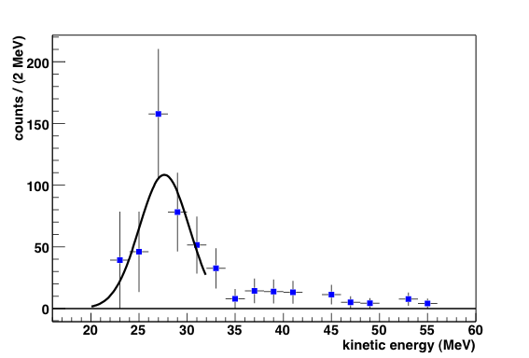
Mesonic weak decay spectra: ⁹_{Λ}Be
FINUDA Coll. and A. Gal, PLB 681 (2009) 139
Correspondence with the calculated strenght functions
T. Motoba et al, Progr. Theor. Phys. Suppl. 117 (1994) 477.
A. Gal, Nucl. Phys. A 828 (2009) 72.
Initial hypernucleus spin
J^{π} (⁹_{Λ}Be_{g.s.}) = 1/2⁺
O.Hashimoto NPA 639 (1998) 93c.
⁹B: 3/2⁻_{gs} & 1/2⁻(2.75 MeV)
FINUDA ΔT ~ 4 MeV FWHM
@38 MeV
Notes:
Our spectrum is consistent with the interpretation from (pi+,K+) exp. According to which 9LBe g.s. is dominantly a 1s-L coupled to 8Be(0+)g.s.
FWHM sperimentale ~ 7.5 MeV

Slide 13
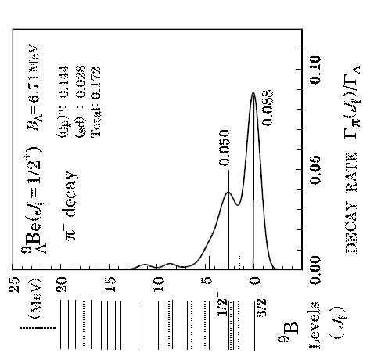
Mesonic weak decay spectra: ⁹_{Λ}Be
FINUDA Coll. and A. Gal, PLB 681 (2009) 139
Correspondence with the calculated strenght functions
T. Motoba et al, Progr. Theor. Phys. Suppl. 117 (1994) 477.
A. Gal, Nucl. Phys. A 828 (2009) 72.
Initial hypernucleus spin
J^{π} (⁹_{Λ}Be_{g.s.}) = 1/2⁺
O.Hashimoto NPA 639 (1998) 93c.
⁹B: 3/2⁻_{gs} & 1/2⁻(2.75 MeV)
FINUDA ΔT ~ 4 MeV FWHM
@38 MeV
T. Motoba (Private Communication))
Notes:
Our spectrum is consistent with the interpretation from (pi+,K+) exp. According to which 9LBe g.s. is dominantly a 1s-L coupled to 8Be(0+)g.s.

Slide 14
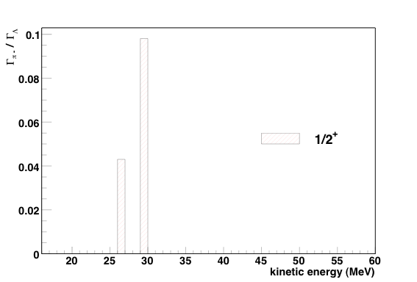
Mesonic weak decay spectra: ⁹_{Λ}Be
FINUDA Coll. and A. Gal, PLB 681 (2009) 139
Correspondence with the calculated strenght functions
T. Motoba et al, Progr. Theor. Phys. Suppl. 117 (1994) 477.
A. Gal, Nucl. Phys. A 828 (2009) 72.
Initial hypernucleus spin
J^{π} (⁹_{Λ}Be_{g.s.}) = 1/2⁺
O.Hashimoto NPA 639 (1998) 93c.
⁹B: 3/2⁻_{gs} & 1/2⁻(2.75 MeV)
FINUDA ΔT ~ 4 MeV FWHM
@38 MeV
20
25
30
35
40
45
50
55
60
kinetic energy (MeV)
T. Motoba (Private Communication))
Notes:
Our spectrum is consistent with the interpretation from (pi+,K+) exp. According to which 9LBe g.s. is dominantly a 1s-L coupled to 8Be(0+)g.s.

Slide 15
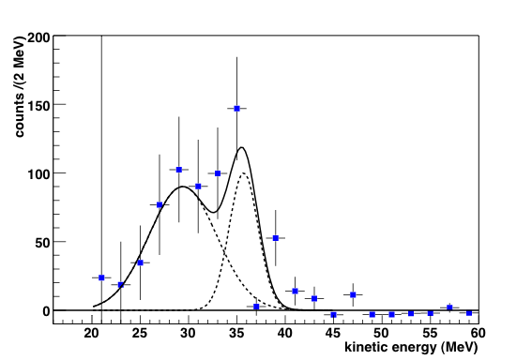
Mesonic weak decay spectra: ¹¹_{Λ}B
Correspondence with the calculated strenght functions
H. Bando et al, Pers. Meson Science (1992) p.571
A. Gal, Nucl. Phys A 828 (2009) 72.
Two contributions of the ¹¹C ground state 5/2⁻ and its 7/2⁻ excited state
Initial hypernucleus spin
J^{π} (¹¹_{Λ}B_{g.s.}) = 5/2⁺ : experimental confirmation
(Sato et al., PRC 71 (2005) 025203) by different observable
¹¹C: 3/2⁻_{gs} & 7/2⁻ (~6.5 MeV)
FINUDA Coll. and A. Gal, PLB 681 (2009) 139
Notes:
5/2+: Zieminska (1975) emulsion data, Sato (KEK) (2005) by comparing the measured decay rate with calculations of Motoba (Perspectives 1992)
Risoluzione in T @ 38 MeV=4.5 MeV

Slide 16
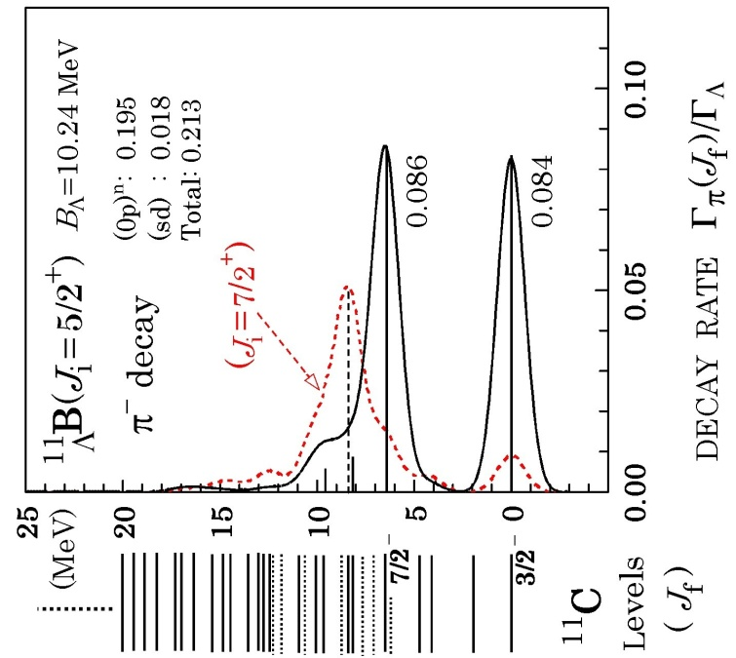
Mesonic weak decay spectra: ¹¹_{Λ}B
Correspondence with the calculated strenght functions
H. Bando et al, Pers. Meson Science (1992) p.571
A. Gal, Nucl. Phys A 828 (2009) 72.
Two contributions of the ¹¹C ground state 5/2⁻ and its 7/2⁻ excited state
Initial hypernucleus spin
J^{π} (¹¹_{Λ}B_{g.s.}) = 5/2⁺ : experimental confirmation
(Sato et al., PRC 71 (2005) 025203) by different observable
¹¹C: 3/2⁻_{gs} & 7/2⁻ (~6.5 MeV)
T. Motoba (Private Communication)
FINUDA Coll. and A. Gal, PLB 681 (2009) 139
Notes:
5/2+: Zieminska (1975) emulsion data, Sato (KEK) (2005) by comparing the measured decay rate with calculations of Motoba (Perspectives 1992)
Risoluzione in T @ 38 MeV=4.5 MeV

Slide 17
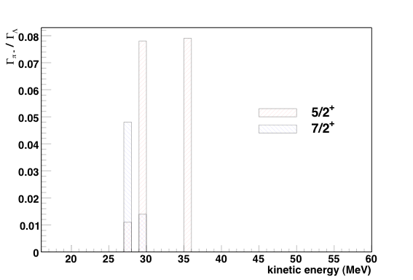
Mesonic weak decay spectra: ¹¹_{Λ}B
Correspondence with the calculated strenght functions
H. Bando et al, Pers. Meson Science (1992) p.571
A. Gal, Nucl. Phys A 828 (2009) 72.
Two contributions of the ¹¹C ground state 5/2⁻ and its 7/2⁻ excited state
Initial hypernucleus spin
J^{π} (¹¹_{Λ}B_{g.s.}) = 5/2⁺ : experimental confirmation
(Sato et al., PRC 71 (2005) 025203) by different observable
¹¹C: 3/2⁻_{gs} & 7/2⁻ (~6.5 MeV)
T. Motoba (Private Communication)
FINUDA Coll. and A. Gal, PLB 681 (2009) 139
Notes:
5/2+: Zieminska (1975) emulsion data, Sato (KEK) (2005) by comparing the measured decay rate with calculations of Motoba (Perspectives 1992)
Risoluzione in T @ 38 MeV=4.5 MeV

Slide 18
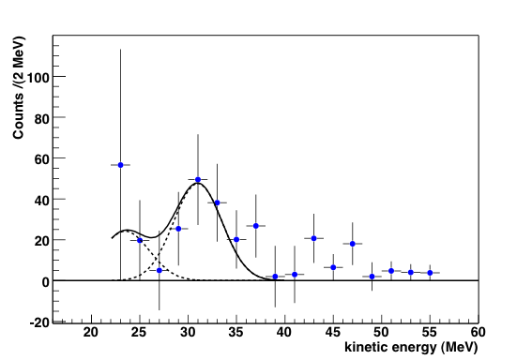
Mesonic weak decay spectra: ¹⁵_{Λ}N
FINUDA Coll. and A. Gal, PLB 681 (2009) 139
Correspondence with the calculated strenght functions
T. Motoba et al, Nucl. Phys. A 489 (1988) 683.
A. Gal, Nucl. Phys. A 828 (2009) 72.
¹⁵_{Λ}N_{g.s} spin not known. J^{π} (¹⁵_{Λ}N_{g.s.}) = 3/2⁺
D.J.Millener, A.Gal, C.B.Dover Phys. Rev. C 31 (1985) 499.
Spin ordering not obtained from γ-rays of ¹⁶_{Λ}O M.Ukai et al. Phys. Rev.C 77 (2008) 054315.
First experimental determination of for
J^{π} (¹⁵_{Λ}N_{g.s.}) = 3/2⁺ from decay rate value (and
spectrum shape)
¹⁵O: 1/2⁻_{gs} & sd (~6 MeV)

Slide 19
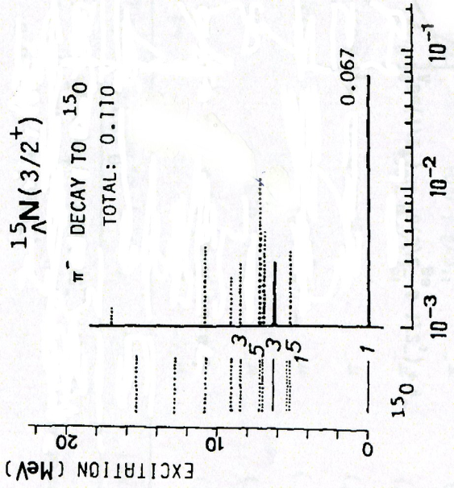
Mesonic weak decay spectra: ¹⁵_{Λ}N
Correspondence with the calculated strenght functions
T. Motoba et al, Nucl. Phys. A 489 (1988) 683.
A. Gal, Nucl. Phys. A 828 (2009) 72.
¹⁵_{Λ}N_{g.s} spin not known. J^{π} (¹⁵_{Λ}N_{g.s.}) = 3/2⁺
D.J.Millener, A.Gal, C.B.Dover Phys. Rev. C 31 (1985) 499.
Spin ordering not obtained from γ-rays of ¹⁶_{Λ}O M.Ukai et al. Phys. Rev.C 77 (2008) 054315.
First experimental determination of for
J^{π} (¹⁵_{Λ}N_{g.s.}) = 3/2⁺ from decay rate value (and
spectrum shape)
¹⁵O: 1/2⁻_{gs} & sd (~6 MeV)
T. Motoba NPA 489 (1988) 683.
FINUDA Coll. and A. Gal, PLB 681 (2009) 139

Slide 20
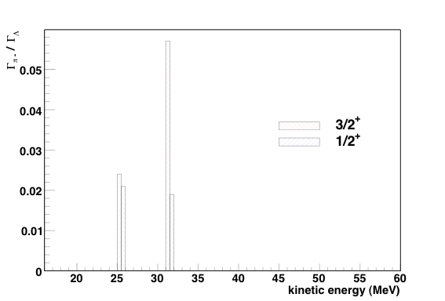
Mesonic weak decay spectra: ¹⁵_{Λ}N
Correspondence with the calculated strenght functions
T. Motoba et al, Nucl. Phys. A 489 (1988) 683.
A. Gal, Nucl. Phys. A 828 (2009) 72.
¹⁵_{Λ}N_{g.s} spin not known. J^{π} (¹⁵_{Λ}N_{g.s.}) = 3/2⁺
D.J.Millener, A.Gal, C.B.Dover Phys. Rev. C 31 (1985) 499.
Spin ordering not obtained from γ-rays of ¹⁶_{Λ}O M.Ukai et al. Phys. Rev.C 77 (2008) 054315.
First experimental determination of for
J^{π} (¹⁵_{Λ}N_{g.s.}) = 3/2⁺ from decay rate value (and
spectrum shape)
¹⁵O: 1/2⁻_{gs} & sd (~6 MeV)
¹⁵O: 1/2⁻_{gs} & sd (~6 MeV)
T. Motoba NPA 489 (1988) 683.
FINUDA Coll. and A. Gal, PLB 681 (2009) 139

Slide 21
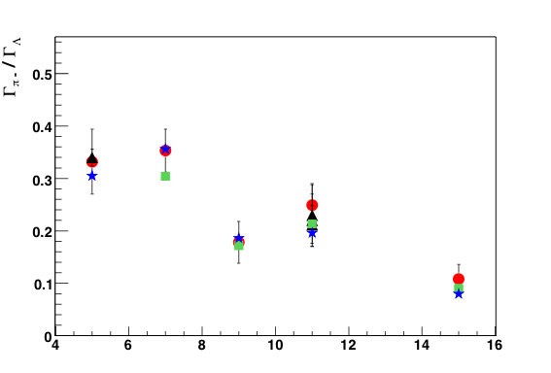
Mesonic decay ratio: Γ_{π−} / Γ_{Λ}
Γ_{tot} / Γ_{Λ} = (0.990±0.094) + (0.018±0.010) •A
fit from measured values for A=4-12 hypernuclei
present data
T. Motoba PTPS 117 (1994) 477
previous data
A.Gal NPA 828 (2009) 72
A
strong nuclear structure effects
Notes:
Ricordare le ref. dei previous data! Su 5LHe: Szymanski e Kameoka; su 11LB: Noumi, Sato (Montwill non riportato ma si confonde con gli altri sulla scala del grafico)
Errori: statistico: 17%, 28%, 20%, 35%; sistematico:4%, 6%, 15%, 13%.

Slide 22
Mesonic decay: results
MWD π⁻ spectra for ⁷_{Λ}Li, ⁹_{Λ}Be, ¹¹_{Λ}B and ¹⁵_{Λ}N
spin-parity assignment confirmed for ⁷_{Λ}Li, ⁹_{Λ}Be, ¹¹_{Λ}B g.s.
new spin-parity assignment for ¹⁵_{Λ}N, based on decay rate (and spectrum shape)
MWD decay rates calculated and compared with theoretical calculations and previous measurements
nuclear structure effects

Slide 23
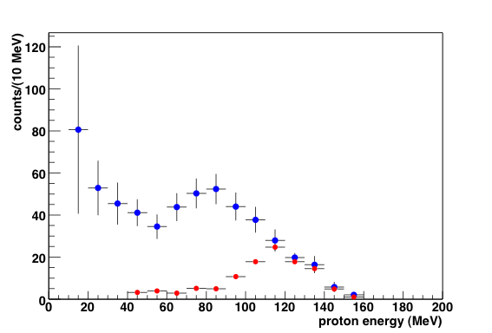
Non Mesonic weak decay spectra: the method
background reaction: K⁻ np Σ⁻ p
Σ⁻ n π⁻
coincidence
Coincidence spectra: ¹²_{Λ}C, all targets
π⁻
p
Data
Data
simulation + reconstruction + selection + normalization
simulation + reconstruction + selection + normalization
normalization region
NMWD p
subtraction
M. Agnello et al., NPA 804 (2008),151

Slide 24
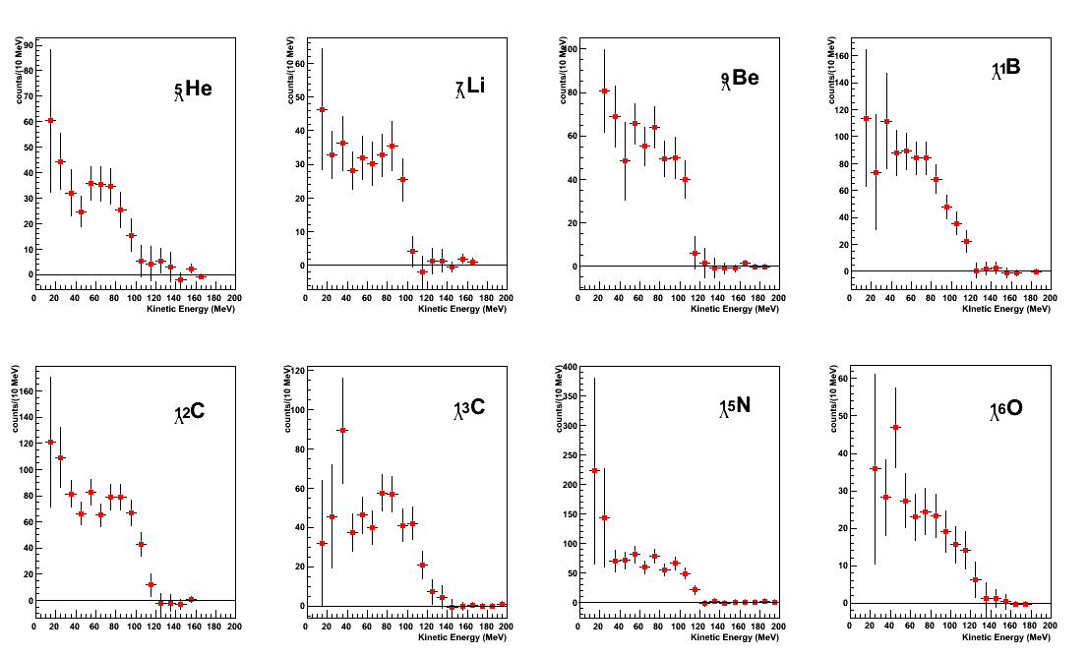
Non Mesonic Weak Decay spectra
15 MeV
K⁻np background subtracted
1N + 2N + FSI !!
NPA 804 (2008),151
NPA 804 (2008),151
NPA 804 (2008),151
FINUDA Coll. and G. Garbarino, PLB 685 (2010) 247

Slide 25
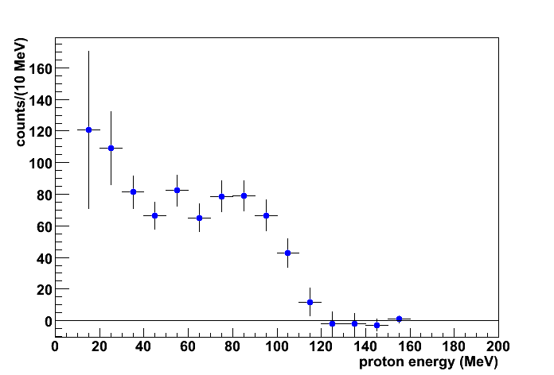
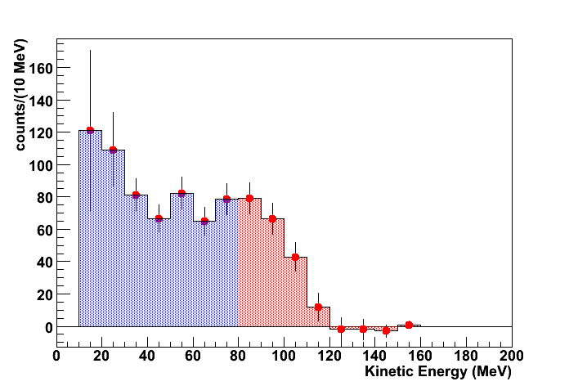
FSI & ΛNN contribution evaluation: the method
2N / NMWD independent on A
assumption
W.Alberico and G.Garbarino,
Phys. Rev. 369 (2002) 1.
NMWD p
gaussian fit
free μ
¹²_{Λ}C
μ from fit
A_{low}
A_{high}
A_{low}: spectrum area below μ
1N + 2N + FSI
A_{high}: spectrum area above μ
1N + FSI
2N(>70 MeV) ~ 5% 2N_{tot}
G,Garbarino, A.Parreno and A.Ramos, Phys.Rev.Lett. 91 (2003) 112501.
Phys.Rev. C 69 (2004) 054603.
assumption
Notes:
As model independent as possible method. Nevertheless, to relate the spectra area directly to the amplitude G1p, G2np it is necessary to make some assumption … light assumption!

Slide 26
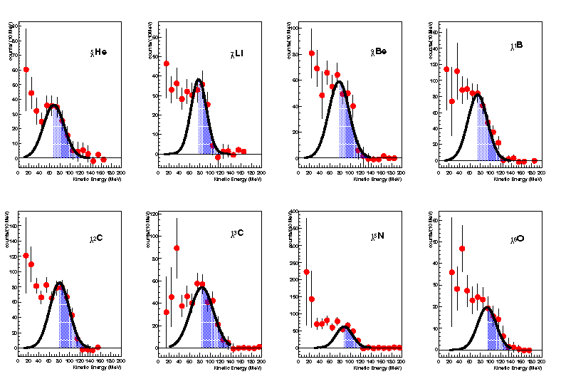
FSI & ΛNN contribution evaluation: systematics
FINUDA Coll. and G. Garbarino, PLB 685 (2010) 247

Slide 27
FSI & ΛNN contribution evaluation
A_{low} = 0.5 N(Λp ➔ np) + N(Λnp ➔nnp) + N_{p}^{FSI-low}
A_{high} = 0.5 N(Λp ➔ np) + N_{p}^{FSI-high}
N(Λnp ➔nnp)
Γ_{np}
Γ₂
assumption
=
≈
N(Λp ➔ np)
Γ_{p}
Γ_{p}
Γ_{np} : Γ_{pp} : Γ_{nn} = 0.83 : 0.12 : 0.04
E. Bauer and G.Garbarino,
Nucl.Phys. A 828 (2009), 29.
A_{low}
0.5
N(Λp ➔ np) +
N(Λnp ➔nnp) + N_{p}^{FSI-low}
=
A_{low} + A_{high}
N(Λp ➔ np) +
N(Λnp ➔nnp) + N_{p}^{FSI-low} + N_{p}^{FSI-high}

Slide 28
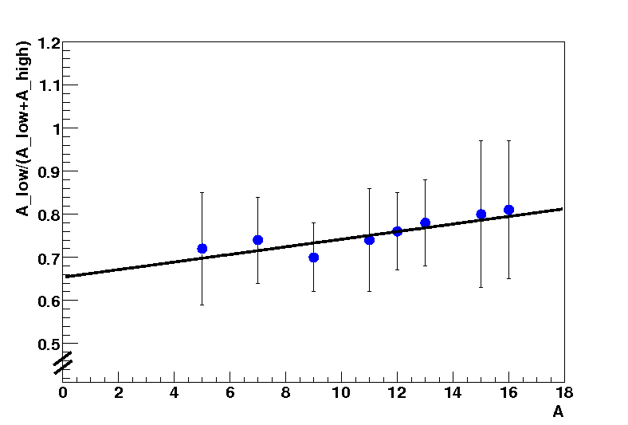


Non-Mesonic Weak Decay
A_{low}
0.5
N(Λp ➔ np) +
N(Λnp ➔nnp) + N_{p}^{FSI-low}
=
A_{low} + A_{high}
N(Λnp ➔nnp) + N_{p}^{FSI-low} + N_{p}^{FSI-high}
FSI linear on A up to A=16
E. Bauer and G.Garbarino, NPA 828 (2009), 29.
FINUDA Coll. and G. Garbarino, PLB 685 (2010) 247
Assumption: Γ₂/Γ₁ and Γ_{n}/Γ_{p} indipendent
from A→ supported by exp and the
Notes:
I valori di Bhang sono per 5LHe e 12LC; il valor medio e’ 0.48+/- 0.12

Slide 29
NMWD, FSI & 2N: results
p-induced NMWD proton spectra from ⁵_{Λ}He to ¹⁶_{Λ}O
first experimental indication of the relevant rôle played by the two–nucleon induced mode in the NMWD of hypernuclei
contribution as large as almost 24% of all the non–mesonic weak decays
very large contributions from 2N suggested by theoretical calculation
W.Alberico, A.De Pace, G.Garbarino and A.Ramos, Phys. Rev. C 61 (2000) 044314.
G. Garbarino, A.Parreno and A.Ramos, Phys. Rev. C 69 (2004) 054603.
E. Bauer and G. Garbarino , NPA 828 (2009) 29.
Γ₂/Γ_{NMWD} experimental indications:
FINUDA value: 0.24 ± 0.10
H. Bhang et al., EPJ A33 (2007), 259: ~ 0.4 ¹²_{Λ}C
J.D.Parker et al., PRC 76 (2007), 035501: ≤ 0.24 (95% CL) ⁴_{Λ}He
M.Kim et al., PRL 103 (2009) 182502: 0.29 ± 0.13 ¹²_{Λ}C

Slide 30
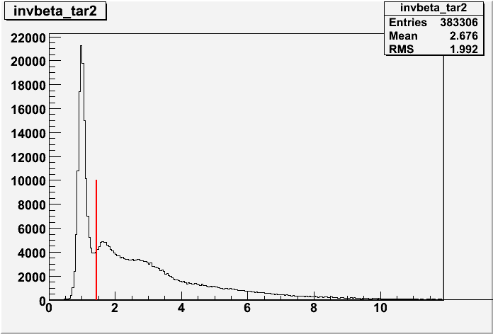
Triple coincidence analysis
γ prompt
Neutron detection efficiency ~10%
Neutron energy resolution ~9% at 80 MeV
TOF allows n/γ discrimination
Background prevails if no correlations or selections are imposed
1/β>1.47
1/β
Analysis of (π-,n,p) coincidence
N_{n} (cosθ≥- 0.8, E_{p}< μ−20 MeV): 2N + FSI and small contribution of 1N
N_{n} = number of n in coincidence with (π-,p)
Number of neutrons for all targets (from A=5 to A=16)
No spectra shape analysis (20 events for each target)
Background study (events from K⁻np absorption)
Acceptance correction
Normalization to the number of protons with energy greater than the μ value of the gaussian fits
of the proton spectra from FINUDA Coll. and G. Garbarino, PLB 685 (2010) 247

Slide 31
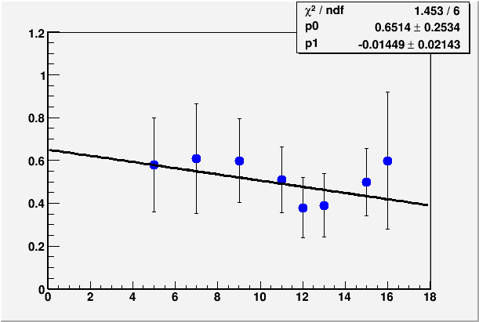
Non-Mesonic Weak Decay from np coincidence
N_{n} (cosθ≥- 0.8, E_{p}< μ−20 MeV)
N(Λnp ➔nnp) + N^{FSI}
=
N_{p} ( E_{p}>μ value from proton
spectra fit)
0.5 N(Λp ➔np) + N^{FSI}
N_{n}/N_{p}
A
Low statistic but direct measurement-→ error lowered by a factor 3

Slide 32
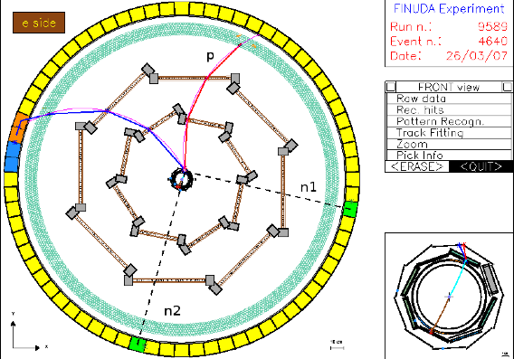
Triple coincidence (n+n+p) events @ FINUDA
exclusive Λnp→nnp ⁷_{Λ}Li→⁴He+p+n+n decay event
p _{π−} = 276.93 MeV/c
E_{tot} = 178.3 MeV
Q-value = 167 MeV
p miss = 216.6 MeV/c
E(n1) = 110.2 MeV E(n2) = 16.9 MeV E(p) = 51.0 MeV
θ(n1 n2) = 95°
θ(n1 p) = 102°
θ(n2 p) = 154°
no n-n scattering
First direct experimental evidence of 2N-induced NMWD !!

Slide 33
Conclusions
First systematic study of p-induced NMWD from ⁵_{Λ}He to ¹⁶_{Λ}O
Energy threshold never reached before: 15 MeV
Evaluation of the FSI and 2N-induced NMWD: values in agreement with theoretical calculation and latest experimental results
First direct evidence of the relevant contribution of the 2N stimulated NMWD
Results confirmed with smaller errors by means of the analisys of (π-,n,p) coincidences
First detection of clear events with pnn emitted from the 2N-induced NMWD

Slide 34
…… thank you!

