Slide 1
Simulation of the decay pion spectroscopy at JLab
Sept. 6 2010
Tohoku Uni. S.Nagao
Contents
Purpose
Experimental outline
Geant4 simulation
Summary
yield & S/N
momentum calibration
detector configuration
momentum resolution
particle identification
yield estimation

Slide 2
outline
talk about weak decay pion spectroscopy of hyper nuclear
realistic simulation about decay pion spectroscopy
focus on the pion from ⁴_{Λ}H (4 body system)
expected value to perform experiment
decay pion yield
S/N ratio
momentum calibration
momentum resolution
particle ID

Slide 3
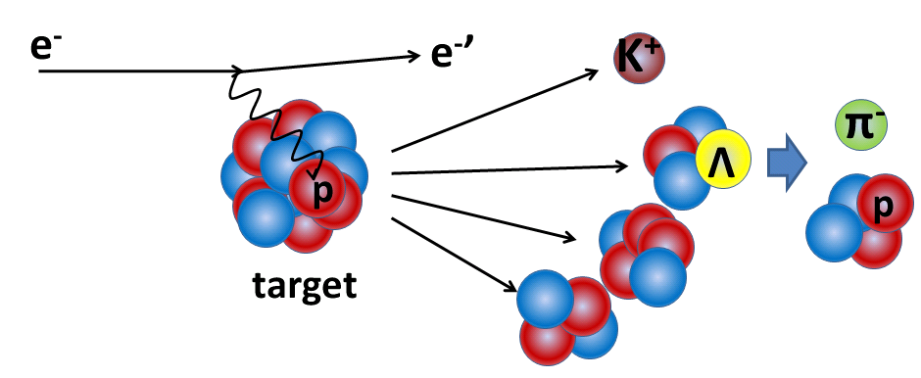

What is the decay pion spectroscopy ? (purpose)
We had established the (e,e’K⁺) reaction spectroscopy at JLab
We push ahead with hyper nuclear research using electron beam
decay pion spectroscopy
Tag
M_{π} , p_{π}
M_{HYP}
spectrometer
(FWHM~100keV/c)
M_{ncl}
deduce mass
deduce the mass of hyperfragment <momentum resolution 130 keV (FWHM)
※ (e,e’K) reaction spectroscopy ~300keV (¹²_{Λ}B g.s.)

Slide 4
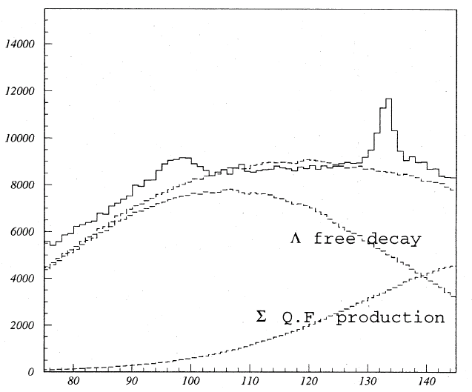
What kind of hyperfragment can be measured ?
emulsion data in stopped K⁻ reaction (G. BOHM et al. Nucl. Phys. B4 (1968) 511)
Hyper nuclei | Number of π⁻ two body |  |  | Decay Events others |  | p_{π} (two body) (MeV/c)
total |  | 1061 |  | 1767
⁴_{Λ}H | π⁻ ⁴He | 760 | 72% | 93 | 5% | 132.9
^{4 or 5}_{Λ}He | - | - | - | 1204 | 68% | -
¹²C target (stopped K⁻ π⁻)
pion from ⁴_{Λ}H
FWHM 3~4 MeV/c
feasibility test ;
in Spring 2012 at J-Lab
(E08-012 (5days))
π⁻ momentum (MeV/c)
Notes:
target

Slide 5
What should we estimate for the experiment ?
decay pion yield
S/N ratio
method of momentum calibration
momentum resolution
method of particle ID
decay pion yield
S/N ratio
method of momentum calibration
momentum resolution
method of particle ID
outline

Slide 6
yield & S/N
1. decay pion yield
π⁻ (139.2 MeV/c) → βγc_{τ} ~ 7.4 m
short path length
large solid angle acceptance
2. S/N
main back ground component
scattered electron
muon from pion decay
pion from quasi free Lambda & Sigma decay
cherenkov counter or dE/dx or TOF
locate spectrometer behind of target
target
e⁻ beam
Λ
Λ
p
p
π
π
boost forward
uniform
Notes:
It is to be desired that spectrometer having short path length and

Slide 7
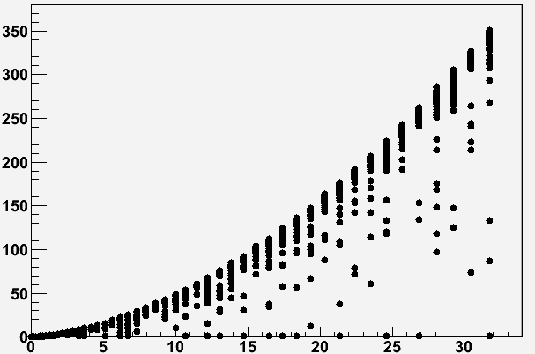
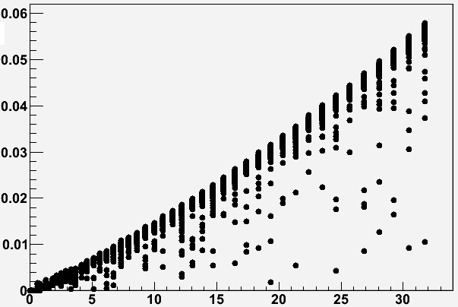
Stop range & time of ⁴_{Λ}H (¹²C target) (MC simulation)
Target thickness (mg/cm²)
Stop time (ns)
Kinetic energy(MeV)
Kinetic energy(MeV)
Target thickness (100mg/cm2)
Life time (~0.1 ns)
In the case of 10MeV
Maximum range of ⁴_{Λ}H ; within target
Maximum stopping time of ⁴_{Λ}H ; less than 0.1ns
Notes:
rainn

Slide 8
momentum calibration
The absolute value of pion momentum must be known (∓30 keV)
3. momentum calibration of spectrometer
(Decide the mass precision)
monochromatic source
alpha source
near by pion momentum (~130MeV/c)
Vacuum area
focal plane (FP)
position at FP
alpha source
momentum
spectrometer
Candidate list of alpha source
source | Energy (MeV) | Momentum (MeV/c)
¹⁴⁸Gd | 3.18 | 154.00
²³⁰Th | 4.617 | 185.58
 | 4.684 | 186.92
²¹⁰Po | 5.305 | 198.93
source | Energy (MeV) | Momentum (MeV/c)
¹⁴⁸Gd | 3.18 | 154.00
²³⁰Th | 4.617 | 185.58
 | 4.684 | 186.92
²¹⁰Po | 5.305 | 198.93
source | Energy (MeV) | Momentum (MeV/c)
²⁴¹Am | 5.442 | 201.49
 | 5.484 | 202.27
²⁴²Cm | 6.066 | 212.74
 | 6.11 | 213.51
source | Energy (MeV) | Momentum (MeV/c)
²⁴¹Am | 5.442 | 201.49
 | 5.484 | 202.27
²⁴²Cm | 6.066 | 212.74
 | 6.11 | 213.51
Notes:
Candidate list of

Slide 9
Simulation
Yield
S/N ratio
method of momentum calibration
momentum resolution
method of particle ID
Yield
S/N ratio
method of momentum calibration
momentum resolution
method of particle ID
geant4
spectrometer ; Enge type magnet
magnet field ; TOSCA

Slide 10
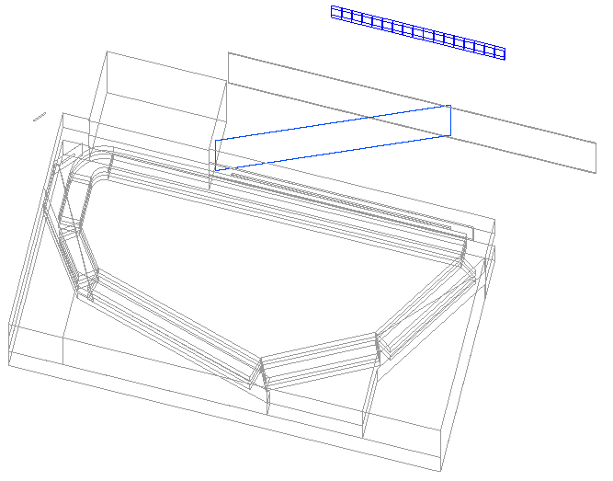
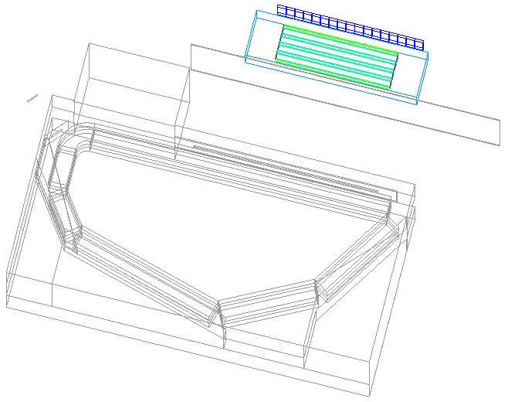
Geant4 simulation
Plan 1 (SSD)
Plan 2 (DC)
Hodoscope
20mm thickness
target ¹²C
100mg/cm²
Focal Plane
(aligned SSD)
Drift Chamber
(He 50%+ CH4 50%)
Decay pion
Decay pion
Vacuum Chamber window
Enge Magnet

Slide 11
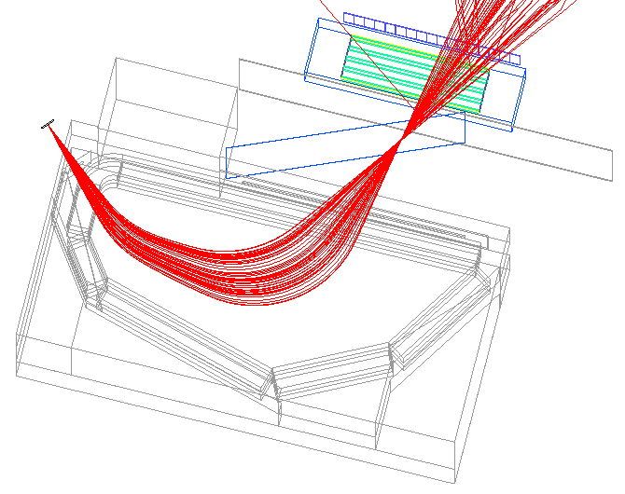
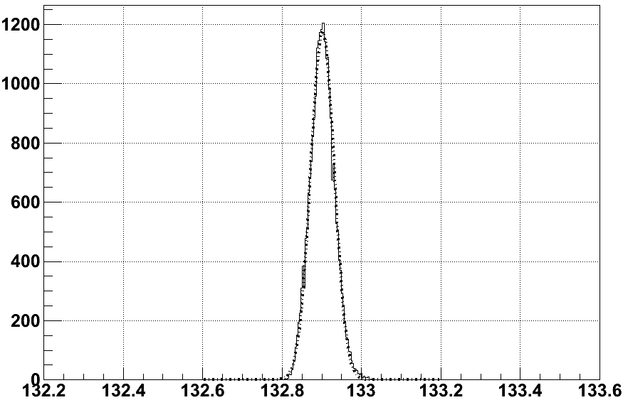
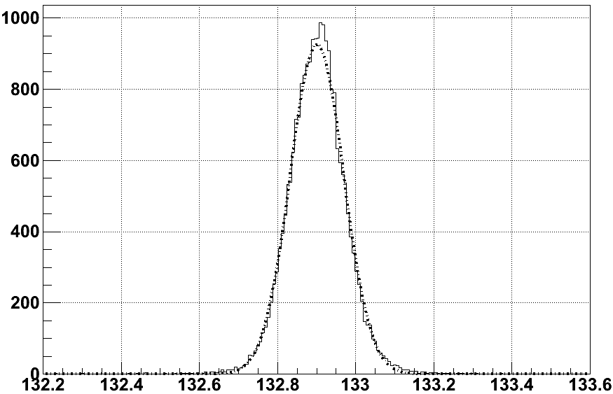
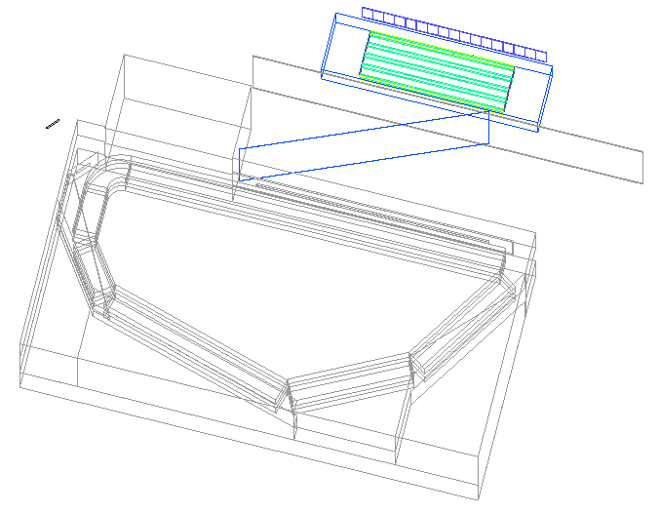
momentum resolution (simulation)
simulate momentum resolution at 132.9 MeV/c pions
detect at SSD (500um pitch)
detect at DC (He 50% + CH4 50%)
counts
simulation
simulation
DC
FWHM = 70 keV/c
FWHM = 160 keV/c
SSD
multiple scattering effect
momentum (MeV/c)
momentum (MeV/c)
Materials
Vacuum chamber window (Mylar 100 um & Kevlar 200 um)
Air (1 cm)
DC window (Mylar 12.5 um)
DC Gas (He + CH4)
DC
SSD
Notes:
Multi aka

Slide 12
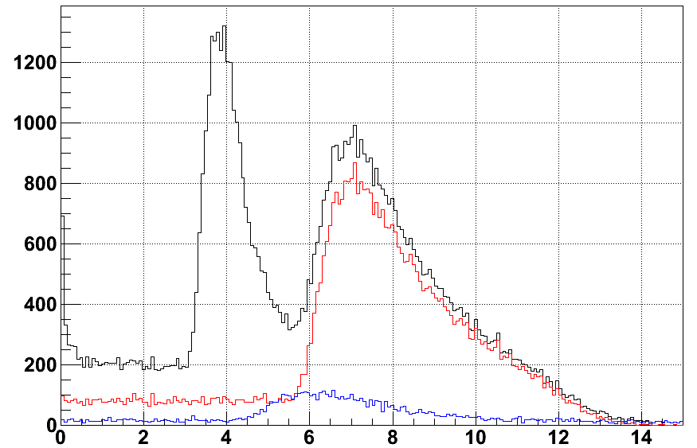
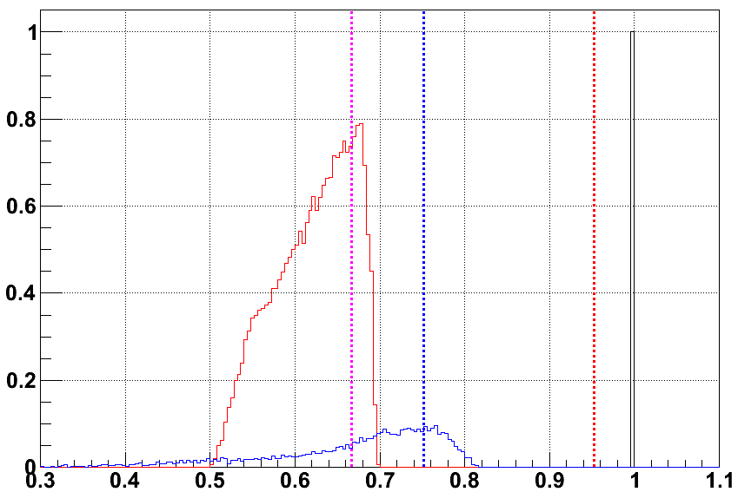
PID (simulation)
ratio : pion : electron = 4 : 1
angle ; ∓2 degree (uniform)
momentum ; 85 MeV/c ~ 145 MeV/c (uniform)
generate particle
energy deposit at hodoscope (t=20mm)
beta distribution behind of hodoscope
Counts
simulation
simulation
aerogel
electron
Hodoscope
lucite
water
pion
electron
pion
muon
muon
Energy deposit (MeV)
beta
electron ; reject with water or aerogel cherenkov
muon ; not significant background (less than 30% contamination)
Notes:
E ni simulation

Slide 13
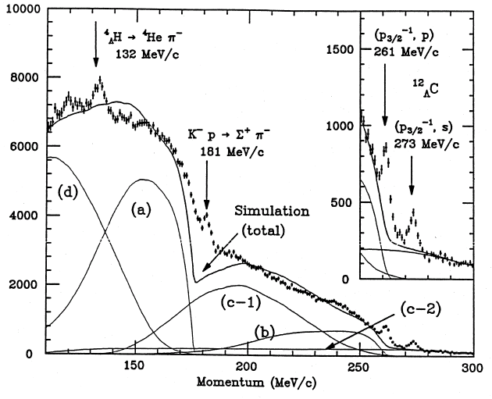
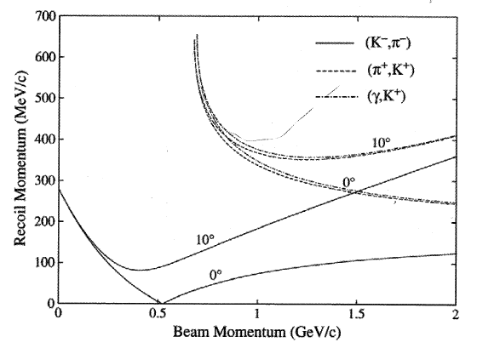
yield
stopped (K⁻,π⁻) ; decay π⁻ from ⁴_{Λ}H : π⁻ from ¹²_{Λ}C ground state formation
= 3~4 : 1
stopped (K-,π-) (¹²C target)
momentum transfer at ¹²C target
Progress in Particle and Nuclear Physics 57 (2006) 564
Progress of Theoretical Physics Supplement No.117 1994
(e,e’K⁺) ; decay π⁻ from ⁴_{Λ}H : ¹²_{Λ}B ground state cross section
= 3~4 : 1
200 nb/sr
Notes:
Line transfer

Slide 14

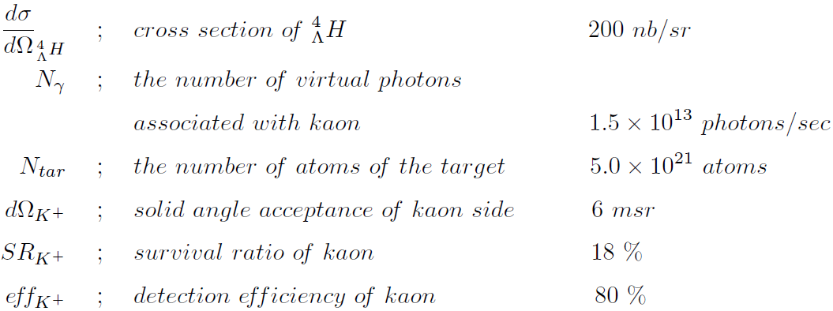
yield
target ; ¹²C (100mg/cm² thickness)
beam ; 2.3 GeV 50 uA
tagging kaon momentum ; 1.2 GeV/c
tagging kaon angle ; 6 degree

Slide 15

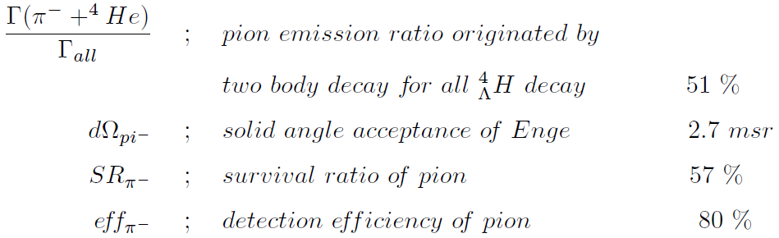
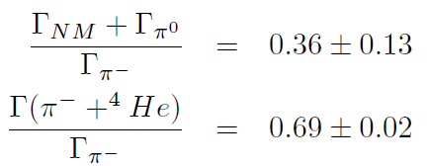


yield
simulation

Slide 16
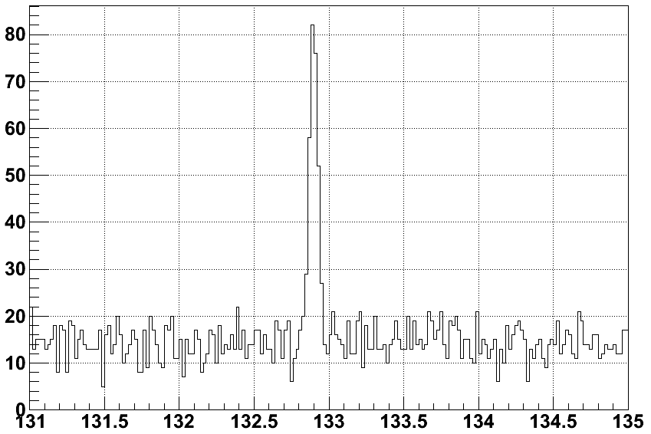
yield (simulation)
condition
particle ; pion
angle ; ∓ 2deg (uniform)
momentum ;
85 MeV/c ~ 145MeV/c (uniform) & 132.9 MeV/c
200 (50,000 count) : 1 (250 count)
Expected decay pion spectrum detect at SSD
(momentum resolution ~70 keV/c)
counts
simulation
momentum (MeV/c)
Notes:
Simuration in E

Slide 17
summary
We will study about the new method of hyper nuclear formation
Momentum is calibrated by alpha sources
70 keV/c (SSD) or 160 keV/c (DC) momentum resolution
Adopt aerogel or water cherenkov counter to reject the electrons
Pion from ⁴_{Λ}H is about 250 count/5days
Feasibility test in Spring 2012

Slide 18
backup

Slide 19
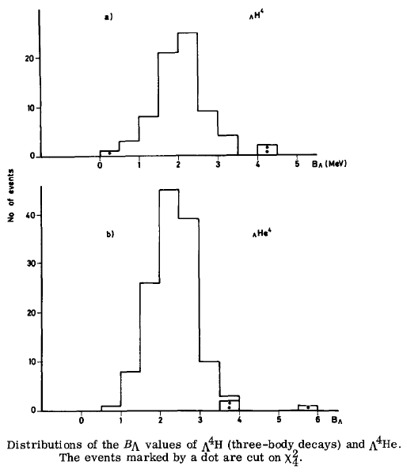
⁴_{Λ}H & ⁴_{Λ}He
emulsion data in stopped (K⁻,π⁻)
G.Bohm et al. Nucl. Phys. B4 (1968) 511

Slide 20
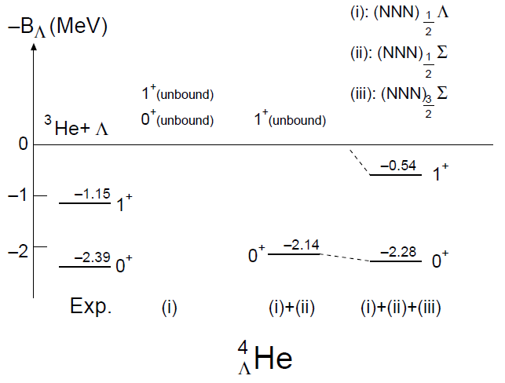
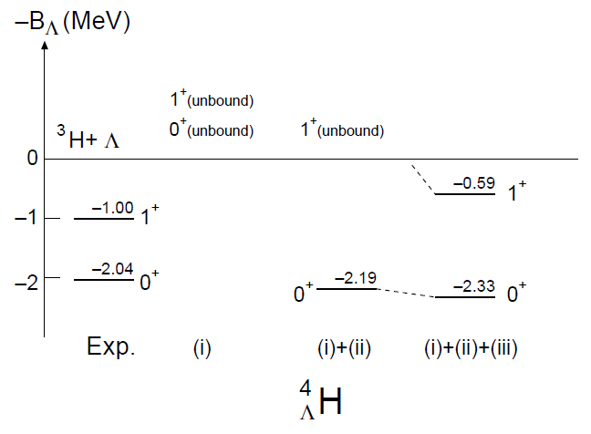
⁴_{Λ}H & ⁴_{Λ}He
Hiyama et al. Phys. Rev. C65 (2002) 011301

Slide 21
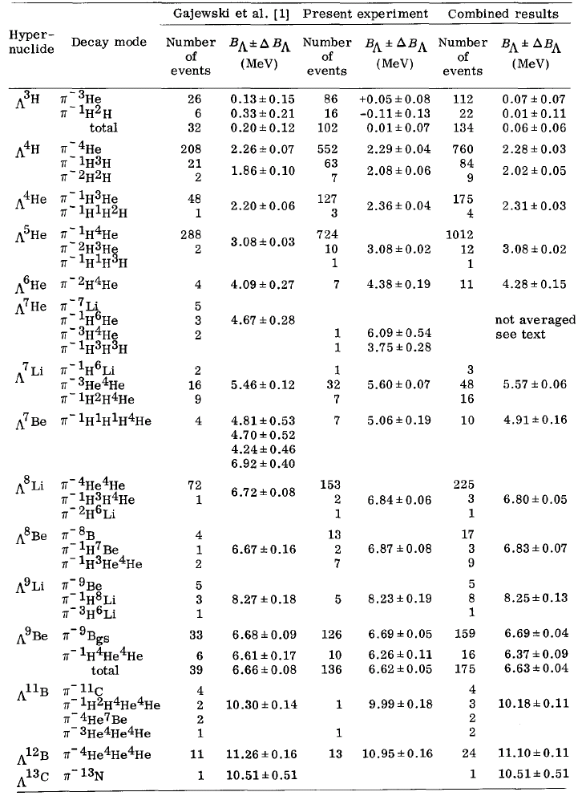
⁴_{Λ}H & ⁴_{Λ}He
G.Bohm et al. Nucl. Phys. B4 (1968) 511

Slide 22
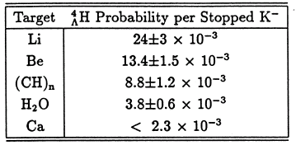
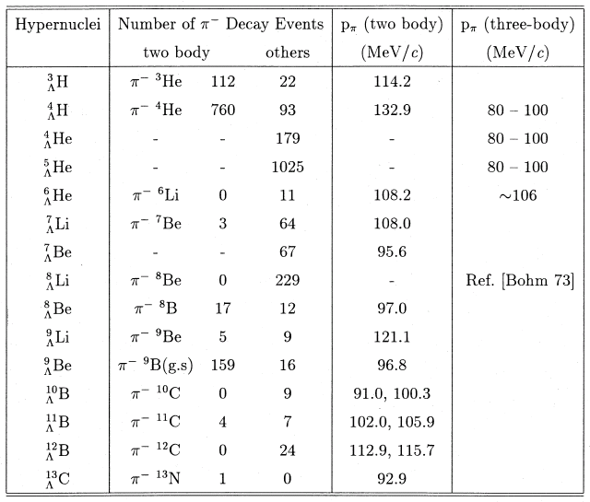
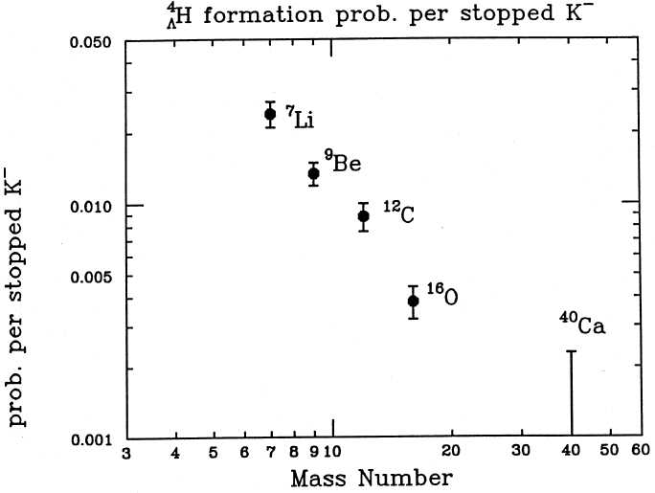
⁴_{Λ}H

Slide 23
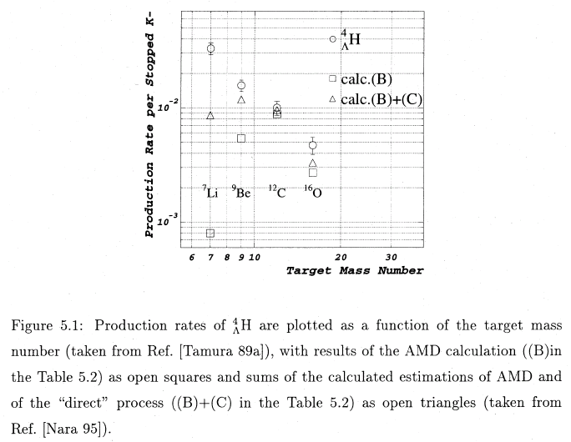
⁴_{Λ}H rate target dependence

Slide 24
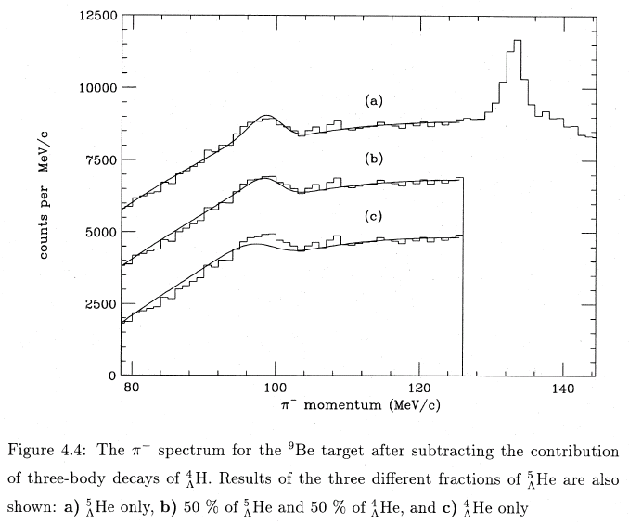
⁵_{Λ}He & ⁴_{Λ}He

Slide 25
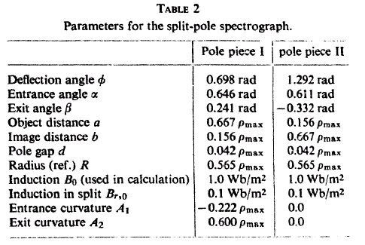
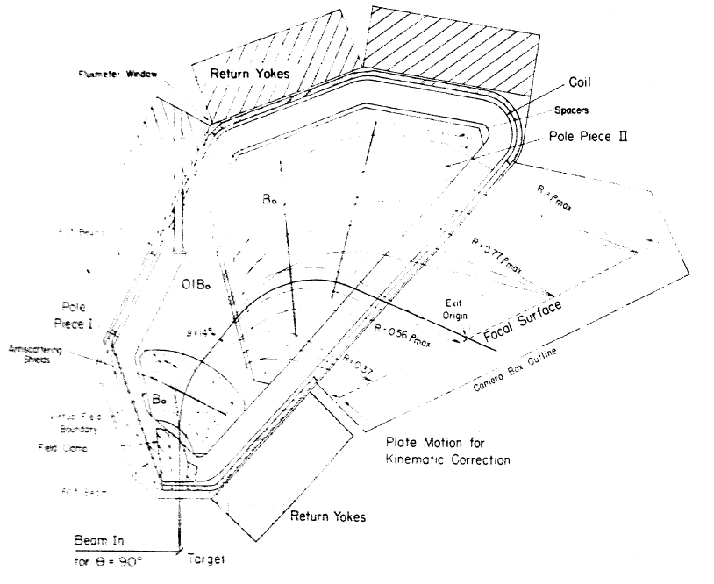
Enge
J.E.SPENCER and H.A.ENGE NIM 49 (1967) 181

Slide 26
Enge input (raytrace)
raytrace ; optical calculation software

Slide 27
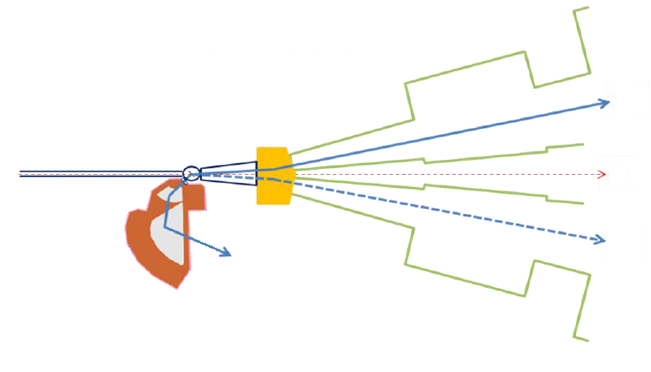
experimental setup
HRS
K⁺
CEBAF Primary
Electron Beam
Splitter Magnet
Beam Dump
π⁻
e⁻’
Enge Type Magnet
(Enge)
make lambda hyper nuclear with (e-,e⁻’K⁺) reaction
emit π- from weak decay of lambda hyper nuclear
observe π⁻ momentun at Enge Type Magnet
detect K⁺ at HRS to surppress π⁻ from non-strangeness reaction
(e.g. Δ formation)

Slide 28
momentum calibration
position
at
forcal plane
estimate with TOSCA
experimental field value
magnetic field value

Slide 29
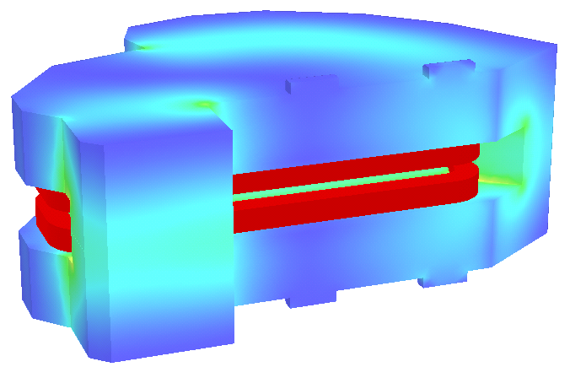
TOSCA
about TOSCA
magnetic field calculation software
field value accuracy is about 10⁻³
can output field value of each cell edge.

Slide 30
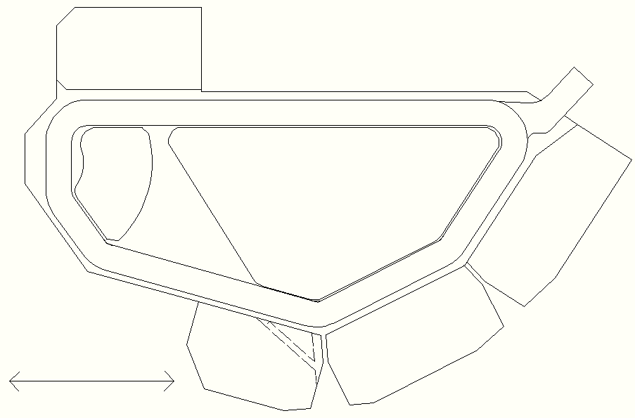
simulation
TOSCA model is based on CAD file.
mean field value is about 0.57 Tesla
output field value every 10mm at x, z direction and 2mm at y direction
yoke
exit
entrance
pole1
pole2
coil
x
yoke
1 m
z

Slide 31
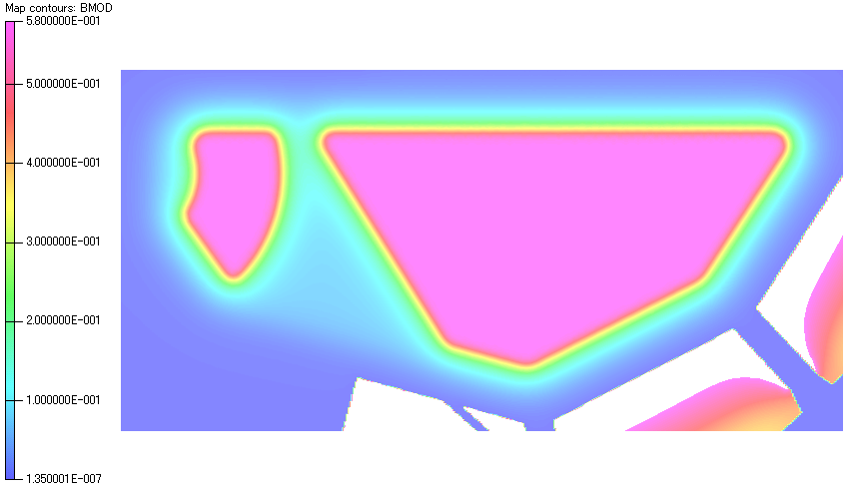
simulation
TOSCA model is based on CAD file.
mean field value is about 0.57 Tesla
output field value every 10mm at x, z direction and 2mm at y direction
yoke
exit
entrance
pole1
pole2
coil
x
yoke
1 m
z

Slide 32
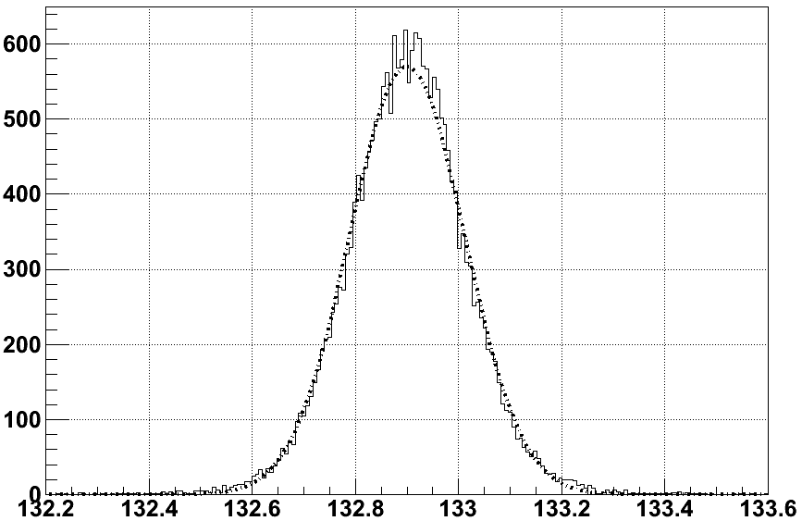
momentum resolution (DC Ar 50% + C2H6 50%)
FWHM = 262 keV
MeV/c

Slide 33
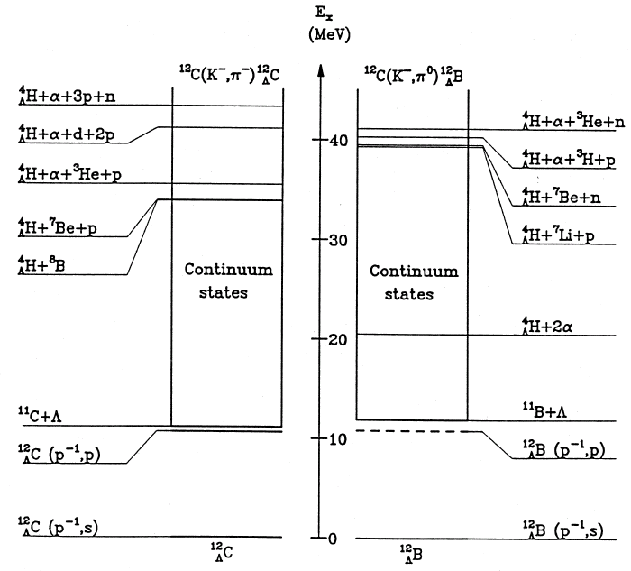
Mechanism of ⁴_{Λ}H Formation
Formation via Compound Nucleus
Recoil energy K- absorption
at rest
～40 MeV

Slide 34
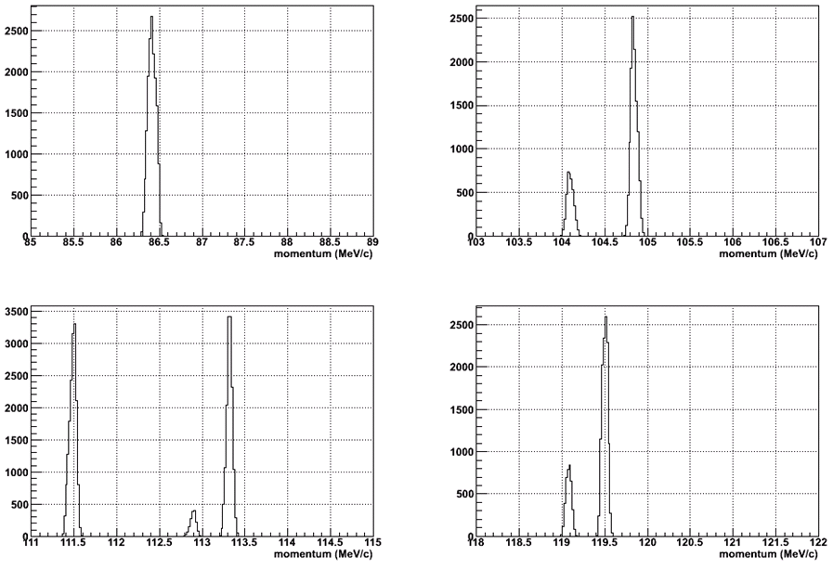
alpha observation

Slide 35
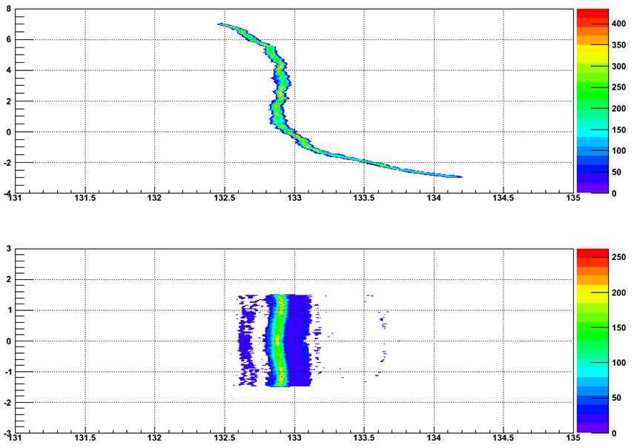
position at FP v.s. theta at generate point (geant4)
theta_i (deg)
phi_i (deg)
momentum (MeV/c)

Slide 36
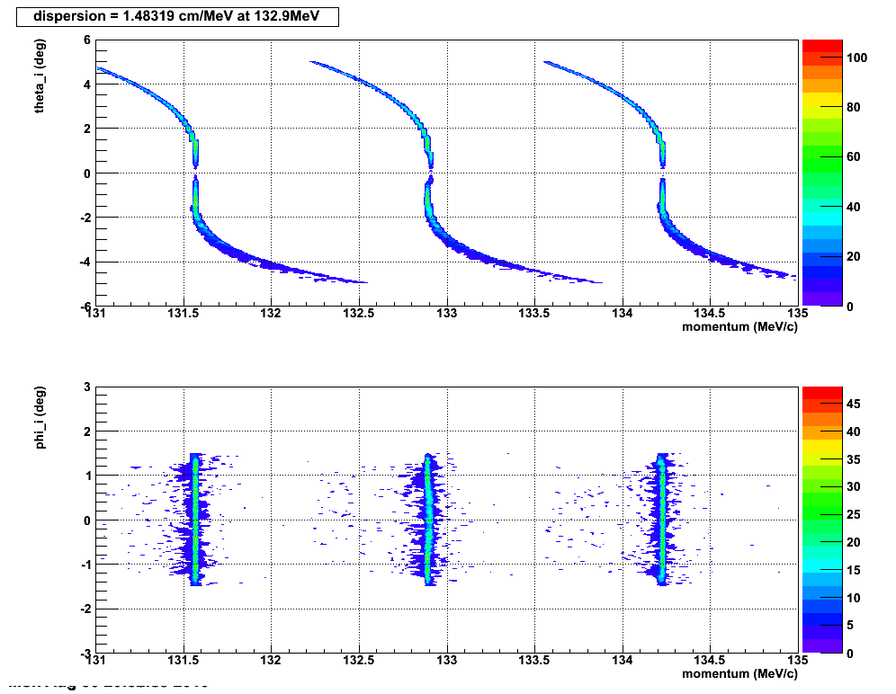
position at FP v.s. theta at generate point (raytrace)

Slide 37
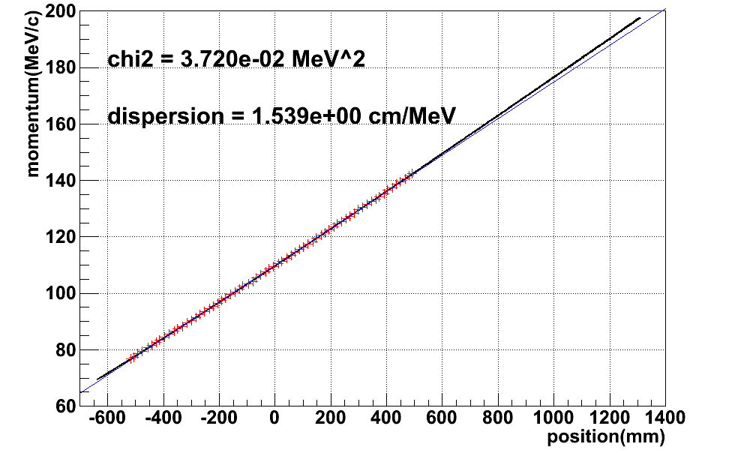
dispersion
Ana range (dp±30%)

Slide 38
Geant4 simulation (plan2)
Splitter Magnet
Hodoscope
20mm thickness
target
¹²C
100mg/cm²
Drift Chamber
(He 50%+ CH4 50%)
Focal Plane
(aligned SSD)
Decay pion
Enge Magnet
Vacuum Chamber window
Primary Electron Beam
Vacuum Area

