Slide 1
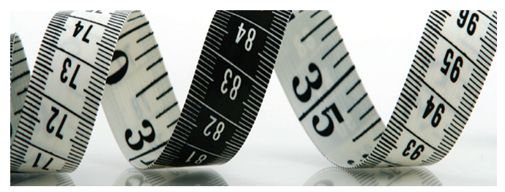
WEB OF KNOWLEDGE UPDATE
Ing. David Horký
Country Manager – Central and Eastern Europe
david.horky@thomsonreuters.com
Notes:
1

Slide 2
OBSAH
Politika výběru časopisů do Web of Science
Platforma Web of Knowledge 5
Hodnocení VaV
Article Match & Retrieve
Dotazy

Slide 3
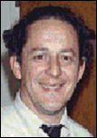
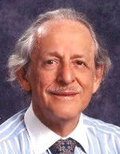
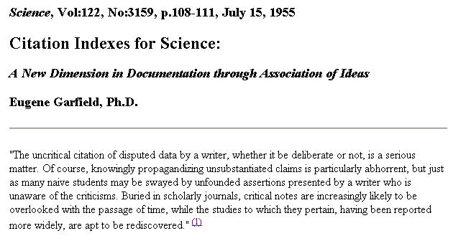
CITACE VE VĚDECKÉ KOMUNIKACI
Garfield, E.
“Citation indexes for science: A new dimension in documentation through association of ideas.” Science, 122 (3159), p.108-111, July 1955.
Citované záznamy
vztahy mezi vědeckými pracemi
Citační rejstříky
nový přístup k věcné kontrole vědecké literatury

Slide 4
WEB OF SCIENCE
POLITIKA VÝBĚRU ČASOPISŮ
Proč vybíráme časopisy?

Slide 5
JOURNAL CITATION REPORTS
40% časopisů:
80% publikací
92% citovaných článků
4% časopisů:
30% publikací
51% citovaných článků

Slide 6
WEB OF SCIENCE
POLITIKA VÝBĚRU ČASOPISŮ
Každoročně je hodnoceno cca 2000 časopisů
  akceptováno 10-12%
Editoři Thomson Reuters
  Informační profesionálové
  Knihovníci
  Odborníci na publikace ve svém vědním oboru
Web of Science
Kvalita časopisů
Analyzované časopisy

Slide 7
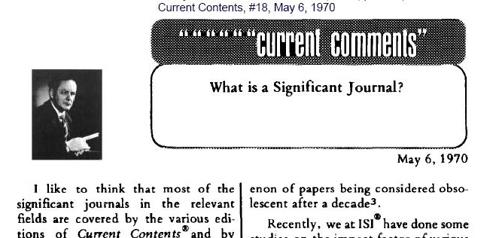
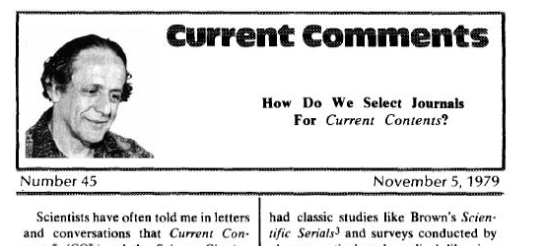
FILOSOFIE VÝBĚRU ČASOPISŮ DO WOS
Kvalita
Rozmanitost
Hloubka
Od počátku existence ISI (nyní Scientific Business of Thomson Reuters), bylo naším zakladatelem, Dr. Eugenem Garfieldem , stanoveno, že obsah se bude skládat z časopisů z celého světa, které představují kvalitu a vliv ve svém oboru.
Po desetiletí se hodnocením a výběrem časopisů zabývají odbnorníci z oddělení Editorial Development.

Slide 8
KOMPONENTY HODNOCENÍ ČASOPISŮ
V hodnocení časopisů:
  Jsme objektivní (“publisher-neutral”) - na hodnocení nemá vliv, zda se jedná o časopis vydávaný komerčním nakladatelem, akademickým, nakladatelem, zda se jedná o Open Access časopis apod.
  Pro časopisy všech typů nakladatelů jsou používány stejné standardy
Proces výběru časopisů Thomson Reuters:
  http://thomsonreuters.com/products_services/science/free/essays/journal_selection_process/
  http://science.thomsonreuters.com/mjl/selection

Slide 9
ZÁKLADNÍ PUBLIKAČNÍ STANDARDY
Včasnost vydávání časopisu
  Schopnost vydávat časopis v předem stanovených termínech. Velice důležitá podmínka, kvůli které většinou hodnotíme minimálně tři po sobě jdoucí vydání a někdy i více.
Mezinárodní publikační standardy
  Kompletní bibliografická informace na všech úrovních – pro časopis, články, autory a citované reference.
Názvy článků, abstrakty, klíčová slova a citované reference v anglickém jazyce
  Velice vhodné, aby časopis mohl oslovit co nejširší cílovou skupinu.
Peer review
  Zcela zásadní

Slide 10
OBSAH
Pokrytá témata
Povaha obsahu
  Původní články
  Recenze
  ‘Metodické’ články
Odpovídající intelektuální úroveň
Zásadní otázka
  „Co nového tento časopis přináší databázi Web of Science? ”

Slide 11
Mezinárodní rozmanitost
Autoři, redaktoři a členové redakční rady
  Je jejich složení mezinárodní?
  Odráží tento časopis globální povahu dnešní vědy a výzkumu?
Regionální časopisy
  Rovněž se snažíme o pokrytí těchto časopisů, abychom podchytili globální klima, ve kterém se věda a výzkum odehrává
  V současnosti a i do budoucna budeme na tento aspekt klást velký důraz

Slide 12
Citační analýza
Časopisu
  Pokud časopis existuje několik let, bude k dispozici citační historie. Ta je pro proces hodnocení extrémně důležitá.
  K hodnocení se většinou používá celkový počet citací, přibližný Impakt Faktor a Immediacy Index.
Autorů a redaktorů
  Důležitá je rovněž analýza individuální citační historie autorů a redaktorů
  V případě nových časopisů se jedná o jediný indikátor potenciálního citačního vlivu
Kvalifikovaný odhad potenciálního vlivu

Slide 13
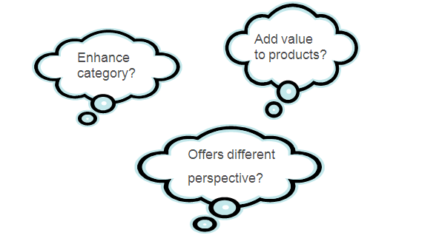
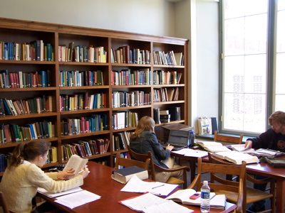
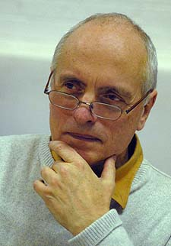
13
Notes:
13

Slide 14
Porovnávání výsledků a provádění výběru
Hodnocené časopisy jsou porovnávány s časopisy, které již jsou obsaženy ve Web of Science a s dalšími hodnocenými časopisy – a to v rámci daného vědeckého oboru.
Bereme v úvahu všechny výše uvedené faktory a snažíme se vybrat ty časopisy, které nejvíce obohatí a rozšíří současně indexované zdroje.
Naší filosofií není indexování veškerých časopisů.
„Objemový” přístup k rozvoji obsažených zdrojů není pokládán za prospěšný.
Cílem je poskytnout uživateli přístup k hlubokému, multidisciplinárnímu obsahu, jehož hodnota je průkazná –
Web of Science obsahuje kvalitu.

Slide 15
´UDRŽENÍ´ ČASOPISU VE WOS
Redaktoři nadále monitorují kvalitu časopisu dle kritérií výběru
Chtějí vidět konzistenci, v některých případech zlepšení
Pokud dojde k viditelnému poklesu vlivu časopisu, jeho publikačních standardů (např. pozdní vydávání), nebo k něčemu jinému, co může signalizovat nějaké problémy časopisu, časopis bude sledován a pokud třeba, vyřazen z Web of Science
15
Notes:
15

Slide 16
RŮST POKRYTÍ REGIONÁLNÍCH
A ČESKÝCH ČASOPISŮ
Web of Science | 2005 | 2010 | Nárůst | Procentní změna
Celkový počet indexovaných časopisů | 8,834 | 11,423 | 2,589 | + 29%
Regionální časopisy | 1,716 | 3,605 | 1,889 | + 110%
České časopisy | 30 | 56 | 26 | + 87%
16
Notes:
16

Slide 17
NÁRŮST POKRYTÍ ČESKÝCH ČASOPISŮ VE WEB OF SCIENCE
Web of Science | 2005 | 2010 | Nárůst | Procentní změna
Science Citation Index – Expanded | 23 | 36 | 13 | + 57%
Social Sciences Citation Index | 4 | 11* | 7 | + 175%
Arts & Humanities Citation Index | 3 | 12** | 9 | + 300%
*1 titul pokryt zároveň v SCIE a SSCI
**2 tituly pokryty zároveň v SSCI a A&HCI

Slide 18
CELKOVÉ POKRYTÍ
WEB OF SCIENCE
Region | Počet časopisů z regionu ve WoS
Evropa | 5,573 49%
Severní amerika | 4,251 38%
Asie a pacifická oblast | 965 9%
Latinská amerika | 272 2%
Střední východ/Afrika | 200 1%
Jazyk | Počet časopisů ve WoS
Angličtina | 9114 81%
Jiný | 2147 19%

Slide 19
WEB OF KNOWLEDGE PLATFORM

Slide 20
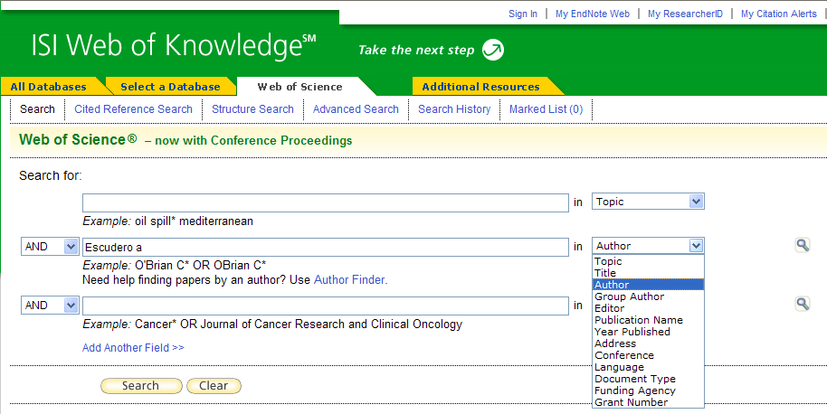
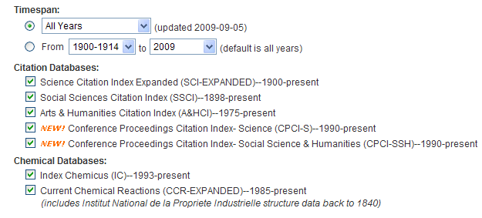
WEB OF SCIENCE
SEARCH OPTIONS

Slide 21
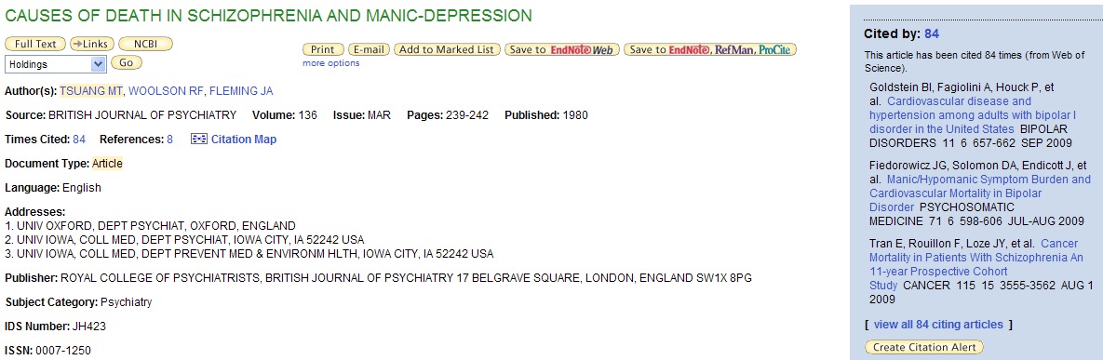
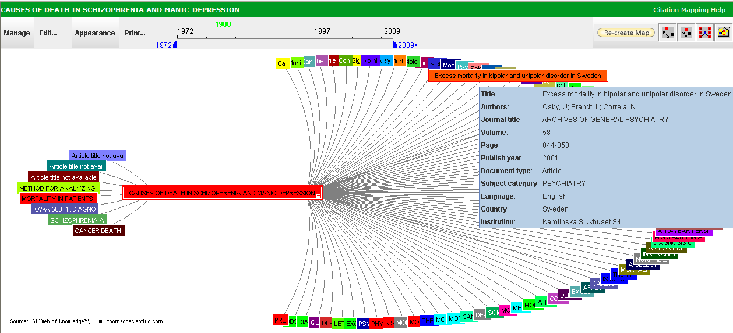
WEB OF SCIENCE
VALUE OF CITATION NETWORK
Este artículo sobre Bipolar Disorder (trastorno bipolar) es muy citado y relevante, pero no contiene el término ‘Bipolar Disorder’
Así, un investigador no encontrará este Full Record buscando con el término ‘Bipolar Disorder’, pero se encuentra facilmente a través de las citas

Slide 22
WEB OF SCIENCE
CONFERENCE PROCEEDINGS CITATION INDEX
  Two Editions:
  - Science & Technology
  - Social Sciences & Humanities
  Approx 5.5 million records
  Updated Weekly
  Over 385,000 records per year
  More than 120,000 conferences covered in total
  Approximately 12,000 conferences covered annually
  Coverage from 1990, cited references from 1999
  Comprehensive, multidisciplinary and international coverage from conferences proceedings published in books, journals, reports, series, and preprints
  Details of each conference are indexed and searchable, data includes: conference title, sponsor, location, description and date

Slide 23
WEB OF SCIENCE
DEPTH OF CITATION INDICES
Century of Science
Science Citation Index
1900
1945
Century of Social Sciences
SSCI
1900
1956
A&HCI
1975
56 years of added coverage in the Social Sciences
CPCI
1990
>300 journals added that focus on the first half of last century

Slide 24

CASE STUDY:
Charles Warren Thornthwaite
C. Warren Thornthwaite was a Geographer
and Climatologist best known for devising
a Climate Classification System proposed
in his landmark paper in 1948 which also discusses the importance of evapotranspiration on climate.
Thornthwaite published 28 papers between 1931 and 1965, mostly in the fields of Geography and Geochemistry & Geophysics.
His works have gone on to be highly influential to researchers in many fields and in recent years have been particularly utilized by researchers involved in climate change and water management

Slide 25
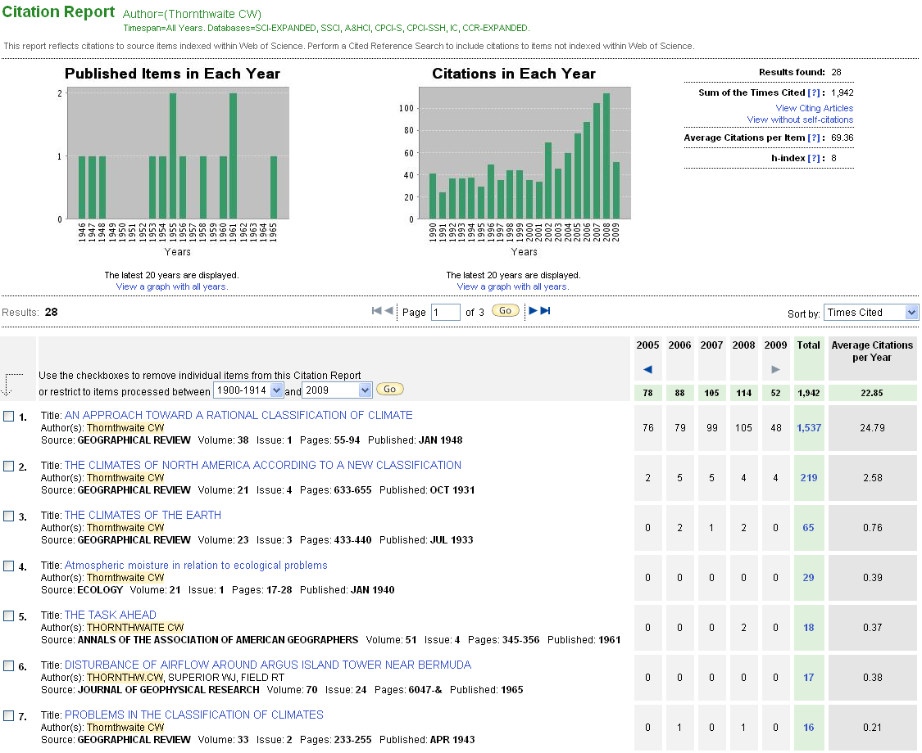
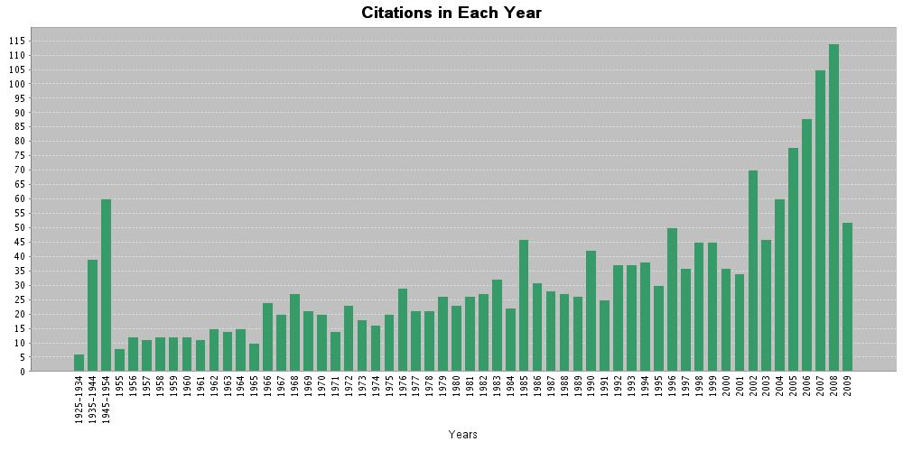
The works of C. Warren Thornthwaite
Thornthwaite produced 28 highly influential works in the Social Sciences which have been consistently cited throughout their history

Slide 26
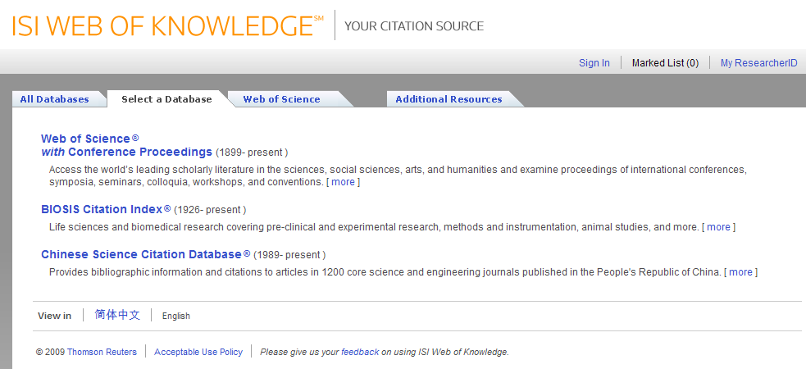
ISI WEB OF KNOWLEDGE 5
CITATION UNIVERSE

Slide 27
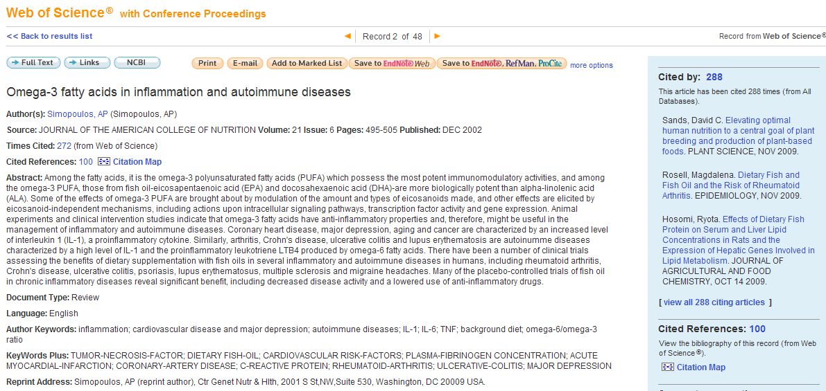
CITATION COUNTS USING
WEB OF KNOWLEDGE VALUES

Slide 28
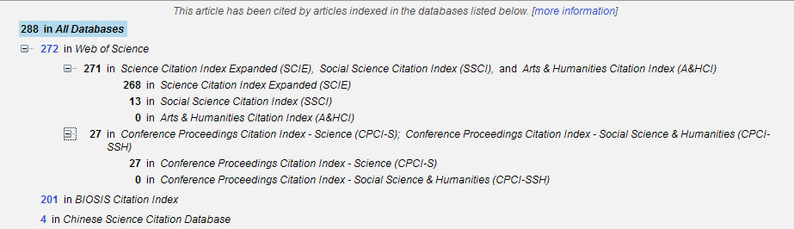
WEB OF KNOWLEDGE
CITATION BREAKDOWN TABLE
28

Slide 29
BIOSIS CITATION INDEX
BIOSIS CONTENT WITH CITATION DATA
Biosis Previews
  Widest collection of life sciences fields in the world
  agriculture, biodiversity, biotechnology, botany, drug discovery, gene therapy, marine biology, wildlife conservation, zoology
Biosis Citation Index
  Provides cited references for BIOSIS Previews
    Cited references for all Previews content (beginning 2006)
    Cited references for 60% of high impact Previews journals (1926 - 2005)
Exclusive to Web of Knowledge platform

Slide 30
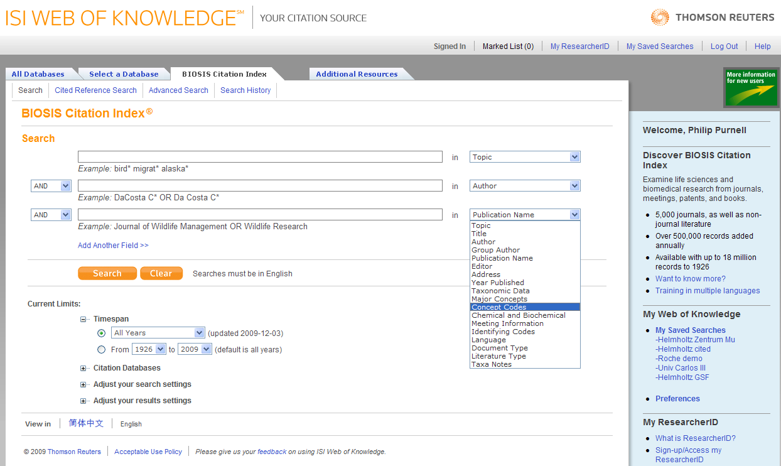
BIOSIS CITATION INDEX
ON ISI WEB OF KNOWLEDGE 5

Slide 31
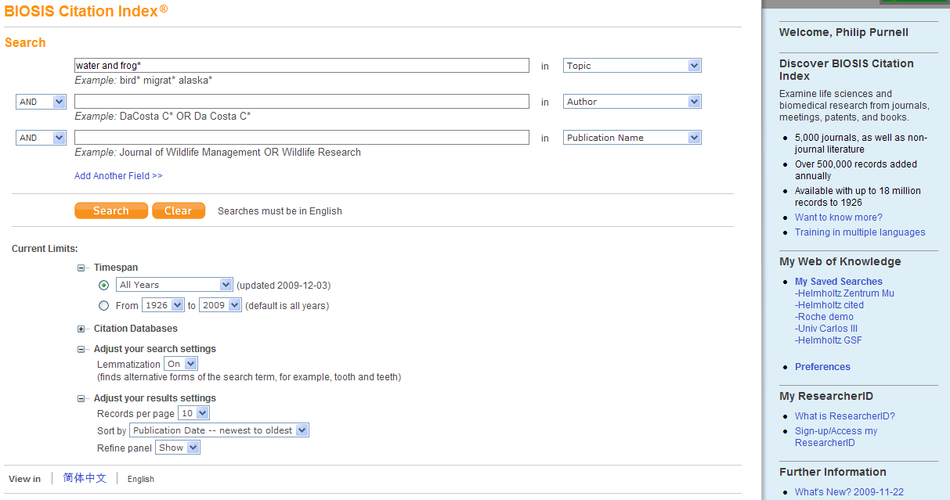
BIOSIS CITATION INDEX
SEARCHING
Set your search parameter defaults
Select years, use lemmatization and sort by publication date

Slide 32
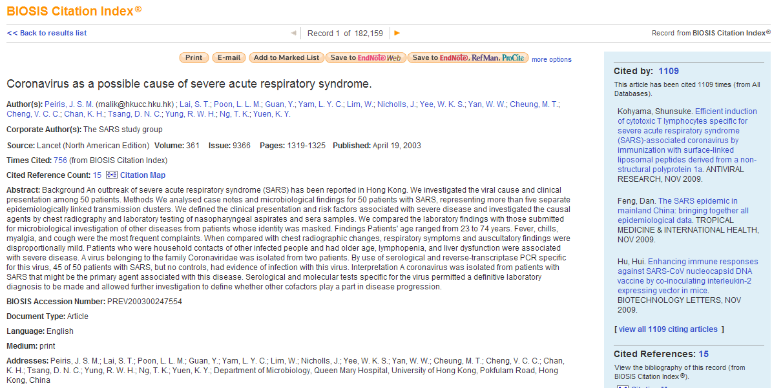

BIOSIS CITATION INDEX
CITATION BREAKDOWN TABLE

Slide 33
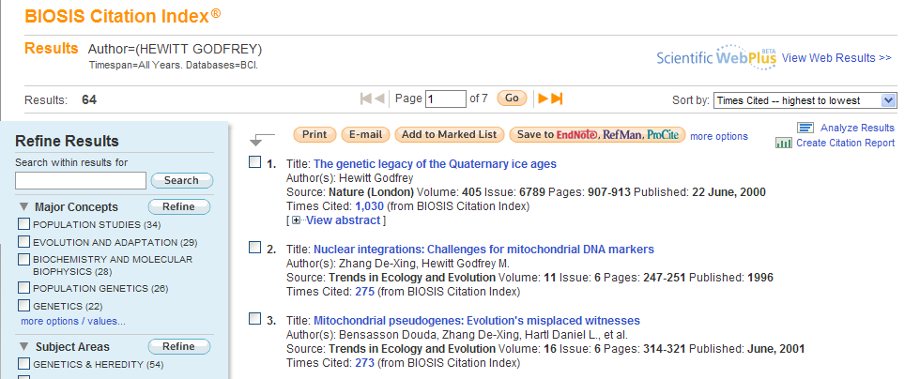
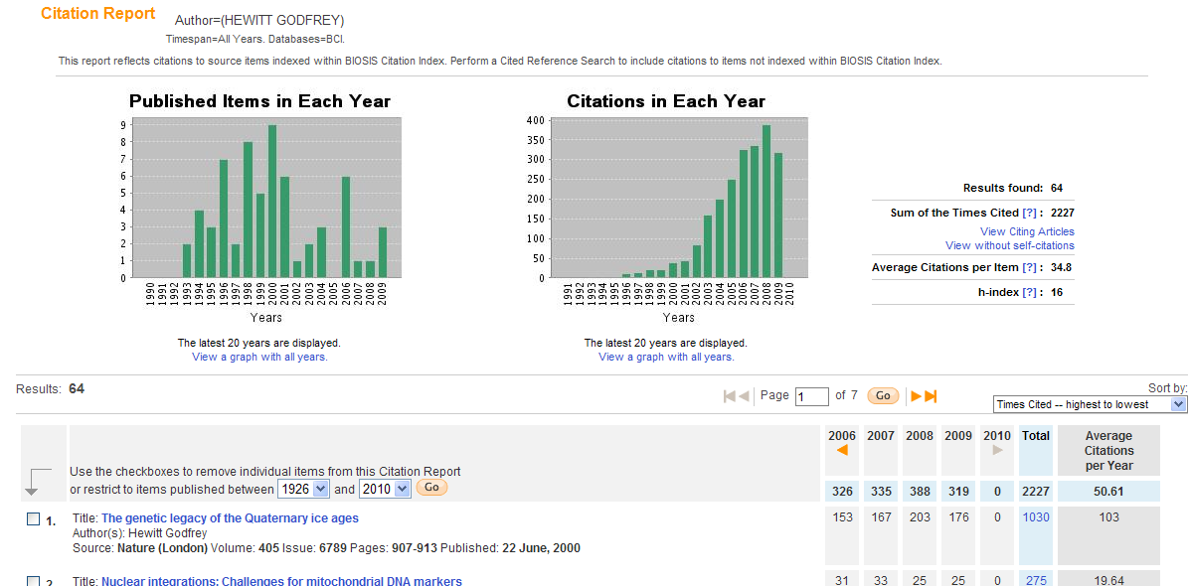
BIOSIS CITATION INDEX
CITATION REPORT

Slide 34
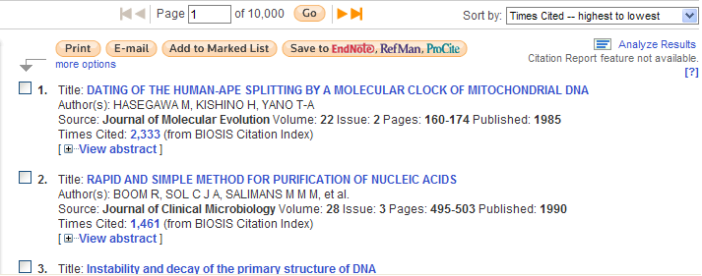
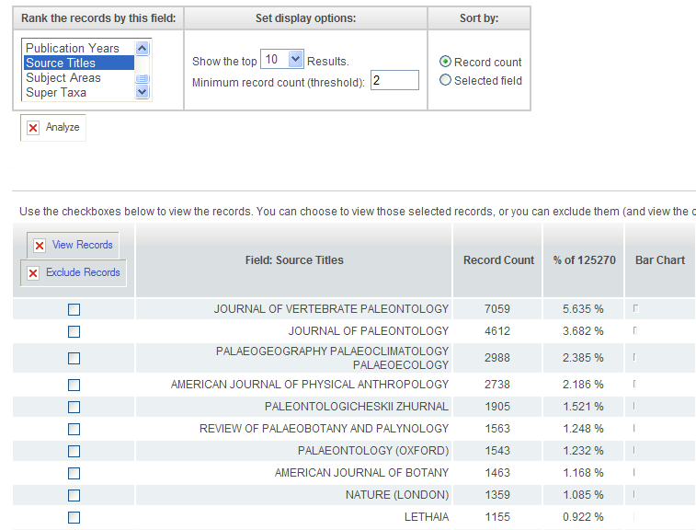
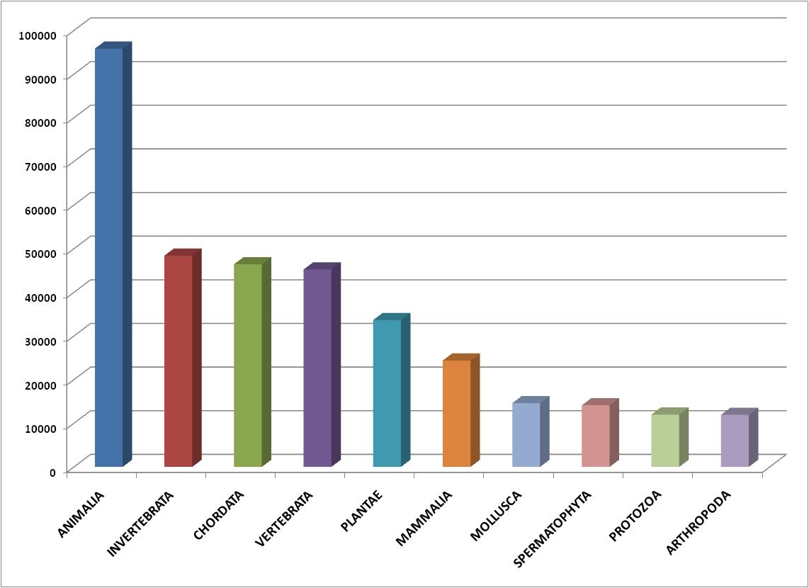
BIOSIS CITATION INDEX
ANALYZE RESULTS
Analyze by Super Taxa

Slide 35
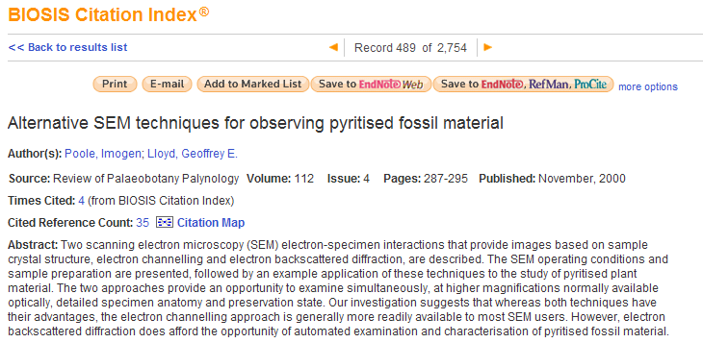
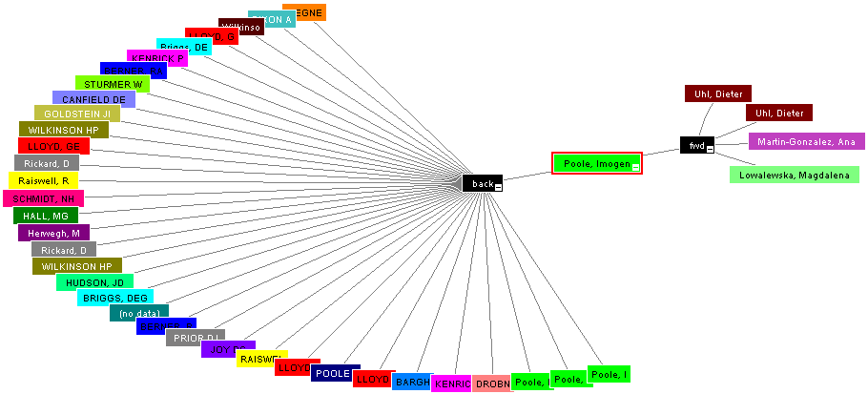
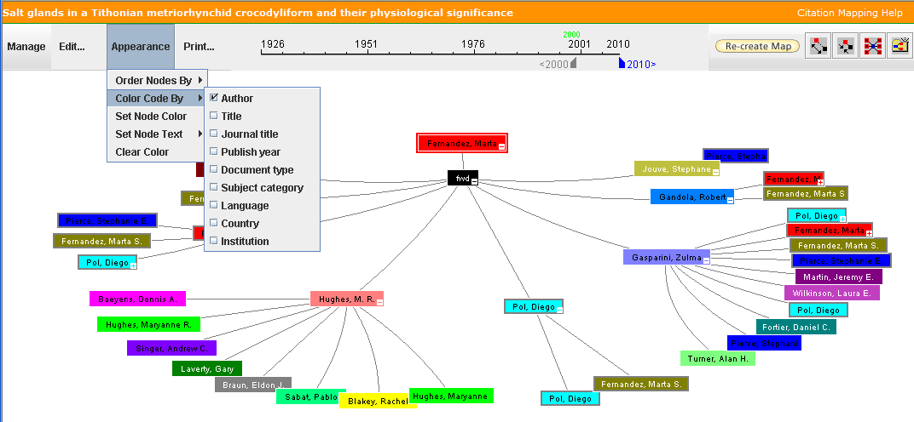
BIOSIS CITATION INDEX
CITATION MAP
Citation maps can find relevant papers not returned in your search results
2nd generation citations reveal citation pathways

Slide 36
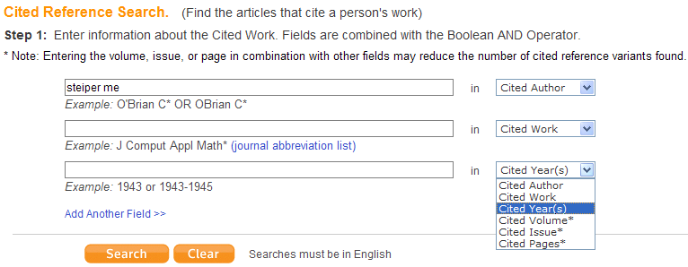
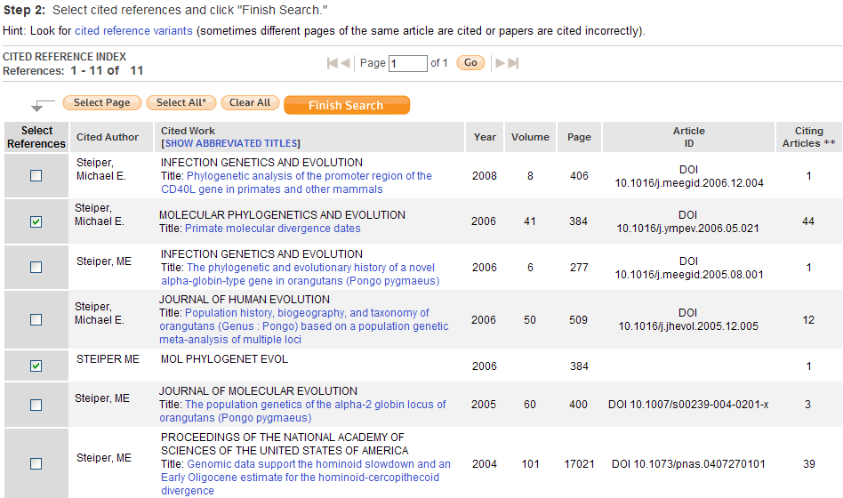
BIOSIS CITATION INDEX
CITED REFERENCE SEARCHING
Cited reference searching helps users to find ‘missing citations’

Slide 37
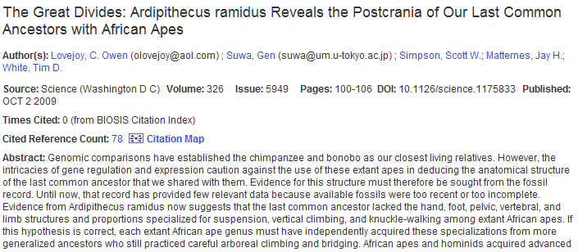
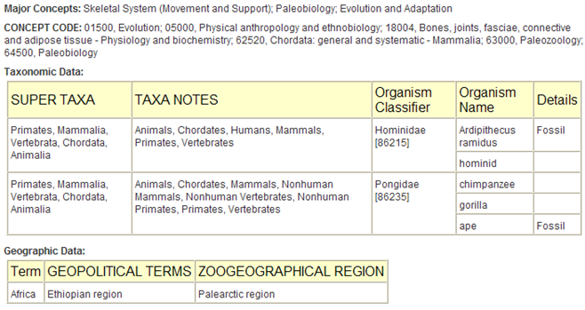
BIOSIS CITATION INDEX
SPECIALIZED INDEXING
Searching Biosis Citation Index for ‘Fossil* and Africa and humans’ returns this paper
The same search in ‘All Databases’ reveals that this record is also present in Web of Science
But the same search in Web of Science does not find the article
It is the Biosis specialized indexing fields that has found these terms that are not indexed in Web of Science

Slide 38
BIOSIS CITATION INDEX
SUMMARY
Combines
  World-leading Biosis life sciences content
  with valuable cited references back to 1926
Enhances
  Web of Science searches via the All Database Search using common indexing backbone
Employs
  ISI Web of Knowledge cited reference searching
Exclusive
  ISI Web of Knowledge

Slide 39
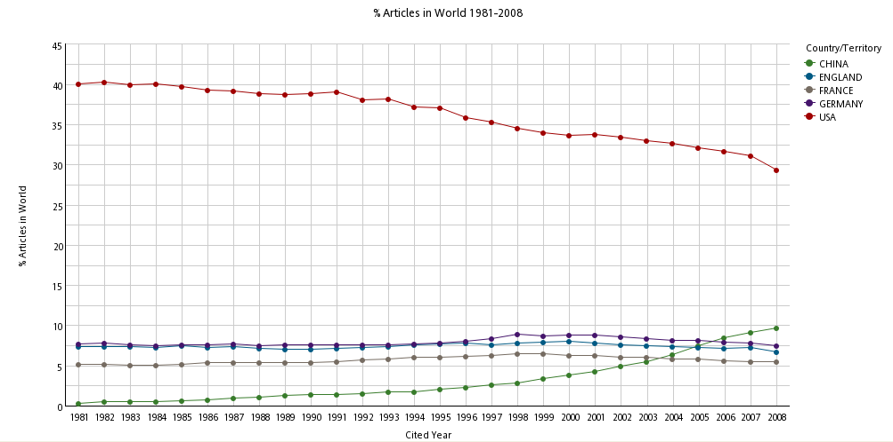
EMERGENCE OF CHINESE RESEARCH

Slide 40
CHINESE SCIENCE CITATION DATABASE
AVAILABLE NOW!
Over 2 million records
Over 13 million cited references
Subject Areas
  Mathematics, Physics, Chemistry, Geosciences, Biology, Agricultural Sciences, Engineering (Computer Science, Mechanics, etc.), Medicine, and Management
Dual Language
  Since 2002, 80% of records have full English bibliographic information and most have English abstracts
Content is searchable in both English and Chinese

Slide 41
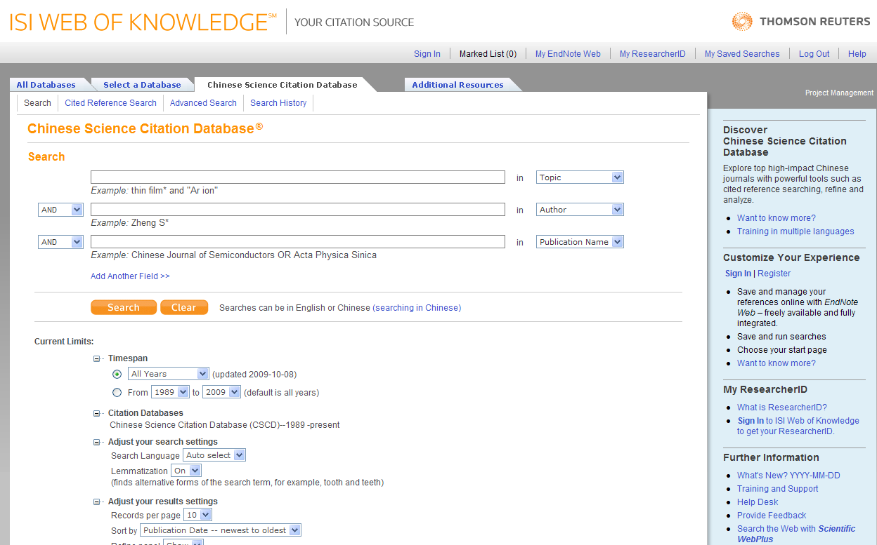

Slide 42
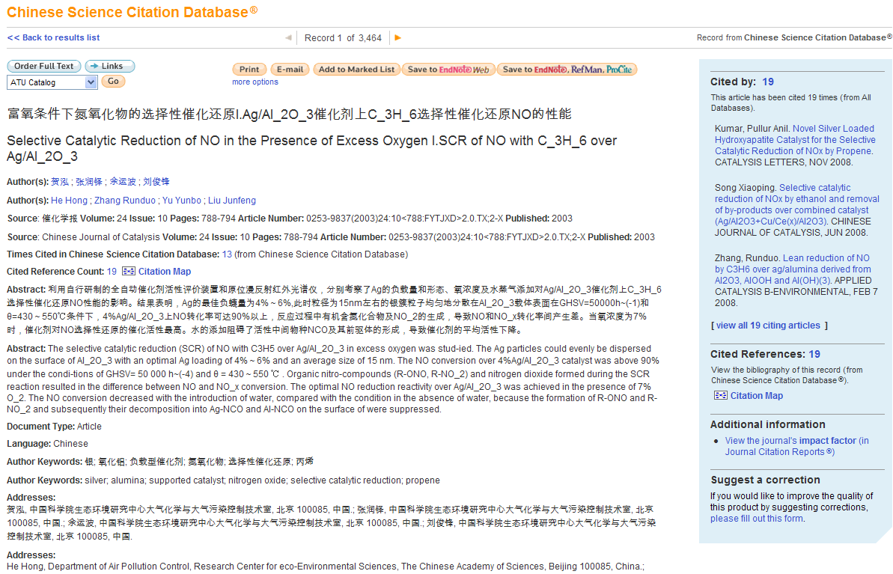
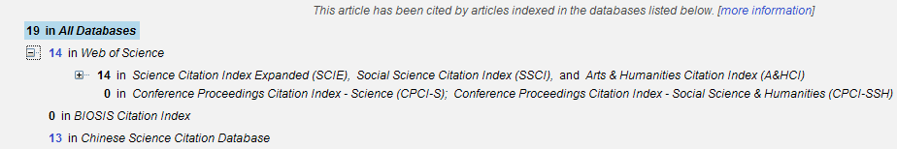
CSCD
CITATION BREAKDOWN TABLE
Bibliographic information in English and Chinese

Slide 43
EVALUATING JOURNALS

Slide 44


EFFICIENCY
JOURNAL IMPACT FACTOR
2005
2006
2007
2008
2009
All Previous Years
2008 Impact Factor
Citations
Source paper – published in 2008
Cited reference – published in 2006 or 2007
Notes:
The journal Impact Factor looks at the average number of times recent articles were cited in a particular year. As an example…

Slide 45
CALCULATING 2008 IMPACT FACTOR
COLLECTION OF CZECHOSLOVAK CHEMICAL COMMUNICATIONS
Citations in 2008
To items published in 2007 = 78
To items published in 2006 = 100
Sum = 178
178
227
= 0,784
Number of items
Published in 2007 = 118
Published in 2006 = 109
Sum = 227

Slide 46
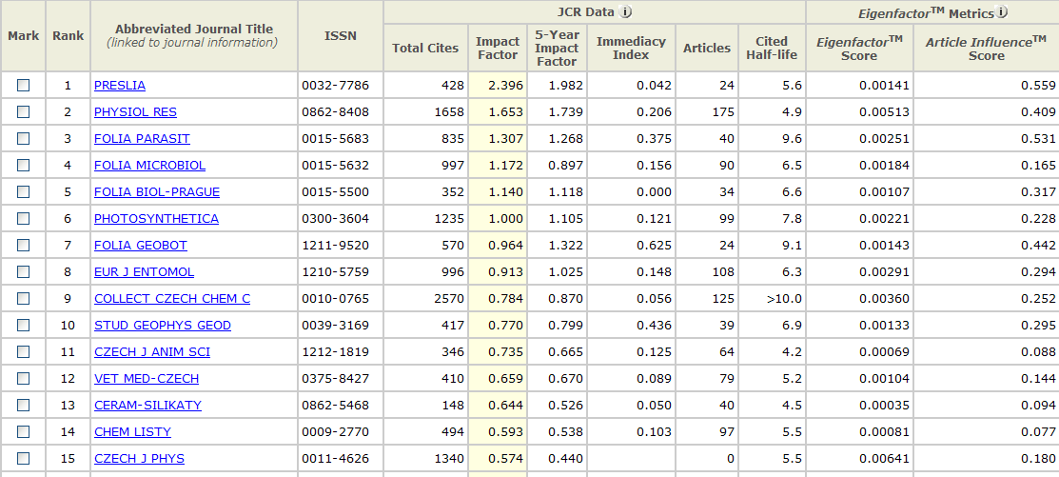
JOURNAL IMPACT FACTOR
CZECH JOURNALS

Slide 47
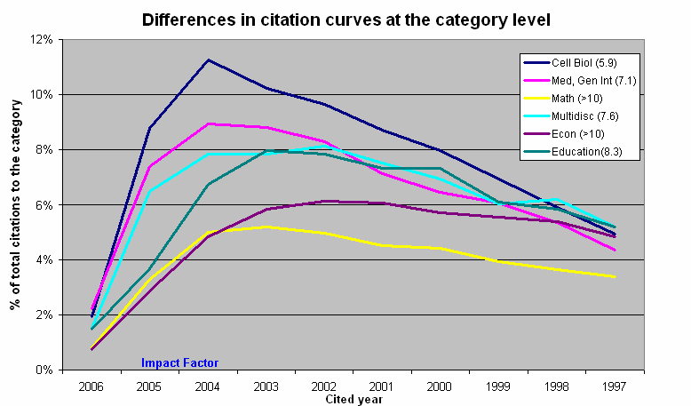
CITATION BEHAVIOUR VARIES
BETWEEN SUBJECT CATEGORIES

Slide 48
JOURNAL 5-YEAR IMPACT FACTOR
CZECH JOURNALS

Slide 49
EVALUATING COUNTRIES

Slide 50
GOVERNMENTS AND INSTITUTIONS USING TR DATA FOR EVALUATION (INCL.)
Czech Republic: Czech Academy of Sciences; Government
France: Min. de la Recherche, OST - Paris, CNRS
Germany: Max Planck Society, several gov’t labs, DKFZ, MDCUS: National Institutes of Health
United Kingdom: King’s College London; HEFCE
European Union: EC’s DGXII(Research Directorate)
US: NSF: biennial Science & Engineering Indicators report (since 1974)
Canada: NSERC, FRSQ (Quebec), Alberta Research Council
Australian Academy of Science, gov’t lab CSIRO
Japan: Ministry of Education, Ministry of Economy, Trade & Industry
People’s Republic of China: Chinese Academy of Science

Slide 51
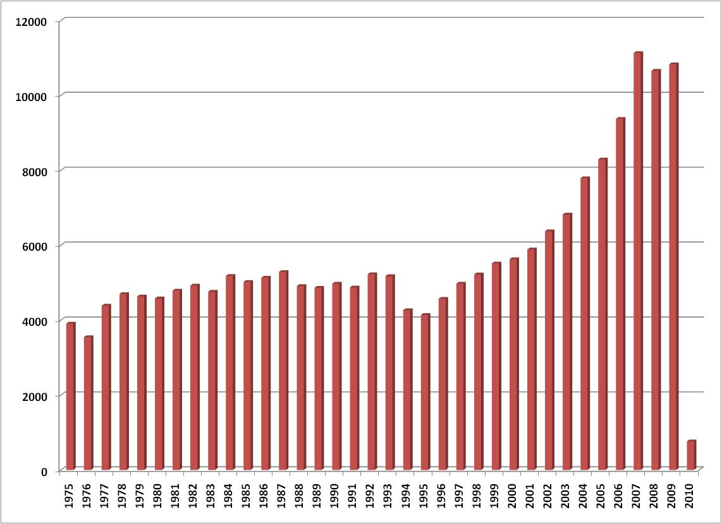
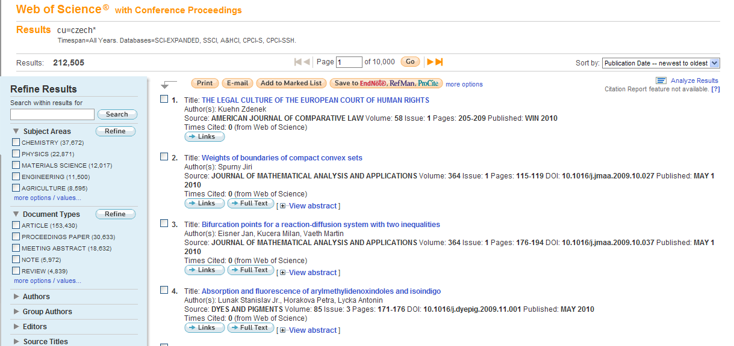
CHANGING NATURE OF CZECH RESEARCH
Czech researchers averaged just over 4,000 papers a year in the 70s – 90s.
Now over 10,000 papers per year

Slide 52
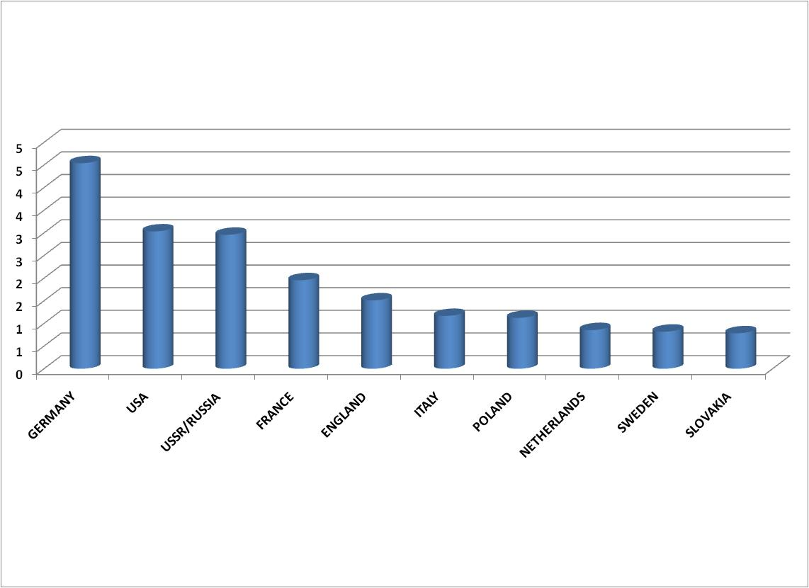
CHANGING NATURE OF CZECH RESEARCH
INTERNATIONAL COLLABORATION
Between 1970 and 1999, 14% of Czech papers had at least one international co-author

Slide 53
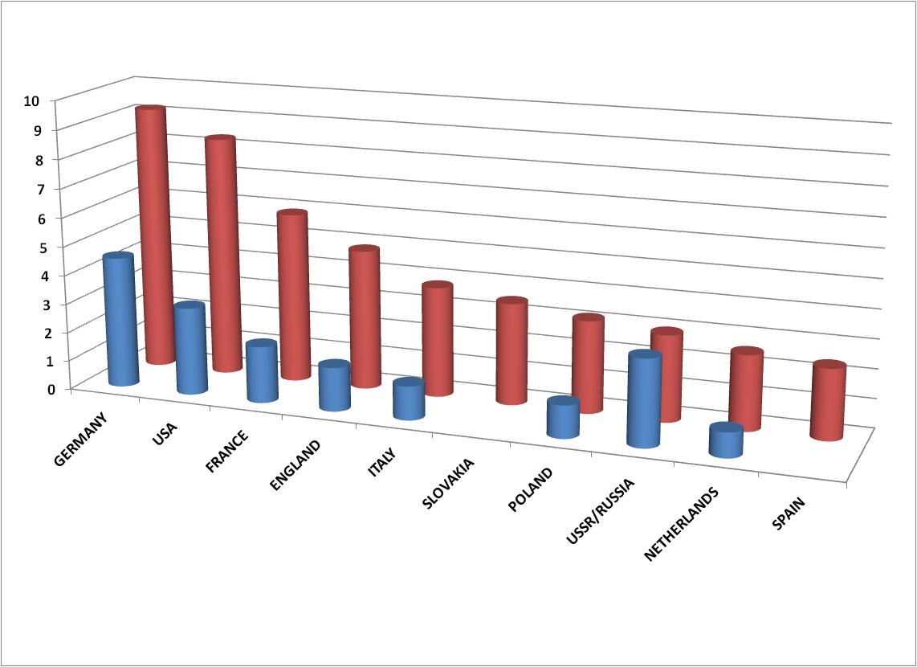
CHANGING NATURE OF CZECH RESEARCH
INTERNATIONAL COLLABORATION
In the last decade 2000 – 2010, this figure has risen to 63%

Slide 54
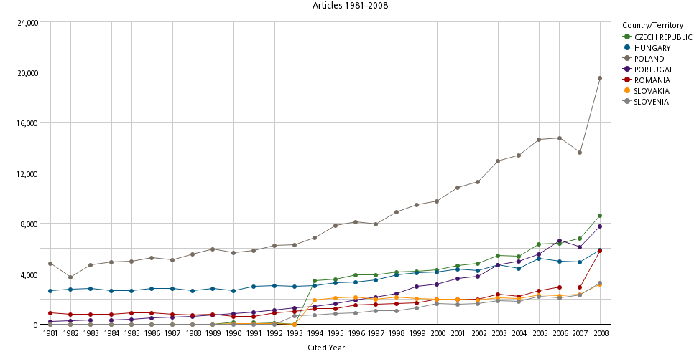
SCIENTIFIC RESEARCH PRODUCTIVITY
IN CENTRAL EUROPE
Thomson Reuters InCites

Slide 55
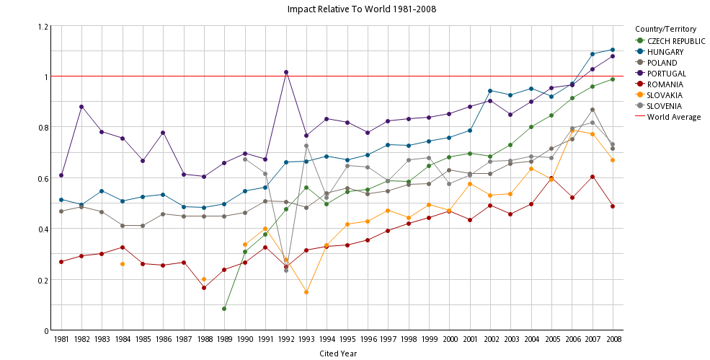
SCIENTIFIC RESEARCH IMPACT
IN CENTRAL EUROPE
Thomson Reuters InCites

Slide 56
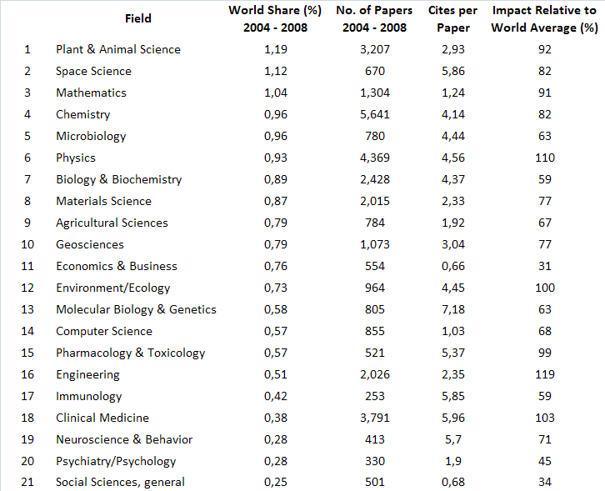
CZECH RESEARCH
BY OUTPUT AND IMPACT
Ranking by percentage share of Thomson Reuters (ISI) indexed papers 2004 - 2008

Slide 57
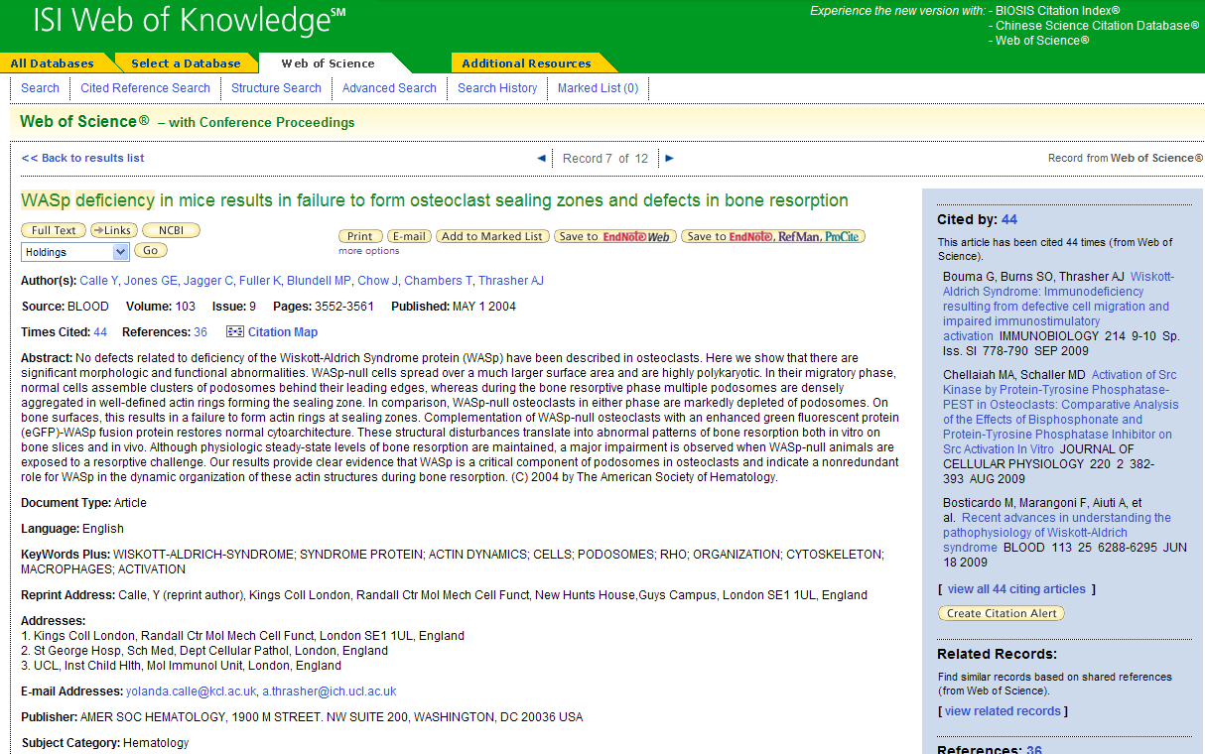
BENCHMARK YOUR PAPERS AGAINST
GLOBAL AVERAGES – IS THIS A HIGHLY CITED PAPER?
This article is ranked in the 12,92nd percentile in its field by citations
Articles published in ‘Blood’ from 2004 have been cited 34,30 times
Hematology articles from this year have been cited 18,83 times
This paper has received 40/34,30=1,17 times the expected citations for this journal
This paper has received 40/18,83=2,12 times the expected citations for this subject category

Slide 58
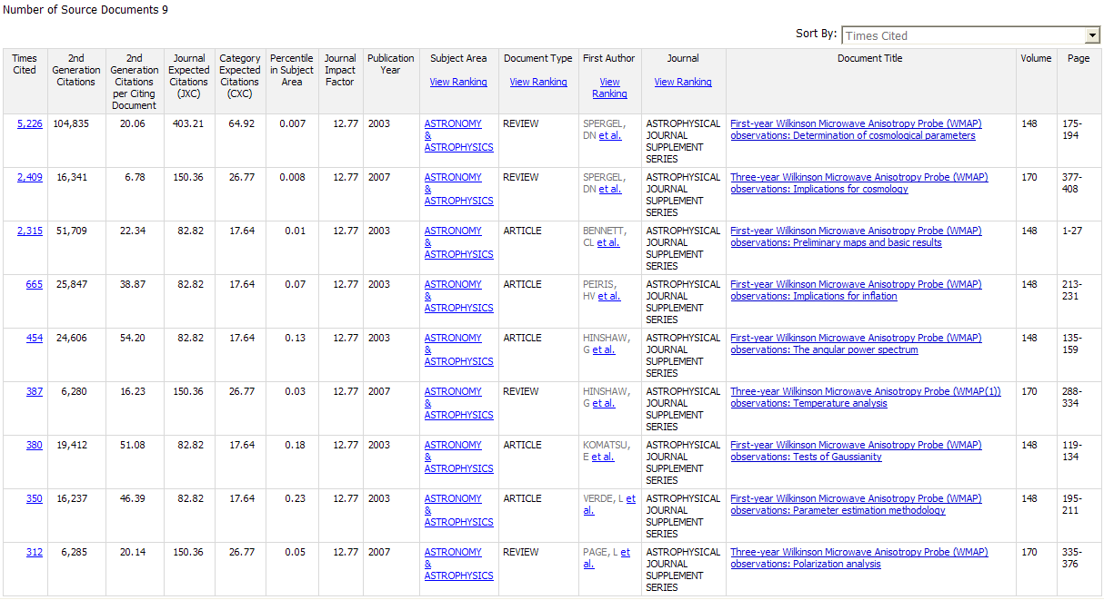
AGGREGATING PAPERS

Slide 59
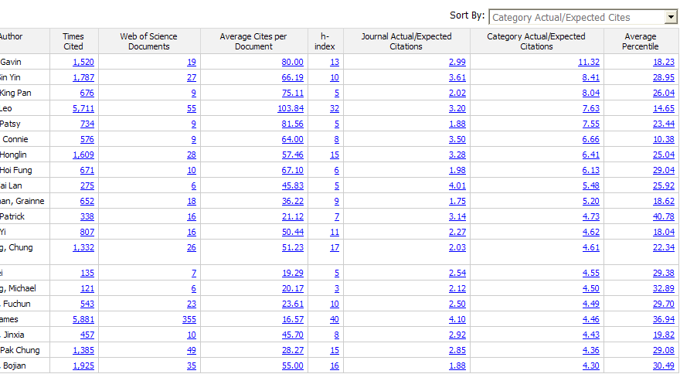
WHICH AUTHORS’ PAPERS HAVE PERFORMED BEST IN THEIR FIELD?
Computer Science
Medicine
Source: Thomson Reuters InCites

Slide 60
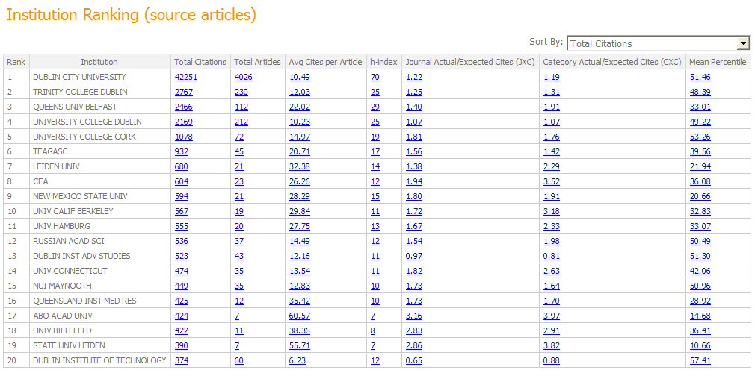
WITH WHOM DOES OUR FACULTY COLLABORATE?

Slide 61

WHICH OF THOSE COLLABORATIONS ARE THE MOST VALUABLE?

Slide 62
RESEARCHERID

Slide 63

RESEARCHERID
SCHOLARLY RESEARCH COMMUNITY
Accurate Identification
Organize and Manage
Increase Visibility and Recognition
Measure Performance
Collaboration
Security
Science, March 2009
Notes:
Name ambiguity is a recurring issue that impacts research accuracy and quality, career advancement and tenure, global collaboration among researchers, and identification and attribution of funding for institutions and individual authors alike.
By assigning unique identifiers to registered participants, ResearcherID helps to solve the common problem of author misidentification. But that’s not all ResearcherID does, and it’s not a tool only for published authors.
Accurate identification:
A system-generated unique identifier ensures your work is correctly attributed to you
Provides a way for your institution to properly measure your performance
Find your colleagues' work easily
Organize and Manage:
Manage your publication list and professional profile online, in one place
An online publication list allows others easy access to your body of work
Listing previous institutions in your profile helps others find you as you move throughout your career
Increase Visibility & Recognition:
Include your ResearcherID number in your email signature
ResearcherID badge:
Can be placed in almost any online environment (webpage, blog, etc.) to showcase recent publications
Links people directly to your profile and full publication list in ResearcherID
Measure Performance:
Personal metrics like times cited counts and H-index quantify your performance
Citing Articles and Collaboration Networks tools in the Labs show the reach of your work
Collaboration:
Searching keywords can help you find researchers in your specific field or line of interest to work with
View other researchers’ Citing Articles and Collaboration Networks to find others in your field you may want to work with
A multi-disciplinary community online fosters collaboration around the world
Security:
A secure online environment and profile controls provide a safe environment

Slide 64


INDIVIDUAL LEVEL
RESEARCH EVALUATION
See personalized metrics using Web of Science citation data
View accurate publication list due to unique author identification
Notes:
ResearcherID is a global, multi-disciplinary scholarly research community. With a unique identifier assigned to each author in ResearcherID, you can eliminate author misidentification and view an author’s citation metrics instantly. ResearcherID is used to:
- Search the author registry to locate colleagues and view their profiles
- Find citations, collaborators, key thought leaders, speakers, editors, and reviewers
- Track citation counts, average citations, and h-index for ResearcherID participants
- Register to manage your own publication list
- Share your personal publication URL with others – include it in your e-signature
- Explore citation maps to see how research is used globally

Slide 65


RESEARCHER ID
ANALYZE COLLABORATION NETWORK
Seek global collaboration opportunities by author, field, institution or country

Slide 66



RESEARCHER ID
VISUALIZE CITING ARTICLES NETWORK

Slide 67
RESEARCHERID
UPLOAD SERVICE
Institutions can upload content on behalf of their researchers
  Upload researcher names → Obtain a ResearcherID account
  Upload individual publication portfolios → Articles are matched to Web of Science records and ResearcherID portfolios are generated
Notes:
ResearcherID Batch Upload Process:
Customer supplies information on profiles to create / publications to upload using the ResearcherID Upload Web Service.
The ResearcherID batch process sends the customer an email upon commencement of processing, with estimated completion time.
Upon completion, ResearcherID sends customer email notification that processing has completed along with reports with processing statistics.
ResearcherID will send the individual accounts notice of completion of the batch upload process (optional, set per customer, per upload)

Slide 68
RESEARCHERID
DOWNLOAD SERVICE
Download data about the individuals at your institution
  Names and name variants, current and past affiliations
Download ResearcherID publication portfolios
  Bibliographic details of each item in the portfolio
  For articles that were successfully matched to Web of Science records there will be a Times Cited count and UT tag.
Can be used by the customers for their own internal systems
Notes:
The ResearcherID Download service is a subscription-based web service that allows an entitled institution the ability to download publication and profile data for their researchers from the ResearcherID database. In order to download information, the researcher needs to “associate” with the institution by one of two methods: 1.) The researcher profile/publication list created by the ResearcherID upload service; or 2.) The researcher's account is manually associated via the ResearcherID support utility.
The Download service easily allows an institution to download publications for all researchers at their institution who are members of ResearcherID.
Academic administrators and librarians are the primary audience; however, the service would need to be implemented by an IT librarian/staff as use of the service requires familiarity with XML and web service protocols.

Slide 69
ARTICLE MATCH & RETRIEVE

Slide 70






LINKS – ARTICLE MATCH & RETRIEVE

Slide 71




LINKS – ARTICLE MATCH & RETRIEVE

Slide 72




LINKS – ARTICLE MATCH & RETRIEVE

Slide 73
Děkuji za pozornost!
Ing. David Horký
Country Manager – Central and Eastern Europe
david.horky@thomsonreuters.com
Notes:
73

