Slide 1
Interaction between magnetic impurities on surfaces of noble metals and alloys
  Balázs Újfalussy
  Research Institute for Solid State Physics and Optics
Eszter Simon, RISSPO, Budapest
László Szunyogh, TU Budapest

Slide 2
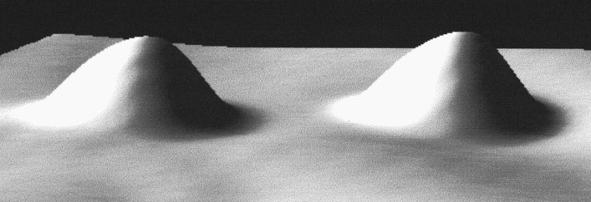
Exchange interactions
Between impurities (in bulk)
Non magnetic bulk
ΔE_{x} (μeV)
RKKY
d (a₀)
P
J(D)
D
Between layers
P
D
AP
D
D
Between impurities (on surface)
FCC(100)
FCC(110)
FCC(111)
}
STM image of two Co atoms on Au(111) surface
W. Chen, T. Jamneala, V. Madhavan, and M. F. Crommie: Phys. Rev B, 12, 60 (1999)

Slide 3
Outline
Short survey of method of calculations
Shockley state affects the interaction
  A brief theory of the Rashba splitting
Interaction:
Effects of disorder on
  Surface states
  Impurity interactions
Concluding remarks
Ab-Initio spin-dynamics
STM image of Co adatoms on (111) surface of platinum
in bulk (RKKY)
on surface (100, 110 and 111)

Slide 4
Method of calculations
Density Functional Theory in the Local Spin-Density Approximation
Relativistic treatment (Kohn-Sham-Dirac equation)
Screened Korringa-Kohn-Rostoker (SKKR) method
Green’s function method, exact treatment of the semi-infinite host
Green’s function embedding technique
No periodic boundary conditions
Magnetic force theorem
Vacuum
Ferromagnetic
Impurities
Antiferromagnetic
Host

Slide 5
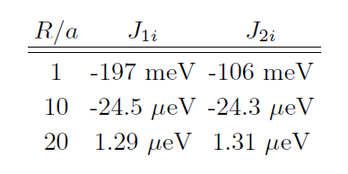
Treatment of impurity potentials: one vs. Two potential embedding
Error becomes very small well before the asymptotic limit

Slide 6
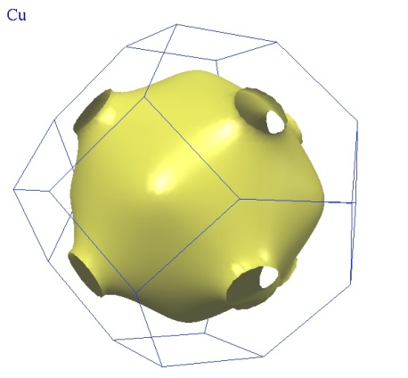
RKKY interaction in Cu and Au bulk materials
Asymptotic limit:
d_{ij}
M. A. Ruderman and C. Kittel, 1954, T. Kasuya, 1956, K. Yosida, 1957.
2k_{F} depends on the direction
extremal vectors from the Fermi surface cut
perpendicular to the [110]
ΔE_{x} (μeV)
d (a₀)
ΔE_{x} (μeV)
d (a₀)

Slide 7
[110]
[111]
[100]

Slide 8
}
}
(100) Direction
(110) direction
(111) direction
ΔE_{x} (μeV)
}
d (a₀)
ΔE_{x} (μeV)
ΔE_{x} (meV)
d (a₀)
d (a₀)

Slide 9
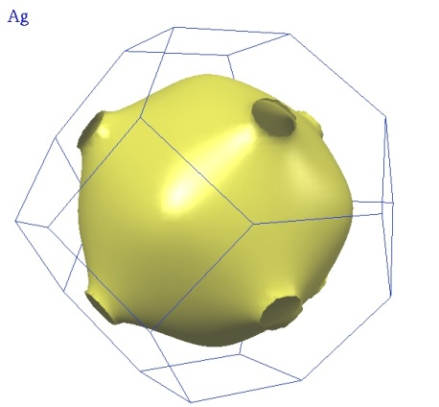
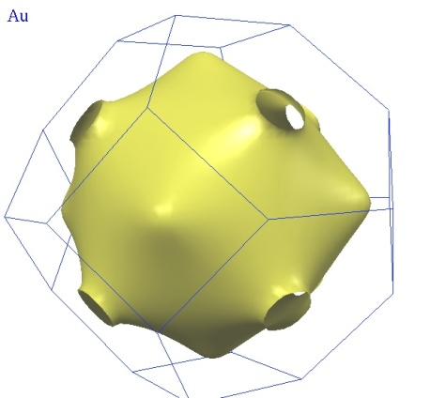
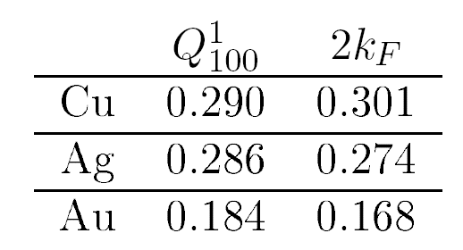
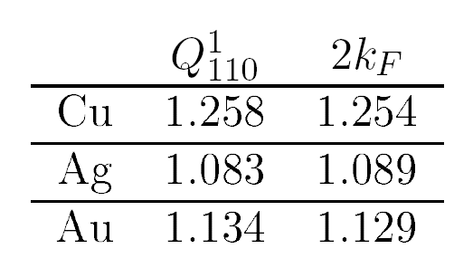
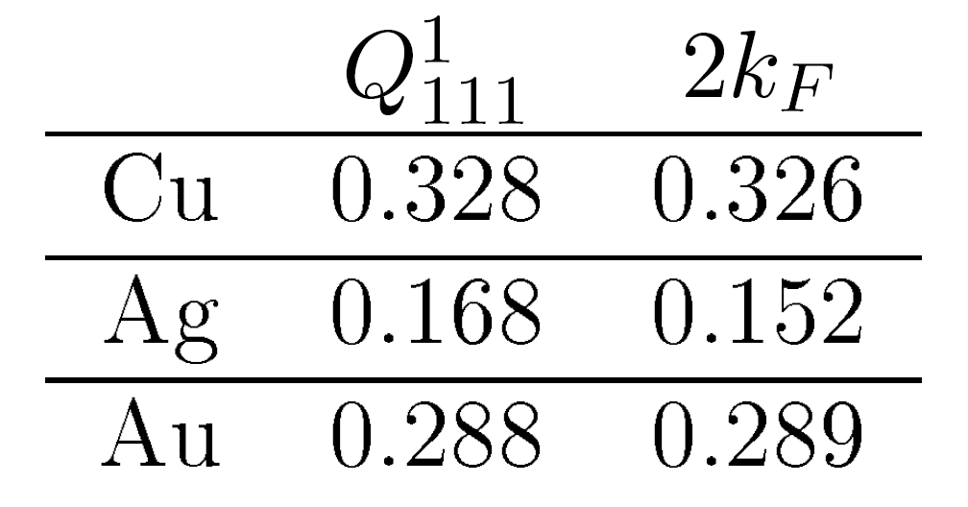
Extremal vectors and calculated periods : Co impurity in bulk

Slide 10
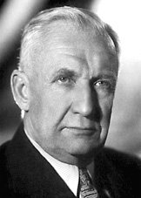
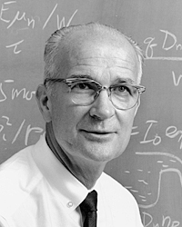
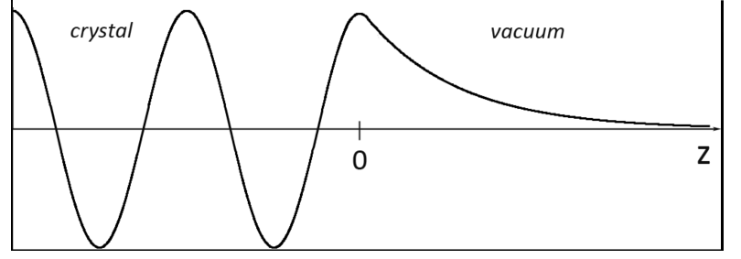
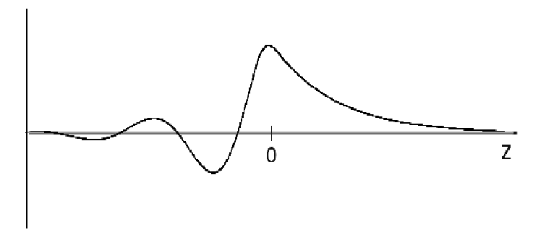
Igor E. Tamm (1895-1971)
William B. Shockley
(1910-1989)
Electrons on crystal surfaces
allowed and forbidden energy bands
basis of surface state formation
V(x)
Wave function matching at x=0:
Crystal
V(x)=V(x+na)
Vacuum
V(x)=V₀
x
x=0
(Surface)
Real ,,k”
Re [Ψ]
Two different cases:
„k” real: linear equation in tree variable (for A,B and D)
„k” complex:
the same state near the surface and in the bulk
Complex ,,k”
Re [Ψ]
MegjAppearence of a localised state near the surface
SURFACE STATE

Slide 11
Shockley type surface state
Calculated Cu bandstructure
(111)
on the (111) or (110) surfeces there is a „relative gap”
In this „relative gap” there is a state, the surface state
(111) surface state Around the Γ point
(110) surface state Around the Y pont
(100) No surface state
(110)
K
S
Γ
M
Γ

Slide 12
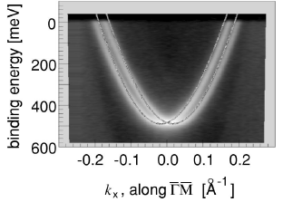
Properties of Surface States
parabolic dispersion → 2D free electron gas
The dispersion relation is calculated from the Bloch spectral function:
Maybe split due to spin-orbit coupling : Rashba – effektus
Diszpersion relation can be written as:
Can be measured
Rashba splitting is measurable on Au surfaces
Felületi Brillouin - zóna
Bloch spectral function
.
Γ
k_{x}
M
G. Nicolay, F. Reinert, S. Hüfner and P. Blaha: Phys. Rev. 65, 033407 (2001)

Slide 13
Surface state on the Au (110) surface
Local „gap” around the Y point
spin-orbit coupling (SOC) splits the free-electron-like dispersion
without SOC
with SOC
2k_{F}
splitting

Slide 14
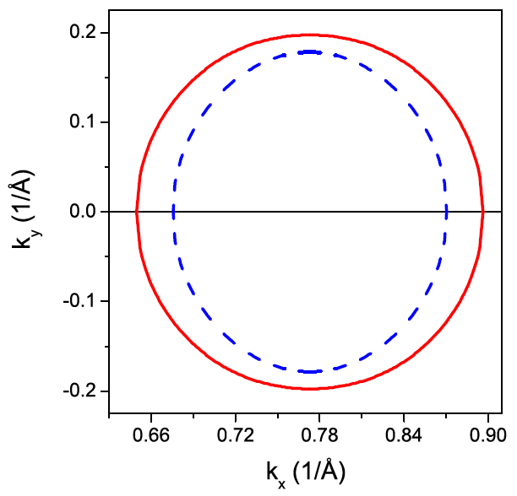
Rashba effect
In two dimensional free electron gas the Schrödinger equation is
where α_{R} is the Rashba parameter. This hamiltonian is isotropic in k
Summarize the results for Cu(110) and Au(110) surface in the two directions:
The Rashba parameter is about 5 times bigger in the x direction than in the y direction
in x direction
in y direction
 | m*/m_{e} | α_{R} | m*/m_{e} | α_{R}
Au(111) | 0.19 | 0.57 | 0.19 | 0.57
Au(110) | 0.11 | 0.8 | 0.32 | 0.17

Slide 15
kp perturbation theory for the surface states
Let us construct a perturbation theory for the surface states :
Bloch states on the Au(110) surface :
Where should satisfy:
Where the effective spin-orbit interaction can be written as :
(1)

Slide 16

Ha k=0 és 0:
Az pontban az irreducibilis ábrázolások :
A kp perturbációszámításban másodrendig elmenve (és a SOC kölcsönhatást elhanyagolva :

Slide 17


Perturbációszámítás az effektív SOC operator szerint:
Csak a k-ban lineáris tagokat meghagyva két tagot kapunk:
Izotróp Rashba Hamiltoni (a szokásos)
ahol
Az (1)-es képlet második tagjából származik
Anizotróp Rashba csatolás:
Ez a tag nyilvánvalóan a bulk állapotok és a felületi állapotok keveréséből ered
Az (1)-es képlet első tagjából jön be.

Slide 18


The resulting new Rasba Hamiltonian consists of two terms:
The usual isotropic Rasba term :
The new, anisotropic Rashba term:
Energy eigenvalues:
Isotropic Rasba splitting in
Au (111)
Anisotropic Rashba splitting in
Au (110)

Slide 19
Energy eigenvalues

Slide 20
Properties of Surface States
We obtained good agreement with experiments for SS parameters in the case of (111) surfaces
Calculation includes layer relaxations
Experiment
F. Reinert et all. Phys. Rev. 63, 115415 (2000)
Calculation
 | m*/m_{e} | k_{F}[Å⁻¹] |  | m*/m_{e} | k_{F}[Å⁻¹]
Ag | 0.397 | 0.080 |  | 0.423 | 0.086
Au | 0.255 | 0.167/0.192 |  | 0.242 | 0.152/0.195
Cu | 0.412 | 0.215 |  | 0.377 | 0.207
d_{réteg}

Slide 21
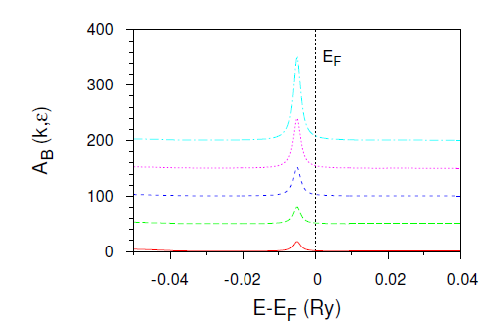
Consequences of surface states
Does the surface states effect interactions between impurities?
Solvable theory: Embedding of two magnetic impurities in 2D free electron gas
V. I. Litvinov and V. K. Dugaev: Phys. Rev. 58, 3584 (1998)
Asimptotically decays like 1/R²
2k_{F} Comes from the surface state
2k_{F}
splitting

Slide 22
Exchange interaction on (111) surface
Fcc(111) view from above:
x-direction
ΔE_{x} (μeV)
ΔE_{x} (μeV)
Cu
Au
d(a₀)
d(a₀)
Cu, Au: oscillatory interaction decays like 1/x²
2D nearly-free-electron gas determines the frequency on surface
Two frequencies

Slide 23
Rashba-splitting of Au(111)
Exchange with SOC
Exchange without SOC
ΔE_{x} (μeV)
ΔE_{x} (μeV)
d(a₀)
d(a₀)
2k_{F}¹ and 2k_{F}² from Rashba splitting
Exchange interaction includes two frequencies
Without SOC, no Rashba-splitting, only one frequency

Slide 24
Dispersion relations and properties of (110) surface state
Only C2v symmetry around the Y point → Dispersion relation depends on the direction
X
S
Y
Y → S
Γ
Cu
Au
X
S
Y
Γ
Γ → Y
Cu
Au
Cu: Very small splitting in both directions
Au: In Y→ S direction there is bigger splitting than in Γ→Y direction

Slide 25
Exchange interaction on (110) surface
y-direction
x-direction
ΔE_{x} (μeV)
ΔE_{x} (μeV)
Cu
Cu
d(a₀)
d(a₀)
ΔE_{x} (μeV)
ΔE_{x} (μeV)
Au
Au
d(a₀)
d(a₀)

Slide 26
Exchange interaction on (100) surface
Fcc(100) view from above:
x-direction
ΔE_{x} (meV)
ΔE_{x} (meV)
Cu
Au
d(a₀)
d(a₀)
Surface state is above the fermi level
Interaction exponetially decays for both hosts

Slide 27
Exchange between bulk and top in case of Cu(100)
Cu(100)
On top
On top
S
S
S-1
Q²₍₁₁₀₎
ΔE_{x} (meV)
S-2
In bulk
Under the top there is RKKY exchange with a new frequency
From top to bulk the frequency of exchange increases
Also, the amplitude increases from top to bulk
In bulk
Q¹₍₁₁₀₎
d(a₀)

Slide 28


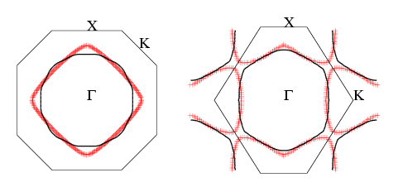
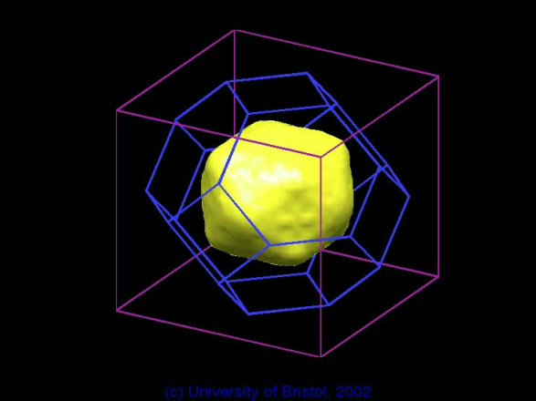
Exchange interaction surfaces of random substitutional alloys
CuAu Similar fermi surfaces, there is a neck: expecting surface state for all concentrations
CuPd Very different fermi surfaces
Positron annihilation experiments
(Phys. Rev. Lett. 87, 216401 (2001) )
KKR-CPA calculations
(Phys. Rev. Lett. 50 374 (1983))

Slide 29
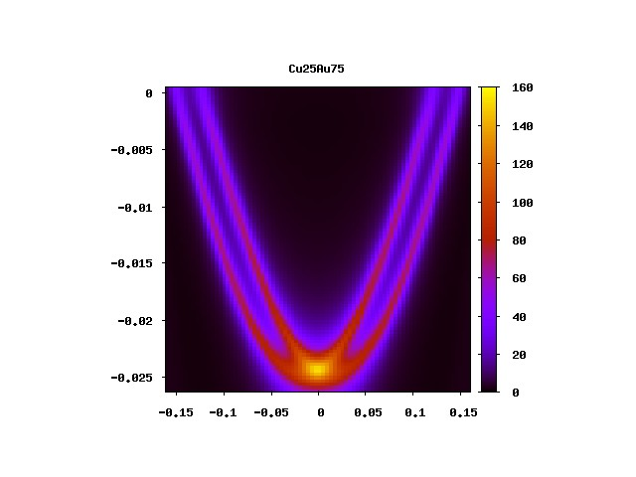
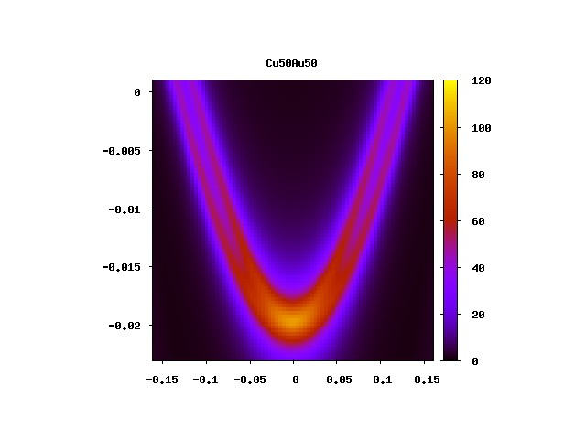
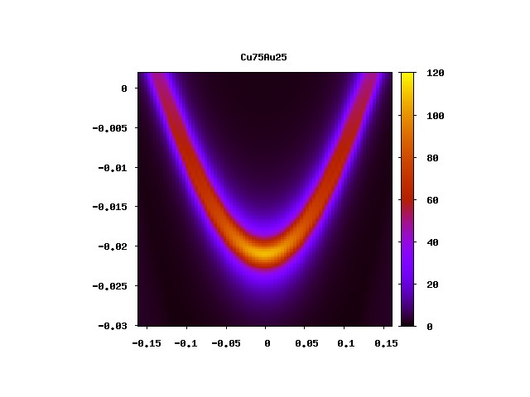
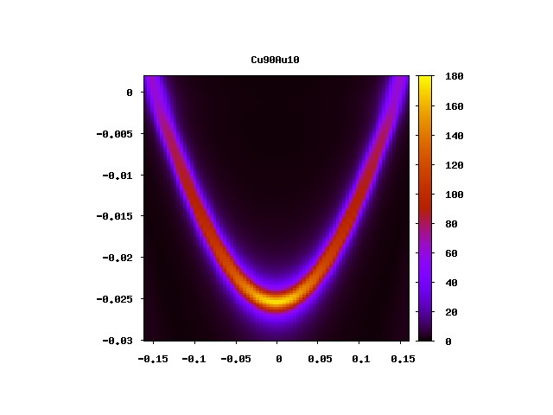
Surface state in CuAu random alloys: Scaling the spin-orbit coupling
Cu₂₅Au₇₅
Cu₅₀Au₅₀
Cu₇₅Au₂₅
Cu₉₀Au₁₀
E-E_{F}
k

Slide 30
Exchange interaction on Cu_{x}Au_{(1-x)}

Slide 31
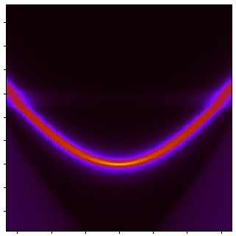
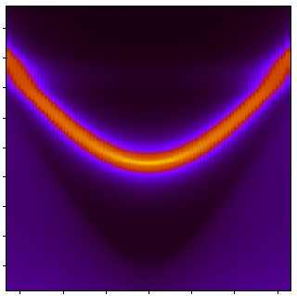
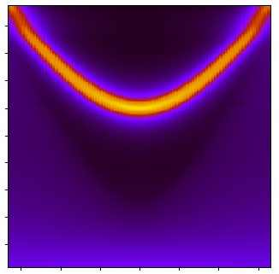
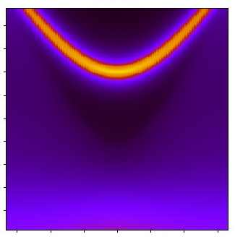
Changing the Fermi surface, changing the surface state : Cu_{(1-x)}Pd_{x}(111)
Ast the Pd concentration increases, the L-gap closes, the surface state disappears.
E-E_{F}
Cu₉₅Pd₅
Cu₈₅Pd₁₅
Cu₇₅Pd₂₅
Cu₆₅Pd₃₅
k
k
k
k
Increase in smearing due to increase of disorder
Shifting upwards : 2k_{F} becomes shorter → frequency decreases, wavelenght increases

Slide 32
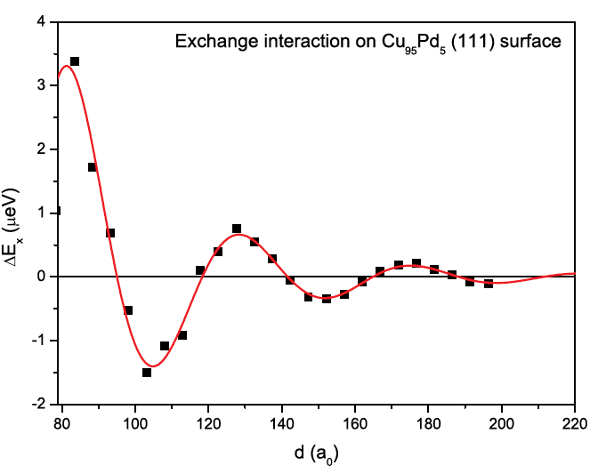
Changing the Fermi surface, changing the surface state,
changing the exchange coupling
Can be fitted with the function
Similarly to Interlayer Exchange Coupling across CuPd spacer discussed by
Holmström et al (PRB 70, 064408 (2004)
There is an exponential decay due to disorder
There is an oscillatory part due to the surface state
As the gap closes, the wavelenght of the oscillations becames larger and finally dies

Slide 33
Summary
Oscillatory interaction between magnetic impurities are mediated by the surface states
  No surface state, no oscillation
  Rashba-split surface state → two frequences
  Alloying effects
  Diappearance of surface state kills oscillatory interaction

Slide 34
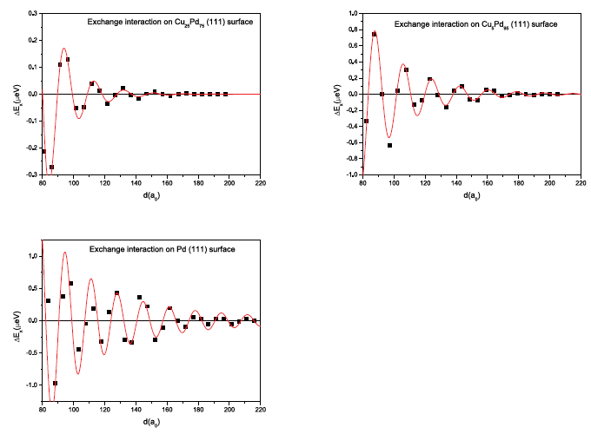
Do you think you understood something?
By increasing the Pd concentration the oscillatory exchange reappears!
Pd₇₅
Pd₉₅
Pd

Slide 35
Origin of the interaction?
There are clues:
It can not be a surface state
Decay can be better fitted with a 1/d³ function
Frequency is that of bulk Pd
Magnetic impurities induce significant moments very far from the impurity in Pd and Pt.
Can it be RKKY in the bulk between the induced momets?

Slide 36
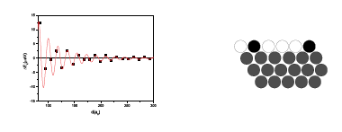

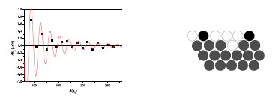
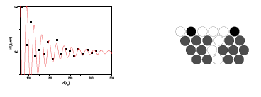
Computer experiment: Let’s try to separate them!
No separation
Separated by a 1 layer deep valley
Separated by a 3 layer deep valley

Slide 37
Conclusion
We showed that the asymptotic limit of the exchange interaction on surfaces are connected to the surface states
The large Rashba splitting on Au results in a doubling of the oscillation frequencies
Alloying Au by Cu allows constantly tuning the Rashba splitting
Alloying Cu with Pd removes the surface state and consequently kills the oscillatory exchange
Oscillatory exchange reappears in the Pd rich end : possible reason is bulk RKKY of induced moment clouds.

Slide 38
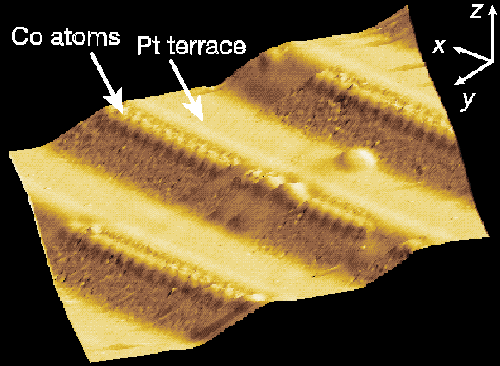
Magnetic structure of finite nanoparticles
Co-chains at a Pt(111) step edge
Experiment: P. Gambardella et al., Nature 416, 301–304
  STM image
  XMCD → magnetic moment is canted towards the step
easy axis
hard axis
θ
θ_{Expt}=43º
Is canted magnetism (uniquely) related to the step-edge geometry?
Can first principles spin dynamics (accurately) reproduce this magnetic state?
t=1

Slide 39
First principles spin dynamics
Orientational State
Adiabatic decoupling of fast motion of electrons and slow motion of spins time-independent LSDA
Rigid Spin Approximation M_{i} = M_{i} e_{i}
Interaction with thermal bath (friction)
Equation of motion for spin-magnetization:
“Ab initio Description of Spin Dynamics in Magnets” V. P. Antropov et al. PRL 75, 729 (1995), Phys. Rev. B54, 1019, (1996)
“Adiabatic Dynamics of Local Spin Moments in Itinerant Magnets” Q. Niu, et al. PRL 83, 207 (1999).
“Spin Currents and Spin Dynamics in Time-Dependent Density-Functional Theory”, K. Capelle, et al., PRL 87, 206403 (2001)
Needed: LSDA for a general non-collinear constrained state

Slide 40
Constrained DFT
P.H. Dederichs et al., PRL 53, 2512 (1984)
G.M. Stocks et al., Phil. Mag. B 78, 665 (1998)
B. Újfalussy et al., JAP 85, 4824 (1999)
Constraint
  Local magnetization along local orientation e_{i}
Constraining field
  Transverse to internal exchange/correlation field
  Effective potential in spin-space
  Iterative algorithm for constraining field
Non-collinear

Slide 41
Magnetic structure of finite nanoparticles
Co-chains at a Pt(111) step edge
Experiment: P. Gambardella et al., Nature 416, 301–304
  STM image
  XMCD → magnetic moment is canted towards the step
easy axis
hard axis
θ
θ_{Expt}=43º
Is canted magnetism (uniquely) related to the step-edge geometry?
Can first principles spin dynamics (accurately) reproduce this magnetic state?
t=1

Slide 42
Canted magnetism of a linear atomic chain
Model geometry
fcc(111) surface
chain along the x axis
Consider ferromagnetic system with magnetization
Note:
φ = 90º (yz) plane
φ = 0º (xz) plane

Slide 43
Symmetry principle: R symmetry operation of the lattice
fcc(111) surface only one independent second order invariant polynomial: z²
( C_{3v} )
(K₂: second order anisotropy constant)
The easy axis is either parallel or normal to the surface.
fcc(111) surface with a linear atomic chain along the x axis (yz) mirror plane
independent second order invariant polynomials:
The easy axis is either parallel or normal to the mirror plane.

Slide 44
Ground state
a)
perpendicular to the wire
b)
parallel to the wire

Slide 45
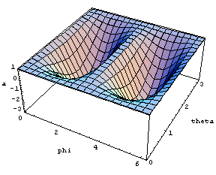
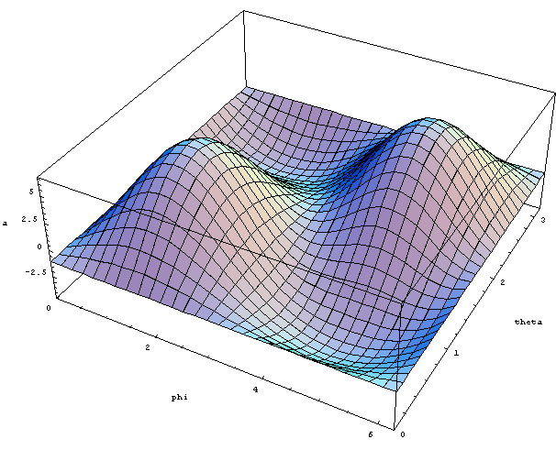
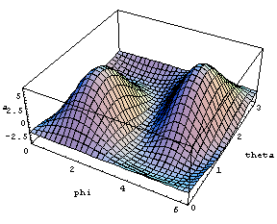
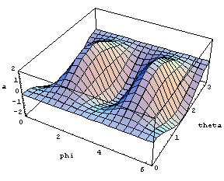
Ε
Ε
θ
θ
φ
φ
Continuous degeneration
Ε
Ε
θ
θ
θ
φ
φ
φ

Slide 46
Toy model: Fe dimer on Cu(111)
SD calculations damping only time step τ = 1/λ
θ(Fe₁)= θ(Fe₂)
φ(Fe₁)+ φ(Fe₂)=π
66.8º
13.1º
0.73º
on the surface (first vacuum layer, S+1)
in the surface (surface layer, S)
under the surface (subsurface layer, S-1)

Slide 47
Magnetic Force Theorem calculations (from SD ground state)
Energy map of the ferromagnetic state
S+1
S-1
S
Anisotropy constants (meV)
layer | K_{2,1} | K_{2,2} | K_{2,3} | θ | θ_{SD}
S+1 | -0.51 | -0.39 | -0.003 | 0.083º | 0.73º
S | -0.18 | 0.23 | -0.079 | 62.0º | 66.8º
S-1 | -0.21 | 0.10 | -0.065 | 15.7º | 13.1º

Slide 48
Co-chain at a Pt(111) step edge
Model geometry
  7 Co atoms embedded into a ‘cavity’ of the Pt(111) surface layer
Side-view
Empty site
Top-view
Pt
Co

Slide 49
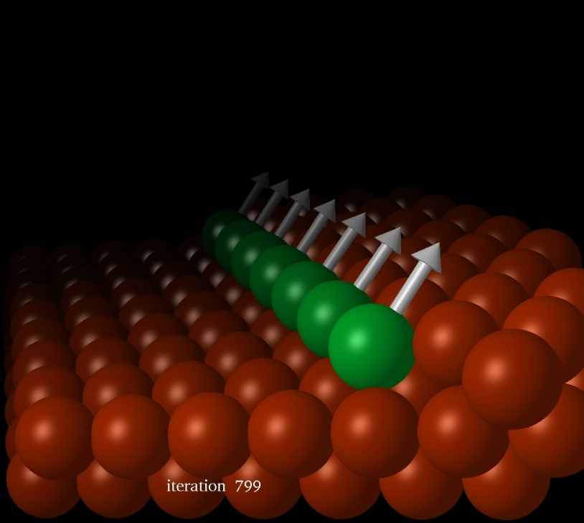
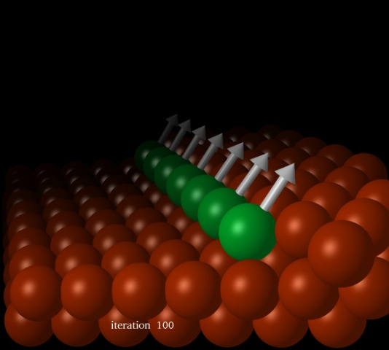
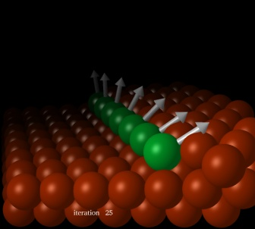
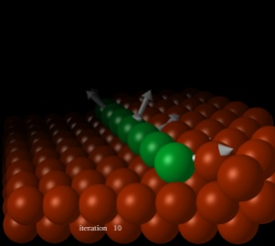
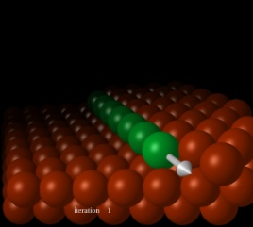
First principles spin-dynamics
t=800
θ_{Calc}=42º
t=100
t=25
t=10
t=1
Full convergence in about 800 time steps
  Nearly ferromagnetic state with θ = 42º and φ = 90º

Slide 50
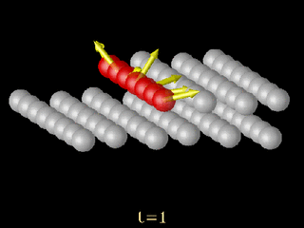
SD simulation
(start with random configuration)

Slide 51
SCF spin- and orbital moments
atom | Spin | moment | Orbital | moment
 | μ_{B} | θ (deg) | μ_{B} | θ (deg)
1 | 2.23 | 41.1 | 0.25 | 39.1
2 | 2.18 | 42.5 | 0.20 | 41.5
3 | 2.18 | 42.3 | 0.19 | 40.1
4 | 2.18 | 42.4 | 0.20 | 41.3
5 | 2.18 | 42.3 | 0.19 | 40.2
6 | 2.18 | 42.5 | 0.20 | 41.5
7 | 2.23 | 41.1 | 0.25 | 39.1
Pronounced devation from collinear arrangement at the edges of the wire!

Slide 52
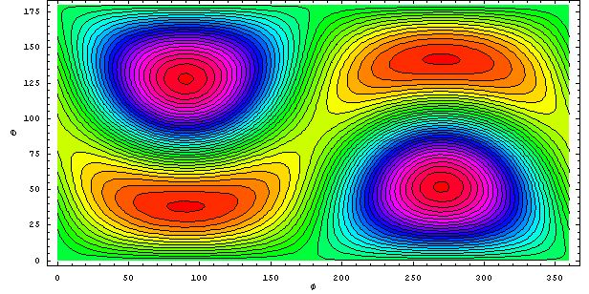
Magnetic Force Theorem calculations: all moments parallel
Easy axis : θ = 38º φ = 90º , hard axis : θ = -52º φ = 90º
Anisotropy energy: E_{a} = 1.42 meV / Co atom ~ 16.5 K
(experiment : ~15 Co atoms, 2 meV / Co atom, T_{B}=15 K)
Metastable state : θ = 90º φ = 0º , ΔE = 0.33 meV / Co atom ~ 3.8K

Slide 53
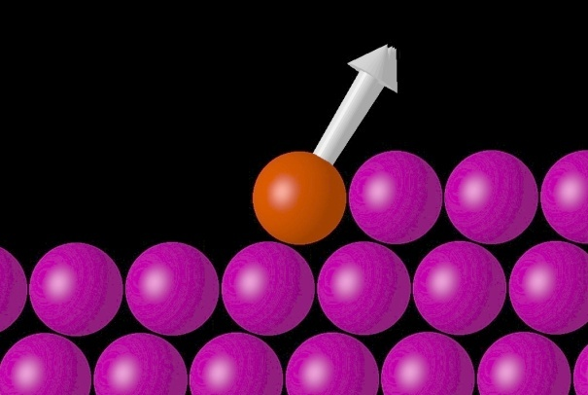
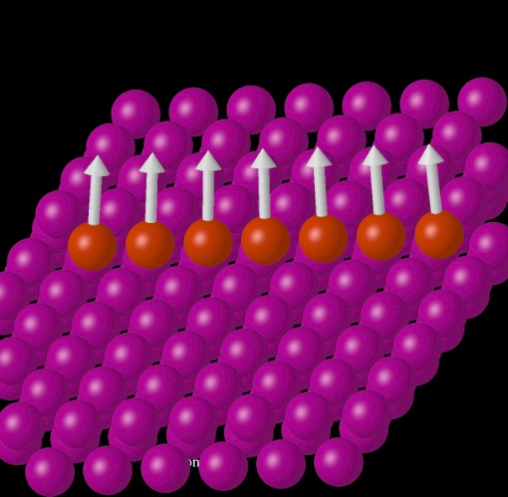
Fe-chain at a Pt(111) step edge
1 31.0879 80.8598
2 32.6039 84.3801
3 33.2840 86.6254
4 34.0533 89.9915
5 33.2865 93.3563
6 32.6105 95.5974
7 31.0936 99.1148
Origin of departure from ferromagnetic alignment?
  Site-dependent anisotropy
  Tensor exchange

Slide 54
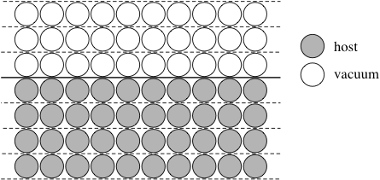
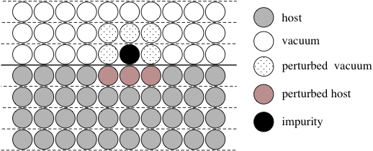
The Embedded Cluster Method
SKKR for surfaces/interfaces
Green’s function embedding for finite clusters

