Slide 1


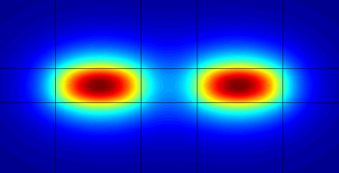
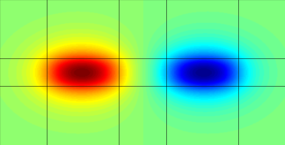
Introduction to Waveguide Optics
Jiří Čtyroký
ctyroky@ufe.cz
Institute of Photonics and Electronics AS CR, v.v.i.,
Prague, Czech Republic

Slide 2
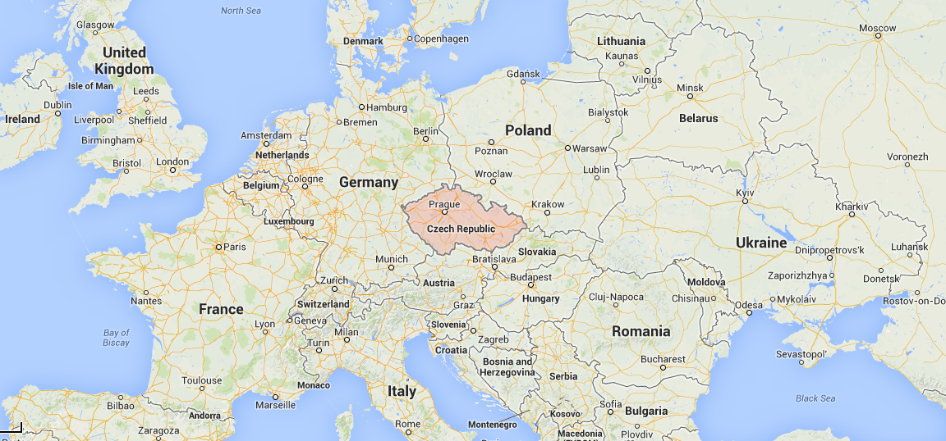

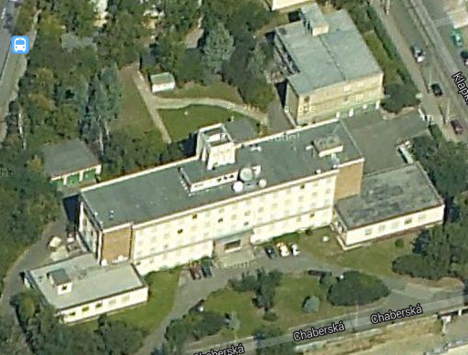
Where I come from…
Institute of Photonics
and Electronics AS CR, v.v.i.
Academy of Sciences of the Czech Republic is a non-university institution for basic and applied research consisting of 54 independent institutes

Slide 3
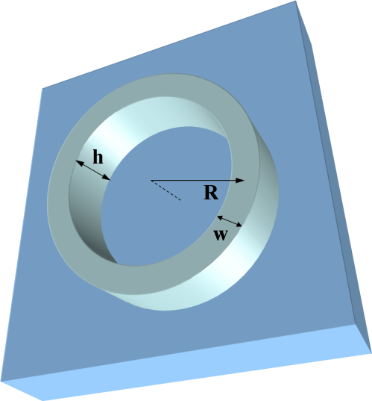
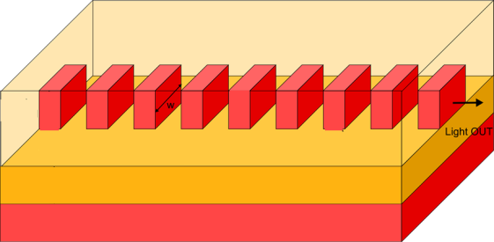
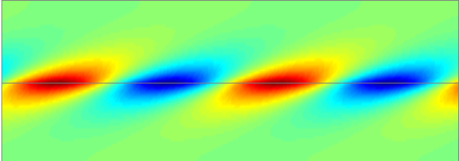
Examples of waveguide structures
optical fibre
channel optical waveguide
“ARROW”
(antiresonant reflecting OW)
longitudinally uniform
microring
resonator
plasmonic waveguide
angularly
uniform
metal
subwavelength grating waveguide
photonic crystal
waveguide
“gain/loss” waveguide
loss
gain
longitudinally
periodic
etc…
optická vlákna

Slide 4
Theoretical fundamentals of optical waveguides
Tentative list of topics
Planar waveguides; waveguide modes, their properties. Guided and leaky modes.
Other types of waveguiding, guiding by a single interface
Waveguide bends, whispering-gallery modes, circular resonators
Channel waveguides, approximate analytical methods.
More complex waveguide structures. Fundamentals of a rigorous coupled-mode theory
Introduction to modal methods; transfer matrix method, basics of the film mode matching
Periodic media, Bloch modes, origin of the bandgap, SWG waveguides, (photonic crystals)
“Canonical” waveguide structures: Y-junctions, directional coupler, two- and multimode
interference couplers, microresonators
Plasmonic waveguides and structures. Surface plasmon sensing. Hybrid dielectric-plasmonic
slot waveguide, plasmonic devices
Waveguide structures with loss and gain; asymmetric grating couplers, (“PT-symmetric”
waveguide structures)
…
Basic requirements: Theory of electromagnetic field, Maxwell equations

Slide 5
Basic math & phys background
Dielectric (possibly also metallic) non-magnetic linear source-free medium,
time-harmonic dependence of electromagnetic field:
Plane-wave solution:
complex
wave vector

Slide 6
Field at the interface between two media
Plane wave incident on a planar interface
TE polarization
TM polarization
Field continuity conditions at

Slide 7
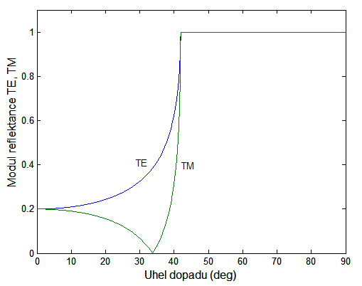
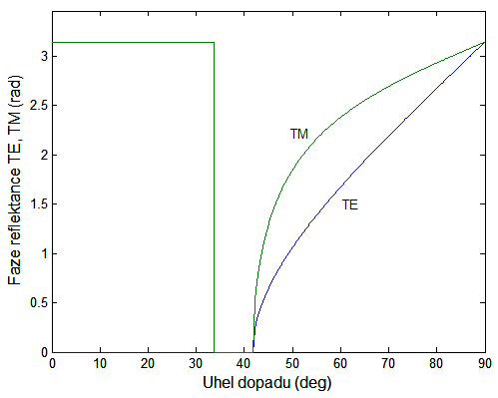
Fresnel coefficients
critical angle
total reflection
|R^{TE}|, |RTM|
arg(R^{TE}), arg(RTM)
“region of interest”
of waveguide optics
Brewster angle
Angle of incidence (deg)
Angle of incidence (deg)

Slide 8
The simplest waveguide: two (perfect) conductors
perfect conductors
Two equivalent physical pictures:
1. a series of successive reflections of a plane wave
2. two plane waves propagating upwards and downwards
In both cases, the “nonzero wave” in the waveguide can exist only under
the “condition of transverse resonance”
(for TM only)
Waves can thus propagate only as discrete waveguide modes with propagation constants
… polarization degeneracy
(except for m = 0)
The transverse field distributions have the forms

Slide 9
Dielectric slab waveguide
Total reflection at both interfaces:
Condition of transverse resonance:
or
Dispersion equation for N_{m} shows polarization birefringence,

Slide 10
Effective thickness & “period of propagation”
Total internal reflection is linked up
with the Goos-Hänchen shift,
(and a similar, somewhat more complicated expression for TM) – effective thickness
… “period of propagation”
These “ray-optic concepts” are useful also for inherently “wave-optic” phenomenon of optical waveguiding.

Slide 11
Dispersion diagram (examples)
Asymmetric waveguide
All modes exhibit cut-off
Symmetric waveguide
Number of TE and TM modes identical,
TE₀ and TM₀ always exist

Slide 12
Distribution of modes of a slab waveguide

Slide 13
Electromagnetic theory of a slab waveguide
Planar waveguide as a structure with 1D permittivty distribution:
1. TE polarization:
2. TM polarization:
Eigenmode field:
Eigenvalue equations for eigenfunctions and eigenvalues

Slide 14
Analogy between a planar waveguide
and a potential well in quantum mechanics
Field equation for a TE mode
in a planar waveguide
Schrödinger equation for a particle
in a potential well
There is not such an exact analogy
for TM polarization, but its behaviour
is very similar
guided modes
substrate mode
free particle
reflection from
the potential barrier
radiation mode
bound states

Slide 15
Guiding of optical radiation in a dielectric waveguide
guided
mode
substrate
mode
superstrate
mode
guided mode
“substrate” mode
Guided modes:
radiation mode
Radiation (substrate) modes:
Radiation modes (superstrate):

Slide 16
Orthogonality of eigenmodes
It can be shown that fields of guided modes (from the discrete spectrum) are orthogonal,
For radiation and evanescent modes, the orthogonality condition sounds
(in the sense
of the principal value
of the integral)
Radiation and evanescent modes are always orthogonal to discrete guided modes:
For lossless waveguides,
of guided modes are real, and thus
(Only) in this case, eigenmodes are also power-orthogonal:
power carried by a superposition of (guided and non-evanescent radiation) modes
is given by the sum of powers of individual modes

Slide 17
Leaky modes
Leaky modes are not “true” eigenmodes of the waveguide structure but often allow for
a simple description and physically understandable interpretation of wave propagation
in waveguide structures with (weak) radiation loss
SOI planar waveguide
radiating into the Si wafer
Waveguide with coupling grating
as a leaky-mode structure
…“frustrated” reflection coefficient ,
tunelling
“Standard” dispersion relation
(transverse resonance condition)
SOI waveguide supports only leaky modes with complex effective indices,

Slide 18
Another type of waveguiding – ARROW
Bragg grating (“1D photonic crystal”)
waveguiding layer (“defect in the photonic crystal”)
Bragg grating (“1D photonic crystal”)
Antiresonant reflecting optical waveguide – ARROW)
Differences between an ARROW and a conventional index-guiding waveguide
refractive index of the guiding layer can be lower than those of the grating
the gratings must operate in the Bragg regime
(the 1D photonic crystal has to exhibit a bandgap)
theoretically, ARROW with lower index guiding layer supports only leaky modes;
the number of periods has to be sufficient to suppress power leakage
through the grating
M. A. Duguay et al., Appl. Phys. Lett. vol. 49, 13, 1986.

Slide 19
Another type of waveguiding – ARROW
Bragg grating (“1D photonic crystal”)
waveguiding layer (“defect in the photonic crystal”)
Bragg grating (“1D photonic crystal”)
Antiresonant reflecting optical waveguide – ARROW)
Differences between an ARROW and a conventional index-guiding waveguide
refractive index of the guiding layer can be lower than those of the grating
the gratings must operate in the Bragg regime
(the 1D photonic crystal has to exhibit a bandgap)
theoretically, ARROW with lower index guiding layer supports only leaky modes;
the number of periods has to be sufficient to suppress power leakage
through the grating
M. A. Duguay et al., Appl. Phys. Lett. vol. 49, 13, 1986.

Slide 20
Guiding by a single interface
Are two interfaces essential for waveguiding? (Typically yes, but…)
Pole of the reflection coefficient: possible only for TM polarization
Wave is confined if
1. Surface plasmon-polariton at dielectric-metal interface
Supported if
power
flow
2. Interface between media with a balance of loss and gain
power
flow
3. Zenneck wave at the interface of a lossy and lossless media (1907)

Slide 21
Circularly bent waveguide
Straight waveguide:
Bent waveguide:
Conformal mapping:
Transformed equation:
M. Heiblum and J. H. Harris, IEEE JQE, vol. QE-11, pp. 75-83, 1975.
„whispering
gallery“ mode
optical
tunelling
internal interface
“not necessary”
Very large radius
bent guide
strong bend

Slide 22
Ring resonator, or bent waveguide?
Polarization:
Helmholz equation:
Separation of variables:
angular propagation constant
Bessel equation
Field continuity conditions: continuous at :
(We are not going to solve this equation!)

Slide 23
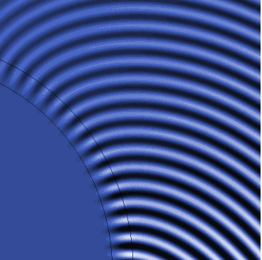
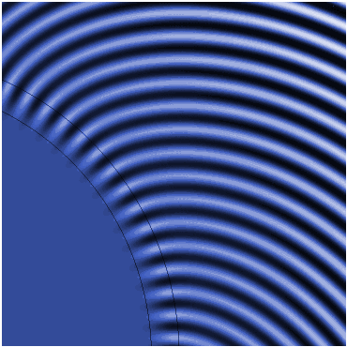
Ring resonator, or bent waveguide?
Dispersion equation:
Frequency introduced “on purpose”
We have two basic possibilities how to proceed:
fix and seek for (complex) azimuthal propagation constant for a bent waveguide, or
fix (as an integer) and seek for (complex) resonant frequency of a ring resonator.
bent waveguide
ring resonator

Slide 24
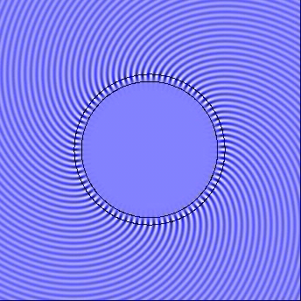
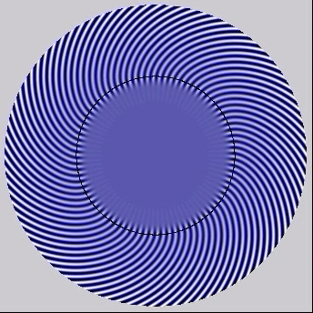
Examples of field distributions
(Lossy) resonators
ring
disk
Eigenmodes of dielectric resonators are leaky modes!

Slide 25
Channel waveguides
General considerations: vector equation
Let’s separate transversal and longitudinal field components of an eigenmode:
We obtain a 2D eigenvalue equation
Modes of channel waveguides are hybrid – all field components are generally nonzero
Weakly guiding waveguide: term is negligibly small; then
…essentially scalar equation, small.

Slide 26
E.A.J. Marcatili, Bell System Tech Journal 48, 2071-2102, 1969
Marcatili method – separation of variables
A very simple approximate mode solving method for 2D waveguides
Approximation of weak guiding,
Simple solution if the profile were separable:
Then , and
Subtracting from the permittivity in the corners makes the profile separable,
The task is reduced to solving 2 simple 1D equations, but results close to cut-off are questionable.

Slide 27
Effective-index method for 2D profile
Semi-intuitive method – reduction to a 1D problem
planar waveguide with a vertical profile,
effective index N₁ and mode field e₁(x)
planar waveguide with a vertical profile,
effective index N₂ and mode field e₂(x)
planar waveguide with a vertical profile,
effective index N₃ and mode field e₃(x)
„planar“ waveguide with a lateral profile
N₁ , N₂, N₃ and the field e₄(y)
The total field is approximately given by the product e(x,y)  e₂(x)e₄(x).
Advantage: simplicity, clear physical interpretation.
Disadvantage: inaccurate near cut-off, accuracy difficult to assess;
Well-applicable to shallow ridges and diffused channel waveguides,
in many other cases very useful as a first guess. Commonly used method.

Slide 28
Effective-index method for diffused channel waveguides
Efficient approximate method based on physical intuition.
Suitable for graded-index waveguides and complex structures
Weak guiding, lateral dependence weaker:
Non-separable, but let us try
where “the strong” y-dependence is concentrated in :
is a parameter
Then we solve this equation for several values of and get as an effective lateral profile.
In the next step, we solve the “lateral equation” to get and
What if there is no guided mode for some ? Take the substrate value instead of

Slide 29
More complex waveguide structures:
“rigorous” formulation of the coupled-mode theory
Wave propagation in the permittivity distribution can be analyzed using the completeness
and orthogonality of the eigenmodes of a waveguide with the permittivity profile
Eigenmode fields:
Mode orthogonality:
Wave in can be expressed as
From Maxwell equations we get the set of first order linear equations for complex amplitudes,
D. Marcuse, Theory of dielectric optical waveguides, 2nd ed. Academic Press, 1991

Slide 30
Slowly varying amplitudes
The coupling constants are given by overlap integrals
Introducing slowly varying amplitudes we obtain

Slide 31
First-order (Born) approximation
Let us formally integrate the set of equations:
Supposing slow variation of amplitudes and for small z
The integrals are “importantly non-zero” only if the integrands do not rapidly oscillate.
Thus, if K is slowly vaying, the modes with close propagation constants are strongly coupled .
Coupling of modes with significantly different β’s requires that this difference is compensated
by rapidly varying K(z).

Slide 32
Two simple applications
1. Coupling of two forward modes
Let us preserve only “slow” terms satisfying the phase-matching condition:
For slowly-varying amplitudes w can approximately take
Next, we will apply the Taylor expansion for and take only the first two terms:
We define the “transmission coefficient” from mode to mode and get
The spectral dependence of the “transmission coefficient” is approximately given
by the Fourier expansion of the spatial dependence of the coupling constant.

Slide 33
Waveguide Bragg grating mirror
2. Coupling of forward and backward modes by a waveguide grating
Coupled equations:
Boundary conditions:
Solution:
Grating reflectance:
For

Slide 34
Spectral dependence of the reflectance

Slide 35
Numerical methods for modelling waveguide structures
Three main classes of modelling methods:
Frequency-domain mode solvers for calculation of eigenmodes and propagation constants
of straight and bent uniform waveguides; 1D, 2D, approximate, “rigorous”;
scalar, semivectorial, full-vector; modal methods (Fourier modal method),
discretization-based methods like FD, FE. BE, etc.
Frequency-domain “beam propagation” methods (BPM); in principle, scattering methods
calculating optical field distribution within a waveguide structure for a given excitation field;
modal, FFT-BPM, FD-BPM, FE-BPM; 2D, 3D, scalar, full-vector;
unidirectional, bi-directional (in fact, omnidirectional), etc.
Time-domain methods (FDTD , FETD,…): numerical model of optical field generated
by a given distribution of sources. Essentially, direct numerical solution
of Maxwell equations.
… and many other special methods

Slide 36
The transfer matrix method
From Maxwell equations applied to a layer l we get
layer L
TE
layer l
TM
layer 1
Matrices are even functions of !
Transformation over the whole multilayer structure:
dispersion
equation

Slide 37
2D vectorial mode solver
Method of Lines (MoL) - requires 1D discretization, FD method
school of prof. Reinhold Pregla, Fern-Universität Hagen, Germany
Film mode matching (FMM)
(straight guides: Sudbø 1993, 1994, bent guides Prkna 2004)
Transversal refractive index distribution
piecewise constant
waveguide cross-section
Subdivide the cross-section into
laterally uniform “slices”; each slice
represents a multilayer
Find TE and TM modes of each slice
Express total field as superposition
of slice modes
Match fields at the boundaries of slices
Stable (impedance or scattering matrix)
formalism; fully vectorial solution

Slide 38
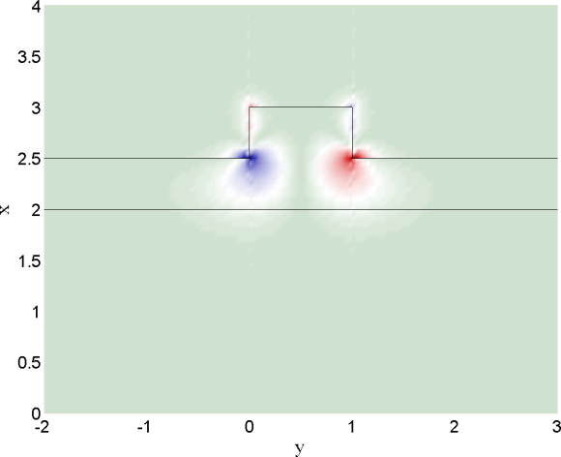
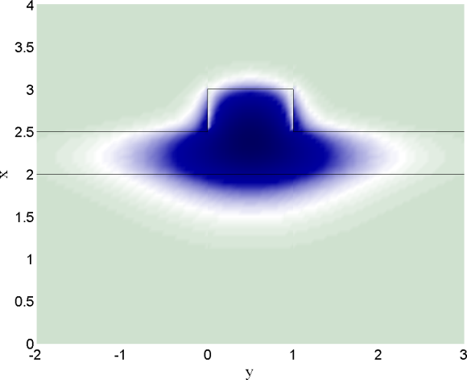
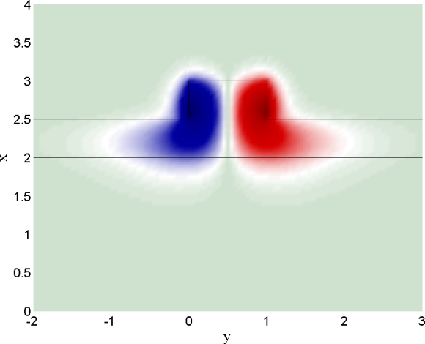
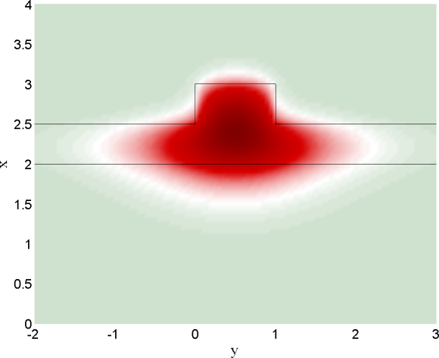
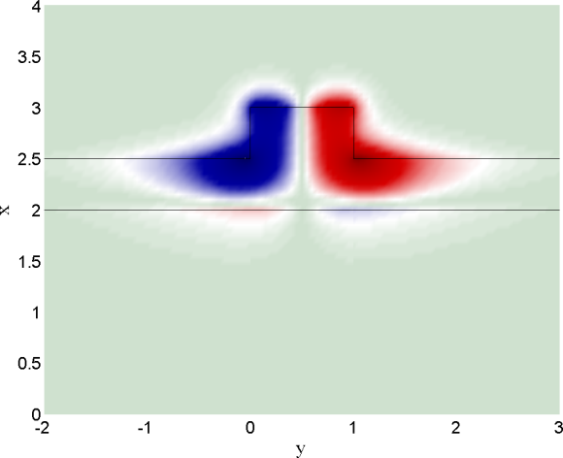
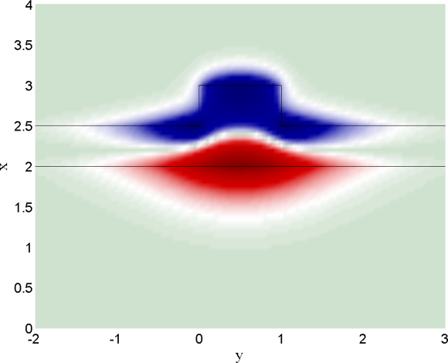
An example: quasi-TE mode of a rib waveguide

Slide 39
Film mode matching for circularly bent waveguides
L. Prkna, M. Hubalek, J. Čtyroký, IEEE Phot. Technol. Lett. vol. 16, 2057-2059 (2004).
L. Prkna et al., IEEE J. Sel. Topics in Quantum Electr. vol. 11, 217-223 (2005)
Treatment analogous to the rectangular case;
radial instead of lateral dependence.
Problem:
Cylindrical functions of complex order instead of trigonometric functions.
subdivision of the structure into radially uniform “slices”,
each “slice” forms a multilayer;
in each “slice”, mode field is expanded into TE and TM modes of a multilayer
field matching at the interfaces between “slices”.
No (or minimum) discretization
Field within the slice described analytically

Slide 40
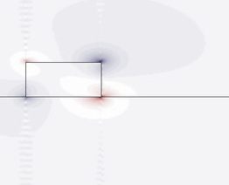
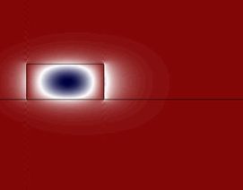
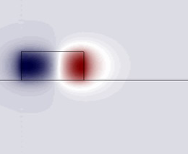
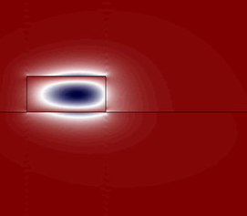
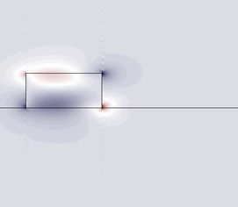
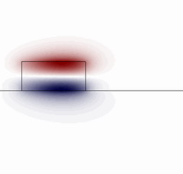

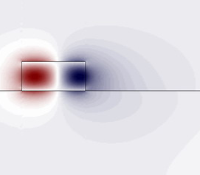
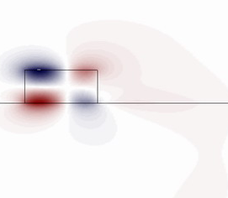
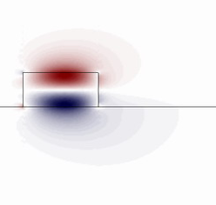
High-contrast SOI microresonator
Quasi-TE₀₀
Quasi-TM₀₀
Quasi-TM₁₀

Slide 41
Wave propagation in a periodic structure
Photonic analogy of the “Kronig – Penney” model of an electronic crystal
tangential propagation
constant (given )
longitudinal
prop. constant
TE
TM

Slide 42
Electromagnetic Floquet – Bloch modes
Transmission through layers 1 and 2 is described by matrices
The matrix for transitin over a single period is evidently
Floquet-Bloch mode is determined as an eigenfunction and eigenvector of
β^{F} is determined up to an additive constant
is the prop. const.
of the FB mode.
it is sufficient to determine β^{F} in the interval
⇒ first Brillouin zone.

Slide 43
Eigenvalues and the photonic bandgap
Let us denote
eigenvalues of the matrix
are then
FB mode is propagating only if
i.e., if
outside the bandgap,
The normalized wavenumber can be explicitly expressed as
within the bandgap
If
β^{F} is complex, the wave is attenuated, and the photonic bandgap is created.

Slide 44
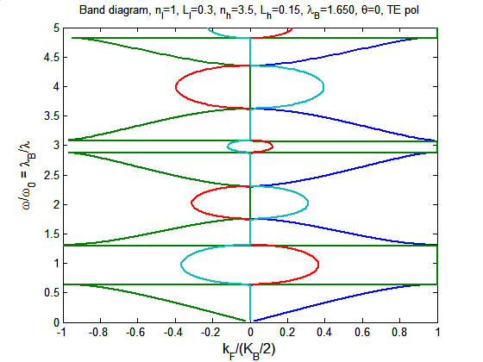
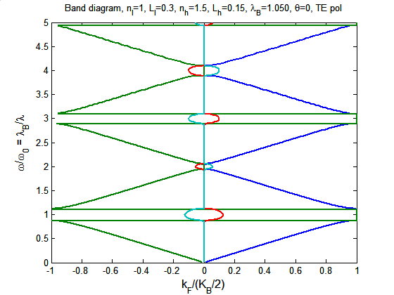
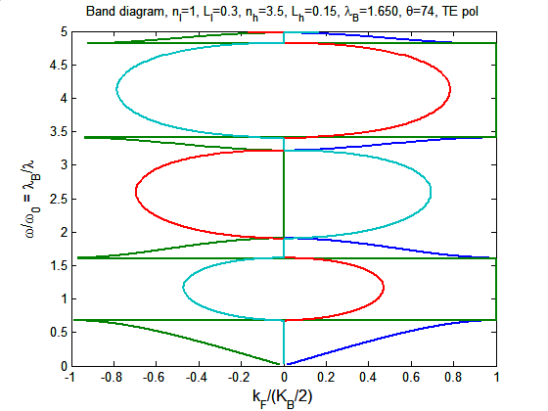
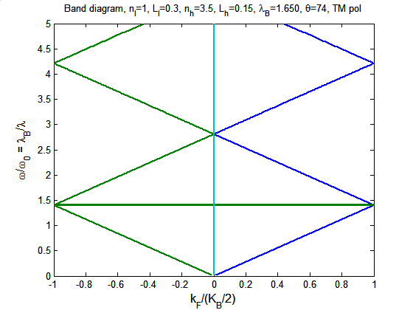
Band diagrams of a “1D crystal”
“conduction”
band
“valence”
Brewster angle
“air”
band
“dielectric”

Slide 45
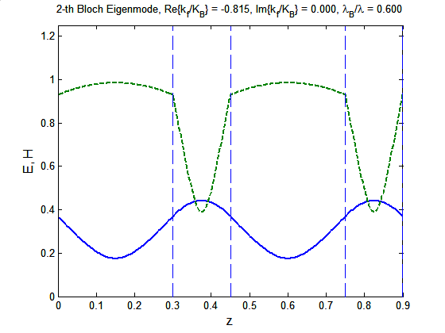
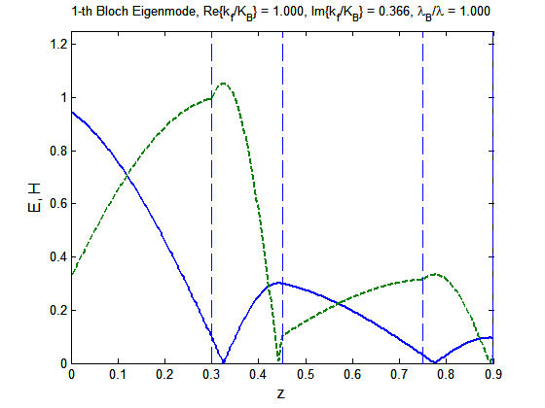
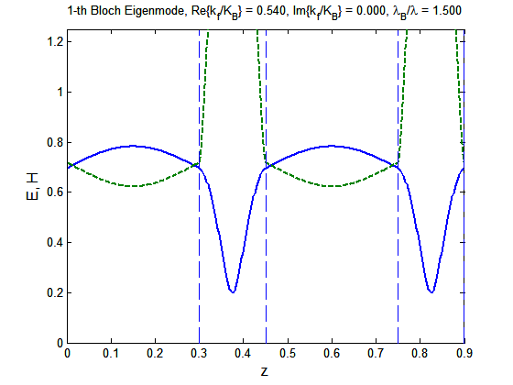
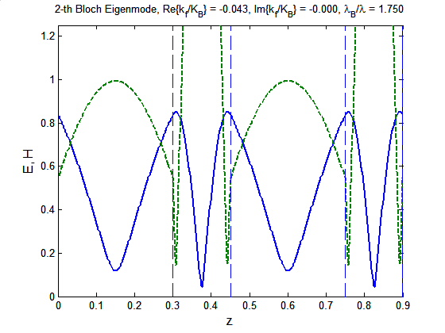
Electromagnetic Floquet – Bloch modes
“dielectr.”
band
inside
band
gap
“air”
band
near edge
of the BZ

Slide 46
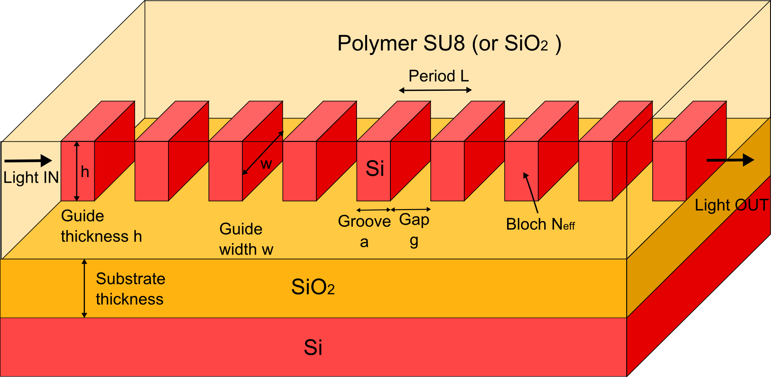
3D analogue – subwavelength grating waveguides
Propagating modes in SWGW are Bloch modes
Propagation constant and the effective refractive index
of the m-th Bloch mode:
Grating constant of the SWGW:
“First Brillouin zone” of the SWGW as a 1D photonic crystal:
For lossless propagation,
Group effective index:
In analogy with the behaviour of photonic crystals we expect that
(the “bandgap edge”)
Region of represents the slow light region

Slide 47
“Canonic” (elementary) waveguide devices

Slide 48
Elementary waveguide structures
Symmetric Y-junction (1×2 power splitter)
Excitation into the single mode common arm
Power is equally divided between the two output arms due to symmetry

Slide 49
Basic waveguide structures
Symmetric Y-junction excited in the opposite direction
2. Excitation into a single arm
The antisymmetric mode canot propagate in the single-mode
output arm and its power is radiated into the substrate

Slide 50
Basic waveguide structures
Symmetric Y-junction excited in the opposite direction
2. Excitation into a single arm
Without the second arm, the transmittance is ≤ 100 %

Slide 51
Basic waveguide structures
Symmetric Y-junction excited in the opposite direction
3. Excitation into both arms with an arbitrary phase shift between the arms

Slide 52
Asymmetric Y-junction as a mode splitter
single-mode arms
two-mode waveguide
symmetric
mode
antisymmetric
mode
Adiabatic splitter: negligibly small mode coupling along the propagation length.
The fundamental mode of the two-mode section remains “fundamental”, etc.
Criterion of asymmetry:
Since cannot be made too large, the decisive role is overtaken by θ.
Typically, for and , the Y-junction behaves “asymmetrically”,
for and , the Y-junction behaves as power splitter.

Slide 53
Application: spectrally independent 2×2 (3-dB) splitter
Symmetric Y-junction
(power divider)
Asymmetric Y-junction
(mode splitter)
Spectral bandwidth is limited by the requirements regarding the number of modes;
the input and output ports must be single-mode, the central junction double-moded.
The bandwidth 1.2 – 1.6 µm is rather easily attainable.

Slide 54
Application: spectrally independent 2×2 (3-dB) splitter
Reversed direction of propagation
AsymmetricY-junction
(mode splitter)
Symmetric Y-junction
(power divider)
Spectral bandwidth is limited by the requirements regarding the number of modes;
the input and output ports must be single-mode, the central junction double-moded.
The bandwidth 1.2 – 1.6 µm is attainable.

Slide 55
Directional coupler

Slide 56
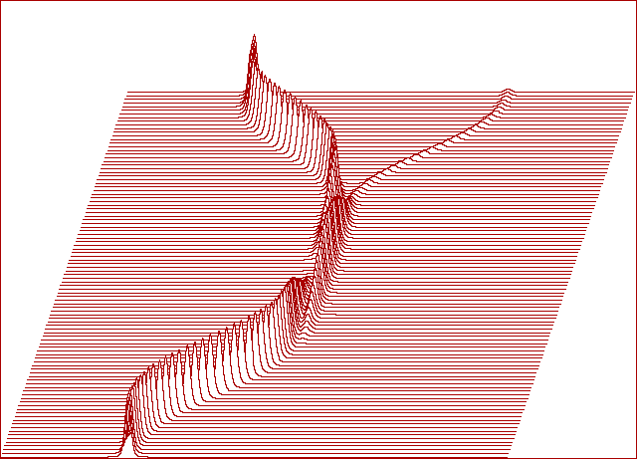
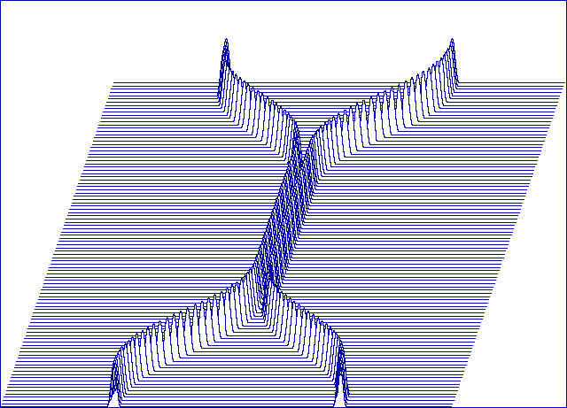
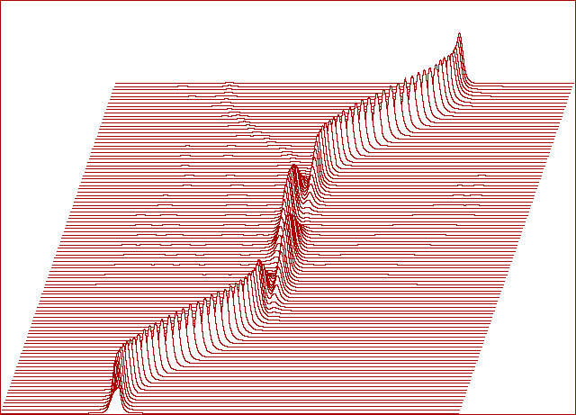
Spectral dependence of the directional coupler
Distribution of optical intensity
Refractive index profile (eff.index)
Directional coupler can be used
as a (coarse) wavelength demux

Slide 57
Coupled-mode theory of the directional coupler
- normalized field
Approximate description of the field:
Coupled-mode equations:
Power conservation condition:
Without lost of generality we choose
Boundary conditions:
Solution:

Slide 58
Two-mode interference coupler
Single-mode I/O ports,
two-mode central section
Similar to directional coupler,
shorter “transfer length” L_{t}

Slide 59
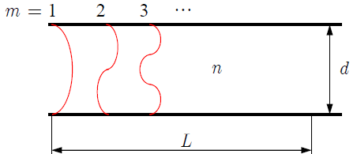
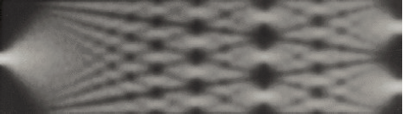
Imaging properties of an optical waveguide
Two-conductor waveguide:
Propagation constants in a multimode waveguide:
If
After propagation along a distance L , all modes meet (approximately) with the same phase.
The field distribution at z = 0 is then reproduced at z = L. At the halfway, the “image” is reversed.
(inverted image)
O. Bryngdahl and W.-H. Lee, J. Opt. Soc. Am. vol. 68, pp. 310-315, 1978.

Slide 60
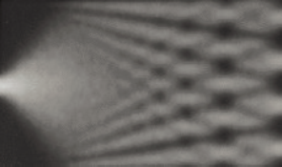
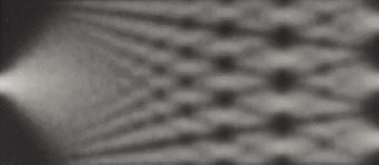
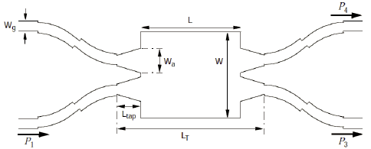
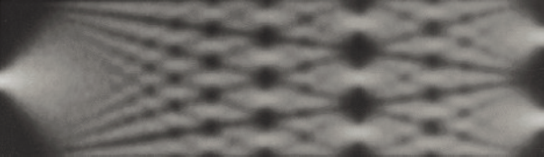
Multimode interference coupler (MMI)
Advantage:
splitters with small
footprint;
Problems:
(inverted image)
● dependence in dielectric waveguides is “less parabolic”
phase error for higher-order modes; error is larger
for higher refractive-index contrast;
● transversal spatial resolution depends on the number
of guided modes with small enough phase errors
Solution:
M.T.Hill, J. Lightwave Technol. 21, 2305-2313, 2003

Slide 61
Microring resonators
in
through
at resonance
out
in
through
microresonator
out of resonance
out
A. Driessen et al.:"Microresonators as building blocks for VLSI photonics," AIP Proceedings Vol.709, 2003.

Slide 62
Basic theory of microring resonators
(Lossless) couplers:
in
through
Ring with the perimeter and the (complex)
propagation constant :
drop
After elementary manipulations we obtain
At resonance,
Off resonance,
For minimum cross-talk,

Slide 63
Spectral properties of a microresonator
Lossless microresonator
FSR
in
intensity
through
thru
drop
drop
Resonant wavelength
frequency
Lossy microresonator
Free spectral range
intensity
thru
depends on the group index
“Finesse”
Quality factor
drop
frequency

Slide 64
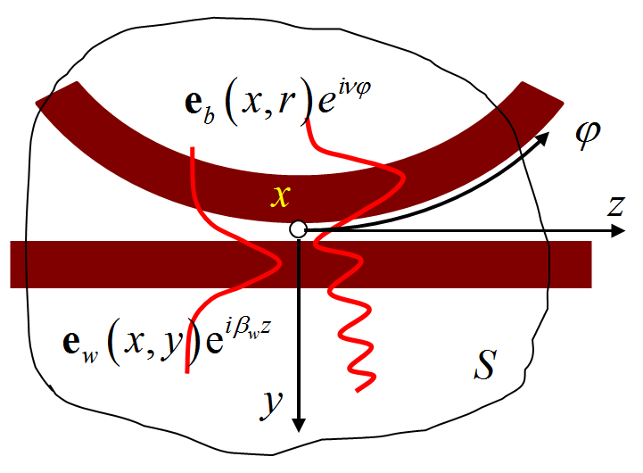
Coupling between straight and bent waveguide
Problems:
coupling between guided (lossless) and
leaky (radiating) modes
Role of the phase synchronism?
(variable relative phase velocities)
Possible approach: linear superposition of mode fields of a straight and bent waveguides:
+ application of some general theorem, e.g., Lorentz-Lorenz reciprocity theorem:
then successive multiplication by followed by surface integration over S
Finally we obtain a set of first-order coupled-mode equations for complex amplitudes
with coupling “constants” given
by overlap integrals of mode fields at .
R. Stoffer et al., Opt. Commun., vol. 256, pp. 46-67, Dec 2005.

Slide 65
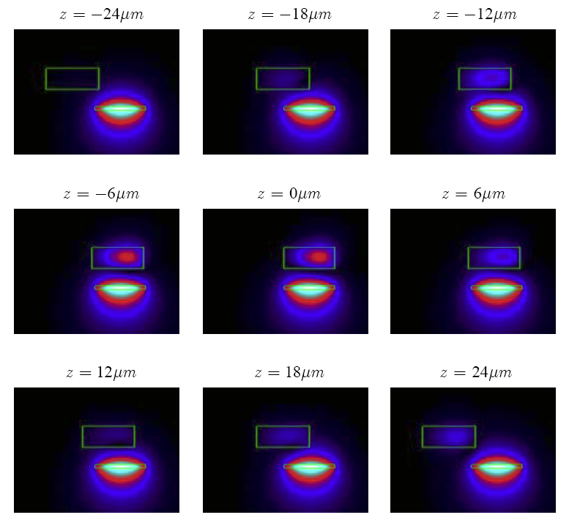
Some results of the 3D CMT for the coupling
of straight and bent waveguides
Cooperation within 6FP “NAIS”,
University of Twente & IPE AS CR
R. Stoffer, K. R. Hiremath, M. Hammer,
L. Prkna, and J. Čtyroký,
"Cylindrical integrated optical microresonators:
Modeling by 3-D vectorial coupled mode theory,“ Optics Communications, vol. 256,
pp. 46-67, Dec 2005.

Slide 66
Surface plasmons in guided-wave optics

Slide 67
Surface plasmon(-polariton)
Mutually coupled electromagnetic and charge wave
localized at the interface between a dielectric and a metal

Slide 68
Surface plasmon is a slow wave
Lossless approximation:
factor
SP is a slow wave
It cannot be excited
from the dielectric!!

Slide 69
Waveguide polarization filter based
on resonant excitation of a surface plasmon
J. Čtyroký et al., Proc.10th ECOC’84, pp. 44-45, 1984. (glass, LiNbO₃)
J. Čtyroký, H. J. Henning, Electron. Lett. vol.22, 756-757, 1986. (LiNbO₃)

Slide 70
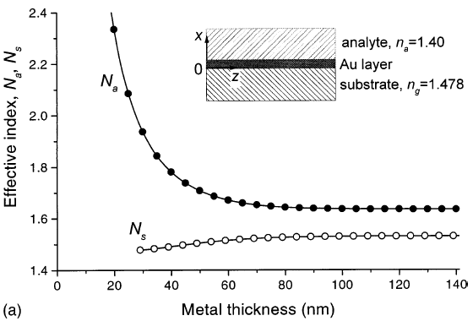
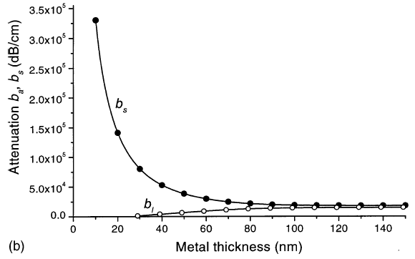
Surface plasmons on a metal layer
short-range (magn. antisymm.)
Mutually coupled surface plasmons
long-range (magn. symmetric)
Slightly asymmetric
structure
short-range
short-range
long-range
long-range
J. Čtyroký et al. : Sensors and Actuators B 54, 66–73, 1999.

Slide 71
Integrated-optic sensor
based on surface plasmon resonance

Slide 72
Field distribution in the waveguide
with a section supporting SP

Slide 73
Experimental arrangement
of a SPR integrated-optic sensor
Refractive index resolution
better than 1.2×10⁻⁶
J. Dostalek, J. Čtyroký, J. Homola et al., Sensors and Actuators B-Chemical 76, 8-12 (2001).

Slide 74

“Bulk” surface plasmon sensor
Refractive index resolution
of about 1×10⁻⁷
`

Slide 75

“Plasmonics”
(“photonics” using surface plasmons instead of photonics)
2D guiding of surface plasmons
SP enables localization of radiation well below the diffraction limit.
However, strong attenutation due to ohmic loss in metal allows for propagation at very short distances of the orders of 1-100 µm
90° bend

Slide 76

Plasmonic waveguides
Metal–dielectric interface IMI (metal film) structure MIM structures
Re(E_{y})
Re(H_{x})
Symmetric Asymmetric
Dielectrically supported Metal stripe SLOT (gap)
(=LOADED)
Low-index hybrid Wedge Channel (groove)

Slide 77







Novel types of plasmonic waveguides
PIROW – plasmonic inverted
rib optical waveguide
Hybrid dielectric-plasmonic
slot waveguide (HDPSW)
SOI “slot waveguide”
??
TE
C. Koos & al., Nat. Photonics
3(4), 16–219 (2009)
H. Benisty and M. Besbes,
J. Appl. Phys. 108(6), 063108 (2010).
H.-S. Chu & al., J. Opt. Soc. Am. B
28(12), 2895 (2011) (others, too)
R. F. Oulton & al., New J. Phys. 10,
105018 (2008)
R. F. Oulton & al., Nat. Photonics 2, 496 (2008);

Slide 78




Hybrid dielectric-plasmonic slot waveguide
Basic geometric parameters
w = 150 nm
A: d = 100 nm
B: d = 200 nm
C: d = 300 nm
D: d = 400 nm
A: d = 100 nm
w = 150 nm
A: d = 100 nm
B: d = 200 nm
w = 150 nm

Slide 79




Multimode interference coupler
1x2 MMI – simple configuration
1x2 MMI – improved configuration
3
3
1
1
2
2

Slide 80



Mach-Zehnder interferometer
“On” state
“Off” state
J. Čtyroký et al.,, JEOS-RP vol. 8, 13021-13026 (2013).

Slide 81
Waveguide structures with loss and gain
Asymmetric complex grating-assisted coupler
Basic theory:
L. Poladian, Phys. Rev. E, 54, 2963-2975, (1996).
M. Greenberg, M. Orenstein, Opt. Express, 12, 4013-4018, 2004.
M. Greenberg, M. Orenstein, Opt. Lett., 29, pp. 451-453, 2004.
M. Greenberg, M. Orenstein, IEEE JQE, 41, 1013-1023, 2005.
Application proposals:
M. Greenberg and M. Orenstein, PTL, 17, 1450-1452, 2005.
M. Kulishov et al, Optics Express, 13, 3567-3578, 2005.
Photonic analogues of quantum-mechanical “PT-symmetric” systems
First works:
H.-P. Nolting, M. Sztefka, J. Čtyroký, Proc. of IPR, Boston, 76-79, 1996.
G. Guekos, Ed., Photonic Devices for telecommunications, Springer, 1998, pp. 76-78. (“COST 240 Book”)
From the recent avalanche of papers:
R. El-Ganainy et al., Optics Letters, vol. 32, pp. 2632-2634, 2007.
K. G. Makris et al., Phys. Rev. Lett. vol. 100, pp. 103904(1-4), 2008.
J. Čtyroký et al., Optics Express, vol. 18, pp. 21585-21593, 2010.
C. E. Rüter et al., Nature Physics, vol. 6, pp. 192-195, 2010.
H. Benisty et al., Optics Express, vol. 19, pp. 18004-18019, Sep 2011.
A. A. Sukhorukov et al., Optics Letters, vol. 37, pp. 2148-2150, 2012.
J. Čtyroký, Opt. Quantum Electron. vol.46, 465-475, 2014.
…and many others…

Slide 82
Asymmetric complex grating-assisted coupler
or alternatively
Grating-assisted directional coupler using asymmetric complex grating
complex, periodic in z
Fourier expansion contains only positive exponentials (“SSB modulation”)

Slide 83
Asymmetric complex grating
Complex permittivity perturbation in individual grating segments:
or
The second option seems
technologically simpler
since it requires
only two different values
of and

Slide 84
Some more coupled-mode theory…
Let us consider the following ideal case of the grating at synchronism,
Then, the coupled equations read
For
we get the solution
for

Slide 85
ACGC is a reciprocal device!
Forward propagation
Backward propagation

Slide 86




Numerical modelling (in-house 2D Fourier Modal Method)
Forward propagation
Backward propagation

Slide 87

Straightforward ACGC applications
Wideband ADD multiplexor
M. Greenberg and M. Orenstein,
PTL 17, 1450-1452, 2005
Light trapping in a ring resonator
(a “dynamic memory cell”)
M. Kulishov et al., OE 13, 3567-3578, 2005
grating “switched on”:
grating “switched off”:

Slide 88
Coupled waveguides with loss & gain:
historical remarks
H.-P. Nolting, M. Sztefka, J. Čtyroký, Proc. of IPR, Boston, 76-79, 1996.
G. Guekos, Ed., Photonic Devices for telecommunications, Springer, 1998, pp. 76-78. (“COST 240 Book”)

Slide 89


“Rigorous” 2D analysis (planar waveguides)
guided waves
guided
waves
surface
wave
surface
wave
(TM)
mode
fields

Slide 90
Formal analogy between a photonic waveguide
and quantum-mechanical potential well
Eigenmode equation for TE modes
of a planar waveguide
Schrödinger equation for a particle in
a 1D potential well
mode field distribution
wave function
wave number
mass; Planck constant
relative permittivity profile
potential
effective refractive index
particle energy
Loss/gain structure:
“PT symmetry”: complex potential,

Slide 91


Coupled waveguides with loss/gain
Balanced loss/gain
“switching”:
Below
exceptional
point
Above
exceptional
point
gain channel
loss channel
C. E. Rüter et al. "Observation of parity–time symmetry in optics," Nature Physics, vol. 6, pp. 192-195, 2010.

Slide 92


Coupled waveguides with loss/gain
Fixed loss/variable gain
switching:
Below
exceptional
point
Above
exceptional
point
gain channel
loss channel

Slide 93




Plasmonic loss/gain structure
Hybrid dielectric-plasmonic slot waveguide directional coupler with gain section
gain section
Strongly unbalanced structure!
Only gain (ε_{g}” ) in the gain section is changed:

Slide 94
Linear arrays of coupled waveguides with loss and gain
(quasi-TE polarization)
4 coupled channel waveguides
6 coupled channel waveguides
8 coupled channel waveguides

Slide 95






“Circular” arrays of coupled waveguides with loss and gain
4 waveguides
(TE-like)
6 waveguides
8 waveguides

Slide 96








45 years of
Integrated Optics:
Is there really anything new
under the Sun?
Yes! (hopefully…)

