Slide 1
Session 1:
Recent developments at the participating Academies:
institutional reforms, new programmes, and national initiatives in the field of science policy

Slide 2

Insight into the recent developments
of the Hungarian Academy of Sciences (MTA)
and its research network
PÁLINKÁS József
26 October, 2012
V4 Academies Forum, Mátraháza

Slide 3
The structure of the Hungarian Academy of Sciences is not unknown in Central Europe:
MTA Public Body
(„learned society”)
MTA Research Network
MTA Secretariat governed by the Assembly and the President

Slide 4
MTA
as a
„public body”
or
„learned society”

Slide 5
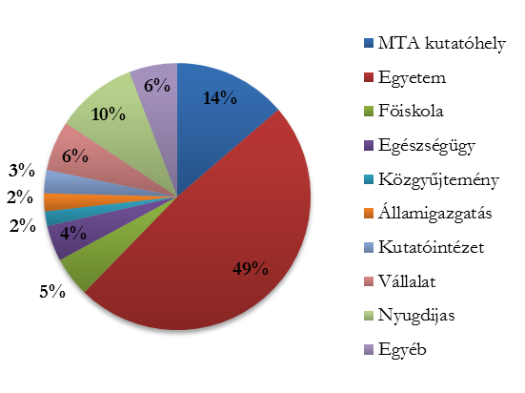
Affiliation of the members of the public body of the Hungarian Academy of Sciences
MTA research network
Universities
High Schools
Health
Public collections
Polity
Other research insitutes
Company
Senior Citizen
Other
Total number of MTA Public Body Members is appr. 15 thousands

Slide 6
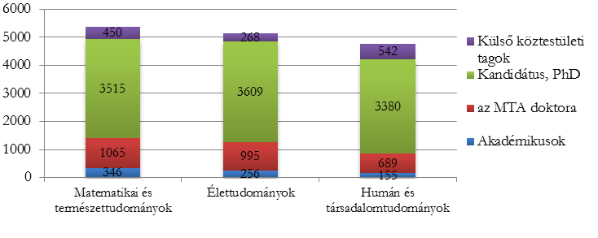
Membership distribution of the MTA public body
Members from abroad
PhD
DSc
„Member of the Academy”
Math&nat. sci. Life sci. Humanities and soc. sci.
I. Section of Linguistics and
Literary Scholarship
II. Section of Philosophy and
Historical Sciences
III. Section of Mathematics
IV. Section of Agricultural Sciences
V. Section of Medical Sciences
VI. Section of Engineering Sciences
Section of Chemical Sciences
Section of Biological Sciences
IX. Section of Economics and Law –
including sociology, demography
and political sciences
X. Section of Earth Sciences
XI. Section of Physical Sciences
Ladies
Gentlemen
Female
Male

Slide 7
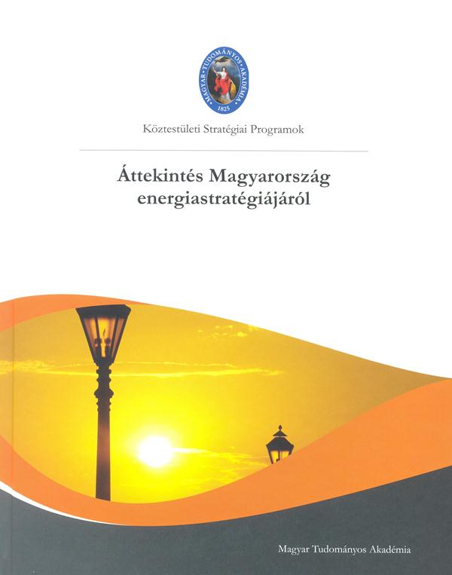
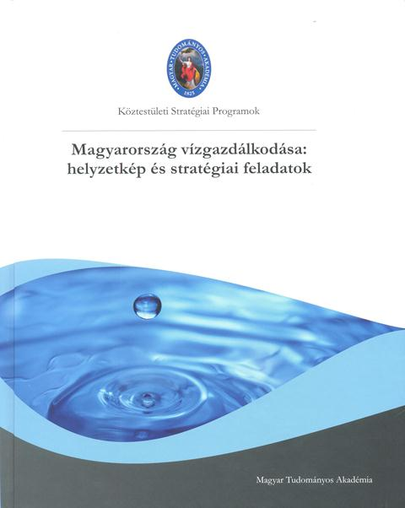
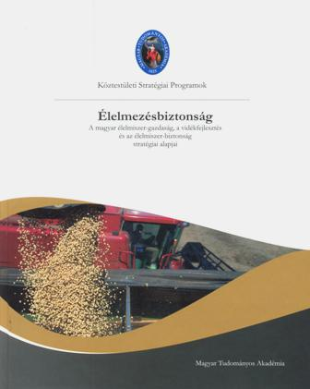
Recent publications by the MTA public body
Energy strategy, 2012
Water management, 2011
Food security, 2011

Slide 8
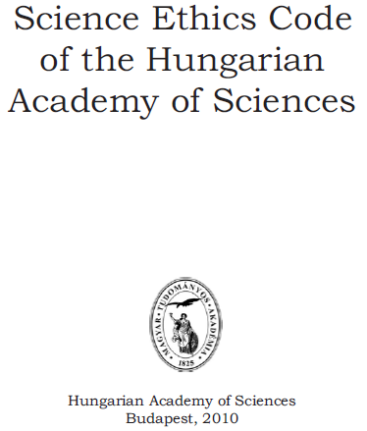

Slide 9
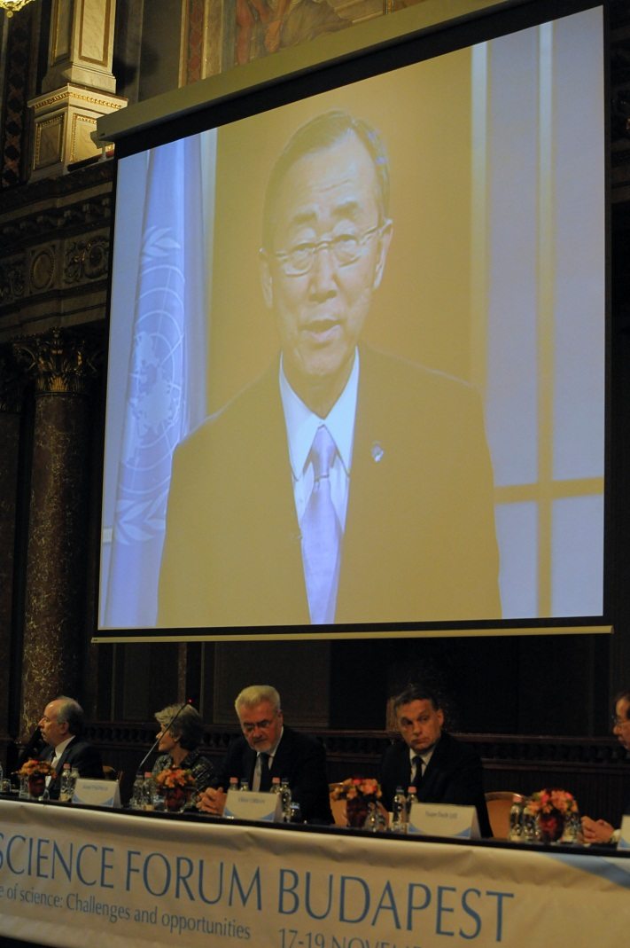
The Hungarian Academy of Sciences as a contributor to European and International Science Policy making
Europe:
European Academies Science Advisory Council (EASAC) – policy advisory
Science Europe – interest representation
A special attention to Central Europe (V4 etc.)
Global:
Organiser of World Science Forums in co-operation with UNESCO, ICSU, AAAS, TWAS
Active member of the global scientific community

Slide 10
ABOUT THE MTA RESEARCH NETWORK
2009-: The Lendület „Momentum” programme
(From brain drain to brain gain)
2011/12: The year of of a complete renewal:
15 institutions were created from 40 ones

Slide 11
State support to the Hungarian Academy of Sciences (2000-2010)
in percents of the real value in the year 2000
a period of regression and stagnation

Slide 12
State support to the Hungarian Academy of Sciences
in billion HUF (nominal value)
a period of regression and stagnation

Slide 13
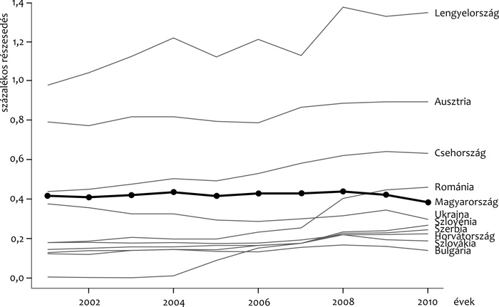
Poland
Austria
Czech Republic
Romania
Hungary
Ukraine
Slovenia
Serbia
Croatia
Slovakia
Bulgaria
Publication activity of Hungary and some other countries of Central Europe between 2001-2010,
in per cent of the world’s total yearly outputs as covered by Web of Science
(Kampis et al.: Magyar Tudomány, August 2011)

Slide 14
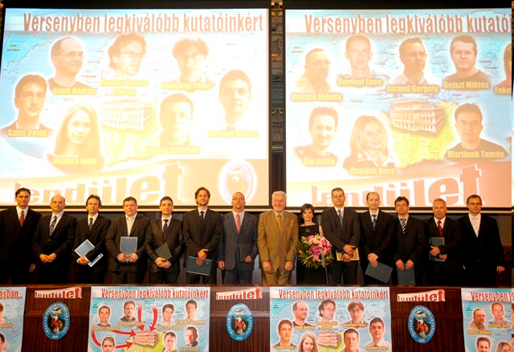
The winners of the Lendület programme in 2011

Slide 15
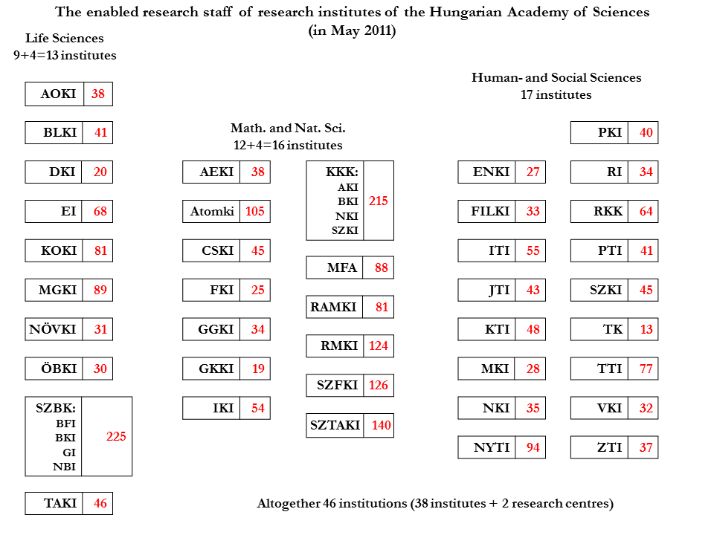

Slide 16
The main aspects of the renewal
of the MTA research network:
To create a sustainable research network
Creation of conditions with a limited amount of resources which allow in the long run:
  to maximalize the efficiency and the output
  to return the invested amount both in financial and social terms
Organizational frame for a new evolution
We work for the future
The renewal of the Academy is iconic in Hungary

Slide 17
Research centres and research institutes
of the Hungarian Academy of Sciences from 2012
Red: research staff; green: main office
New research centres
ECOLOGY
Tihany
91
ENERGY SCIENCE
Budapest
92
HUMANITIES AND ARTS
Budapest
312
AGRICULTURE
Martonvásár
202
NATURAL SCIENCES
Budapest
411
SOCIAL SCIENCES
Budapest
156
ASTRONOMY AND EARTH SCIENCE
Sopron
123
„WIGNER” PHYSICS
Budapest
250
ECONOMY AND REG. SCI.
Budapest
144
Unchanged research institutions
MEDICAL SCIENCE
Budapest
81
MATHEMATICS
Budapest
81
LINGUISTICS
Budapest
94
BIOLOGY
Szeged
225
NUCLEAR RESEARCH
Debrecen
105
INFORMATICS
Budapest
140

Slide 18
The MTA Research Network 2012
RESEARCH INSTITUTE Network: 10 RESEARCH CENTRES 5 RESEARCH INSTITUTES (There are 39 Lendület („Momentum”) RG-s at the 15 institutions) | RESEARCH group NETWORK: „ACADEMY” RESEARCH GROUPS AT UNIVERSITIES AND OTHER PUBLIC INSTITUTIONS (2012-2017: 74) LENDÜLET („MOMENTUM”) RG-S AT UNIVERSITIES: 26

Slide 19
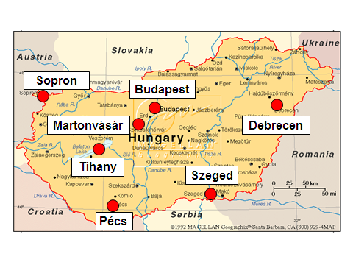
Main offices of the MTA research institute network:
Budapest: 9, outside Budapest: 6

Slide 20
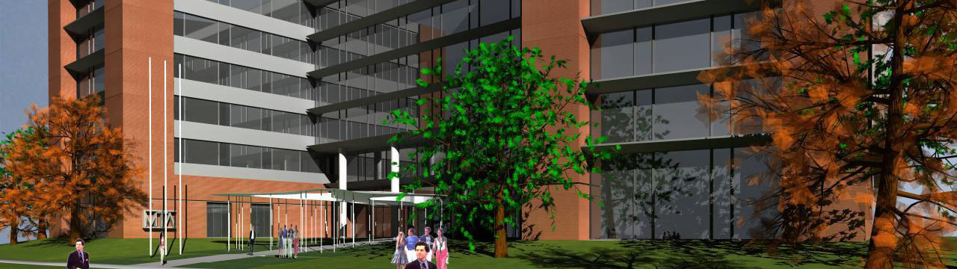
The new building of the Research Centre for Natural Sciences
is expected to be ready by the of 2013

Slide 21
Some further new initiatives:
Renewal of the scientific infrastructure
Digital data base of Hungarian scientific works and their citations
(„MTMT”)
Invitation of excellent foreigner scientists
to work together with Hungarian research teams
Renewal of bilateral programmes

Slide 22
State support to the Hungarian Academy of Sciences
in billion HUF (nominal value)
A NEW TURNING POINT?

Slide 23
State support to the Hungarian Academy of Sciences (2000-2012)
in percents of the real value in the year 2000
A NEW TURNING POINT?

Slide 24
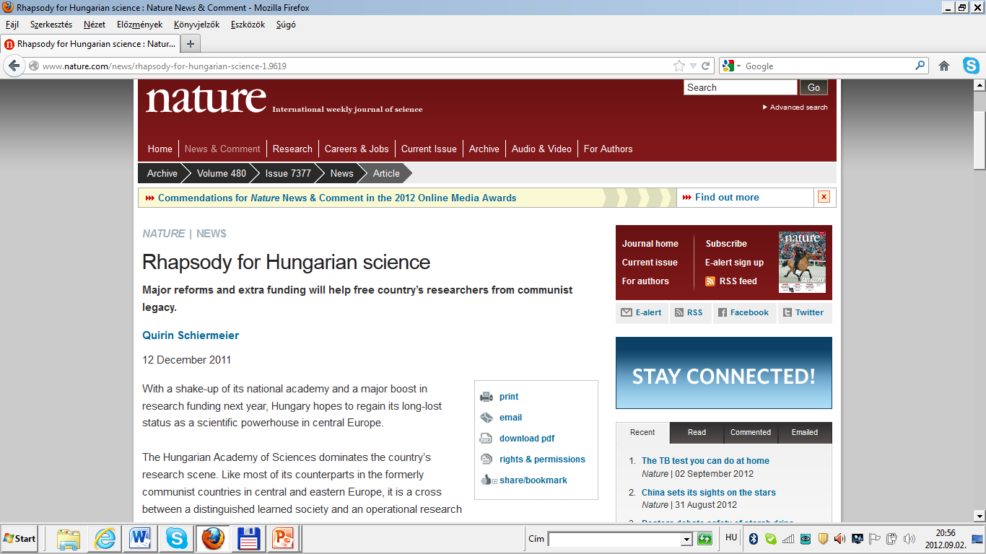

Slide 25
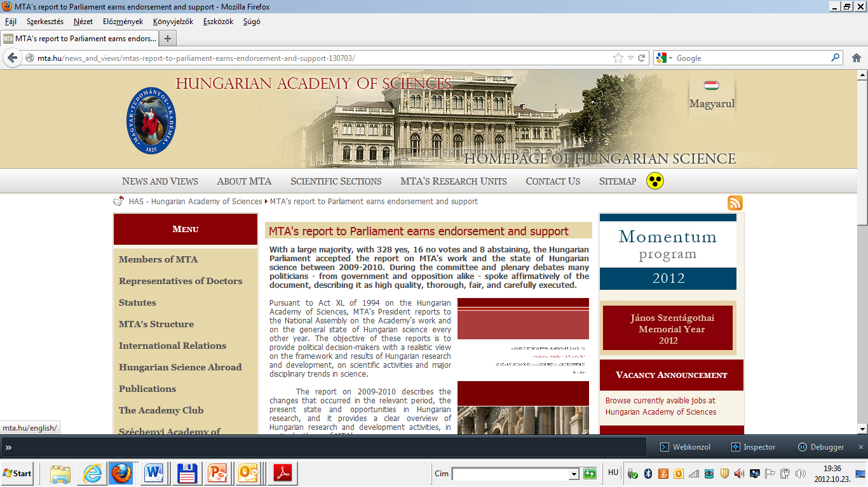
18 October, 2012

Slide 26
CHALLENGES
(national and international ones)

Slide 27
National challenge:
R&D expenditure in the percentage of the Hungarian GDP
The new R&D&I policy in Hungary is still under preparation…

Slide 28
International challenges
(to be discussed in details in Session 2):
- Transition to Open Access (Academy mandate: 24 September, 2012)
- Horizon 2020

