Slide 1
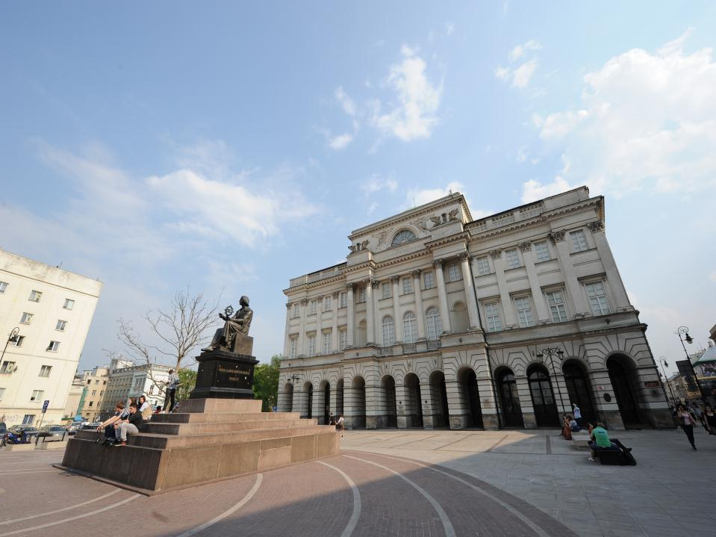

Structure and activity of the
Polish Academy of Sciences (PAS)

Slide 2

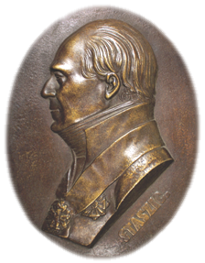
The PAS is a leading scientific institution in Poland, founded in 1952. Its roots stretch back to the Enlightenment age, as it is a successor to the Society of Friends of Science, set up in 1800 by Stanisław Staszic (1755-1826) and other outstanding scientists of his day.
The PAS is a state research institution continuing and cultivating the most illustrious traditions of national scientific organizations. Its operations are regulated by the Act on the Polish Academy of Sciences (dated 30 April 2010).

Slide 3
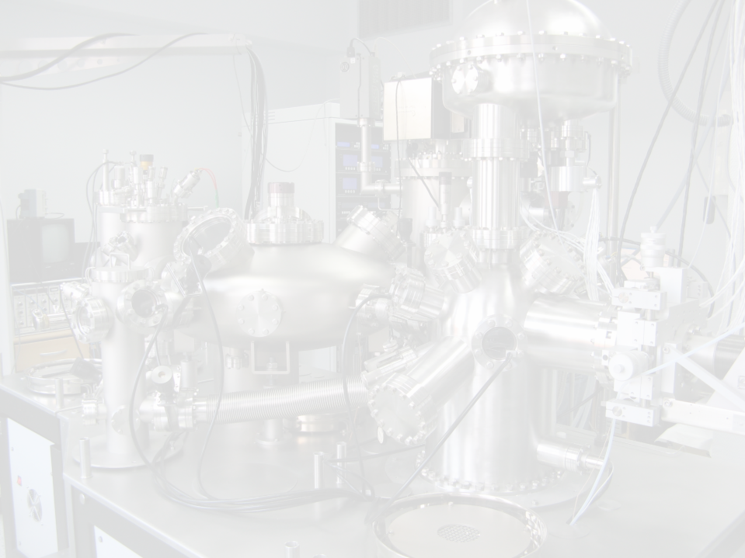
The mission of the Academy is a comprehensive work for the development of science and establishing the highest standards and ethical norms of research that serves the public and enriches the national culture.
In specific, the Academy’s tasks include:
1) pursuing research and development work;
2) supporting the furtherment of individuals embarking on a research career, as described in art. 2 point 3 of the Act on the National Research Center (dated 30 April 2010, Dz. U. Nr. 96, item. 617);
3) educating researchers via doctorate studies, post-graduate programs, and other forms of study;
4) formulating principles of research ethics;
5) presenting opinions and programs dealing with scientific matters and with the harnessing of R&D work results in practice;
6) drawing up opinions, evaluations, expert reports, and forecasts concerning matters of importance for planning and implementing state policies – when requested to do so by the President, Speaker of the Sejm or Senate, ministers, or central bodies of governmental administration;
7) expressing opinions about draft regulations meant to regulate the field of research, its applications, and education;
8) collaborating with institutions of higher education, research institutions, and scientific societies, especially in terms of pursuing research and development work;
9) collaborating with the socioeconomic environment to seek ways to put research and development work into application;
10) developing international research cooperation by setting up scientific consortiums and pursuing research projects together with foreign partners;
11) participating in international research organizations/programs and working together with foreign research institutions;
12) entering into scientific cooperation agreements with international research organizations and foreign research institutions.
from the Act on the Polish Academy of Sciences
(dated 30 April 2010)

Slide 4
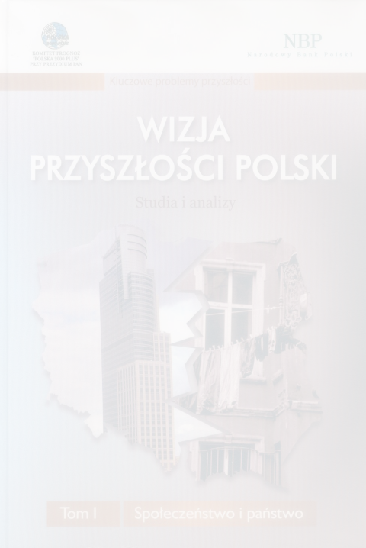
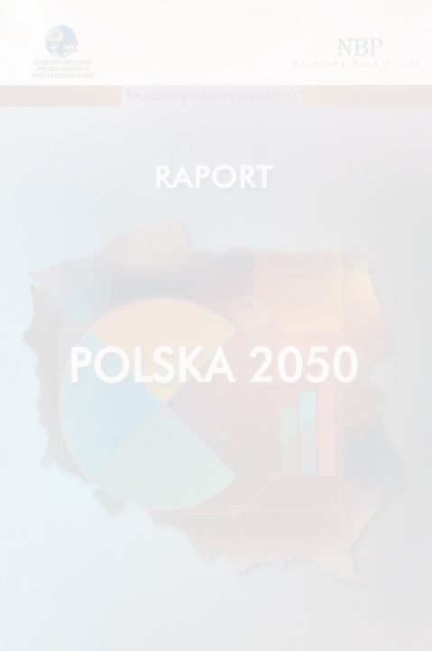
Expert evaluations and opinions issued by the PAS
The PAS has issued opinions of draft regulations prepared by :
the Ministry of Science and Higher Education
the Ministry of Foreign Affairs
the Ministry of the Environment
the Ministry of Health
the Ministry of Regional Development
the Ministry of the Economy
the Ministry of National Education
the Ministry of Labor and Social Policy
the Ministry of Finance
the Ministry of Culture and National Heritage
and others.
PAS representatives have been invited to participate in numerous ministerial bodies, including:
Research Committee for the Development of Science (Ministry of Science and Higher Education)
panels of experts, National Center for Research and Development (Ministry of Science and Higher Education)
Monitoring Committee for the “Innovative Economy” Operational Programme (Regional Development Ministry)
Monitoring Committee for the EEA Financial Mechanism and Norwegian Financial Mechanism (Regional Development Ministry)
National Ethical Committee for Animal Experimentation and local committees (Ministry of Science and Higher Education)

Slide 5
General Assembly
no more than 350 national members
Foreign Members
Presidium
President
4 Vice Presidents
Chancellor
Chancellery
Division I – Humanities and Social Sciences
Task-Force Committees
Division II – Biological and Agricultural Sciences
PAS Archives, Libraries, and Museums
Division III – Mathematics, Physics, Chemistry and Earth Sciences
Foreign Scientific Centers
Territorial Branches
Division IV – Technical Sciences
Academy of Junior Scholars
Division V – Medical Sciences
Research Ethics Committee
3 International Institutes
Audit Committee

Slide 6
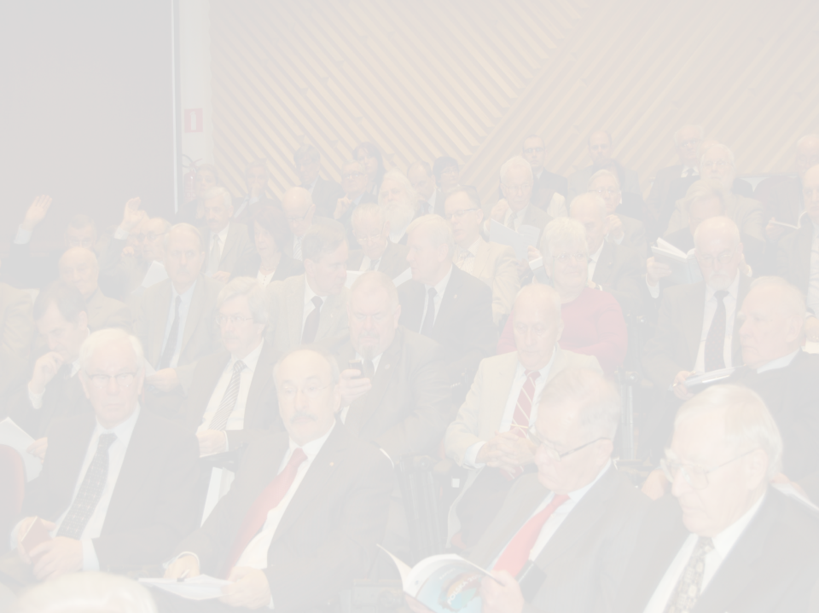
General Assembly
The General Assembly is the highest body of the Polish Academy of Sciences.
The General Assembly oversees the overall operations of the Academy, adopting resolutions that are binding for other Academy institutions.
In particular, the General Assembly:
  1) elects new members of the Academy;
  2) elects the President of the Academy from among the national Academy members;
  3) elects Vice Presidents of the Academy from among national Academy members representing different research specializations; candidates for these positions are put forward by the President of the Academy;
  4) approves the annual financial statements of the Academy, together with an auditor’s evaluation of those financial statements and a report on the Academy’s statutory operations presented by the President of the Academy;
  5) accepts the results of audits, together with statements on how their recommendations are being implemented, presented by the President of the Academy;
  6) may appoint ad-hoc or standing committees to prepare drafts of General Assembly resolutions on the issues specified in the resolution appointing such a commission;
  7) elects an auditing committee;
  8) sets forth the strategic directions of the Academy’s operations;
  9) elects a research ethics committee;
  10) approves the ethics code for research staff, put forward by the research ethics committee.
The General Assembly may make statements on issues of importance for the Polish Nation and State.

Slide 7
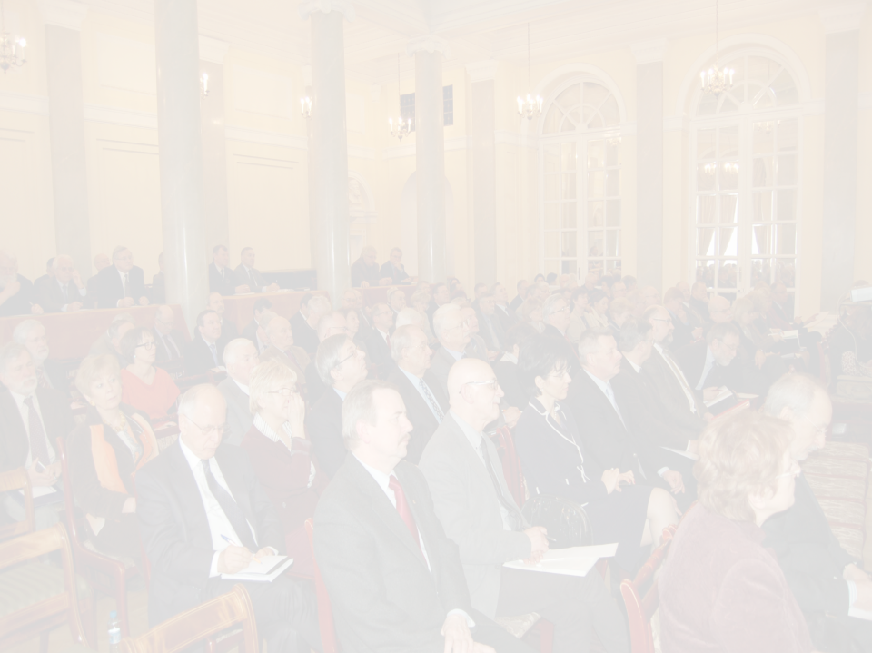
Committees
The scientific committees of the Polish Academy of Sciences (cooperating with the Academy’s Divisions) comprise national-level, self-governing bodies representing individual fields of research, with the objective of integrating researchers throughout the country. The members of the scientific committees include the national members of the Polish Academy of Sciences within the respective specialization; other outstanding researchers representing higher-education schools, Polish Academy of Sciences units, and other R&D institutes affiliated with the Polish ministries; as well as representatives of economic and social institutions.
To serve specific objectives, the Presidium of the Academy may set up task-force committees for the duration of the Presidium’s appointed term of office. These task-force committees may be affiliated with the Presidium itself, or with one of the Divisions of the Academy.
The scientific and task-force committees, as standing bodies of the Academy affiliated with the Divisions or directly with the Presidium itself, primarily function as advisory and opinion-issuing bodies. Their advisory activity is particularly important, especially their production of expert reports, evaluations, and scientific opinions for institutions of state administration.
In the 2011-2014 term, there is a list of 95 scientific committees functioning in collaboration with the individual Divisions of the Academy. The Presidium of the Academy moreover established 6 task-force committees plus 3 councils that have the status of task-force committees, all affiliated directly with the Presidium itself.

Slide 8
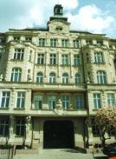
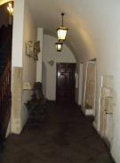
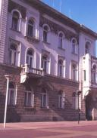
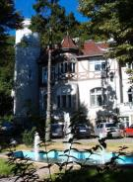
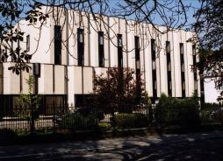
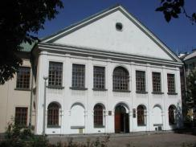
Territorial Branches
The Academy has 7 Territorial Branches, in:
Gdańsk, Katowice, Kraków, Lublin, Łódź, Poznań, and Wrocław.
Their role involves the following, in particular:
1) integrating research life and collaborating with all the research institutions within a given region of the country;
2) working with local governmental bodies and regional state administration bodies, particularly in terms of drawing up expert evaluations for use by these bodies;
3) initiating and engaging in international research cooperation with regions of EU member states and other countries neighboring on the Republic of Poland.
Wrocław
Kraków
Łódź
Gdańsk
Poznań
Lublin

Slide 9
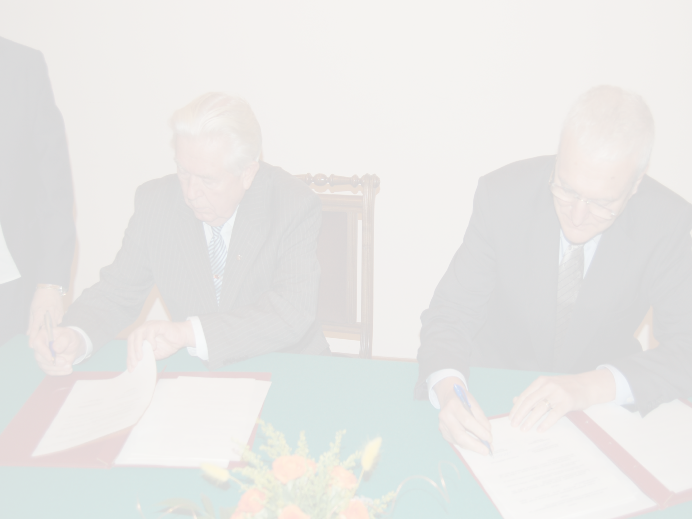
The international cooperation efforts
of the Polish Academy of Sciences are based on:
79 bilateral agreements with foreign academies
and research organizations in 45 countries
membership in approx. 100 international research organizations
direct cooperative ties between Polish research units and foreign partners

Slide 10
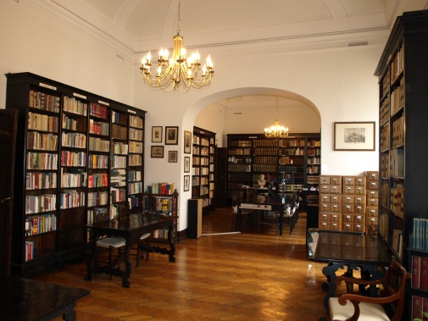
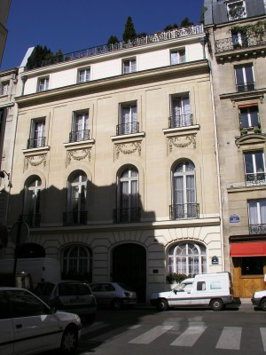
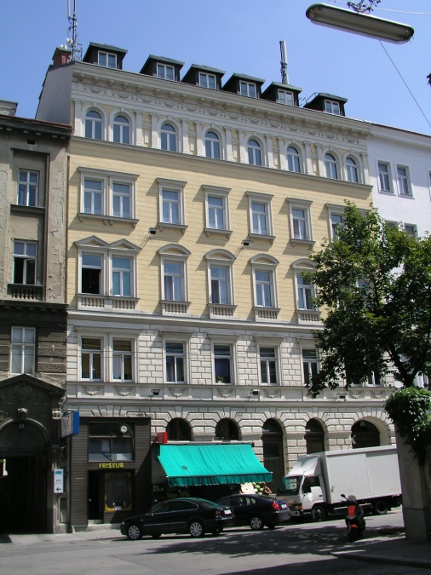
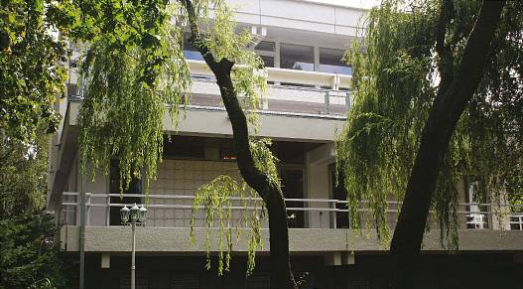
Scientific Centers
The Polish Academy of Sciences maintains 7 foreign scientific centers,
in Berlin, Brussels, Moscow, Paris, Rome, Vienna and Kiev.
Their role is to work together with research institutions, to facilitate contacts with the local research community, and to promote Polish science abroad.
Rome
Paris
Vienna
Berlin

Slide 11

Structure of the Polish Academy of Sciences after the adoption of the reform of science sector
11

Slide 12
In April 2010 Polish Parliament adopted a package of acts reforming Polish science sector, including the act on the Polish Academy of Sciences.
Implementation of the above-mentioned acts necessitated numerous organisational and restructuring endeavours aimed at improvement
of the efficiency of functioning of the corporation and a better use of research potention of PAS. Key organisational changes include the establishing
of the new structure, tasks and divisions of the Academy.

Slide 13
Structure
On 1 January 2011 the structure of the Polish Academy of Sciences was changed. In accordance with the tendencies to integrate scientific milieu and create interdisciplinary structures, currently observed in science world-wide,
the number of Academy divisions was diminished: from seven to five.

Slide 14
Councils of divisions provosts
Within each division the councils of provosts were established. Each council
is composed of Academy members who are under 70 years of age and other distinguished representatives of Polish and international research community.

Slide 15
The tasks of the councils of provosts include, among others:
carrying out periodic evaluations of scientific units of the Academy,
orgnising competitions for the post of director of scientific institute,
evaluating the activities of the committees of the PAS.

Slide 16
Scientific, task force and national committees
As result of the adoption of the act on the Polish Academy of Sciences formal and legal circumstances of the activities of the Academy’s scientific, task force and national committees have changed. However the autonomyy of those committees has been maintained as well as the right of the Academy to decide about their structure and the scope of their activities.

Slide 17
The Committee for Ethics in Science
In the stucture of the Polish Academy of Sciences functions the Committee
for Ethics in Science. The Committee is composed of nine members representing the whole scientific and higher education community.

Slide 18
Tasks of the Committee include, among others:
expressing opinions on cases concerning a breach of ethics in science
by a member of the staff at a higher and scientific institution or a scientific unit of the Academy,
developing a code of ethics for researchers,
disseminating research integrity standards.

Slide 19
THE ACADEMY OF YOUNG SCIENTISTS
The Academy of Young Scientists was established in order to promote scientific research and R&D activities conducted by the outstanding young representatives of Polish science.
A person under 35 years of age and holding at least the doctoral degree may become the member of the Academy.
The term of office of the Academy members lasts 5 years without a possibility
of reelection.
The members of the Academy of Young Scientists are elected by the General Assembly of the Academy from among the young representatives of Polish scientists having outstanding research achievements.

Slide 20
Self-government of PhD students
In scientific units of the Polish Academy of Sciences there are about 2500 PhD students. The Academy’s institutes can run doctoral studies independently or in the cooperation with higher education establishments.

Slide 21
PhD students of the Academy set up their own self-government with the following objectives:
support and promotion of scientific activity,
integration of the community of the Academy’s PhD students,
organising mutual assistance and team cooperation of the Academy’s PhD students,
acting towards permanent and positive changes in the situation
of the Academy’s PhD students and towards respecting their rights.

Slide 22


