Slide 1



Alina Kuryłowicz, M.D., Ph.D.
Polish Academy of Sciences
Department of Human Epigenetics
Mossakowski Medical Research Centre
Warsaw, Poland

Slide 2

Alina Kuryłowicz – education (1)
1996-2002 – Medicine studies, First Faculty of Medicine, Medical University of Warsaw, Poland
2004-2006 – PhD studies, Department of Edocrinology, Mossakowski Medical Research Centre, PAS, Warsaw
2006 – PhD “The association of the polymorphisms of the vitamin D-related genes with Graves’ disease”, Mossakowski Medical Research Centre, PAS, Warsaw, Poland
The Visegrad Group Academies Young Researcher Award 2012 – Alina Kuryłowicz

Slide 3


Alina Kuryłowicz – education (2)
2006-2007 – Post-graduate studies in dietetics, Faculty of Human Nutrition and Consumer Sciences, Warsaw University of Life Sciences, Warsaw, Poland
2004-2009 – Specialization in internal medicine, Department of Internal Medicine and Endocrinology, Medical University of Warsaw, Warsaw, Poland
Since 2010 – Specialization in endocrinology, Department of Internal Medicine and Endocrinology, Medical University of Warsaw, Warsaw, Poland
The Visegrad Group Academies Young Researcher Award 2012 – Alina Kuryłowicz

Slide 4
Alina Kuryłowicz – employment
2002-2004 – Mandatory Internship, Public Central Teaching Hospital, Medical University of Warsaw, Poland, intern
2006-2011 – Department of Endocrinology, Mossakowski Medical Research Centre PAS, Warsaw, Poland assistant and lecturer
Since 2010 – Department of Internal Medicine and Endocrinology, Medical University of Warsaw, Warsaw, Poland, senior assistant
Since 2011 – Department of Human Epigenetics, Mossakowski Medical Research Centre, PAS, Warsaw, Poland, assistant and lecturer
The Visegrad Group Academies Young Researcher Award 2012 – Alina Kuryłowicz

Slide 5
Main scientific activity
Genetic background of autoimmune thyroid diseases (AITD)
Genetics and epigenetics of ageing
Genetics and epigenetics of obesity
The Visegrad Group Academies Young Researcher Award 2012 – Alina Kuryłowicz

Slide 6
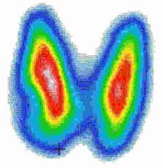
Genetic background of AITD 2002-2008
Investigation of the genetic background of Graves’ disease in Polish, German, Serbian and Japanese populations in cooperation with:
University Hospital Frankfurt, Frankfurt am Mein, Germany
Medical Center Zajecar, Serbia
Kurume University School of Medicine,
Fukuoka, Japan
The Visegrad Group Academies Young Researcher Award 2012 – Alina Kuryłowicz

Slide 7
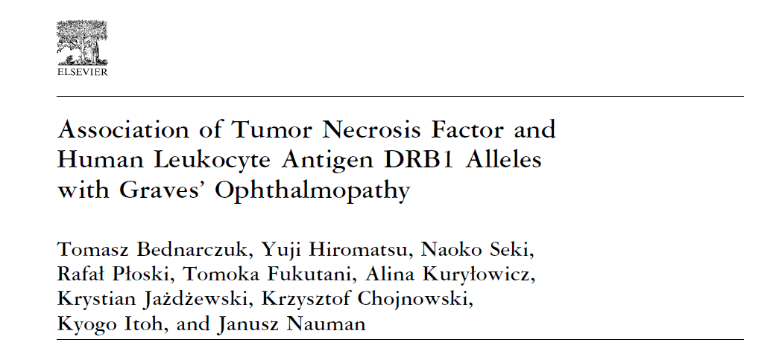
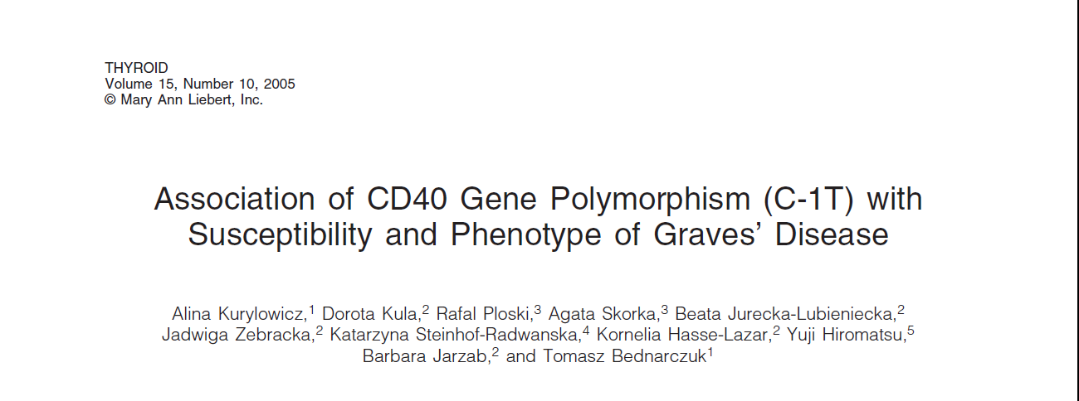

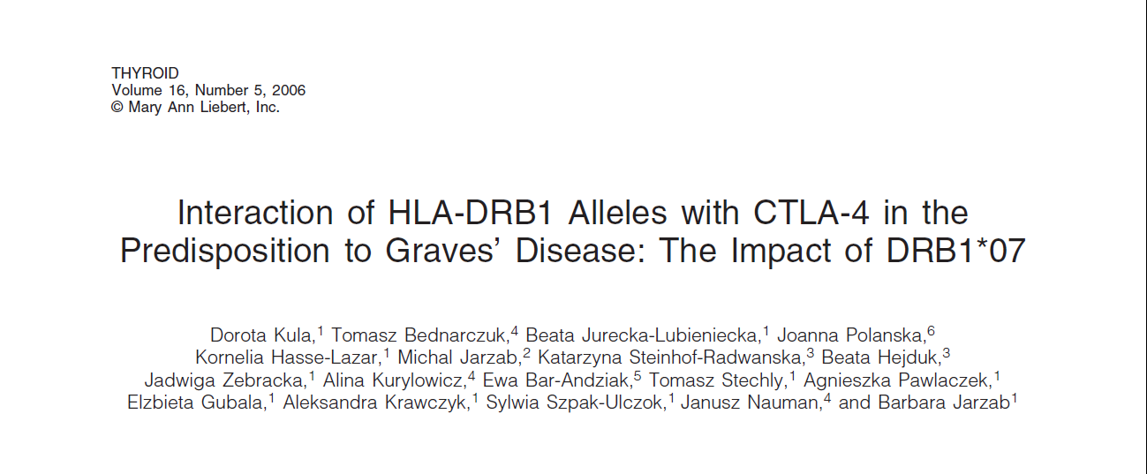
Genetic background of AITD 2002-2008
Confirming the role of HLA-DR3, CTLA-4 and CD40 variants with development of Graves’ disease in Caucasians
The Visegrad Group Academies Young Researcher Award 2012 – Alina Kuryłowicz

Slide 8
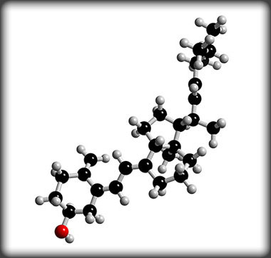
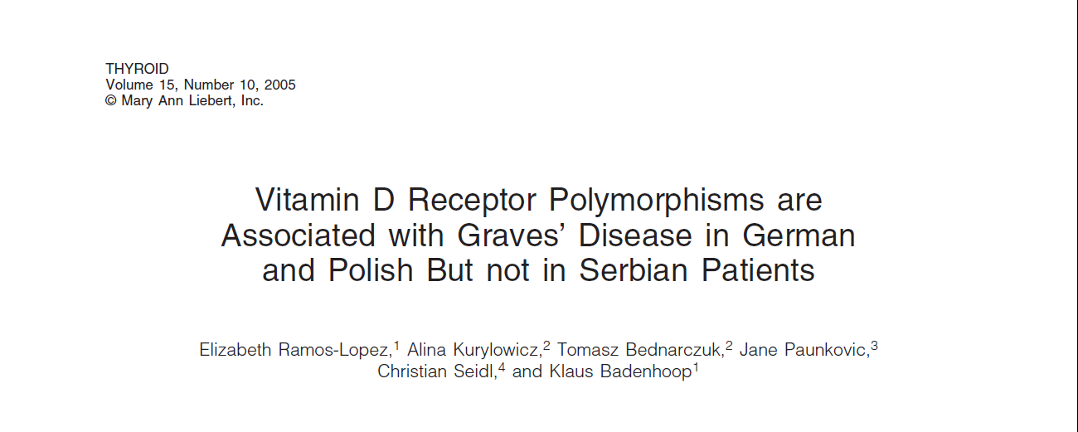
Genetic background of AITD 2002-2008
Confirming the role of polymorphisms in
vitamin D-related genes with development of
Graves’ disease in Polish population:
vitamin D receptor (VDR)
The Visegrad Group Academies Young Researcher Award 2012 – Alina Kuryłowicz

Slide 9
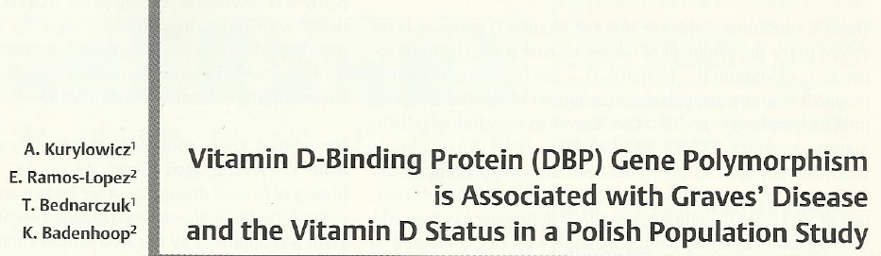

Genetic background of AITD 2002-2008
Confirming the role of polymorphisms in
vitamin D- related genes with development of
Graves’ disease in Polish population:
vitamin D binding protein (DBP)
The Visegrad Group Academies Young Researcher Award 2012 – Alina Kuryłowicz

Slide 10
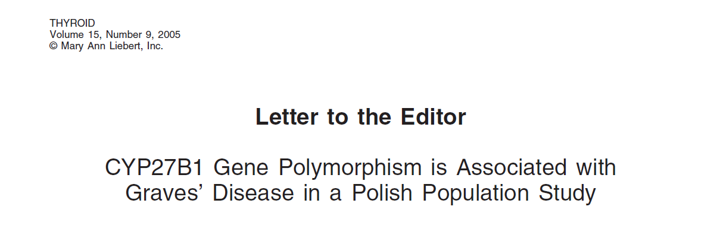
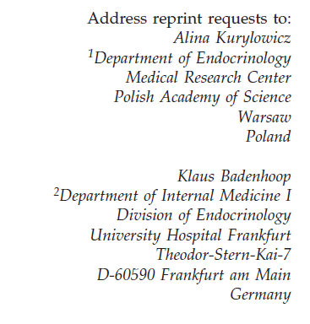
Genetic background of AITD 2002-2008
Confirming the role of polymorphisms in
vitamin D-related genes with development of
Graves’ disease in Polish population:
vitamin D 1α-hydroxylase (CYP27B1)
The Visegrad Group Academies Young Researcher Award 2012 – Alina Kuryłowicz

Slide 11
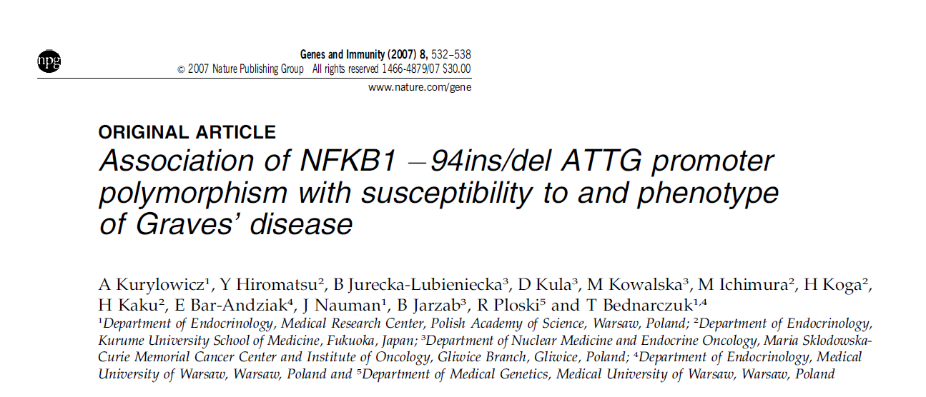
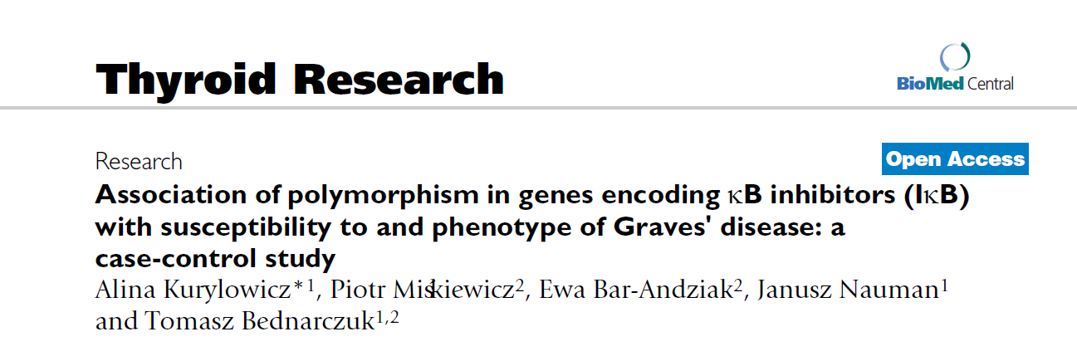
Genetic background of AITD 2002-2008
Confirming the role of nuclear factor κB (NF-κB) – related genes polymorphisms with development of Graves’ disease in Polish and Japanese populations
The Visegrad Group Academies Young Researcher Award 2012 – Alina Kuryłowicz

Slide 12


Genetic background of AITD 2002-2008
Supported by:
German Academic Scientific Exchange (DAAD) grant entitled: The association of the polymorphisms within vitamin D related genes with Graves’ disease (2004)
Polish Ministry of Science and Higher Education Grant 2P05B 120 29: The association of polymorphisms in genes encoding nuclear factor κB-associated proteins with development of Graves’ disease (2005-2007)
The Visegrad Group Academies Young Researcher Award 2012 – Alina Kuryłowicz

Slide 13
Genetics & epigenetics of ageing - since 2006
Investigation of:
genetic variants
expression on mRNA level
mechanisms of epigenetic regulation
of genes influencing human ageing in peripheral blood mononuclear cells
The Visegrad Group Academies Young Researcher Award 2012 – Alina Kuryłowicz

Slide 14
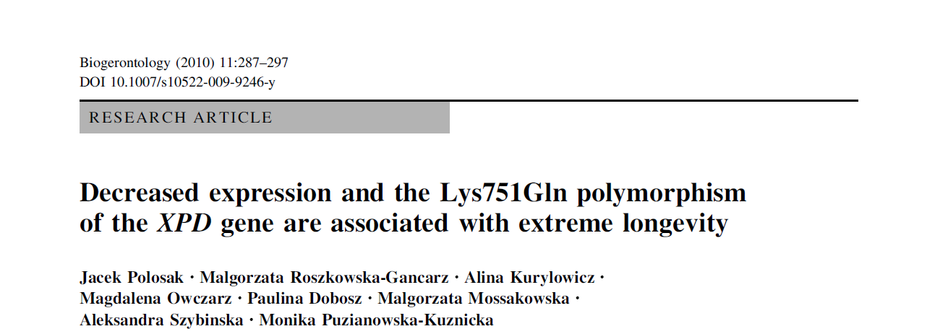
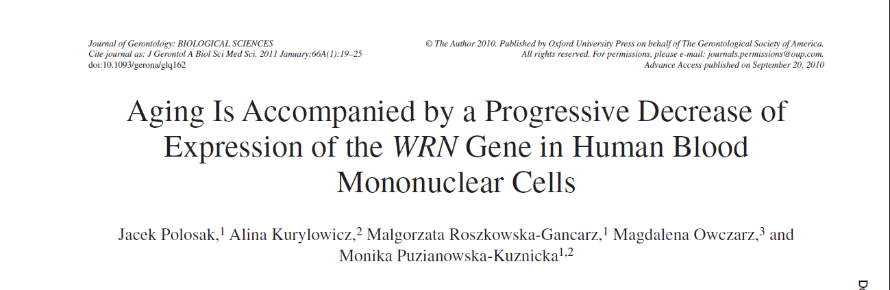
Genetics & epigenetics of ageing - since 2006
Finding that human ageing is accompanied by the progressive decrease of expression of genes encoding proteins involved in DNA repair (XPD, WRN) in blood mononuclear cells
The Visegrad Group Academies Young Researcher Award 2012 – Alina Kuryłowicz

Slide 15
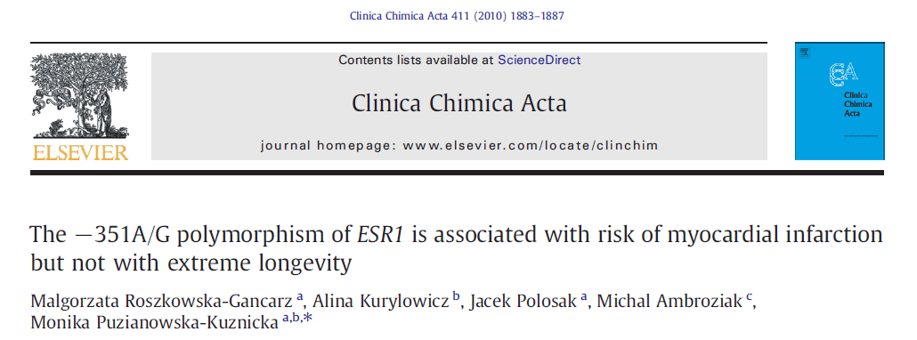
Genetics & epigenetics of ageing - since 2006
Finding that some variants of genes encoding hormones and hormones’ receptors participating in the regulation of metabolism (leptin, leptin receptor, adiponectin, estrogen receptors) may influence ageing due to their association with life-shortening diseases
The Visegrad Group Academies Young Researcher Award 2012 – Alina Kuryłowicz

Slide 16
Genetics & epigenetics of ageing - since 2006
Papers in press:
Total and high molecular weight adiponectin and adiponectin level-modifying polymorphisms of ADIPOQ in centenarians
Malgorzata Roszkowska-Gancarz, Zbigniew Bartoszewicz, Jacek Polosak,
Alina Kurylowicz, Marta Jonas, Malgorzata Mossakowska,
Polish Endocrinology 2012
The G1730A polymorphism in estrogen receptor type 2 gene is associated with the risk of myocardial infarction in young men but not in women
Michał Ambroziak, Alina Kuryłowicz, Małgorzata Roszkowska-Gancarz, Marta Makuch, Andrzej Budaj
Clin Chem 2012
The Visegrad Group Academies Young Researcher Award 2012 – Alina Kuryłowicz

Slide 17
Genetics & epigenetics of ageing - since 2006
Supported by:
Polish Ministry of Science and Higher Education Grant PBZ-MEiN-9/2/2006 /r K143/P01/2007: Development of DNA bank from young, elderly people and centenarians. Searching for genetic polymorphisms influencing the lifespan. (2008-2010)
Polish Ministry of Science and Higher Education Grant N N401 037338: Ageing of the immune system: investigation of expression of genes influencing ageing and of the mechanisms of their epigenetic regulation in blood mononuclear cells in centenarians, young and elderly individuals. (2010-2013)
The Visegrad Group Academies Young Researcher Award 2012 – Alina Kuryłowicz

Slide 18
Genetics & epigenetics of obesity - since 2011
Organization of the bank of nucleic acids isolated from adipose tissues to be used in present and further research tasks.
Analysis of expression (on mRNA level) and mechanisms of epigenetic regulation of
thermogenesis-related genes
genes encoding human sirtuins
in adipose tissues of obese and non-obese subjects and their potential role in the development of human obesity (in progress)
The Visegrad Group Academies Young Researcher Award 2012 – Alina Kuryłowicz

Slide 19
Genetics & epigenetics of obesity - since 2011
Supported by:
Polish Ministry of Science and Higher Education Grant N N402 467939: The influence of adipose tissue and serum vitamin D concentrations on inflammatory parameters in obese subjects. (2010-2013)
Polish Ministry of Science and Higher Education Grant N N402 557440: The influence of epigenetic modifications on thermogenesis related genes expression in fat tissues from obese and non-obese subjects. (2011-2012)
The Visegrad Group Academies Young Researcher Award 2012 – Alina Kuryłowicz

Slide 20
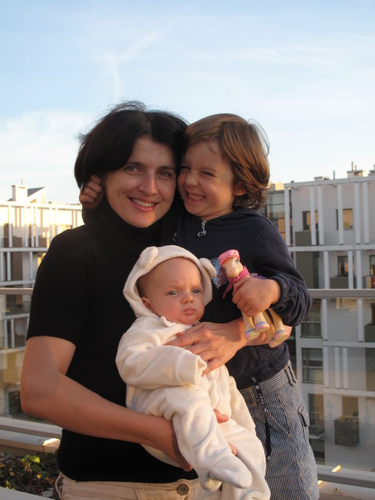
Other projects
Hanna – since 19th of July 2007
Karol – since 6th of August 2012
The Visegrad Group Academies Young Researcher Award 2012 – Alina Kuryłowicz

Slide 21
Thank you for attention… and understanding!
The Visegrad Group Academies Young Researcher Award 2012 – Alina Kuryłowicz

