Slide 1
Hantaviruses as emerging pathogens in Europe and Africa
Boris Klempa
Department of Virus Ecology
Institute of Virology
Slovak Academy of Sciences
Bratislava, Slovakia

Slide 2
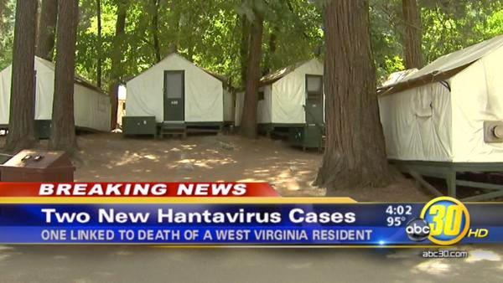
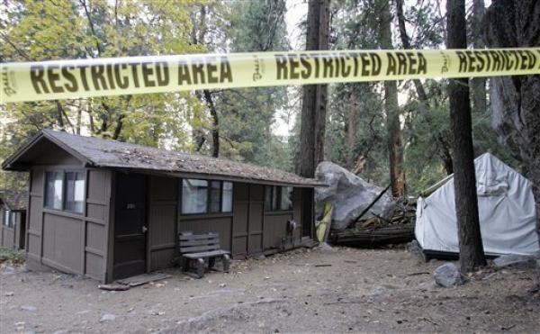
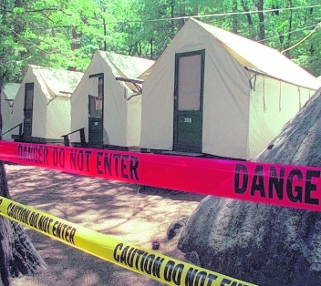
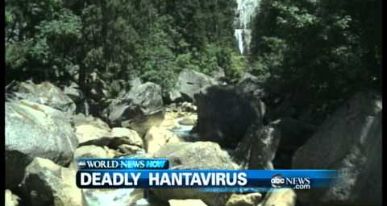
Yosemite Hantavirus Outbreak
August, 2012

Slide 3
Reported hantavirus diseases
in Germany 2001-2012
2.568
2.017
2.100
1.800
1.688
1.500
1.200
900
600
448
185
228
242
241
305
300
144
181
72
2001
2002
2003
2004
2005
2006
2007
2008
2009
2010
2011
1.-9.
2012
source: Robert-Koch-Institute, Berlin

Slide 4

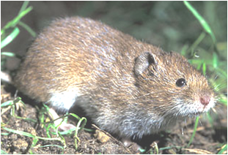
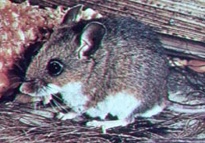
Hantaviruses cause two human zoonoses
  hemorrhagic fever with renal syndrome (HFRS)
    case fatality rate of up to 15%
  hantavirus cardiopulmonary syndrome (HCPS)
    case fatality rate of up to 50%
Puumala
H F R S
Sin Nombre
Dobrava-Belgrade
Hantaan
Seoul
H C P S
Sangassou
Tanganya
H C P S
Magboi
Mouyassue
Azagny
Andes
Klempa et al., Emerg Inf Dis 2006; 2007
Klempa et al., J Inf Dis 2010
Klempa et al., J Virol 2012
Weiss et al., 2012

Slide 5
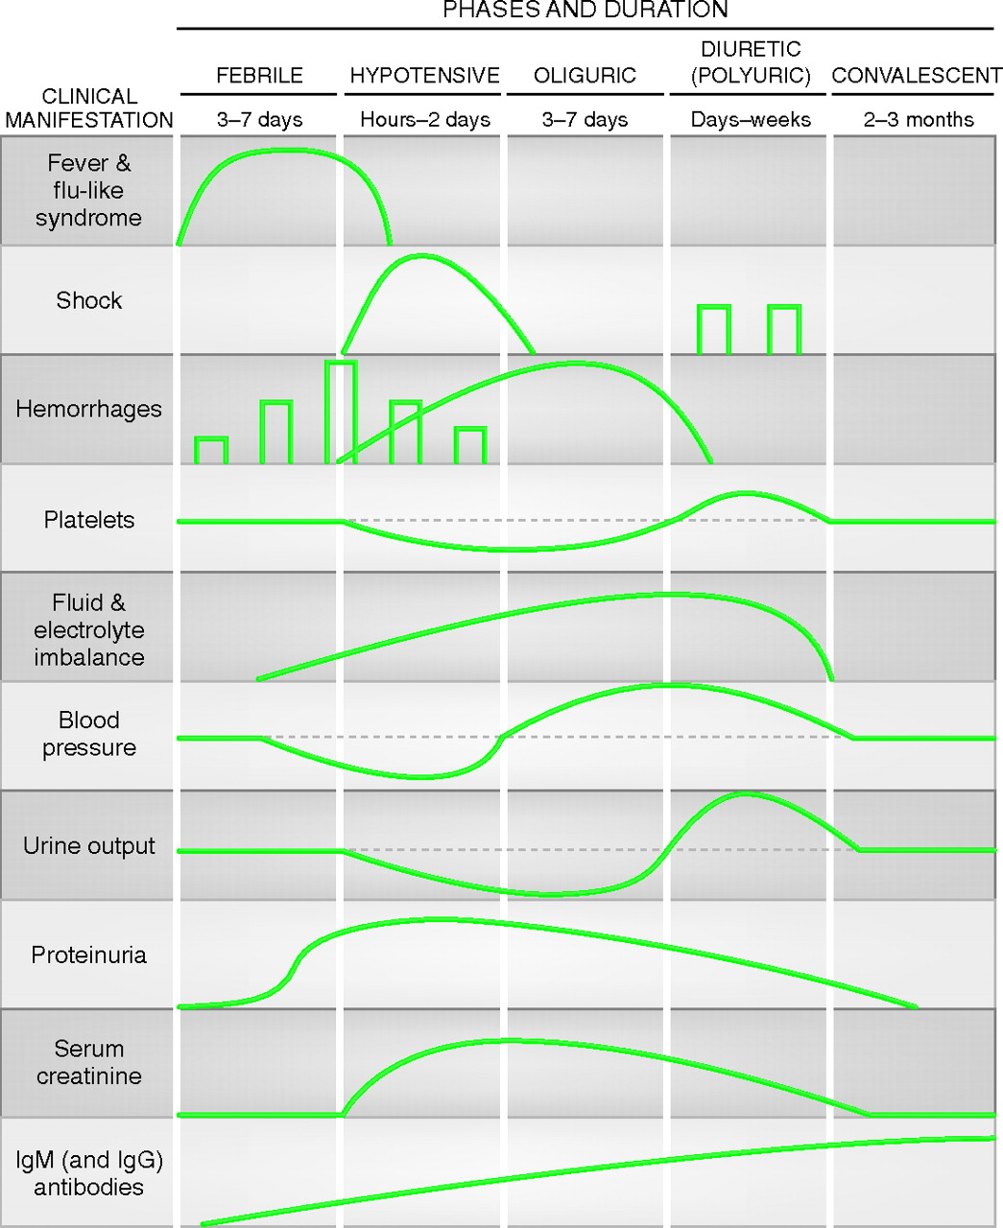
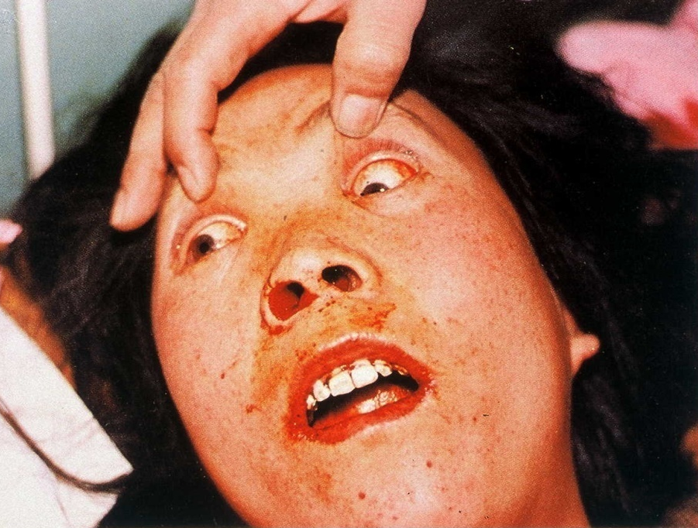
HFRS
200,000 - 300,000 cases annually
, hemorrhages
fever
renal dysfunction
Ferluga D , Vizjak A JASN 2008;19:1653-1658
©2008 by American Society of Nephrology

Slide 6
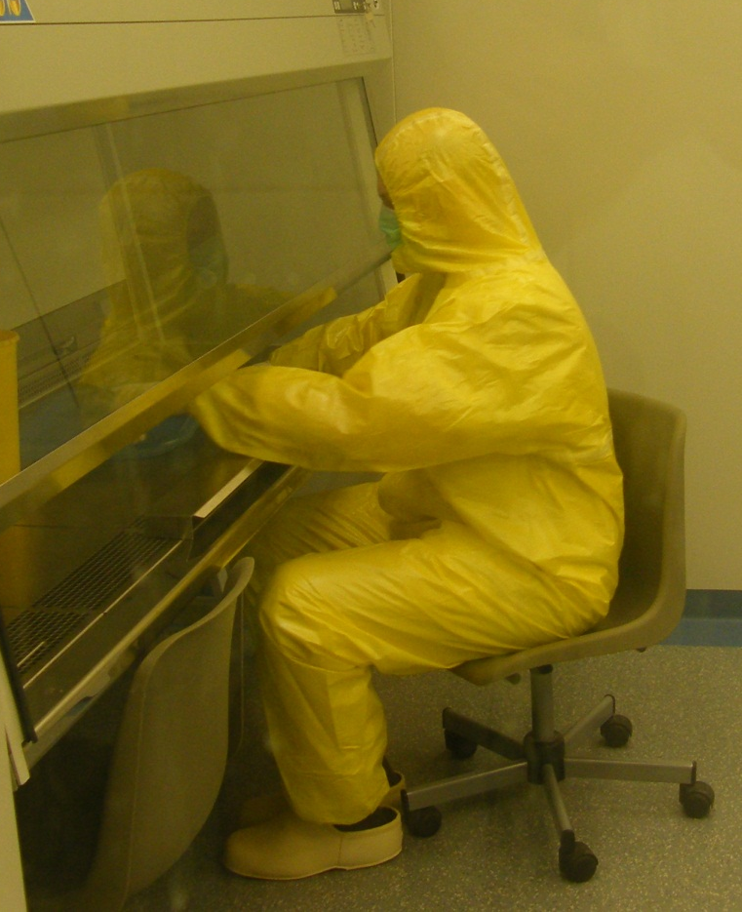
Difficulties to study hantaviruses
biosafety level 3 or 4 conditions
slow growth on cell cultures
no detectable CPE on cell cultures
no reverse genetics
no animal model
virus detectable in patients only very shortly after clinical onset

Slide 7
Strategical approach to identify new hantaviruses and human disease
1. Step
2. Step
Genus specific PCR
Sequencing
Phylogenetic analyses
Recombinant antigen expression for serodiagnostics
Primer design for specific PCR
Virus isolation in cell culture
Neutralisation assay for serotyping
Comparative pathogenesis studies

Slide 8
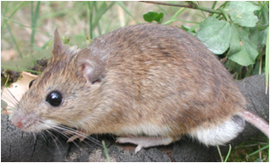
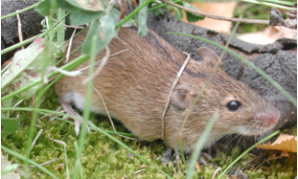
Dobrava-Belgrade hantavirus
emerging in Central Europe
DOBV is present in Central Europe in Apodemus agrarius and forms a separate DOBV-Aa lineage
Klempa et al., J Virol 2003
DOBV-Aa causes HFRS
Klempa et al., J Clin Microbiol 2004
DOBV-Aa cell culture isolates allow fine-serotyping and comparative pathogenesis studies
Klempa et al., J Clin Microbiol 2005
Klempa et al., Emerg Infect Dis 2008
Kirsanovs et al., Virus Genes 2010
Popugaeva et al., Plos ONE 2012
Apodemus flavicollis
A. agrarius

Slide 9
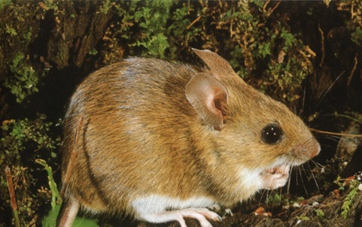
Sochi virus, novel genetic variant of DOBV, causes severe HFRS in Russia
Observation
% of patients
(n = 36)
Acute onset, fever 100
average duration: 6.8 days
Apodemus ponticus
Abdominal pain 81
Vomiting 62
New DOBV lineage discovered
in Apodemus ponticus
Diarrhea 42
Facial flushing 73
Klempa et al., Emerg Infect Dis, 2008
Haemorrhagic sclerae 54
Isolation from a fatal HFRS case
Oliguria <500 µl 85
Dzagurova et al., Clin Infect Dis, 2012
Increased blood urea, creatinine 85
Case fatality rate 16.7 !

Slide 10
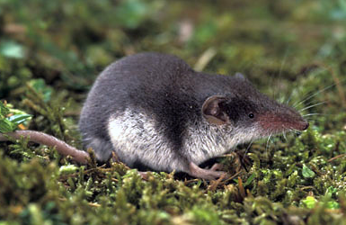
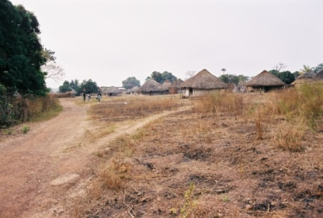


First African hantaviruses
Thottapalayam
Soricidae-
associated
Crocidura theresae
Arvicolinae-
associated
Puumala
Ash River
Tula
Seewis
Sigmodontinae-
associated
Tanganya, Guinea
Jemez Springs
Andes
Tanganya
Sin Nombre
Cao Bang
Hylomyscus simus
Dobrava
Seoul
Klempa et al.,
Emerg Infect Dis, 2007
0.1
Sangassou
Hantaan
Murinae-
associated
Klempa et al., Emerg Infect Dis 2006
Sangassou, Guinea

Slide 11
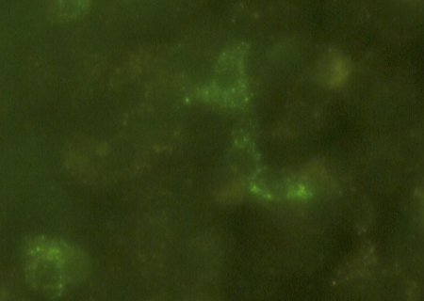
Isolation of Sangassou virus, the first hantavirus from Africa
Seroepidemiological study in Guinea
recombinant N protein expression
  ELISA
  immunization
immunofluorescence test
neutralisation assay (FRNT)
Comparative pathogenesis study
uses ß1 integrin as entry receptor
is a strong inducer of IFN- λ in type I IFN-deficient Vero E6
complete genome sequencing
unique properties within Murinae-associated hantaviruses
Klempa et al., J Inf Dis 2010
Klempa et al., J Virol 2012

Slide 12
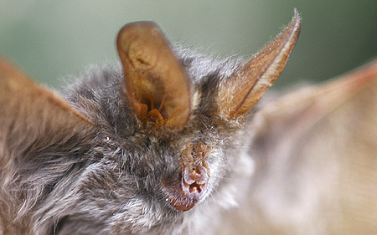
Hantavirus
in African bats
Soricidae-associated
Talpidae-associated
SWSV
RPLV
ARTV
72
JMSV
ARRV
KKMV
CBNV
OXBV
DOBV
ASAV
99
99
70
TANGV
Cricetidae-associated
SERV
99
86
91
ANDV
90
LNV
RIOMV
SEOV
MAPV
82
89
SNV
Magboi virus
Nycteris hispida
Sierra Leone
SANGV
96
CHOV
74
Muridae-
associated
TULV
HTNV
TPMV
83
VLAV
NVAV
PUUV
99
MGBV
Soricidae-associated
MJNV
Talpidae-associated
Nycteridae-associated
ALTV
0,2
Weiss, Witkowski et al., Emerg Inf Dis 2012

Slide 13
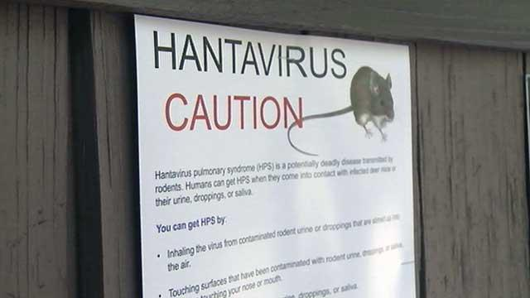
Hantaviruses
still have a potential to emerge:
new virus species
in new natural hosts
in new geographical regions
during new outbreaks

Slide 14





Acknowledgements
Michal Stanko
Marta Siebenstichová
Zuzana Gulášová
Martina Ličková
Lukáš Radosa
Institutes of Virology and Zoology,
Slovak Academy of Sciences
Bratislava, Slovakia
Detlev H. Krüger
Brita Auste
Peter Witkowski
Andreas Rang
Institute of Virology, Charité
Berlin, Germany
Jan ter Meulen
Emilie Lecompte
Philipps University
Marburg, Germany
Lamine Koivogui
Viral Hemorrhagic Fever Project
Conakry, Guinea
Elisabeth Fichet-Calvet
Christiane Denys
Museum National d'Histoire Naturelle
Paris, France
Fabian Leendertz
Sabrina Weiss
Robert Koch Institute Berlin, Germany
Christian Drosten
Jan Felix Drexler
Bonn University, Germany
Evgeniy A. Tkachenko
Tamara Dzagurova
Chumakov Institute
Russian Academy of Medical Sciences, Moscow, Russia
VEGA

