Slide 1
Welcome to the FZU
HR Team

Slide 2
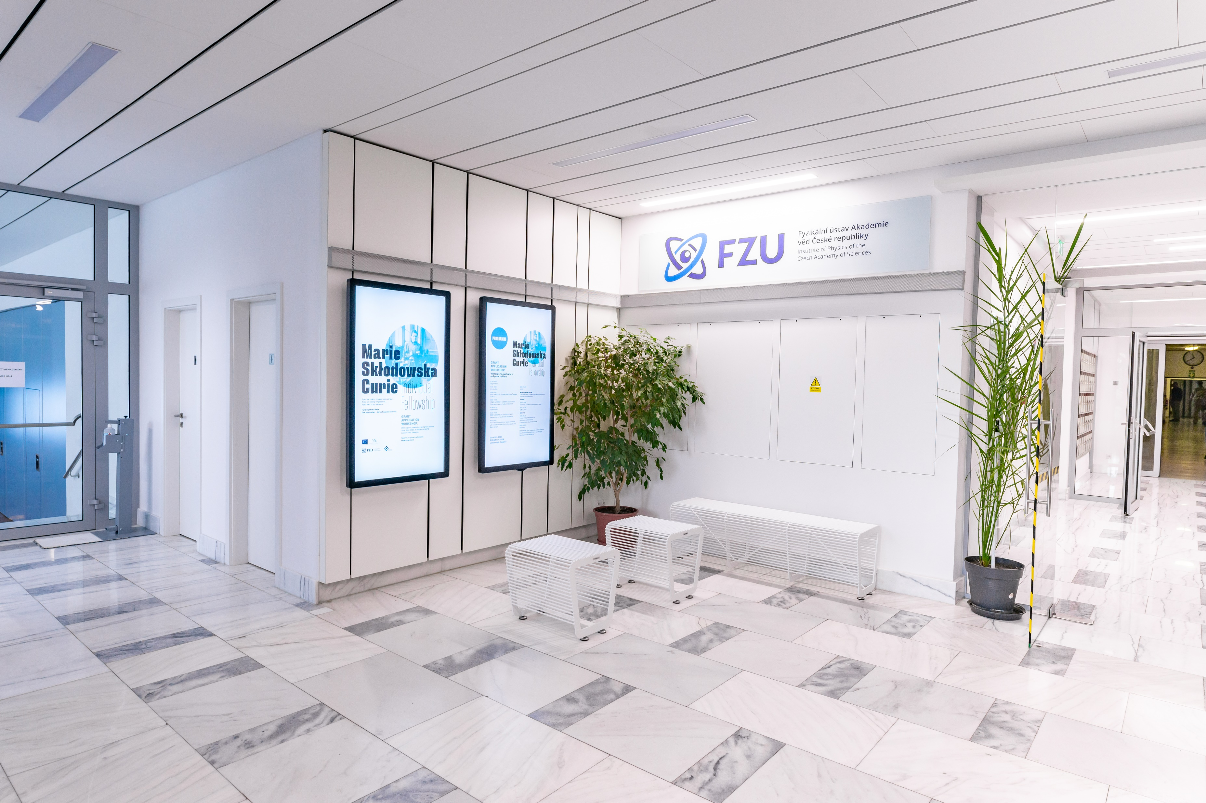
Who We Are
We are the largest Institute of the
Czech Academy of Sciences
We are a public research institution
We belong to top institutions in the field
The history of the FZU spans almost 70 years
Our centres have earned international recognition
We employ more than 1100 workers
We are a proud member of the HR Award community
All information is available at https://www.fzu.cz/en/home

Slide 3
What We Do
We concentrate on basic and applied research in physics.
We strive to push the boundaries of knowledge and to carry out top research in elementary particles, condensed systems, solid state physics, optics, plasma physics and laser physics.
We transfer know-how and experience to younger generation, we popularise science.
We have accredited programmes in place, we cooperate with secondary schools and universities.

Slide 4
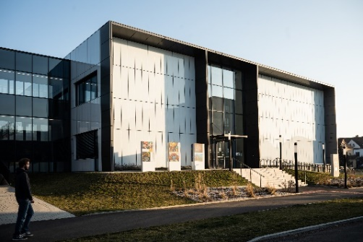
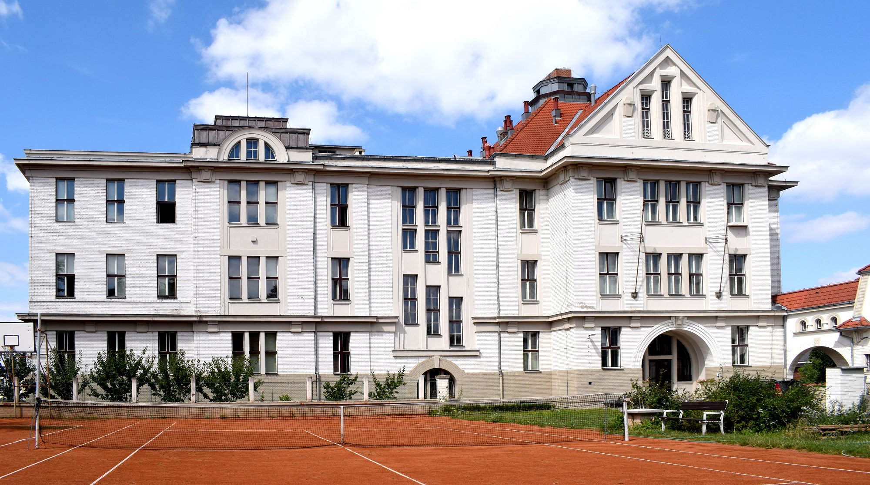
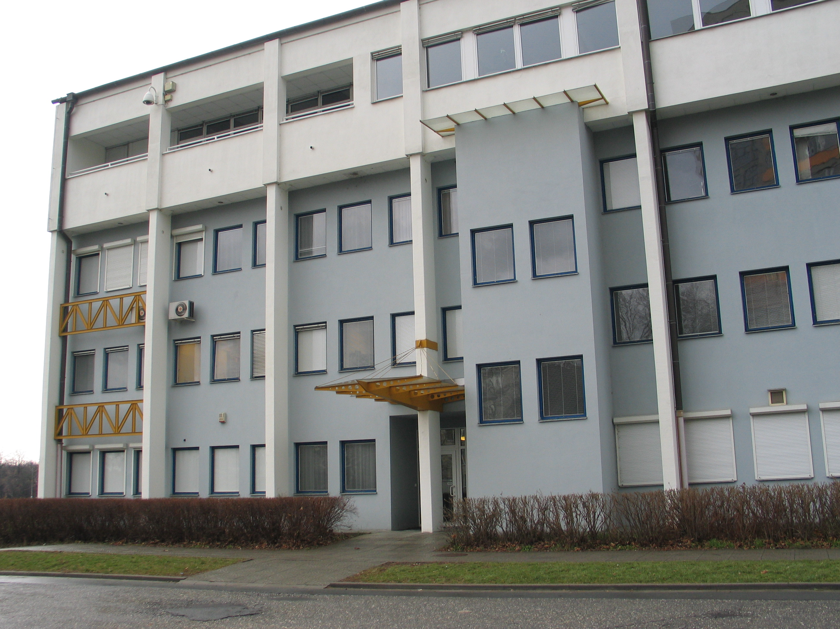
Our Workplaces
Praha
Olomouc
Dolní Břežany

Slide 5
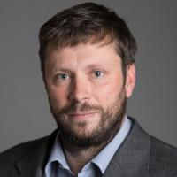
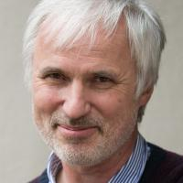
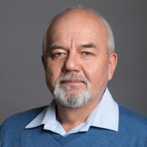
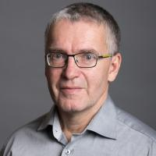
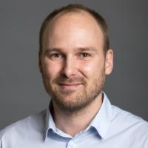
Management
RNDr. Michael Prouza, Ph.D.
Director of the FZU
RNDr. Antonín Fejfar, CSc.
Deputy Director
prof Ing. Martin Nikl, CSc.
Deputy Director for Targeted Research
RNDr. Michal Dušek, CSc.
Deputy Director for „Cukrovarnická“ facility
Scientific Secretary
Ing. Jiří Červenka, Ph.D.
Scientific Secretary
5

Slide 6
Organisation Chart of the FZU
Scientific Departments
Administrative Units
Support Departments
Detailed organisation chart is available at the website of the FZU .

Slide 7
Scientific Divisions
Condensed Matter Physics
Solid State Physics
Optics
Division of High-Power Systems
Elementary Particle Physics

Slide 8
Administration and
Support Departments
Administrative Units
Accounting
Personal and Payroll
Supply and Transport
Technical
Support of AU
Central Unit
Grant Office
Public Relations and International Cooperation Office
Internal Auditor
HR Team
Legal Services
Scientific Library
IT and Technology Transfer
OHS and FS

Slide 9
Our Employees
Cukrovarnická
Slovanka
Joint Laboratory of Optics
HiLASE centrum
305
1/3 of science workers come from abroad
Women account for 1/3 of all employees
Average age of employees is 46
639
121
49

Slide 10
Equal opportunities at FZU
FZU has long supported equal conditions and opportunities for all
From 2021 onwards, the Gender equality plan is being implemented
The working group for the implementation of the plan is the Gender Equality Panel (representation of all sections of FZU)
Discussion meetings, educational activities and campaigns to promote equality and break down unconscious prejudices are held at FZU
E-learning training is available to all
Contact persons: Monika Svobodová

Slide 11
Formal Parties
Qualification Audit Committee
Qualification Audit Process
Ethics Committee
Code of Ethics
Trade Union Organisation
Information on Trade Unions
Elections procedure
Elections to the FZU Council
Only for researchers
1x per 5 years (at least)
Chairman: Jiří Oswald
Committee: 14 members
Chairman: Dušan Kučera
Committee: 9 members
Chairwoman: Lenka Volfová
More than 130 members
By-election at the FZU to select representatives to the Academy Assembly, Academic or Science Council

Slide 12
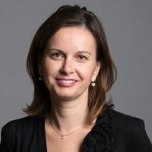
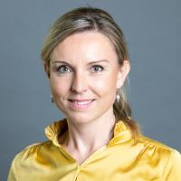
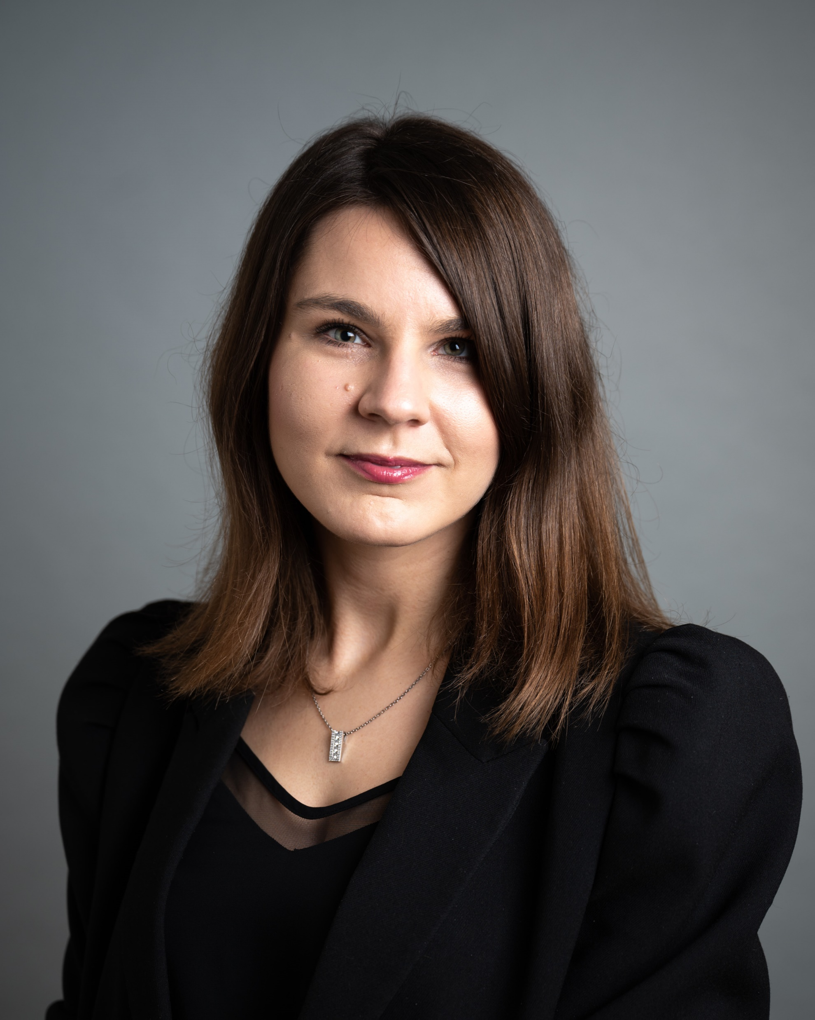
HR Partners
Simona Dačeva
Division 1 a Division7
E-mail: daceva@fzu.cz
Tel: 702 298 635
Monika Svobodová
Division 3 and Division 8
E-mail: monika.svobodova@fzu.cz
Tel: 702 299 555
Petra Kratochvílová
Division 4, dpt. 52 and 55
E-mail: petra.kratochvilova@fzu.cz
Tel: 607 240 074
HR partners are in charge of all HR processes
Expert advice on recruitment and selection procedures, new employees adaptation
Setting up and implementing internal HR processes in compliance with HR AWARD
Close cooperation with Personnel Department
Each employee has their HR Partner

Slide 13
Benefits for Employees
More information about all benefits can be found here
Flexible working time
Childbirth allowance
Work from home
Contributions to children´s activities/camps
Extra vacation days
Contributions to leisure activities
Internal language courses
Contributions to pension/life insurance
Multisport card
Yoga classes in main building

Slide 14
Important Documents
Collective Bargaining Agreement – a basic document, defines employment relations between employee (represented by the trade union organisation) and employer
Information about Trade Unions – basic information about trade union
Code of Ethics for Workers – summary of ethical norms to be observed at the organisation
Qualification Audit Committee – serves for researchers only
European Chart for Researchers – a uniform document applicable for all countries of the EU
Code of Conduct for Researchers – recommendations on selection procedures
Gender Equality Plan – an official plan for ensuring equal opportunities for all
Rules for Home office mode – the decision that lays out conditions for working from home
Flexibile working time – lays out conditions for scheduling working hours
New Employee Brochure - guide to the institute for a new employee
Documents are freely downloadable after logging into intranet.

Slide 15
Useful Links
Booking rooms service
Home page
Webmail
VPN
VERSO system
HR portal

Slide 16
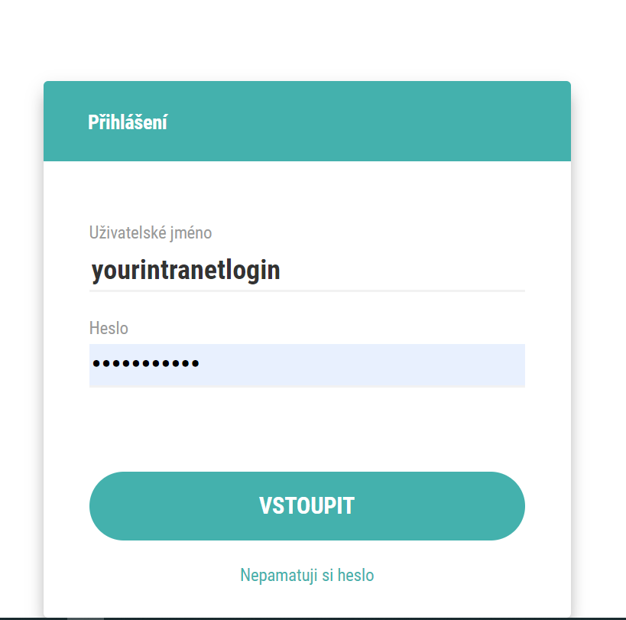
E-learning
www.lms.fzu.cz
Safety
Ethics
Occasional car driver
Unconscious bias
And more…

Slide 17
Grant Support
HEAD OF GRANT OFFICE
Ilona Skordis Gottwaldová
Mail: ilona.gottwaldova@fzu.cz
Tel: 601 084 852
SPECIALISTS
Dominika Vyštejnová
Mail: vystejnova@fzu.cz
Tel: 702 240 735
Adam Matoušek
Mail: matouseka@fzu.cz
Tel: 724 896 732
Complete support before and during the preparation of grant applications
Expert consultations and analysis of individual parts of applications
Providing information on current programs and calls in the European Research Area
Conducting seminars and workshops on the topics of calls and grants
Information service on grant possibilities of national and foreign providers
More information avaliable on the intranet

Slide 18
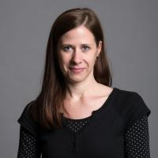
Training and Development
FZU cares about the development and continuous education of its employees, therefore it provides an extensive range of courses and soft skills training
The offer applies to all employees
Trainings are conducted online or in person
Conducting workshops and seminars
Application forms available at: rezervace.fzu.cz
COORDINATORS
Monika Hochmanová
Mail: hochmanova@fzu.cz
Tel: 266 053 007
Olga Kalusová Hrabaňová
Mail: kaluso@fzu.cz
Tel: 266 052 489

Slide 19
Complaints and appeals
If you happen to be dealing with a conflict or crisis situation in the areas of discrimination, sexual harassment, bossing, or disagreeing with decisions and compensation, you have several options for resolving your complaint.
E-Form
Head of dept.
Ethical Comittee
HR partner
Trade Union
More infomation avaliable on the link below: Complaints and appeals

Slide 20
We hope that you do well in FZU!
HR Team

